Slide 1

About OMICS Group
OMICS Group International is an amalgamation of Open Access publications and worldwide international science conferences and events. Established in the year 2007 with the sole aim of making the information on Sciences and technology ‘Open Access’, OMICS Group publishes 400 online open access scholarly journals in all aspects of Science, Engineering, Management and Technology journals. OMICS Group has been instrumental in taking the knowledge on Science & technology to the doorsteps of ordinary men and women. Research Scholars, Students, Libraries, Educational Institutions, Research centers and the industry are main stakeholders that benefitted greatly from this knowledge dissemination. OMICS Group also organizes 300 International conferences annually across the globe, where knowledge transfer takes place through debates, round table discussions, poster presentations, workshops, symposia and exhibitions.

Slide 2
About OMICS Group Conferences
OMICS Group International is a pioneer and leading science event organizer, which publishes around 400 open access journals and conducts over 300 Medical, Clinical, Engineering, Life Sciences, Pharma scientific conferences all over the globe annually with the support of more than 1000 scientific associations and 30,000 editorial board members and 3.5 million followers to its credit.
OMICS Group has organized 500 conferences, workshops and national symposiums across the major cities including San Francisco, Las Vegas, San Antonio, Omaha, Orlando, Raleigh, Santa Clara, Chicago, Philadelphia, Baltimore, United Kingdom, Valencia, Dubai, Beijing, Hyderabad, Bengaluru and Mumbai.

Slide 3

Single Event Effects Induced by High Energy Protons in Gumstix
Kathleen Morse, Ph.D.
Founder of Yosemite Space
http://yosemitespace.com/
CASIS Sponsored Principal Investigator
Team:
Jeremy Zawodny – member of Yosemite Space
John Samson, Ph.D. – Honeywell Aerospace

Slide 4
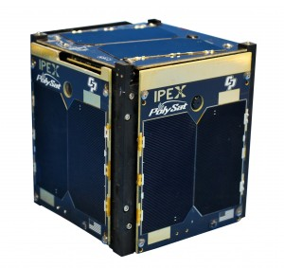
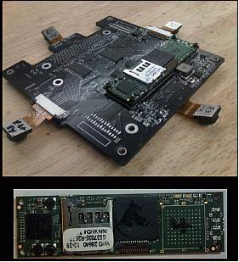
Benefits of Gumstix in Space
Aero Mech 2015
Small form factor:
  Gum stick sized
  Low power consumption (<1W)
  PoP NAND and RAM enables board size
Uses OMAP processors with ARM Cortex-A8 architecture
Worked well in NASA’s IPEX Cubesat mission
Evaluated on ground and in space for radiation effects by Yosemite Space
Being studied for use in the Dependable Multiprocessor (DM) by Honeywell.
IPEX
Ref: http://polysat.calpoly.edu/launched-missions/cp8-ipex/
https://directory.eoportal.org/web/eoportal/satellite-missions/
The Gumstix™ Low Earth Orbit (LEO) study is an important step towards their use in a fault tolerant computers.
10/6/15
Notes:
In addition, the software stack is Linux based, built using the OpenEmbedded framework. This allows developers to use well tested and freely available open source tools and libraries which substantially reduce development time.

Slide 5
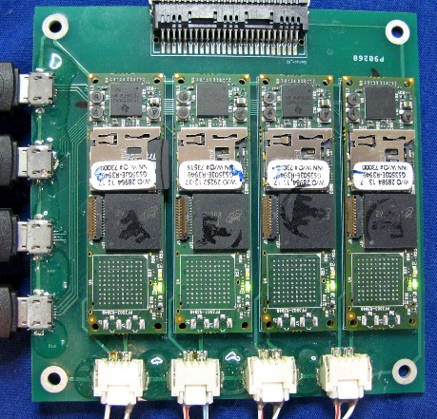
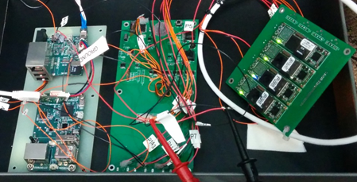
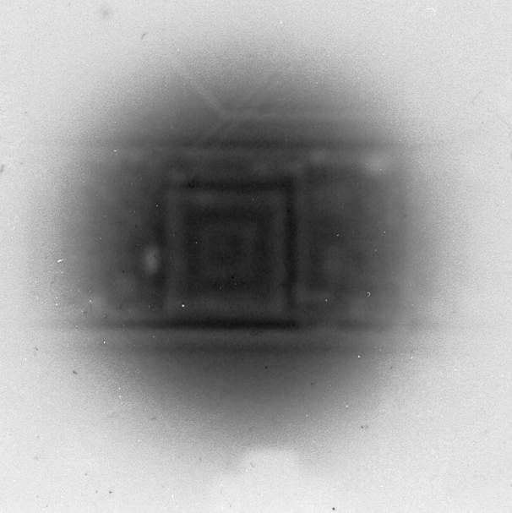
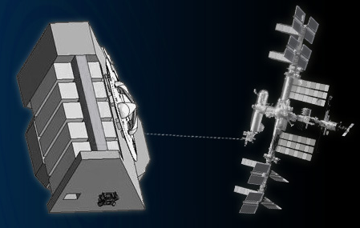
Ground and Space Based Testing
Aero Mech 2015
Gumstix Payload
Models tested include Earth, SandStorm and Water
External watchdog detects SEEs, records and does a hard reboot
Proton testing complete
Space Test on NREP – 11/15
Payload Return - 2016
Flight Boards
Gumstix Radiograph
Nanoracks External
Platform (NREP)
10/6/15

Slide 6
SEE Testing
Aero Mech 2015
Integral Proton Flux for LEO mission:
Proton Testing at Crocker Nuclear Labs (CNL) and Mass General Hospital (MGH):
Solar Max and Trapped
Model | Model ID | Lot Number | Proton Energy (MeV) | Test facility
Water | W3 | 72949 | 64.0 | CNL
Water | W1 | 72949 | 64.8 | MGH
Water | W4 | 72949 | 200.3 | MGH
Earth | E3 | 73000 | 64.0 | CNL
Earth | E1 | 73000 | 64.8 | MGH
Earth | E5 | 73515 | 200.3 | MGH
SandSTORM | S1 | 72281 | 64.0 | CNL
SandSTORM | S5 | 72281 | 64.8 | MGH
SandSTORM | S6 | 72281 | 200.3 | MGH
10/6/15

Slide 7
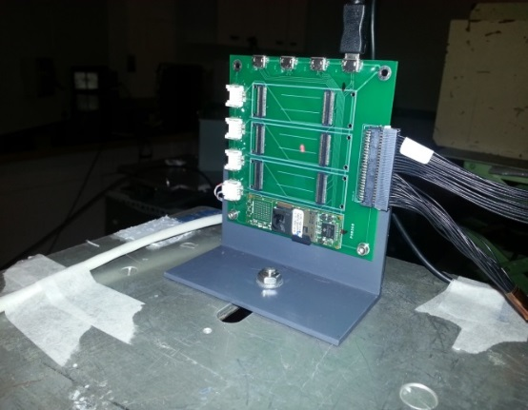
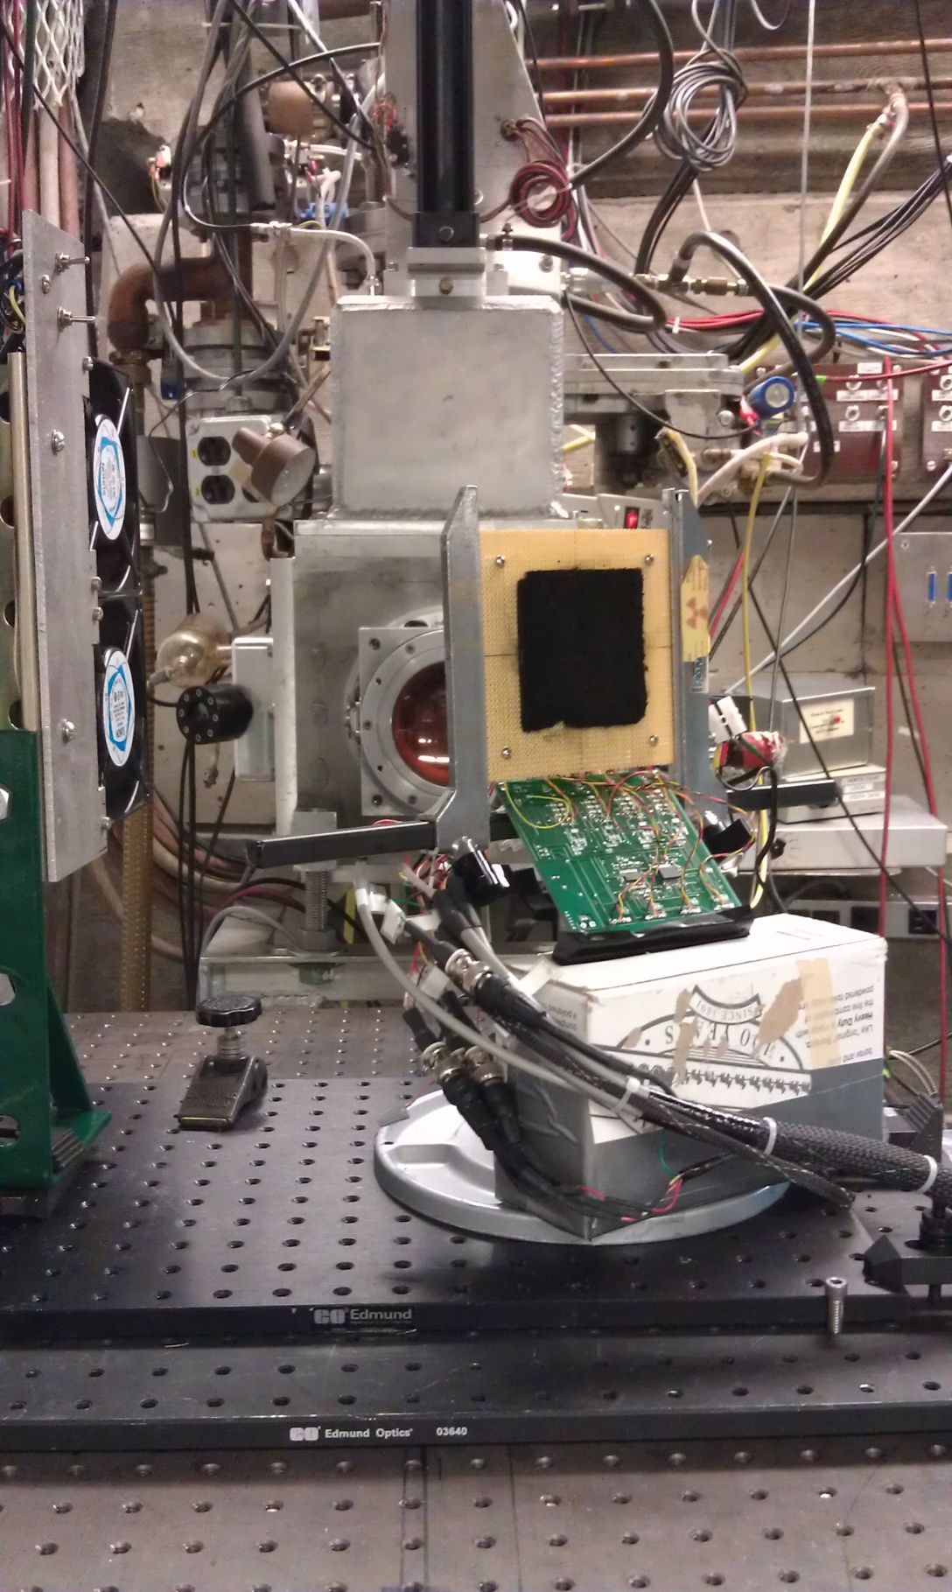
SEE Testing
Aero Mech 2015
Real time data acquisition during radiation exposure determines rate of SEEs
Yosemite Space hardware and software monitors and records current draw (power consumption), application heartbeat (if present) and the SEU test suite results
SEU Test Suite
  Includes NEON, Matrix Multiply, and Workload tests
  The suite logs:
    number of errors generated
    test duration
    net time that the system has been running since the last reboot
  Each log entry is time stamped and written to a microSD card
  If the SEU test ran but generated no errors, 1 error was assigned to that test
10/6/15

Slide 8
NEON Test
Aero Mech 2015
Performs floating point multiplication and division operations in a tight loop
It is compiled with ARM vector floating point (VFP)
Exercises the NEON Floating Point Unit (FPU)
SEUs are detected by comparing output for correctness and compared to a known correct value.
Less than 0.1% of DRAM is exercised
10/6/15

Slide 9
Test Results: NEON
Aero Mech 2015
Weibull Fit Parameters | Earth | Water | Sand STORM | Units
Onset Energy | 7 | 7 | 7 | MeV
Saturation Cross-Section | 7.00E-8 | 6.00E-8 | 1.9E-7 | cm2/device
Width | 20.0 | 20.0 | 20.0 | MeV
Shape Factor | 1.5 | 1.5 | 1.0 | -
10/6/15

Slide 10
Matrix Multiply Test
Aero Mech 2015
Tests basic arithmetic processing and memory functionality
Consists of a large number of multiply and accumulation operations
SEUs are detected with comparing the processed output with a precomputed Golden Standard.
Exercises less than 3% of the DRAM
10/6/15

Slide 11
Test Results: Matrix Multiply
Aero Mech 2015
Weibull Fit Parameters | Earth | Water | Sand STORM | Units
Onset Energy | 6 | 7 | 7 | MeV
Saturation Cross-Section | 7.50E-8 | 4.50E-8 | 4.0E-8 | cm2/device
Width | 30.0 | 20.0 | 20.0 | MeV
Shape Factor | 1.5 | 1.5 | 1.5 | -
10/6/15

Slide 12
Workload Test
Aero Mech 2015
The workload starts with a pre-computed data file containing pairs of 1MB strings and MD5 checksums of those strings.
The workload computes a new MD5 checksum for each string and compares it with the precomputed checksum.
Exercises nearly 80% of DRAM
10/6/15

Slide 13
Test Results: Workload
Aero Mech 2015
Weibull Fit Parameters | Earth | Water | Sand Storm | Units
Onset Energy | 7 | 7 | 7 | MeV
Saturation Cross-Section | 2.50E-8 | 3.00E-8 | 6.0E-8 | cm2/device
Width | 20.0 | 20.0 | 20.0 | MeV
Shape Factor | 1.5 | 1.5 | 1.5 | -
10/6/15

Slide 14
Estimated SEE rate over 180 Day mission
Aero Mech 2015
Gumstix Model | Processor Model | SEU Rate |  |  | SEFI Rate | SEL Rate
 |  | Matrix Multiplier | Workload | NEON
SandSTORM | Sitara AM3703 | P: 17, H:35 | P: 26, H: 52 | P: 82, H:163 | P: 1.7 | P: 20.4
Water | OMAP 3530 | P: 20, H:39 | P: 13, H: 26 | P: 26, H:52 | * | *
Earth | OMAP 3503 | P: 31, H:61 | P: 11, H:22 | P: 31, H:61 | P:1.1 | *
P: Proton
H: Heavy Ion
Fitted proton data, Crème 96, and SPENVIS are used to predict these rates
FOM approach estimates 2 SEU from heavy ions for any 1 SEU event from protons
  An average of 85 SEUs are expected during a 180 day mission
  SEFI and SEL rates from heavy ions can only be determined from heavy ion testing
10/6/15

Slide 15
PoP DRAM Testing
Aero Mech 2015
DRAM exercised during proton radiation exposure.
All devices passed their memory tests prior to radiation exposure.
All devices failed their memory tests after exposure to 64.8MeV and 64MeV proton radiation.
Months later, the number of stuck bits was quantified.
Most stuck bit annealed out after 12 hour, unbiased at 85C. This indicates a microdosing mechanism.
GS Label | fluence | Stuck bits |  |  | TEST FACILITY | Energy (MeV) | Date of Exposure | Stuck Bits Post Anneal | Date of Analysis
W3 | 3.22E9 | 2 | 3 | 3 | CNL | 64 | 8-1-13 | 1 | 12.5 months
W2 | 2.52E9 | 2 | 3 | 3 | CNL | 64 | 8-1-13 | 0 | 12.5 months
W1 | 3.28E9 | 3 | 4 | 4 | MGH | 64.8 | 1-25-14 | 1 | 8 months
W4 | 1.63E9 | 0 | 0 | 0 | MGH | 200.3 | 1-25-14 | 0 | 8 months
E3 | 1.03E9 | 0 | 0 | 0 | CNL | 64 | 8-1-13 | 0 | 12.5 months
E2 | 2.52E9 | 1 | 3 | 1 | CNL | 64 | 8-1-13 | 0 | 12.5 months
E1 | 2.23E9 | 3 | 1 | 1 | MGH | 64.8 | 1-25-14 | 0 | 8 months
E5 | 1.95E9 | 0 | 0 | 0 | MGH | 200.3 | 1-25-14 | 0 | 8 months
S1 | 9.67e8 | 0 | 0 | 0 | CNL | 64 | 8-1-13 | 0 | 12.5 months
S2 | 2.52E9 | 0 | 0 | 0 | CNL | 64 | 8-1-13 | 0 | 12.5 months
S5 | 2.45E9 | 1 | 1 | 1 | MGH | 64.8 | 1-25-14 | 0 | 8 months
S6 | 6.74E8 | 0 | 0 | 0 | MGH | 200.3 | 1-25-14 | 0 | 8 months
F3 | 2.52E9 | 3 | 2 | 2 | CNL | 64 | 8-1-13 | 0 | 12.5 months
F4 | 1.06E9 | 0 | 0 | 0 | CNL | 64 | 8-1-13 | 0 | 12.5 months
10/6/15

Slide 16
Conclusions
Aero Mech 2015
No significant difference in SEU cross-sections between Gumstix models
Earth and SandSTORM had similar SEFI rates. Water did not show any SEFI events at 200.3MeV
SEL data was only obtained for the SandSTORM and Earth models. Water was tested under similar conditions but latch-up was not observed
No catastrophic latch-up was observed
Stuck bits in DRAM observed after proton exposures at 64MeV and 64.8MeV.
10/6/15

Slide 17
Acknowledgements
Aero Mech 2015
The Gumstix ISS flight experiment effort is being performed under CASIS (Center for the Advancement of Science in Space) grant GA-2013-115.
The project will being flown as an ISS National Laboratory flight experiment.
The authors would like to acknowledge the contributions of Matthew Smith (Honeywell Aerospace, Defense & Space) for his help analyzing the results of the ground-based radiation tests.
The authors would like to acknowledge Drs. Steve Guertin, Larry Edmonds and Philippe Adell of JPL for their input of the analysis of stuck bits in RAM.
10/6/15

Slide 18
What is RACP? Reliable Affordable Cubesat Processor
Aero Mech 2015
Multi-processor fault tolerant space computer that integrates current generation SoC
Compatible with existing CubeSat products
Design allows for graceful degradation and minimal interruptions in processing
Supports multiple sensor platforms
Components screened through ground and space radiation testing
"Other upcoming hybrid platforms share some of the same concepts, but the degree of adaptability and performance capabilities of RACP is superior.“- NASA SBIR review
10/6/15

Slide 19
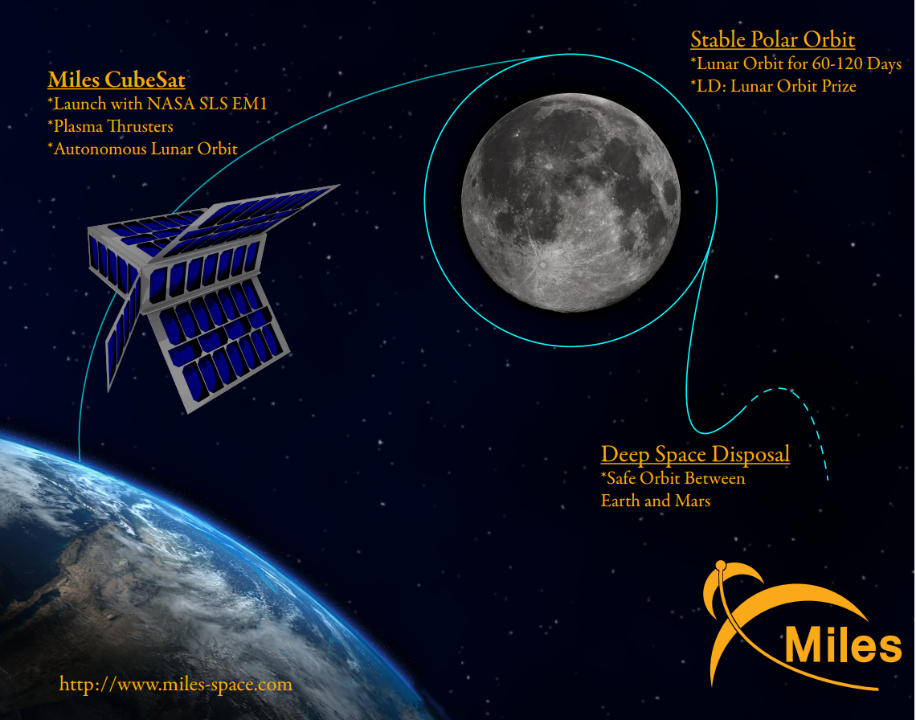
RACP for Deep Space
Aero Mech 2015
10/6/15

Slide 20
RACP Features:
Aero Mech 2015
Fault tolerance
Data Integrity
High Compute Performance
  Average of 2000 MIPS/Watt
  Top performance: 15,000 MIPS, 1,250 MFLOPS, 5,650 MOPS
Run a Linux operating system
Components of RACP screened for radiation tolerance
Design is not specific to a single model of SoC
Supports data processing on multiple sensors
Small in Size and Weight (target size of 9cm by 9cm)
Consumes 0.53 Watts at low end of performance
10/6/15

Slide 21
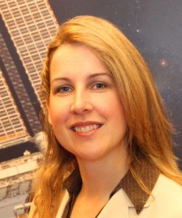
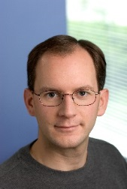
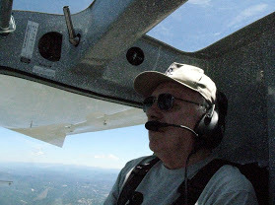
Yosemite Space Team
Aero Mech 2015
Dr. Morse is the majority owner and founder of Yosemite Space. She leads Yosemite Space in exploring how to advance the state of the art in aerospace. Current work focuses on using state of the art (SOA) System on Chip (SoC) processors reliably in space to support autonomy and remote sensing needs of CubeSats and small satellites. She is leading the hardware development of RACP.
Mr. Zawodny serves as the lead software engineer at Yosemite Space. His is developing software for the embedded Linux platform used on SoCs. He developed Yosemite Space’s radiation test monitoring software and hardware. He leads software development of RACP.
Mr. Chapman supports ongoing research and development activities as a senior engineer. Mr. Chapman has 47 years of aerospace experience including electronics design and fabrication, mechanical design and fabrication, optomechanical component design and fabrication, vacuum system design, fabrication, and assembly.
10/6/15
10/6/15

Slide 22
Yosemite Space
Aero Mech 2015
Point of Contact: Kathleen Morse, Ph.D.
Office Phone: 408-960-1474
Email: Kathleen@yosemitespace.com
10/6/15

