Slide 1

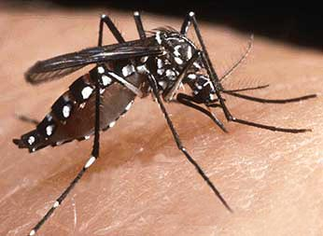
Future prospect of mosquito salivary components as novel target for vector based vaccine against Dengue: Molecular characterization of immunomodulatory protein from salivary glands of Aedes aegypti
Kartika Senjarini & Rike Oktarianti

Slide 2
INTRODUCTION
Fact:
PEOPLE living in endemic area → more resistant to Arthropod Borne-Diseases
they are exposed to Arthropod-bites
Arthropod bites – Pathogen – Host interaction
Sandflies transmit Leishmania to the mammalian host when they probe for a blood meal and inject the parasite in their saliva → Humans living in areas endemic for leishmaniasis naturally develop anti-salivary gland antibodies and that the presence of these antibodies promotes resistance to infection with Leishmania¹

Slide 3
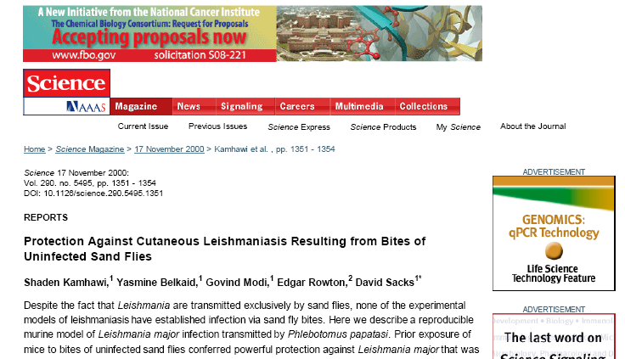
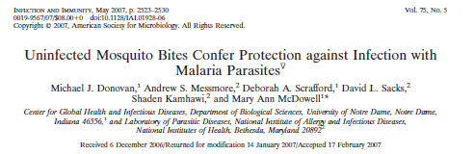
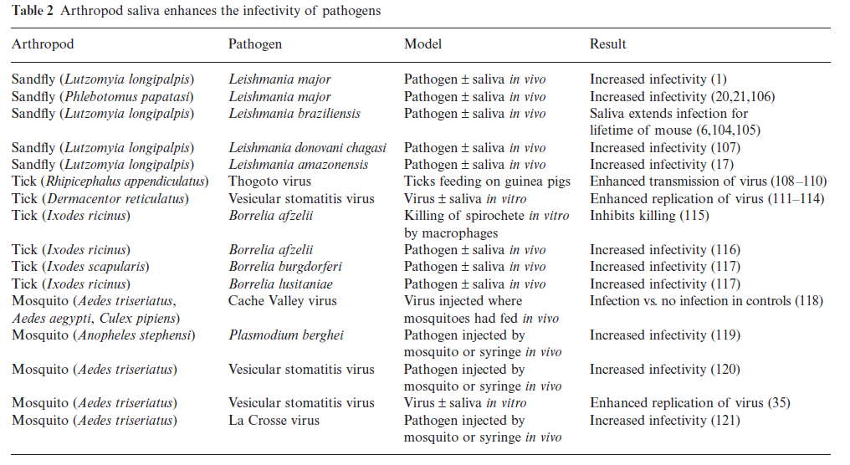
³
⁴
⁵

Slide 4
Mosquito’s Salivary Components
Vasodilator
Manipulating host homeostatis
Immunomodulator
Modulating host immune response

Slide 5
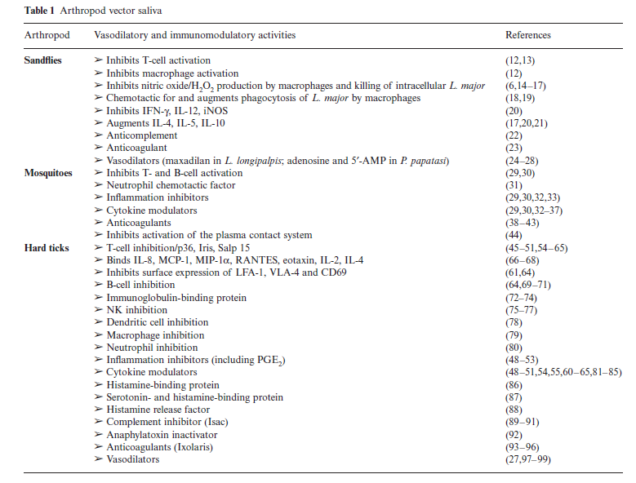

Slide 6
HYPOTHESIS
Saliva of mosquito that transmits disease contains immunomodulatory factors that enhance pathogen infection.Therefore vaccinating the host against the molecule(s) in saliva that potentiate the infection will prevent the pathogen from establishing infection in the host
(Transmission Blocking Vaccine)

Slide 7
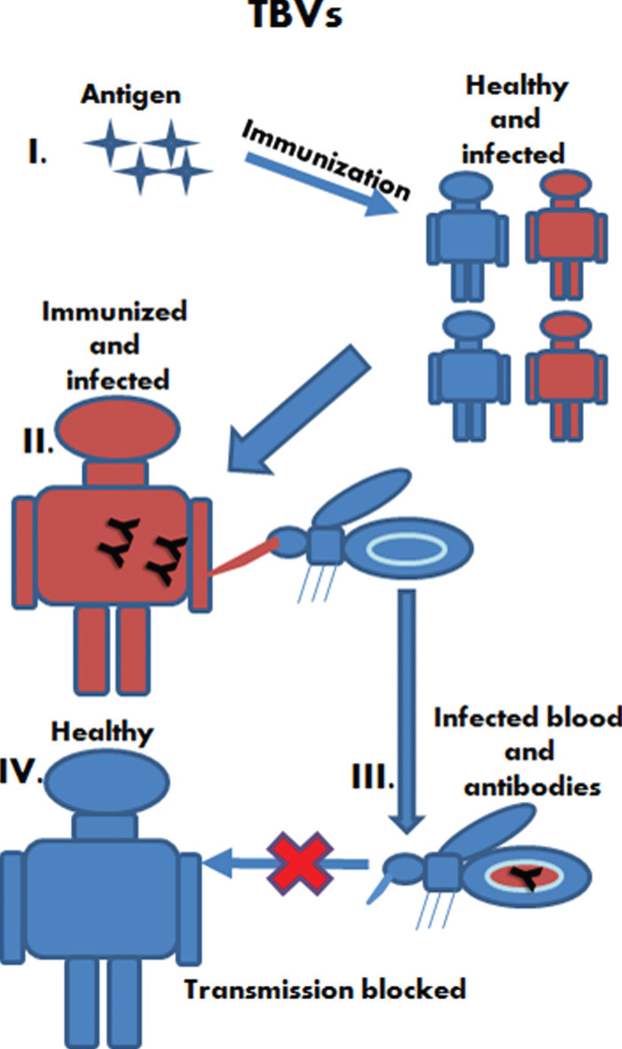
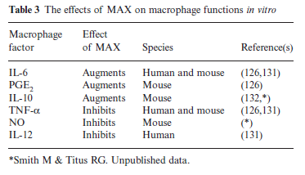
Transmission Blocking Vaccine

Slide 8
DENGUE: NO SPECIFIC TARGET HAS BEEN IDENTIFIED SO FAR, although, salivary activities in modulating immune response have been reported:
Activities | References
SGE: surpressed cellular proliferation & T cell cytokines production Type I (IL2, IFNγ & TNF-α) - anti viral immune mechanism in vitro | Cross et al. Am J Trop Med Hyg 1994;51:690–696
SGE: inhibited Dengue Virus infection in Dendritic Cells (in vitro), enhanced production of IL-12p70 and TNF-alpha | Ader B et al. Viral Immunol. 2004,17(2):252-65
SGE: modulated B-cell & T-cell proliferation, indicating that a protein ~387 kDA important in modulating host immune response | Wasserman et al. Parasit. Immun. 2004, 26: 295-306
SGE: dysregulated APC antiviral signaling → enhance WNV infection via ↓ T-lymphocyte & ↑ IL10 | Schneider et al. Plos Phatogen 2010, 5(7): e11704

Slide 9
OBJECTIVE OF RESEARCH
TO CHARACTERISE IMMUNOMODULATORY PROTEINS FROM SALIVARY GLAND OF MAIN DENGUE VECTOR, Aedes aegypti
IMMUNOGENIC PROTEINS

Slide 10
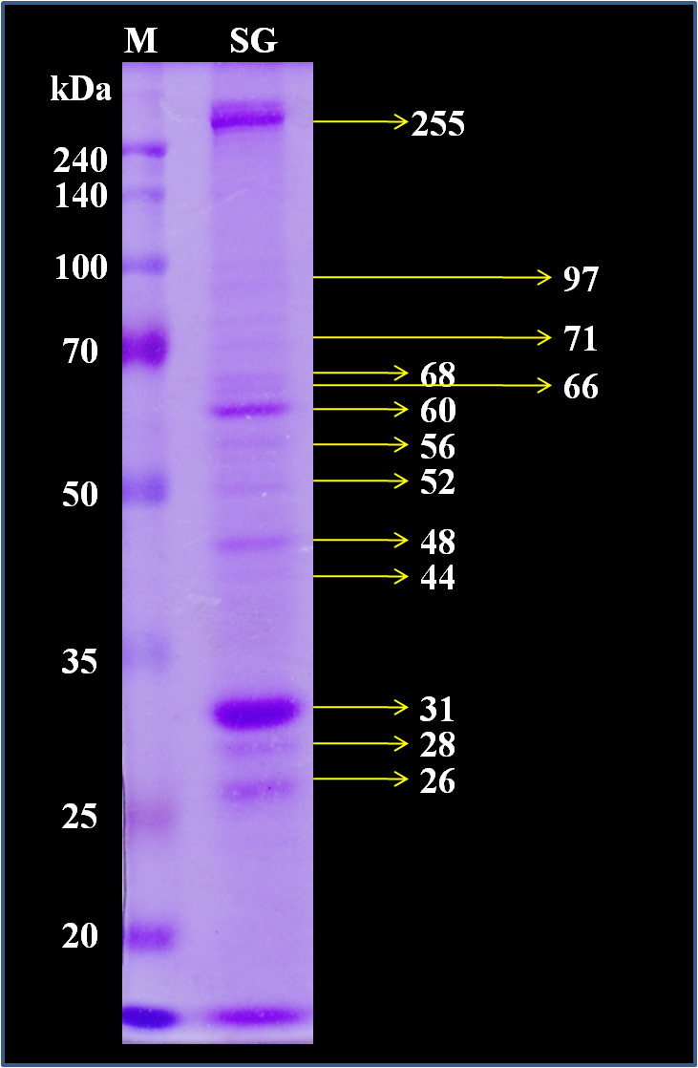
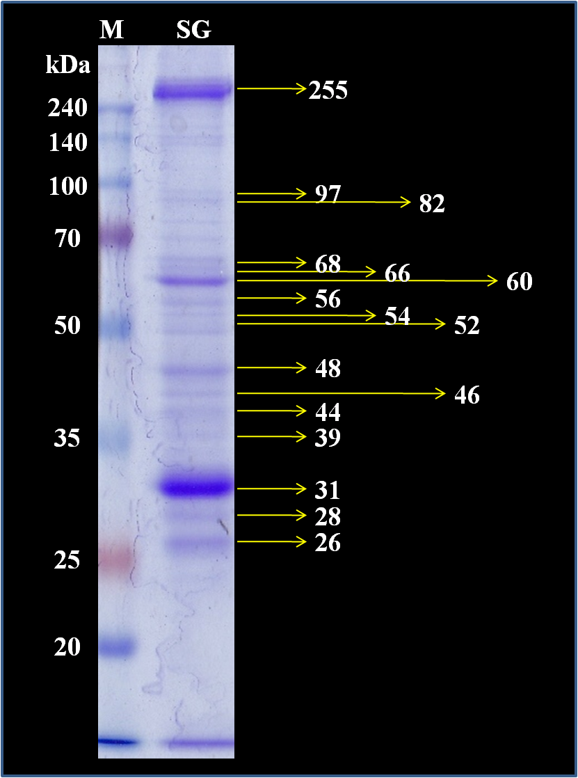
The protein profile is similar between SG of Ae. aegypti from lab scale and from landing collection
Lab scale (n=3)
Landing Collection (n=3)

Slide 11
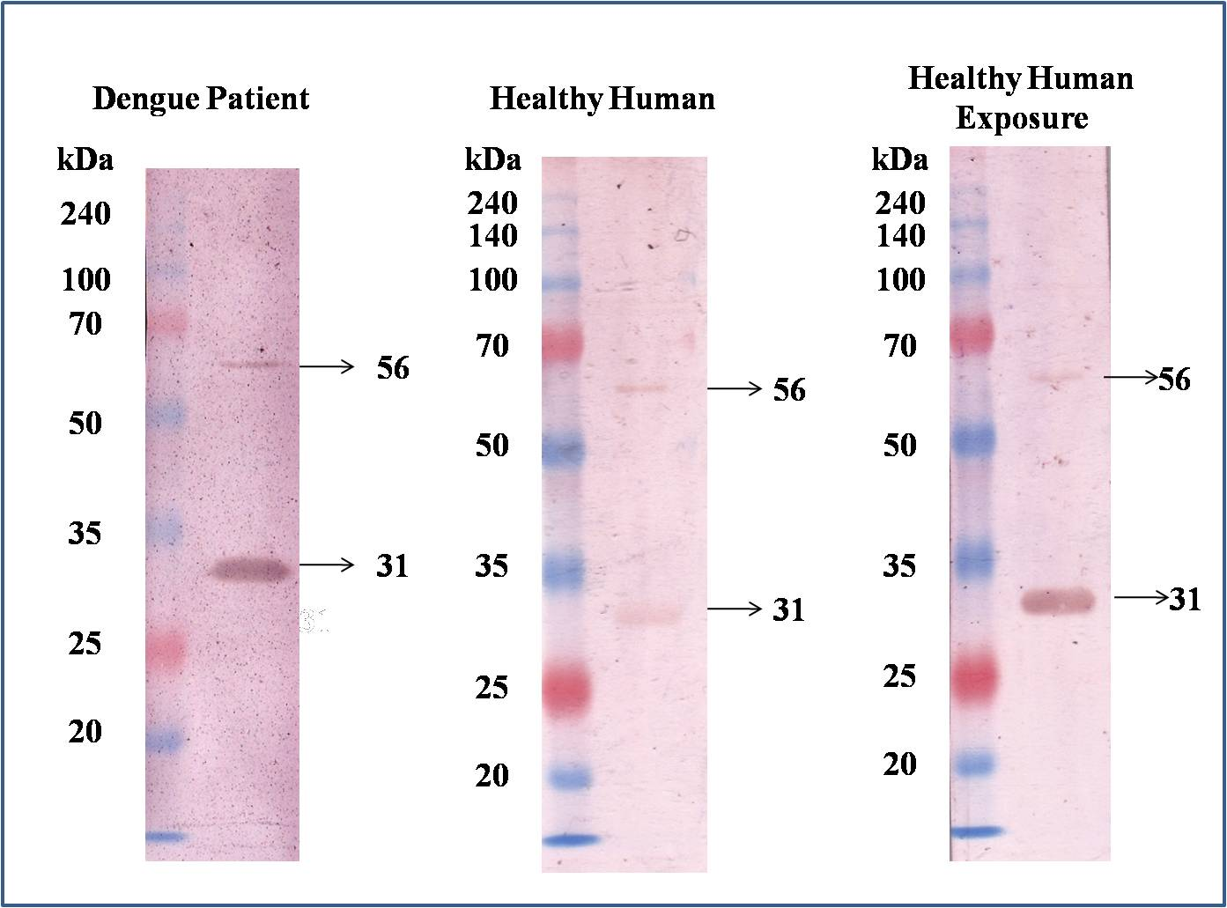
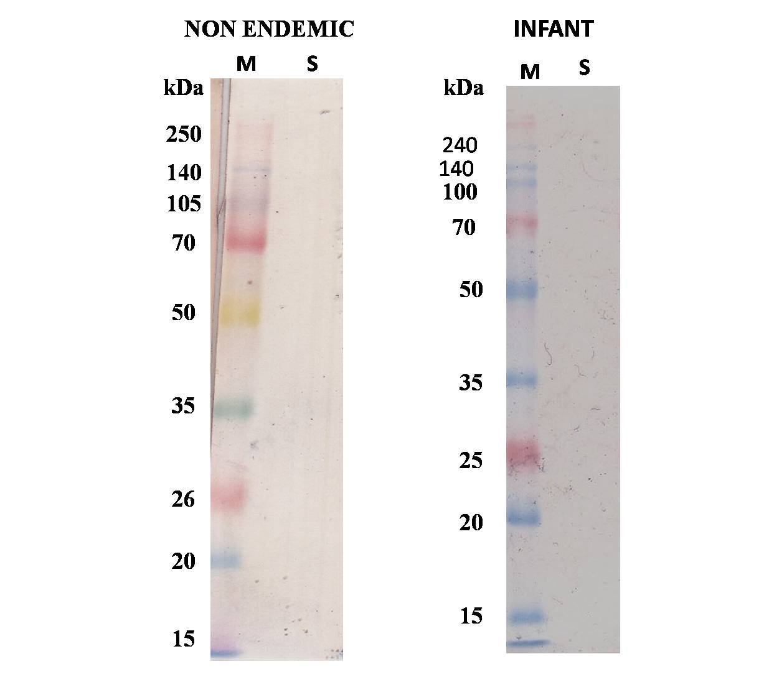
2 immunogenic proteins from SG of Ae. aegypti has been identified
Protein of 31 kDa and 56 kDa were recognized only by sera sample from healthy people, and DHF patient in endemic area, but not by sera sample from healthy people living at non endemic area & infant

Slide 12
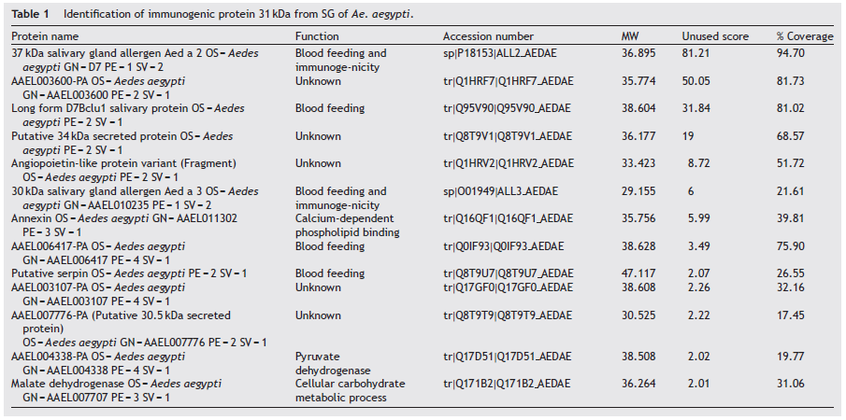
Immunogenic Protein of 31 kDa → D7 Protein Family

Slide 13
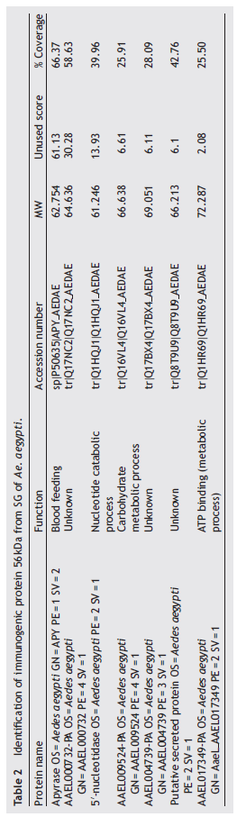
Immunogenic Protein of 56 kDa → Apyrase

Slide 14
Biological Function
1. Protein D7 (Aed a2) & AAEL006417 related to group of Odorant Binding Protein (OBP), protein involved in inhibiting the biogenic amino activities (serotonin, histamine, norepinephrine)
This protein involved in blood feeding & allergen (immunogenic)
2. Apyrase (ATP diphosphohydrolase/r Aed 1) of Ae. aegypti was identified as a member of 5’ nucleotidase family, the apyrase gene is expressed spesifically in the adult female.
Apyrase helps the acquisition of blood meal (inhibit platelet agregation) by destroying ADP or ATP (mediator of platelet agregation & inflammation)

Slide 15
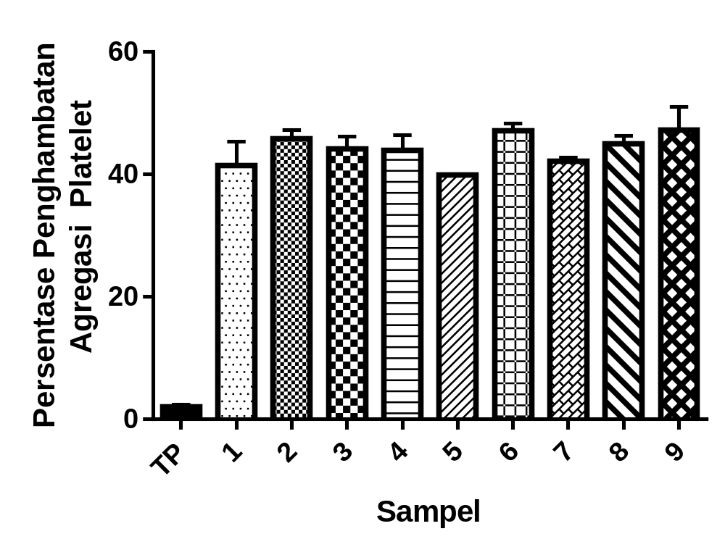
Biological Function

Slide 16
CONCLUSION & OUTLOOK
Vector based vaccine by using salivary component is an alternative strategy for developing vaccine against vector borne diseases to block the transmission of pathogens
2 immunogenic proteins i.e. 31 & 56 kDa have been identified from SG of Aedes aegypti. Further characterisation by Mass-Spec Analysis showed that the 31 kDa protein was identified as D7 protein (37 kDa salivary gland allergen Aed a2), whereas 56 kDa were Apyrase.
Further characterization is needed to define their real function in relation with immunomodulatory activities

Slide 17





Acknowledgement
We are grateful to :
1. Prof. Ceccil Czerkinsky & Dr. Huan Hu Nguyen from International Vaccine Institute – Seoul – South Korea
2. Prof. Toshiya Hayano, Ph.D - Proteomic Lab-Biomedical Science, Graduate School of Life Sciences, Ritsumeikan University, Japan

Slide 18



Slide 19
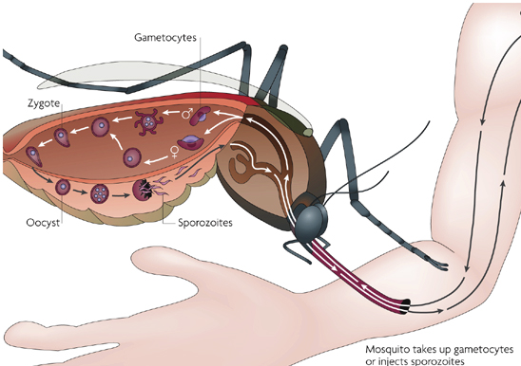
TRANSMISSION BLOCKING VACCINE
Mosquito immune increase→ parasite die
gamesitogenesis blocked
Blocked sporozoit move
To salivary gland
Mosquito salivary component
Flying vaccinator

Slide 20
METHODS
VECTOR LAB. SCALE REARING & ISOLATION OF SALIVARY GLAND
PROTEIN PROFILE : SDS-PAGE
IMMUNOGENIC/ANTIGENIC PROTEIN: WESTERN BLOTTING
IDENTIFICATION OF PROTEIN TARGET : MASS SPECTOMETRY
IMMUNOMODULATORY EFFECT ASSAY
IMMUNOMODULATORY PROTEIN

Slide 21
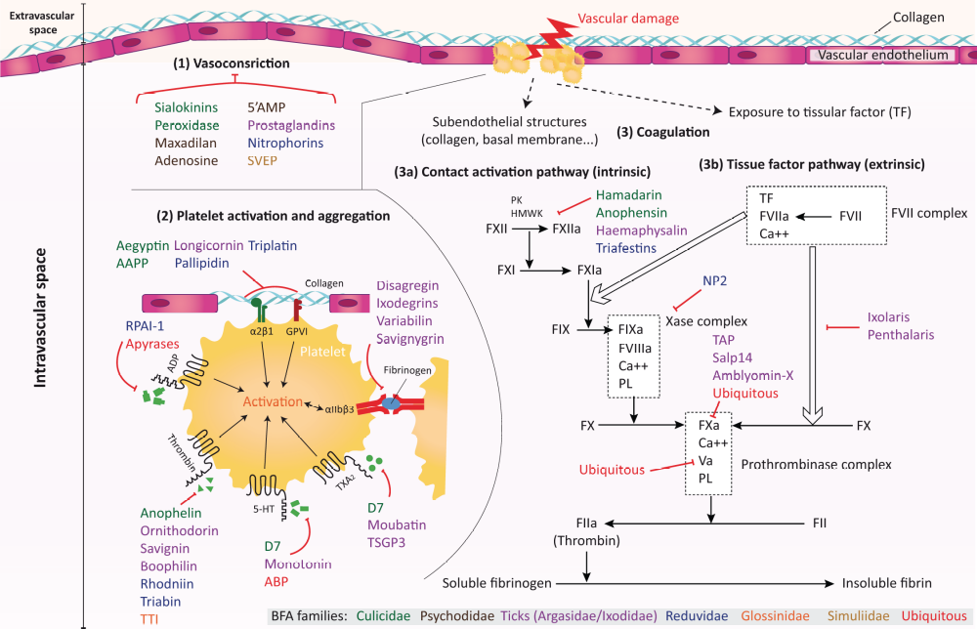

Slide 22

RG Dengue & Malaria

Slide 23
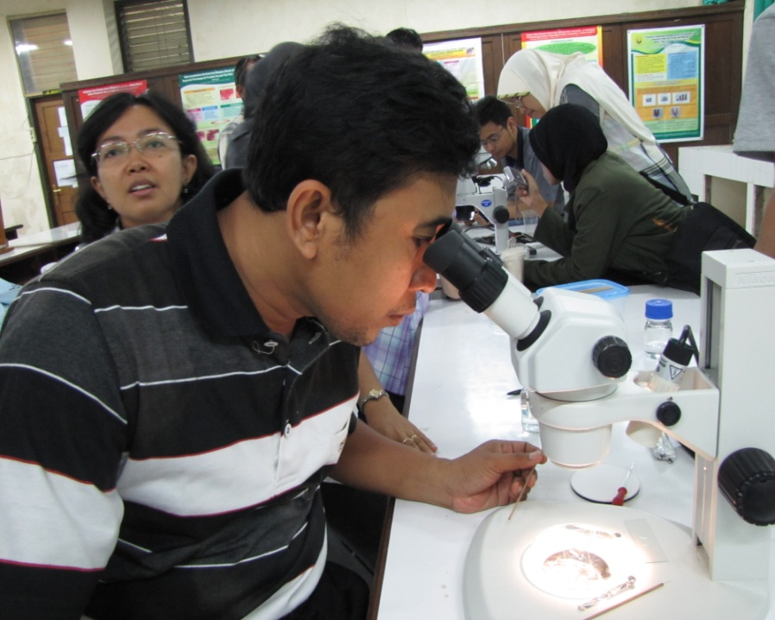
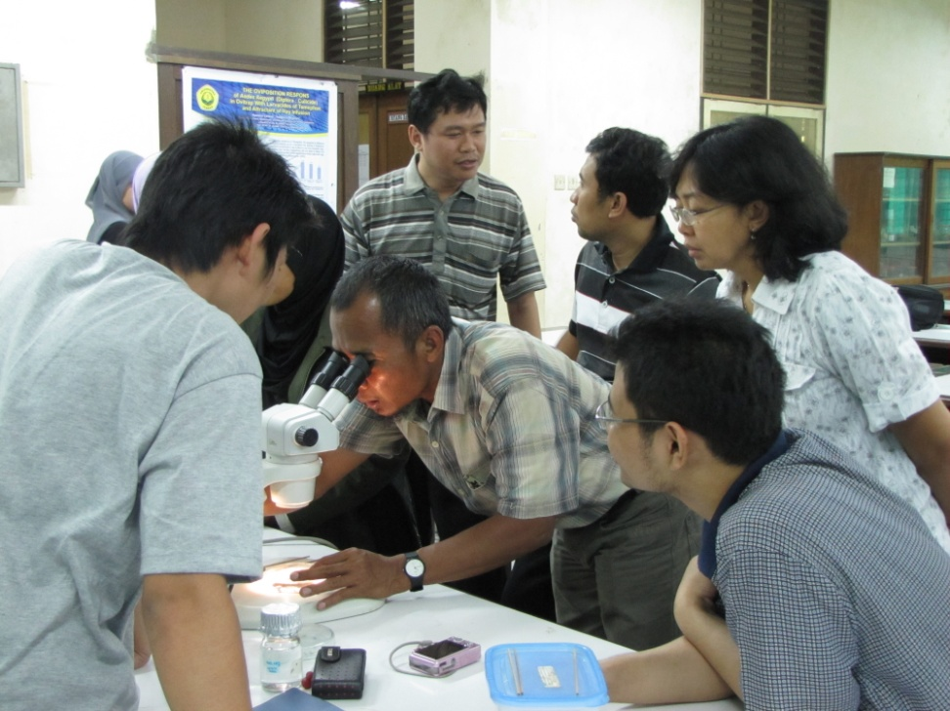
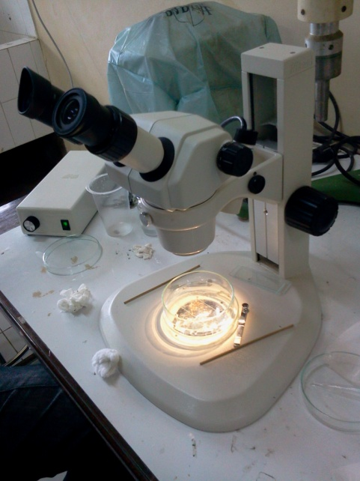
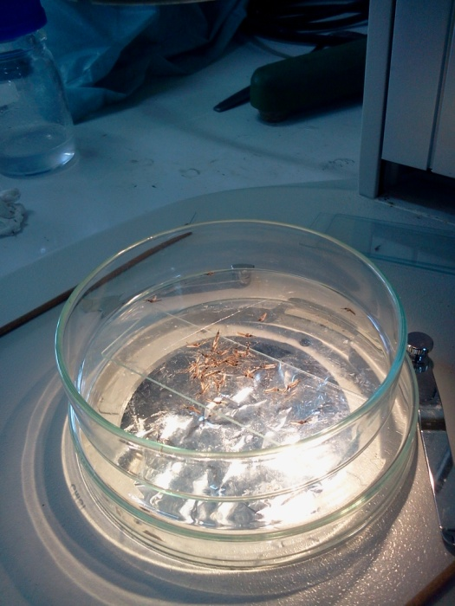
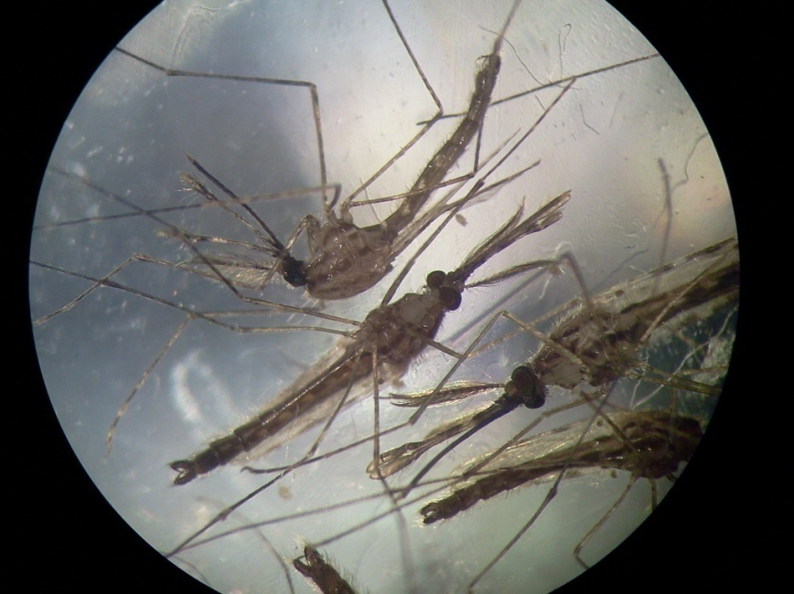
Identification Mosquito

Slide 24
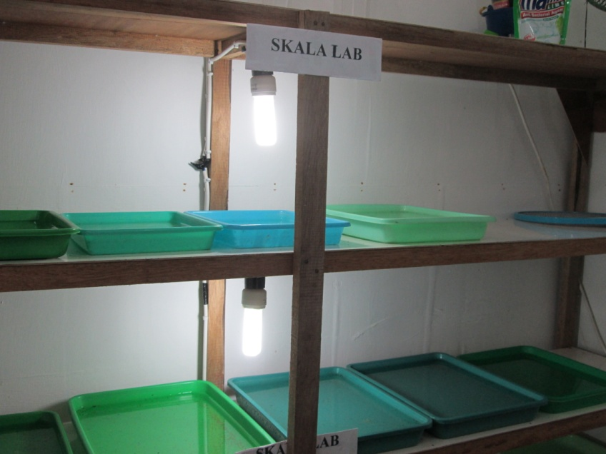
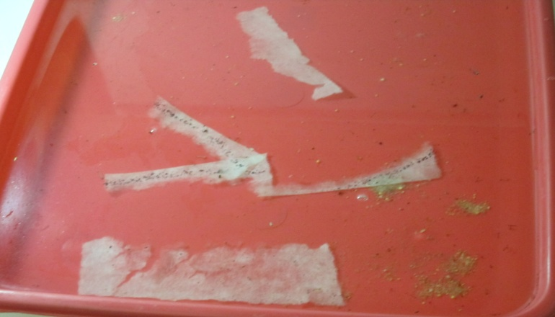
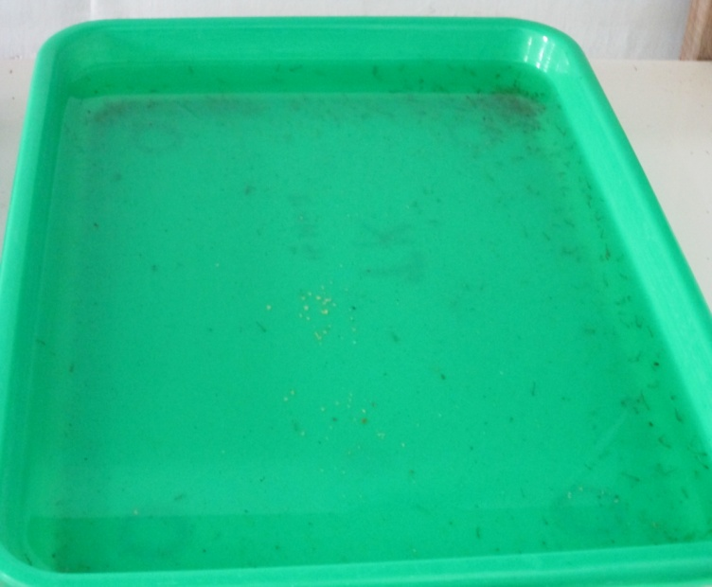
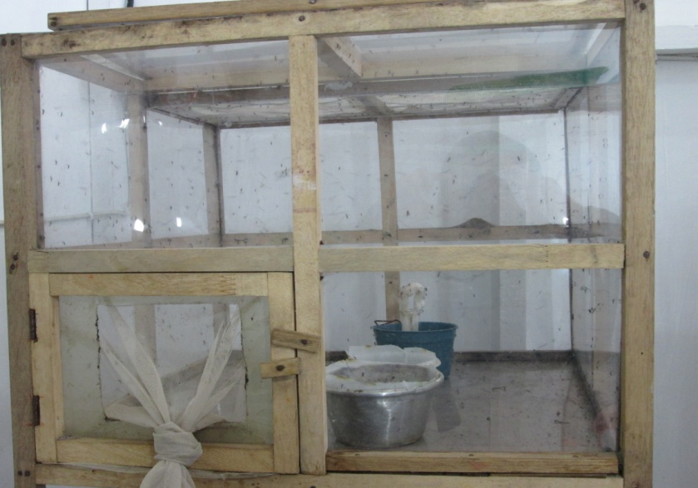
MOSQUITOES REARING
Notes:
24
Rearing skala Lab dan isolasi kelenjar saliva secara mikrodiseksi
24

Slide 25
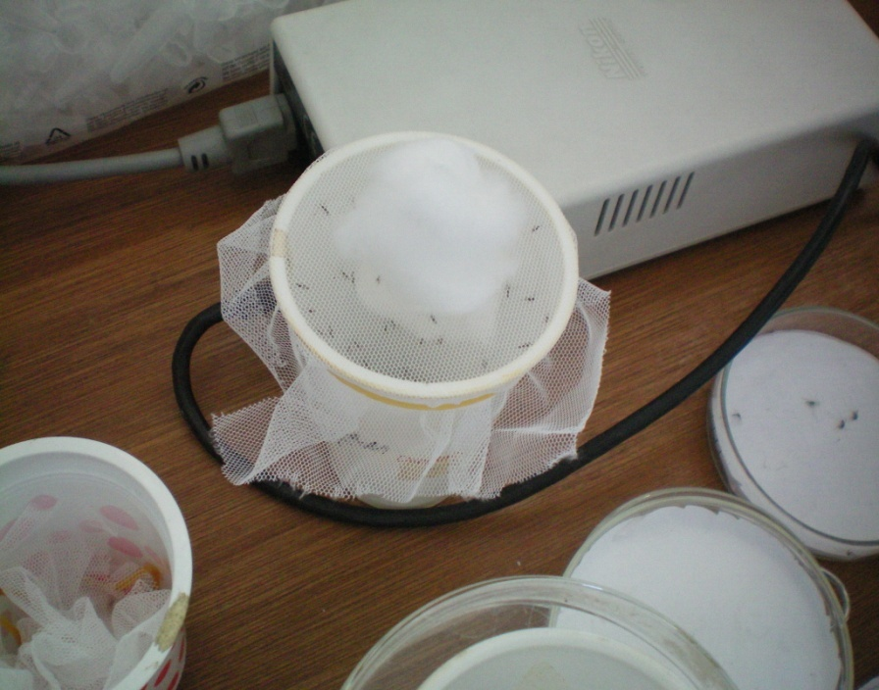
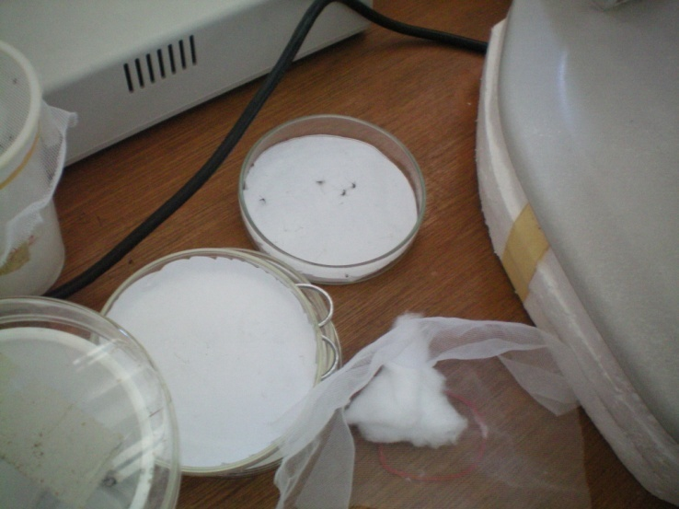

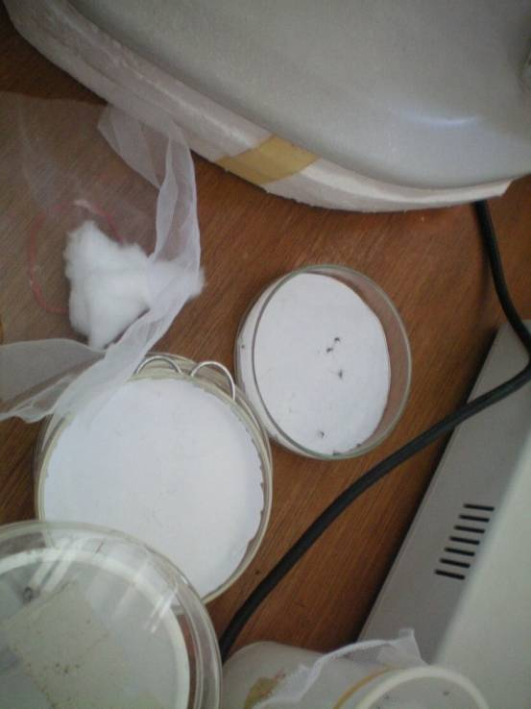
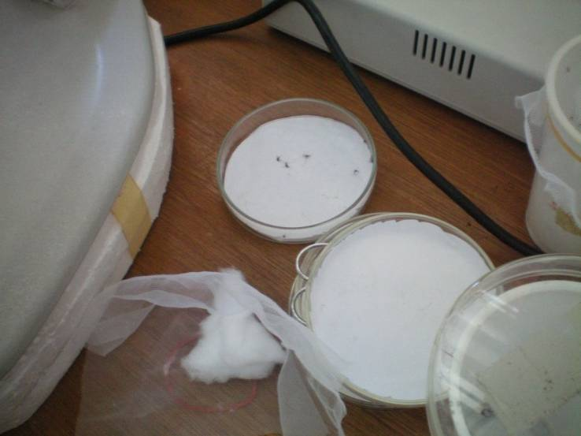
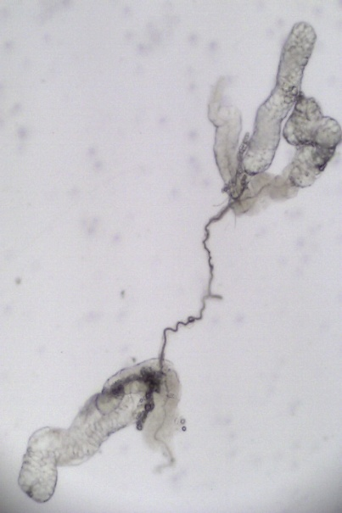
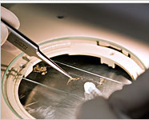
Isolation of Salivary Gland
Anesteted mosquitoes
2
1
3
Fresh Salivary glands or dilluted in PBS, kept in
-80 ⁰C (SGL)
microdissection
25
Notes:
Rearing skala Lab dan isolasi kelenjar saliva secara mikrodiseksi
25

Slide 26
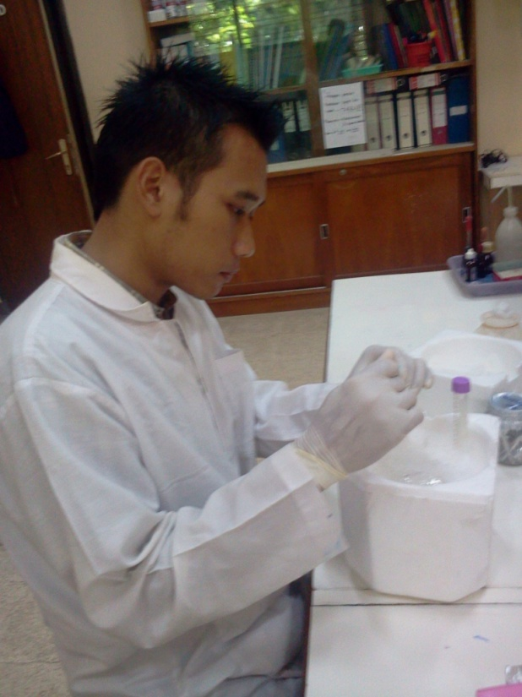
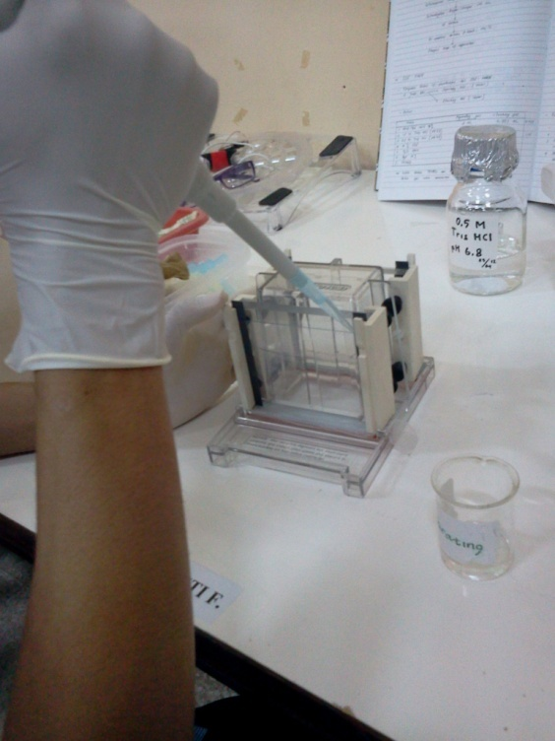
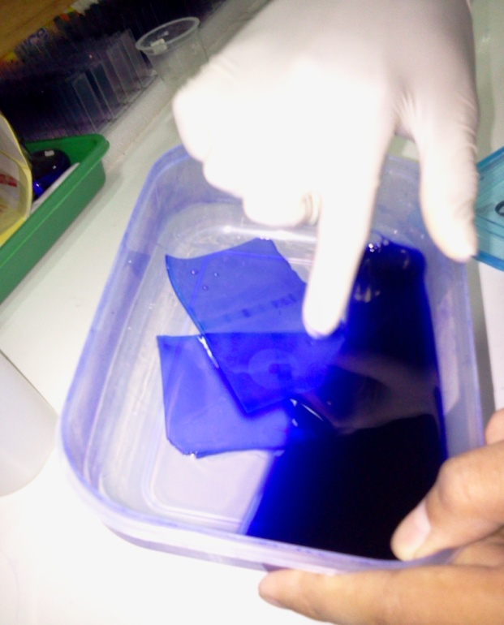
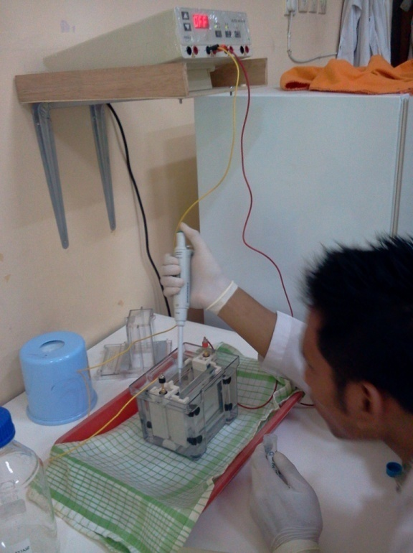
SG Analysis

Slide 27
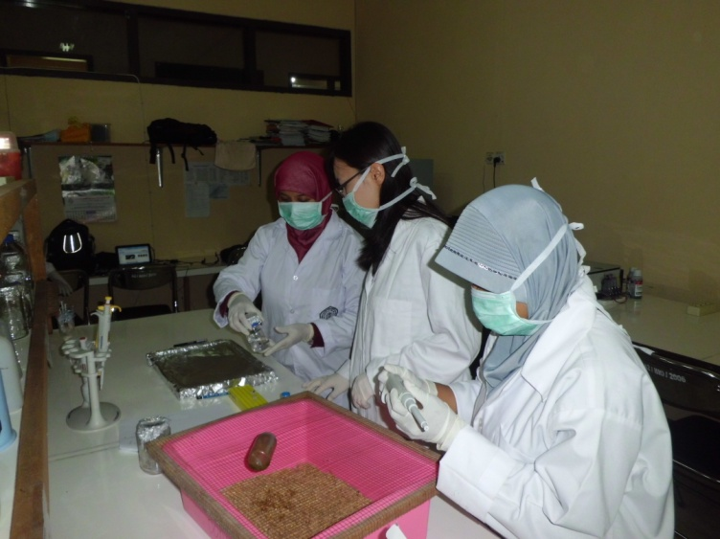
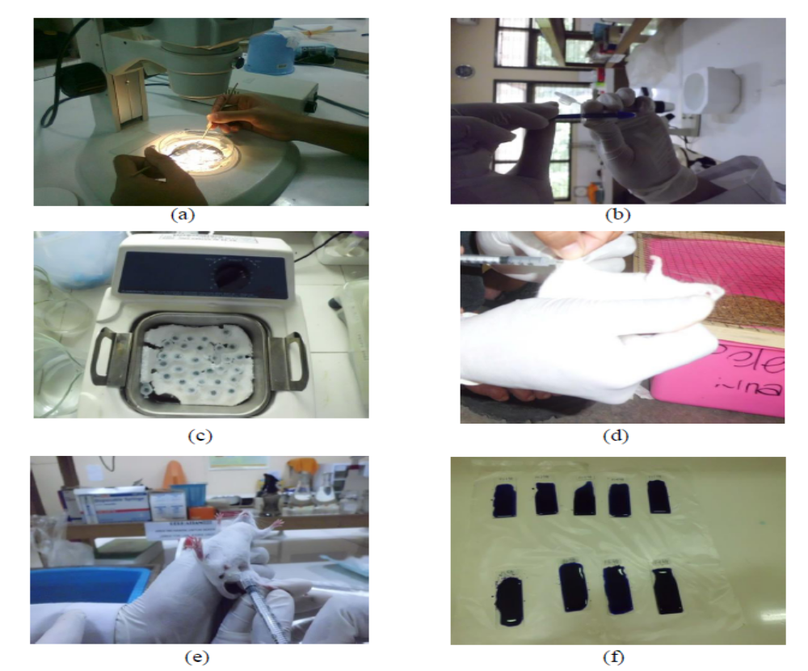
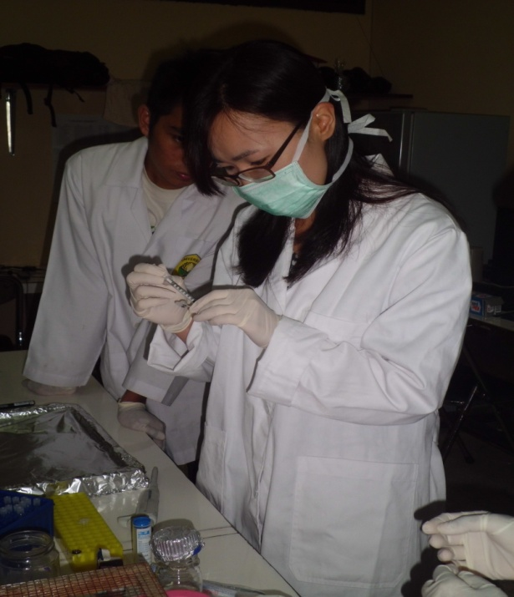
Potential Assay of Mosquito Salivary Gland to Control the Development of Parasite

Slide 28
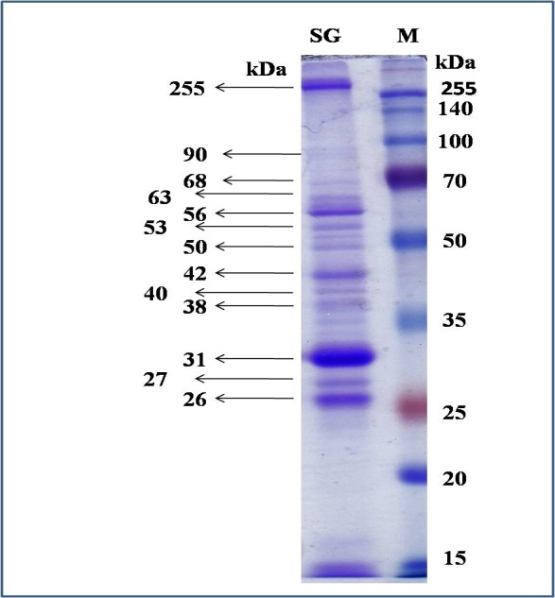
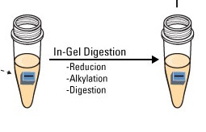
METHODS
Proteomic Analysis by using LC MS/MS
Desalting Process (absorbed peptides)
Cut off
Anhydration process : the gel dehydrated by using100 μl 100 % acetonitrile (ACN), dry up using the vacuum centrifuge.
Reduction process : Protein were reduced by using 100 μL of 10mM DTT–100 mM am. bicarbonate.
Alkylation process by using 100 μL of 55 mM iodoacetamide–100 mM ammonium bicarbonate
Trypsin digestion : by using 10 mL solution of 50 mM ammonium bicarbonate in 5 mM CaCl2 / trypsin
Desalting process were washed with 100 μL of 0.1% TFA–2% ACN (solution A) and extracted with 100 μL solution B (70% ACN, 0.1% TFA). Desalted peptide solution to be dried & keep in -20 before analized.

Slide 29

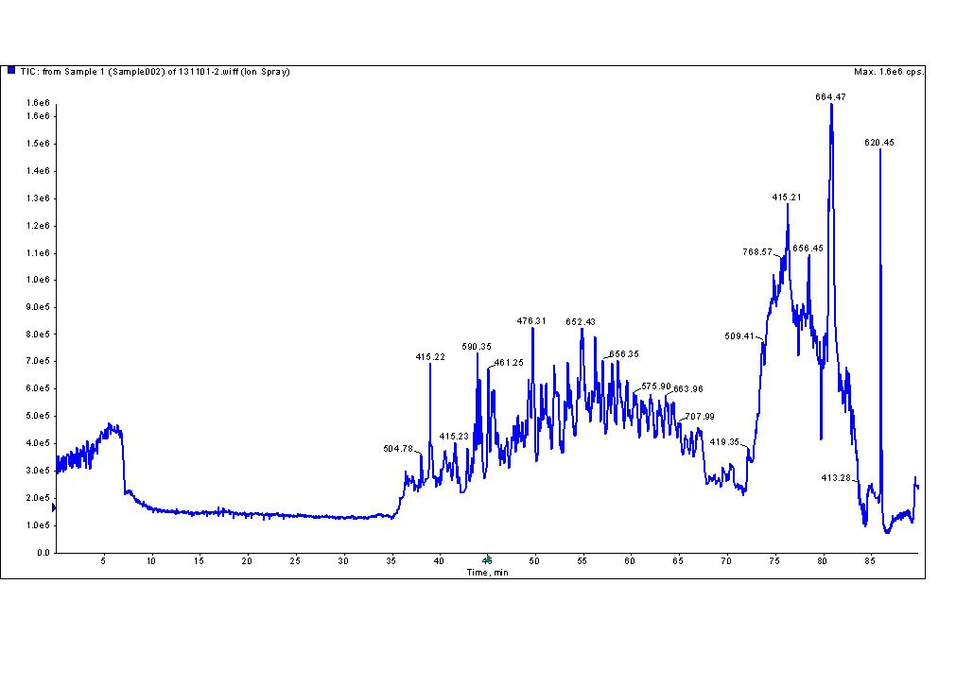
The digested and desalted peptides were identified by LC–MS/MS.
The digested and desalted peptides were identified by LC–MS/MS.
The digested and desalted peptides were identified by LC–MS/MS.
The digested and desalted peptides were identified by LC–MS/MS.
The digest & desalted peptides were identified by using LC MS/MS analysis Q-TOF hybrid mass spectrometer (QSTAR Elite, AB SCIEX, Foster City, CA, USA)
The accumulated MS/MS spectra were processed by using ProteinPilot software 2.0 (AB Sciex) against the Aedes aegypti UniProt database (version 2013_10)

Slide 30

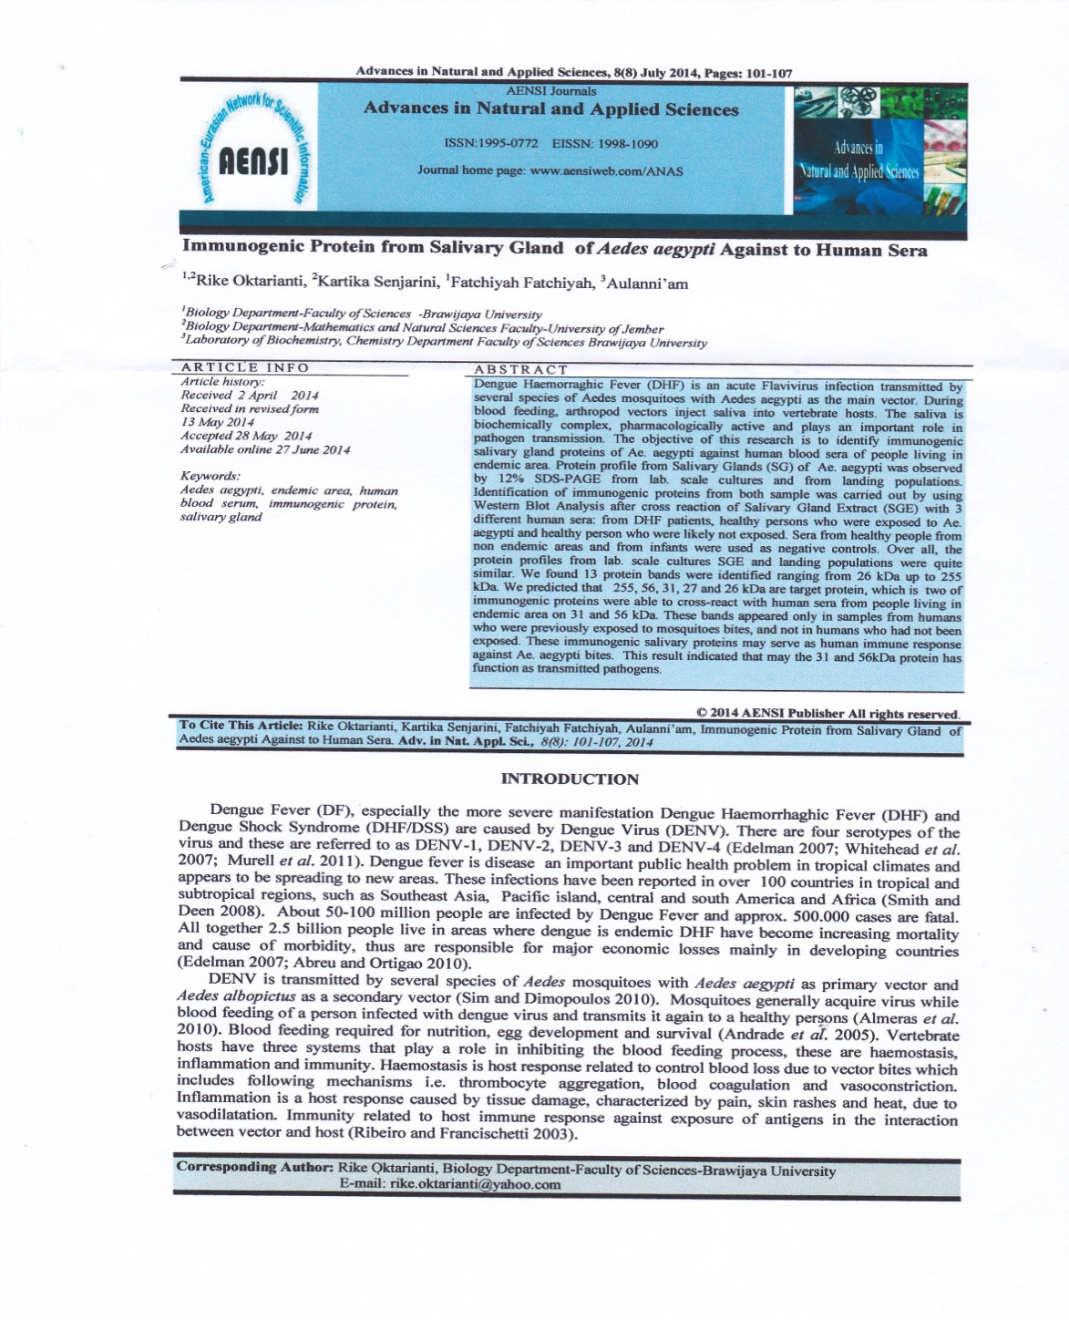

International Conferrence Biological Science (ICBS) UGM 2013 tanggal 20-21 September 2013
“Individual Human Sera Response against Protein Extracts from Salivary Gland of Aedes aegypti”
Asean Congress Of Tropical Medicine and Parasitology (ACTMP) KL, Malaysia 5-7 Maret 2014 “ Human Immune Response of People Living in Endemic Area DHF as Indicator of Immunogenic Protein against Protein Salivary Gland of Aedes aegypti”

Slide 31
Unused Protein score = ∑peptide contribution values (unused = peptides not claimed by another protein)
Coverage protein : total aas in detected peptides (at that threshold) / Total number of aas in protein sequence.)

