Slide 1
CHANGING TRENDS OF CLINICAL TRIALS IN INDIA
Mr. Karthikeyan Swaminathan Final MBBS part I MBBS
Dr.V.Krishnan , Department of Pharmacology, Saveetha Medical College, Chennai.
Field of Research –Pharmacology- Drug development and approval.

Slide 2
INTRODUCTION
India was emerging as one of global hubs for conducting clinical trials until 2011.
Then , there were comments ‘Plummet of trials in India’
This necessitates this most important analysis to reflect India clinical scenario at present ,
And hence we present our findings in this prestigious global audience

Slide 3
Objectives
To review and analyze the current trend, various phases and regional distribution of clinical trials in India
To note the regulatory changes regarding clinical trials in India

Slide 4
Methodology
Data collected from clinical trial registry India-forum(clinicaltriasl.gov.in) – clinical trials being conducted in the year 2011-2016 and analyzed
In order to review recent statistics and trend, only active trials that were open to recruitment were included.
Negative impact of trials on Indian trial participants ( death /adverse events ) , data was obtained from official web of health and family welfare department
Descriptive statistics was used

Slide 5
Result
Total number of trials(2011-2016)
Year | Number of clinical trials registered in CTRI
2011 | 56
2012 | 38
2013 | 49
2014 | 42
2015 | 32
2016 | 19

Slide 6
Results- Study Design
Non randomised- Placebo controlled -7
- Active controlled- 61
- Multiple arm- 34
Randomised
–Parallel – 474
- Placebo controlled- 247
- Active controlled- 371
- Multiple arm-73
- Crossover- 52
- Cluster- 18
- Factorial- 5

Slide 7
Results- Number of SAEs/deaths in Clinical trials
2,209 people have died in clinical trials in India since 2011, figures released by the office of the Drug Controller General of India have shown.
The figures, which go up to 20 October 2015, included 1335 deaths since January 2013

Slide 8
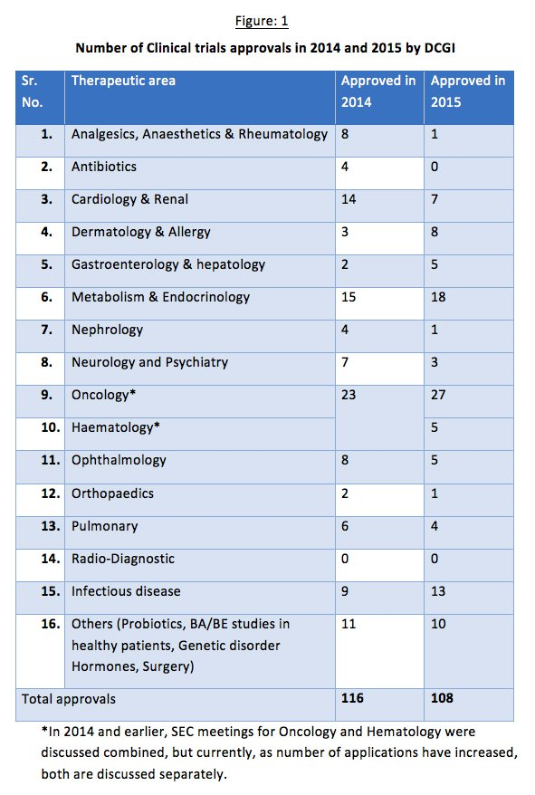

Slide 9
Discussion
Our Perspectives …
India, home to more than 1.2 billion people, is second largest pharmaceutical market in Asia estimated at US$ 5.40 billion and is growing by more than 9% annually now …
Despite this, till March 2013 only 1.5% of worldwide clinical trials registered at National Institute of Health, United States of America (USA), were from India.

Slide 10
Reasons for fall …
Compensation issue
Safety reporting
Unethical regulation
Ethics Committee regulations
Timelines and delay for approval

Slide 11
For an instance …
Because of time-consuming government approvals and rising allegations of unethical tests, further hindered possibilities of gathering a large sample size of people
Supreme Court‘s hearing on petition filed by Indore based group, Health Forum, brought 162 ongoing clinical trials in India to a halt as it asked government to give details about its trial approval process.

Slide 12
Transition begins…
Meanwhile, amendments to clinical trial regulations under Drugs and Cosmetics Rules (Third Amendment) was introduced in February 2013.
The objective was to improve patient safety, reporting timeliness of serious adverse events including deaths during clinical trials, and the payment of compensation to patients.

Slide 13
Transition begins…
Because of these changes to regulatory framework, many multinationals withdrew their clinical studies from India.
This resulted in a standstill for entire clinical research industry in India.
The new regulations were stringent and increased the time, effort, and cost causing investigators to shy away from clinical trials

Slide 14
Important Implications …
Prof. Ranjit Roy Chaudhury, expert committee, constituted by the Ministry of Health and Family Welfare enlists practices that would be conducive for growth of clinical trial industry in India –
Clinical trials should be conducted in accredited sites by an accredited Investigator
Audio-visual recording of consent process
An investigator cannot take part in over three trials at a time
SAE Reporting and Compensation
having at least 50 bed hospital

Slide 15
‘India became the first country in the world to give out compensations to victims of clinical trials on the basis of a formula that computes the sum after considering the age and health risk of the deceased’ during the trial period , though issues happened not related to trial per se

Slide 16
Further Recommendations …
Dr G N Singh, Drug Controller General of India (DCGI), said that the decisions were taken over two meetings held with all stakeholders recently. "The idea is to create conducive environment for pharma sector to enter swiftly into drug discovery and research phase,"
Dr Singh further highlighted that relaxed norms will help India register its presence in the international market as it will give Indian scientists and doctors the much needed liberty.
With relaxed norms we will give more research opportunities to scientists

Slide 17
How Resurrection occurs
UNDER NEW NORMS
Clinical researcher will be allowed to perform as many trials as approved by ethics committee, instead of previous cap of three trials
Restrictions on number of minimum beds at clinical trial site have also been removed. Earlier, clinical trial site was mandated to have at least 50 beds.
Drug makers also need not take ‘no objection certificate' from DCGI in case of addition or deletion of new clinical trial site or investigator
New rules notified by Central Drugs Standard Control Organisation (CDSCO) of India under Ministry of Health and family Welfare recently.

Slide 18
Pertaining to Ethics committee
Certification, and recertification of Ethics Committee members and all investigators
Good clinical practice training to all ethics committee members
Most recently , from December 2017 onwards , Ethics committee needed NABH accreditation to approve trials

Slide 19
‘We welcome global stakeholders , to promote ethical research to meet the unmet need and thereby to give more generics , biosimilars and new drugs as well to serve the under privileged population’

Slide 20
Conclusion
India is one the few countries with diverse population which makes to most suitable to conduct trail and its finding has more generalization when drug comes to market
Govt of India took all possible measures to increase trials including academic trials in medical teaching tertiary care hospital
We are very keen to promote trails WITHOUT compromising ethics .

Slide 21
References
REFERENCES
1. Mallath MK, Chawla T. Investigators viewpoint of clinical trials in India: Past, present, and future. Perspect Clin Res. 2017;8:31–6.
2. Thatte UM, Marathe PA. Ethics Committees in India: Past, present, and future. Perspect Clin Res. 2017;8:22–30.
3. Sarojini N, Divya B. The invisible: Participants experiences in clinical trials. Perspect Clin Res. 2017;8:5–10.
4. International Conference on Harmonisation (ICH) Harmonised Tripartite Guideline Clinical Safety Data Management: Definitions and Standards for Expedited Reporting E 2A. [Last accessed on 2010 Dec 10]. Available from:http://www.emea.europa.eu/docs/en_GB/document_library/Scientific_guideline/2009/09/WC500002749.pdf.
5. Bhatt A. Are registered ethics committees empowered to ensure human research protection? Perspect Clin Res. 2016;7:149–151. [PMC free article] [PubMed]
6. Mandava A, Pace C, Campbell B, Emanuel E, Grady C. The quality of informed consent: Mapping the landscape. A review of empirical data from developing and developed countries. J Med Ethics. 2012;38:356–65. [PMC free article] [PubMed]

Slide 22
THANK YOU

Slide 23
