Slide 1
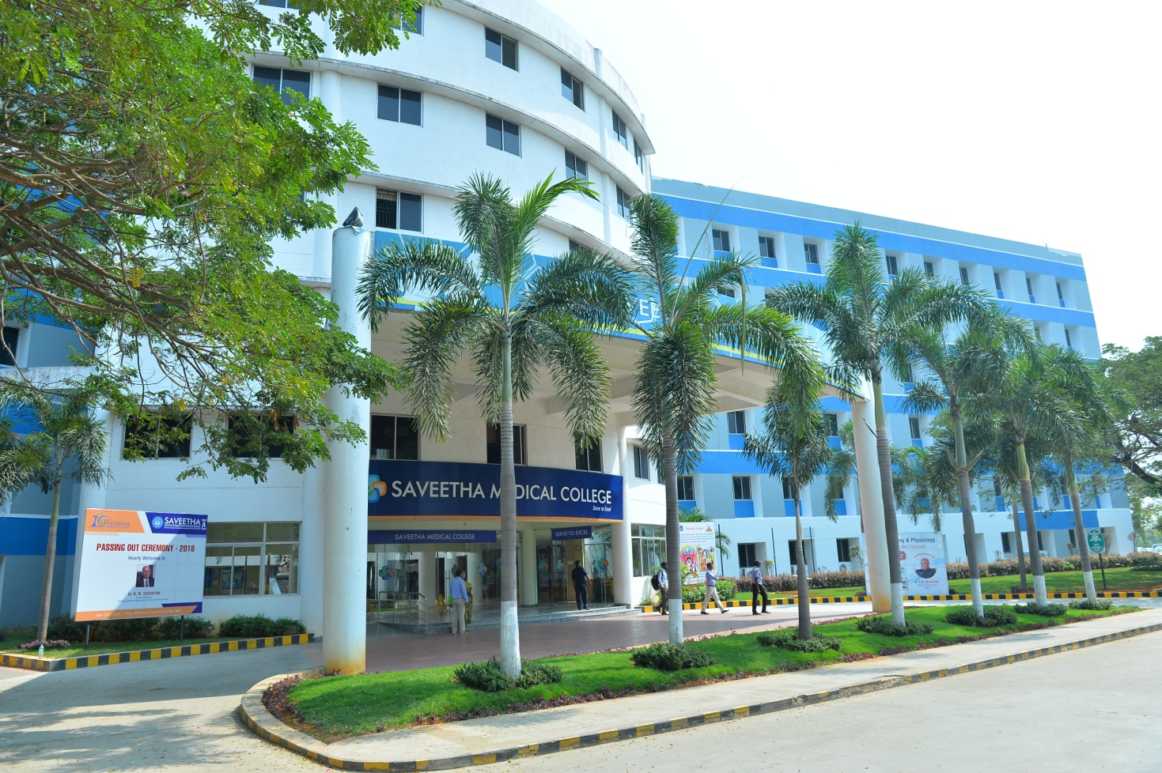
Dr G Karthikeyan,
MBBS,MD (Anatomy)
Assistant Professor,
Dept of Anatomy,
Saveetha Medical College and Hospital,
Chennai, Tamil Nadu, India
A STUDY ON EFFECTS OF ALCOHOL IN HUMAN EXFOLIATED BUCCAL CELLS
Dr G. Karthikeyan, Dr Gunapriya Ragunath, Dr Vijayalakshmi, Dr Vijayakumar, Dr Sankaran,
Dr Sudhakshina, Dr .Kumaresan, Dr Priyadhashini, Dr Zareena & Dr.Yuvaraj

Slide 2
INTRODUCTION
Cancers are the most commonest cause of death in adults.
Oral cancer is among the top three cancers in India.
Oral cancer is any malignant neoplasm which is found on the lip, floor of the mouth, cheek lining, gingiva, palate or in the tongue (primary site)

Slide 3
RISK FACTORS
World-wide, 48% of the total adult population (approximately 2 billion people) consume alcohol and 33% (approximately 1.3 billion people) consume tobacco.
Betel nut chewing and human papilloma virus(HPV)
Oral cancer may also occur due to poor dental care and poor diet
Genotoxic agents can causes carcinogenic damage to the chromosomes and form several secondary nuclei known as micronuclei.

Slide 4
AIM OF THE STUDY
To study the micronuclei using oral exfoliative cytology in alcoholic subjects.

Slide 5
MATERIALS AND METHODS
This prospective study was conducted in 332 adult subjects between the age 30-50 years, they were divided into three groups
Group 1- control subjects(n=120) – had no habit of alcohol and cigarettes smoking
Group 2- Subjects present only with habit of alcohol consumption (n= 110)
Group 3- Subjects present with habit of both alcohol consumption & cigarettes smoking (n=102)

Slide 6
INCLUSION CRITERIA
More than 10 years of alcohol consumption
( Regular or occasional )
Habit of smoking ( Regular or occasional)
EXCLUSION CRITERIA
Any oral pathology
Poor diet
Any oral substance abuse ( betel nut, hans, pan masala, kutka)
Under any medication

Slide 7
COLLECTION OF SPECIMENS
The material was collected from the oral cavity by scraping the buccal mucosa on the cancer prone area using a clear wooden spatula
Scraped material was spread on the precleaned slide and fixed with methanol and glacial acetic acid for 20 minutes.
These fixed slides were stained with Giemsa stain and studied for presence of micronuclei.

Slide 8
Statistical analysis
One way ANOVA
P value less than 0.05 considered to be significant

Slide 9
RESULTS AND DISCUSSION
Presence of micronuclei in group 2 is significantly increased when compared to group 1
But not significantly increased between group 2 & group 3
 | Group 1 | Group 2 | Group 3
Total No of subjects | 120 | 110 | 102
No of subjects showing micronucleus in buccal mucosa | 11 | 80 | 97

Slide 10
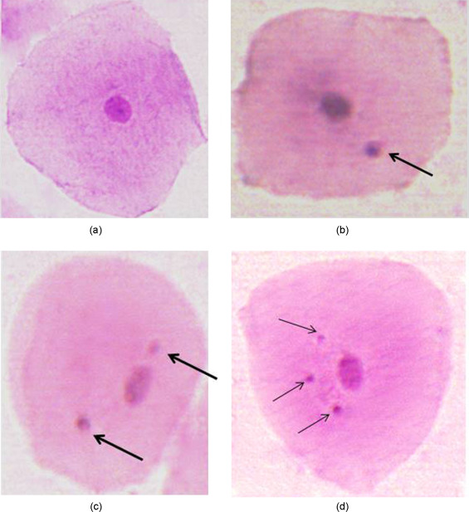
Buccal smear (Giemsa staining)
A - CONTROL GROUP
B - CONTROL GROUP SHOWING MICRONUCLEUS
A
B
C - GROUP 2( ALCOHOLIC) presence of more micronucleus
D= GROUP 3( ALCOHOLIC+ SMOKING) presence of numerous micronucleus
D
C

Slide 11
DISCUSSION
Micronucleus test on the buccal mucosa is useful to examine an early cellular response to any carcinogens
This study clearly demonstrated that MN frequencies were significantly increased in alcoholic subjects with increased incidence of oral cancer.

Slide 12
Factors favouring formation of micronucleus in alcoholics
Dehydrating effect of alcohol on cell
Enhances the ability of other carcinogens to permeate
Nutritional deficiencies associated with heavy drinking
Lack of antioxidants

Slide 13
Only 11 out of 120 subjects in control group showed micronuclei
This may be due to drugs, viral infections, environmental pollutants.
80 smears out of 110 alcoholic subjects showed micronuclei indicating higher risk of developing oral cancers.

Slide 14
97 smears out of 102 subjects with both alcohol consumption and smoking showed more micronuclei.
Which further increases the risk of developing oral cancers.

Slide 15
MICRONUCLEI
Cell division
Alcohol
Genotoxic agents
Alcohol
Tobacco
HPV
Betal nut chewing
Damage to the chromosome
Deficiency in dietary folate and vitamin B12
Chromosomal fragments (Lag behind in anaphase)
Lagging elements will be included in daughter cells
Secondary nuclei

Slide 16
There is evidence that deficiency in dietary folate and vitamin B12 may also increase in occurrence of MN
Localized folate deficiency induced by alcohol consumption can cause micronuclei in buccal mucosa cells which is independent of the plasma folate level.
Plasma and buccal mucosal levels of folate and vitamin B12 were however, not assessed in the present study.

Slide 17
It is evident from our study, that alcohol consumption is a high risk for development of the oral cancer
The frequency of MN is further increased by the habit of cigarette smoking increasing the risk further.
It cannot be concluded that oral carcinoma will arise from these sites.
The possibility to quantitative genotoxic damage in various tissues will make this approach applicable for a wide spectrum of studies on human population groups.

Slide 18
CONCLUSION
There is a high increase in micronuclei in alcoholic subjects which is aggravated by smoking than that of controls.
This concludes that MN assay can be used as a biomarker for detecting the progression of cancer and can be used as a screening test in the population at risk.

Slide 19
REFERENCES
Rajesh Dikshit, Prakash C Gupta, Chinthanie Ramasundarahettige, Vendhan Gajalakshmi, Lukasz Aleksandrowicz, Rajendra Badwe, Rajesh Kumar, Sandip Roy, Wilson Suraweera, Freddie Bray, Mohandas Mallath, Poonam K Singh, Dhirendra N Sinha, Arun S Shet, Hellen Gelband, Prabhat Jha for the Million Death Study Collaborators, "Cancer mortality in India: a nationally representative survey"
J. K. Elango, P. Gangadharan, S. Sumithra, and M. A. Kuriakose, “Trends of head and neck cancers in urban and rural India,” Asian Pacific Journal of Cancer Prevention, vol. 7
Moshberg , Merletti F, Boffetla P, Gandolfo S, Ozzellon F, Pracchia F, et al. Appearance, site of occurrence, and physical and clinical characteristics of oral carcinoma in Tornio, Italy. Cancer, 1989; 63(12): 2522-2527.
Anil K. Chaturvedi, William F. Anderson, Joannie Lortet-Tieulent, Maria Paula Curado, Jacques Ferlay, Silvia Franceschi, Philip S. Rosenberg, Freddie Bray, and Maura L. Gillison, "Worldwide Trends in Incidence Rates for Oral Cavity and Oropharyngeal Cancers“
PLopez Jornet,* FJ Gomez Garcia,* M Lucero Berdugo,* F Parra Perez,* A Pons-Fuster Lopez, "Mouth self-examination in a population at risk of oral cancer“
Wen-JiunLin,1 Rong-SanJiang,1 Shang-HengWu,1 Fun-JouChen,2 andShih-AnLiu1,3, "Smoking,Alcohol, andBetel QuidandOralCancer: AProspective CohortStudy“
Fenech M., Browne RM, Camsey MC, Waterhouse JAH, Manning GL. Etiological Factors in oral squamous cell carcinoma. Comm Dent Oral Epidemiol, 1977; 5(6): 301-306.
Garewal HS, Ramsey L, Kaugars G, Boyle J. Clinical experience with the micronucleus assay. J Cellul Biochem, 2004; 53(17): 206-212.
Halder A, Chakraborty T, Mandal K, Gure PK, Das S, Ray Chowdhury R, et al. Comparative study of Exfoliated oral mucosal cell micronuclei frequency in normal. Precancerous and malignant epithelium. Int J Hum Genet, 2004; 4(4): 257-260.
Proja NK. Paszkuioizc GM, Nasca MA, Franke GE, Pauly JL. Smoking and smokeless tobacco- associated human buccal cell mutations and their association with oral cancer - A Review. Cancer Epidemiol Biomark Prev, 2006; 15(6): 1061-1077.
Pawitan JA. Biological tests for mutagenesis in man. A Clinical Review. Medical progress, 1999; 16-18
Yadaw JS, Chadha P. Genotoxic studies in Pan Masala chewers: A high cancer risk group. Int J Hum Genet, 2002; 2(2): 107-112.
Stich HJ, Curtis JR, Parida BB. Application of the micronucleus test to exfoliated cells of high cancer risk groups; tobacco chewers. Int J Cancer, 1982; 30(5): 553-559.

Slide 20
THANK YOU

Slide 21
MICRONUCLEI
Micronuclei are extra-nuclear cytoplasmic bodies; they are induced in cells by numerous genotoxic agents that damage the chromosomes including alcohol and tobacco.
The damaged chromosomes, in the form of a chromosome fragments, lag behind in anaphase when centric elements move towards the spindle poles.
After telophase, the undamaged chromosomes, give rise to regular daughter nuclei.[7,8,9]

Slide 22
The lagging elements are included in the daughter cells, but a considerable proportion is transformed into one (or) several secondary nuclei, much smaller than the principle nucleus and is therefore called micronuclei [7,8,9]
Useful biomarker to assess cytogenetic damage in biomonitoring studies using peripheral lymphocytes and epithelial cells

Slide 23
It is evident from our study, that in alcohol consumption, the buccal mucosa are at high risk for development of oral cancer, showing an increase in the MN frequencies, which is further increased by the habit of cigarette smoking.
However, it cannot be concluded that oral carcinoma will arise from these sites. The possibility to quantitate genotoxic damage in various tissues will make this approach applicable for a wide spectrum of studies on human population groups.

Slide 24
Micronuclei are induced in oral exfoliated cells by a variety of substances, including genotoxic agents and carcinogenic compound in tobacco, betal nut and alcohol [10].
With this view in mind, the present study was carried out to assess the occurrence and compare the levels of micronuclei in oral exfoliative cytology of healthy control subjects and subjects presenting with habit of alcohol consumption.

Slide 25
EFFECTS OF ALCOHOL COMSUMPTION
Alcohol’s effect on the mouth may be the key to understanding how it works with tobacco to increase the risk of developing cancer. The dehydrating effect of alcohol on cell walls enhances the ability of tobacco carcinogens to permeate mouth tissues; additionally, nutritional deficiencies associated with heavy drinking can lower the body’s natural ability to use antioxidants to prevent the formation of cancers.

Slide 26
EFFECTS OF ALCOHOL COMSUMPTION
Alcohol’s effect on the mouth may be the key to understanding how it works with tobacco to increase the risk of developing cancer.
The dehydrating effect of alcohol on cell walls enhances the ability of tobacco carcinogens to permeate mouth tissues;
Additionally, nutritional deficiencies associated with heavy drinking can lower the body’s natural ability to use antioxidants to prevent the formation of cancers.

Slide 27
These agents damage the chromosomes to form several secondary nuclei known as micronuclei.
This study identifies the occurrence of micronuclei and also evaluates the frequency of micronuclei in stained smears of oral exfoliative cells from healthy subjects and alcoholic subjects.

Slide 28
The increase in MN may be due to induction of cytogenetic damage in the epithelium by carcinogenic agents released from alcoholic consumption.
Hence the micronucleus assay can be used as a biomarker of genotoxicity in predicting effects of carcinogenic agents.

Slide 29
Discussion
Micronuclei has been proposed as a useful biomarker to assess cytogenetic damage in biomonitoring studies using peripheral lymphocytes and epithelial cells [8, 9]. Segregational defects are considered to be one of the causes for chromosomal instability, where centric and a-centric micronuclei are formed during telophase [3, 9]. Mammalian tissue exposed to various chemical or physical carcinogens show a great variety of nuclear anomalies and mitotic irregularities producing extra-nuclear DNA containing bodies like micronuclei formed by classical mechanisms [10]. The sensitivity of the micronucleus test is

