Slide 1
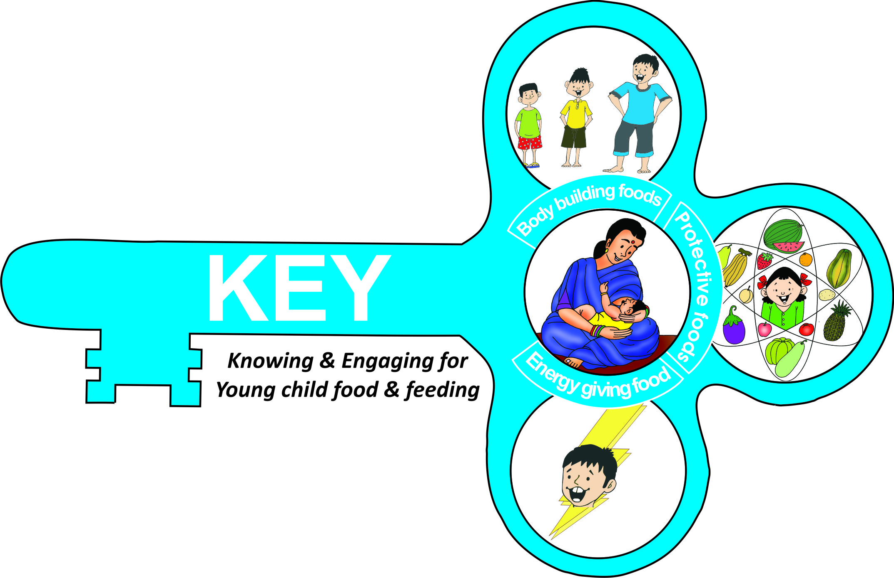



K.E.Y-Knowing and Engaging for Young child food and feeding:
(Leveraging a successful literacy initiative assessment approach)
An implementation pilot
Dr. Smriti Pahwa, PhD Food and Nutrition; Dr. Malavika Subramanyam, MBBS MD MPH DSc; Aditi Macwan, MSW; Karishma Vats*
Presented by Karishma Vats, M.Sc Food and Nutrition

Slide 2


INTRODUCTION & BACKGROUND

Slide 3
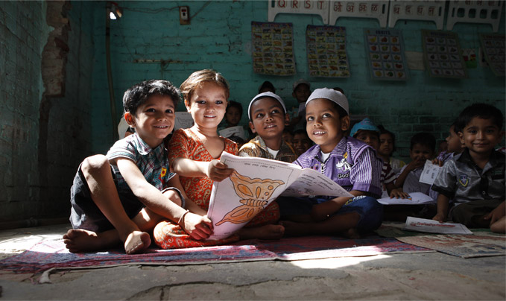
Pratham Education Foundation
Pratham Education foundation was established in 1995 in Mumbai and has grown in both scope and geographical coverage since then.
India’s largest non government organization.
An innovative learning organization created to improve the quality of education.
Run various programs reaching 7.7 million children across the country*.
*http://www.pratham.org/
Notes:
Focus on quality education and ensure that children not only attend school but even prospers. Aim is to support government programs and not to replace them.

Slide 4
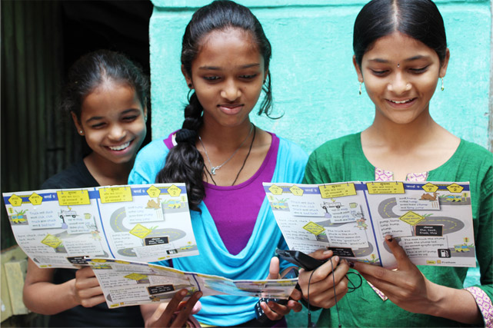
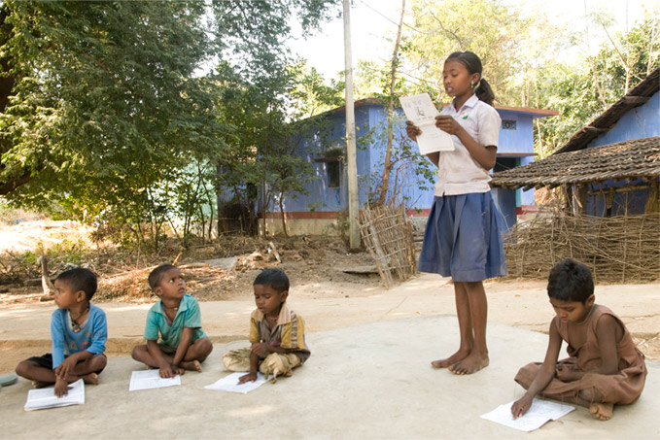
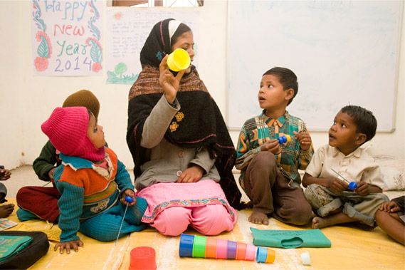
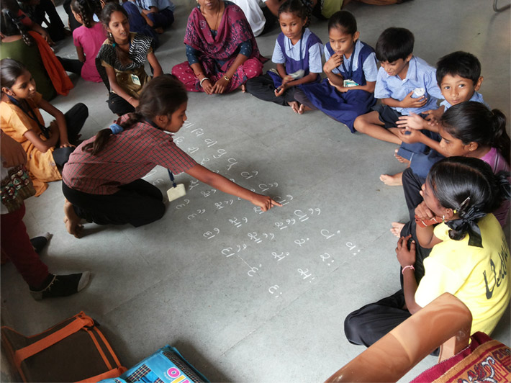
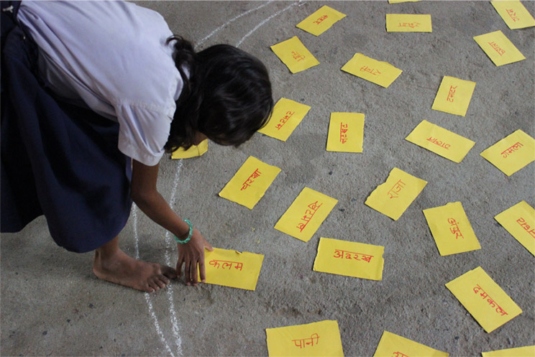

Slide 5
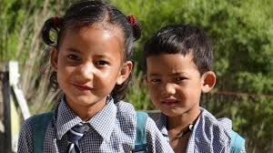
ASER (Annual Survey of Education Report)
ASER Centre was established in 2005.
The largest non-governmental household survey conducted in rural India.
ASER surveys have been involving more than 25,000 volunteers and covering over 700,000 children in 15,000 villages each year.
Tracks children’s ability to read and do basic arithmetic involving local organizations and institutions in every rural district in the country.
Has become an important resource for the education policies of both Central and State governments.
Notes:
Aser believes when ordinary people are empowered with knowledge, they can bring about extraordinary change. When they learn to measure what affects their lives, they communicate with each other in villages, states and take steps to resolve them.
700,000 children in age group 3-16 years across the country

Slide 6
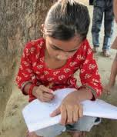
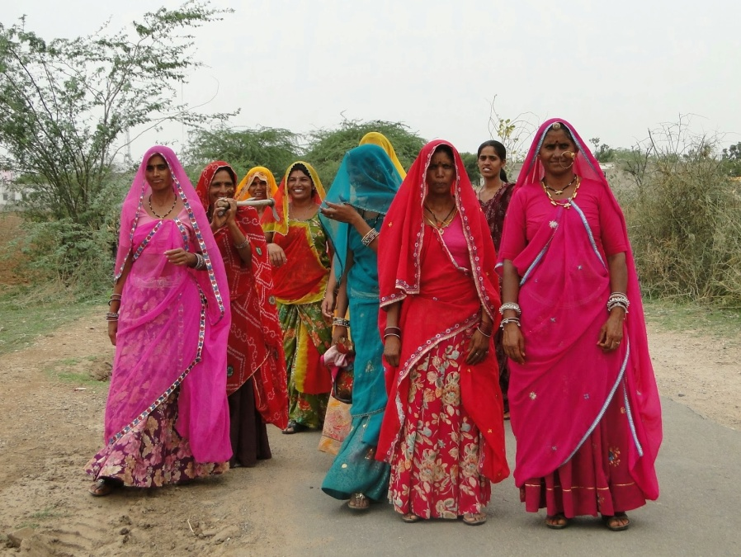
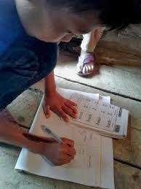
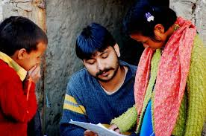

Slide 7
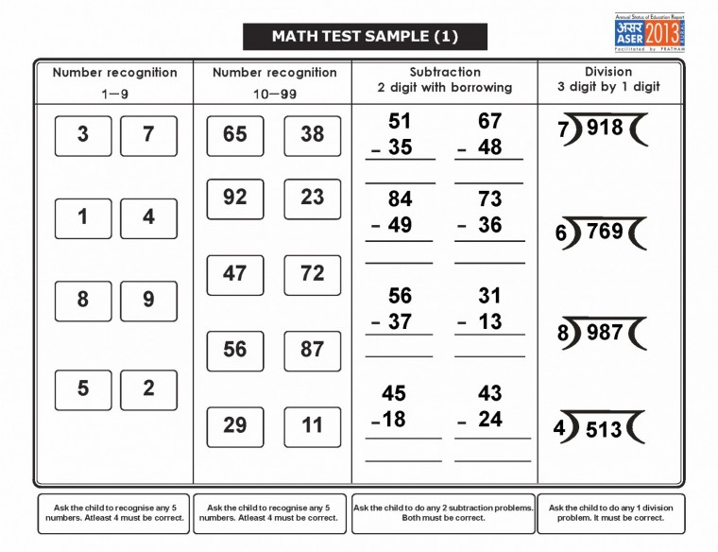
ASER Testing tool for Arithmetic

Slide 8
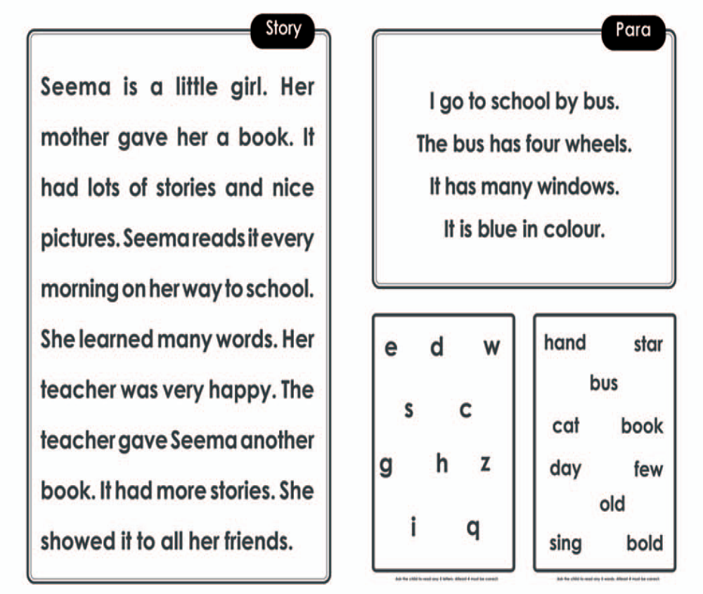
ASER Testing tool for Language

Slide 9
Rapid diet assessment tool developed
Based on ASER philosophy of community involvement, simple assessment and understandable evidence
Rapid Diet Assessment tool:
A rapid diet assessment tool was developed.
An attempt to involve common people/ with not necessarily a technical background to unpack the age appropriate complementary feeding.
A possible interface for common people to look at IYCF, analyze and assess gaps for possible actions.
Reference period: 24 hour
* The community workers were trained on fundamentals of food and nutrition and had no prior technical knowledge about diet planning.

Slide 10
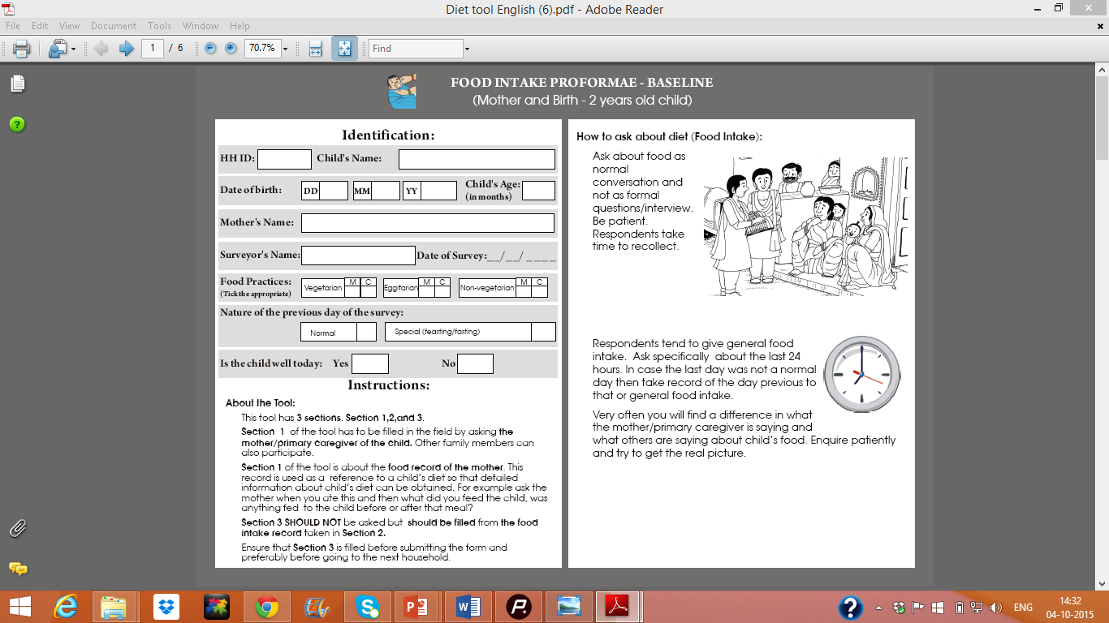
Rapid diet assessment tool

Slide 11
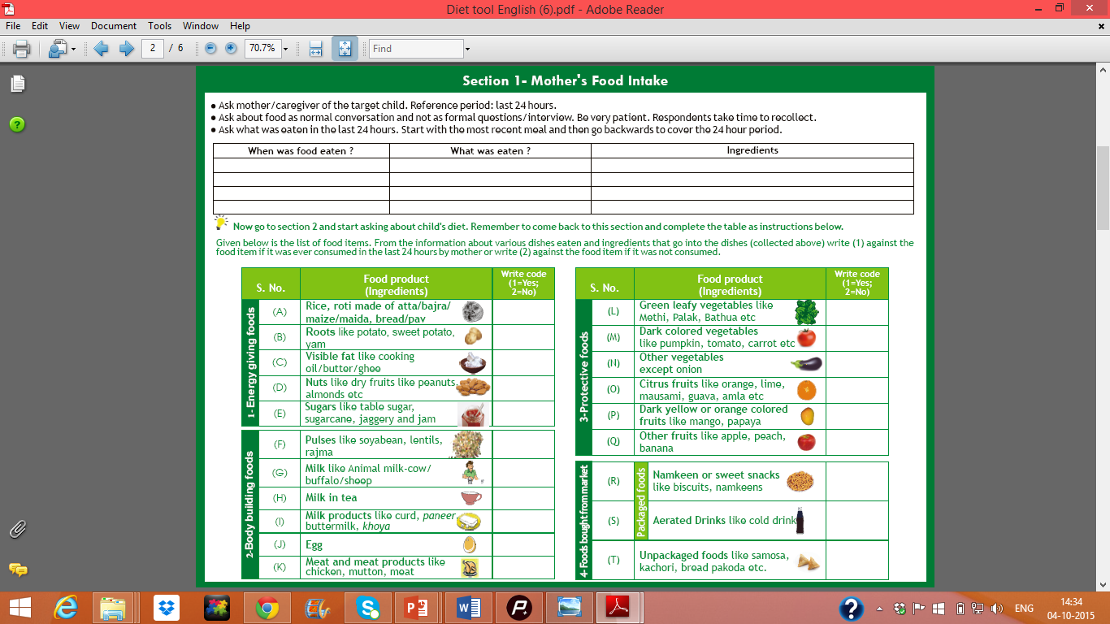
Rapid diet assessment tool

Slide 12
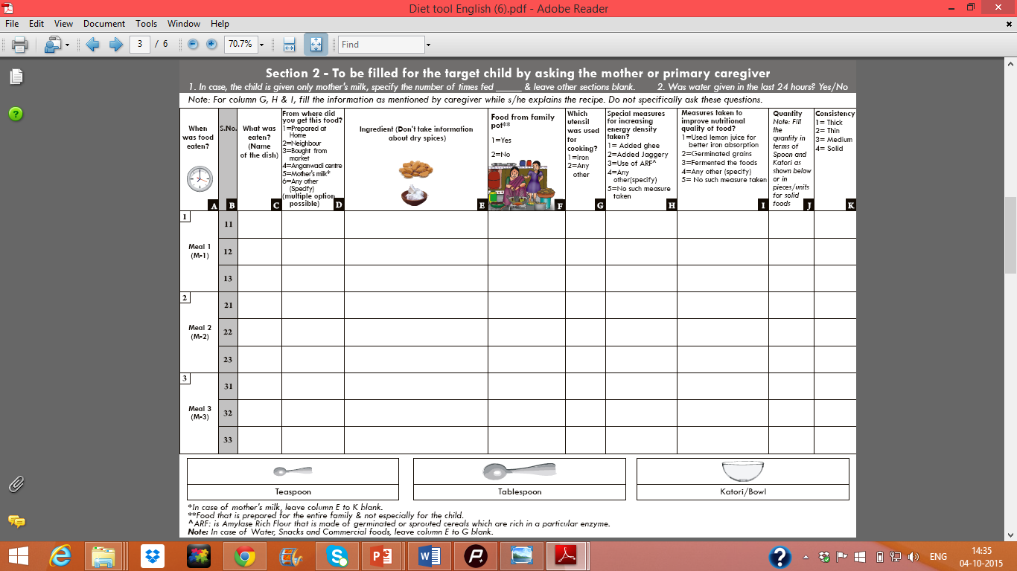
Rapid diet assessment tool

Slide 13
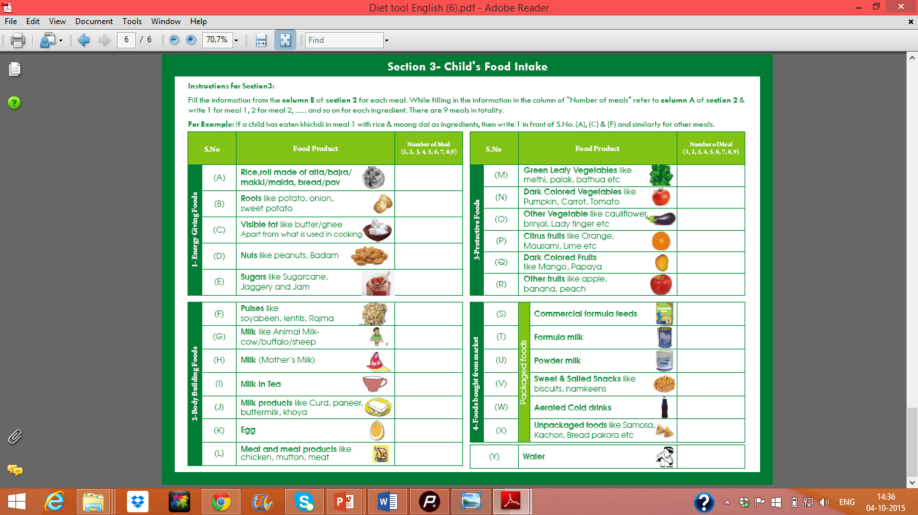
Rapid diet assessment tool

Slide 14
Genesis: PAHELI (People’s Assessment of Health Education and Livelihoods)
First PAHELI was done in 2006, the second and latest one in 2011.
It applies ASER model in understand other human development domains: Life & Livelihoods, Water & Sanitation, Education & Literacy and Mother & Infant Health & Care.
Done in eight districts across seven states.
Notes:
This was attempted to apply aser’s approach to assessment to several human development domains.
Odinary people should eb anabled to measure and understand status of basic human devpt outcomes in their household
d.

Slide 15
Pratham Gujarat Primary Caregivers Programme-K.E.Y
A collaboration between partners were ASER centre, Pratham and IIT Gandhinagar.
OBJECTIVE: This pilot aimed to create an interface wherein community workers could be trained to assess the situation of Infant and young child practices in their areas as well as engage with the community for corrective actions if required.
METHODS: The study included Balwadi teachers in Ahmedabad (intervention site, n=60) and Baroda (control site, n=30).
Notes:
Offers a ripe landscape for piloting ECD-Nutrition curriculum.

Slide 16
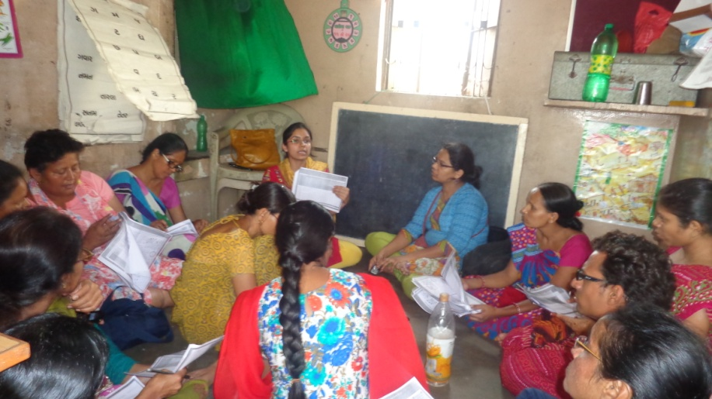
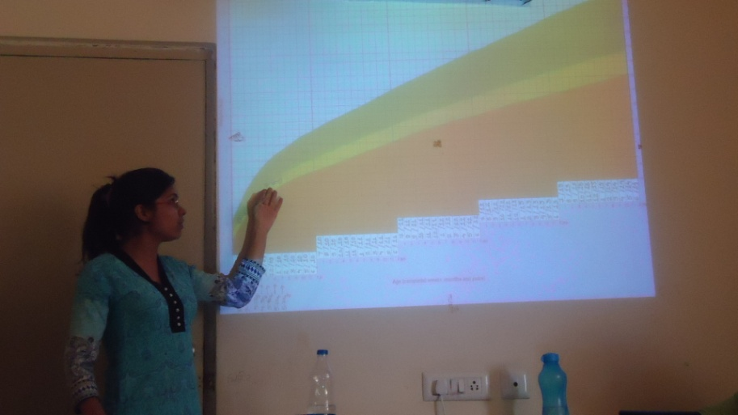
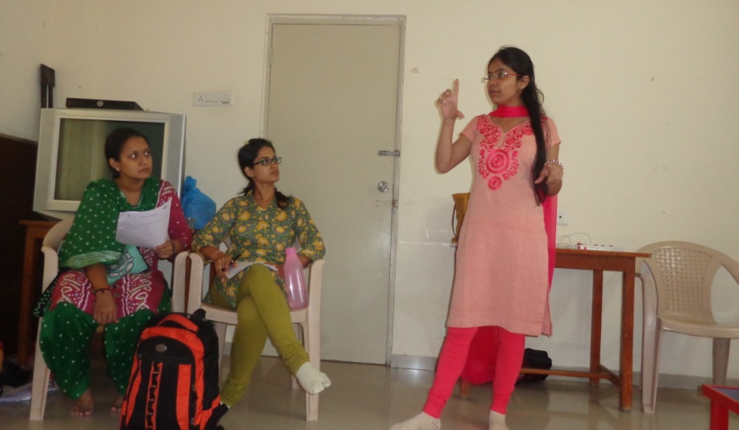
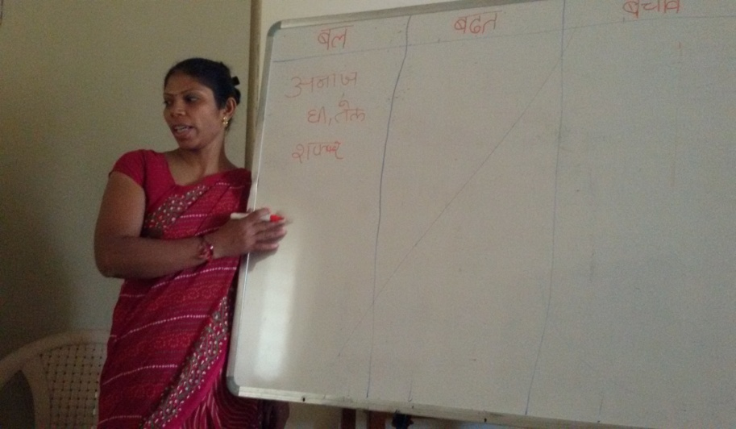
Step 1
Training: Community workers were trained on rapid assessment tools and K.E.Y curriculum
* The community workers had no prior technical knowledge about diet planning.

Slide 17
K.E.Y (Knowing and Engaging for Young child food and feeding)
An ECD-Nutrition curriculum to train frontline workers/volunteers to work with caregivers of very young children (less than 3 years) on nutrition, health and overall development.
Simple, measurable and actionable indicators have been identified to enable volunteers and caregivers to monitor Young child food and feeding practices, growth and overall health and development.

Slide 18
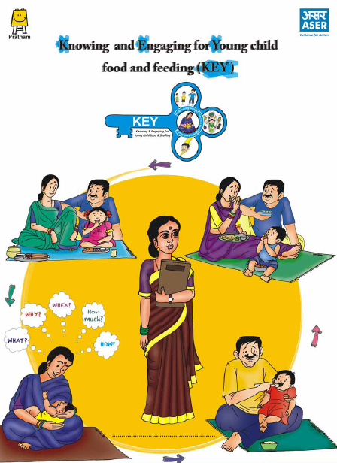
ECD Nutrition curriculum comprises of:
Main K.E.Y module
Supporting modules- Growth monitoring, Immunization, Diarrhoea, Water, hygiene and sanitation

Slide 19
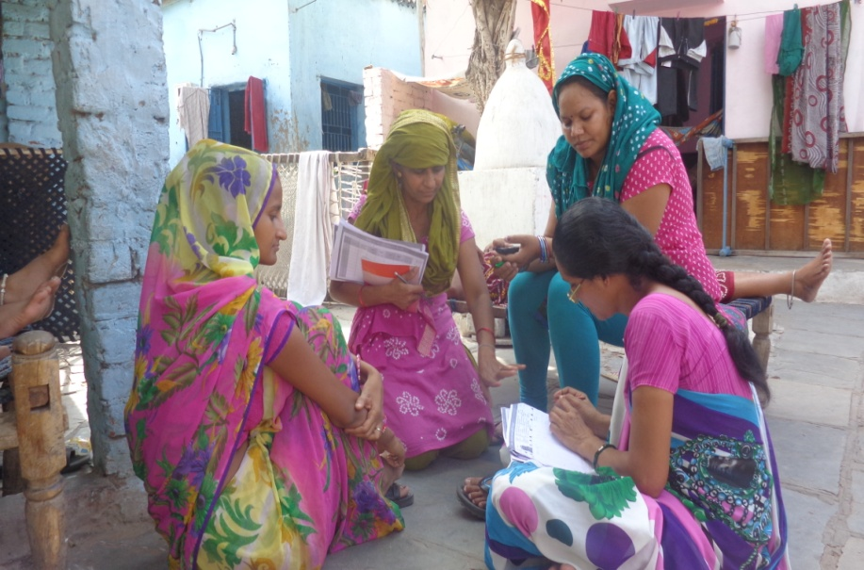
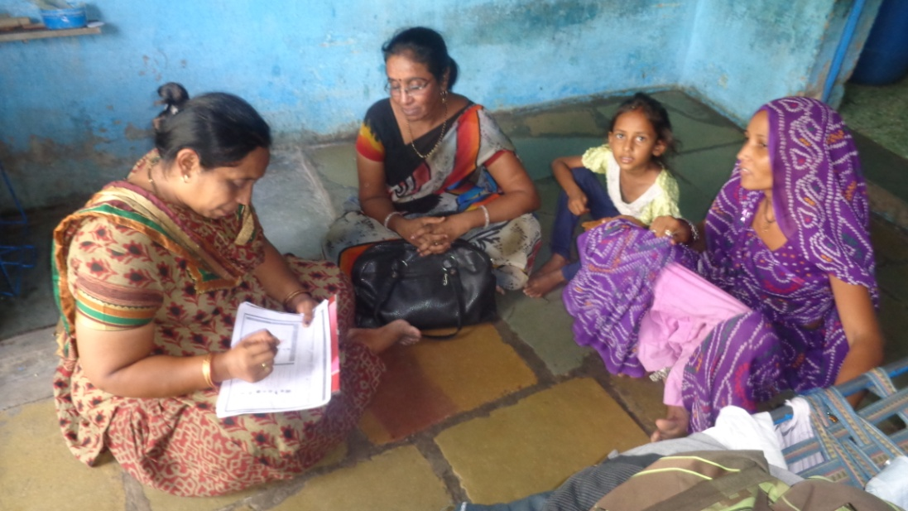
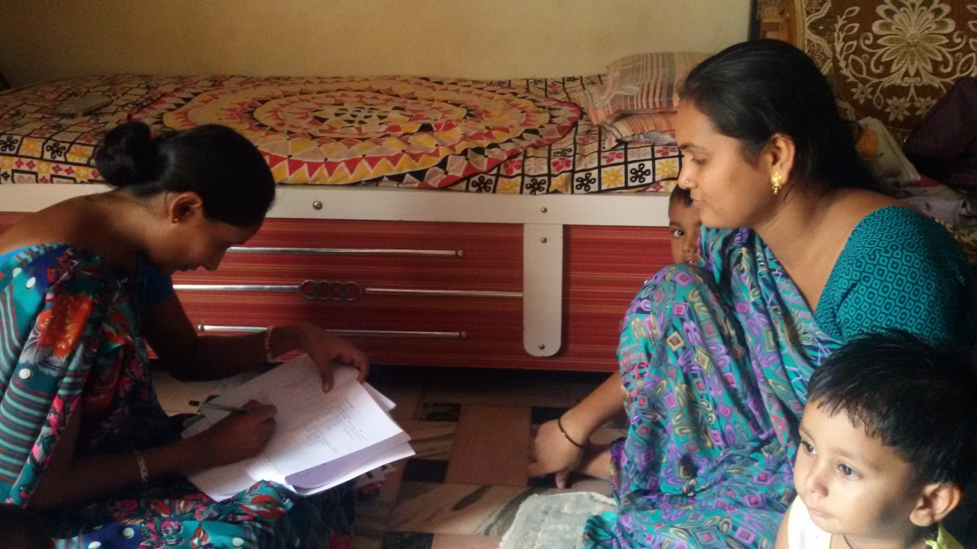
Step 2
Baseline: Rapid diet tool and baseline questionnaire

Slide 20
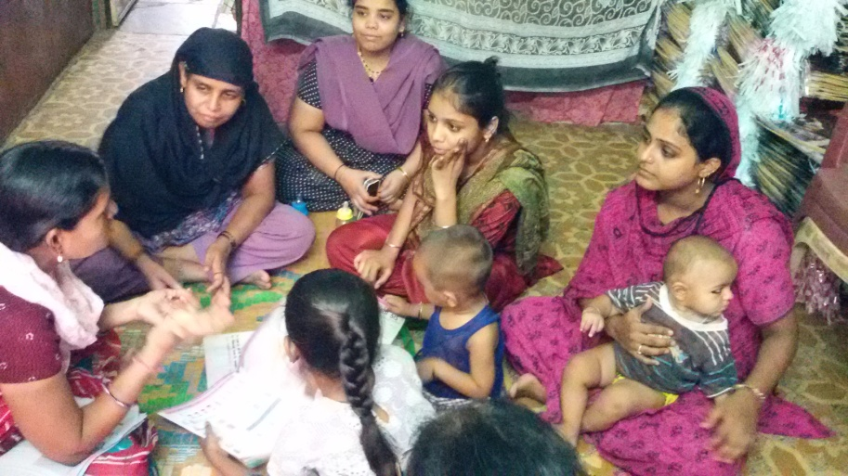
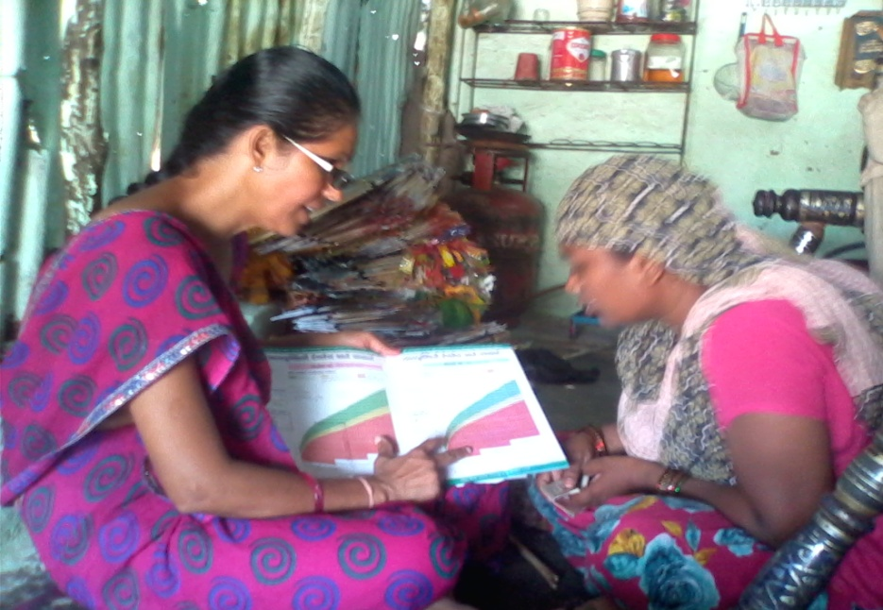
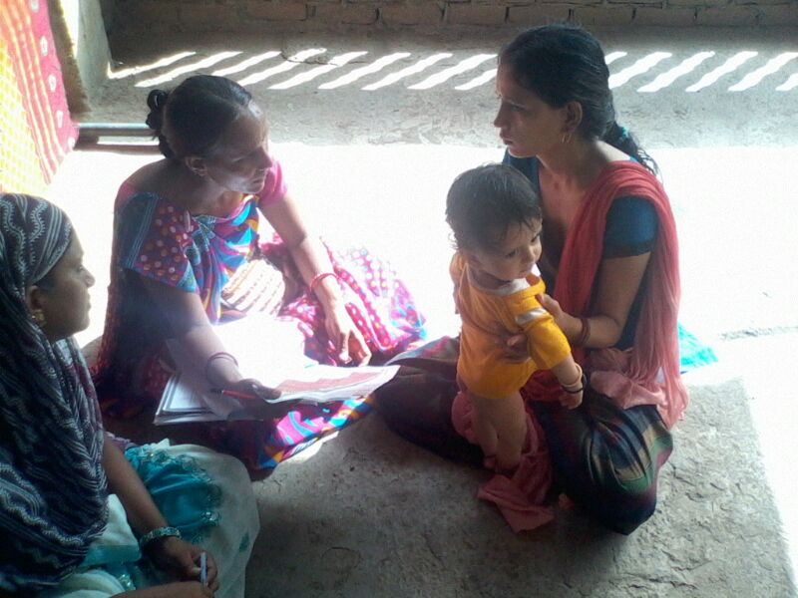
Step 3
Intervention: Application of ASER approach by Balwadi teachers
Home visits: 33 visits in every household
Total 33*86= 2838 home visits

Slide 21
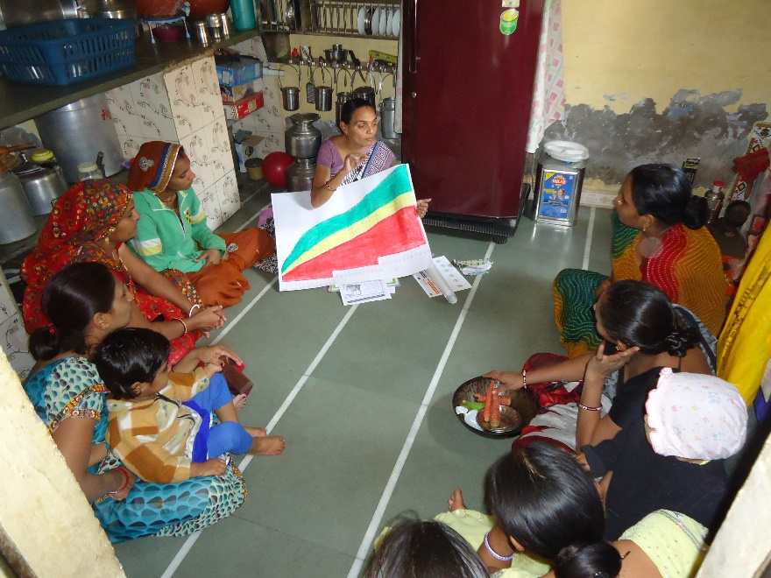
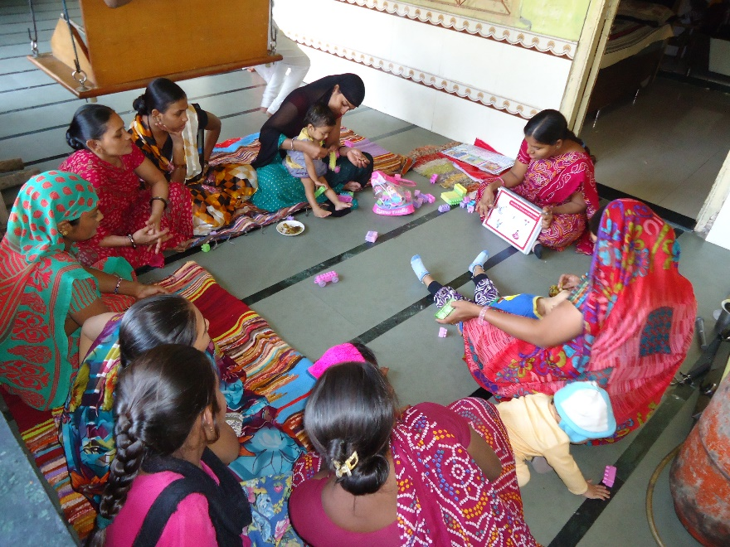
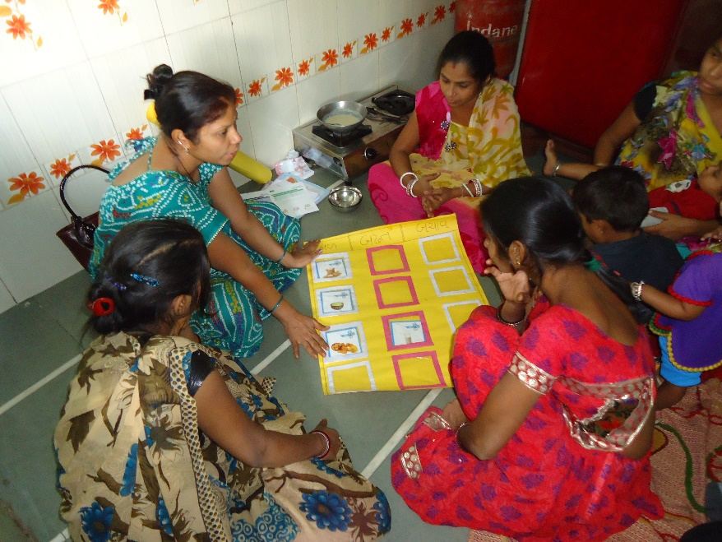
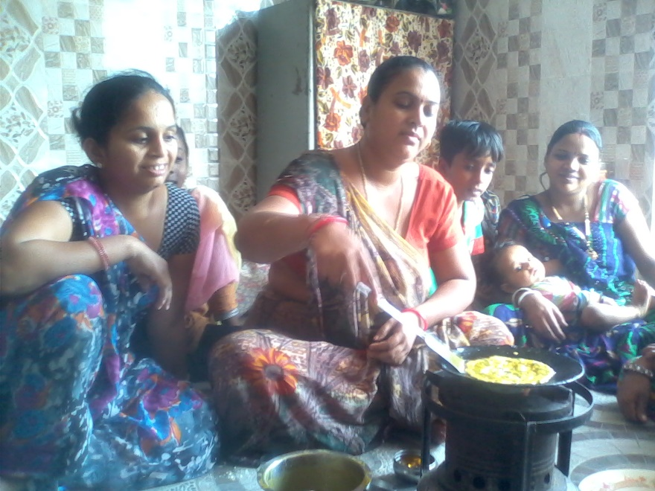
Monthly group meetings in the community 7 monthly meetings by each teacher (7*6=42 community meetings)

Slide 22
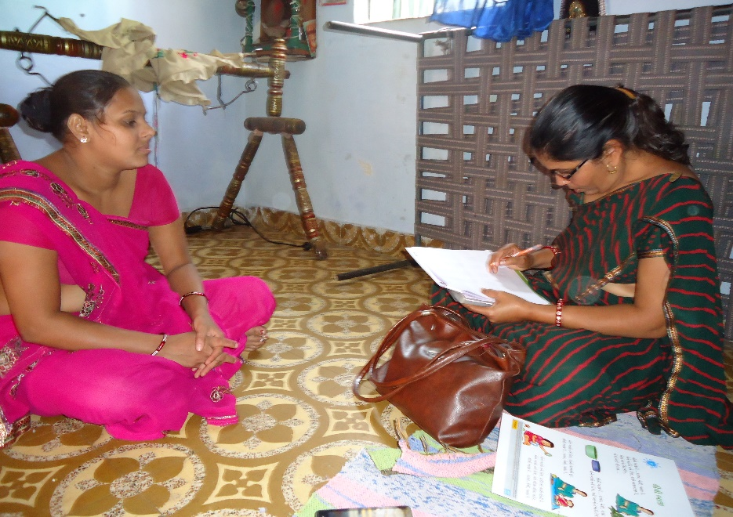
Step 4
Endline: Rapid diet tool and baseline questionnaire

Slide 23
Picture pertaining to Infant and young child food and feeding and other practices

Slide 24
Sample Profile
Total sample involved in the pilot-86; age bracket of birth till 2 years.
Majority of the children were in the age group of 12-23 months at the time of baseline(55.8%) crossed the age of two by the endline.
86% were young mothers between the age bracket of 18-30 years
One third of them were the first time mothers.
Mothers who attended secondary schools – 24.4%
Fathers who attended secondary schools – 40%
Notes:
Nearly one fourth of the mothers (24.4%) attended secondary schools. In case of fathers around 40% attended secondary school.

Slide 25
Sample Profile…
83.7% mothers were home makers.
Amongst fathers one third were self employed (35.7%), a quarter was working on the daily wages (28.9%).
More than 50% of the children (59.3%) belonged to joint families.
A large percentage of families (86.1%) were Hindu by religion.

Slide 26
Household Characteristics
Provision of toilets inside the household – 87.2%
Use of community taps as source of drinking water – 85%
75% of the households with cemented flooring.
61.6% used stove as a means of cooking fuel.
Household Possessions
97.7% had electricity in the household, 80.2% had television and mobile phone and 40.7% had a two- wheeler.
Majority (86%) did not own any land; while only around 11.6% owned livestock.
Notes:
More that three fourth of the families (87.2%) had the provision of toilets inside the households. and more than 85% had community taps as the source of their drinking water.

Slide 27
Salient findings:
Changes observed in Endline assessment wrt Infant and Young child food and feeding based on the rapid diet tool assessment

Slide 28
Adherence to guidelines wrt frequency of feeds given to children
44.8% point increase
26.3% point increase
n= 54
n= 43
n= 19
n= 19

Slide 29
Consumption of different food groups
Locale | Energy giving |  | Body building |  | Protective
 | Baseline | Endline | Baseline | Endline | Baseline | Endline
Ahmedabad | 85.2% | 97.7% | 88.9% | 97.7% | 29.6% | 93%
Baroda | 100% | 94.7% | 94.7% | 100 | 42.1% | 57.9%

Slide 30

Consistency of feeds while feeding the child
n= 54
n= 43
n= 19
n= 19

Slide 31

n= 54
n= 43
n= 19
n= 19

Slide 33
Improvement in sensitization about feeding very young children (< 2 years)

Slide 34
Awareness about mother’s milk

Slide 35
Awareness about the advantages of breastfeeding
7-8 months
50%*
75%*
0%*
9-11 months
88.2%*
100%
88.2%*
100%
17.6%*
100%
12-23 months
95.8%*
100%
93.8%*
100%
43.8%*
100%
23 months and above
100%
100%
71.4%

Slide 36
Signs of changes observed in other practices
7-8 months
50%*
75%*
0%*
9-11 months
88.2%*
100%
88.2%*
100%
17.6%*
100%
12-23 months
95.8%*
100%
93.8%*
100%
43.8%*
100%
23 months and above
100%
100%
71.4%

Slide 37
Growth Monitoring
(n=60)
(n=42)
(n=26)
(n=19)

Slide 38
(n=60)
(n=42)
(n=26)
(n=19)

Slide 39
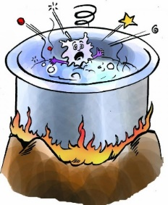
Hygiene Practices
Toilet facility
(n=60)
(n=42)
(n=26)
(n=19)

Slide 40

Garbage disposal facility

Slide 41
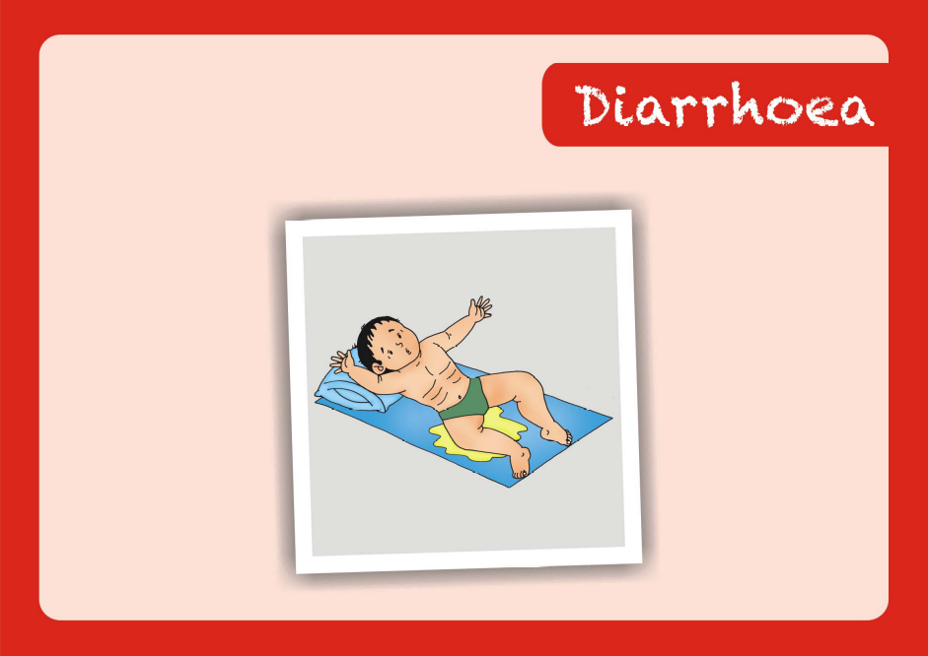
Awareness about causes of diarrhoea

Slide 42
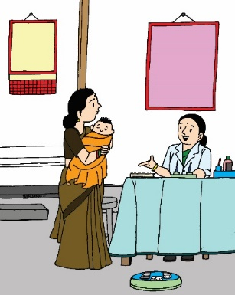
Use of ORS as treatment for diarrhoea
Took to Private practitioner (6%)
(n=60)
(n=42)
(n=26)
(n=19)

Slide 43
It was an attempt to give people some ownership/chance to come and participate in assessing and knowing and take actions also.
Via these simple diet tool assessments beneficiaries itself can be a part for action and motion.
This means that there is a potential for grass root engagement where simple tools like these might be able to address many sensitive issues by simple rapid assessments.
The development of human resource is key to the development of a nation.
Notes:
USP was assessment, sensitization through assessments. Assessments has always been a domain of experts. Here we attempted to bring together people, undaertand the simple evidences and take action.
While the sample size was less, we are not rejoicing the quantum of improvements but it was an attempt to give people some ownership/chance to come and participate in assessing and knowing and take actions also.

Slide 44
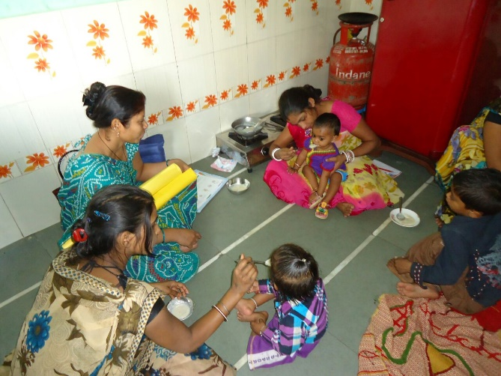
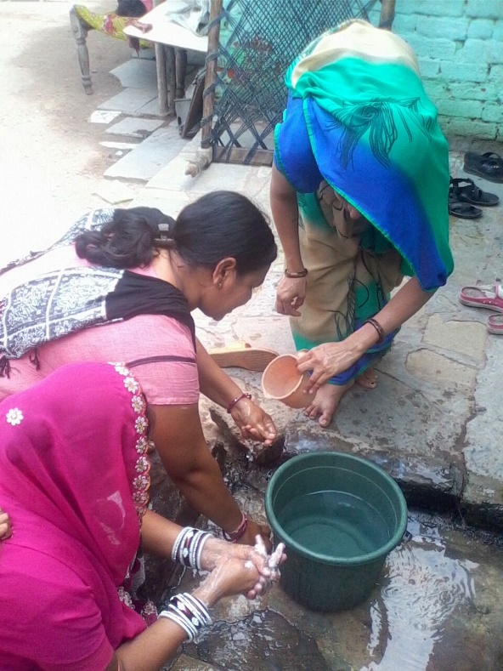
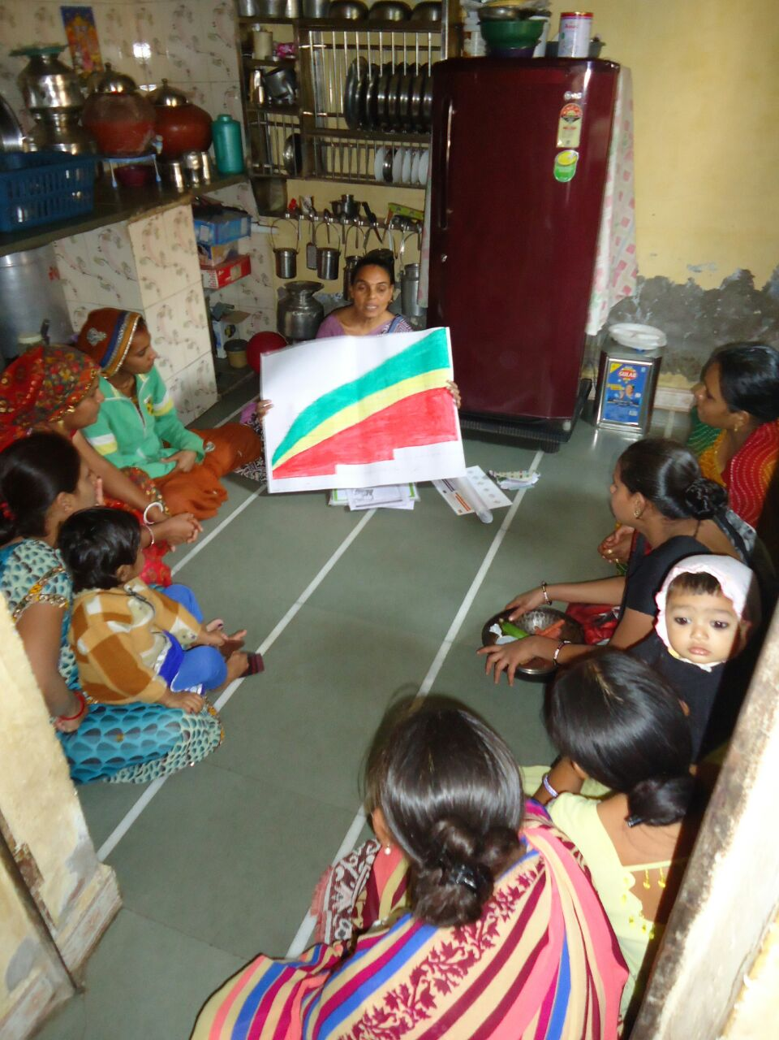
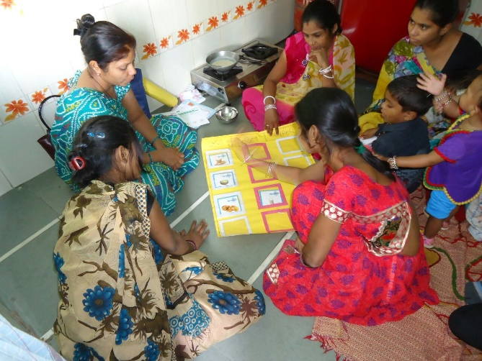
Some field shots

Slide 45
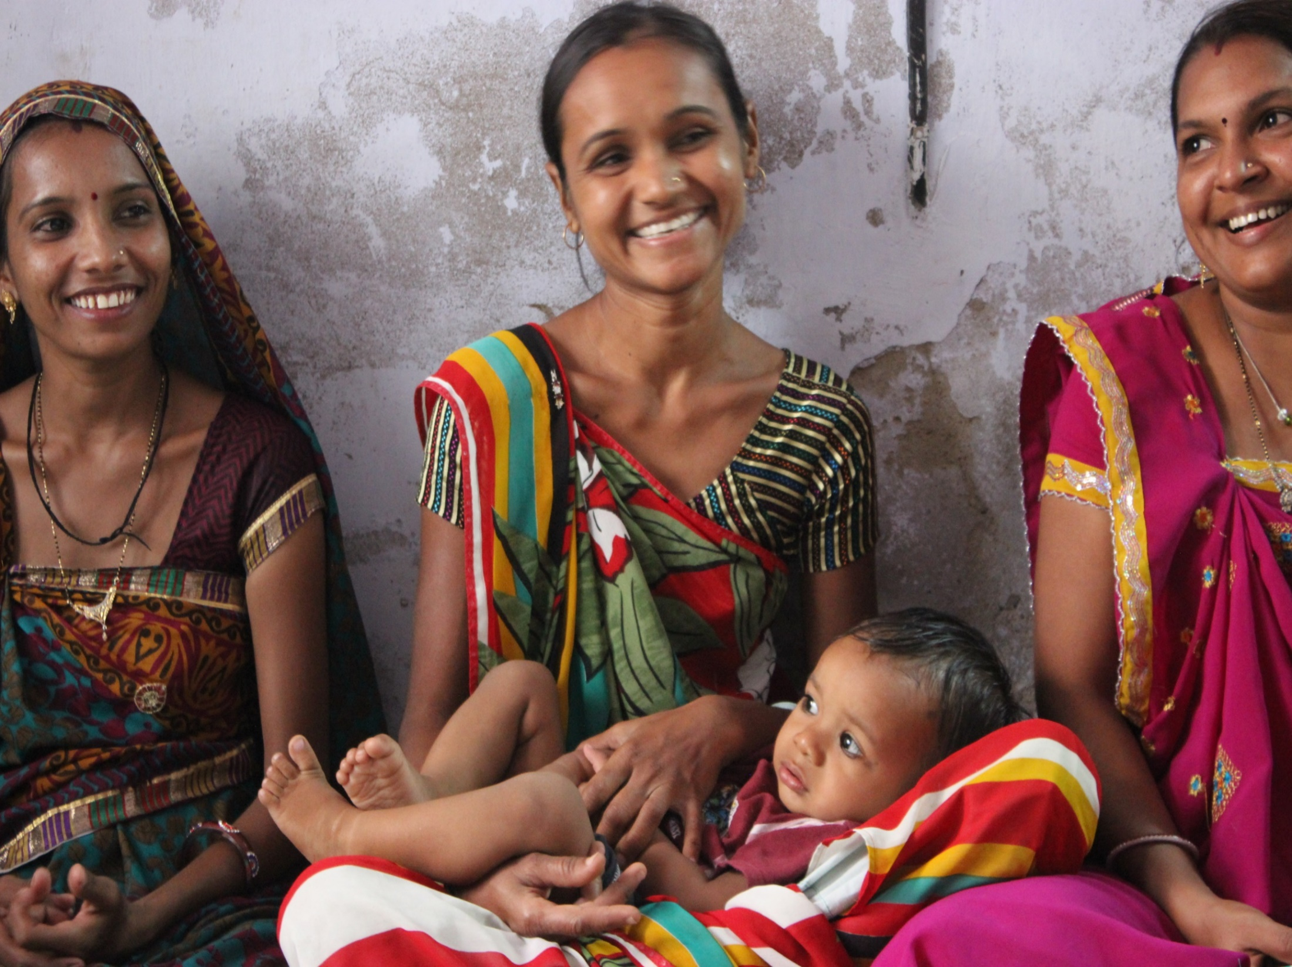
Thank you!

