Slide 1


Nurses main challenges in caring for parents and young children with cancer during the child’s entire cancer trajectory
Karin Enskär, Professor of Nursing
School of Health and Welfare,
Jönköping University
karin.enskar@ju.se
Notes:
Chairman, ladies and gentlemen, it is a great pleasure for me to be here to day to present my research related to;
Nurses main challenges in caring for parents and young children with cancer during the child’s entire cancer trajectory
My name is Karin Enskär, registered nurse, PhD in Nursing, Professor in Nursing, School of Health and Welfare, Jönköping University

Slide 2
Background
About 80% of child with cancer will be cured with intensive medical treatment
Having childhood cancer involves repeated hospitalizations, a change in the child’s and family’s everyday life and routines
Concrete how the nurse can act when caring for children with cancer in various phases is sparsely researched
Notes:
Background
About 80% of child with cancer will be cured with intensive medical treatment. But more can be done to improve both survival rates and quality of survival.
Having childhood cancer involves repeated hospitalizations, a change in the child’s and family’s everyday life and routines.
Nursing science and psychosocial science plays a central role in pediatric oncology clinical services and research. But, concrete how the nurse can act when caring for children with cancer in various phases is sparsely highlighted in the literature.

Slide 3

Aim
This study aims to describe nurse’s main challenges in caring for young children with cancer and their parents, during the diagnose-, on-treatment-, of-treatment and follow-up phase
Notes:
Aim
This study aims to describe nurse’s main challenges in caring for young children with cancer and their parents, during the diagnose-, on-treatment-, of-treatment and follow-up phase.

Slide 4
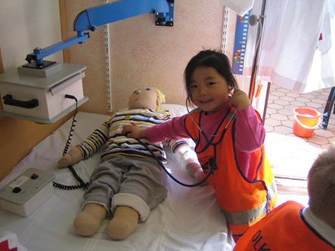
Method
13 children with newly diagnosed cancer aged 1 to 6 years and their parents
Semi-structured interviews
Analyzed with a deductive content analysis
Using the Swanson caring theory
Notes:
Method
13 children with newly diagnosed cancer aged 1 to 6 years and their parents
Connected to a pediatric oncology unit in Southern Sweden participated in this study
through semi-structured interviews.
Child and parent data were analyzed with a deductive content analysis, using the Swanson caring theory.

Slide 5
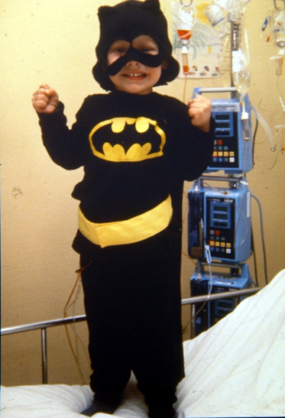
Swanson’s theory
Maintaining belief
Knowing
Being with
Doing for
Enabling
Notes:
Swanson’s theory differentiated five processes of caring: knowing, being with, doing for, enabling/empowering, and maintaining belief (Swanson, 1993). Each of the caring processes included definitions that served as the basis for nursing interventions.
Maintaining belief incorporated a fundamental belief in people and their abilities to make it through events and transitions and to face a future with purpose. Practices in this process included believing in or holding in esteem, maintaining a hope-filled attitude, offering realistic optimism, and “going the distance.
Knowing entailed striving to understand an event as it had meaning in the life of another (i.e., appreciating the lived experiences of that person). This process involved practices such as avoiding making assumptions, thoroughly assessing, seeking cues, and centering on the person who is receiving care.
Being with included being genuinely present to others in order to convey that their experiences have significance. Behaviors associated with this process included being present, enduring with, listening, attending, sharing feelings, and seeking to lighten the other person’s burden.
Doing for consisted of doing for the other persons what they would do for themselves if possible. Actions in this process involved anticipating, protecting, preserving dignity, comforting, and performing competently and skillfully.
Enabling entailed assisting individuals to acquire the tools they needed to be able to care for themselves, including passages through life-transitioning events. Practices in this process encompassed explaining, informing, supporting, allowing, advocating, validating, and preparing for future needs. (Swanson, 1993, Wojnar, 2006).

Slide 6
Result
Nurse’s main challenges in caring for young children with cancer and their parents, are to some extent but mainly different between during the diagnose-, on-treatment-, of-treatment and follow-up phases
Notes:
Result
Nurse’s main challenges in caring for young children with cancer and their parents, are to some extent but mainly different between during the diagnose-, on-treatment-, of-treatment and follow-up phases.

Slide 7
Nurses main challenges in the diagnose-phase
Create a trustful relationship in order to diminish fear and anxiety
Letting the parents act as secure base for their child and not being a career
Create trust and safety not to frightening the child
Explaining for children and parents so they understand what will happen
Notes:
Nurses main challenges in the diagnose-phase
Infuse hope by letting the child taking part in its own care
In the first phase closely after the child’s diagnose, it is important for the nurse to instill hope in both the child and its parents. This could be done by having faith in the child’s and parents’ ability to handle situations, both surviving the cancer disease and getting through procedures. One way of doing this is to involve the child in the treatment and procedures for example by shaking the blood samples, choosing plaster, letting them take off their clothes themselves when examining the body.
Create a trustful relationship in order to diminish fear and anxiety
In the beginning of the child’s disease it essential to create a trustful relationship where the child and its parents feel free to share earlier experiences and feeling. The building of a trustful relationship is a precursor for the possibility of getting a long lasting good relationship which can help them through tough periods. The possibility of building this trustful relationship, continuity is of crucial importance. In the beginning it is easier for the parents to focus a few nurses and not too many. The nurse should it this phase focus the child and its parents in order to assess their earlier experiences and needs and not assume that she know what they need and experience even if the nurse have extensive experience of caring for young children with cancer.
Letting the parents act as secure base for their child and not being a career
For the child it is prerequisite that the child is physically and mentally present for their sick child. The nurse need to show the parents that they have time for both the child and the parents even in stressful moments. If the nurse is loaded with lots of work, she could resume the conversation later. At this point it is important to give them a specific time for that conversation where she communicates a feeling that she is interested in the individual child/parent by showing them a personal engagement and empathy.
Create trust and safety not to frightening the child
When being diagnosed with cancer it involves a threat to the child’s life and the family’s secure everyday life. Thus, the nurse role is to create some sort of stability in life for the child and its parents, so they can trust the nurses and have faith in the treatment. This could be done by carefully assess and plan nursing interventions and by having a holistic perspective and not just focus on each part in the treatment. For example, if the child has to be given drugs several times during the night, the nurse should not just focus on giving the drugs but also how the parents get the ability to rest and recover. To be able to do this, it requires that the nurse have knowledge and experience about the disease and also about caring for seriously sick children and their parents. To be able to do this, the nurse have to be open and adaptable towards each child and parent’s experiences and needs and to adapt and adjust the interventions towards each family.
Explaining for children and parents so they understand what will happen
In the first phase of the child’s disease the child and its parents need to get knowledge about the disease, treatment and procedures to be able to understand their new situation and its effect on everyday life. In the beginning it is hard for them to take in too much information. Therefore, the nurse has to give small amounts of information at different time points, so the child and its parents are given the possibility to take it in and consider it. It is not necessary to give all information at the same time, but more taking the information, hour by hour helping the child and parents handling each day separately. Consequently, the information and explanations needs to be individualized and that the nurse consider the child’s age. To be able to grasp the new everyday life and the given, that they need support from the nurse.

Slide 8
Nurses main challenges in the on-treatment phase
Creating a positive atmosphere when meeting the child and the parents in order to build strength
To focus and assess the needs of every child and parent
To show empathy and a personal engagement in every child and parent
To create a child friendly caring environment built on knowledge
Being supporting by creating a structure for when and how the information are given
Notes:
Nurses main challenges in the on-treatment phase
Creating a positive atmosphere when meeting the child and the parents in order to build strength
When some time has passed since the child’s diagnose, it is still important that the nurse believe that the child and its parents have the capabilities to handle their situation. The role of the nurse is to create and maintain a positive atmosphere that surrounds the child and its parents. This means that the nurse plays, jokes and have fun with the child. Letting the child meet other team members for example the play specialist/therapist, the clowns can also be appreciated by the child and its parents. The nurses’ positive outlook makes it easier for the child and the parents to handle their situation and give them hope and faith in carry out the treatment.
The child has now quite extensive experience about many procedures which implies that they have wishes and also demands on how things are to be carried out. Examples can be that some wants the nurse to count down before putting the needle into the port a chat, and some do not. This means that it is of outmost importance that the child participates in its own care and plan it together with the nurse.
To focus and assess the needs of every child and parent
When some time have passed since diagnosis the child has begun to come to term with their disease and their new everyday life. Even though the nurse has built a relationship to the child and its parents, she still has to focus on each of them individually and listen to their experiences and needs and not assuming and taking things for granted. The nurse also has to have a holistic approach assessing all dimensions of the child’s health i.e physical, mental, social and existential dimension. The assessments of child make a foundations for creating an individual care plan based on each child’s and parent’s own needs.
To show empathy attention??? and a personal engagement in every child and parent
When some times has passed since diagnosis, the child and the parents has become “a part” of the pediatric oncology ward. The nurses know them, and they know many of the nurses. It is also the fact that new children have been diagnosed and also needs attention from the nurse. Despite of this, the child and its parents still need to feel that they nurses focus on them and their needs since they cannot be left alone yet. The nurse has to be available, pay attention and take time to the child and its parents as they still run into new situations and problems which they must problem-solving. The children and parents therefore appreciate when the nurses show that they get affected of the child’s situation and also remember things the child and its parents have earlier shared.
To create a child friendly caring environment built on knowledge
The parents appreciated when the nurses performed skillfully and when they felt that they nurse had extensive knowledge. Skillfull nurses were perceived as being able to focus on the child and not only the parents. This was shown when they greeted the child before the parent when entering a room. The skillful nurse also had the ability to make the child feel special and she also addressed things that children like for example involving the teddy bear into the procedure. She also did the extra small things that made the day for the child and the parents. Another aspect of a child friendly environment is to respect the child’s integrity by asking for permission when for example wanting the child to take off their clothes.
Being supporting by creating a structure for when and how the information are given
Children and parents that have got information and knows what is happening, this is perceived as supportive and they feel thankful towards the nurses. The information can be seen as a prerequisite for feeling supported.
For the children and its parents, it was of outmost importance of how and when the information was delivered. The information could be experienced as good but also insufficient. The nurse should make up a time plan in order to offer specific timepoints when meeting the child and its parents in order to assess their information needs and also to give them the information and explanations needed.
In this phase, the parents stressed that the information also was delivered to other persons involved in the child’s everyday life and care. The nurses need to have a plan how to collaborate with for example other health care facilitates and preschool. The nurses also have to be unanimous for the children and parents to perceive that the nurses are consistent.

Slide 9
Nurses main challenges in the of-treatment phase
Make the child and parents feel that they are trusted
Keep on asking the child and its parents. Do not assume!
To see each child
Let the child and the parents be involved in the care and decision making
Give support in handling everyday functioning
Notes:
Nurses main challenges in the of-treatment phase
Make the child and parents feel that they are trusted
After a year, the child and the parents had extensive experience and knowledge in both their child’s needs and wants as well as how nursing tasks should be carried out. The child and its parents wish to be meet with respect and that they are able to carry out the tasks themselves. Some parents want to give the child their drugs and food supplement in their tube in hospital if they are doing it themselves at home. This means that they nurse should ask both the child and its parents how and who they want to deliver the care/nursing interventions. It is also important that the nurses keep on having a positive attitude and outlook for the child’s care and life. This boostes the child and the parents to get through the cancer trajectory.
Keep on asking the child and its parents. Do not assume!
A year after the child’s diagnose, the parents and children feel like experts on the disease and treatment and the effect on themselves and their everyday life. Therefore, they do not want the nurses to assume that they know how their everyday life and situation is even if the nurse has an extensive experience in pediatric oncology care. Parents felt disappointed when the nurses did not pay attention to how they managed the everyday life at home and when they just assumed that they had the time to rest and to charge their batteries themselves. Parents experienced that nurses that had knowledge and experience in taking care of children with cancer could manage this better than the unexperienced and less educated nurses.
To see each child
When caring for a child that is known on the ward and are admitted for routine treatment, it is important that the nurse is physically there taking the time to focus on each child even if they are at hospital a lot. Even if the nurses feel that they have a lot to do, the parents appreciate when the nurses take their time and focus on the child without making comments about how busy they are. However, if the nurses feel very busy, the parents appreciate if the nurses schedule a later time where they could talk more relaxed. Thus, it is not enough just being physically present but also emotionally present showing empathy. Parents experienced that they got better care if there were continuity in meeting the same nurses and when having a dedicated nurse responsible for their child. For those children and parents that had a named nurse responsible for the child’s care, it felt comfortable and safe and they did not have to start from the beginning and tell their whole cancer story but could start where they were.
Let the child and the parents be involved in the care and decision making
As the child often were not at hospital as much as in the beginning of the treatment, the parents appreciated that when they came to hospital, they had a plan for their visit that was known for both the child and its parents. In this phase the child knew the routines and how things usually were carried out. However, it is important for the nurse to still involve the child in the practical nursing care as well as the decision making. Being involved in the care, did not just mean that the child did whatever the nurses wanted them to do. It also involved that the child could make protest. When the child and its parents were not at hospital, the parents appreciated that the nurse phoned them at home asking how they felt. Even if the parents stressed the importance for standardized routines, they also wanted the nurses to be flexible.
Give support in handling everyday functioning
At this point the parents have broad and deep knowledge concerning their child and its treatment. Still they might need repeated and deepening information about thing they have already gone through. However, this knowledge sometimes contribute to the parents questioning the care, information and treatment. The nurses need to meet the parents in their questioning. This is done when the nurses uses their deepened knowledge and experience to guide them and helping them to reflect on different options. For the child, the information needs to be individualized based on the child’s age and maturity.
The support needed at this time point, is much about supporting the parents functioning in everyday life. They need support in the contact with health care services and preschool. They also need support in taking care and handle the siblings, the relationship between the wife and husband, how to handle, set limits and raise the child but also how to take care of oneself such as getting physical activity.

Slide 10
Nurses main challenges in the follow-up phase
Remind and emphasize the positive moments in the cancer trajectory
Reflecting over the child’s cancer trajectory
Have a plan when ending treatment and start follow-up
To help the child and its parents to feel trust in new situations
Have children and parents know what is happening and where to turn for knowledge and support
Notes:
Nurses main challenges in the follow-up phase
Remind and emphasize the positive moments in the cancer trajectory
When the child’s treatment is completed, the young child often does not remember fully what happened, but often highlight positive experiences and happy moments during their cancer trajectory such as the play therapy, nurses playing with the child or the clowns. The child and its parents remind them on these good moments help. The nurses now need to reinforce self-esteem in the parents being the expert on their own child dealing with everyday life situations when they do not have so much contact with the pediatric oncology team but when meeting the “ordinary care” at for example the primary health care.
Reflecting over the child’s cancer trajectory
The parent wished to have a meeting with the health care team when the child ended treatment, reflect over the entire cancer trajectory, to discuss follow up, everyday life issues. The nurse need to make up a care plan for future health care contacts.
Have a plan when ending treatment and start follow-up
After the child had ended treatment the parents experienced a long lasting emotional stress even if the child felt well. Some parents even felt symptoms of depression and lack of support. Parents wanted emotional support for example from the hospital psychologist or from other health care settings. Concerning the child, the school nurse was a secure base and helped with practical issues and preventing infections in the former ill child.
To help the child and its parents to feel trust in new situations
When the treatment had finished the parents experienced being thankful and satisfied with the care provided during the child’s treatment. As they at this time point is not at the hospital that very often, both the child and its parents are very pleased when they are recognized when visiting the hospital. The pediatric oncology ward is still seen as a secure base providing support and treatment as it represents safety, highly skilled and competent pediatric nurses with a team working with them. This contributes that it is not hard to go there. As they are so used to visit the pediatric oncology ward it is hard for them to turn to other health care settings. However, this is a challenge for the nurse to help the parents to believe and trust other health care settings such as the primary health care.
Have children and parents know what is happening and where to turn for knowledge and support
The parents experienced the child’s ending of treatment as scary and frightening. The worried for relapses and short and long-term side effects. Parents had a constant worry about relapse and information and support from the nurses could not fully diminish these worries. Still, listening and taking the parents worries seriously could be considered supportive.
Another supporting intervention for the parents was experienced as meeting other parents that had been or was in the same situation. This could be physical meetings but also meetings over internet. However, some parents experienced that this was most supporting in the beginning, and some even experienced it as a burden as they were remembered of the disease and treatment.

Slide 11
Conclusion
The nurse’s main challenges in caring for young children with cancer and their parents during the cancer trajectory are to;
Help children and families in the transition to a new normality
Create hope by a trustful relationship
Support coping by giving knowledge and information
Decrease distress, anxiety and pain in children
Display interested in the child´s and parent’s life outside the hospital
Have a plan for follow-up
Notes:
Conclusion
The nurse’s main challenges in caring for young children with cancer and their parents during the cancer trajectory are to;
Help children and families in the transition to a new normality
Create hope by a trustful relationship
Support coping by giving knowledge and information
Decrease distress, anxiety and pain in children
Display interested in the child´s and parent’s life outside the hospital
Have a plan for follow-up

Slide 12
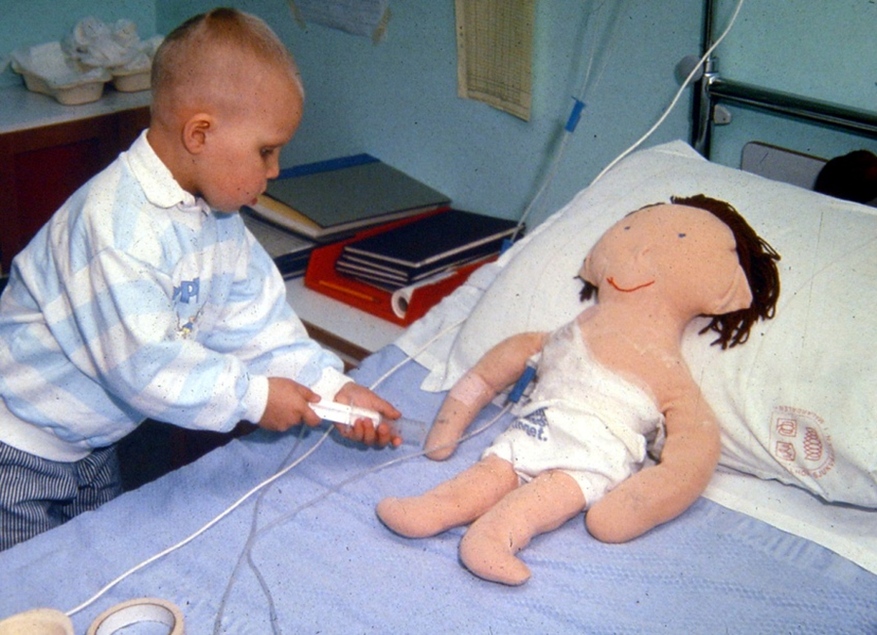
Implications for practice
Develop a standardized and structured nursing care plan/clinical guideline with detailed information on how to carry out the clinical nursing care in the different phases
Notes:
Implications for practice
From these results, it would be recommended for nurses to;
Develop a standardized and structured nursing care plan or clinical guideline with detailed information on how to carry out the clinical nursing care
in the different phases, diagnose-, on-treatment-, of-treatment and follow-up phases.

Slide 13


Thank you
Karin Enskär
Notes:
Thank you for lisening!

Slide 14
Notes:
Thank you!

