Slide 1

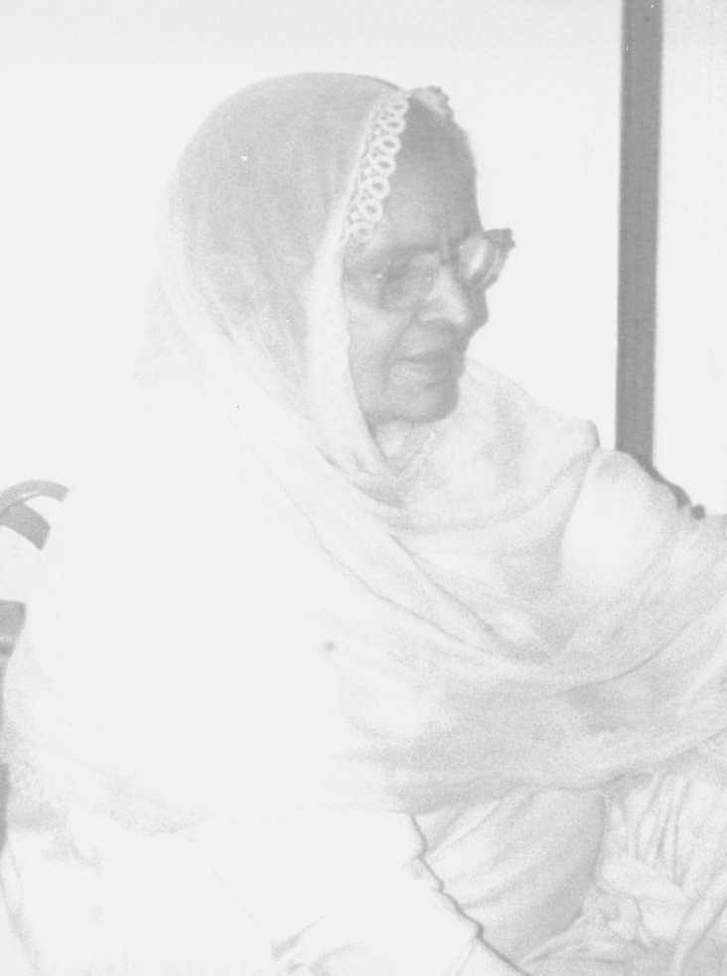
Working with migrant communities: achieving cultural competency in dementia care
Dr Karan Jutlla
Lecturer in Health and Social Care
De Montfort University
Leicester

Slide 2
Outcomes
By the end of this presentation you will:
  Recognise the key challenges for people living with dementia from migrant communities
  Consider how person-centred dementia care represents the guiding principles for what it means to be culturally competent

Slide 3
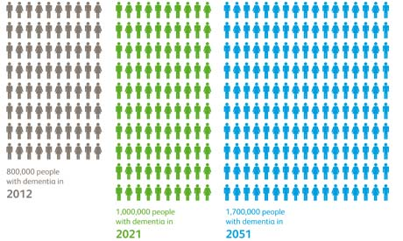
Some numbers…
Notes:
You can see from this slide that dementia is on the increase. And according to these predictions, for every 3 of us in this room – 1 of us may develop a dementia. And I’m fairly sure that there are a number of you that know of, or have been close to someone who has a dementia.

Slide 4
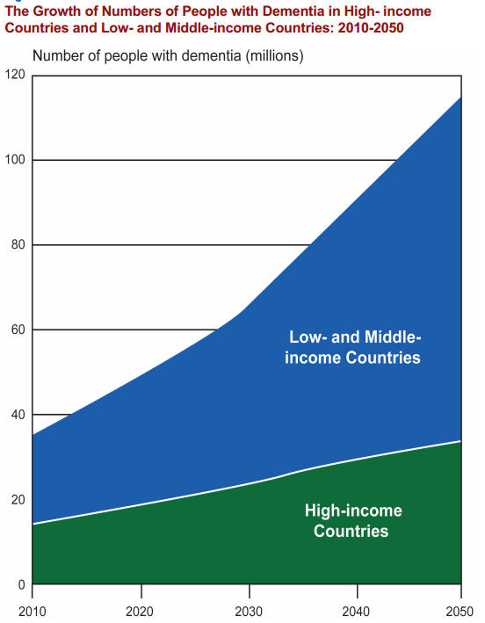
Really big numbers...
35.6 million now to 115 million by 2050
(Alzheimer’s Disease International 2011)
Notes:
4
And this is global issue.

Slide 5
Dementia does not discriminate
Current estimate of nearly 25,000 people with dementia from BAME communities in England and Wales.
This number is expected to grow to nearly 50,000 by 2026 and over 172,000 people by 2051.
This is nearly a seven-fold increase in 40 years. It compares to just over a two-fold increase in the numbers of people with dementia across the whole UK population in the same time period.
BAME communities are not just getting older but they are also growing in numbers
(APPG 2013)

Slide 6
Ethnic group | Population (2011) | Percentage of total population
White: Total | 55,010,359 | 87.1
Gypsy/Traveller/ Irish Traveller: Total | 63,193 | 0.1
Asian or Asian British: Indian | 1,451,862 | 2.3
Asian or Asian British: Pakistani | 1,174,983 | 1.9
Asian or Asian British: Bangladeshi | 451,529 | 0.7
Asian or Asian British: Chinese | 433,150 | 0.7
Asian or Asian British: Other Asian | 861,815 | 1.4
Asian or Asian British: Total | 4,373,339 | 6.9
Black or Black British: Total | 1,904,684 | 3.0
Mixed or Multiple: Total | 1,250,229 | 2.0
Other Ethnic Group: Total | 580,374 | 0.9
Total | 63,182,178 | 100

Slide 7
Dementia in South Asian communities
Jutlla (2013); Moriarty et al (2011); Jutlla & Moreland (2007); Seabrooke and Milne (2004):
Vascular dementia is common due to the risk factors: higher incidences of hypertension and diabetes
Lower levels of knowledge and awareness about dementia
No word for ‘dementia’ in any of the South Asian languages
Stigma of mental health
Hidden problem
Low dementia diagnosis
Present themselves in crisis situations: need for early intervention

Slide 8
Dementia in South Asian communities cont…
Lack of knowledge & access to services
Lack of culturally appropriate services
Language barriers
Reluctance to ask for, and accept, formal support
Familial roles and a duty to care
Need to portray an image of well being to those outside of the family
Assumptions about community support – ‘They look after their own don’t they?’ (DoH 1998)

Slide 9
Service Perspective
Fear of the ‘unknown’
Being ‘politically correct:’ ‘I’m sometimes frightened to ask in case I say the wrong thing’ (Care worker)
Assumptions about community support: ‘They look after their own don’t they?’
Reliance on family for information
Language is seen as the biggest barrier

Slide 10
Dementia is not about a single service intervention
Our health and social care services aim to support people and their families through targeted case detection, timely diagnosis, post diagnostic support and adjustment, progressive and unpredictable loss of functioning, adjusting to help at home, changing lifestyle needs, hospitalisations, housing support, care home admission and complex end of life issues.
All of this needs to be done with due respect and sensitivity to the person’s lifestyle, family context and the context of the community in which they live.
©Copyright Karan Jutlla
Notes:
Evidently, dementia is not about a single service intervention ….

Slide 11
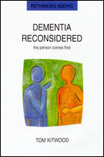
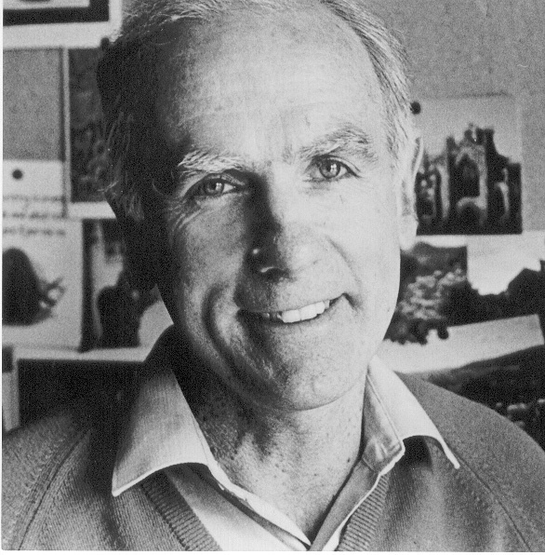
Person Centred Dementia Care
Professor Tom Kitwood
©Copyright Karan Jutlla

Slide 12
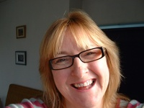
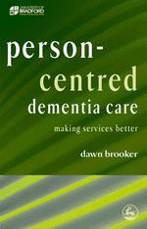
Person centred care fit for VIPS
V = Values people
I = Individuals needs
P = Perspective of service user
S = Supportive social psychology
©Copyright Karan Jutlla

Slide 13
Person centred care & Personhood….
Person Centred Care are the processes by which service providers maintain the Personhood of those who receive their services…..
“Personhood is a standing or status that is bestowed on one human being, by others, in the context of relationship and social being. It implies recognition, respect and trust…..”
(Kitwood 1997)
©Copyright Karan Jutlla

Slide 14
Person Centred Care for BAME communities
Represents the guiding principles for what it means to be culturally competent.
©Copyright Karan Jutlla

Slide 15
Cultural competency
“Culture” refers to integrated patterns of human behaviour that include the language, thoughts, actions, customs, beliefs and institutions of racial, ethnic, social or religious groups.
“Competence” implies having the capacity to function effectively as an individual or an organisation within the context of the cultural beliefs, practices and needs presented by people and their communities
(Cross et al. 1989; Lee and Farrell 2006).
©Copyright Karan Jutlla

Slide 16
Cultural competency cont…
For Gallegos et al. (2008:54) cultural competence refers to ‘the process by which individuals and systems respond respectfully and effectively to people of all cultures, languages, classes, races, ethnic backgrounds, religions, and other diversity factors in a manner that recognises, affirms, and values the worth of individuals, families, and communities and protects and preserves the dignity of each.’
©Copyright Karan Jutlla

Slide 17
Cultural competency cont…
Involves more than having an awareness of cultural norms. It is an approach that values diversity and promotes inclusivity
It represents a value-based perspective that recognises individuality (Gallegos et al. 2008)
Requires ‘cultural humility’: a lifelong commitment to self-evaluation and the awareness that one’s own culture is not the only or best one (Schuessler et al. 2012)
©Copyright Karan Jutlla

Slide 18
Person-centred care with migrant communities
In order to achieve ‘mutually satisfying user/provider relationships’ such people should be regarded as individuals alongside knowledge of the social and political influences on their lives rather than regarding them as members of ‘other’ groups (Mackenzie 2007:76).
Promoting inclusivity in existing services
©Copyright Karan Jutlla

Slide 19
BAME communities
International Community: Migration
Local Community
Family
Person
National Community
©Copyright Karan Jutlla
Notes:
Using PCC as our value base, what is it that we need to understand about people from the various BAME communities?
Various research studies inform our understanding of this – for example, we are beginning to understand the importance of migration experiences and the impact that these have had for individuals, families and communities residing in the UK.

Slide 20
Social & Political Influences
Social influences: culture and community norms as members of different groups
Political influences: understanding migration experiences and what these mean for groups and the individual
©Copyright Karan Jutlla

Slide 21
Understanding Communities:
Ethnic identity & cultural diversity
Whilst there are similarities across different ethnic communities, there are also differences both within and across communities based on:
Religion
Language
Migration experiences
Caste
©Copyright Karan Jutlla

Slide 22
Caste
Castes within the Sikh population in rural Punjab fit into a hierarchy comprising four broad categories. Similar across other South Asian communities (Ballard and Ballard 1979; Kalra 1980):
Brahmins and Khatris - high rank priestly class who traditionally acted as warriors to the Gurus. They comprise approximately ten per cent of the rural population of the Punjab.
Jats - the ‘landowners’ and ‘farmers’ and comprise approximately 50 per cent of the rural population of the Punjab.
Craftsmen and service caste - comprise approximately 15 per cent of the rural population, of whom the Ramgarhias (carpenters) are the largest group.
The ‘untouchables’ - comprise approximately 25 per cent.
©Copyright Karan Jutlla

Slide 23
Cultural Diversity Illustration
 | Punjab | East Africa
Caste
1 | Sikhs Muslims Hindus | Sikhs Muslims Hindus
2 | Sikhs Muslims Hindus | Sikhs Muslims Hindus
3 | Sikhs Muslims Hindus | Sikhs Muslims Hindus
4 | Sikhs Muslims Hindus | Sikhs Muslims Hindus
e.g. Shared language
e.g. Shared social norms
©Copyright Karan Jutlla

Slide 24
Segregation or Inclusion?
…Let’s imagine a specialist service
©Copyright Karan Jutlla

Slide 25
Migration and Dementia
Key Historical Events | Sukhvinder (Sikh) | Rajesh (Hindu) | Abdul (Muslim)
1947 India/Pakistan partition
X
1982 Khalistan movement in India
X
©Copyright Karan Jutlla
Notes:
Sukhvinder, Rajesh and Abdul are sitting in the lounge area in the day care facility. Thinking about dementia and its associated roll back memory loss, something triggers them to go back to 1947 during the time of the India and Pakistan partition. In the riots which preceded the partition in the Punjab region, between 200,000 to 500,000 people were killed. The participants in my doctoral research with Sikh carers of a family member with dementia living in Wolverhampton spoke heavily about their experiences of the partition - experiences which were quite traumatic due to the racial attacks they experienced. Because all 3 gentleman are now in a time of hostility, Abdul is starting to feel threatened by Sukhvinder’s and Rajesh’s expressive behaviour. Consequently, Abdul is removed from the day care facility lounge. Left in the day care facility lounge are Sukhvinder and Rajesh. Something triggers them to go to the1984 Khalistan movement which involved a series violent riots between Sikhs and Hindus in response to the assassination of Indira Gandhi by her Sikh bodyguards. Now, although many members of the South Asian community were already settled in the UK by the 1980s, the riots that took place in India had a knock on effect with Sikhs and Hindus living in the UK. Consequently, Sukhvinder begins to feel threatened by Rajesh and the two are separated.

Slide 26
Sukhvinder – high caste Sikh
Key life events | The Sikh care worker | The male White British care worker
Growing up in rural Punjab
X
1960s UK – experiences of the National Front
X
©Copyright Karan Jutlla
Notes:
Now alone, resting in the lounge is Sukhvinder who needs some assistance with personal care. Sukhvinder is a high caste Sikh and due to his dementia, has reverted to many of the norms from his younger years in rural Punjab during the 1940s. Earlier I mentioned that caste is identifiable via surname and guess what? the Sikh care worker is from the ‘untouchables’ category and tries to assist Sukhvinder to the bathroom during a time when, in his mind’s eye, it was shunted upon to associate with members of the lower castes. I’m sure I don’t need to explicitly state what might happen next.
This incidence causes the manager to send in the White British care worker. As highlighted by the participants in my research, the UK in the 1960s was a hostile environment for migrants with many experiences of racial encounters. I remember my father spoke often about his experiences of the National Front during the 1960s in Handsworth Birmingham where South Asians had to form gangs in order to protest their right to stay in the area. As some of you will know, National Front have a particular look to them; often with shaved heads and a distinguished tattoo. Guess what? The White male British care worker is tall, with a shaved head and approaches Sukhvinder in a manner that causes a previous memory of a racial encounter to be triggered. Again, I do not need to explicitly state what might happen next.

Slide 27
Darshan Kaur, aged 49 years, cares for mother
‘Her [mother’s] benefits weren’t covering it so everybody, all the sisters were putting in their little bit so that she can stay in this fantastic home… and there were actually…I think about four, maybe even five carers or nurses whatever... staff... that were Punjabi. But, that was another thing because if...when mom knew this is a lady called... I don’t know... Usha or Parveen or something that she knows that’s not Sikh, that’s Hindu...or in the conversation it would come out... then that would be another thing that she didn’t sort of... it’s almost like...if it’s completely ‘Goreh’ [White people] you know it’s one thing, but it’s… it does play on their mind doesn’t it? you know whether they’re Jat... so you know, you can say that you don’t have those sort of problems… but it’s just in their system really isn’t it? She’s not horrible about it, she wouldn’t ... I wouldn’t think she’d...well I’ve never heard her say anything, like insult anybody but ... it’s still there...so having Asian staff is not the answer.’
©Copyright Karan Jutlla

Slide 28
Diversity
Diversity within BAME communities
Diversity within Asian communities
Diversity within one community (i.e. the Sikh community)
One size does not fit all
©Copyright Karan Jutlla

Slide 29
Rani, aged 44 years, cares for father-in-law
‘He went into respite care, became unwell and ended up in hospital for a while. I didn’t realise he wasn’t eating until I went into visit him and saw a sign by his bed saying nil by mouth. I questioned them about this and they told me that the speech therapist had been in and confirmed that he could no longer swallow. They said that he should go to Compton Hospice... They were basically telling me that he was ready to die and there was no way back for him. So, naturally, I demanded to speak to the speech therapist...
©Copyright Karan Jutlla

Slide 30
Rani cont...
...she was assessing him with a banana yoghurt. I couldn’t believe it. He doesn’t like bananas and he doesn’t eat yoghurt. I took some home cooked Indian food in and he ate it.. He ate it all in front of her. That day I brought him back home and decided that he would never go to respite again, or to any other place for that matter. If I didn’t go in, he would be in a hospice dying right now. What made them think they could make such a massive decision like that without talking to us first Karan? What kind of a system is this?’
©Copyright Karan Jutlla

Slide 31
In the case of Rani…
Was this because staff weren’t culturally competent?
Or… because staff weren’t being person-centred?
©Copyright Karan Jutlla

Slide 32
Pilot study participant, aged 70 years, cares for her husband
‘When he used to go to day care, they just assumed that he wanted Asian food and that he wouldn’t be interested in the fish and chips they served every Friday… but we’ve always eaten fish and chips on a Friday. The children used to love it.’
©Copyright Karan Jutlla

Slide 33
A person-centred approach
Understanding cultural norms and discourses help us to understand where people are coming from... Helps us to understand why
People’s interpretations of those norms are dependent upon their own life experiences
Never make assumptions
Reflect upon the stereotypes/prejudices we may hold
©Copyright Karan Jutlla

Slide 34
Person-centred care
‘The APPG feels the term ‘black, Asian and minority ethnic communities’ is useful in this context as it focuses attention on groups that share a similar experience and face particular challenges in getting the support they need. But nonetheless it is important to acknowledge and respond to the differences within ethnic groups and, at an individual level, ensure a person-centred approach is taken’ (APPG 2013: 20).
©Copyright Karan Jutlla

Slide 35
Person Centred Guiding Principles (Brooker 2007)
Do my actions Value and honour the people that I work with?
Do I recognise the Individual uniqueness of the people I work with?
Do I make a serious attempt to see my actions from their Perspective or stand point?
Do my actions provide the Support for people to feel socially confident and that they are not alone?
©Copyright Karan Jutlla

Slide 36
We need to…
Build a “culturally competent” workforce: increase confidence/defeat stereotypes/understand the challenges
Work collaboratively with community organisations, faith groups and families
Know about other work in this area
A clear value base:
Cultural competence is a set of congruent behaviours, knowledge, attitudes and policies that come together in a system, organisation or among professionals that enables effective work in cross-cultural situations (Lee and Farrell 2006)
©Copyright Karan Jutlla

Slide 37
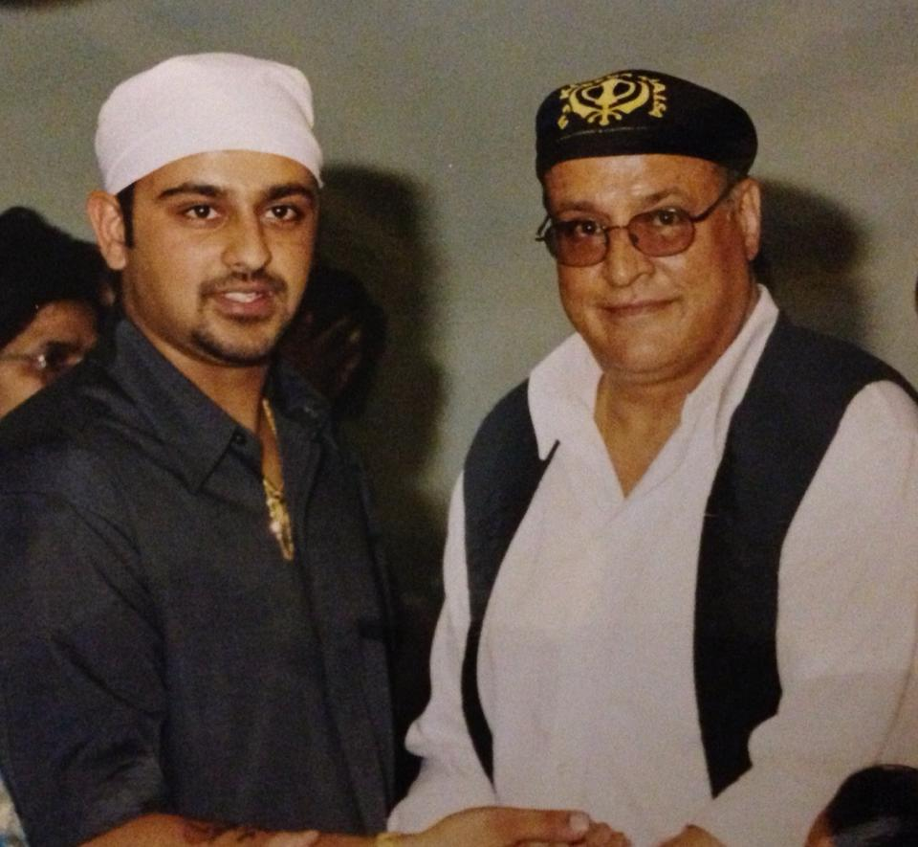
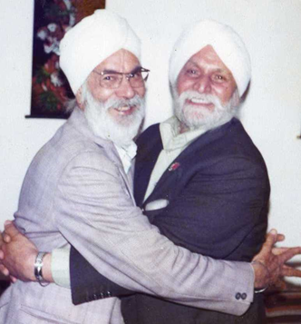
Thank you!
Any questions?
Contact:
karan.jutlla@dmu.ac.uk

