Slide 1
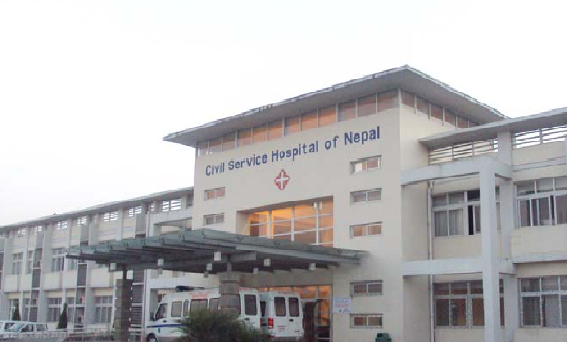
Total hip replacement in subcapital fracture neck of femur in elderly patients
Assistant Professor Dr Kapil Mani KC
Orthopedic and Joint Replacement Surgeon
Civil Service Hospital, Kathmandu, Nepal

Slide 2


Nepal
Kathmandu

Slide 3

Mount Everest

Slide 4
Introduction

Slide 5
Management of subcapital fracture neck of femur
Matter of Controversy and Challenging

Slide 6
Different Surgical Options
Internal Fixation
Hemiarthroplasty
Bipolar Arthroplasty
Total Hip Arthroplasty

Slide 7
Total Hip Replacement
Definitive advantage

Slide 8
Materials and Methods

Slide 9
Prospective analytical study
From 2010 to 2014

Slide 10
Twenty Patients
Managed by both uncemented and cemented arthroplasty

Slide 11
Minimum one year follow up

Slide 12
Results

Slide 15
9 (45%)
11 (55%)

Slide 20
Discussion

Slide 21
Incidence of hip fracture: increasing
In the past standard treatment assumed to be internal fixation

Slide 22
Most studies based on complications and reoperation rates ignoring the functions of hip
Comparision of THR, hemiarthroplasty and Internal Fixation. ( 13 year follow up )
( Skinner et al )
Harris Hip Score: Total 85% of cases excellent and good results (In our study)
Recent Study regarding Internal Fixation.
( Tidermark J et al )

Slide 23
Absolute indications:
Pre-existing arthritis of hip
paget’s disease
Renal osteodystrophy
Severe osteoporosis
Life expectancy more than 5 years
Those with high activity expectations
After failed interal fixation

Slide 24
The current overall mortality in elderly patients one year after hip fracture ranges from 14% to 36%.
(Koval KJ et al, Scott J et al)
One year mortality in our study is 5%

Slide 25
High incidence of post-operative dislocation in the past.
(Gregory RJ et al)
Dislocation rate in our study is nil.
Revision Rate is below 5% in 10 years.
(Gebhard JS et al)
Revision rate is nil in our study
Cost benefit analysis (George M et al)

Slide 26
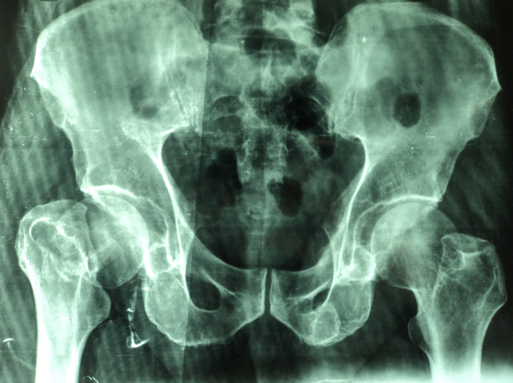
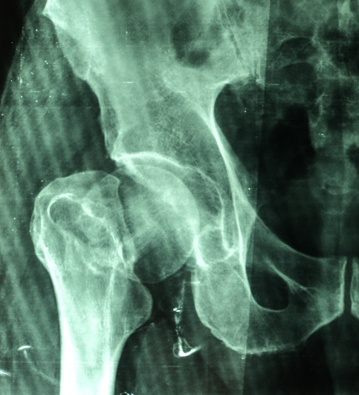
Sub-capital fracture neck of femur in 73 years old male patient.

Slide 27
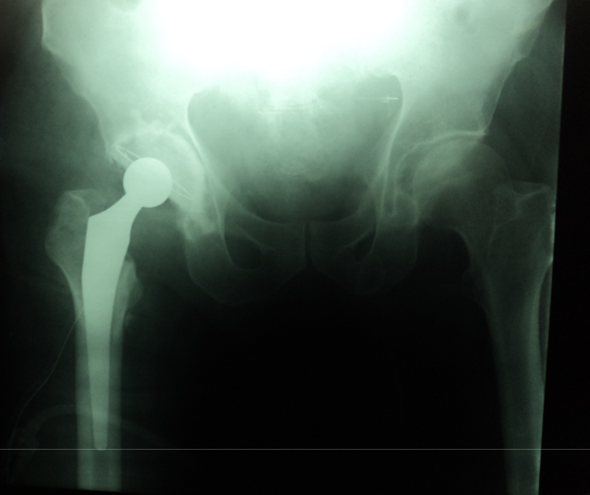
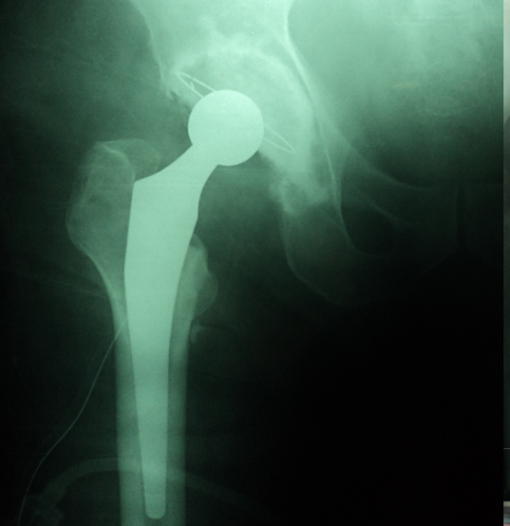
Three month after surgery
One year after surgery

Slide 28
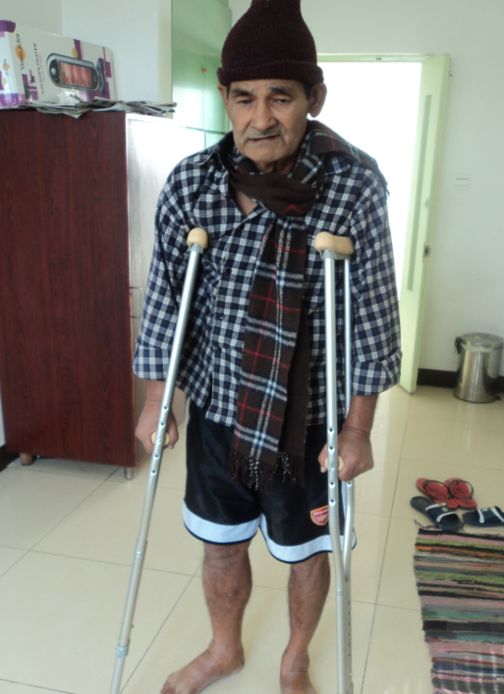
Patient walking with the help of crutches one week after surgery

Slide 29
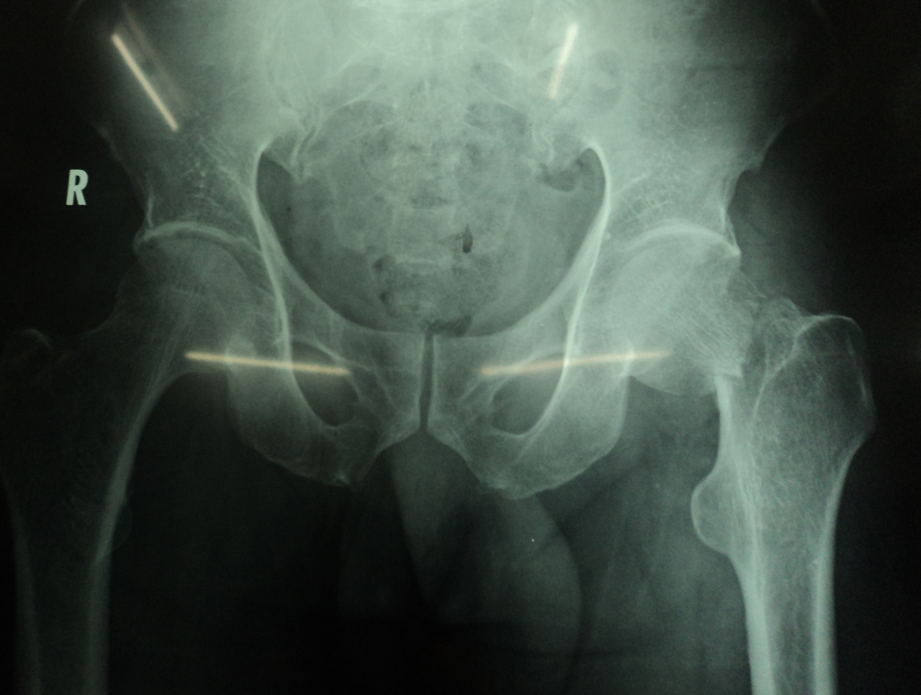

Slide 30
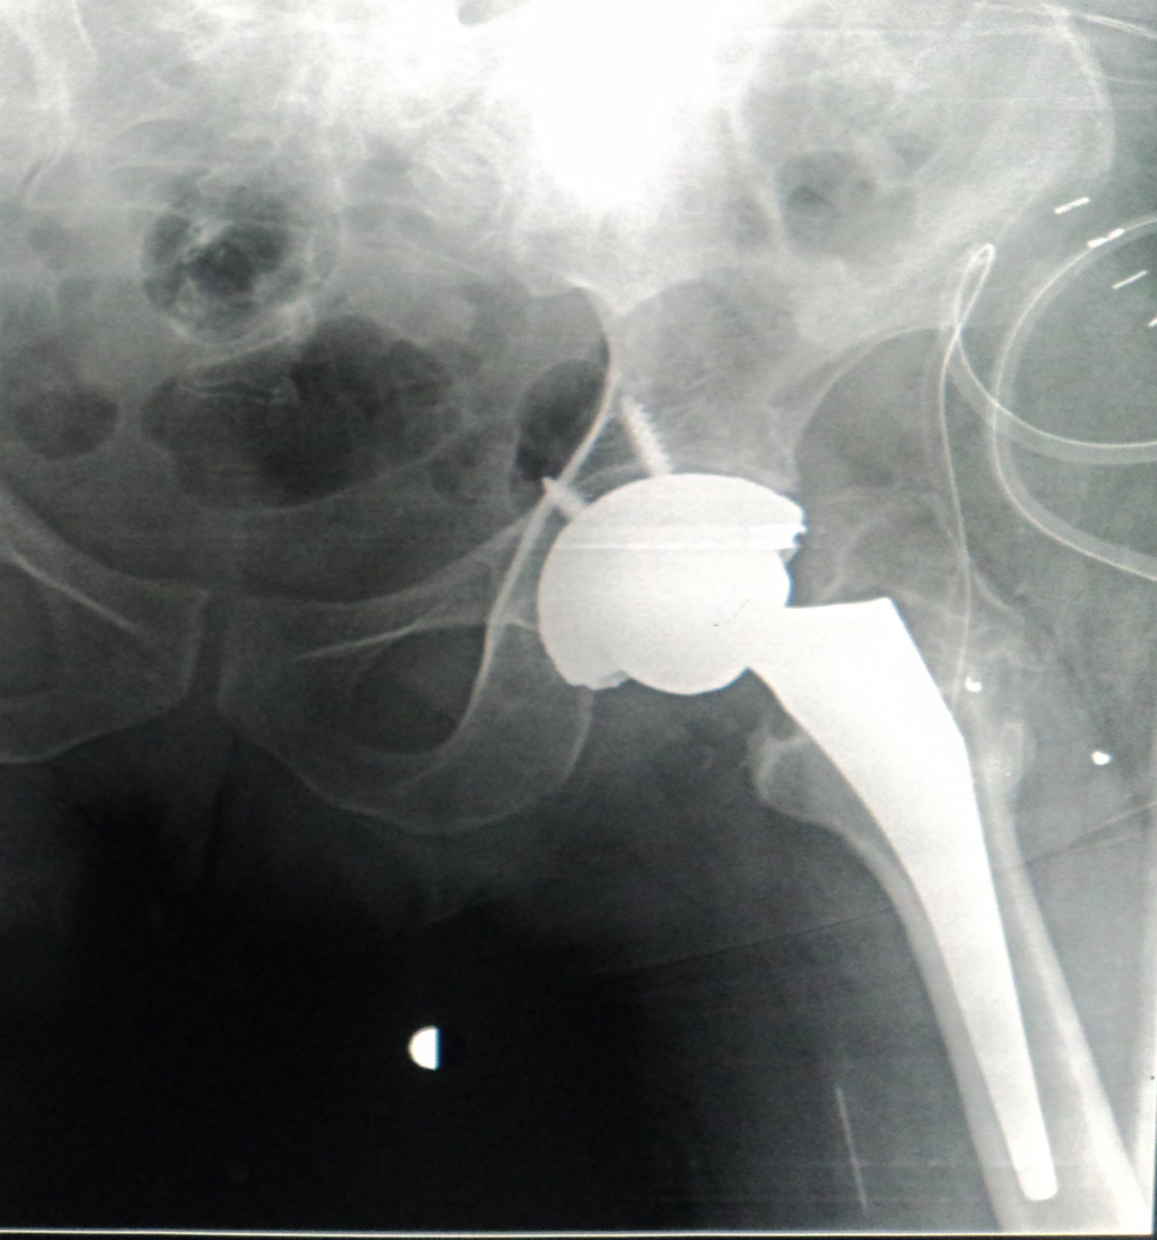

Slide 31
Take Home Message
Total hip replacement is one of the best management options for sub-capital fracture neck of femur in independently mobile elderly patients.
It has better rehabilitational potential, better function of hip and low revision rate.

Slide 32

Thank you !

