Slide 1

Utility of Modified Locust Bean gum for dissolution improvement of poorly soluble drug
PHARMACEUTICS & NOVEL DRUG DELIVERY SYSTEM, DUBAI, UAE
KANAV MIDHA
CHITKARA UNIVERSITY, INDIA

Slide 2
CONTENTS
INTRODUCTION
SOLID DISPERSIONS, TYPES, PREPARATION, ADVANTAGES & LIMITATIONS
MATERIAL & METHODS
DRUG & POLYMER PROFILE
RESULTS & DISCUSSIINS
CONCLUSION
REFERENCES

Slide 3
INTRODUCTION
Solubility is an important parameter to achieve desired concentration of drug in systemic circulation for pharmacological response to be shown. Poorly water soluble drugs are increasingly becoming a problem in terms of obtaining the satisfactory dissolution within the GIT that is necessary for good bioavailability.
The Biopharmaceutical Classification System (BCS System) is a scientific framework for classifying a drug substance based on its aqueous solubility and intestinal permeability.

Slide 4
BCS CLASSIFICATION
Propanolol, Metaprolol, Diltiazam, Verapamil, Water soluble vitamins
Class I (appropriate)
Acyclovir, Captopril, Elanapril, Neomycin B
Class III (problematic)
Chlorthiazid, Furosemid, Tobramycin, Cefuroxim
Class IV (inappropriate)
Nifedipine, Nicardipin, Felodipin, Ketoconazole
Class II (acceptable)
H-P
H-S
L-P
H-S
H-P
L-S
L-P
L-S
H- High
L- Low
P- Permeability
S- Solubility

Slide 5
Solubilisation techniques
Physical Modification | Chemical Modification | Miscellaneous
Micronization | Change in pH | Surfactants
In situ crystallization | Complexation | Hydrotrophy
Super Critical Process | Salt formation | Co solvency
Polymorphs |  | Micellar solublisation
Liquisolid compacts
Solid Dispersion

Slide 6
Solid Dispersion
Sekiguchi and Obi first introduced the concept of using solid dispersions to improve bioavailability of poorly water-soluble drugs in 1961. They demonstrated that the eutectic mixture of sulphathiazole and the physiologically inert water-soluble carrier urea exhibited higher absorption and excretion after oral administration when compared with sulphathiazole alone.
The term ‘Solid Dispersion’ refers to a group of solid products consisting of at least two different components, generally a hydrophilic matrix and a hydrophobic drug. The matrix can either be crystalline or amorphous.
It is the science of dispensing one or more active pharmacological ingredients in an inert matrix in the solid stage in order to:
Obtain sustained release dosage form
Enhancing the dissolution rate
Enhance the release of drugs from ointment and suppository bases
Improve the solubility and stability of active pharmacological ingredients (API)

Slide 7
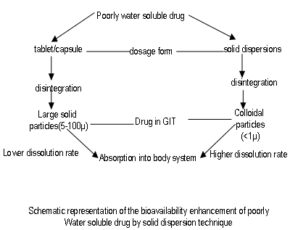

Slide 8
Solid Dispersion Type | Remarks | No. of Phases
I. Eutectics | First type of Solid Dispersion prepared | 2
II. Amorphous precipitation in crystalline matrix | Rarely encountered | 2
III. Solid Solutions | Various types are as follows:
A. Continuous Solid Solution | Miscible at all composition never prepared | 1
B. Discontinuous Solid Solution | Partially miscible, 2 phases even though drug is molecularly dispersed | 2
C. Substitutional Solid Solution | Molecular diameter of drug (solute) differs less than 15% from the matrix (solvent) diameter. Can be continuous or discontinuous; when discontinuous, 2 phases even though drug is molecularly dispersed | 1 or 2
Solid Dispersion Type | Remarks | No. of Phases
D. Interstitial Solid Solution | Drug (solute) molecular diameter less than 59% of matrix (solvent) diameter. Usually limited miscibility, discontinuous. Eg: Drug in helical interstitial spaces of PEG* | 2
IV. Glass Suspension | Particle size of dispersed phase dependent on cooling/evaporation rate. Obtained after crystallization of drug in amorphous matrix | 2
V. Glass Solution | Requires miscibility or solid solubility, complex formation or upon fast cooling or evaporation during preparation Eg: with PVP | 2
* Chiou & Reigelman, 1971, 1969

Slide 9
ADVANTAGES
Increased Dissolution Rate
Enhanced oral bioavailability
Processing equipment available at small and large scale
Most carriers can act as “solid” solvent
Carriers (mainly surface active agents) can maintain supersaturation in GI tract

Slide 10
LIMITATIONS
During processing or storage, the amorphous state may undergo crystallization and dissolution rate decrease with aging.
Most of the polymers used in solid dispersions can absorb moisture, which may result in phase separation, crystal growth or conversion from the amorphous to the crystalline state or from a metastable crystalline form to a more stable structure during storage. This may result in decreased solubility and dissolution rate.

Slide 11
MATERIAL &
METHODS
MATERIAL AND METHODS

Slide 12
Chemicals Used:-
Instruments Used:-
Excipients and chemicals | Commercial source
Glimepiride | Comed Pharmaceutical Pvt. Ltd., India
Locust Bean Gum (LBG) | Lucid Colloids Ltd., India
Ethanol | Changshu Yangyuan chemical , China
Potassium dihydrogen orthophosphate | Loba Chemicals , India
Sodium hydroxide pellets | Merck Pharmaceuticals , India
Instrument | Manufacturer | Model Number
UV visible double beam spectrophotometer | Systronics, Ahmedabad, India | AU – 270i
Micropipette tip | Tarsons | J16210511
ATR-FTIR | Alpha Bruker, Germany | IFS 66/S
Rotary evaporator | Perfit India | -
Orbital shaking incubator | REMI Instruments , India | IHB.083
pH meter | Systronics, Ahmedabad, India | µpH systems 361
Digital weighing balance | Denver instruments, India | S1 – 234
Tapped density apparatus | Microsil, Ambala, India | -
XRD | X’pert Pro | PW3050
Dissolution Test Apparatus | Lab India, Pune, India | DS8000
SEM | JEOL , USA | -
Dessicator | Perfit, India | -
DSC | Mettler Toledo, USA | DSC 821e
Brookfield viscometer | Middlebro,MA,USA | DV-E
Digital melting point apparatus | Perfit, India | -

Slide 13
1. Preliminary studies:
Identification of drug and polymer:
Melting point :
Melting point of the drug was determined by using melting point apparatus.
b) UV spectroscopy:
Calibration curve of Glimepiride was prepared in phosphate buffer (pH6.8). Stock solution was prepared by dissolving 50mg of Glimepiride in 5ml of methanol in volumetric flask (50ml); volume was made up by phosphate buffer (pH6.8). Different dilutions (2 -18 µg/m) were prepared by diluting stock solution with phosphate buffer pH6.8 and absorbance was measured by UV visible double beam spectrophotometer at 226nm.
2. Modification of LBG and evaluation of LBG and MLBG:
a) Modification of locust bean gum:
Locust bean gum was placed in porcelain dish and heated on sand bath for 2 h. The polymer was stirred continuously with spatula to avoid charring of the polymer. The temperature of the bath was kept between 80˚C to 100˚C. The prepared modified locust bean gum (MLBG) which was light brown in colour was sieved through the #80 seive and kept in air tight container away from moisture at room temperature.

Slide 14
Formulation of various mixtures
1. Preparation of solid dispersion:
Solid dispersions were prepared by solvent evaporation method. In this method, the drug Glimepiride and polymer MLBG were mixed in the ratio 1:2, 1:4, 1:6, 1:8 and 1:10 in 25 ml ethanol in round bottom flask of rotary evaporator. The assembly was set and solvent was removed by using rotary evaporator. The temperature of water bath was kept at 60 ̊C. The resultant solid solid dispersions were sieved through 80 # sieve and stored in air tight containers at room temperature. Table shows the composition of various mixtures.
Batch 1:6 was optimized and various other mixtures were then prepared.
2. Preparation of various other mixtures:
a. Preparation of physical mixture:
Accurately weighed Glimepiride (100 mg) and modified locust bean gum (600mg) were mixed thoroughly with the help of a spatula the mixture was sieved through 80 # mesh and stored in air tight containers at room temperature.
b. Preparation of co- grinding mixture:
Accurately weighed drug Glimepiride (100mg) and modified locust bean gum (600mg). Placed the drug in mortar and grinded the mixture properly. The mixture was collected and passed through 80 # mesh sieve. The mixture was stored in air tight container at room temperature.
c. Preparation of kneading mixture:
Accurately weighed drug Glimepiride (100mg) and modified locust bean gum (600mg). were placed in mortar and kneaded with small quantity of ethanol. The kneaded mixture was placed in hot air oven until the constant weight of the mixture was obtained. After the complete drying (evaporation of the solvent) the mixture was collected and passed through the 80 # sieve. The mixture was stored in air tight container at room temperature.

Slide 15
Formulation code | Drug (mg) | Polymer MLBG (mg)
SD1 | 100 | 200
SD2 | 100 | 400
SD3 | 100 | 600
SD4 | 100 | 800
SD5 | 100 | 1000
PM | 100 | 600
CGM | 100 | 600
KM | 100 | 600

Slide 16
Characterisation of solid dispersions
Equilibrium solubility studies
The equilibrium solubility of Glimiperide, solid dispersion,physical mixture , kneading mixture and co-grinding mixture was determined in pH 6.8 phosphate buffer at 37⁰C. For each preparation an equivalent of 10mg of drug was added to 50 ml of buffer in conical flasks and covered with the foil. The flasks were kept in shaking incubator for 24h at 37⁰C. after shaking flasks were kept in the incubator for equilibration for 12 h. The solution was filtered and then assayed At 226nm.
2. Content uniformity
Accurately weighed amount( 5 mg) of solid dispersion were dissolved in 10 ml methanol in 100 ml volumetric flask and volume was made upto the mark using 6.8 phosphate buffer. The solution was filtered and content uniformity was analysed at 226 nm.
3. Fourier Transform IR Spectroscopy (FTIR)
The infrared (IR) spectra of samples were obtained using an Attenuated Total Reflectance-Fourier Transform Infra-Red (ATR-FTIR) spectrophotometer (Alpha, Bruker, germany). The samples were scanned in the spectral region of 4000 cm⁻¹ to 400 cm⁻¹
4. Differential Scanning Calorimetry (DSC)
The thermal transitions of samples were investigated with the use of a Mettler Toledo DSC 821 apparatus, calibrated by using a high purity indium standard. Samples about 10 mg were hermetically sealed in flat bottomed aluminium pans and heated in an atmosphere of nitrogen to eliminate the oxidative and pyrolitic effects. The heating rate was 10ºC/min in a temperature range of 25–300 ºC. The DSC thermograms were recorded.
5. Scanning Electron Microscopy (SEM)
The scanning electron micrographs taken for studying surface morphology were accumulated using a Hitachi S 3400 N SEM. The samples were stuck on a specimen holder using a silver plate, and then coated with palladium in a vacuum evaporator. An accelerator potential of 10 kV was used during the micrograph

Slide 17
6. X-Ray Powder Diffraction (XRD)
The X-ray powder diffraction patterns were traced employing X-ray diffractometer using Ni filtered cu(k-α)radiations in an X-Pert Pro (USA). The diffractometer was operated at 40 mA and 45 Kv. The signals of the reflection angle of 2θ were recorded from 0º to 50º at a scanning rate 20º/sec.
7. In vitro dissolution studies
In-vitro dissolution of various mixtures was studied in USP dissolution apparatus II (DS 8000, Lab India) in 900 ml of phosphate buffer pH 6.8 at 37±0.5 ºC as a dissolution medium. Aliquots of 5 ml each were withdrawn at specified time intervals (0, 15, 30, 45 and 60, 90 and 120 min) and replaced with equal volume of fresh medium. The withdrawn aliquots were filtered and analyzed for drug content using a UV double beam visible spectrophotometer (2202, Systronics, India) at λ_{max} 226 nm. The study was done in triplicate. Drug concentration was calculated and expressed as cumulative percent of the drug released.

Slide 18
IN VIVO Studies
Male Wistar rats weighing 250±20 g, maintained on standard laboratory diet (Ashirwad Feed Industry, Chandigarh, India) and having free access to tap water were employed in the present study. They were housed in the departmental animal house and were exposed to 12 hr cycle of light and dark. The experiments were conducted in a semi-sound proof laboratory. The experimental protocol was approved by institutional animal ethics committee and care of the animals was carried out as per the guidelines of committee for the purpose of control and supervision of experiments on animals (CPCSEA), Ministry of Environment and Forest, Government of India (Chitkara College of Pharmacy Animal Facility Registration Number: 1181/ab/08/CPCSEA).

Slide 19
Experimental Induction of Diabetes:
Animals were allowed to fast for 12 hrs and were administered freshly prepared alloxan (160 mg/kg body weight i.p.) in freshly prepared saline water. The alloxan treated animals were allowed to food over night to overcome drug-induced hypoglycemia. After 72 hrs to allow for the development and aggravation of diabetes, rats with moderate diabetes having persistent glycosuria and hyperglycemia were considered diabetic for further experimentation.
Experimental Design:
In the experiment, a total of 30 rats (25 diabetic surviving rats, 5 normal rats) were used. Group I (Normal group) receives only vehicle. Group II was selected for diabetic control. Group III stands for pure powdered form of glimepiride (2 mg/kg, i.p) control group, Group IV, solid dispersion of glimepiride (2 mg/kg, i.p) Group V, glimepiride CGM (2 mg/kg, i.p). The dosage was prepared in solution form in such a concentration that, each 0.5 ml of solution contains those drugs corresponding to the volume of 5 ml/kg body weight. The blood samples collected from tail vain were analyzed for blood glucose content at 0, 30 min, 1 hr, 2 hr and 3 hours respectively by using Accu check active glucometer.

Slide 20
Statistical Analysis:
The values were expressed as mean ± SEM. The data was subjected to the analysis of variance (one way ANOVA) to determine the significance of changes followed by students “t”-test. The statistical significance of difference between two independent groups was calculated for the determination of blood glucose levels.

Slide 21
DRUG & POLYMER
PROFILE

Slide 22
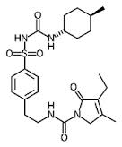
Name | Glimepiride
Synonyms | Glimepirid, Glimepirida, Glimepiridum, Glimepride
Description | Glimepiride is the III generation sulphonyl urea.
Brand Names | Amarel, Amaryl, Endial, Novo-glimepiride,PMS-glimepiride, Ratio-glimepiride
Chemical IUPAC Name | 3-ethyl-4-methyl-N-[2-[4-[(4-methylcyclohexyl)carbamoylsulfamoyl]phenyl]ethyl]-2-oxo-5H-pyrrole-1-carboxamide
Chemical Formula | C₂₄H₃₄N₄O₅S
Chemical Structure
Molecular Weight | 490.22 g/mol
Melting Point | 207 °C
Drug Category | Hypoglycemic Agents Sulfonylurea
Solubility | Practically insoluble in water, soluble in dimethyl formamide, slightly soluble in methylene chloride
Half Life | 5 h
Dose | 1-2 mg
Protein Binding | 99.5% bound to plasma protein

Slide 23
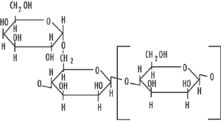
Polymer | Locust Bean Gum
Synonyms | Carob gum, Carob bean gum, Carob flour, St. john’s bread, Gomme de caroube
Biological Source | Obtained from the endosperm of the seed of the carob (locust) tree, Ceratonia siliqua (L.) Taub (Fam. Leguminosae).
Chemical Composition | It consists mainly of a neutral galactomanan polymer made up of 1, 4-linked D-mannopyronosyl units and every fourth or fifth chain unit is substituted on C6 with a D-galactopyranosyl unit. 0 The ratio of D-galactose to D-mannose and this is believed to be due to the varying origins of the gum materials and growth conditions of the plant during production.
Chemical Structure
Appearance | Off white to cream powder odorless and tasteless in the dry powder form
Solubility | Requires heating to 85°C for at least 10 minutes for complete solubility in water.
Viscosity | 2400 – 3400 cps
pH | 5.0 – 7.5

Slide 24
RESULTS &
DISCUSSIONS

Slide 25
PRELIMINARY STUDIES:
Melting point: Melting point of the drug was found to be 207 °C which is within the specified limits.
UV absorption:
The absorbance data is mentioned in Table 5.1 and the calibration curve is shown in Figure 5.1
S.No | Conc ( µg/m) | Absorbance (mean±SD), n = 3
1 | 0 | 0.00 ± 0.00
2 | 2 | 0.16 ± 0.002
3 | 4 | 0.25 ± 0.18
4 | 6 | 0.34 ± 0.009
5 | 8 | 0.44 ± 0.001
6 | 10 | 0.52 ± 0.001
7 | 12 | 0.59 ± 0.001
8 | 14 | 0.674 ± 0.001
9 | 16 | 0.738 ± 0.001
10 | 18 | 0.816 ± 0.001
Table 5.1: Concentration Vs. absorbance data of various dilutions
Figure 5.1: Calibration curve of pure drug in phosphate buffer (pH 6.8)

Slide 26
EVALUATION OF VARIOUS MIXTURES
Table 5.3: Equilibrium solubility of drug and various mixtures
Table 5.4: Content uniformity of various mixtures
Formulation | Equilibrium solubility(µg/ml) (mean ± SD), n=3
Pure drug | 1.39±0.02
SD 1 | 7.09±0.13
SD 2 | 16.72±0.42
SD 3 | 23.73±0.51
SD 4 | 15.96±0.40
SD 5 | 13.79±0.46
PM(1:6) | 11.03±0.33
CGM(1:6) | 19.61±0.29
KM(1:6) | 18.01±0.52
Batch No. | % Content Uniformity (Mean ± SD), n=3
SD 1 | 98.1±0.4
SD 2 | 98±1.0
SD 3 | 98±1.1
SD 4 | 97.5±0.5
SD 5 | 98.2±0.7
PM | 97.4±0.6
CGM | 98±0.9
KM | 98.1±1.2

Slide 27
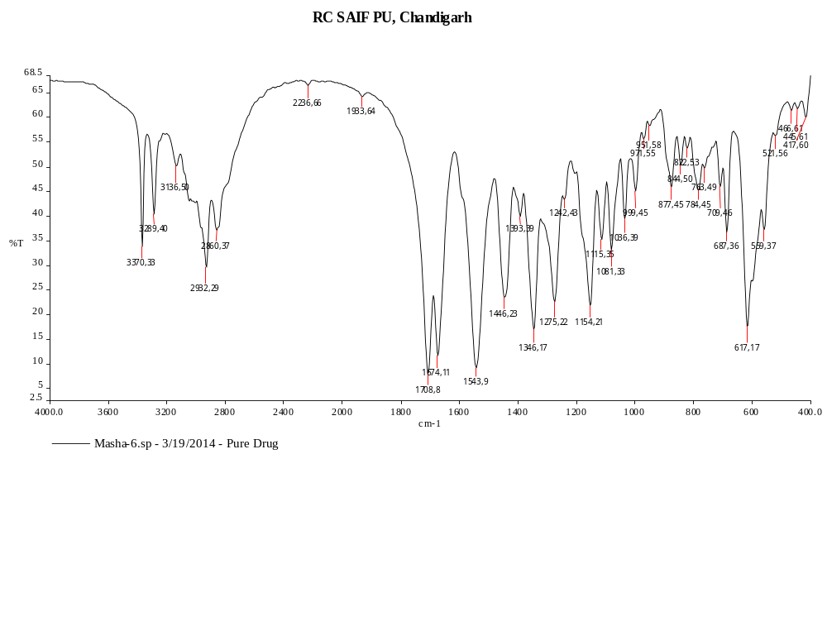
Fig 5.2: FTIR spectrum of Drug Glimepiride

Slide 28
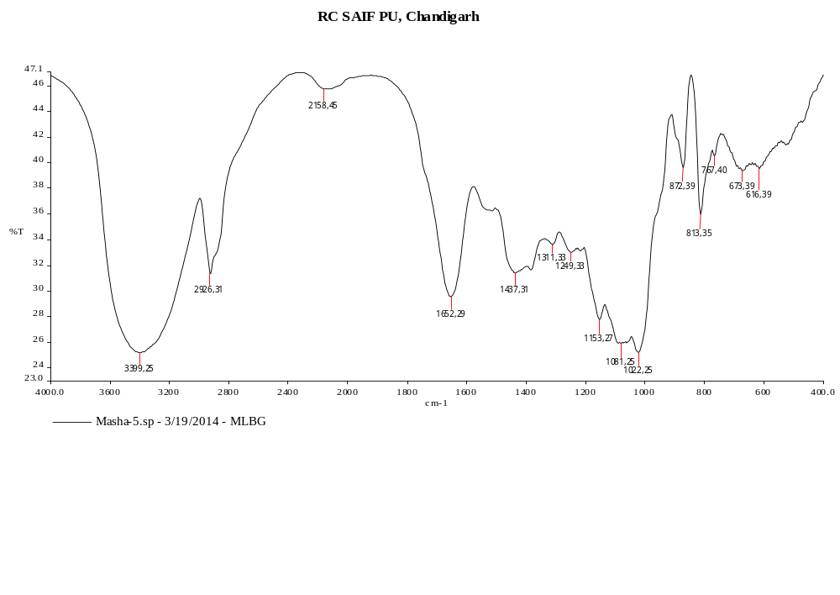
Fig 5.3: FTIR spectrum of MLB

Slide 29
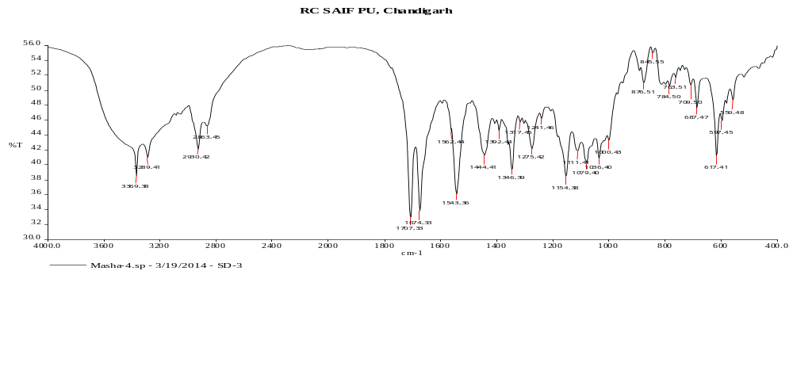
Fig 5.6: FTIR spectrum of SD 3

Slide 30
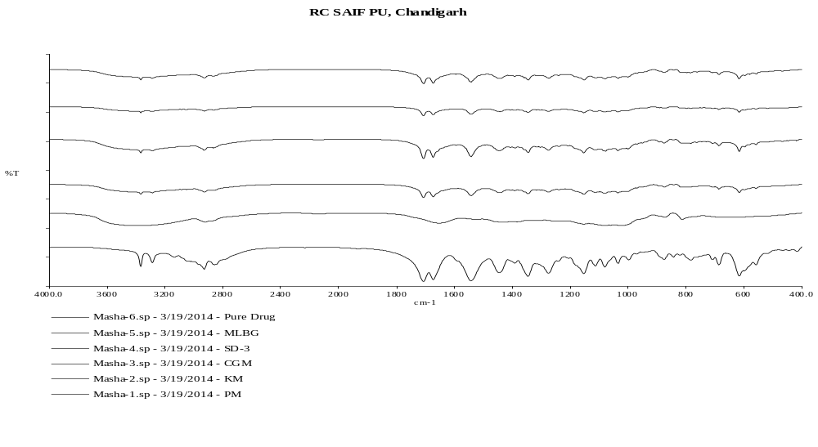
Fig 5.11: Overlay diagram of FTIR of Glimepiride, MLBG SD 3 CGM, KM, PM (bottom to top)

Slide 31
Fig 5.12: DSC thermogram of Glimepiride

Slide 32
Fig 5.15: Overlay diagram of DSC of Glimepiride, CGM (1: 6), and SD 3 (bottom to top)

Slide 33
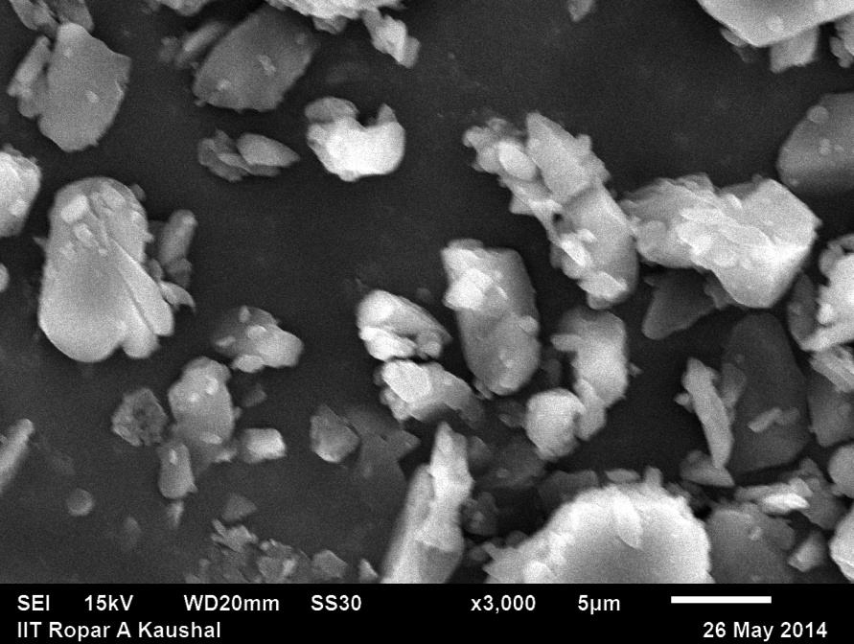
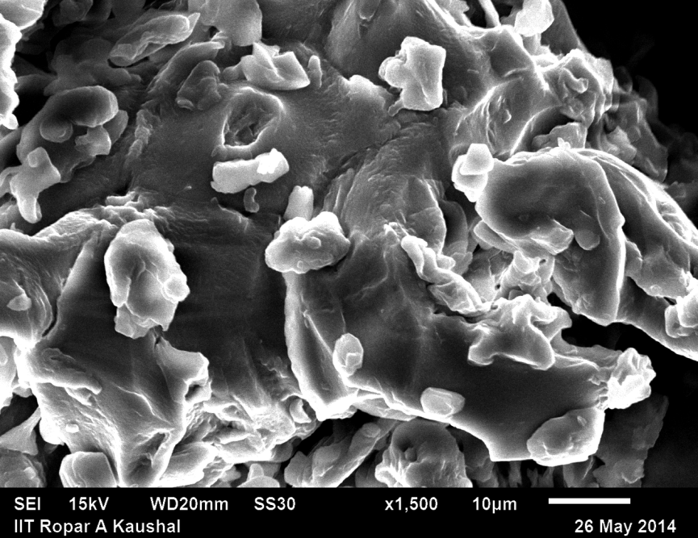

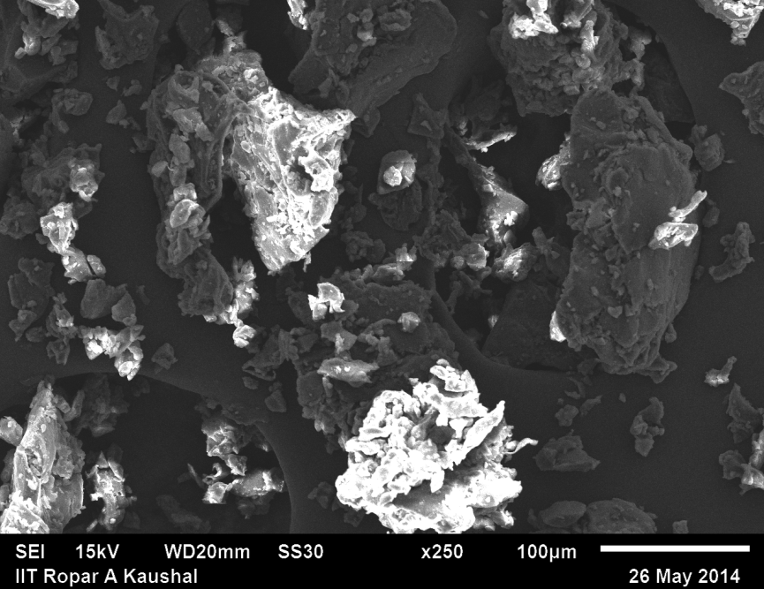

a
b
c
Fig 5.16: Scanning electron micrograph of a) pure drug at 3000 X b) SD3 at 1500 X c) Physical Mixture at 3000 X d) CGM at 250 X e) KM at 3000 X
d
e

Slide 34
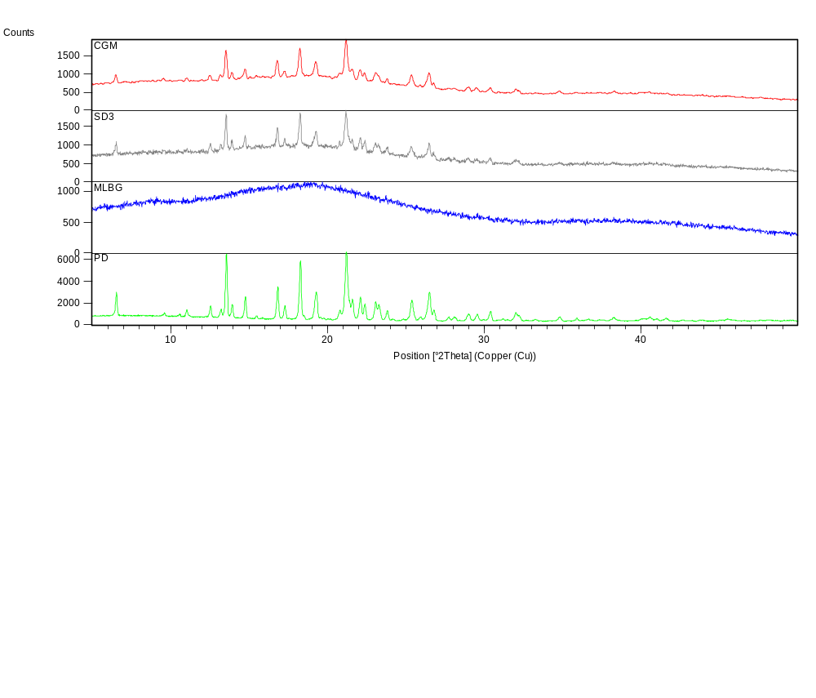
Fig 5.25: Overlay diagram of X-RD of pure drug, MLBG, SD 3, CGM (bottom to top)

Slide 35
IN VITRO studies
 | % Drug Release ± SD
Time | PD | SD 1 | SD 2 | SD 3 | SD 4 | SD 5
0 | 0 | 0 | 0 | 0 | 0 | 0
5 | 17.79 ± 0.80 | 19.36 ± 0.80 | 20.93 ± 0.52 | 24.59 ± 0.52 | 21.97 ± 0.52 | 18.97 ± 0.53
15 | 24.46 ± 0.80 | 25.98 ± 0.79 | 27.03 ± 0.79 | 34.88 ± 0.79 | 31.22 ± 0.79 | 28.22 ± 0.79
30 | 30.22 ± 0.30 | 33.31 ± 0.30 | 31.74 ± 0.30 | 47.96 ± 0.30 | 44.82 ± 0.30 | 36.82 ± 0.30
45 | 38.19 ± 0.52 | 42.38 ± 0.52 | 37.15 ± 0.79 | 54.94 ± 0.52 | 57.55 ± 0.52 | 48.55 ± 0.30
60 | 44.47 ± 0.52 | 45.52 ± 0.52 | 46.04 ± 0.52 | 75.87 ± 0.53 | 62.26 ± 0.53 | 56.26 ± 0.52
90 | 50.04 ± 0.52 | 47.09 ± 0.52 | 60.17 ± 0.52 | 84.76 ± 0.52 | 73.25 ± 0.53 | 61.25 ± 0.52
120 | 57.44 ± 0.79 | 52.15 ± 0.80 | 65.75 ± 0.80 | 87.77 ± 0.79 | 77.26 ± 0.79 | 70.26 ± 0.53
180 | 63.67 ± 0.38 | 57.34 ± 0.55 | 69.56 ± 0.70 | 96.43 ± 0.55 | 79.46 ± 0.75 | 75.87 ± 0.30
% Drug Release
Time (minutes)
Table 5.17: % drug release vs time data of pure drug (PD) and various SD batches
Fig 5.26: In vitro release profiles of pure drug (PD) and various solid dispersion batches

Slide 36
 | % Drug Release ± SD
Time | PD | SD 3 | PM | CGM | KM
0 | 0 | 0 | 0 | 0 | 0
5 | 17.79 ± 0.80 | 24.59 ± 0.52 | 18.13 ± 0.30 | 19.18 ± 0.30 | 21.97 ± 0.52
15 | 24.46 ± 0.80 | 34.88 ± 0.79 | 26.51 ± 0.30 | 27.77 ± 0.52c | 26.68 ± 0.52
30 | 30.22 ± 0.30 | 47.96 ± 0.30 | 32.96 ± 0.53 | 36.29 ± 0.52 | 37.67 ± 0.52
45 | 38.19 ± 0.52 | 54.94 ± 0.52 | 42.90 ± 0.52 | 42.56 ± 0.80 | 46.39 ± 0.79
60 | 44.47 ± 0.52 | 75.87 ± 0.53 | 45 ± 0.80 | 51.28 ± 0.80 | 62.61 ± 0.30
90 | 50.04 ± 0.52 | 84.76 ± 0.52 | 46.91 ± 0.30 | 60.88 ± 0.30 | 76.39 ± 0.53
120 | 57.44 ± 0.79 | 87.77 ± 0.79 | 49.53 ± 0.53 | 69.15 ± 0.53 | 80.05 ± 0.52
180 | 63.67 ± 0.38 | 96.43 ± 0.55 | 51.97 ± 0.44 | 78.58 ± 0.30 | 83.31 ± 0.40
% Drug Release
Time (minutes)
Table 5.18 : %drug release vs time data of pure drug (PD) SD 3 and various mixtures
Fig 5.27: In vitro release profiles of pure drug (PD), SD 3 and various solid mixtures

Slide 37
IN VIVO STUDIES
Group | Dose kg⁻¹ | 0 hr | 30 min. | 1 hr. | 2 hr | 3 hr
Vehicle control | Saline(5 ml/kg) | 106.55±22.09 | 105.23±18.44 | 104.55±22.09 | 105.23±18.44 | 108.16±20.32
Diabetic control | ______ | 350.67±22.3* | 355.67±22.3* | 348.67±22.35* | 346.67±22.35* | 345±22.35*
Pure Drug | 2 mg/kg | 340.67±22.35a | 225.60±20.5a | 175.60±19.45a | 145.60±18.50a | 140.60±16.53a
CGM | 2 mg/kg | 355.67±22.35b | 210.67±20.6b | 150.67±21.6b | 126.67±16.62b | 106.67± 10.6b
SD3 | 2 mg/kg | 348.67±22.4*c | 156.60± 14.73*c | 92.50±9.65*c | 87.50 ± 7.52*c | 82.50 ± 5.72*c

Slide 38
Discussion:
Glimepiride formulations (F1, F2 and F3) in powdered form were evaluated for their efficacy and potency in-vivo testing in wistar Rats. The drug was administered at a dose of 2 mg/kg body weight of Glimepiride solution. After oral administration of SD3 a rapid reduction in blood glucose level was observed and maximum reduction was found at 50% within 1 hour. Maximum 75% reduction was found after administration of solid dispersion of Glimepiride after 3 hour. The significant reduction was considered at 75% blood glucose level.
Blood glucose level was maintained for 3 hour after the treatment with solid dispersion of Glimepiride as compare to pure powdered form of Glimepiride. The Glimepiride solid dispersion formulation showed an instant hypoglycaemic effect due to a faster release and absorption of drug from the solid dispersion over a shorter period of time. Hence, this newly formulated Glimepiride in solid dispersion dosage form is a significant and potential than slow release glimepiride dosage form for the treatment of type-II Diabetes.

Slide 39
CONCLUSION
Dissolution improvement using MLBG is due to less viscosity of the polymer and slight conversion of drug from its crystalline to amorphous state.
SD3 and CGM was found to be the optimum batch for dissolution enhancement of Glimepiride
In vivo studies conformed that after oral administration of SD3 a rapid reduction in blood glucose level was observed, thus faster release and absorption of drug.

Slide 40
acknowledgement
Ms. Masha Rajput, Research Scholar, Chitkara College of Pharmacy, Chitkara University, India
Ms. Garima Singh, Research Scholar, Chitkara College of Pharmacy, Chitkara University, India
Ms. Manju Nagpal, Associate Professor , Dept. of Pharmaceutics, Chitkara College of Pharmacy, Chitkara University, India
Mr. Gurjeet Singh Thakur, Associate Professor and HOD Pharm D, Chitkara College of Pharmacy, Chitkara University, India

Slide 41
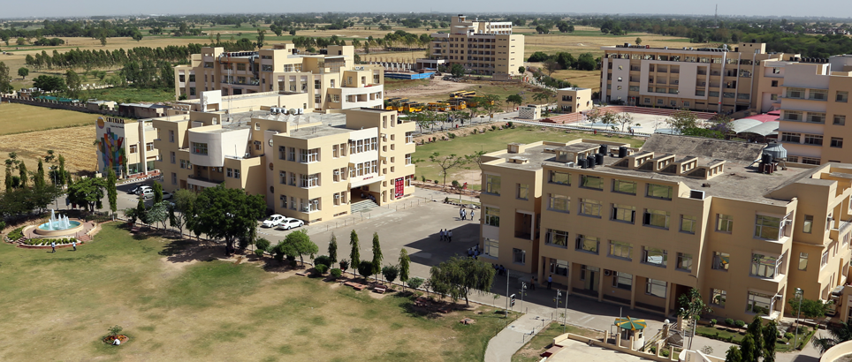
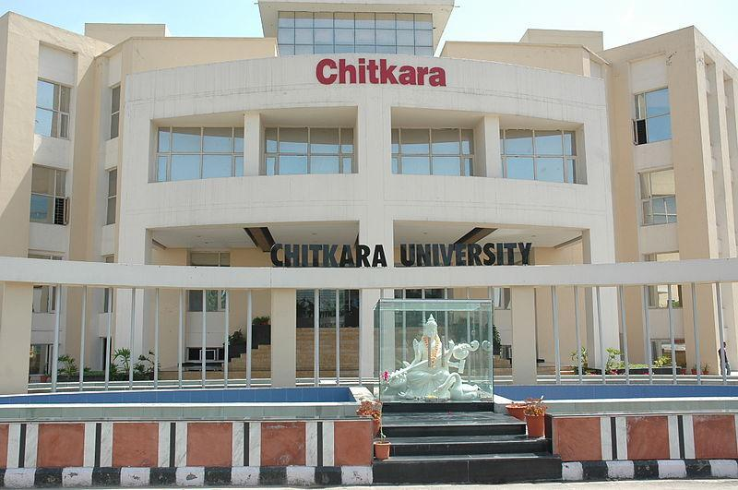

Slide 42
THANK YOU..!!!
☺

