Slide 1
Future of Next generation biosimilar
Dr. Kamlesh Patel, M.D.
GM, Medical Affairs, Abbott Health Care

Slide 2
Disclaimer
Employee of Abbott Health Care
Content is solely my personal view and based on limited experience
No conflict of interest
Examples quoted here have nothing to do with any favor or criticism of any company/molecule/brand
Out of scope : Regulatory Clinical and PV guidelines & Pathways

Slide 3
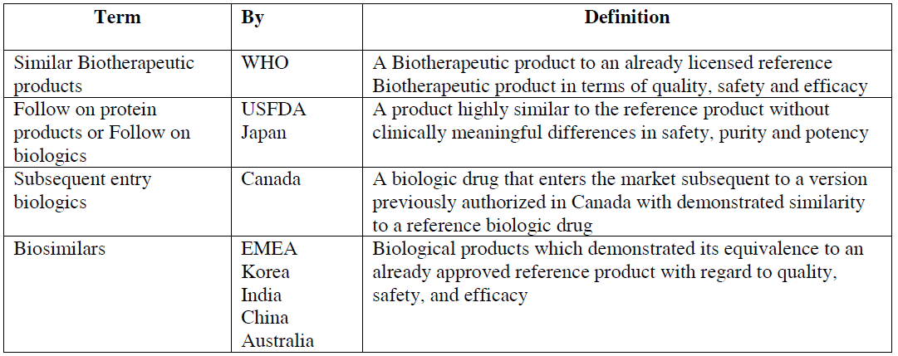

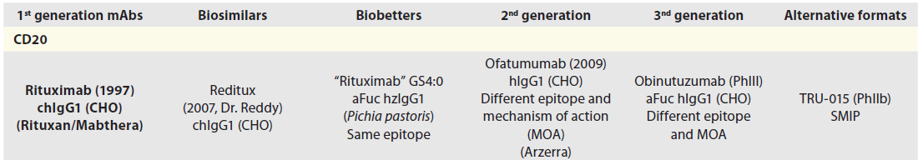
Convince or confuse
Biosimilars/ biogenerics/ biobetters/ biosuperiors,
Follow-on biologics, 2nd /3rd generation antibodies
MAbs. 2011 Mar-Apr; 3(2): 107–110.
Notes:
Biosimilars, follow-on biologics, biogene
Biosimilars are known as follow-on biologics in the US but this term is misleading because it could also refer to second and third generation antibodies (that will be defined and illustrated below) and should be avoidedrics, biobetters, biosuperiors, second and third generation antibodies are terms used in a sometimes confusing way

Slide 4
cost Effective copies
Copies of rituximab, trastuzumab, bevacizumab with a mutation of two or three amino acids in the Fc domain
Resulting in extended pharmacokinetics
Low Cost of treatment
  lower cost of the products
  less frequent administration regimens or lower dosages.
The EMA has pioneered the regulatory framework
The first wave of biosimilar antibodies were copies of current important therapeutic antibodies
Rituximab, India (Reditux; DRL) - (Rituxan/Mabthera)
Abciximab, S. Korea (Clotinab; Abu Abxis)-Centocor (Reopro)

Slide 5
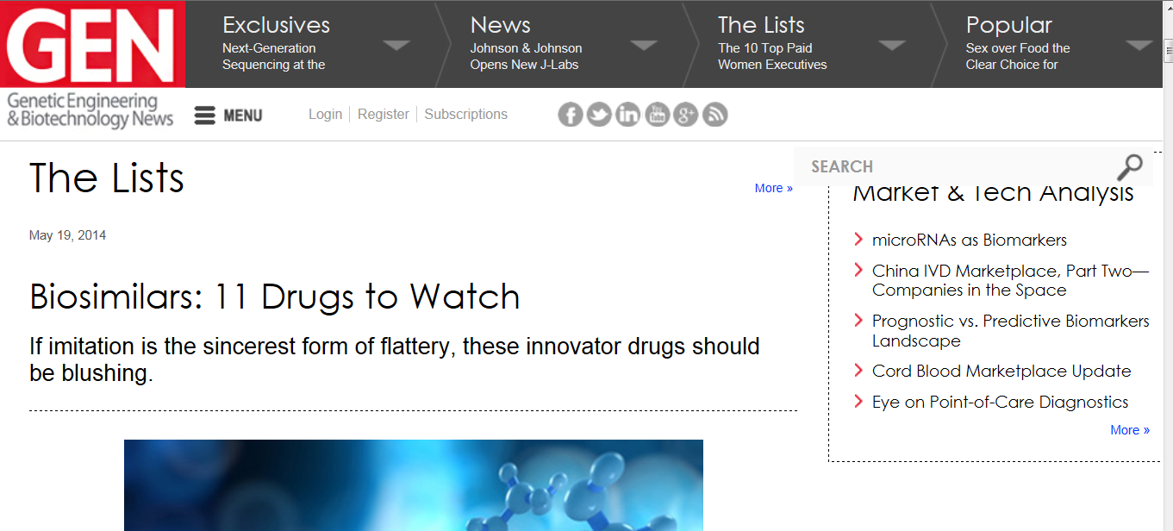
advancing toward multiple biosimilars development milestones
Herceptin (trastuzumab)- July 28, 2014, in Europe
Remicade (infliximab)
Humira (adalimumab), 2016 in U.S
Neupogen (filgrastim)
Neulasta (pegfilgrastim)
Rituxan / MabThera (rituximab)

Slide 6
The manufacturing, regulatory, and commercial issues
Pose significant challenges and leave their short- and medium-term success an open question
However, given the widespread adoption of small-molecule generics, these issues will not necessarily preclude the long-term acceptance and uptake of biosimilars
Medical practices and reimbursement procedures will evolve to be more receptive to the use of biosimilars over time, assuming that experience with them is favorable

Slide 7
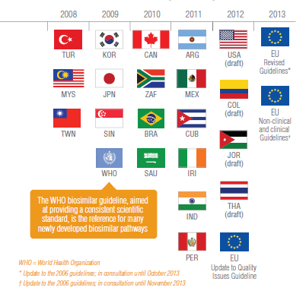
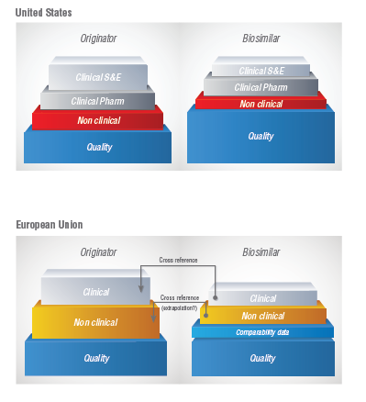
Biosimilar Regulations

Slide 8


FDA throws the (Purple) Book at biosimilars - Purple v. Orange (sept 2014)
Valuable reference tool in developing a biosimilar or interchangeable biologic product
Lists biological products, including any biosimilar and interchangeable biological products licensed by FDA
Orange Book lists small molecule reference listed drugs and their approved counterpart generic drugs

Slide 9
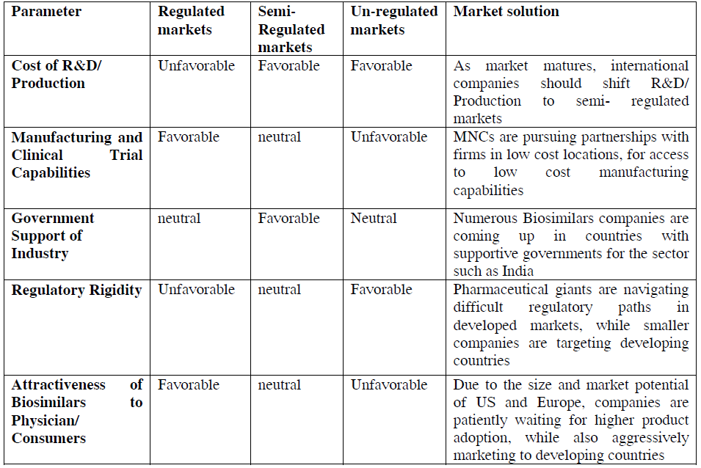
Market attractiveness scoring and solutions
Sruthi Konangi et al /Int.J.PharmTech Res.2013,5(3)

Slide 10
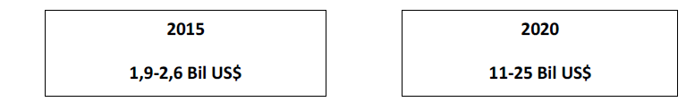
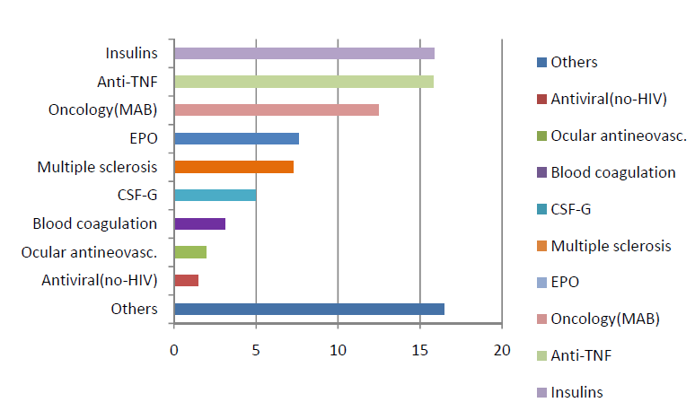
Core therapy area in biologics
(Billion $)
International Journal of PharmTech Research, Vol.5, No.3, pp 924-935, July-Sept 2013

Slide 11
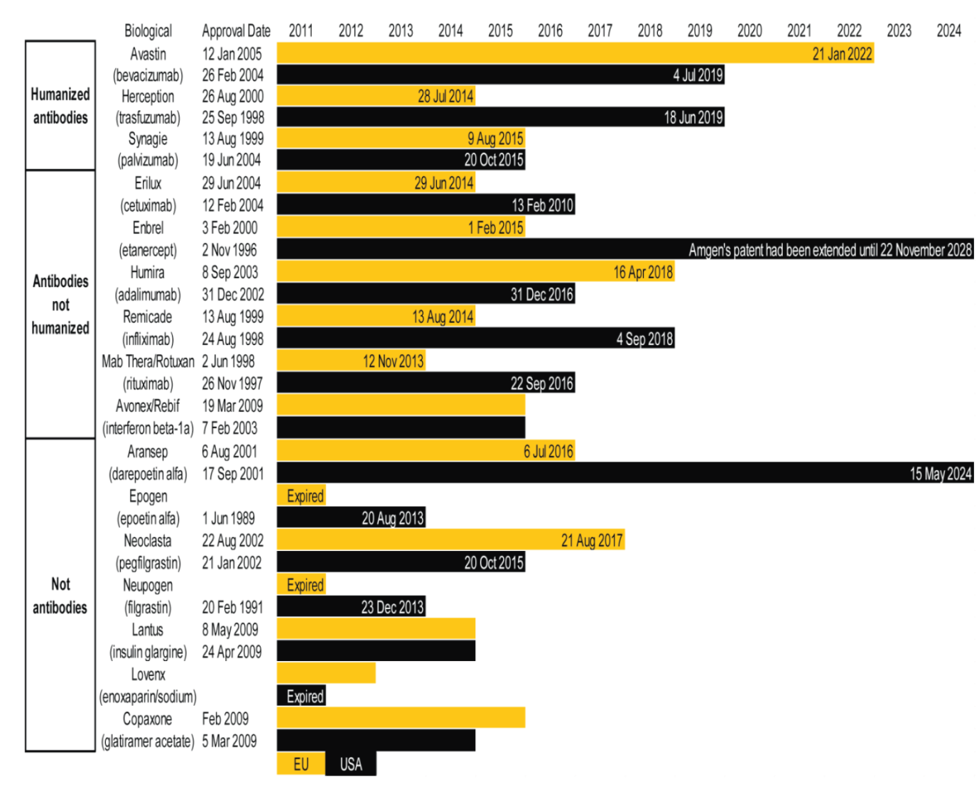
Best selling biologics-up to ?

Slide 12
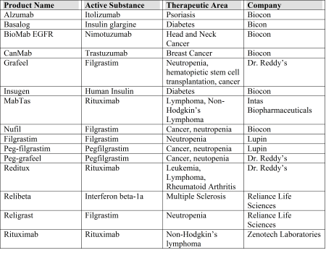
Rise of Similar Biologics in India
“Similar Biologics” Approved in India
Bicon (April 2014 investor report) : working on biosimilar versions of Bevacizumab (Avastin), Adalimumab (Humira), Etanercept (Enbrel), Peg-filgrastim (Neulasta), rh-insulin, Glargine, Lispro and Aspart.
Notes:
CDSCO and Department of Biotechnology (DBT) through the Review Committee on Genetic Manipulation (RCGM), approve similar biologics using an abbreviated version of the pathway applicable to new drugs. CDSCO is the highest regulatory authority in India, addresses issues and challenges for ensuring the safety and efficacy of similar biologics and establishes the appropriate regulatory pathways. Specifically, with respect to similar biologics, CDSCO is responsible for granting import/export licenses, clinical trial approvals and permission for marketing and manufacturing. The RCGM is responsible for monitoring all research scale activity and the approval of nonclinical studies. The DBT is responsible for overseeing the development and preclinical evaluation of recombinant biologics.
In 2012, CDSCO, in collaboration with the DBT, issued the Guidelines on Similar Biologics: Regulatory Requirements for Marketing Authorization in India (Guidelines). The Guidelines detail the regulatory requirements, such as data requirements for the manufacturing, characterization, preclinical studies and clinical trials, for receiving marketing authorization of similar biologics. The Guidelines are applicable for similar biologics developed in or imported into India.
Roche’s block buster drug Herceptin (trastuzumab) is used to treat HER2+ breast cancer. Generally, it is prescribed during post-surgery chemotherapy for women suffering from metastatic breast cancer and has been sold in India under the international brand name Herceptin as well as under a second off-brand name, Herclon. The cost of Herceptin in India is 15 times the per capital monthly income. The maximum price of lower cost Herclon is $75,000 rupees (US$1249.00) for a 440-mg vial.
While there is no compound patent covering trastuzumab (It was a pre-1995 compound and Indian patent law at the time did not allow product patent applications to be examined), Roche received Indian Patent No. 205534 (the ‘534 patent) claiming a formulation containing trastuzumab. The patent issued on April 6, 2007 with an expiration date of May 3, 2019. Specifically, the patent claims “a composition comprising a mixture of an anti-HER2 antibody and one or more acidic variants thereof, wherein the amount of acidic variants(s) is less than about 25%”.
Roche filed three divisional patent applications: (a) 1638/KOLNP/2005 (a divisional of the ‘534 patent) filed August 16, 2005; (b) 3272/KOLNP/2008 a divisional application off of (a) and filed February 12, 2009; and (c) 3273/KOLNP/2008, a divisional off of (a) and filed February 12, 2009.
A post-grant opposition was filed by Glenmark Pharmaceuticals. During the opposition, it came to light that Roche had failed to pay the 15th annuity on the ‘534 patent and as a result, the patent lapsed. There is speculation that Roche did not pay the annuity because the Ministry of Health was poised to issue a compulsory license for Herceptin pursuant to Section 92 of the Indian Patents Act, 1970. Roche avoided the issuance of the compulsory license by abandoning its patents and patent applications.
With respect to the divisional applications, the Controller found that a request for examination had been filed in 1638/KOLNP/2005 on March 17, 2006, one month later than the due date of February 16, 2006 (the request for examination had to be filed within 6 months of its filing date). As a result, the application was deemed to be withdrawn. With respect to the remaining two divisional applications, the Controller found that these applications had been filed after the grant of the first filed application and were not permissible. Thus, these applications were also deemed to be withdrawn.
In December 2013, Biocon announced that it had received authorization from the DCGI to market its jointly developed (with Mylan) trastuzumab similar biologic (under the name CANMAb) for the treatment of breast cancer. However, in early 2014, Roche sued Biocon and Mylan in the Delhi High Court over the impending launch of its trastuzumab similar biologic. Roche made two arguments. First, Roche argued that Biocon and Mylan were misrepresenting their drugs as “trastuzumab”, “biosimilar trastuzumab” and a “biosimilar version of Herceptin” without following the due process for their drugs being approved as biosimilars in accordance with the Guidelines issued in 2012. The second argument accused Biocon and Mylan of passing off their goods as “trastuzumab”, “biosimilar trastuzumab” and a “biosimilar version of Herceptin”. The DGCI was also made a party to the suit for giving permission to Mylan and Biocon to launch their generic versions of the drug. Moreover, Roche argued that that the approvals received by Biocon and Mylan could not have satisfied the requirements for a biosimilar drug under the Guidelines, because the protocol and design study for CANMAb was filed and approved prior to the Guidelines becoming effective. Furthermore, the approval had been granted very quickly which made a weak case for compliance with the Guidelines.
The Court issued an injunction in early February 2014 against Biocon and Mylan stating that the companies were “not entitled to introduce or launch the drug” until they persuaded the Court that their product had undergone sufficient testing and attained requisite approvals.

Slide 13
Patient Safety First-
Tranforming life
Worldwide, nearly 200 biologic medicines have transformed the lives of over 800 million patients with serious illnesses
A “True” Biosimilar with a SMART approach
Authorized biosimilars should be “as good, safe and efficacious as originator biologics.”

Slide 14
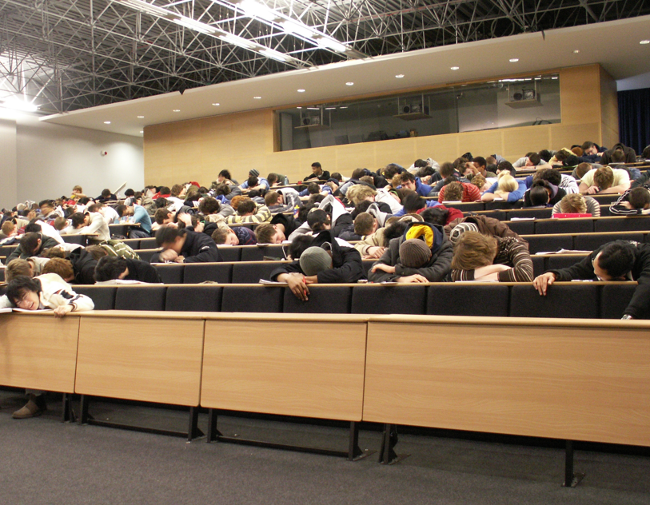

Slide 15

Notes:
The development of legal and regulatory pathways for biosimilars mAbs will continue to raise much debate among lawmakers, regulators, originator and generic industry, patent attorneys, academia and health care professionals, and mAbs looks forward to contributing to the discussions

