Slide 1




Catalytic pyrolysis of olive mill wastewater sludge to produce biofuels
Foster Agblevor & Kamel Halouani
Utah State University , USA and University of Sfax, Tunisia

Slide 2
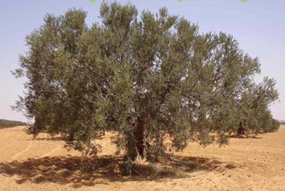
Outline
Olive oil industry in Tunisia
Olive oil wastes
Biomass Fast pyrolysis Mechanisms
Bio-oil from olive mill wastewater sludge (OMWS) Fast Pyrolysis
Catalytic Pyrolysis of OMWS
Patent Publication & Perspectives: Scaling Up for industrial production

Slide 3
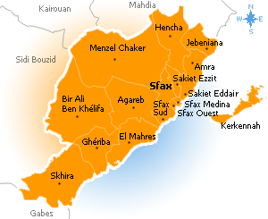
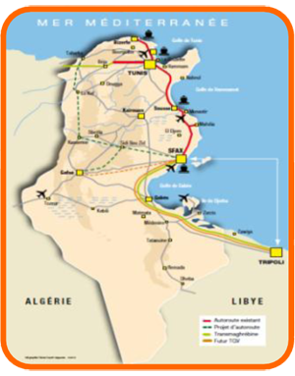
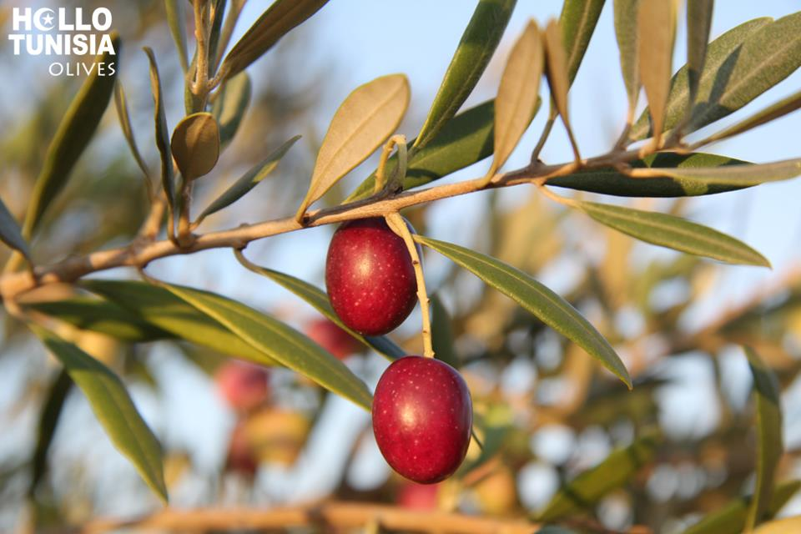
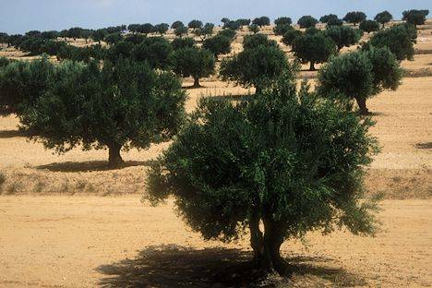
Olive Oil Industry in Tunisia
Sfax is ranked first nationally with 40% of the olive oil production
Tunisia is ranked 4th in the world:
70 millions of olive trees (giving about 2 millons tons /year of olive)
About 1200 factories of olive oil extraction
About 400,000 tons/year of olive oil

Slide 4
Olive Oil Extraction Processes
(Most used in Tunisia)

Slide 5
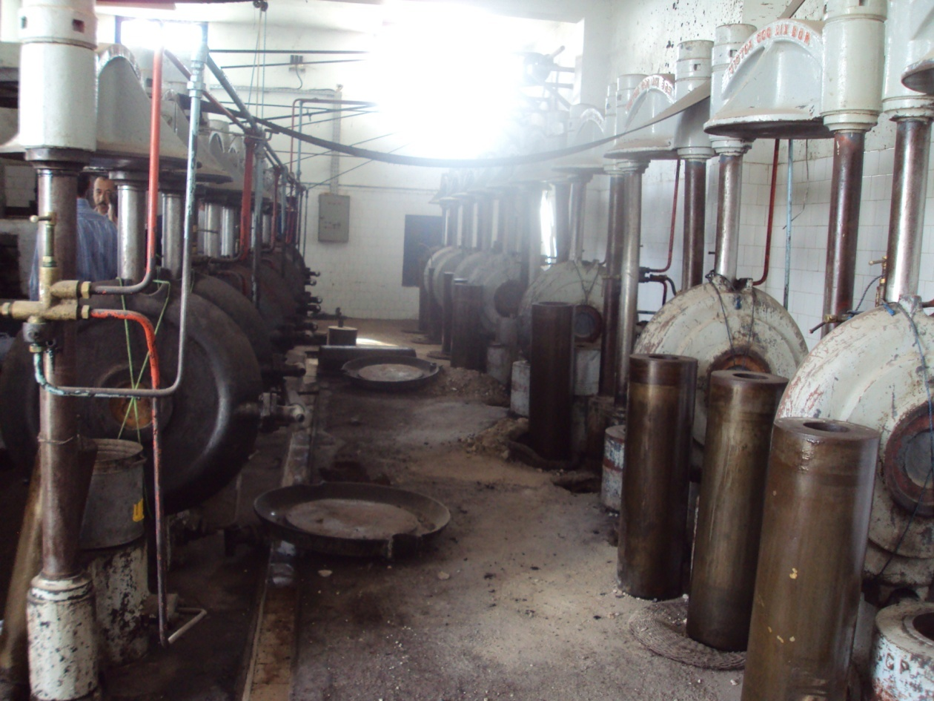
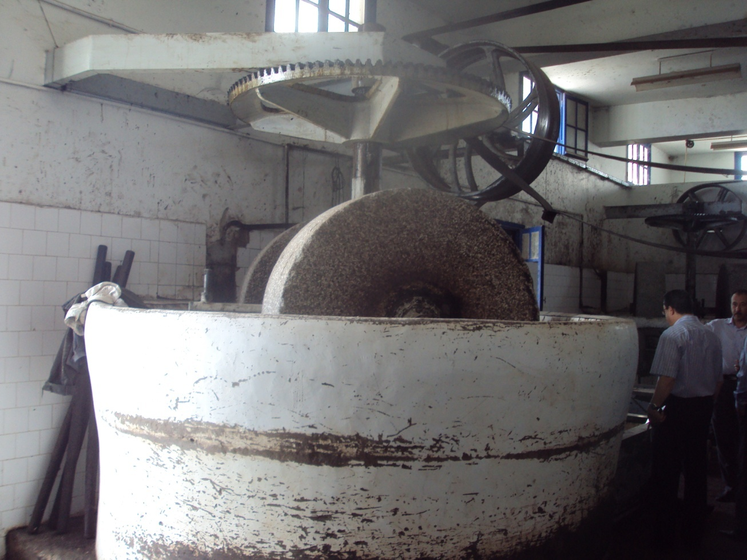

Traditional pressing process

Slide 6
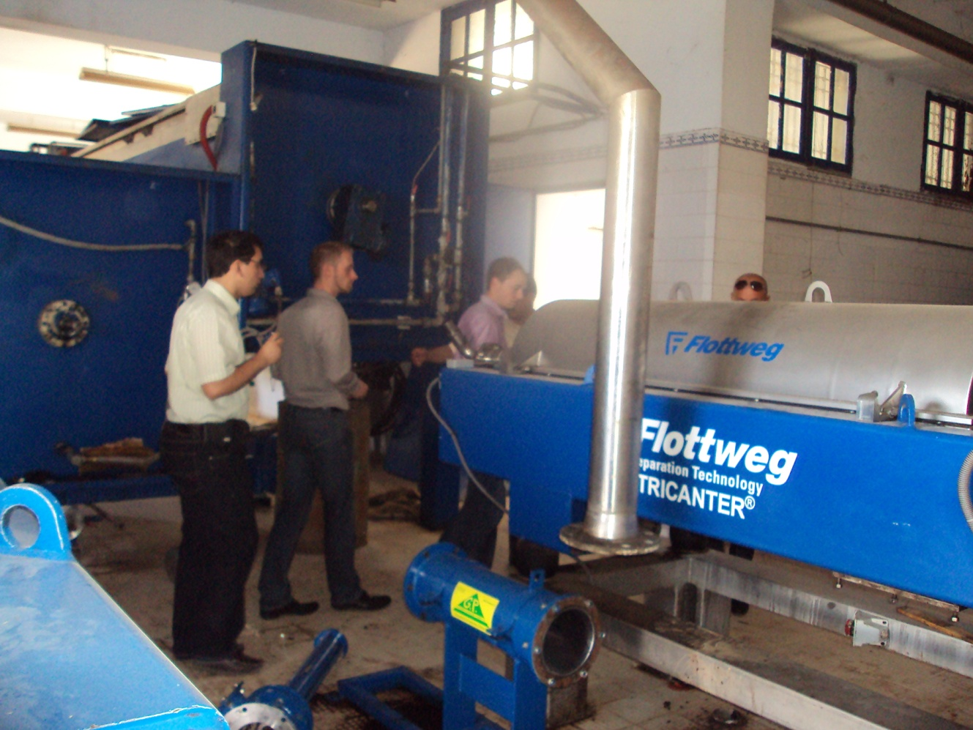
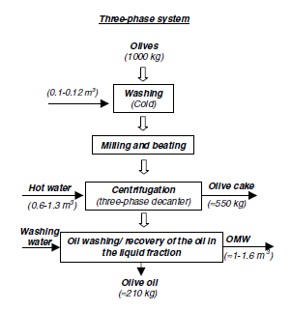
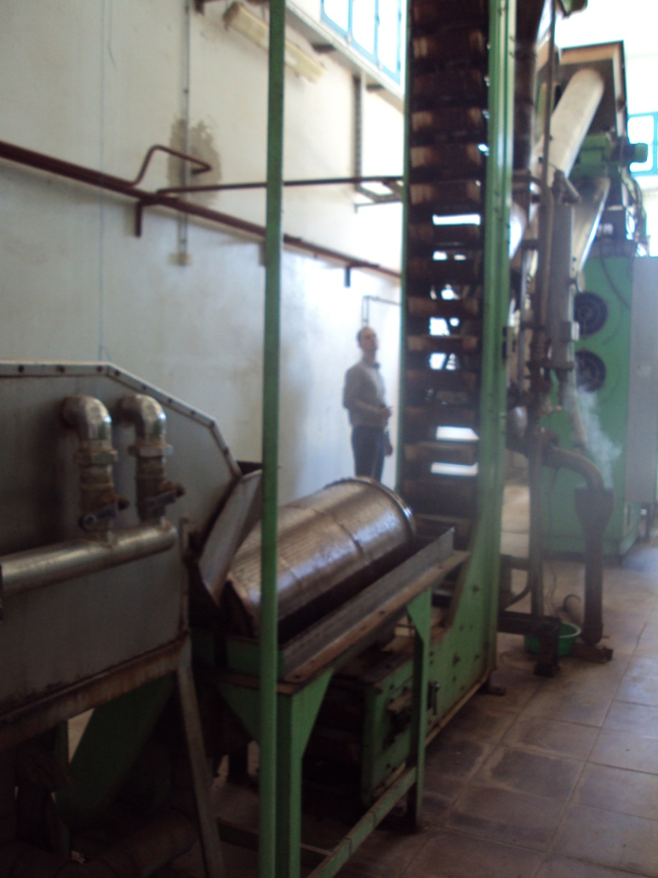
Three-Phases decanter

Slide 7
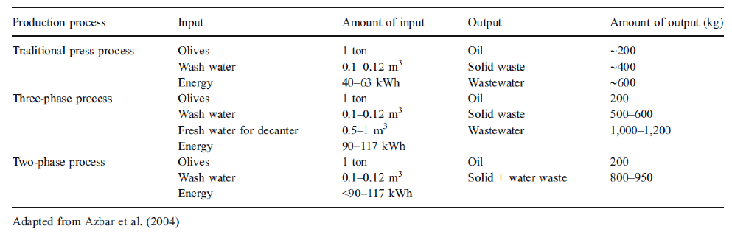
Mass and Energy Balance of olive oil extraction systems

Slide 8
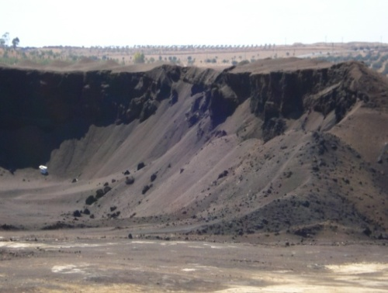
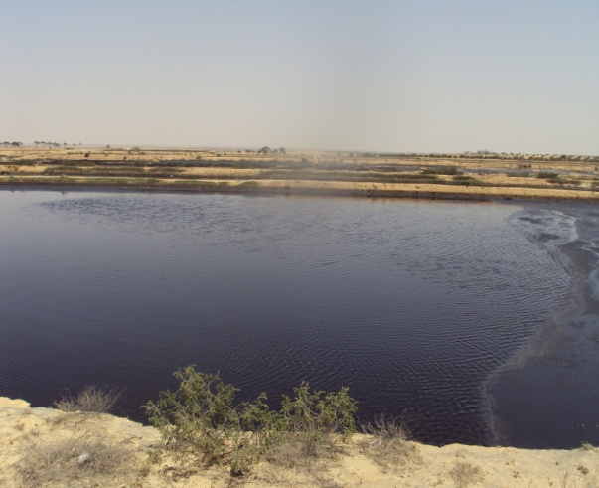
Olive oil residues
About 300.000 tons/year
Olive Cake
600.000 to 1 million tons/year of Olive Mill Wastewater (OMW)

Slide 9
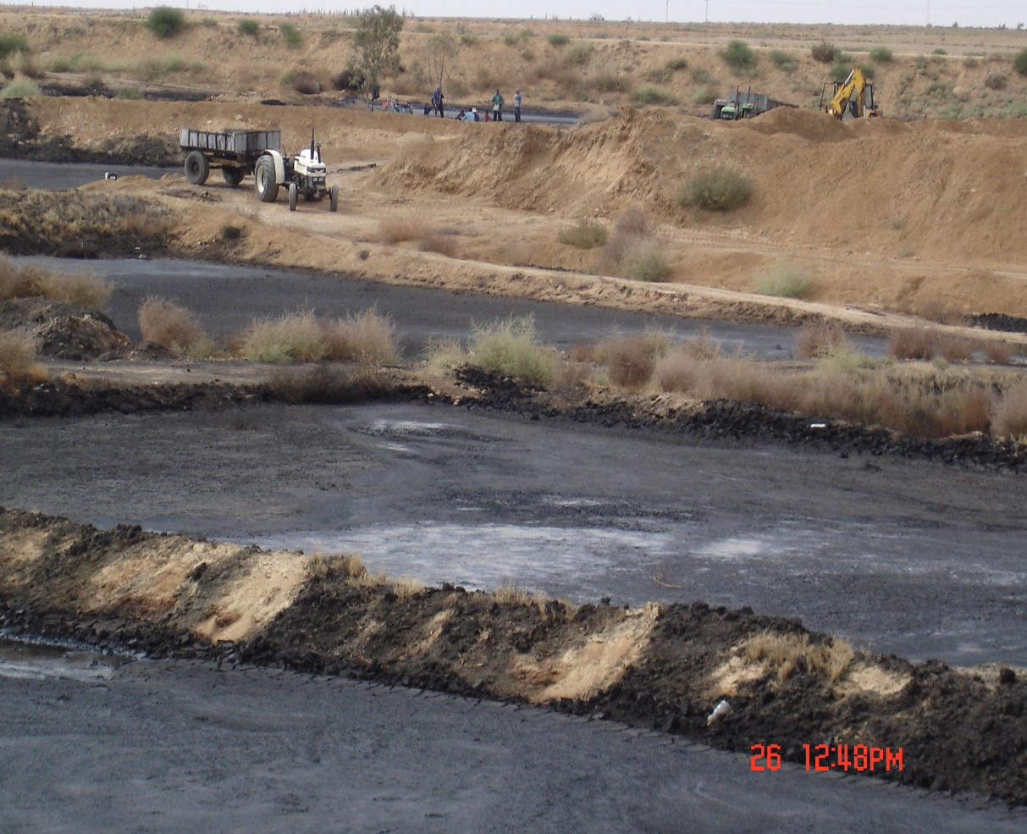
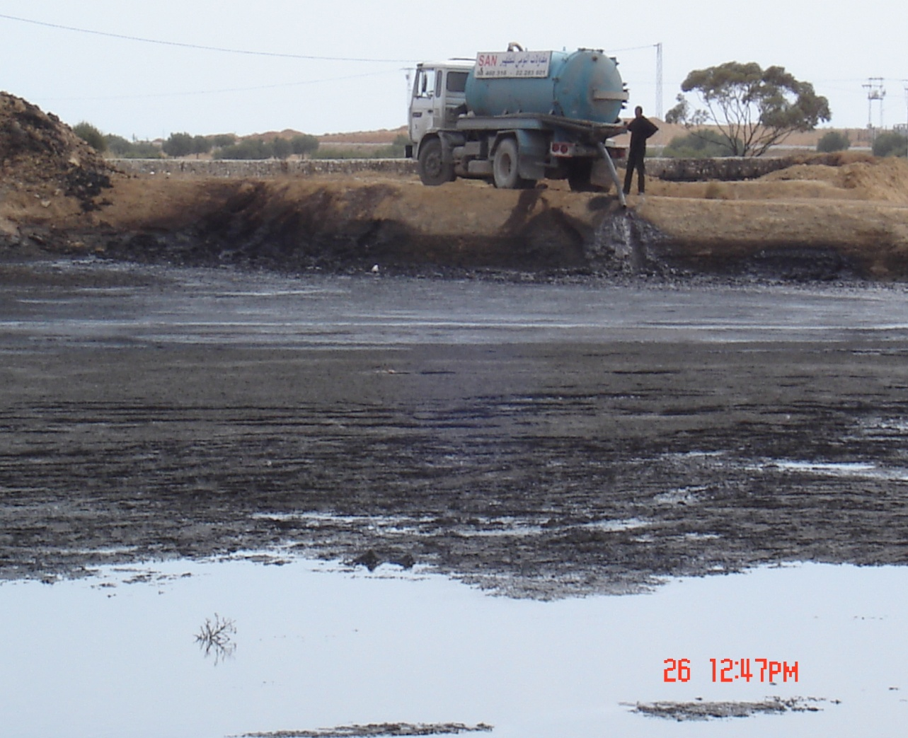
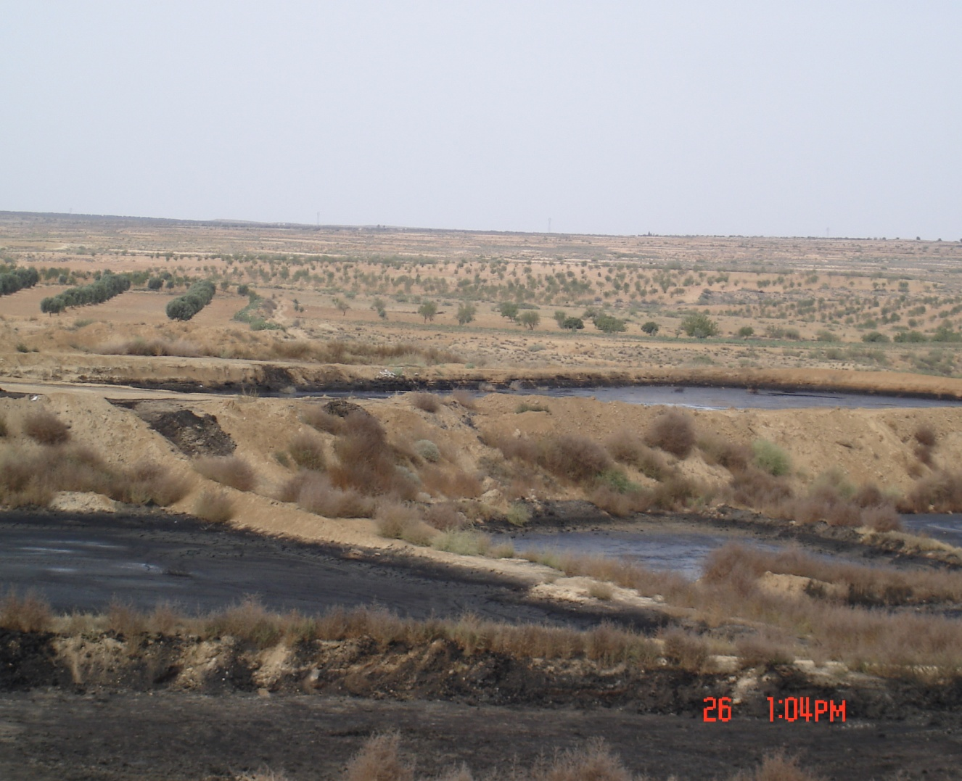
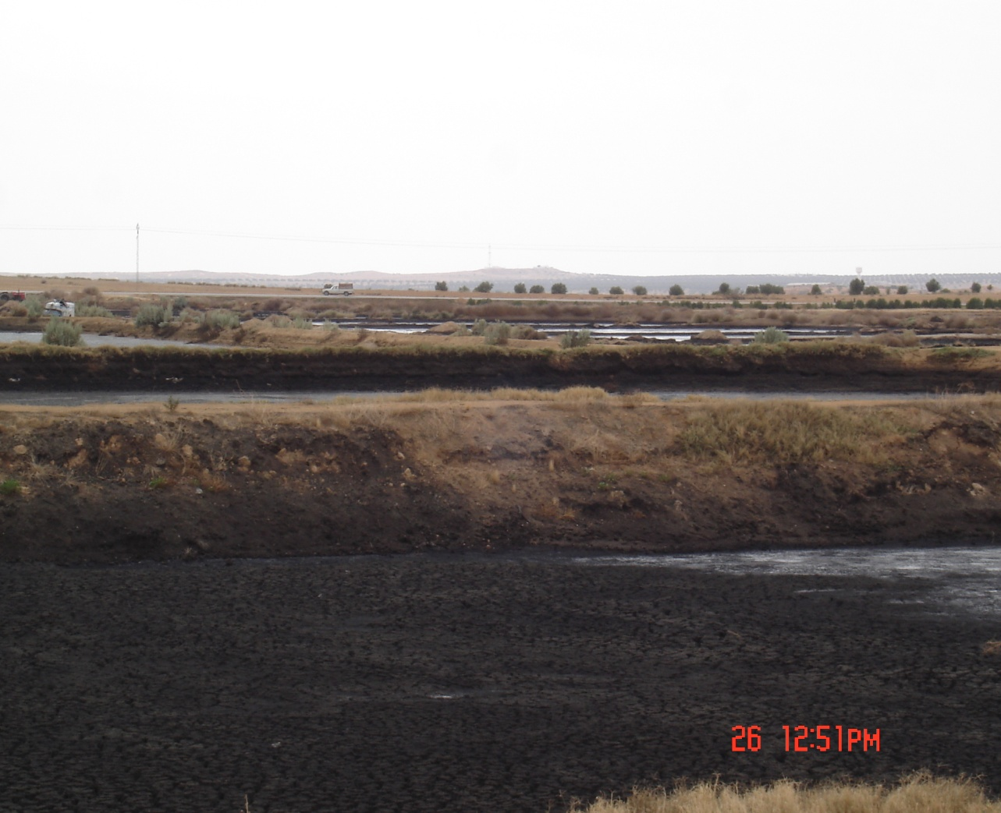
Serious Environmental Impact of olive mill wastewater
Evaporation ponds

Slide 10
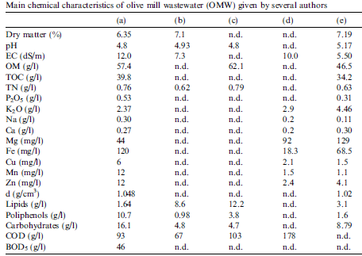
Chemical Characteristics of olive mill wastewater

Slide 11
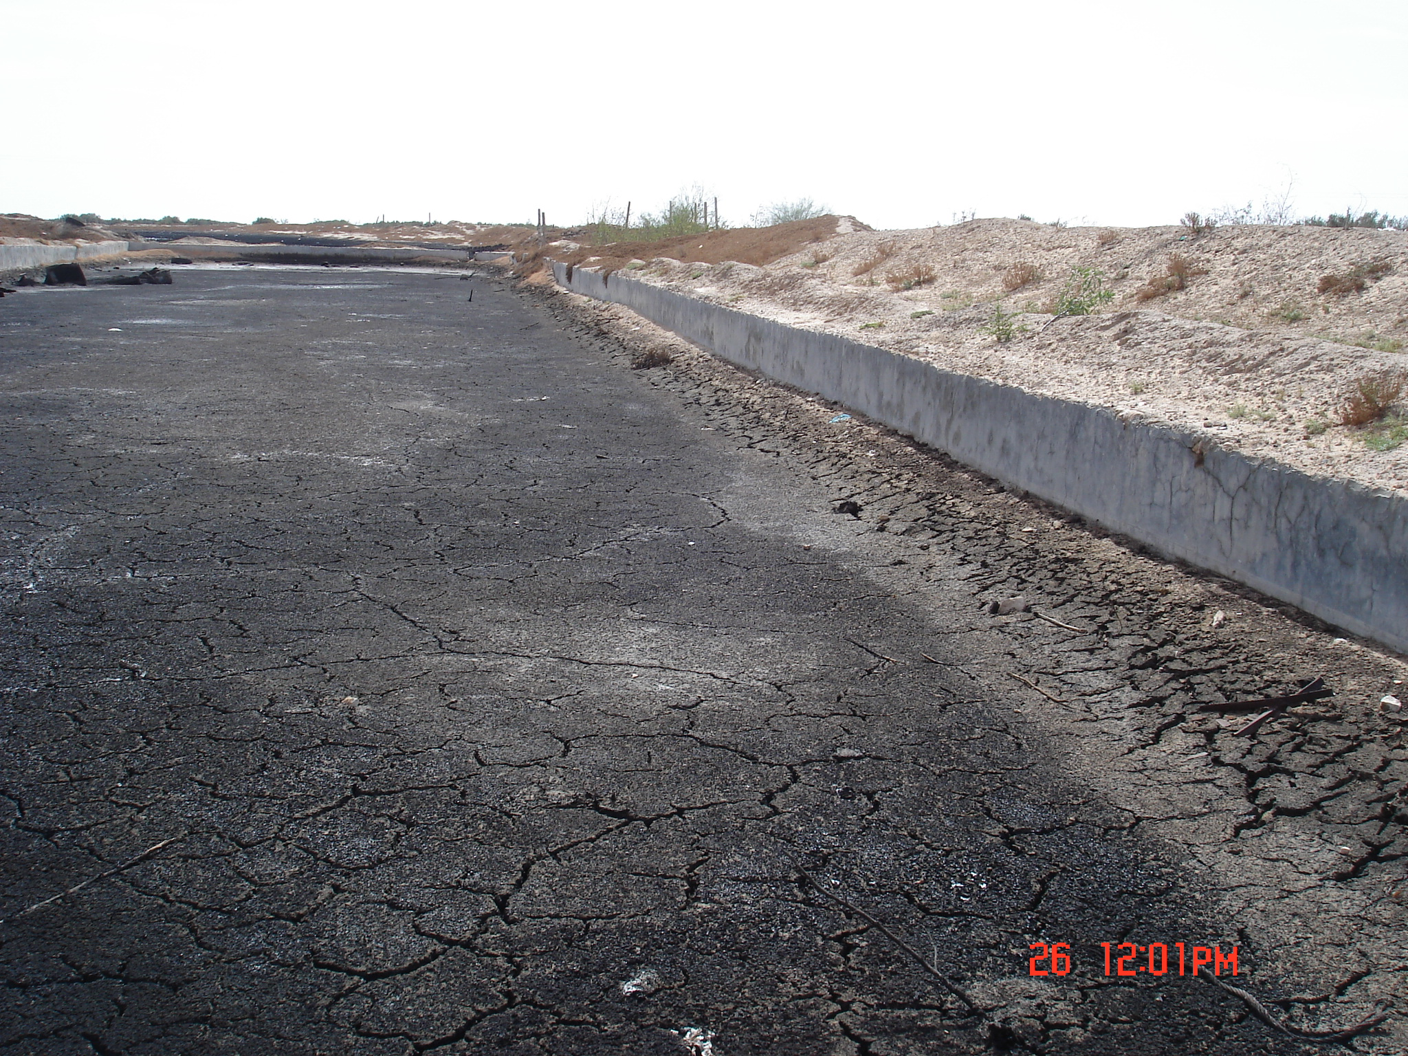
Évaluation des aspects techniques et financiers actuels en matière de gestion des margines en Tunisie
^{PHOTO}
Storage pond

Slide 12
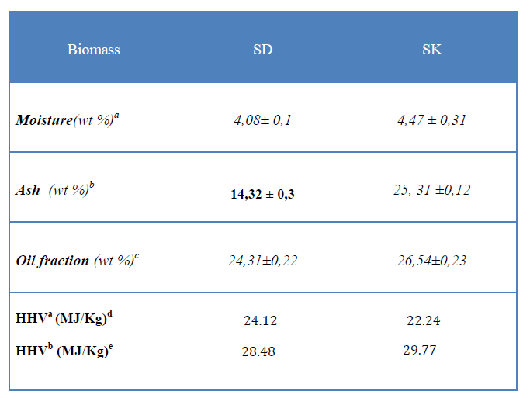
Proximate Analysis of olive mill wastewater Sludge

Slide 13
Fast Pyrolysis of OMWS
"Biofuel"

Slide 14
Biomass Fast Pyrolysis
Fast Pyrolysis
T°:400-600 °C, HR: 1000°C/s, RT: 1-5s
Biochar
Bio-oil
Gas
(CO, H₂ , C_{x}H_{y})
Fuel
&
Activation
Liquid
Biodiesel
Bio-Chemicals
Combustion

Slide 15
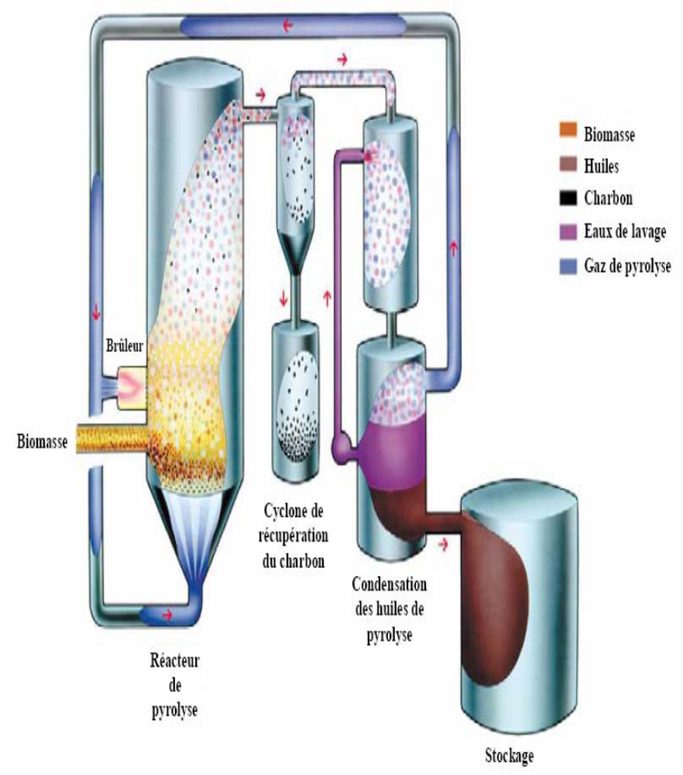
General design of fast pyrolysis reactor system
A general concept of fast pyrolysis fluidized bed system includes:
Feed preparation section
Fast pyrolysis reactor (of any type)
Cleaning system (cyclone and recycling line)
Oil recovery condenser

Slide 16
Operating Conditions
Fast (flash) pyrolysis refers to pyrolysis at temperatures of about 500 °C, with very high heating rates (1000 °C/s or more) and a short pyrolytic vapors residence time (less than 2 s).
Bio-oil is the preferred product of the fast pyrolysis process. It consists of a complex mixtures of compounds derived from the depolymerization of cellulose, hemicelluloses and lignin.
Chemically, they comprise of water, solid particles and hundreds of organic compounds that belong to acids, alcohols, ketones, aldehydes, phenols, ethers, esters, sugars, furans, nitrogen compounds and multifunctional compounds [Milna TA and al.1997].
Liquid phase (bio-oil) yield ranges from 50 to 70%). It has a great potential for use as fuel oil in industry, as transport fuel or as source of valuable chemicals.

Slide 17
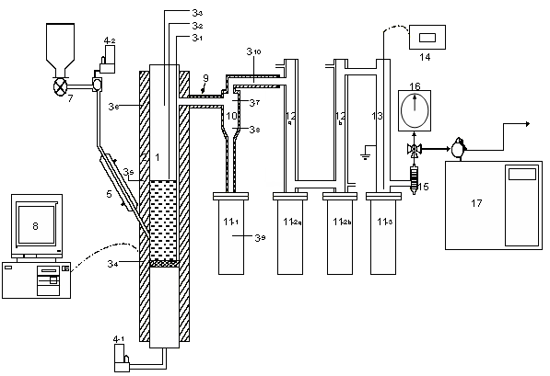
Biomass Fast Pyrolysis Unit
(at Utah University, USA)
1- Fluidized bed reactor,
2- Furnace
3- Thermocouple,
4- Mass flow controller,
5- Jacketed air-cooled feeder tube,
6- Hopper,
7- Screw feeder,
8- Computer,
9- Heating tape,
10- Hot gas filter,
11- Reservoir,
12- Condenser,
13- ESP,
14- AC power supply,
15- Filter,
16- Wet gas meter,
17- Gas chromatograph

Slide 18
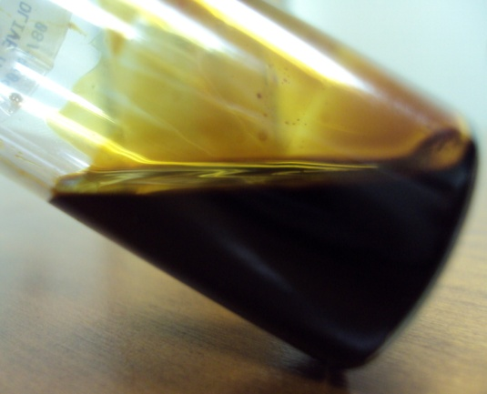
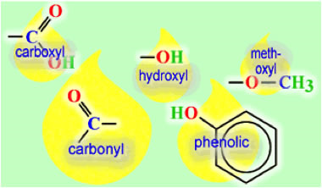
OMWS Bio-Oil
The bio-oil from non-catalytic fast pyrolysis is a strong smell dark-brown and neutral fluid (pH=6) with relatively high dynamic viscosity (20cP @40C), low moisture content (0.5 wt%), low density (0.92 g/cm³) and high HHV (39 MJ/kg) with a relatively high yield (49-50%).
- Analysis: FTIR, ₁₃C-NMR, ₁H-NMR, GC-MS, TG-DTG of Bio-oil were performed to determine its chemical composition (carbonyl, carboxyl, hydroxyl and polyphenolic functional groups, were identified).

Slide 19
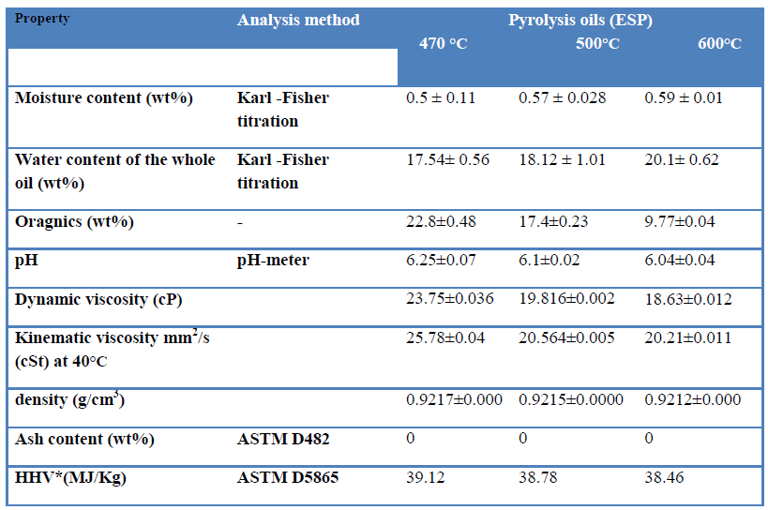
Non-Catalytic Bio-oil Properties

Slide 20
Comparison between
OMWWS bio-oils and diesel properties
Properties | units | Bio-oil | Diesel
Moisture | wt% | 0.5 | 0
Density at 20°C |  | 0.92 | 0.83-0.86
Dynamic viscosity at 20°C | cP | 18-24 | 1.5-6
Flash point | °C | nd | 35-60
Net heating value | MJ/kg | 39 | 42
18-24
The produced bio-oil can be considered a promising fuel oil with its high HHV and Low Moisture.

Slide 21
Catalytic Fast Pyrolysis of OMWS

Slide 22
Advantages of Catalysts
Catalysis has been used to upgrade the primary pyrolysis products to higher quality and higher value fuels and chemicals
Enhances favorable reactions and inhibits the unfavorable ones,
Can be also used for secondary pyrolysis products to increase the suitability and compatibility of bio-oils with petroleum feedstocks (by deoxygenating functionalities such as, guaiacyl and syringyl groups, carbohydrates, ketones, carboxylic acids phenolic and aldehydes, into hydrocarbon fractions),
Catalytic pyrolysis of biomass is the analogous to "Fluid Catalytic Craking" (FCC) used in petroleum refinery.
Red mud is used as catalyst in this work.

Slide 23
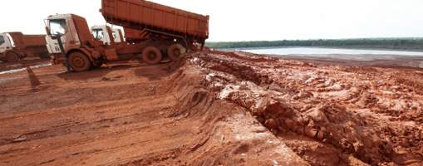
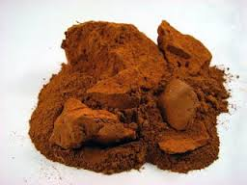
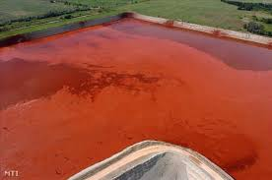
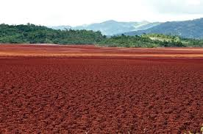
Red mud from pollutant to Catalyst

Slide 24
Pyrolysis products yields for red mud and silica sand pyrolysis media
Pyrolysis medium | Sand |  |  | Red mud
Pyrolysis temp (ºC) | 400 | 450 | 500 | 400 | 450 | 500
Organic liquid (%) | 33.1±0.5 | 37.47±1.4 | 30.4±1.9 | 34.6±2.6 | 29.8±1.4 | 29.5±0.4
Pyrolytic water (%) | 8.8±1.9 | 7.93±1.8 | 8.8±0.1 | 11.3±1.8 | 17.6±1.5 | 11.8±0.9
Total liquid (%) | 42.3±2 | 45.4±0.4 | 39.4±1.8 | 45.9±4.4 | 47.4±0.1 | 42.3±1.3
Char/coke (%) | 31.7±2.3 | 25.7±0.3 | 24.4±0.2 | 29.1±1.8 | 22.7±0.2 | 20.4±0.4
Gas (%) | 26.0±3.7 | 29.3±1.0 | 36.2±1.6 | 24.3±2.6 | 30.0±0.04 | 37.3±1.7

Slide 25
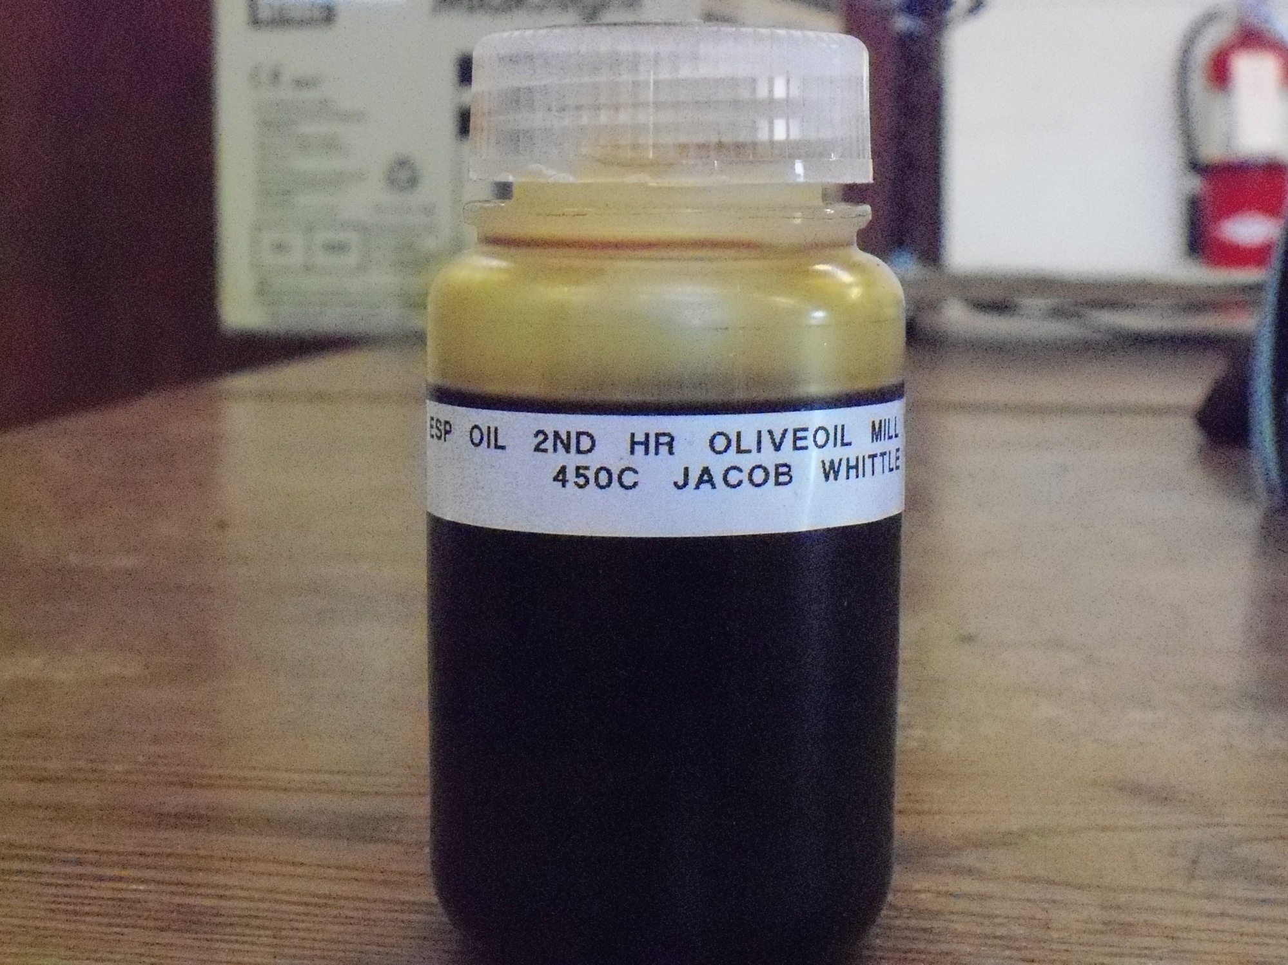
Catalytic Bio-oil Properties

Slide 26
Properties of silica sand and red mud OMWS pyrolysis oils
Pyrolysis medium | Silica sand |  |  | Red mud
Pyrolysis temp (ºC) | 400 | 450 | 500 | 400 | 450 | 500
pH | 6.5 | 6.25 | 6.4 | 7.1 | 7.3 | 7.4
Dynamic viscosity (cP) | 42.9 | 42.9 | 28.0 | 9.2 | 5.4 | 4.6
Density (g/cm³) |  | 0.92 | 0.92 | 0.91 | 0.91 | 0.90
HHV (MJ/kg) |  | 37.5 | 38.8 | 39.5 | 40.4 | 41.3
Carbon (mass%) | 77.19 | 76.67 | 78.19 | 80.30 | 83.39 | 82.40
Hydrogen (mass%) | 11.81 | 11.78 | 11.83 | 11.30 | 11.45 | 11.00
Nitrogen (mass%) | 2.84 | 2.74 | 2.75 | 2.50 | 2.13 | 2.50
Oxygen (%)* | 8.16 | 8.82 | 7.23 | 5.90 | 3.03 | 4.00
Sulfur (mass%) | 0.00 | 0.00 | 0.00 | 0.00 | 0.00 | 0.00
Ash (mass%) | 0.00 | 0.00 | 0.00 | 0.00 | 0.00 | 0.00
Moisture (mass%) |  |  |  |  | 0.2

Slide 27
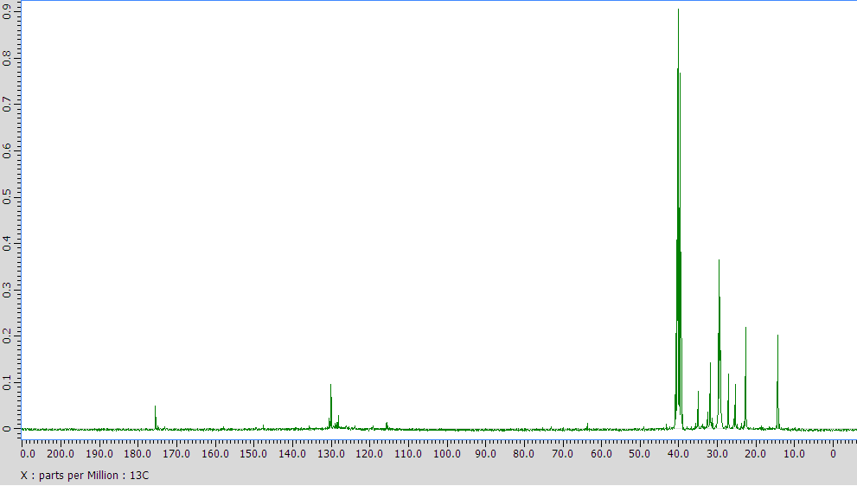
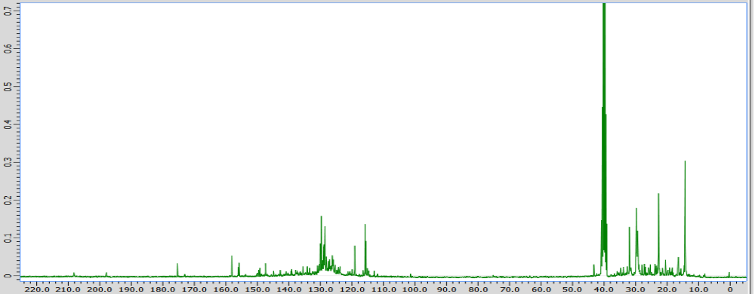
¹³CNMR showing predominance of aliphatic hydrocarbons in oils
Sand 450 °C
C in aromatic rings, C=C (in alkenes)
R₃CH, CH₃CO-
R₂CH₂, RCH₃
Red mud 450 °C

Slide 28
Composition of pyrolysis gases generated from sand and red mud
OMWS pyrolysis at various temperatures (mass%)
Pyrolysis media | Silica sand |  |  | Red mud
Pyrolysis temp (ºC) | 400 | 450 | 500 | 400 | 450 | 500
H₂ | 0.45±0.03 | 0.8±0.1 | 1.1±0.1 | 2.15±0.03 | 3.8±0.3 | 3.88±0.1
CO | 4.7±0.1 | 6.3±0.4 | 6.0±0.6 | 5.9±0.2 | 7.3±0.01 | 10.9±0.9
CO₂ | 81.1±2.6 | 76.6±1.4 | 74.6±0.7 | 78.5±0.1 | 72.5±0.9 | 65.2±1.5
CH₄ | 1.5±0.4 | 2.1±0.2 | 2.6±0.2 | 1.6±0.2 | 2.6±0.1 | 3.8±0.04
C₂-C₅ | 10.5±1.9 | 11.5±1.5 | 13.3±0.8 | 10.0±1.1 | 10.8±0.9 | 13.6±0.9
Other hydrocarbons | 1.9±0.5 | 2.8±0.2 | 2.5±0.5 | 1.9±0.3 | 2.9±0.6 | 2.6±0.5
CO/CO₂ (mass/mass) | 0.06 | 0.08±0.01 | 0.09 | 0.08±0.00 | 0.10±0.00 | 0.17±0.02

Slide 29
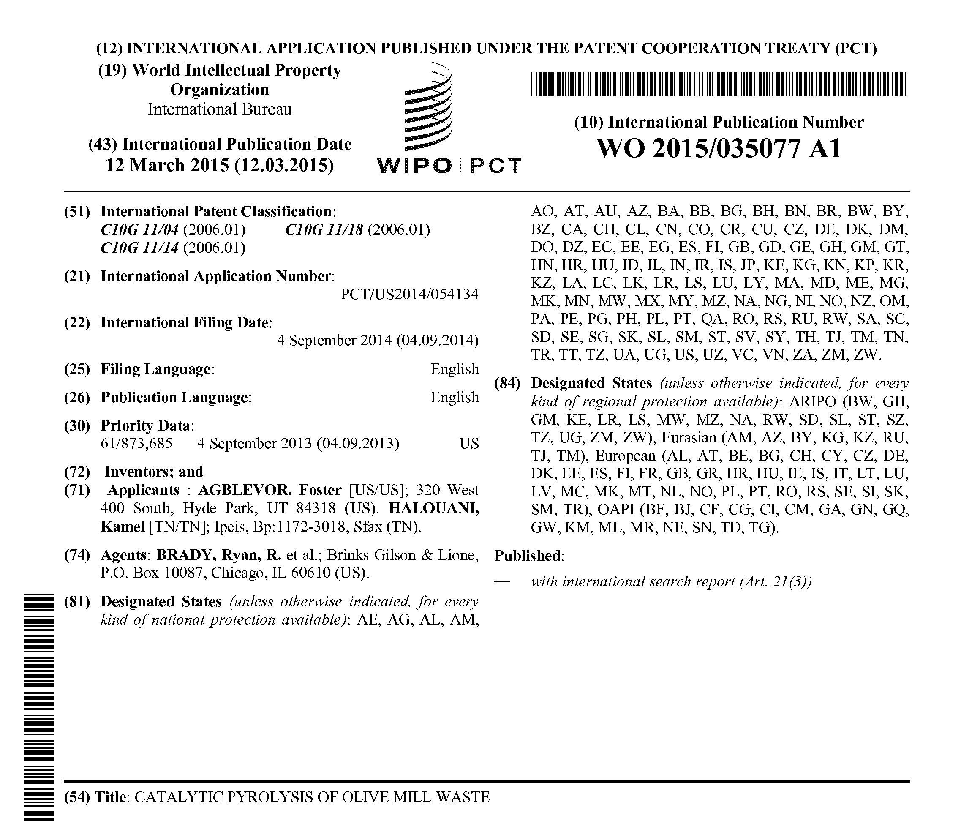

Slide 30
We look for partnership to build a Pilot Plant
“Green Diesel” from OWMS
Olive oil Industry
Bauxite Industry
OMWS
Red mud
Catalytic Pyrolysis
in Fluidized Bed Reactor
Gas
H₂, CO, CH₄, CO₂
Green
Diesel
Fuel
Char
Fertiliser

Slide 31
Pilot Plant Project
“Green Diesel” from OWMS
Initial Processing capacity : 20 OWMS ton/day
Yield : 1,750,000 litres of green diesel
Additional products : biochar and hydrogen
Market Potential:
Sfax region “green” diesel potential ~17 million liters (4.6 million gal) per year
Total Tunisia market “green diesel” potential – 38 million liters (10 million gallons) of olive waste “green” diesel per year

Slide 32
Thanks for Attention
Pr. Foster Agblevor,
Biological Engineering, USTAR BioEnergy Center, Biological Engineering, Utah State University, Logan, UT
Phone: +01-435-797-9268
E-mail: Foster.agblevor@usu.edu
Pr. Kamel Halouani,
National Engineering School of Sfax, University of fax,Tunisia
Phone: +216-98-954-415
E-mail: Kamel.halouani@ipeis.rnu.tn

