Slide 1
Metabolomics Study of Human Seminal Plasma of Infertile Men
Kambiz Gilany, PhD
Associate Professor
Avicenna Research Institute
Avicenna Infertility Clinic
Systems Proteomics Lab
Metabolomics Congress 2017, Singapore, 8-10 May

Slide 2
Introduction

Slide 3
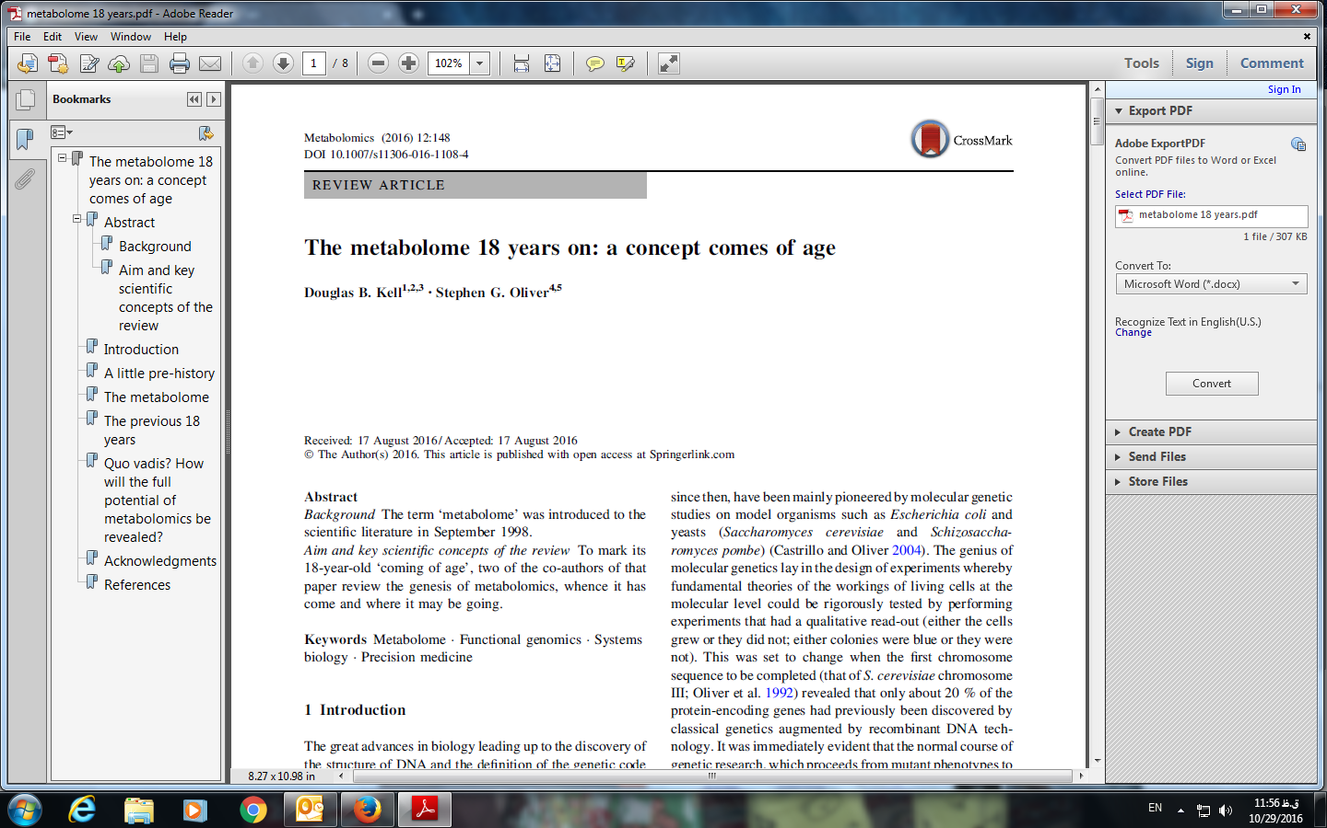
Metabolome becoming 20 years

Slide 4

Metabolomics has a long road behind
Approximately 1,000 years ago, the Persian physician Avicenna observed that an individual’s urine changes during illness. In modern times, changes in the smell or color of urine are known to be related to changes in the concentration of chemical components and dysregulation of biochemical pathways that indicate certain metabolic diseases.

Slide 5
Metabolomics

Slide 6
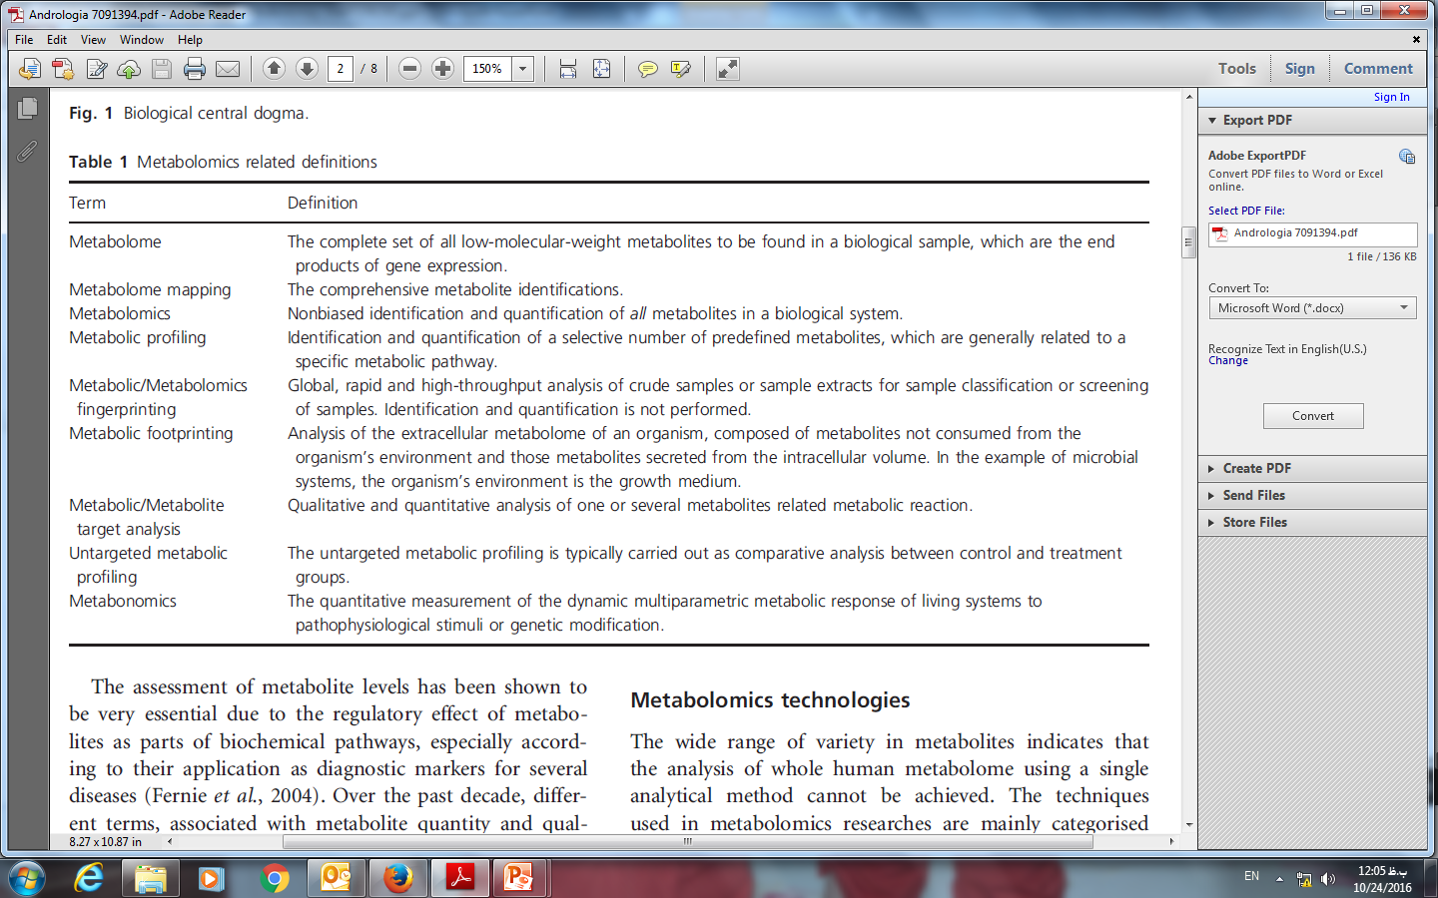
Classification of metabolomics

Slide 7
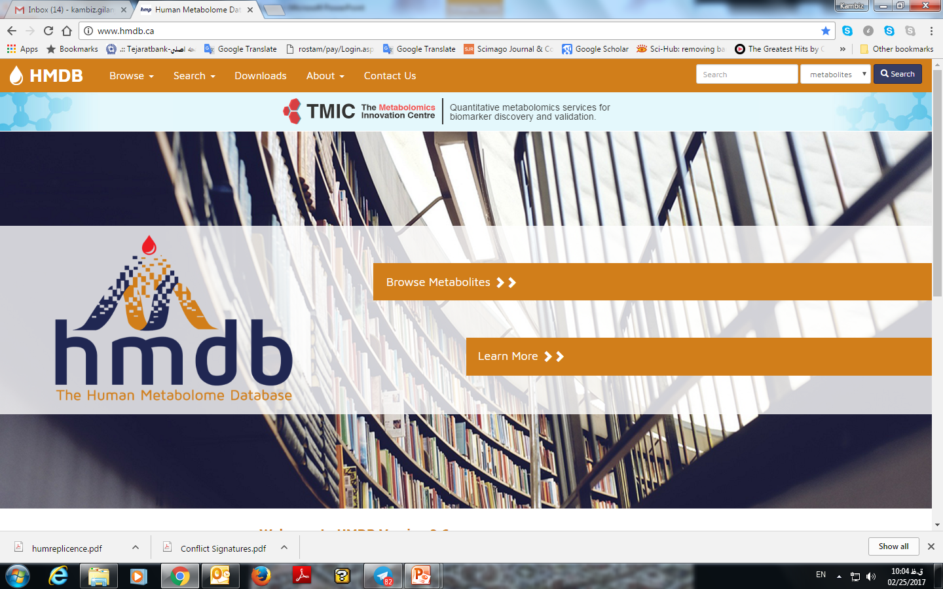
Human Metabolome Database (HMDB) >40,000 metabolites

Slide 8

LOVE
What does have to do with Metabolomics?

Slide 9


Infertile Couples
WHO: 1 year intercourse NO baby ☹
15-20% couples are infertile
It is distribute equally on couples:
  10% women
  10 % men

Slide 10
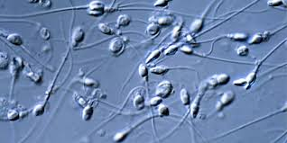
Semen analysis
Classical parameter for analysis of semen:
  Parameter for Sperm :
    Motility
    Morphology
    Concentration/Count
  Non classic parameter:
    pH, Volume, Viscosity, Liquefaction
  Parameter for Seminal Plasma:
    NON !!!

Slide 11
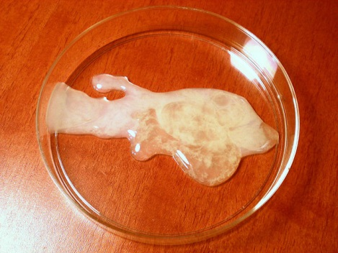
Seminal Plasma Content
Genome
Transcriptome
Proteome
Metabolome

Slide 12
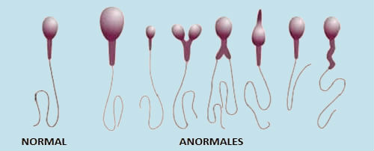
Some types of Infertile men
Idiopathic/Unexplained infertile men
Asthenozoospermia
  slow motility
Teratozoospermia
  abnormal morphology
Oligoasthenozoospermia
  low sperm count and slow motility
Azoospermia:
  Non-obstructive azoospermia:
    Positive TESE (few sperm in testis)
    Negative TESE (No sperm at all)
  Obstructive azoospermia
…

Slide 13
Our Metabolomics Approaches
Metabolomics different studies “still”:
  Metabolic Fingerprinting
  Metabolic Profiling
    Untargeted Metabolic Profiling
    Targeted Metabolic Profiling
  …

Slide 14
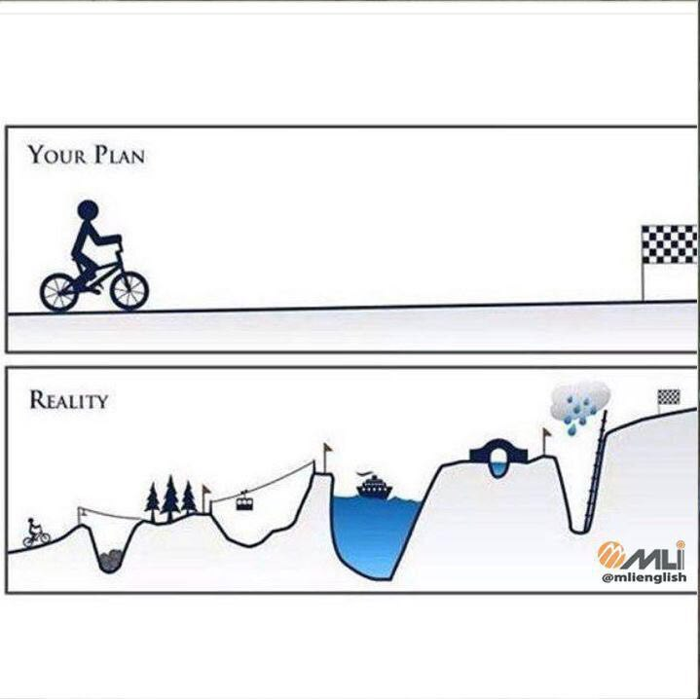
Metabolomics is a
Team Work
Sample preparation
Instrumentation
Data Analysis
Interpretation

Slide 15

Sample preparation is the key to success
KISS!
(Keep It Simple S……)
Extract
the metabolome!!!

Slide 16
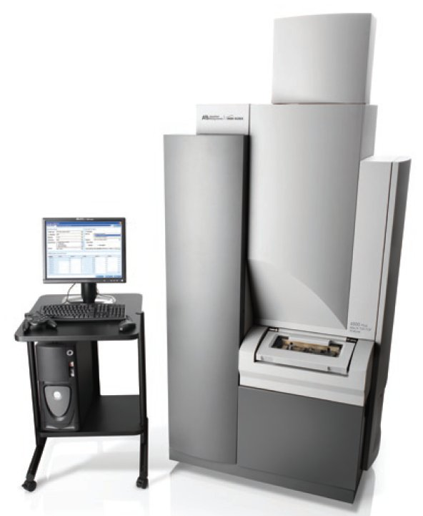
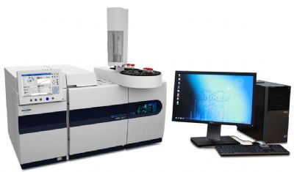
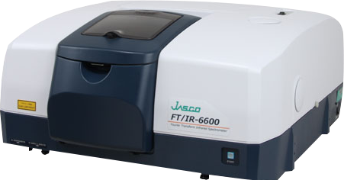
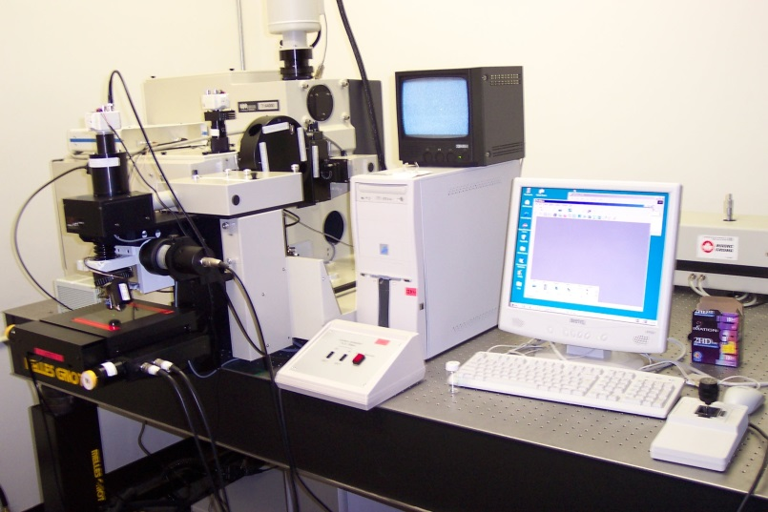
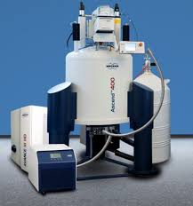
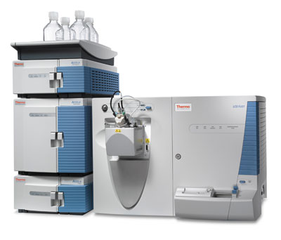
Instrumentations for metabolomics studies
MALDI-TOF/TOF-MS
GC-MS/MS
FT-IR
Raman
NMR
LC-MS/MS

Slide 17

Data Analysis and Interpretation

Slide 18
Results

Slide 19
Idiopathic/Unexplained infertile men

Slide 20
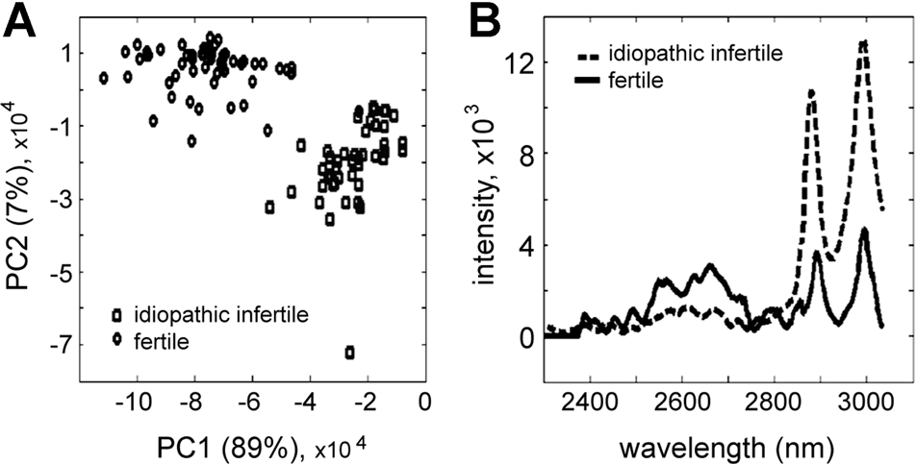
Metabolic fingerprinting of seminal plasma of idiopathic infertile men
ROS

Slide 21
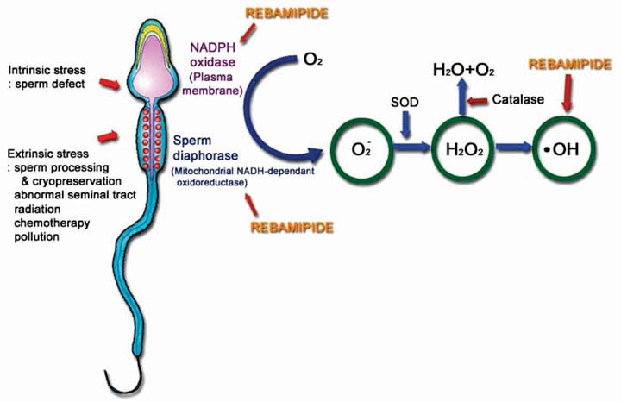
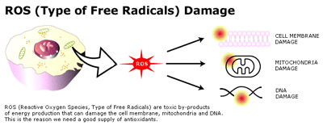
ROS toxic

Slide 22
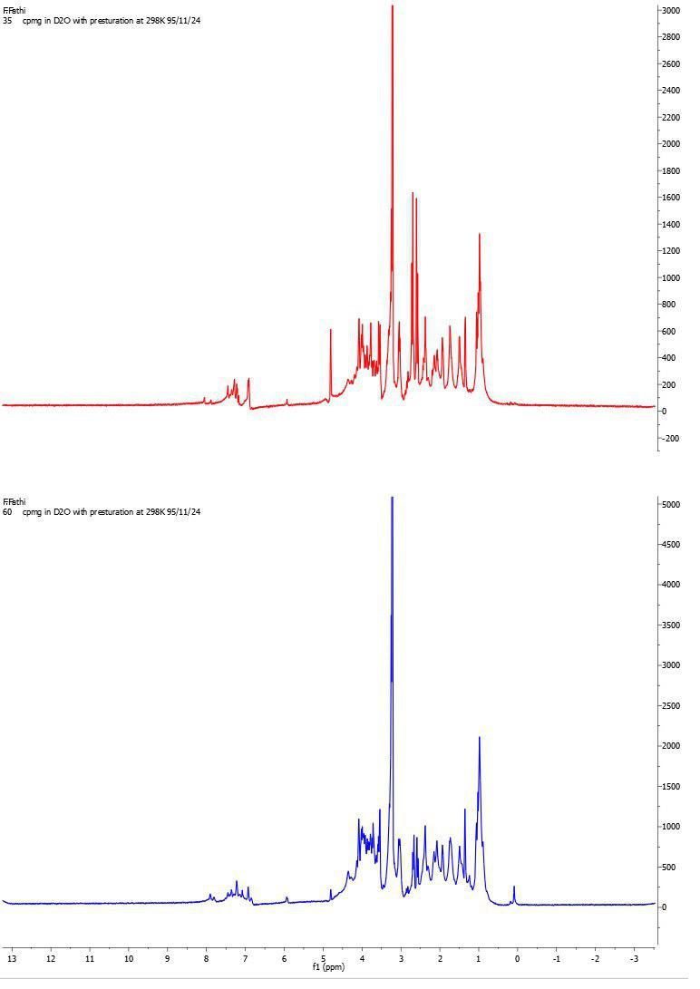
Primarily Result:
ROS level and metabolome by 1H-NMR
ROS > 60 RLU
(High)
ROS < 20 RLU
(Low)
p.p.m | Increase Fold Change (L/H) | Metabolite
7.83 | 3.35
7.07 | 2.14
7.09 | 1.98
3.23 | 1.5
p.p.m | Increase Fold Change (H/L) | Metabolite
7.19 | 1.63
7.27 | 1.68
2D-NMR!
2D-NMR!

Slide 23
Asthenozoospermia

Slide 24
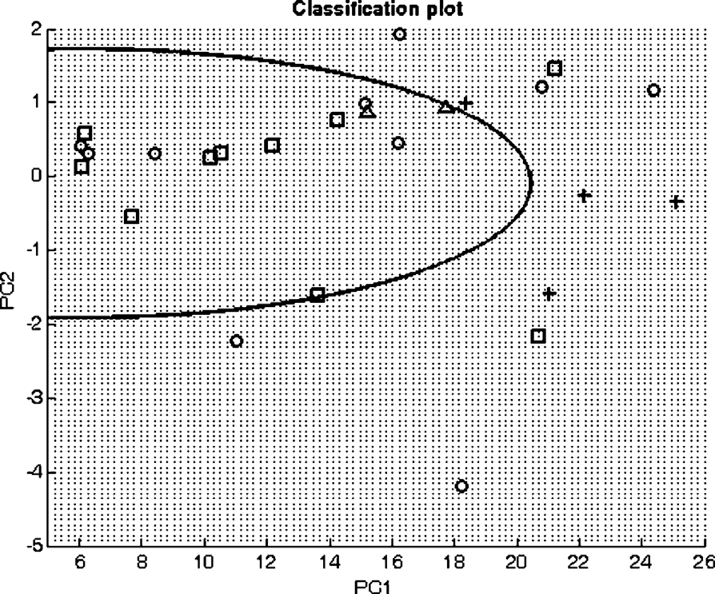
Metabolic fingerprinting:
Asthenozoospermia (slow motility)
(+: Fertile; : Astheno)

Slide 25
Non-obstructive azoospermia

Slide 26
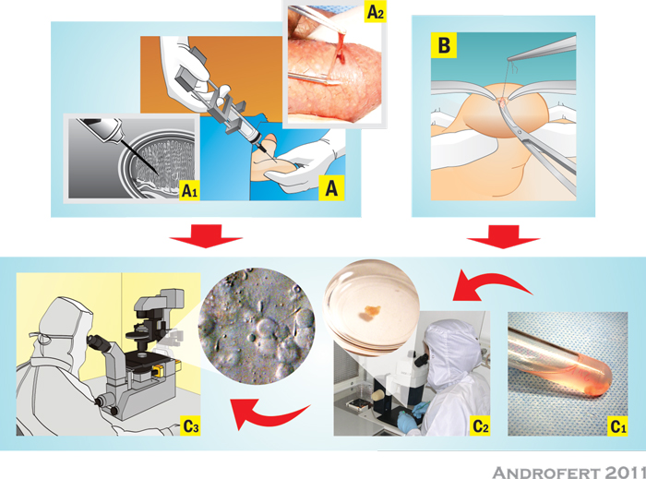
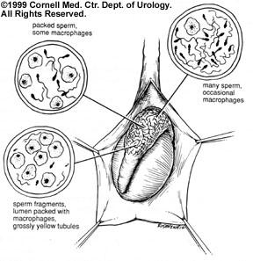
Non-obstructive azoospermia: positive TESE versus negative TESE

Slide 27
Metabolic fingerprinting

Slide 28
Seminal Plasma from Non-obstructive Azoospermia (TESE(+) versus TESE(-))

Slide 29
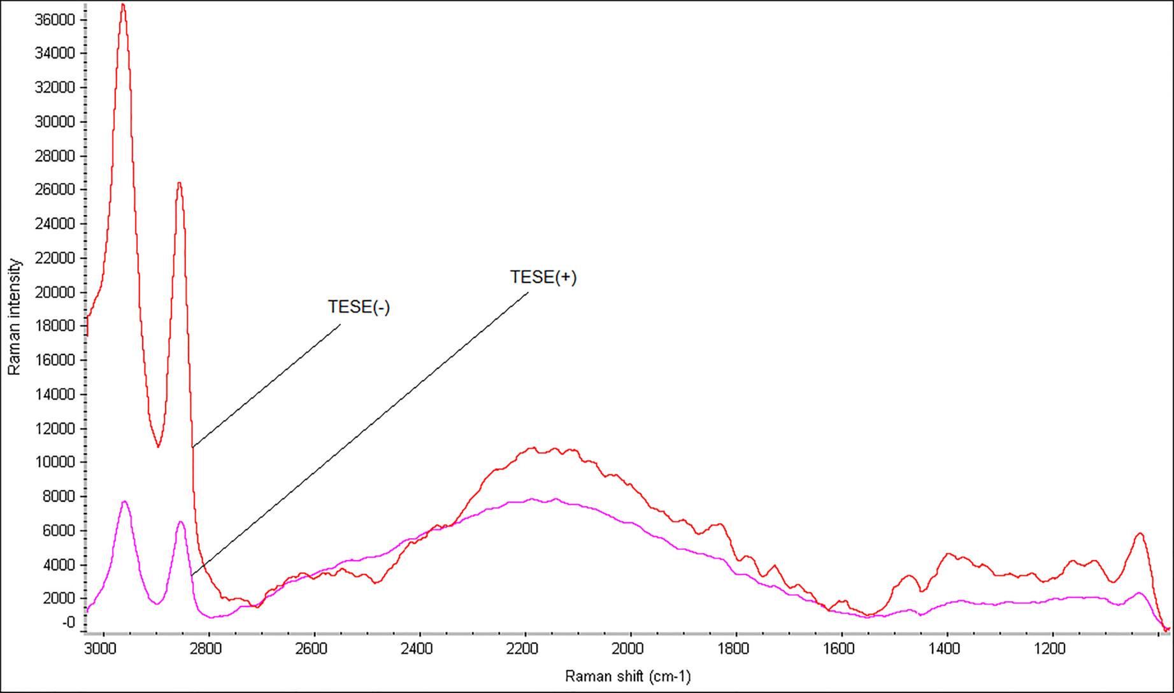
Non-Obstructive Azoospermia:
Oxidative imbalance

Slide 30
Untargeted Metabolic Profiling

Slide 31
Seminal Plasma of Fertile, TESE(+) and TESE(-) (GCMSMS)

Slide 32
Non-obstructive azoospermia
F: Fertile; AZP: TESE(+); AZN: TESE(-)

Slide 33
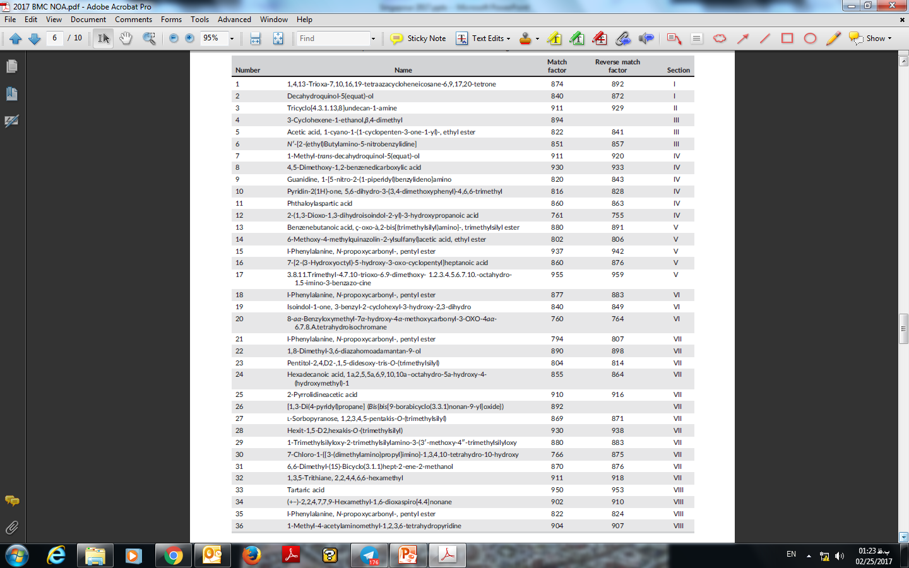
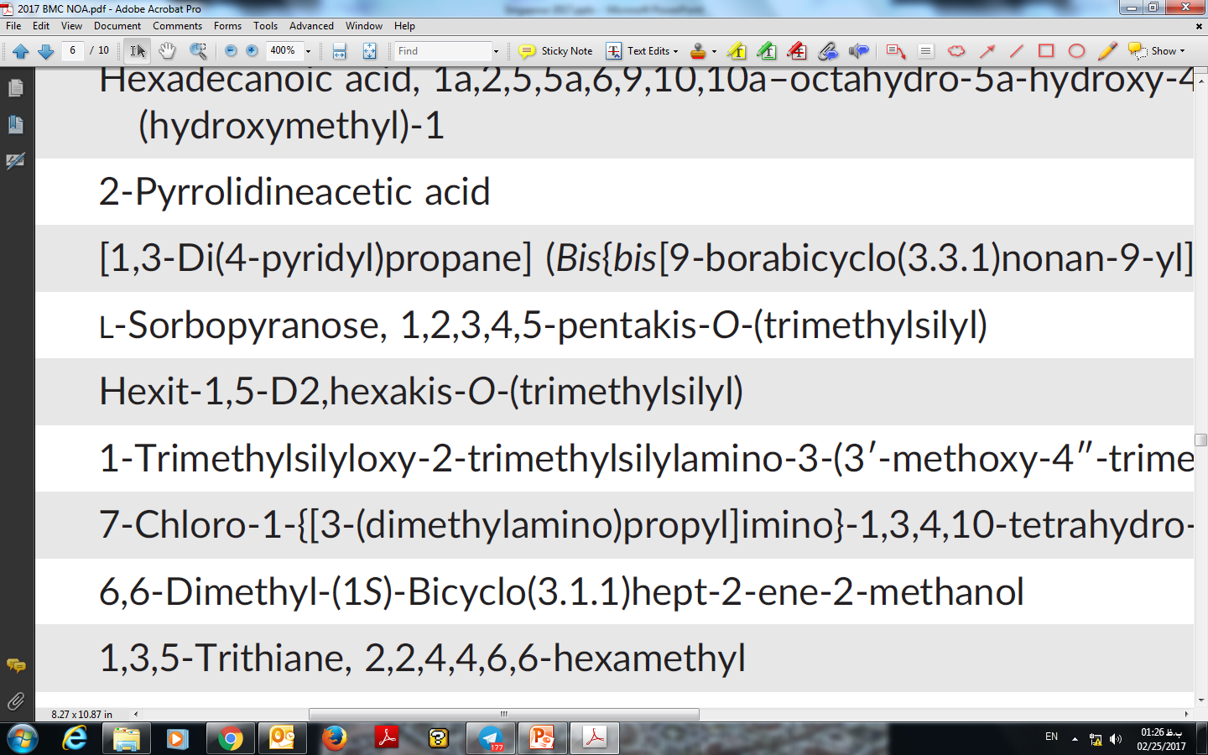
Non-obstructive azoospermia
(36 potential biomarkers)
Sorbose

Slide 34
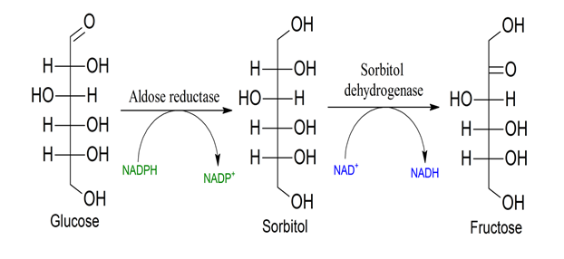
Integrating Proteomics and Metabolomics Data in TESE(-):
Polyol pathway (PMID:22188163 and PMID: 28058728)
Proteomics (Batruch et al. 2012) : Upregulated
Metabolomics (Our Study):
Upregulated
Sorbose
NAD+ or NADP+ level?

Slide 35
Future Work

Slide 36
Systems Proteomics:
Male infertility and Precision Medicine
Antioxidant Therapy
Asthenozoospermia (sperm slow motion)
Transcriptome
(Targeted)
Proteome
Metabolome
System Biology
(11 unique genes not explored)
Treatment!
Sperm Proteome
(~6500 proteins)

Slide 37
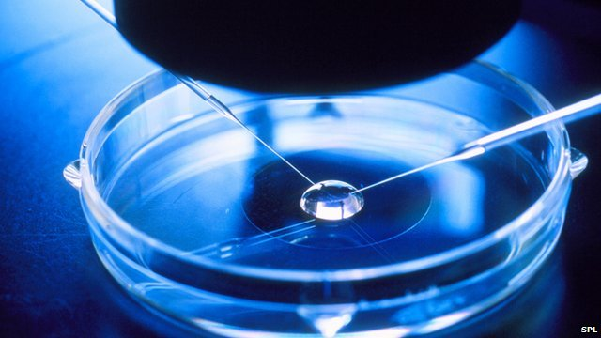
Metabolomics: IVF media & MALDI
Media

Slide 38
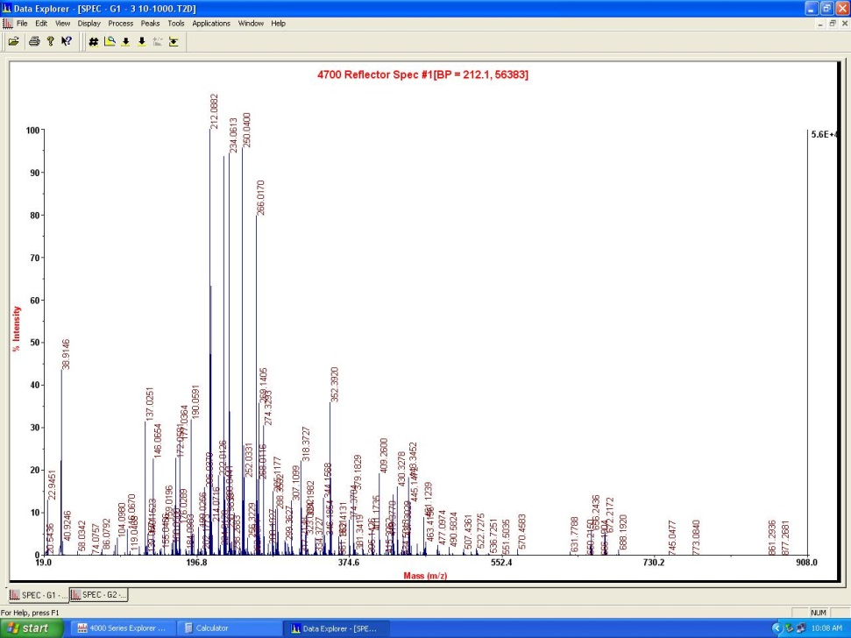
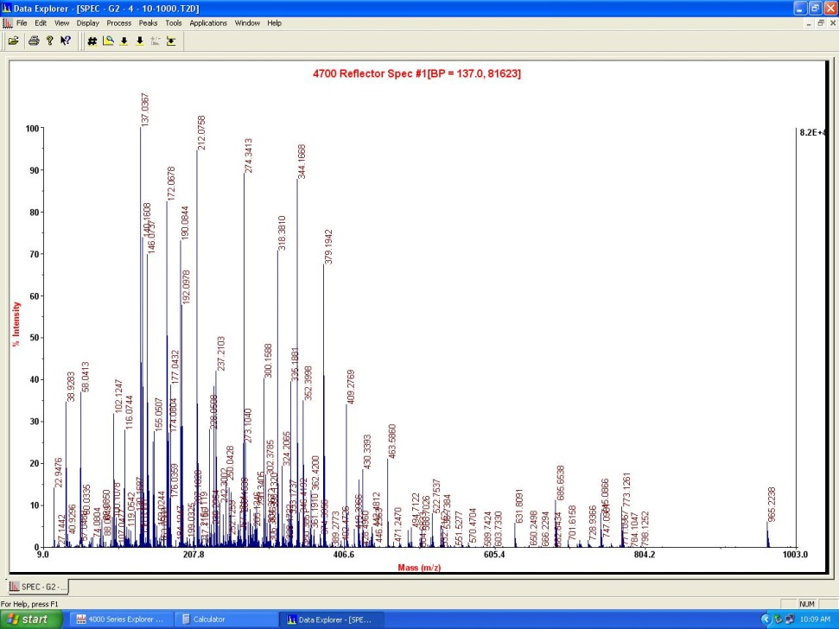
Pilot study of IVF media from Day 3 and 5
Day 3
Day 5

Slide 39
Primarily result: Untargeted metabolic profiling of serum from endometriosis (“ovarian cancer”) patients

Slide 40
Conclusion

Slide 41
Metabolic fingerprinting can be use a potential diagnosis tool for infertile men and detection of spermatogenesis
However …
  Bioinformatics is lacking behind …
  Because it is a “quit” new omics a lot of physician are not familiar with the technology
  It will take a few years to introduce the technology in the practical clinic …
  In Iran, the first Metabolomics Research Center is just established.

Slide 42
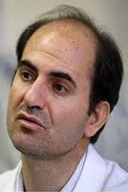
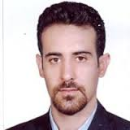
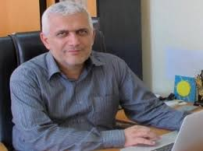



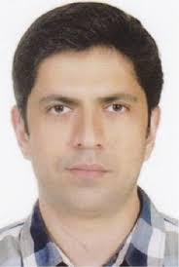
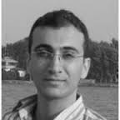

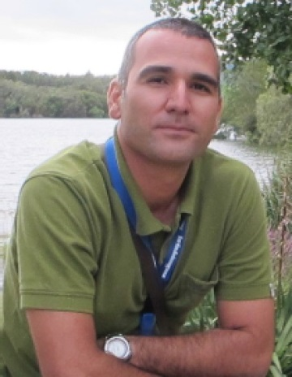


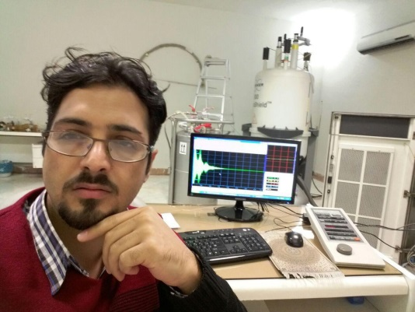
Colleagues

Slide 43

Thank you for your time …

