Slide 1
Genetic Toxicology Screening Assays
Kamala Pant, M.S.
BioReliance
Study Director/Principal Scientist

Slide 2
Topics for Discussion
Rational for performing screening assays
Different screening assays
  design
  method
  evaluation criteria
  advantages and limitations (if any)
  Bacterial mutation screens (Ames assay)
  In vitro chromosome aberration screens
  In vitro micronucleus screens

Slide 3
Screening Assays –
Rationale for Early Evaluation
Chemicals with positive mutagenicity results are frequently dropped from development
  positive results require disclosure/consent in clinical trials, unfavorable labeling, and may result in diminished market potential
Pre-screening in drug discovery/lead optimization can weed out “bad actors”
  focus time and resources on most promising candidates
Facilitate efficient planning for follow-up testing
Screening or miniaturized GLP assays can be performed with impurities when test article amount is a limiting factor.
3
Notes:
3

Slide 4
Screening Assays –
Discovery/Lead Optimization
Non-GLP Screening assays used at early stages to select candidates for further development
Advantages
  low(er) cost
  quick turn-around time
  minimal test article requirements
  can be highly predictive
Customize design based on available sample
HOWEVER, design should mimic the ultimate GLP/regulatory study as closely as possible for best predictive value
4
Notes:
4

Slide 5
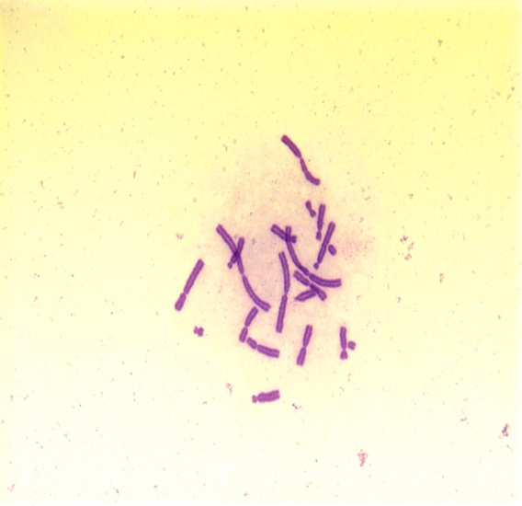
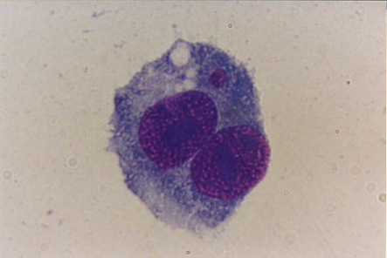
Screening Assays –
Types
Miniaturized “standard assays”
  predict GLP/regulatory results
Bacterial mutation Assays
(Ames and Ames II)
In Vitro Chromosome Aberrations
In Vitro Micronucleus
5

Slide 6
Bacterial Reverse Mutation
(Ames) Screens

Slide 7
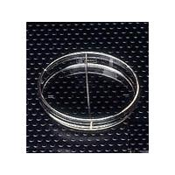
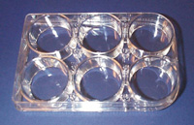
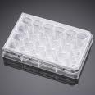
Ames Screens –
Variations
Abbreviated standard assay
  100-mm plates
Multi-well modifications
  mini-Ames (6-well plating)
  micro-Ames (24-well plating)
Liquid micro-plate method (standard and/or Ames II strains)

Slide 8
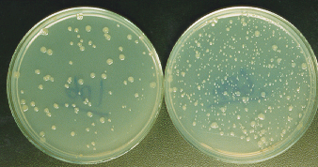
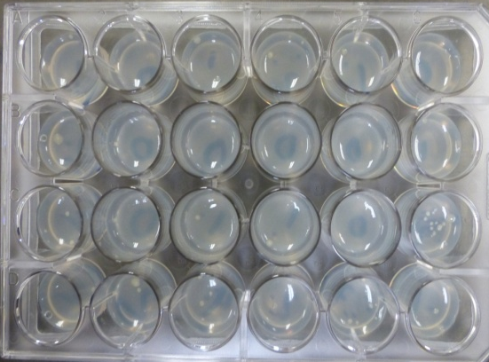
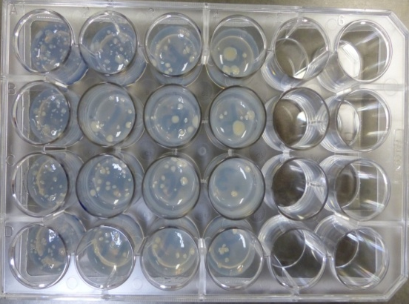
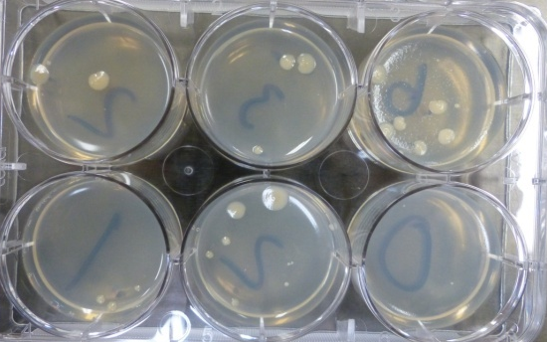
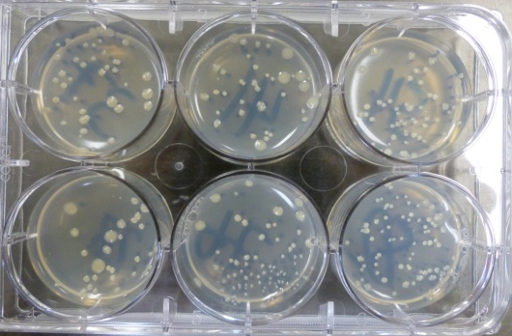
Ames Screens –
Abbreviated Standard Assay
Minimally use TA98 and TA100
  detect ~ 93% of positive compounds
Substitute or add strains as needed
±S9
8 dose levels at 1.50 to 5000 µg/plate
  proportionately reduced in 6- and 24-well plates
Requires 90, 18 or 5 mg, respectively (as compared to 900 mg for GLP assay)
Plate incorporation or preincubation method
TA100

Slide 9
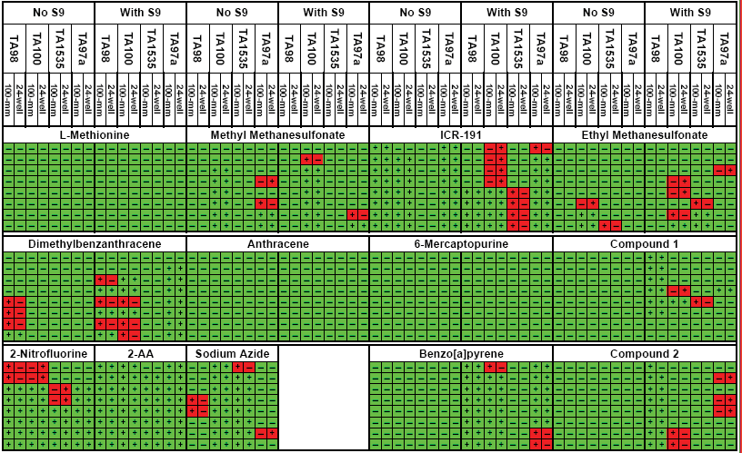
Ames Screens –
Micro vs. Standard
From: Sawant et al. (2008), Work done at BioReliance
Concordant results
Discordant results

Slide 10
Ames Screens –
Pros/Cons
Mini- and micro-Ames screens are essentially equivalent to standard 100-mm plate assay
100% compound to compound concordance (+/–)
93% concentration to concentration concordance
Uses same tester strains as regulatory version
  can be justified to address ICH M7 requirements if GLP
Significantly less test article usage
micro-Ames screen uses ~94% less test article (12.5 vs 225 mg)

Slide 11
Ames II™ Assay

Slide 12
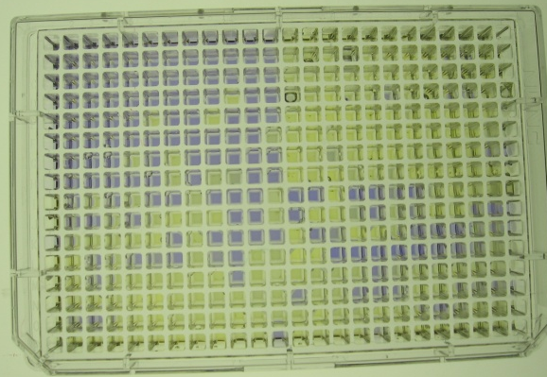
Ames Screens – Ames II™
Strains engineered for base-pair substitutions (TA7001 to TA7006)
TA98 used to detect frameshift mutagens
  kits available from Moltox
Automated plating system
6 mg test article needed

Slide 13
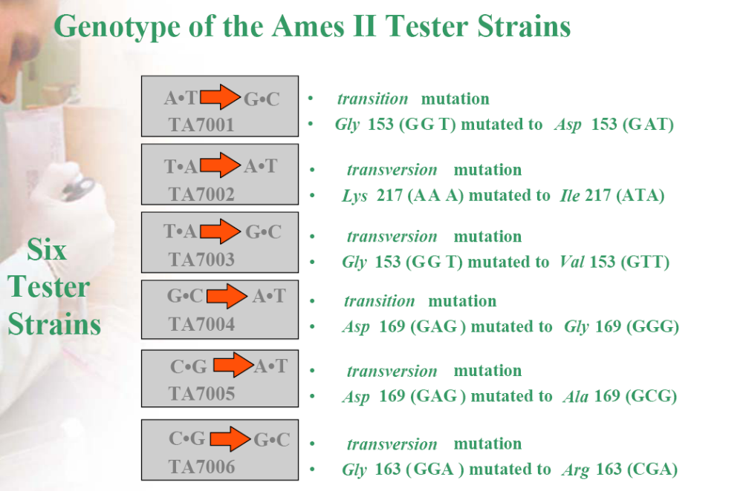
Ames Screens – Ames II™

Slide 14
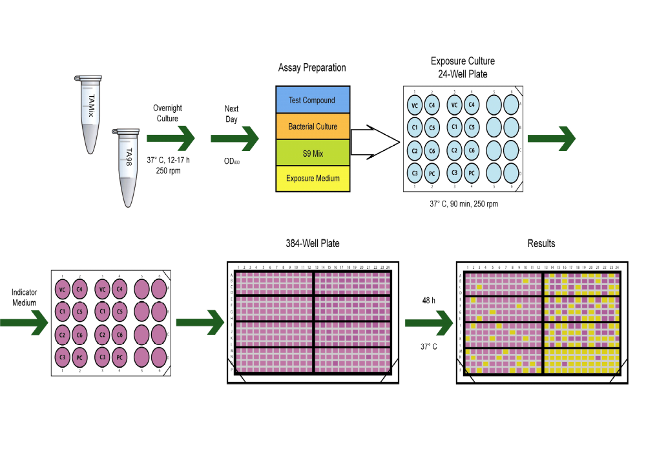
Ames Screens –
Ames II™ Method

Slide 15
In Vitro Chromosome
Aberration (CAb) Screen

Slide 16
In Vitro CAb Screen –
Design
Test systems and treatment same as GLP protocol
  CHO cell line or human peripheral blood lymphocytes (HPBLs)
  4-hour treatment +S9, 20-hour treatment –S9;
  harvest cells at 20 hours after start of treatment (~1.5 normal cell cycles)
  9-15 pre-selected concentrations (0.1 to 2000 µg/mL)
CHO metaphases collected by mitotic shake-off (enriches for metaphase cells)
Highest concentration scored based on 50-60% cytotoxicity
(RICC or MI)
Score 3 dose levels, positive and vehicle controls
  No chromosome counting, CHO cells with ~20 chromosomes scored (not 2n ± 2), 100-200 metaphases analyzed per dose
  Aberrations not classified/categorized
    Cells recorded as normal, aberrant, poly or endo

Slide 17
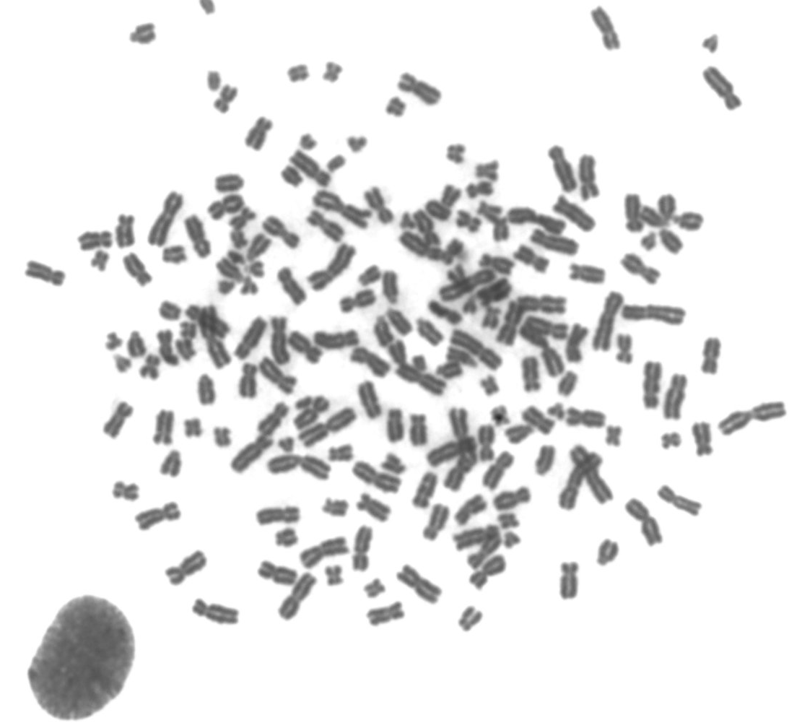
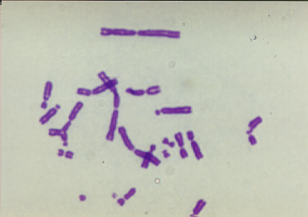
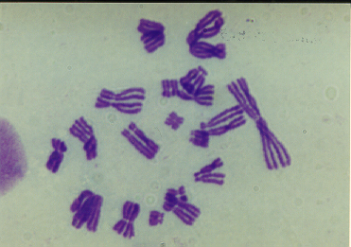
In Vitro CAb Screen –
Scoring
Break
Polyploidy
Exchange
Endo-reduplication

Slide 18
In Vitro CAb Screen –
Pros/Cons
Significantly less test article required
Fewer cells scored
  Reduced statistical power to detect weak response
May not evaluate all three treatment conditions

Slide 19
In Vitro Micronucleus (MN) Screen

Slide 20
In Vitro MN Screen –
Design
Test systems and treatment same as GLP protocol
  CHO or TK6 cell lines
  human peripheral blood lymphocytes (HPBLs)
  4-hour treatment +S9, 24-hour treatment –S9;
  harvest cells at 24 hours after start of treatment (~1.5-2 normal cell cycles)
  Cytotoxicity based on CBPI (cytokinesis blocked proliferation Index)
500-1000 binucleated cells analyzed per dose for micronuclei
Doses for scoring based on 50-60% cytotoxicity

Slide 21
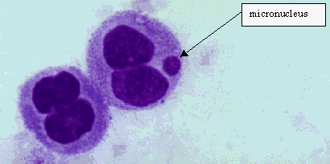
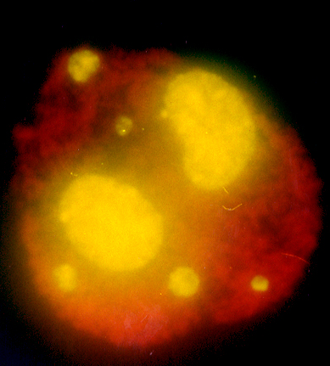
In Vitro MN Screen –
Scoring

Slide 22
In Vitro MN Screen –
1 mL vs 5 mL Validation
Performance of the micro HPBL screen is equivalent to HPBL assay
  100% compound to compound correlation
Miniaturized screen has similar sensitivity to 5 mL HPBL MN assay
  95% concentration to concentration correlation
1 mL MN screen used ~80% less test article
  60 vs 300 mg
  Work done at BioReliance.

Slide 23
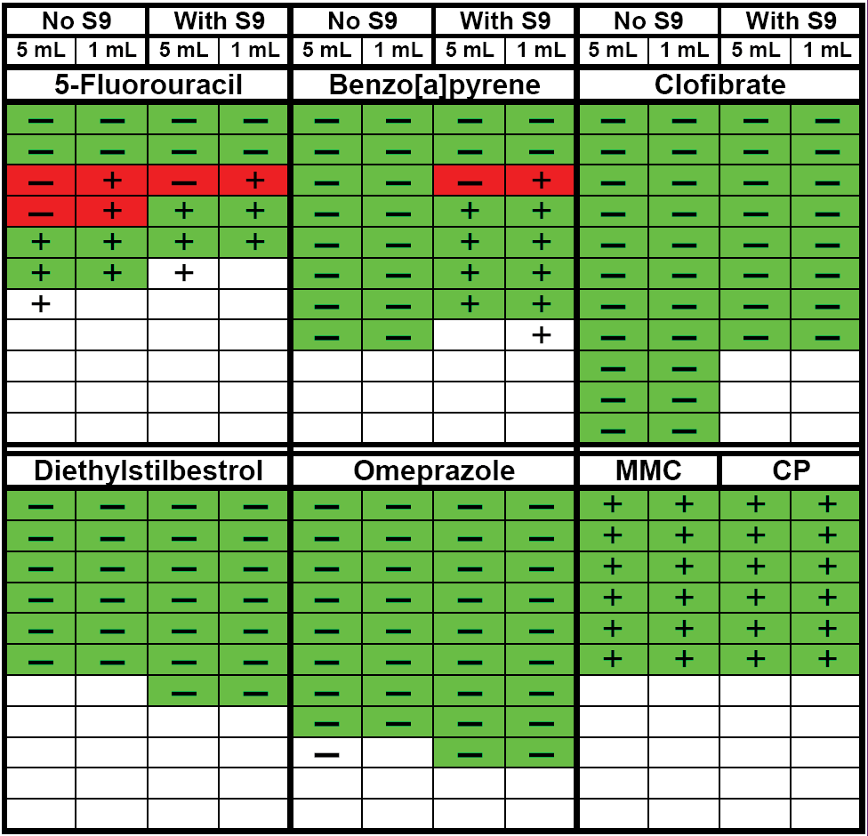
In Vitro MN Screen –
1 mL vs 5 mL Validation
Same results in both assays
Different results in both assays

Slide 24
In Vitro MN Screen –
Pros/Cons
Significantly less test article required
Fewer cells scored
  Reduced statistical power to detect weak response
May not evaluate all three treatment conditions

Slide 25
In Vitro and In Vivo Screens –
Others
Virtually any regulatory assay can be scaled down to conserve test article, time and money
  fewer dose levels, replicates, strains, animals
  fewer cells scored
CHO/HPRT
Mouse lymphoma assay
In vitro comet
In vivo micronucleus
Cell transformation

Slide 26
Conclusions
Miniaturized screens correlate well with corresponding regulatory assays
  the closer the design, the better the correlation
Miniaturized screens require substantially less test article
Earlier screening to identify genotoxic chemicals earlier in development saves valuable time and resources

Slide 27
Thank you
Any question?

