Slide 1



Effects of PCOS on Women’s Health
Effects of PCOS on Women’s Health
Dr Kalpana Dash
MD, DM ( Endocrinology & Diabetes)
India
D17.11.15/Seattle, WA, USA

Slide 2
Introduction
POLYCYSTIC OVARY SYNDROME (PCOS) is the most common endocrine disorder in reproductive age women with a prevalence of 6.1–19.9% depending on the diagnostic criteria used. Yildiz BO et al Prevalence, phenotype and cardiometabolic risk of polycystic ovary syndrome under different diagnostic criteria. Hum Reprod. 2012;27(10):3067–3073
Most common consequences of PCOS are oligo-/amenorrhea, hirsutism, and acne, several studies have revealed a broad range of other health issues such as obesity, dyslipidemia, and chronic inflammation frequently related to the syndrome. Azziz R et al. The prevalence and features of the polycystic ovary syndrome in an unselected population. J Clin Endocrinol Metab. 2004;89(6):2745–2749.

Slide 3
Women with PCOS are often insulin-resistant, and they have significantly increased risks of impaired glucose tolerance (IGT), type 2 diabetes mellitus (T2DM), and metabolic syndrome. Amsterdam ESHRE/ASRM-Sponsored 3rd PCOS. Consensus Workshop Group. Consensus on women's health aspects of polycystic ovary syndrome (PCOS). Hum Reprod. 2012;27(1):14–24.
All these conditions are known to contribute to and promote the risk of cardiovascular diseases (CVDs). Wild RA et al. Assesssment of cardiovascular risk and prevention of cardiovascular disease in women with the polycystic ovary syndrome: a consensus statement by the androgen excess and polycystic ovary syndrome (AE-PCOS) society. J Clin Endocrinol Metab. 2010;95(5):2038–2049.

Slide 4
Stein Levinthal: 1935
  They were first to recognize association of polycystic ovaries with hirsutism and signs of amenorrhea
Polycystic ovarian disease
  With successful wedge resection of ovaries in women with stein levinthal syndrome, menstrual cycle became regular and women were able to conceive.
  Primary ovarian disorder came to be known as polycystic ovarian disease

Slide 5
Polycystic ovarian syndrome
  Biochemical , clinical and endocrinological abnormalities have shown an array of clinical abnormalities known as polycystic ovarian syndrome
Syndrome O
  Its Ovarian confusion, Ovarian disruption caused by Over nourishment and Over production of insulin
However in reality :
  “Polycystic ovary syndrome (PCOS), characterized by hyperandrogenism, oligo-/amenorrhea, and polycystic ovaries” .

Slide 6
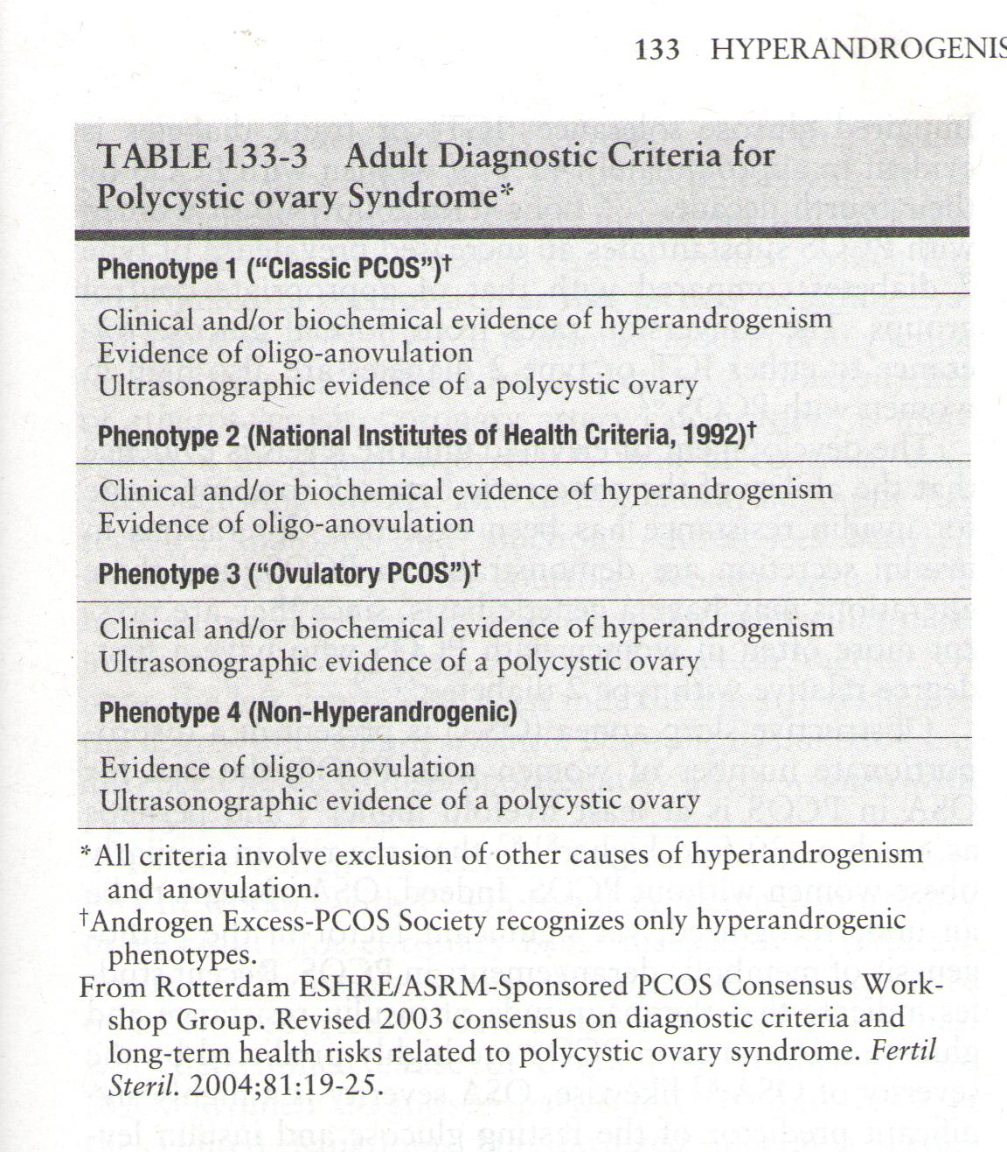
Classification and diagnostic criteria

Slide 7
Apart from the common presentations like hirsutism, menstrual irregularity and infertility or subfertility, other associated morbidities such as, diabetes, cardiovascular diseases, lipid abnormalities, obstructive sleep apnea syndrome, endometrial cancer, NAFLD and anxiety/ depression .
It is important to understand the long-term health risks associated with the disease.
However not all women with PCOS will develop all these conditions but having PCOS does increase your health risk.

Slide 8
Effects of PCOS on women’s health
Definite:
  Type 2 diabetes mellitus
  DLP
  Endometrial Ca
Possible:
  Obesity/IR/MS
  Gb stone
  CVD: CAD, CVA, HTN
  Depression
  Anxiety disorder
  OSA
  Pregnancy complication: GDM and pregnancy HTN
Contoversial :
  PIH
  Miscarriage
  Ovarian CA
  Breast Ca
  Epilepsy

Slide 9
Type2 DM
50% of PCOS have DM/ prediabetes before age 40
CVD: 5-7 times higher rate of CAD
Gall Bladder stone
Obesity
Infertility
PCOS
OSA
NAFLD
Endometrial CA
Gout

Slide 10
PCOS and Diabetes/ prediabetes/IR/obesity
IGT and T2DM are highly prevalent among PCOS adolescents , up to 40% of women with classic PCOS develop IGT or T2DM by the fourth decade of life , with age and weight gain worsening glycemic control Reaven GM et al, 1993, Annu Rev Med. Legro RS, Dunaif A 2005 Changes in glucose tolerance over time in women with polycystic ovary syndrome: a controlled study. J Clin Endocrinol Metab 90:3236–3242
Moreover, women with PCOS are more likely to have insulin resistance , central adiposity, dyslipidemia, and hypertension than normally cycling women .
Other markers of cardiovascular disease, such as C-reactive protein and homocysteine , have also been found to be elevated in women with PCOS.

Slide 11
IR occurs in approximately 60–80% of women with PCOS and in 95% of obese women with PCOS Carmina E, Lobo RA 2004 Use of fasting blood to assess the prevalence of insulin resistance in women with polycystic ovary syndrome. Fertil Steril 82:661–665 .
In most classic cases of PCOS, insulin-mediated glucose uptake is impaired.
These women with PCOS have IR independent and additive with that of obesity, with PCOS and obesity acting synergistically to impair insulin sensitivity Dunaif A, Segal KR, Futterweit W, Dobrjansky A 1989 Profound peripheral insulin resistance, independent of obesity, in polycystic ovary syndrome. Diabetes 38:1165–1174

Slide 12
Consequently, IGT and MBS, as predictors of T2DM and premature CVD mortality. Tominaga M et al. The Funagata Diabetes Study. Diabetes Care 22:920–924 40, 41, 42), are prevalent in women with PCOS (odds ratio, approximately 4:1.
Alarmingly, IGT and T2DM are highly prevalent among PCOS adolescents. Palmert MR, Dunaif A 2002 Screening for abnormal glucose tolerance in adolescents with polycystic ovary syndrome. J Clin Endocrinol Metab 87:1017–1023 .
In one study, classic PCOS patients had a 5-fold risk of developing T2DM over 8 yr vs. age- and weight-matched controls , although only 12% of PCOS patients without obesity developed glucose abnormalities. Norman RJ, 2001 Relative risk of conversion from normoglycaemia to impaired glucose tolerance or non-insulin dependent diabetes mellitus in polycystic ovarian syndrome. Hum Reprod 16:1995–1998 .

Slide 13
Approximately half of all women with PCOS are overweight or obese. Gambineri A et al. 2002 Obesity and the polycystic ovary syndrome. Int J Obes Relat Metab Disord 26:883–896 .
Several studies have reported endocrine and metabolic differences between lean and obese women with PCOS. Dunaif A, Segal KR, Futterweit W, Dobrjansky A 1989 Profound peripheral insulin resistance, independent of obesity, in polycystic ovary syndrome. Diabetes 38:1165–1174
Obesity has been shown to be an independent predictor of conversion to impaired glucose tolerance or type 2 DM in women with PCOS. Norman RJ et al, 2001 Relative risk of conversion from normoglycaemia to impaired glucose tolerance or non-insulin dependent diabetes mellitus in polycystic ovarian syndrome. Hum Reprod

Slide 14
The common rise of both has led us to link them together in some cause-and-effect manner. As women became fatter, they became more hirsute with fewer menses; the epidemics go hand in hand.
Obesity clearly modifies the PCOS phenotype, especially metabolically, and it blunts responses to treatment, especially infertility treatments.
There is adverse metabolic effects of obesity on the PCOS phenotype. However, the take-home message is not to ignore obesity when it presents with PCOS, but rather not to ignore the PCOS that presents with obesity.

Slide 15
PCOS and CVD
Polycystic ovary syndrome (PCOS) is associated with the metabolic syndrome and potentially increased risk of cardiovascular disease (CVD) and related mortality later in life.
7-fold increased risk of myocardial infarction (MI) in PCOS women. Dahlgren E , 1992 Polycystic ovary syndrome and risk for myocardial infarction. Evaluated from a risk factor model based on a prospective population study of women. Acta Obstet Gynecol Scand 71:599–604
Studies regarding CVD and mortality in PCOS women well into the postmenopausal age are lacking.
Women over the age of 45 year with PCOS have been found to have subclinical measure of CVD like greater IMT. (Talbott EO, 2000 Evidence for association between polycystic ovary syndrome and premature carotid atherosclerosis in middle-aged women. Arterioscler Thromb Vasc Biol 20:2414–2421) than normal cycling controls and greater CAC (Christian RC, 2003 Prevalence and predictors of coronary artery calcification in women with polycystic ovary syndrome. J Clin Endocrinol Metab 88:2562–2568) and increase in LVMi .

Slide 16
Cardiovascular Disease and Risk Factors in PCOS Women of Postmenopausal Age: A 21-Year Controlled Follow-Up Study: Johanna Schmidt, 2011.
Objective : To examine whether postmenopausal PCOS women differ from controls regarding cardiovascular risk factors, myocardial infarction (MI), stroke and mortality.
Design: University hospital, a prospective study of 35 PCOS women (61–79 yr) and 120 age-matched controls. The study was performed 21 yr after the initial study.
Interventions included reexamination, interviews, and data from the National Board of Health and Welfare and from the Hospital Discharge Registry.
Blood pressure, glucose, insulin, triglycerides, total cholesterol, high- and low-density lipoprotein, apolipoprotein A1 and B, fibrinogen, and plasminogen activator inhibitor antigen were studied. Incidences of MI, stroke, hypertension, diabetes, cancer, cause of death, and age at death were recorded.

Slide 17
Result: PCOS women had a higher prevalence of hypertension (P = 0.008) and higher triglyceride levels (P = 0.012) than controls. MI, stroke, diabetes, cancer, and mortality prevalence was similar in the two cohorts with similar body mass index.
Conclusions: The well-described cardiovascular/metabolic risk profile in pre- and perimenopausal PCOS women does not entail an evident increase in cardiovascular events during the postmenopausal period.

Slide 18
There are several possible explanations of the fact that cardiovascular events do not occur more often despite the obvious presence of additional CVD risk factors.
One explanation may be the sustained long-term protection by the perimenopausal high HDL found in the PCOS women , which had disappeared during the postmenopausal period.
Another plausible explanation is that the hyperandrogenicity, which remains during the postmenopausal period , has protective effects.
Notes:
Page 20

Slide 19
A protective effect could also be obtained by the possibly delayed menopause , also indicated by the decreased FSH levels compared with controls.
Finally, the lower prevalence of hypothyroidism during the postmenopausal period in PCOS women could have a protective effect, because a relationship between hypothyroidism and CVD had been established .
It should also be noted that in our population, we found that the controls caught up with the PCOS women with regard to abdominal fat distribution and body weight, which may diminish any difference in CVD events between the groups.

Slide 20
A crucial factor in assessing CVD risk for a woman with PCOS is the definition of PCOS itself .
When Rotterdam or AE-PCOS vs “classic” NIH criteria are applied, the prevalence of PCOS in the population increases to over 20%. Belosi C, 2006 Is the PCOS diagnosis solved by ESHRE/ASRM? Hum Reprod 21:3108–3115 , with approximately 75% of referred PCOS patients having classic PCOS and the remaining 25% evenly divided between ovulatory and non-hyperandrogenic PCOS phenotypes. Abbott DH, 2009 Fetal, infant, adolescent and adult phenotypes of polycystic ovary syndrome in prenatally androgenized female rhesus monkeys. Am J Primatol 71:776–784
Notes:
page55

Slide 21
Women with classic PCOS have greater menstrual irregularity, hyperandrogenism, total and abdominal obesity, and insulin resistance (IR) and have more severe risk factors for T2DM and CVD than PCOS patients diagnosed using non-NIH criteria. Moran L, Teede H 2009 Metabolic features of the reproductive phenotypes of polycystic ovary syndrome. Hum Reprod Update 15:477–488 .
Ovulatory PCOS patients have:
  lower body mass index (BMI) and abdominal obesity,
  lesser degrees of hyperandrogenism and hyperinsulinemia,
  reduced MBS prevalence,
  milder forms of dyslipidemia in nonhyperandrogenic PCOS patients have the most metabolically favorable profile, often indistinguishable from normal women

Slide 22
PCOS-related CVD risk be categorized as:
PCOD at CVD risk
Obesity
Smoking
HTN
DLP
Subclinical vascular disease
IGT
FHO CVD
PCOD at High Risk
MBS
Type 2 diabetes
Overt vascular or renal diasease

Slide 23
All women with PCOS should be assessed for CVD risk. Recommendation:
Waist circumference and BMI be determined at every visit , using the National Health and Nutrition Examination Survey method
Based upon AHA guidelines, a complete lipid profile (total cholesterol, LDL-C, non-HDL-C, HDL-C, and triglyceride)
A 2-h post 75-g oral glucose challenge be performed in PCOS women with a BMI greater than 30 kg/m2, or alternatively in lean PCOS women with advanced age (>40 yr), personal history of gestational diabetes, or family history of T2DM be determined.
Routine BP check up every visit
Assessment for depression, anxiety and QOL

Slide 24
PCOS and other metabolic diseases
HTN: In 2008, 22 of 32 (69%) of the PCOS women and 39 of 95 (41%) of the controls (P = 0.008) had hypertension.
The proportion of patients with a family history of MI, stroke, or hypertension did not differ between PCOS women and controls.
Systolic and diastolic BP levels were similar in PCOS women and controls

Slide 25
2. Dyslipedemia: reported in 70% of PCOS cases:
Women with PCOS would be predicted to be at high risk for dyslipidemia because they have elevated androgen levels and are frequently obese
A number of studies have shown that women with PCOS have:
    Lower high-density lipoprotein (HDL) and/or HDL2 levels
    Higher triglyceride and low-density lipoprotein (LDL) levels than age-, sex-, and weight-matched control women.
    Insulin, rather than androgen, levels correlate best with lipid abnormalities, and suppressing androgen levels does not alter lipid profiles in PCOS
PCOS women also have impaired fibrinolytic activity with increased circulating levels of plasminogen activator inhibitor ( PAI-1).

Slide 26
3. GDM:
Women with a history of GDM:
  are insulin resistant,
  at increased risk to develop diabetes mellitus,
  have defects in the β-cell function
  PCOS women share these traits, and it would be expected that they would be at increased risk to develop GDM.

Slide 27
How Does PCOS Affect Pregnancy?
Women with PCOS can have trouble getting pregnant.
They also have:
  Higher chance of having a miscarriage
  Higher chance of developing GDM
  Can have preeclampsia
  compared to woman without PCOS
Women with PCOS have a slightly higher chance of having premature birth or a large baby.

Slide 28
PCOS and OSA
The prevalence of OSA in women with PCOS (even in premenopausal subjects) 5- to 30-fold higher and exceeded that observed in women without PCOS after adjustment for age and BMI.
The prevalence of IGT is approximately 2-fold higher (55 vs. 23%) in women with PCOS who have OSA compared with those without OSA, whereas successful treatment of OSA by C-PAP ( continuous positive air pressure) improves cardiometabolic function, blood pressure, and insulin resistance in young, obese PCOS women .
Tasali E , 2011 Treatment of obstructive sleep apnea improves cardiometabolic function in young obese women with polycystic ovary syndrome. J Clin Endocrinol Metab 96:365–374

Slide 29
53 women with PCOS (age range, 16-45 yr) and 452 control premenopausal women (age range, 20-42), were evaluated in the sleep laboratory for 1 night. Vgontzas.A.N et al , JCEnM 2001.
PCOS women were tested for plasma free testosterone, total testosterone, and FBG and serum insulin concentrations.
It was found that, PCOS patients were 30 times more likely to suffer from sleep disordered breathing (SDB) than the controls [odds ratio = 30.6, 95% confidence interval (7.2-139.4)]
In addition, PCOS patients reported more frequent daytime sleepiness than the controls (80.4% vs. 27.0%, respectively; P < 0.001).

Slide 30
PCOS and NAFLD
Obesity and insulin resistance are key features of NAFLD, on the basis women with PCOS are expected to demonstrate a high prevalence of NAFLD.
This has been confirmed by several studies which suggests a significantly higher prevalence of NAFLD in PCOS women (27.4–62%) (Tan Set al, 2010 Apoptotic markers indicate nonalcoholic steatohepatitis in polycystic ovary syndrome. J Clin Endocrinol Metab 95:343–348) compared with weight- and age-matched non-PCOS females
In contrast to other population subgroups where a minority of patients suffering from NAFLD progress to NASH, the prevalence of NASH in women with PCOS is remarkably high , even in the adolescent females with PCOS (Brzozowska MM , Ostapowicz G , Weltman MD 2009 An association between non-alcoholic fatty liver disease and polycystic ovarian syndrome. J Gastroenterol Hepatol 24:243–247).

Slide 31
PCOS and risk of Cancer
There are no prospective studies on the risk of cancer among PCOS women.
A cohort study (Pillay OC , 2006 The association between polycystic ovaries and endometrial cancer. Hum Reprod 21:924–929) and retrospective case control study reported 2.7 fold increase in risk of endometrial cancer in PCOS-.
However, breast cancer is still the most common cancer type among PCOS women, but there is no increased risk compared with the normal population (Wild S , 2000, Long-term consequences of polycystic ovary syndrome: results of a 31 year follow-up study. Hum Fertil (Camb) 3:101–105 ).
Small studies have suggested that a lack of ovulation (anovulation), is linked with a risk of breast cancer that is three to four times that of women without anovulation
Johana Smith et al, 2011, obs Gyn: detected no difference in the overall cancer incidence or in any specific type of cancer.
Notes:
Page 20

Slide 32
PCOS and depression
There is growing evidence that mood disturbances, mostly severe depression, are independent CVD risk factors and prevalent in women with PCOS. Jones GL, et al ; 2008 Health-related quality of life measurement in women with polycystic ovary syndrome: a systematic review. Hum Reprod Update 14:15–25 (74, 75).
Depressed women with PCOS have higher BMI and greater IR and CVD risk than nondepressed women with PCOS.
Weight loss through an energy-restricted diet improves their depression and quality of life.

Slide 33
Identification of patients at risk for development of long term consequences:
Diagnosis is based on presence of oligomenorrhea, hyperandrogenism, polycystic ovaries in sonograph
How ever the key abnormalities leading to long term consequences are because of insulin resistance- hyperinsulinemia, trunkal obesity in the presence of normoglycemia

Slide 34
Therapeutic considerations
Agents that exacerbate insulin resistance should be avoided in PCOS, particularly in obese women.
Oral contraceptives are widely used in PCOS to control menstrual irregularities and hyperandrogenism, they cause insulin resistance
Norethindrone-only containing contraceptives do not cause insulin resistance in normal women , hence should be used

Slide 35
Glucocorticoids can exacerbate insulin resistance and should be avoided in PCOS.
Therapeutic agents for hyperandrogenism that do not worsen insulin sensitivity in PCOS are spironolactone, GnRH analogs, and flutamide
Although medroxyprogesterone acetate does decrease insulin sensitivity in normal women , intermittent progestin withdrawal with this agent in minimally effective dose (i.e., 5 mg daily for 10 days monthly or every other month) would be preferable to continuous oral contraceptive therapy for endometrial protection.

Slide 36
Weight loss is well known to decrease androgen levels and restore ovulation in PCOS.
As little as a 7% reduction in body weight can restore fertility in obese PCOS women
Metformin acts mainly by suppressing hepatic glucose production, and its insulin-sensitizing actions are primarily mediated through the weight loss that frequently occurs during therapy
Antibesity drugs: orlistatin
Bariatric surgery: One large case series from Spain that characterized subjects both before and at varying time points after surgery reported marked resolution of multiple biochemical abnormalities, as well as improvements in menses and hirsutism after bariatric surgery, implying the procedure was a “cure” for PCOS and morbid obesity.
Escobar-Morreale HF, The polycystic ovary syndrome associated with morbid obesity may resolve after weight loss induced by bariatric surgery. J Clin Endocrinol Metab. 2005;90(12):6364–6369

Slide 37

Conclusion

Slide 38
The long-term health consequences of PCOS are a concern particularly in the background of the current obesity pandemic
Thus, women with PCOS may require more regular screening for such risks as well as effective and targeted lifestyle advice to prevent weight gain.

Slide 39

Thank you!
Thank you!

Slide 40
Diagnosis
A diagnosis of PCOS was made if at least 2 of the following criteria were met:
1) oligomenorrhea (intermenstrual interval >35 days or irregular menstruation [menstrual interval with >7 days difference from one period to another]),
2) hyperandrogenism (hirsutism score ≥8 [Ferriman–Gallwey score] or serum testosterone ≥2.7 nmol/L)
3) polycystic ovaries (PCOs) (as observed in transvaginal ultrasonography, ≥8 follicles 3–8 mm in diameter in one plane in at least one ovary).

Slide 41
Current Definition: A Dunaif, 2013
The current recommended diagnostic criteria for PCOS are hyperandrogenism and ovulatory dysfunction with the exclusion of specific disorders, such as nonclassic adrenal 21-hydroxylase deficiency, hyperprolactinemia, or androgen-secreting neoplasms (1) (Table 2). The polycystic ovary morphology is consistent with, but not essential for, the diagnosis of the syndrome (1, 3). Polycystic ovaries are defined on ultrasound by the presence of eight or more subcapsular follicular cysts ≤10 mm and increased ovarian stroma (2, 3). These changes, however, can be present in women who are entirely endocrinologically normal (2, 3). Thus, the ovarian morphological change must be distinguished from the endocrine syndrome of hyperandrogenism and anovulation.

Slide 42
Conclusion
In conclusion, POLYCYSTIC OVARY SYNDROME (PCOS) is the most common (6.1-19.9%) endocrinopathy in women.
Common diagnostic features are hirsutism, acne, polycystic-appearing ovaries, obesity and oligo/amenorrhea.
It has many features in common with the metabolic syndrome such as insulin resistance, central obesity, hypertension, IGT/ diabetes mellitus, dyslipidemia, increased prevalence of CVD and all-cause mortality.
They have a higher prevalence of breast cancer, uterine cancer, infertility, NAFLD, OSA, depression, mood disturbances and decreased quality of life.

Slide 43
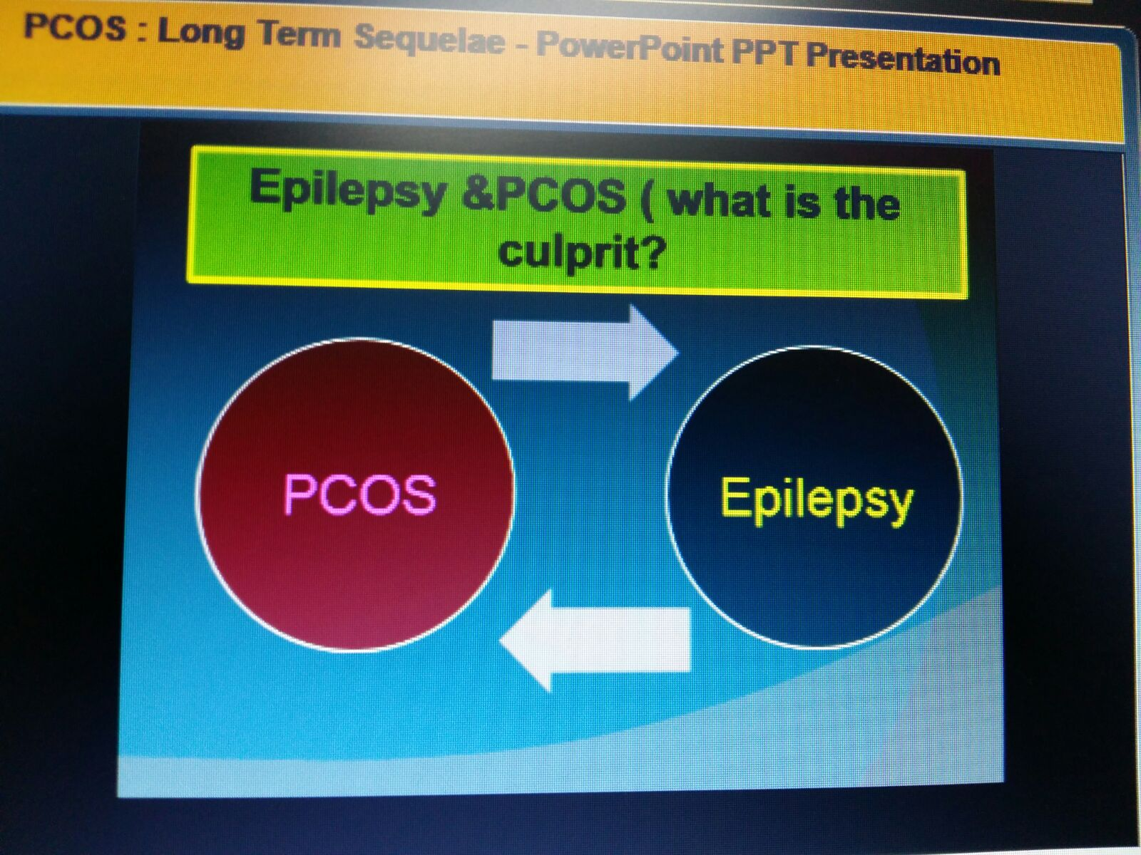

Slide 44
Women with PCOS have greater chances of developing several serious health conditions, and most of them are non-communicable diseases.
PCOS has many features in common with the metabolic syndrome (insulin resistance, central obesity, hypertension, fasting hyperglycemia, and dyslipidemia , which in female population, is associated with an increased risk of diabetes mellitus, cardiovascular disease (CVD) and all-cause mortality .

Slide 45
Link between metabolic syndrome and PCOS
MS
PCOS
IR

Slide 46
Diabetes, a strong risk factor for CVD, as well as insulin resistance and hyperinsulinemia are common among PCOS women of premenopausal (2, 4) and perimenopausal/early postmenopausal age .
This study showed similar levels of insulin, glucose, HOMA index, and prevalence of diabetes in PCOS women and controls.
Because the prevalence of diabetes in our PCOS cohort was markedly higher than among controls in 1987, the elimination of this difference was unanticipated.
There is only one study examining glucose metabolism in an exclusive postmenopausal PCOS population , where the HOMA index was increased in the 11 PCOS women compared.
In a larger retrospective study of more than 300 PCOS women, covering the large age span from 38–98 yr, the OR for diabetes among PCOS was approximately 2 after BMI adjustment .

Slide 47
IR occurs in approximately 60–80% of women with PCOS and in 95% of obese women with PCOS (36, 37). In most classic cases of PCOS, insulin-mediated glucose uptake is impaired, but the precise mechanism remains elusive (38, 39). These women with PCOS have IR independent and additive with that of obesity, with PCOS and obesity acting synergistically to impair insulin sensitivity (38).
Consequently, IGT and MBS, as predictors of T2DM and premature CVD mortality (40, 41, 42), are prevalent in women with PCOS (odds ratio, approximately 4:1) (43, 44). Alarmingly, IGT and T2DM are highly prevalent among PCOS adolescents (45), and, although incident data are not rigorous, up to 40% of women with classic PCOS develop IGT or T2DM by the fourth decade of life (46, 47), with age and weight gain worsening glycemic control (46, 47, 48). In one study, classic PCOS patients had a 5-fold risk of developing T2DM over 8 yr vs. age- and weight-matched controls (48), although only 12% of PCOS patients without obesity developed glucose abnormalities (47).

Slide 48
With the exception of age and smoking, which are not pertinent to the presence or absence of PCOS, all of the other factors that increase cardiovascular disease are increased in women with PCOS.
Unless there is an aspect of the pathophysiology of PCOS that ameliorates the effects of hypertension, diabetes, hyperinsulinemia, or dyslipidemia on cardiovascular disease, it follows that individuals who have a greater prevalence of such conditions (i.e. women with PCOS) have a greater likelihood of developing actual cardiovascular events.

Slide 49
Hypertension is one of the strongest risk factors for stroke , and the fourth strongest modifiable risk factor for MI .
An increased prevalence of manometrically recorded hypertension was reported in premenopausal and perimenopausal PCOS women.
In a retrospective study, the hypertension diagnosis rate in general practitioner notes was increased among a group of pre- and postmenopausal PCOS women

