Slide 1
THE REVELATIONS OF MALARIA ASSOCIATED KIDNEY DISEASE- A MENACE IN THE TROPICS.
DR. KALLOL BHATTACHARJEE
SILCHAR MEDICAL COLLEGE, INDIA

Slide 2
DEFINITION OF MALARIA ASSOCIATED AKI (MAKI)
AN ABRUPT DECLINE IN RENAL FUNCTION IN A MALARIA PATIENT WITHIN 48 HOURS- CHARACTERIZED BY
-CREATININE ELEVATION BY >0.3 MG/DL OR
-CREATININE ELEVATION BY >50% OF BASELINE OR
-OLIGURIA ( <0.5ML/KG/HOUR IN >6 HOURS)
(MISRA ET AL, SEMINARS IN NEPHROLOGY,VOL 28, JULY 2008)

Slide 3
HOWEVER,
THE W.H.O DEFINITION FOR SEVERE MALARIA BASED ON RENAL FUNCTION, REQUIRES A ---
-CREATININE LEVEL OF >3 MG/DL or
-URINE OUTPUT < 400 ML IN ONE DAY
(WHO. SEVERE FALCIPARUM MALARIA. TRANS R SOC TROP, 2009)

Slide 4
INCIDENCE
AKI IS SEEN IN 0.5% TO 15% OF MALARIA CASES.
(SITPRIJA V. NEPHROPATHY IN FALCIPARUM MALARIA. KIDNEY INT. 1988)

Slide 5
CAUSE FOR THIS WIDE VARIABILITY
THIS VARIABILITY OCCURS DUE TO 3 FACTORS
AGE
IMMUNITY
LOCALITY
(EIAM ONG. S. MALARIA NEPHROPATHY. SEMIN NEPHROL. 2003)

Slide 6
AGE
MAKI IS MORE COMMON IN ADULTS AS COMPARED TO CHILDREN.

Slide 7
IMMUNITY
MAKI IS MORE COMMON IN NON-IMMUNE INDIVIDUALS AFFECTED WITH MALARIA.

Slide 8
LOCALITY
MAKI IS MORE COMMON IN AREAS WITH LOW ENDEMICITY OF MALARIA.
EG- EUROPEAN NATIONS,
-AREAS OF SOUTH-EAST ASIAN NATIONS AND INDIA OTHER THAN THE HIGH-ENDEMICITY POCKETS

Slide 9
THUS, A NON-IMMUNE, EUROPEAN MALE ADULT IS AT GREATER RISK OF MAKI THAN AN IMMUNE, CHILD IN AFRICA.

Slide 10
AKI AND TYPE OF MALARIA
SEVERE COMPLICATIONS OF MALARIA SUCH AS AKI, OCCUR ONLY IN P. FALCIPARUM MALARIA.
HOWEVER, RECENTLY A FEW REPORTS OF AKI ASSOCIATED WITH P.VIVAX HAVE APPEARED.
(KAUR D. J TROP PEDIAT. 2007)

Slide 11
PATHOPHYSIOLOGY
MAKI IS CAUSED DUE TO A COMBINATION OF TWO PROCESSES
CYTOADHERENCE
CYTOKINES

Slide 12
CYTOADHERENCE
PARASITIZED RBC’S EXPRESS PROTEINS CALLED ‘VARIANT SURFACE ANTIGENS’ (VSA) ON THEIR SURFACE.
THESE RBC’S ATTACH TO VASCULAR ENDOTHELIUM, USING THE VSA.

Slide 13
SEQUESTRATION OF THESE RBC’S INTO GLOMERULAR AND TUBULOINTERSTITIAL CAPILLARIES MAY CAUSE MAKI.
(KYES S. ET AL. ANN REV MICROBIOL. 2001)

Slide 14
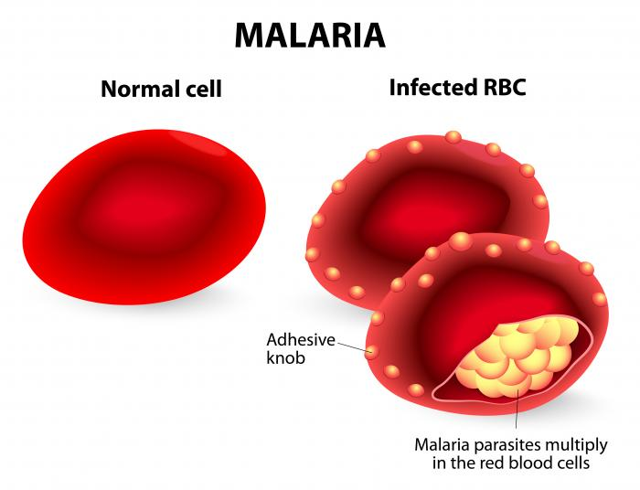
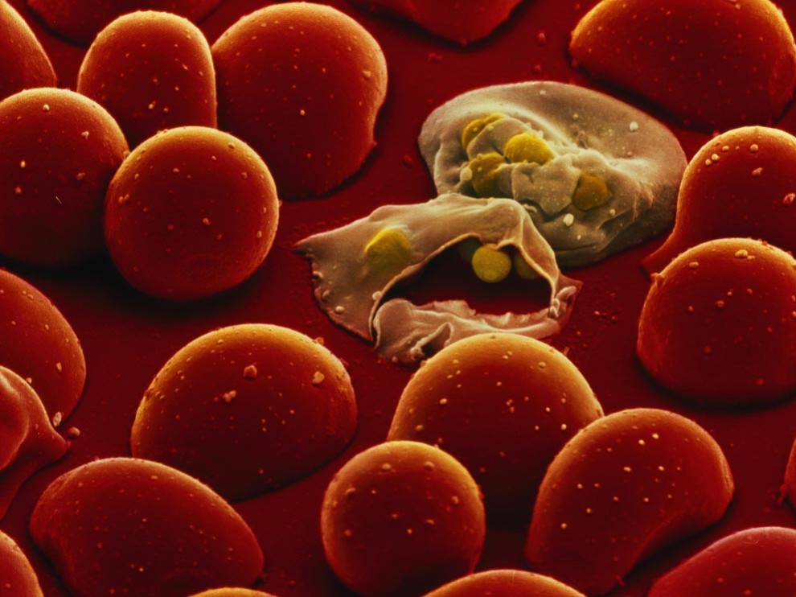

Slide 15
CYTOKINES
THE FOLLOWING CYTOKINES ARE UPREGULATED IN MALARIA
-TNF-ALPHA
-IL 6
-IL 8
-IFN- GAMMA
(MSHANA R. ET AL. J. CLIN LAB IMMUNO. 1991)

Slide 16
THE EFFECT OF CYTOKINES
THERE ARE TWO EFFECTS
INCREASED NITRIC OXIDE
MITOCHONDRIAL SHUTDOWN

Slide 17
THIS LEADS TO-
VASODILATATION
HYPOTENSION
LACTIC ACIDOSIS
RESISTANCE OF VESSELS TO SYMPATHETIC STIMULATION.

Slide 18
P. FALCIPARUM INFECTION
SEQUESTRATION OF RBC’S
INCREASED FLUID LOSS AND DECREASED INTAKE
HOST IMMUNE RESPONSE
CLOGGING OF CAPILLARIES
CYTOKINES
HYPOVOLEMIA
INCREASED LACTATE INCREASED H+
DECREASED ATP

Slide 19
P. FALCIPARUM INFECTION
SEQUESTRATION OF RBC’S
INCREASED FLUID LOSS AND DECREASED INTAKE
HOST IMMUNE RESPONSE
CYTOKINES
INCREASED LACTATE INCREASED H+
DECREASED ATP
GENERALIZED ARTERIAL VASODILATION
VASCULAR RESISTANCE TO PRESSOR HORMONES

Slide 20
P. FALCIPARUM INFECTION
SEQUESTRATION OF RBC’S
INCREASED FLUID LOSS AND DECREASED INTAKE
HOST IMMUNE RESPONSE
GENERALIZED ARTERIAL VASODILATION
HYPOVOLEMIA
INCREASED SYMPATHETIC TONE
RAAS ACTIVATION
RAISED AVP

Slide 21
INCREASED SYMPATHETIC TONE
RAAS ACTIVATION
RAISED AVP
RENAL VASOCONSTRICTION
SODIUM AND WATER RETENTION
ACUTE KIDNEY INJURY

Slide 22
P. FALCIPARUM INFECTION
HOST IMMUNE RESPONSE
IMMUNE COMPLEX DEPOSITION
ACUTE KIDNEY INJURY
GLOMERULAR INJURY

Slide 23
VULNERABLE POPULATIONS
PREGNANT WOMEN
HIGH PARASITEMIA
VERY HIGH JAUNDICE
PROLONGED DEHYDRATION
ON NSAID THERAPY

Slide 24
CLINICAL FEATURES
MAKI MAY PRESENT IN ONE OF TWO WAYS
IN ASSOCIATION WITH MODS
AS AKI ALONE

Slide 25
MAKI ASSOCIATED WITH MODS | MAKI ALONE
THIS GROUP PRESENTS AT THE TIME WHEN THE PATIENT PRESENTS WITH OTHER ORGAN DAMAGE FEATURES | THIS GROUP PRESESNTS AFTER THE OTHER COMPLICATIONS HAVE SUBSIDED
THE PATIENT USUALLY HAS ALTERED MENTAL STATUS OR COMA | THE PATIENT IS CONCIOUS, ORIENTED AND AFEBRILE
THE TIME OF PRESENTATION IS SUCH THAT THE PARASITES ARE STILL PRESENT IN THE RBC’S | THE TIME OF PRESENTATION IS SUCH THAT THE PARASITES HAVE ALREADY CLEARED OFF FROM THE RBC’S

Slide 26
MAKI ASSOCIATED WITH MODS (CONT’D) | MAKI ALONE (CONT’D)
DIAGNOSIS RELIES ON PBF | DIAGNOSIS RELIES ON A HIGH INDEX OF SUSPICION AND RAPID DIAGNOSTIC KITS
POOR PROGNOSIS | BETTER PROGNOSIS

Slide 27
STUDY AT DEPARTMENT OF MEDICINE-SILCHAR MEDICAL COLLEGE
NUMBER OF HOSPITALIZED PATIENTS WITH MALARIA FROM AUGUST 2009 TO MARCH 2017= 725
NUMBER OF PATIENTS SELECTED FOR STUDY= 668
INCIDENCE OF MAKI= 124 (18.6%)
INCIDENCE OF MALARIA WITHOUT MAKI= 544 (81.43%)

Slide 28
STUDY AT DEPARTMENT OF MEDICINE-SILCHAR MEDICAL COLLEGE
AGE GROUP | NUMBER | PERCENTAGE
10-30 | 21 | 16.9%
30-50 | 78 | 62.9%
50-70 | 15 | 12.1%
>70 | 8 | 6.4%
TOTAL | 124 | 100%

Slide 29
STUDY AT DEPARTMENT OF MEDICINE-SILCHAR MEDICAL COLLEGE

Slide 30
STUDY AT DEPARTMENT OF MEDICINE-SILCHAR MEDICAL COLLEGE

Slide 31
STUDY AT DEPARTMENT OF MEDICINE-SILCHAR MEDICAL COLLEGE

Slide 32
STUDY AT DEPARTMENT OF MEDICINE-SILCHAR MEDICAL COLLEGE

Slide 33
STUDY AT DEPARTMENT OF MEDICINE-SILCHAR MEDICAL COLLEGE
OCCURRENCE OF MAKI WITH MODS AND MAKI ALONE
MAKI CASES | NUMBER | PERCENTAGE
MAKI WITH MODS | 94 | 75.8%
MAKI ALONE | 30 | 24.2%
TOTAL | 124 | 100%

Slide 34
STUDY AT DEPARTMENT OF MEDICINE-SILCHAR MEDICAL COLLEGE

Slide 35
STUDY AT DEPARTMENT OF MEDICINE-SILCHAR MEDICAL COLLEGE

Slide 36
STUDY AT DEPARTMENT OF MEDICINE-SILCHAR MEDICAL COLLEGE

Slide 37
STUDY AT DEPARTMENT OF MEDICINE-SILCHAR MEDICAL COLLEGE

Slide 38
STUDY AT DEPARTMENT OF MEDICINE-SILCHAR MEDICAL COLLEGE

Slide 39
TREATMENT
TREATMENT OF MAKI MAYBE CONSIDERED UNDER 4 HEADINGS
ANTIMALARIAS
BALANCE OF FLUIDS AND ELECTROLYTES
COMPLICATIONS- TREATMENT
DIALYSIS

Slide 40
ANTIMALARIALS
THE PREFERRED ANTIMALARIAL IS I.V. ARTESUNATE
DOSE- 2 MG/KG AT 0, 12 AND 24 HOURS, FOLLOWED BY 2MG/KG DAILY FOR THE NEXT 7 DAYS.
(MISRA ET AL, SEMINARS IN NEPHROLOGY,VOL 28, JULY 2008)

Slide 41
IMPACT ON OUTCOME
A CLEAR MORTALITY BENEFIT EXISTS FOR THE USE OF ANTIMALARIALS IN MAKI.

Slide 42
DRUGS TO BE AVOIDED
AMINOGLYCOSIDES
NSAIDS
CHLOROQUINE
SULFADOXINE-PYREMETHAMINE

Slide 43
BALANCE OF FLUIDS AND ELECTROLYTES
THREE CHALLENGES IN THE MANAGEMENT OF MAKI
FLUID CHALLENGE
DIURETIC CHALLENGE
DOPAMINE CHALLENGE

Slide 44
FLUID CHALLENGE
20 ML/KG OF 0.9% NORMAL SALINE SHOULD BE INFUSED OVER 1 HOUR
TO PREVENT VOLUME OVERLOAD,
-AUSCULTATION OF LUNG FIELDS
-JVP MONITORING
-CVP MONITORING
IS DONE AFTER EVERY 200 ML.

Slide 45
DIURETIC CHALLENGE
IF URINE OUTPUT IS NOT PRESENT DESPITE FLUIDS, IV FUROSEMIDE IS USED
INITIAL DOSING IS 40 MG
THIS IS INCREASED EVERY 30 MINUTES TO 200, 300 AND 400 MG IF NO REPSONSE IS SEEN.
(WHO. SEVERE FALCIPARUM MALARIA. TRANS R SOC. TROP. 2009)

Slide 46
DOPAMINE CHALLENGE
IF NO RESPONSE IS ACHIEVED ON DIURETIC USE, THEN LOW DOSE DOPAMINE IS USED
( 2.5 MICRO GRAM/KG/MIN)
HOWEVER THE ROLE OF DOPAMINE IN MAKI HAS NOT BEEN ESTABLISHED FULLY YET.

Slide 47
IMPACT ON OUTCOME
CONVINCING EVIDENCE IS NOT AVAILABLE FOR RECOMMENDING THE ROUTINE USE OF THE FOLLOWING.
DIURETICS
DOPAMINE
VASOPRESSIN
ALBUMIN

Slide 48
DIALYSIS
INDICATIONS OF DIALYSIS INCLUDE
UREMIC SYMPTOMS
VOLUME OVERLOAD
HYPERKALEMIA
METABOLIC ACIDOSIS
NOT RESPONDING TO MEDICAL TREATMENT.

Slide 49
IMPACT ON OUTCOME
EARLY INITIATION OF DIALYSIS HAS MORTALITY BENEFIT.

Slide 50
NUTRITION
CALORIE REQUIREMENT- 20- 30 KCAL/KG/DAY
PROTEIN REQUIREMENT-
NON-CATABOLIC STATE- 0.8-1 GM/KG
CATABOLIC STATE/ DIALYSIS- 1- 1.5 GM/KG

Slide 51
ACKNOWLEDGEMENTS
DR. A. MURUGANATHAN
DR. G. KAR
DR. P. BHATTACHARJEE
DR. DWIJEN DAS
DR. A. JOG

Slide 52
REFERENCES
MISRA ET AL, SEMINARS IN NEPHROLOGY,VOL 28, JULY 2008
WHO. SEVERE FALCIPARUM MALARIA. TRANS R SOC TROP, 2009
SITPRIJA V. NEPHROPATHY IN FALCIPARUM MALARIA. KIDNEY INT. 1988
EIAM ONG. S. MALARIA NEPHROPATHY. SEMIN NEPHROL. 2003
KAUR D. J TROP PEDIAT. 2007
KYES S. ET AL. ANN REV MICROBIOL. 2001
MSHANA R. ET AL. J. CLIN LAB IMMUNO. 1991

Slide 53

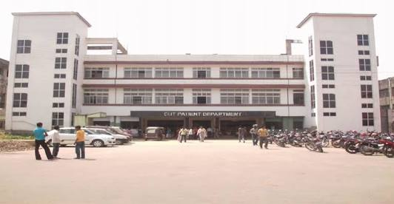
THANK YOU

