Slide 1
ROME - 2016

Slide 2

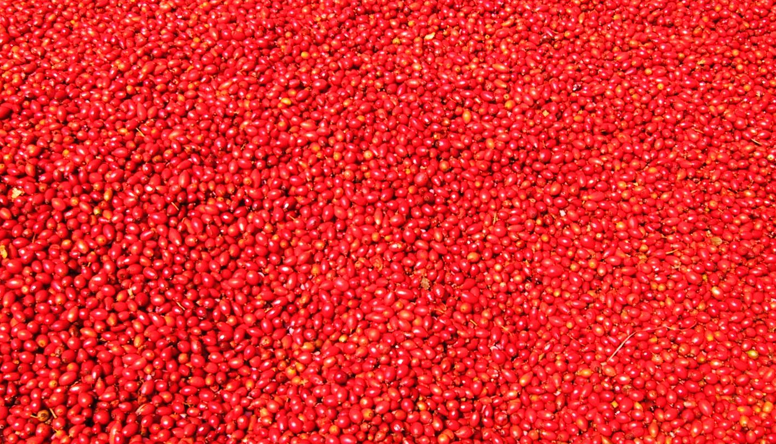

Slide 3
OSTEOARTHRITIS
The Percentage of patients who reported on the yes/no basis, a reduction in Pain, after the initial 3 months treatment period.
*
* P < 0.009 vs Placebo
NINE OUT OF TEN RESPONDED WITH A REDUCTION IN PAIN IN THE GROUP INITIALLY ACTIVELY TREATED.

Slide 4
CONSUMPTION OF PAIN KILLERS AFTER 6 MONTHS OF TREATMENT
OSTEOARTHRITIS
CHANGE IN CONSUMPTION OF TABLETS
P<0.0313
P<0.0182
Reduction of 40%
Reduction of 35%

Slide 5
A RANDOMISED, PARALLEL, DOUBLE-BLINDED AND PLACEBO-CONTROLLED STUDY OF LIQUID ROSE HIP, IN VOLUNTEERS DURING THE WINTER SEASON, WITH SPECIAL REFERENCE TO THE OCCURRENCE AND SYMPTOMS OF COLDS.
Winther K, Warholm L, Marstrand K, Campbell-Tofte J. Department of Nutrition, Exercise and Sports, University of Copenhagen, Denmark. Department of Trauma and Medicine, Horsens Hospital, Denmark. Department of Orthopaedic Surgery, Elverum Hospital, Norway.

Slide 6
INTRODUCTION:
COLD IS A COMMON WIDESPREAD DISEASE WORLDWIDE, WITH GREAT SOCIAL AND ECONOMICAL IMPLICATION.
A REDUCTION IN THE NUMBER OF DAYS AWAY FROM WORK AND/OR A LIMITATION IN SYMPTOMS CAN SOCIOECONOMICALLY INFLUENCE SOCIETY.

Slide 7
AIM:
TO TEST IF A LOW DOSE LIQUID ROSE HIP (HYBEN VITAL®) BASED ON SHELLS OF ROSE HIP CAN ALLEVIATE THE NUMBERS AND THE SEVERITY OF SYMPTOMS FROM COLD.
THE IMPACT OF TREATMENT ON ANTI-INFLAMMATORY MARKER CRP AND AN EVALUATION OF THE STIFFNESS OF MUSCLES WAS ALSO INCLUDED.

Slide 8
PATIENTS AND METHODS:
120 MIDDLE-AGED TO ELDERLY VOLUNTEERS, MEAN AGE 61.5 +/- 7.3 YEARS, WERE RANDOMLY ASSIGNED TO DAILY TREATMENT WITH EITHER 2 GRAM OF A LIQUID ROSE HIP PREPARATION (RH) OR PLACEBO (P) OF SIMILAR TASTE, ODOR AND COLOR FOR A SIX MONTH WINTER PERIOD.

Slide 9
FLOWCHART
0
1
2
3
4
5
6
Group A
n = 60
Placebo
Run In
0
1
2
3
4
5
6
Group B
n = 60
Active

Slide 10
DEMOGRAPHIC CHARACTERISTICS OF THE STUDY PARTICIPANTS
PARAMETER | ACTIVE TREATMENT | PLACEBO | P-LEVEL
Females | 47 | 49 | 0.637
Males | 13 | 11
Age (Years) | 61.5 ± 7.5 | 61.5 ± 7.1 | 0.869
Weight (kg) | 68.6 ± 11.1 | 69.7 ± 12.7 | 0.709
BMI (kg/m2) | 24.2 ± 3.7 | 24.6 ± 3.0 | 0.431
Smokers | 9 | 10 | 1.000
Retired | 29 | 29 | 1.000
Still at work | 31 | 31 | 1.000
Daily physical training | 57 | 58 | 1.000
Consumption of PM | 33 | 36 | 0.712
Systolic Blood Pressure (mmHg) | 144.1 ± 19.1 | 142.2 ± 23.6 | 0.362
Diastolic Blood Pressure (mmHg) | 86.6 ± 10.9 | 86.5 ± 10.8 | 0.657

Slide 11
TOTAL NUMBER OF REPORTED COLDS IN MONTH TWO
P<0.014
A SIGNIFICANT REDUCTION IN COLDS REPORTED WAS OBSERVED DURING ACTIVE TREATMENT

Slide 12
TOTAL NUMBER OF PATIENTS REPORTING COLD IN ALL SIX MONTHS
P<0.38
A TREND IN FAVOUR OF ACTIVE TREATMENT, BUT NOT STATISTICAL SIGNIFICANT

Slide 15
OVERALL STIFFNESS OF MUSCLES
(DURING ALL 6 MONTHS)
P<0.043
ACTIVE TREATMENT RESULTED IN A REDUCTION IN PATIENTS REPORTING ON STIFFNESS OF MUSCLES
(SIMILAR REPORTS ON DOGS AND HORSES)

Slide 16
THE IMPACT ON TOTAL CHOLESTEROL
Active
Placebo
P<0.073
A BORDERLINE LOWERING IN TOTAL CHOLESTEROL WAS SEEN AS A RESULT OF TREATMENT WITH ROSE-HIP (HYBEN VITAL®)

Slide 17
CONCLUSION:
THE PRESENT ROSE-HIP PREPARATION (HYBEN VITAL®) RESULTS IN:
SYMPTOM REDUCTION OF COLD
A DECLINE IN THE STIFFNES OF MUSCLES

