Slide 1

Lumbar herniated disc treated with
Percutaneous Disc Fx
Dr. Kailash Kothari, MD
Spine and Pain specialist
Director, Pain clinic Of India (Mumbai and Goa)
Fortis, Global.
Breach candy hospitals

Slide 2

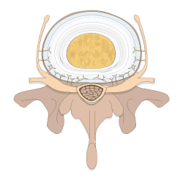
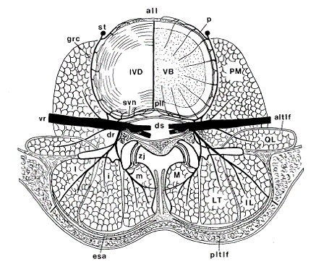
Herniated disc
Annulus fibrosus has nerve supply
Nucleus herniates through the broken annulus
Newer neurovascular bundles grows inside fissures

Slide 3
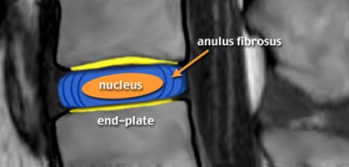
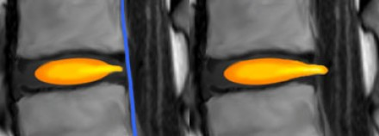
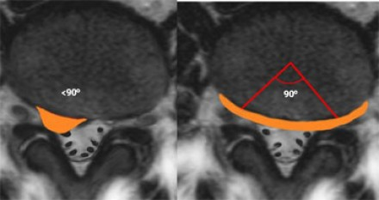
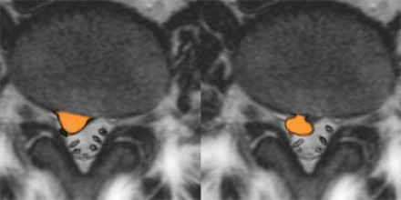
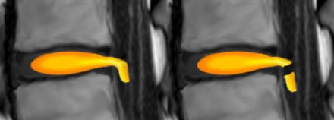
NORMAL DISC
Annular Tear
Disc Herniation
Focal Herniation
Broad Herniation
Protrusion
Extrusion
Migration
Sequestration

Slide 4
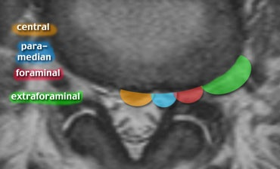
Since the PLL (posterior longitudinal ligament) is at its thickest in this region, the disc usually herniates slightly to the left or right of this central zone.
Posterocentral
Paramedian - number one region
Postero lateral (foraminal /Subarticular)- Only 5% to 10%, 'Dorsal Root Ganglion' (DRG) lives in this zone resulting in severe pain, sciatica and nerve cell damage.
extra foraminal) uncommon
Most common site is L4-5 and L5-S1

Slide 5
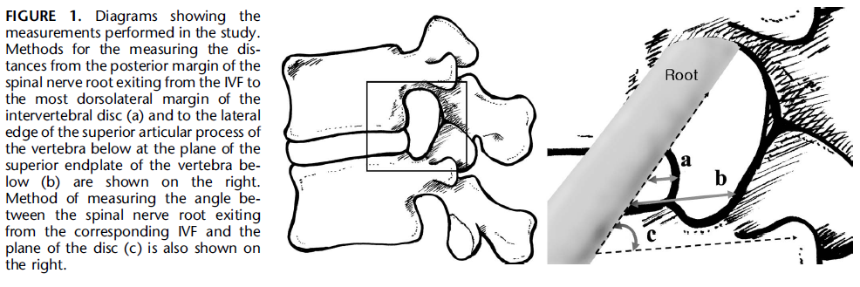
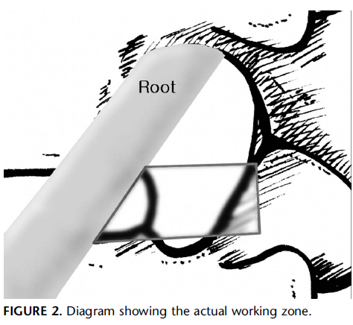
Triangular Zone – Kambel’s triangle
The goal is to access the "neural triangular working zone" defined by the exiting root, the proximal vertebral plate inferiorly, and the superior articular facet

Slide 6
Different techniques for IVDP
Mechanical decompression
Thermal – laser, coblation, RF
Chemonucleolysis
These procedures are being done separately for different indication with varying success rates

Slide 7
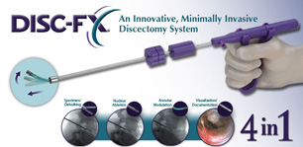
Disc Fx with Elliquence generator
Currently, it is standard practice to use radiofrequency techniques with frequencies of 300–500KHz.
A frequency of 1.7MHz provided by the elliquence Surgi-Max® generator with correspondingly different modulations and the affiliated special biophysical characteristics
A major component of this newly developed intervention is the application of high radiofrequency using a steerable probe (Trigger-Flex, elliquenc, LLC)

Slide 8
The safety and effectiveness of this technology has been demonstrated with more than 100,000 endoscopic interventions worldwide
Reduced heat, thermal convection and minimised tissue alteration
Two modulation types are available., Each waveform offers distinct tissue effect
Bipolar Turbo - nucleus ablation
Bipolar Hemo - annulus modulation with shrinkages

Slide 9
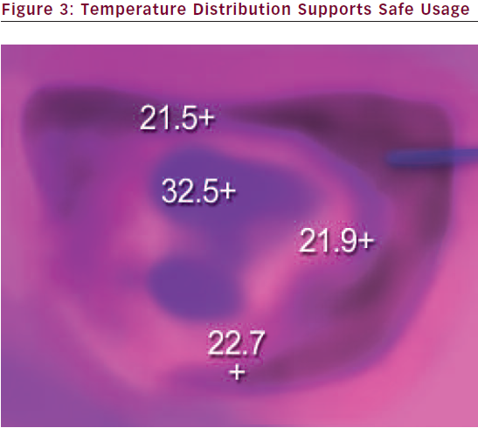
Temperature Distribution
Demonstrably negligible thermal convection
The use of higher frequency offers the advantage of reduced heat and minimal tissue alteration

Slide 10
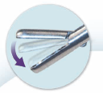
Mechanical removal of disc
Additional mechanical removal of disc material with a rongeur increases the effectiveness of this method
Free fragments within the annulus and in the subligamentary area can be removed

Slide 11
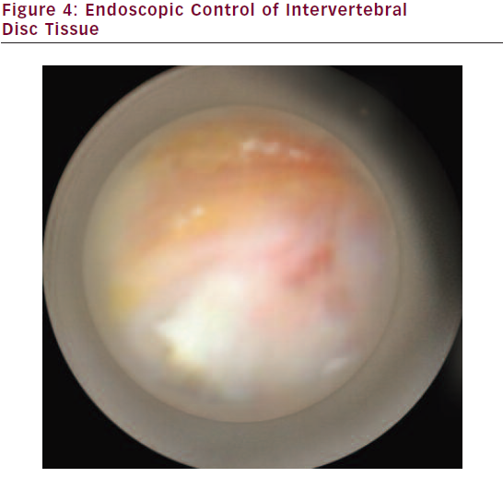
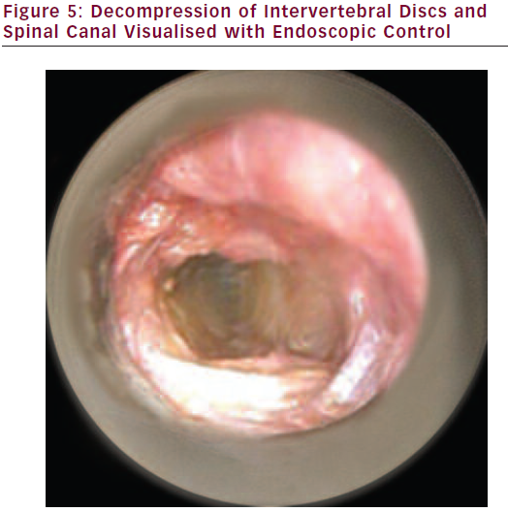
Fluoroscopic control is used primarily for orientation during the intervention
Optional semi-endoscopic control can also take place between the individual work steps
This ensures documentation of the decompression effects and nucelotomy

Slide 12
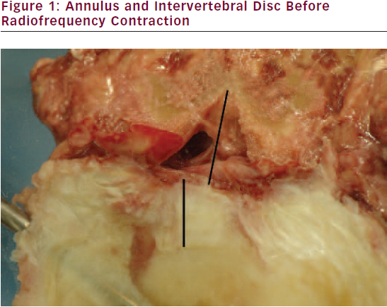
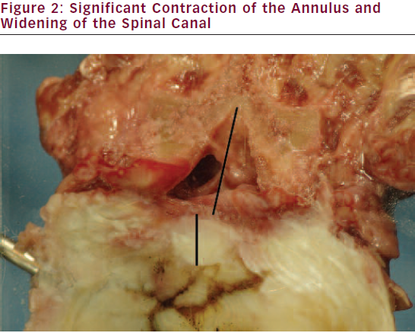
High ablation rates in turbo mode as well as significant contraction of the annulus in Bipolar Hemo mode with a decompression have been demonstrated in post-mortem intervertebral disc studies
IVF
A
Feldman A, Hellinger S, Disc-FX – A new combination procedure for disc surgery – radiowave disc ablation,annulus decompression and mechanic nucleotomy in one –basics and a prospective study, IJMIST, 2008;Suppl. 1(1)[2].
Ashley JE, Gharpuray VM, Saal JS, et al., Temperature distribution in the intervertebral disc: a comparison of intranuclear radiofrequency needle to a novel heating catheter, BED, 1999;42:77–8.
Barendse GA, van Den Berg SG, Kessels AH, et al., Randomized controlled trial of percutaneous intradiscal radiofrequency hermocoagulation for chronic discogenic pain. Lack of effect from a 90-second 70 C lesion, Spine, 2001;26(3):287–92.
Houpt JC, Conner ES, McFarland EW, Experimental study of temperature distributions and thermal transport during radiofrequency current therapy of the intervertebral disc, Spine, 1996;21(15):1808–13.
Kleinstueck FS, Diederich CJ, Nau WH, et al., Temperature and dose distributions during intradiscal electrothermal therapy in cadaveric lumbar spine, Spine, 2003;28:1700–8.

Slide 13
Most of the pain is derived from the sinuvertebral nerve from the intervertebral discs as well as tissue surrounding the nerves
Venous stasis in the early phase of the pain syndrome appears to play a large role
The smallest changes in the epidural area can cause clear changes to the venous flow conditions and thereby influence the disease
Barr JS, Lumbar disc lesions in retrospect and prospect, Clin Orthop, 1977;129:4–8.
Hall LT, Esses SI, Noble PC, Kamaric E, Morphology of the lumbar vertebral endplates, Spine, 1998;23(14):1517–23.
MacNab I, Negative disc exploration. An analysis of the causes of nerve-root involvement in sixty-eight patients, J Bone Joint Surg, 1971;53A:891–903
Olmarker K, Rydevik B, Nordborg C, Autologous nucleus pulposus induces neurophysiologic and histologic changes in porcine cauda equina nerve roots, Spine, 1993;18(11):1425–32.
Postacchini F, Management of herniation of the lumbar disc, J Bone Joint Surg Br, 1999;81(4):567–76.

Slide 14
Application for the technology
Contained Herniation
Symptomatic protrusions
Advanced degeneration with obvious intervertebral pain

Slide 15
Always after failed conservative treatment

Slide 16
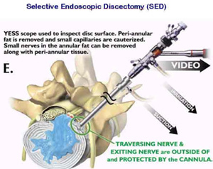
Disc FX and PTFED

Slide 17
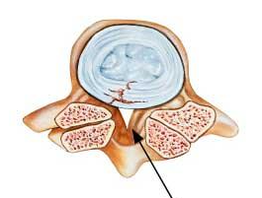
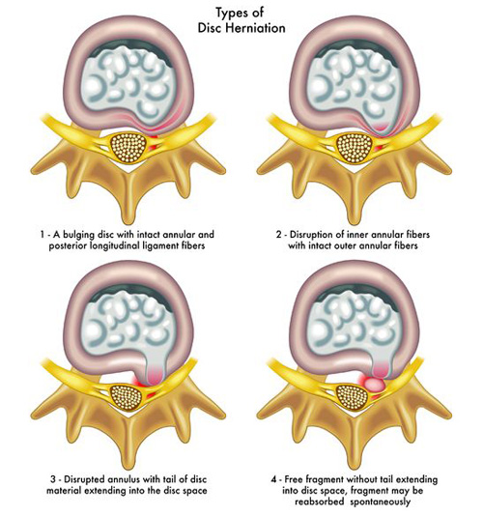
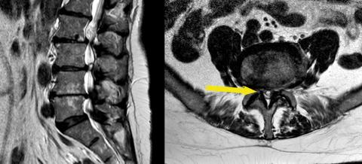

Slide 18
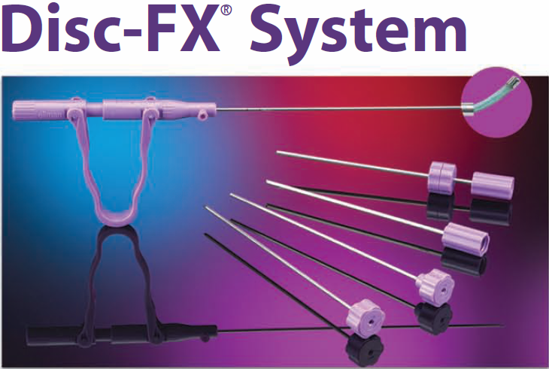
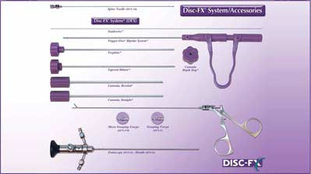
Trigger-Flex® Bipolar System
Guide wires
Cannula, Straight
Cannula, Beveled
Cannula Depth Stop
Tapered Dilator
Trephine

Slide 19
STEPS
Done under LA + Sedation
Skin markings
Deciding needle entry point
18/16G needle entry in AP
Hit facet joint
Slip anteriorly to the joint

Slide 20
Steps
Keep watching needle tip in AP (medial middle and lateral part of pedicle/Facet) and correlate same in lateral (direction and depth)
Watch for nerve injury – go slow
Enter annulus, place needle tip in middle (AP) and in dorsal part of disc (Lat)
Discography
Mechanical decompression – Rongeur
Use of trigger flex – turbo (Nucleus) and hemo mode (Annulus)

Slide 21
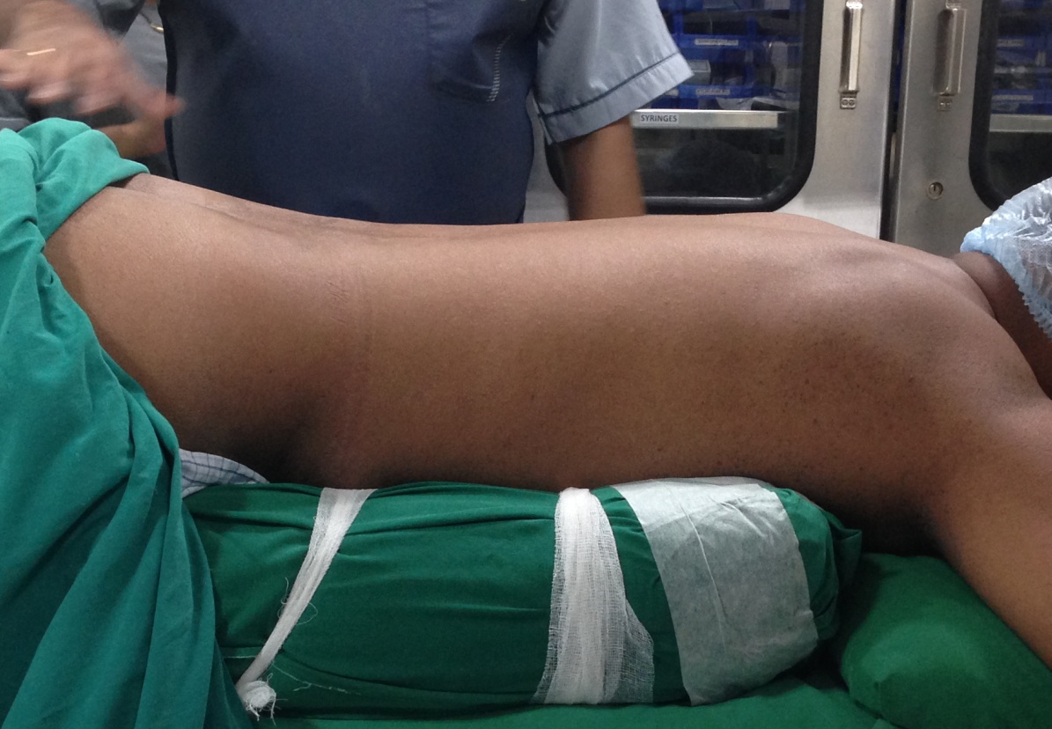
Patient position
BOLSTERS

Slide 22
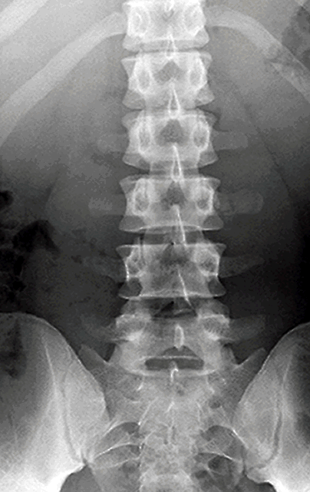
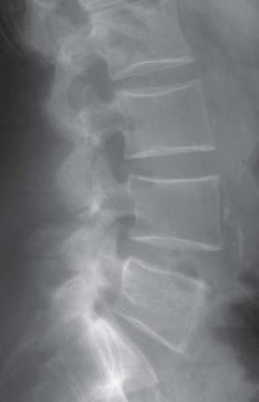

Slide 23
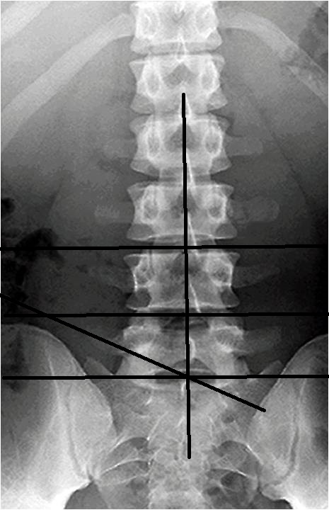
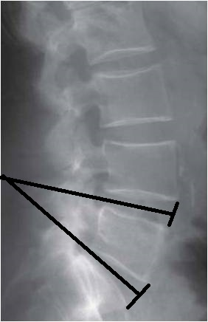
Skin Marking
Line joining Spinous processes
Disc Inclination angles
Anterior Vertebral Border
Iliac Crest adjusted
L4-5
L5-S1

Slide 24
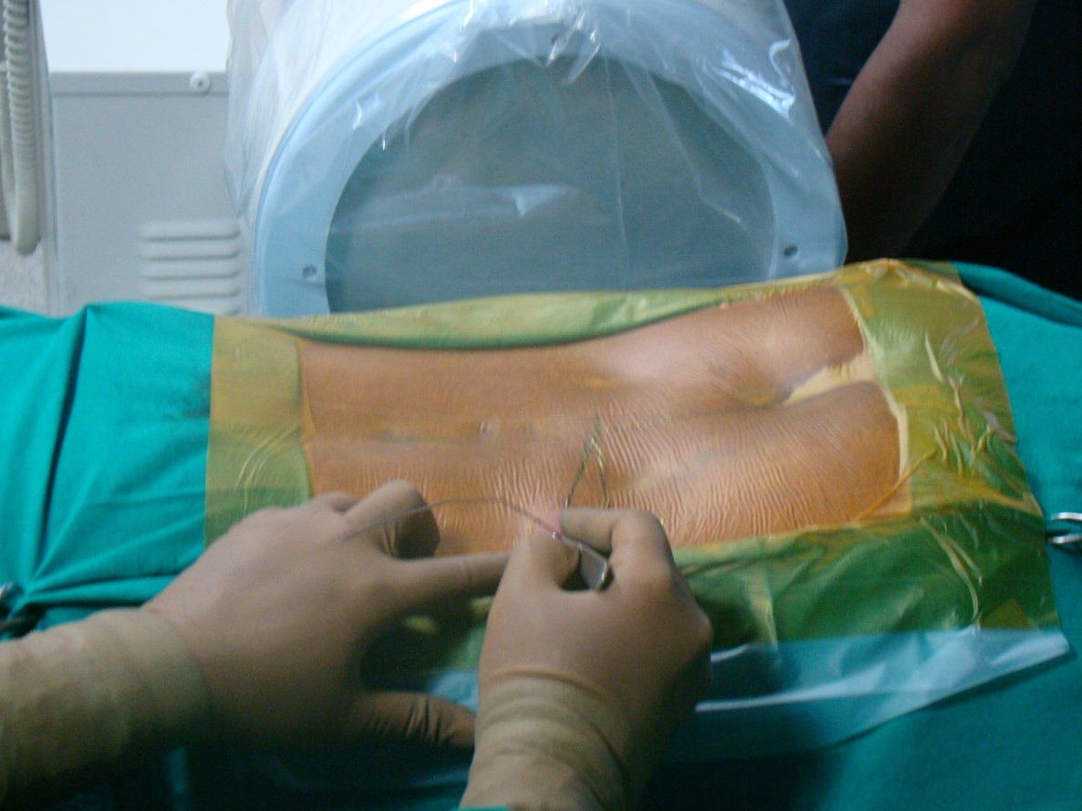
Entry point – 12-14cm Lateral to midline

Slide 31
Provocative Discography –
Concordant pain / leaking disc

Slide 32
Guide wire insertion

Slide 33
Remove 16G needle

Slide 34
Insert dilator and then Canula
Remove Guide wire

Slide 35
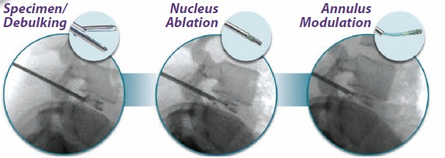
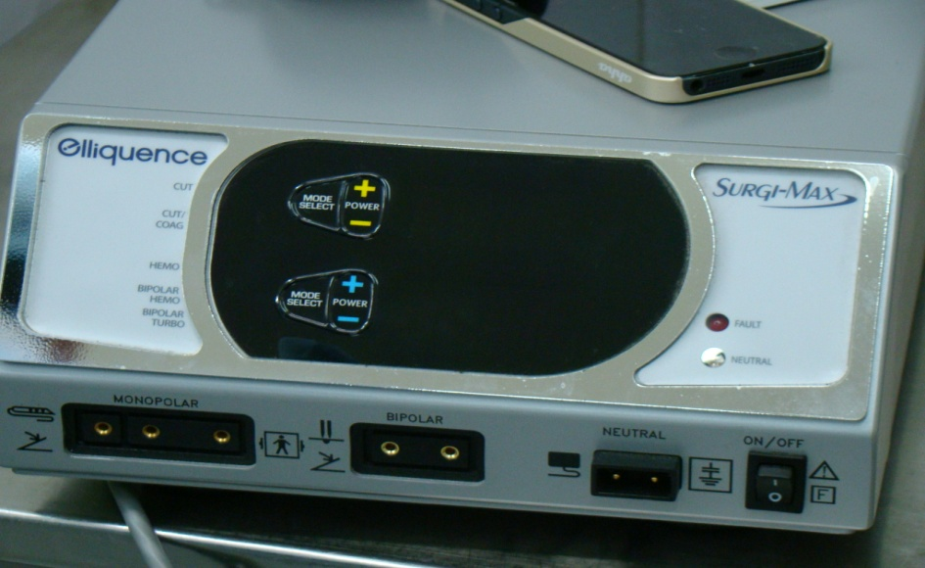
CLICK FOR VIDEO

Slide 36
Our experience
Treated 25 patients from 2014 feb
Inclusion criteria – Contained central or paracentral disc herniation, single level with MRI finding of annular tear with intact outer annulus
Exclusion – Protrusion, extrusion, spondylolisthesis, Multi level degenerative problems

Slide 37
Male - 16
Females – 9
Mean Age – 38

Slide 38
Pre Operative
Average Pre op VAS – 8
Radicular component – All
Back pain – All

Slide 39
Post op Avg VAS
2 week – 6 (n - 25)
4 weeks – 3 (n – 25)
3 months – 3 (n – 23)
6 months – 3 (n – 22)
At 3 months 2 patients had to undergo percutaneous transforaminal endoscopic discectomy (PTFED) for ongoing pain
At 6 months 1 more patient had pain recurrence and was referred for PTFED

Slide 40
Results
Radicular pain reduced in all patients
Back pain was annoying complaint in 16 patients which lasted for 3-4 weeks
Most patients settled in 4-6 weeks durations with significant relief in all symptoms

Slide 41
Conclusion and Clinical Relevance
In addition to clinical results, the complication rate is also to be considered as a major factor of the value of this procedure
To date, Minimal and minor complications have been encountered
In comparison with other minimally invasive spinal column surgeries, risk rates are low
Complications include -
Infection (Discitis)
Nerve injury
Bleeding
Post surgery pain
Recurrent herniation

Slide 42
Conclusion
For contaied disc herniations Disc Fx is good minimally invasive option
Intra-discal newer treatments are less invasive then conventional open discectomy,
Indicated when other less invasive methods fails
Good safety profile with good results

Slide 43
THANK YOU

