Slide 1
Mitglied der Helmholtz-Gemeinschaft

Slide 2
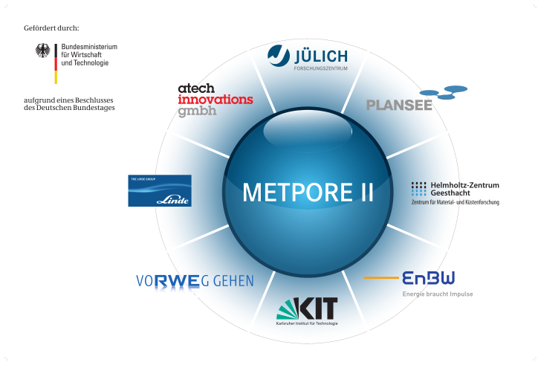
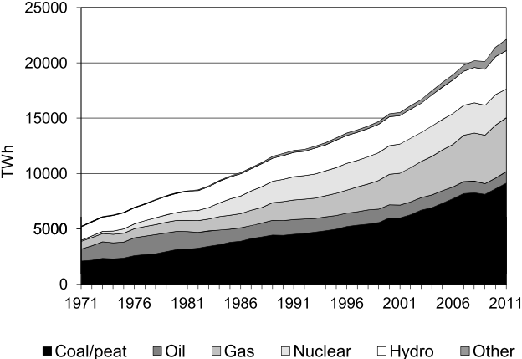
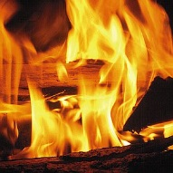



Motivation
Until the year 2035 the demand for electricity will increase by about 70 %
The majority of the electric energy is generated by the use of fossil fuels resulting in the emission of large amounts CO₂
The steady increase in the concentration of CO₂ in the atmosphere contributes to global warming
CO₂ Capture in the power plant is requiered
Use of membranes for energy-efficient gas separation
¹) IEA World Energy Outlook 2012, OECD Publishing
²) IEA, CO2 Emissions From Fuel Combustion – Highlights 2013, pp. 158

Slide 3
Outline
Introduction
  Separation mechanism
  Membrane design
  CO₂-separation from flue gas
Results
  Laboratory tests
  Exposure tests
  Module test rig
Conclusions
Outlook
Acknowledgements

Slide 4


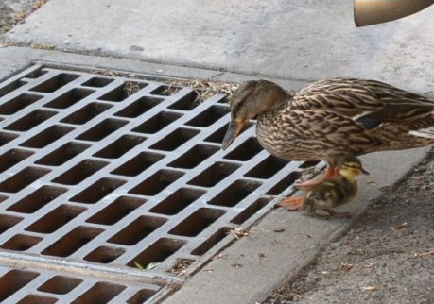
Separation mechanism
of porous membranes

Slide 5
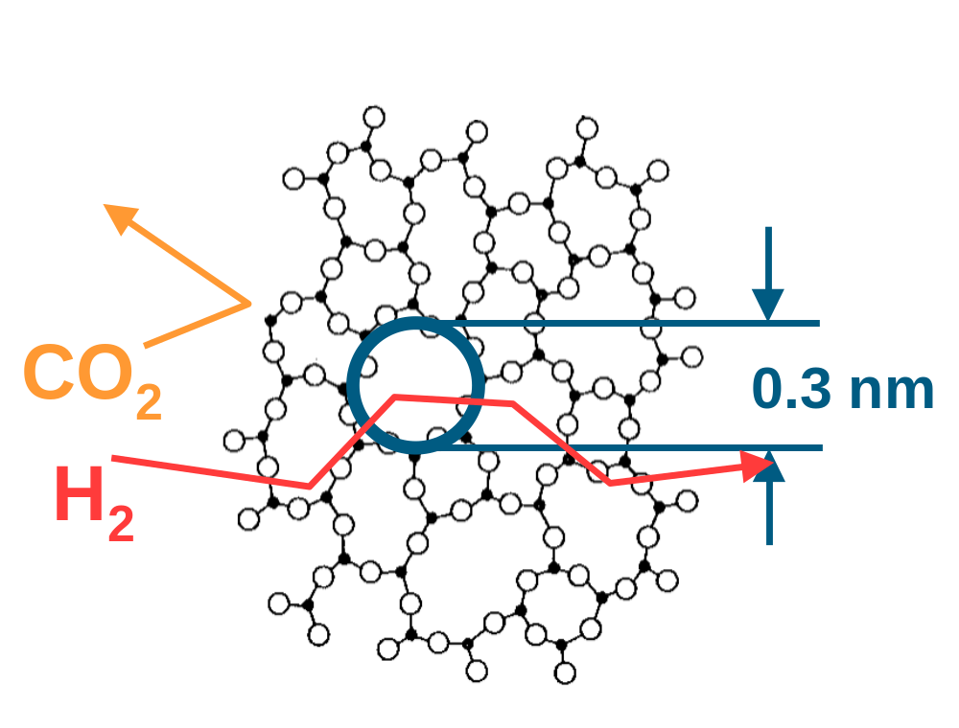
Separation mechanism
Definition in: International Union of Pure and Applied Chemistry (IUPAC):
Macro porous: Pore Size > 50 nm
Meso porous: Pore Size 2 - 50 nm
Micro porous: Pore size < 2 nm
Effective gas separation with micro porous membranes needs microstructures
with „free volume“ in the range of size of the gas molecules which have to be separated
He: 2.6 Å
H₂: 2.89 Å
CO₂: 3.3 Å
N₂: 3.64 Å
also sorption properties are relevant for separation
e.g. amorphous SiO₂-Structures

Slide 6
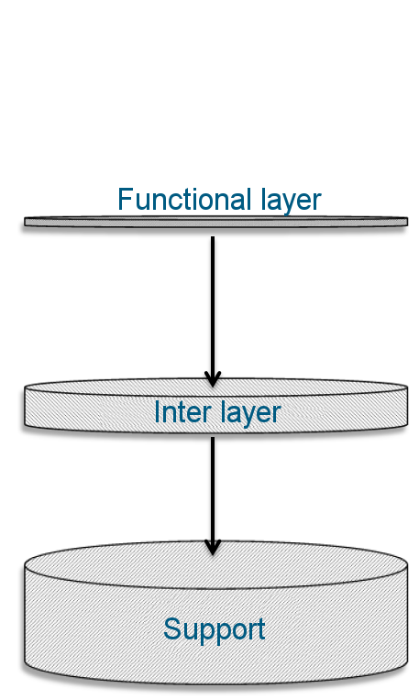

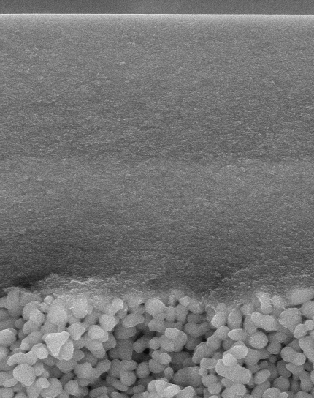
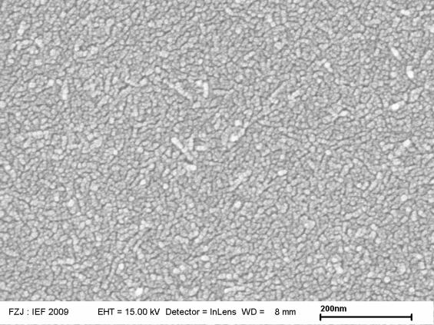
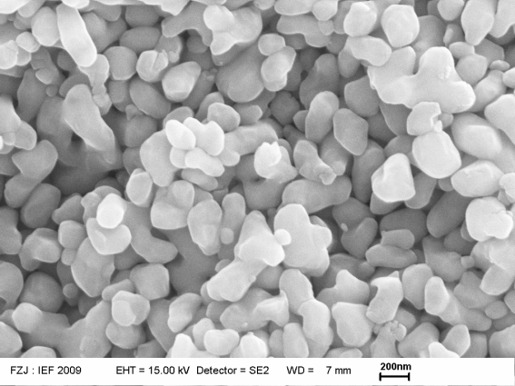
Membrane design
Graded multilayer system
Cross-section
Top view
SiO₂-functional layer
Functional layer: SiO₂
Sol-Gel-dip coating
Layer thickness: < 100 nm
Pore size: ≈ 2 nm
Gas separation
200 nm
γ-Al₂O₃-interlayer
Inter layer: γ-Al₂O₃ / 8YSZ
Sol-Gel-dip coating
Layer thickness : 4-5 µm
Pore size : 4-7 nm
Reduction of pore size and surface roughness
200 nm
Support: α-Al₂O₃
Vacuum-slip-cast
Layer thickness : ca. 2 mm
Pore size: 80-100 nm
mechanical stability
1 µm
α-Al₂O₃-support
400 nm
39 mm

Slide 7
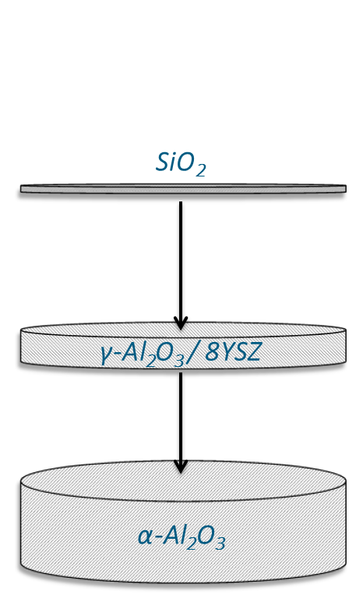
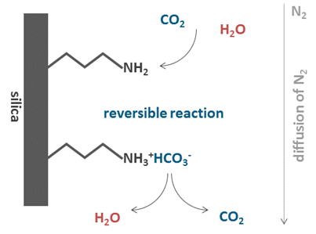

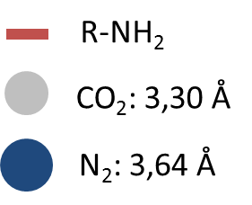
Membrane design
Selective CO₂-transport:
Enhanced CO₂-affinity by post synthesis functionalization with amino-groups (-NH₂)
Pore channel
Silica
reversible reaction
Diffusion von N₂
R-NH₂
CO₂: 0,33 nm
N₂: 0,36 nm
Selective adsorption of CO₂
CO₂ -transport along a partial pressure gradient
Reversible adsorption of CO₂ forming carbamates and carbonates
39 mm

Slide 8
CO₂-Separation from flue gas
Post-Combustion Capture
Membrane requirement
Air
Steam generation
high CO₂/N₂-selectivity and high CO₂-permeabitity
Stability in application environment
Coal
Furnace
Turbine and generator
Flue gas
N₂, CO₂, O₂, H₂O
SO₂, NO_{X}
dust
Flue gas cleaning
Main goals of the work
N₂, CO₂, O₂, H₂O
T < 100°C
P ≈ 1 bar
Flue gas
Development of a CO₂/N₂-selective silica-membrane
Systematic investigation of the aging behavior under application-oriented conditions
Membrane
CO₂-Separation
CO₂
Flue gas
N₂, (O₂, H₂O)

Slide 9
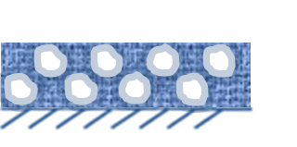
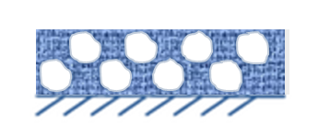
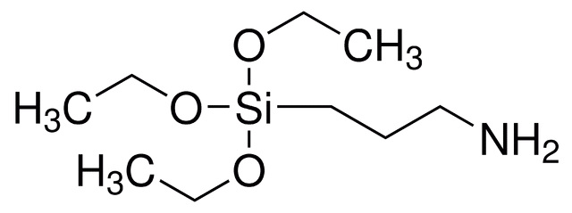
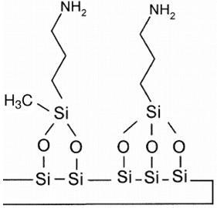
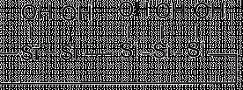
Laboratory tests
Amino functionalization of the pore surface
Characterisation
Liquid-phase modification
XPS-sputter-profil
Modifing solution:
0,064 M APTES* in 1-Propanol
not
funktionalized
K1_848
K1_849
Nitrogen
Silica-surface
Silica-surface
SiO₂
γ-Al₂O₃
Single gas permeation
Mixed gas permeation
CO₂ / N₂ (15/85)
He
H₂
CO₂
N₂
CO₂
N₂
T = 110°C
*γ-Aminopropyltriethoxysilan

Slide 10
Exposure tests
RWE lignite powerplant Niederaußem und EnBW hard coal power plant Karlsruhe
Karlsruhe
Niederaußem
Motivation
Air
Steam generation
Investigation of aging behavior of membrane components in direct contact with flue gas
Exploring the conditions for membrane processes in the power plant
Coal
Furnace
Turbine and generator
Flue gas
Flue gas
bypass
Flue gas cleaning
REAplus
Main components [Vol.-%]
CO₂ 13-15
N₂ 78
O₂ 6-8
Flue gas
Flue gas
Power plants
Trace components [mg/Nm³]
Dust 5-20
SO₂ 50-200
NO_{X} 20-200
Trace components [mg/Nm³]
Dust < 1
SO₂ < 10 (> 1000*)
NO_{X} 20-200
EnBW “Rheinhafen-Dampfkraftwerk” Block 7
Fuel: hard coal
Year: 1985
Electrical output: 550 MW_{el}
RWE power plant Niederaußem Block K
Fuel: lignite
Year: 2003
Electrical output: 1000 MW_{el}
ϑ ≈ 60°C
rH ≈ 60 %
ϑ ≈ 70°C
rH ≈ 100 %
Membrane test rig
Membrane test rig
* Short peaks during efficiency tests of the desulphurization unit

Slide 11
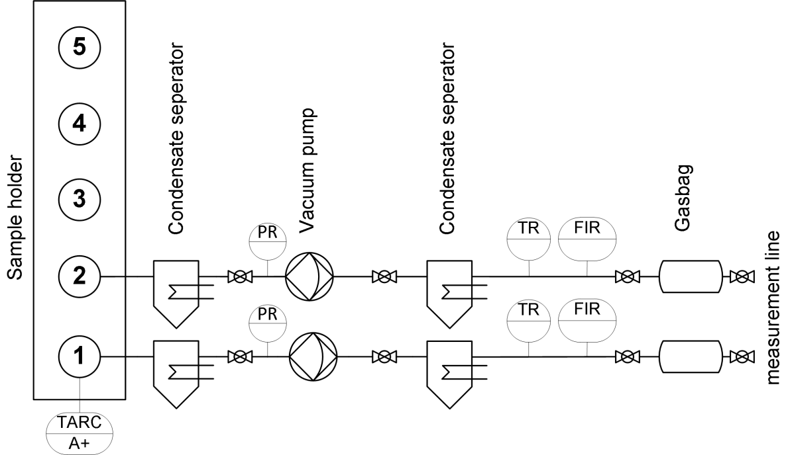
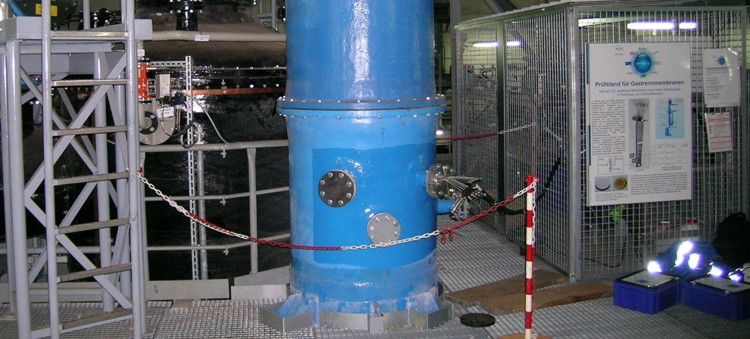
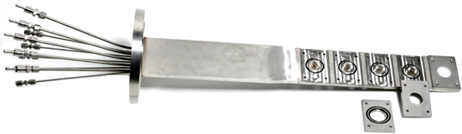
Exposure tests
RWE lignite powerplant Niederaußem und EnBW hard coal power plant Karlsruhe
Karlsruhe
Niederaußem
Membrane test rig
Motivation
Hauptanteile [Vol.-%]
CO₂ 13-15
N₂ 78
O₂ 6-8
Investigation of aging behavior of membrane components in direct contact with flue gas
Exploring the conditions for membrane processes in the power plant
Rauchgas
Rauchgas
Nebenleitung
Rauchgasreinigung
REAplus
Rauchgas
Rauchgas
Membranprüfstand
Membranprüfstand
Spurenanteile [mg/Nm³]
Staub 5-20
SO₂ 50-200
NO_{X} 20-200
Spurenanteile [mg/Nm³]
Staub < 1
SO₂ < 10
NO_{X} 20-200
25 cm
T ≈ 60°C
rH ≈ 60 %
T ≈ 70°C
rH ≈ 100 %

Slide 12
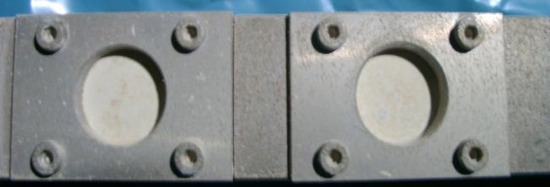
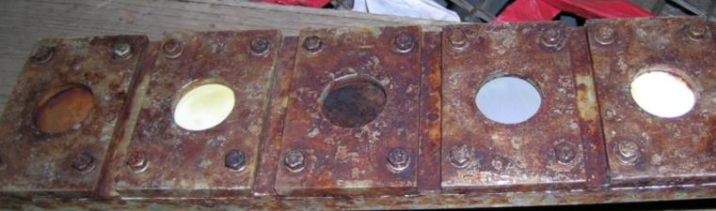
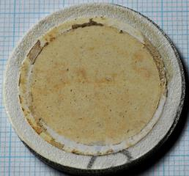
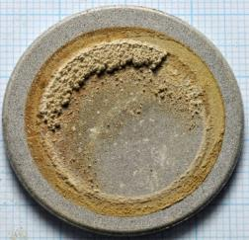
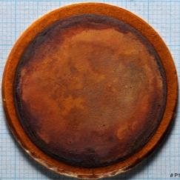
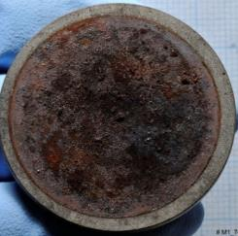
Exposure tests
After 1100 h Exposition
Power plant Karlsruhe
Power plant Niederaußem
Sample holder
1.4571
Sample holder
1.4571
Polyactive on 316L
316L (1.4404)
Polyactive on 316L
316L (1.4404)
Little corrosion, distinct ash/dust covering
Severe corrosion, no identifiable ash/dust covering
(Colouring of Polymer-membrane due to corrosion of sample holder)

Slide 13
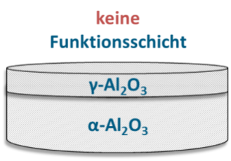
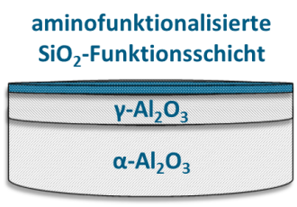
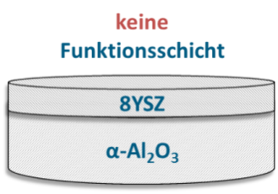
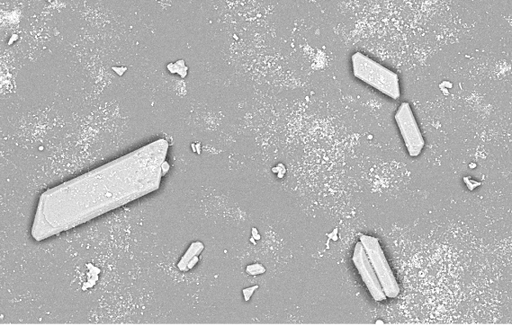
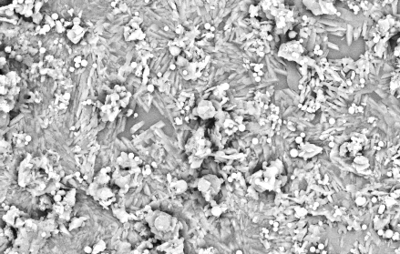
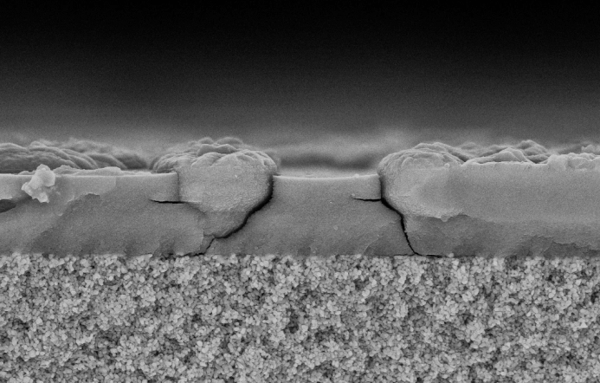
Exposure tests
(Exposure time ca. 100 h)
no
functional layer
amino functionalized
SiO₂-function layer
no
function layer
Niederaußem experiment 1
Niederaußem experiment 2
Karlsruhe
SO₂ < 10 mg/m³
Begin: SO₂ Ø374 mg/m³
SO₂ Ø200 mg/m³
End: SO₂ < 10 mg/m³
Top view
40 µm
K1_722
20 µm
K1_721
10 µm
K1_587
EDX: Al, O, S, Si, Na, K, Cl
XRD: Natronalunite Na_{X}K_{1-X}Al₃(SO₄)₂(OH)₆
Cross section
EDX: Al, O, S, Si, Na, K, Cl
5 µm
K1_722
5 µm
K1_721
5 µm
K1_587

Slide 14
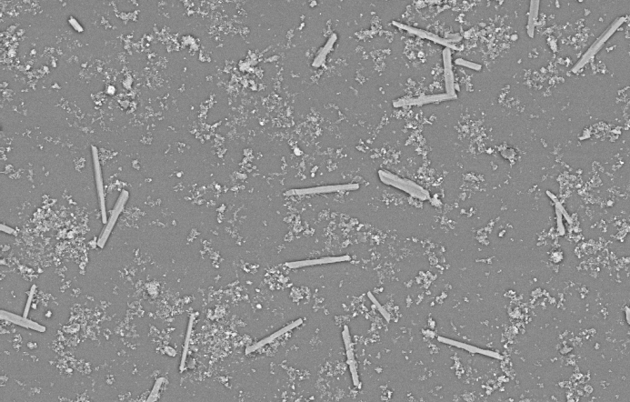
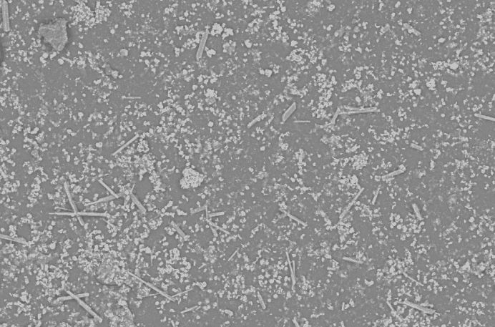
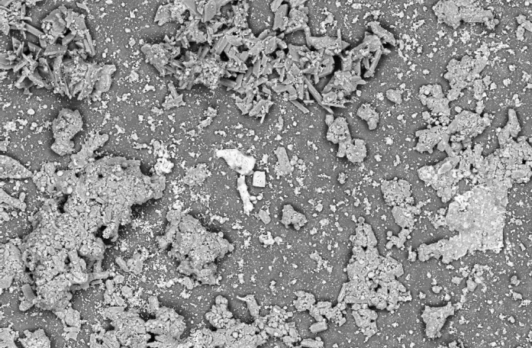
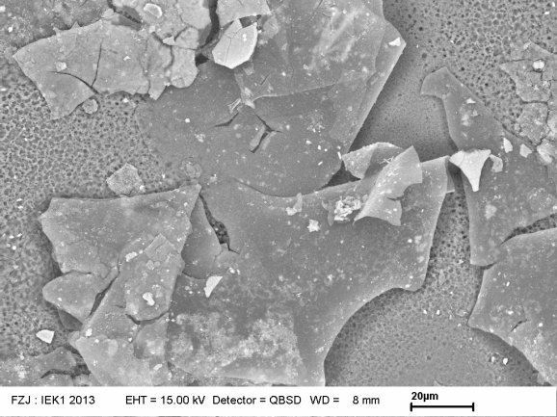
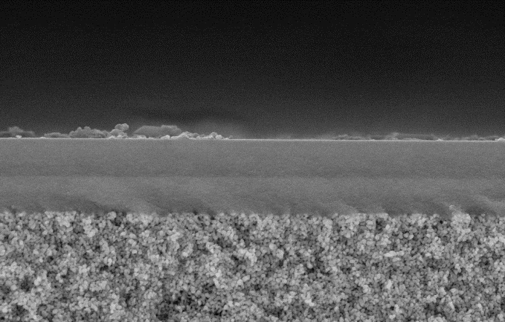
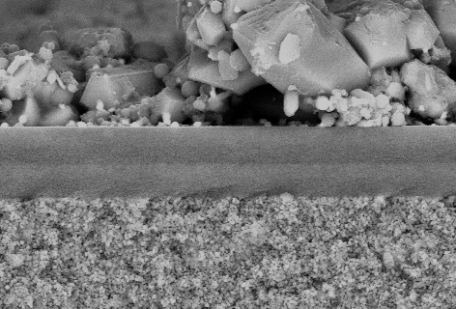
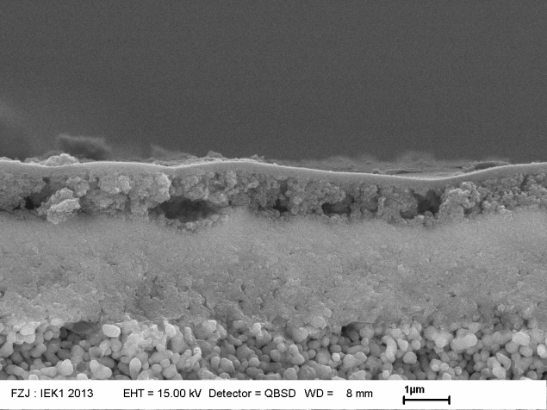
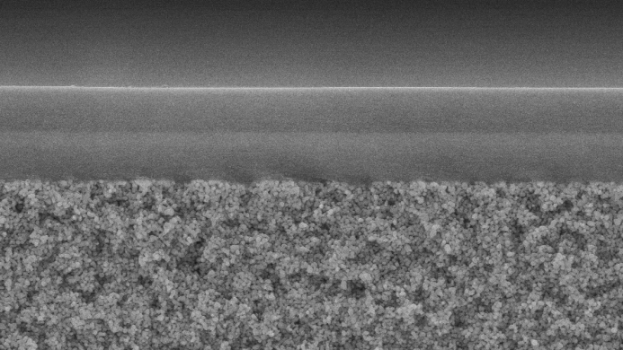
Exposure tests
(Exposure time ca. 100 h)
no
functional layer
amino functionalized
SiO₂-functional layer
no
functional layer
+900 h
Niederaußem experiment 2
Karlsruhe
Niederaußem experiment 1
Niederaußem experiment 3
Beginn: SO₂ Ø374 mg/m³
SO₂ < 10 mg/m³
Begin: SO₂ Ø374 mg/m³
SO₂ < 10 mg/m³
SO₂ Ø200 mg/m³
SO₂ Ø200 mg/m³
SO₂ Ø247 mg/m³
Ende: SO₂ < 10 mg/m³
End: SO₂ < 10 mg/m³
Top view
40 µm
K1_750
20 µm
K1_721
40 µm
40 µm
K1_764
10 µm
K1_412
K1_722
K1_412
50 µm
K1_587
50 µm
K1_562
20 µm
EDX: Al, O, S, Si, Na, K, Cl
XRD: Natroalunite Na_{X}K_{1-X}Al₃(SO₄)₂(OH)₆
EDX: Al, O, S, Si, Na, K, Cl
XRD: Natronalunite Na_{X}K_{1-X}Al₃(SO₄)₂(OH)₆
Cross section
EDX: Al, O, S, Si, Na, K, Cl
EDX: Al, O, S, Si, Na, K, Cl
5 µm
K1_750
K1_764
5 µm
K1_722
5 µm
K1_750
5 µm
5 µm
K1_721
K1_412
K1_764
5 µm
5 µm
5 µm
5 µm
5 µm
K1_562
K1_587
K1_412
2 µm
K1_412

Slide 15
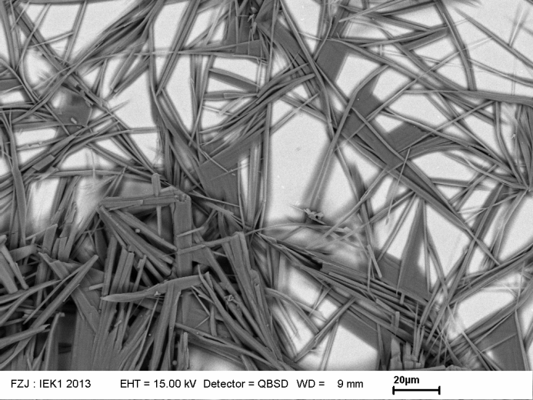
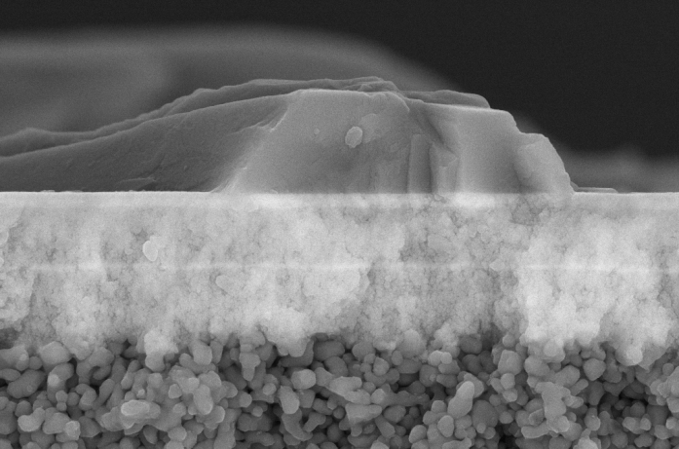
Exposure tests
(Exposure time ca. 100 h)
no
functional layer
amino functionalised
SiO₂-functional layer
no
functional layer
Niederaußem experiment 2
Beginn: SO₂ Ø374 mg/m³
Helium-single gas permeation
Before exposure: 5,5 m^{3·}m^{-2·}h^{-1·}bar⁻¹
After exposure: 0,1 m^{3·}m^{-2·}h^{-1·}bar⁻¹
Ende: SO₂ < 10 mg/m³
Top view
20 µm
K1_761
Cross section
EDX: Zr, O, Y, Al, S, Na, K
2 µm
K1_761

Slide 16

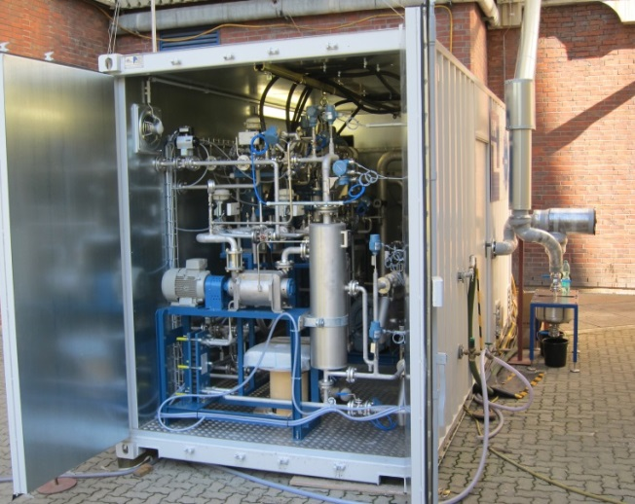
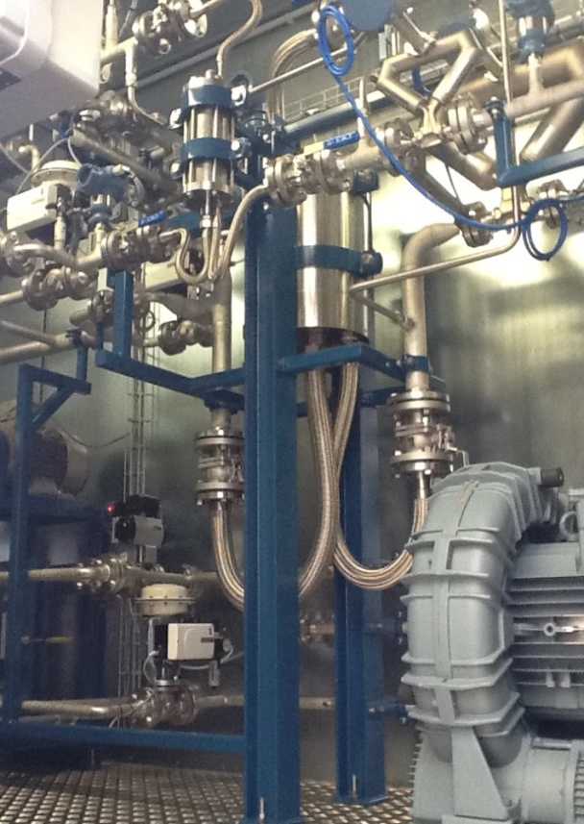
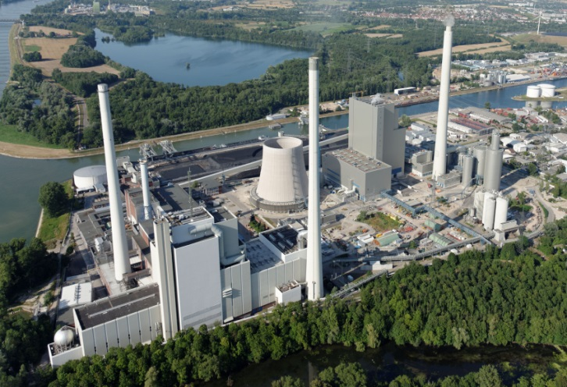
Membrane module test rig
Operated by the Helmholtz-Zentrum Geesthacht (HZG) at the EnbW Rheinhafen-Dampfkraftwerk Karlsruhe
HZG Membrane module
(up to 70 m² and 900 m²/m³)
Modules
1 m² 12 m²
Flue gas
pre-conditioning
Flue gas
Feed
Vaccuum pump
21
21
21
21
21
Retentate
· · ·
· · ·
· · ·
· · ·
· · ·
Permeate
· · ·
· · ·
· · ·
· · ·
· · ·
blower
https://www.enbw.com/blog/kunden/files/2014/09/130802_RDK_024.jpg

Slide 17
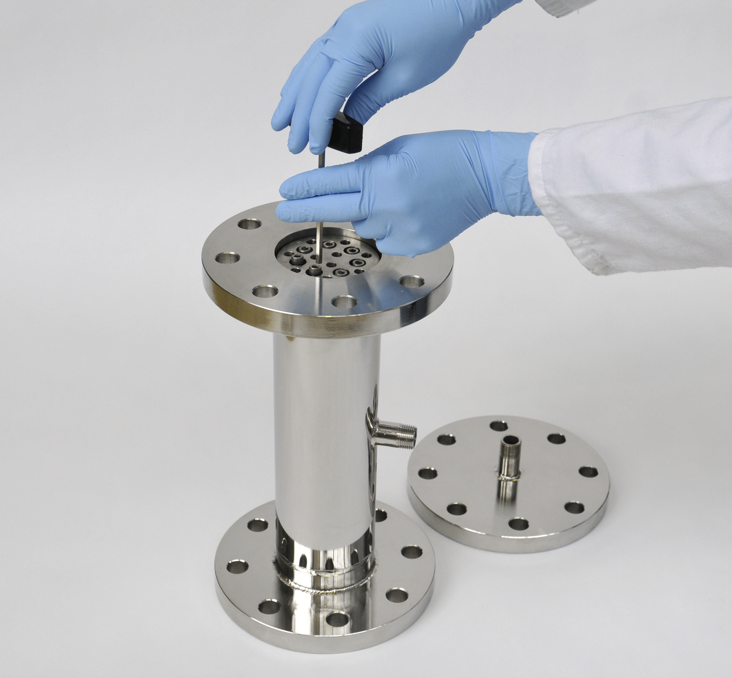
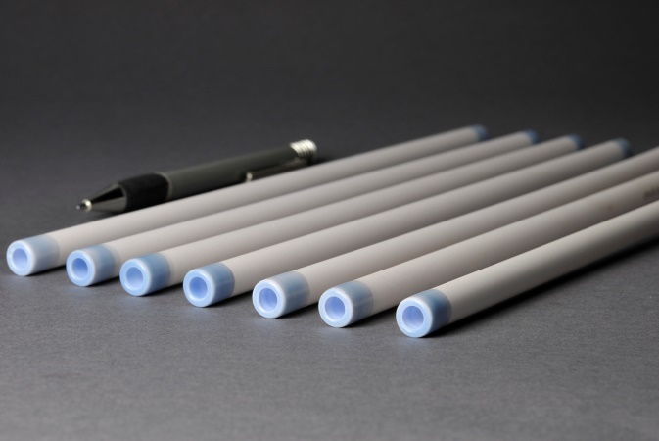
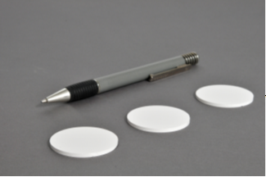

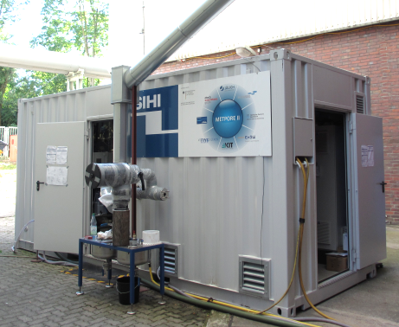
Membrane module test rig
Proof of CO₂-separation at application conditions
Membrane area ≈ 3 cm²
Execution
Membrane area ≈ 50 cm²
Transfer of the membrane concept to tubular supports
Assembly of a membrane module with ten tubular membranes resulting in 500 cm² membrane area!
36 h test run of the module with preconditioned flue gas at the Metpore II module test rig
(Rheinhafen-Dampfkraftwerk Karlsruhe)
ϑ ≈ 35°C
rH ≈ 50 %
CO₂-concentration ≈ 14 %
results
CO₂-concentration in the permeate
  Begin ≈ 60 %
  End ≈ 50 %
First time proof of CO₂ separation under application conditions!

Slide 18
Conclusions
Exposure tests in direct contact with flue gas
The operation of ceramic membranes in direct contact with flue gas is problematic.
Analogues to polymeric membranes a flue gas conditioning is required (dehumidification)
Damage mechanisms in direct contact with flue gas
Forming of a filter cake respectively a layer of fly ash and gypsum
Corrosion of γ-Al₂O₃ intermediate layer connected to a phase transition
Blocking of pores by condensing water and minerals in the inter layers

Slide 19
Conclusions
Amino-functionalized membranes: Promising for CO₂/N₂-Separation at high temperatures
CO₂-concentration from 15 Vol.-% up to 67 Vol.-% at 90°C in the laboratory
First time proof of CO₂ separation under application conditions
CO₂-enrichment from 14 Vol.-% up to 60 Vol.-% at 35°C
(pre-conditioned flue gas)

Slide 20
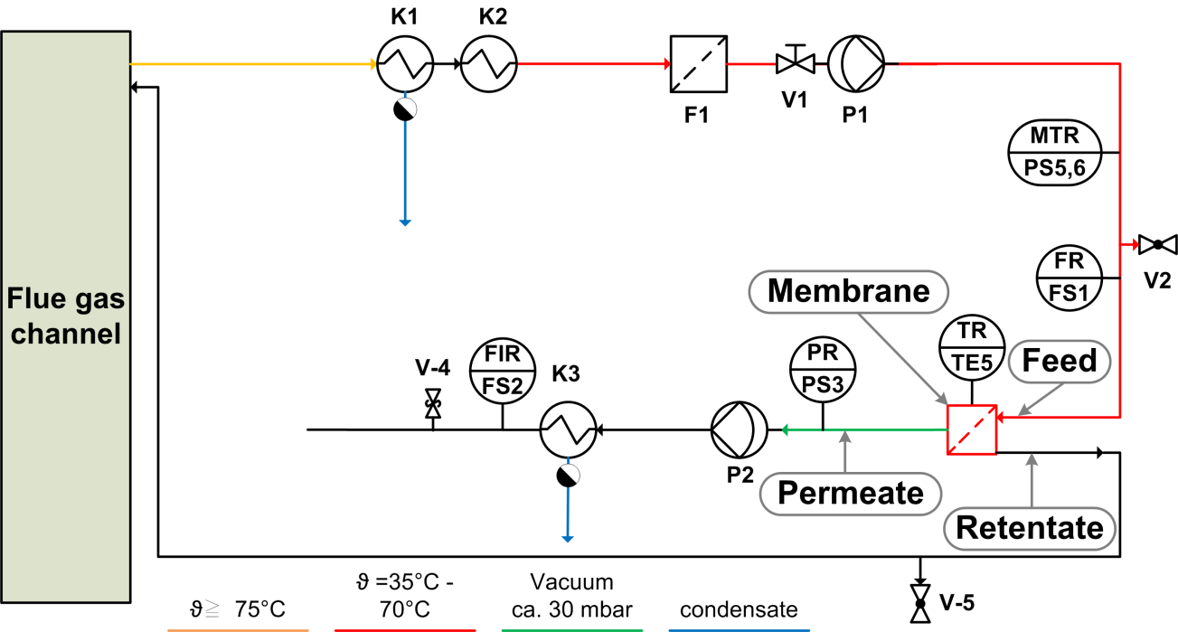
Outlook
Development of ceramic membranes will continue in the follow-up project MemKoR
As a consequence of the results the setup of the test rig was changed
First experiment with a Polyactive™ membrane from our project partner HZG was successful
Conditions (Feed)
Parameter |  | Components
Pressure difference [bar] | 1 | CO₂ [Vol.-%] | 15
Temperature [°C] | 40 | O₂ [Vol.-%] | 6
Volume flow [Nl/h] | 70 | SO₂ [ppm] | 3
Humidity [ rH %] | 10 | NO_{x} [ppm] | 100
 |  | N₂ [Vol.-%] | Rest
Single gas permeation after exposure
New membrane | Permeation [Nm³/(m² h bar)] | Selectivity [CO₂/N₂]
CO₂ | (3,026) 2,967 | (56) 53
N₂ | (0,054) 0,056
Almost no loss of selectivity and permeability after 2250 h!

Slide 21



Acknowledgements
METPORE II
Nano-structured ceramic and metal supported
membranes for gas separation
(FKZ: 03ET2016)
MemKoR
Membrane processes for separation of carbon dioxide from power plant flue gases
(FKZ: 03ET7064)
Thank you for your kind attention!

