Slide 1
About OMICS Group
OMICS Group International is an amalgamation of Open Access publications and worldwide international science conferences and events. Established in the year 2007 with the sole aim of making the information on Sciences and technology ‘Open Access’, OMICS Group publishes 400 online open access scholarly journals in all aspects of Science, Engineering, Management and Technology journals. OMICS Group has been instrumental in taking the knowledge on Science & technology to the doorsteps of ordinary men and women. Research Scholars, Students, Libraries, Educational Institutions, Research centers and the industry are main stakeholders that benefitted greatly from this knowledge dissemination. OMICS Group also organizes 300 International conferences annually across the globe, where knowledge transfer takes place through debates, round table discussions, poster presentations, workshops, symposia and exhibitions.

Slide 2
About OMICS Group Conferences
OMICS Group International is a pioneer and leading science event organizer, which publishes around 400 open access journals and conducts over 300 Medical, Clinical, Engineering, Life Sciences, Phrama scientific conferences all over the globe annually with the support of more than 1000 scientific associations and 30,000 editorial board members and 3.5 million followers to its credit.
OMICS Group has organized 500 conferences, workshops and national symposiums across the major cities including San Francisco, Las Vegas, San Antonio, Omaha, Orlando, Raleigh, Santa Clara, Chicago, Philadelphia, Baltimore, United Kingdom, Valencia, Dubai, Beijing, Hyderabad, Bengaluru and Mumbai.

Slide 3
Supercapacitive Swing Adsorption

Slide 4
Concept of conventional pressure and temperature swing adsorption (PSA and TSA)
Lower temperature/
Higher pressure
Higher temperature/
Lower pressure
Reversible adsorption of gas molecules to porous adsorbents or molecules is achieved by reversible pressure and temperature changes.

Slide 5
Concept of capacitive swing adsorption
Capacitive charge
- - - - - - - - - -
Capacitive discharge
Reversible adsorption and desorption is achieved by capacitive charge and discharge
of high-surface area carbons.

Slide 6
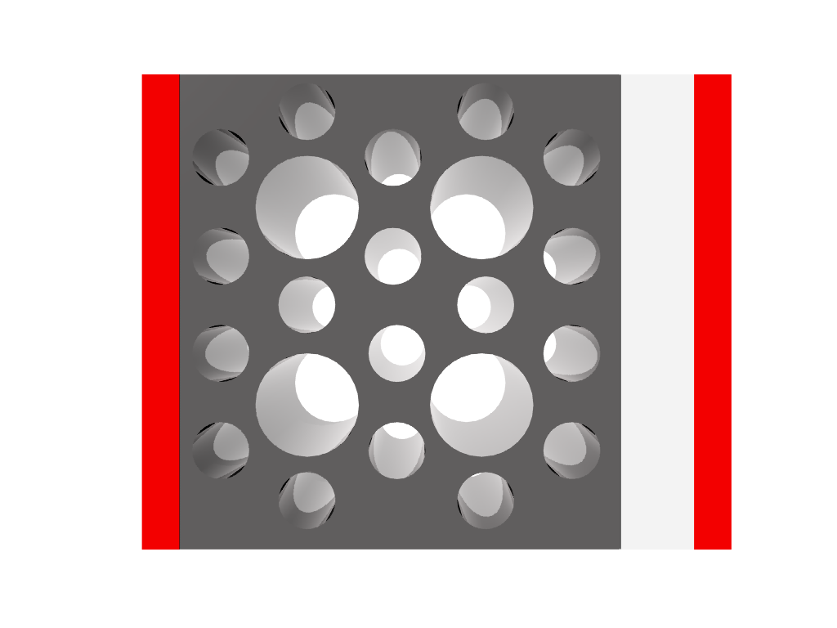
Capacitive Swing Adsorption
-
-
-
-
-
-
-
-
-
-
-
+
+
+
+
+
+
+
+
+
+
+
metal plate
Nanoporous carbon
metal plate
No change in gas sorption properties were observed up to 5 kV.

Slide 7
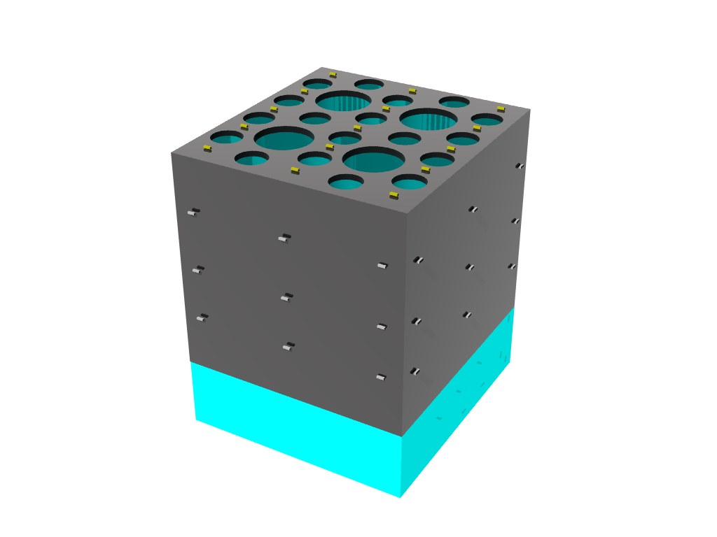
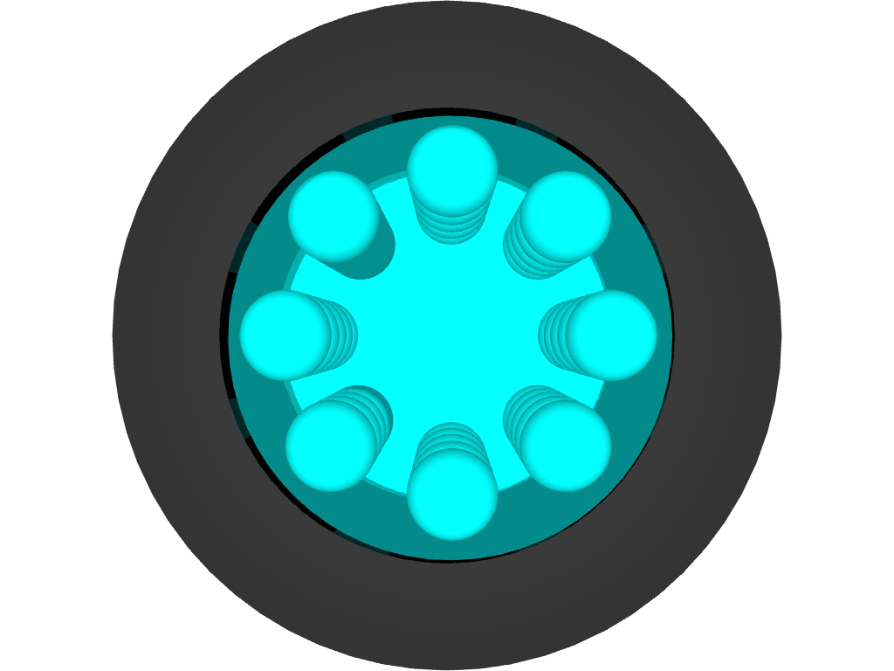
Supercapacitors
-
-
-
+
+
+
-
+
+
-
+
+
-
+
-
-
Electrode in contact with electrolyte, e.g. H₂SO₄ , NaCl.
Electric double layer

Slide 8

Supercapacitive Swing Adsorption (SSA) with aqueous electrolytes

Slide 9
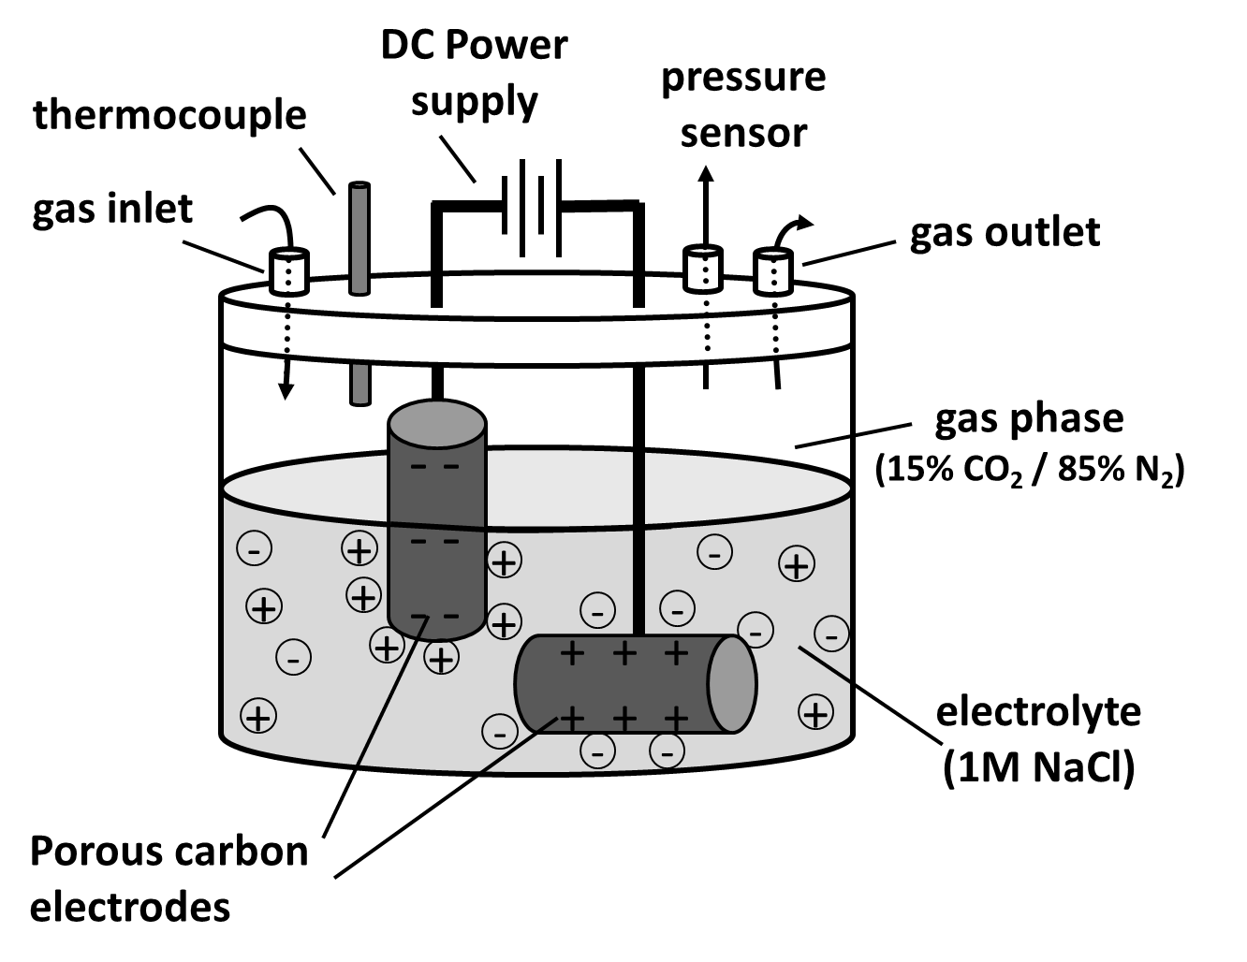
Design of a Supercapacitive Swing Adsorption
(SSA) experiment
(3.7 g)
Notes:
Red curve: Charge. Black curve: Discharge.

Slide 10
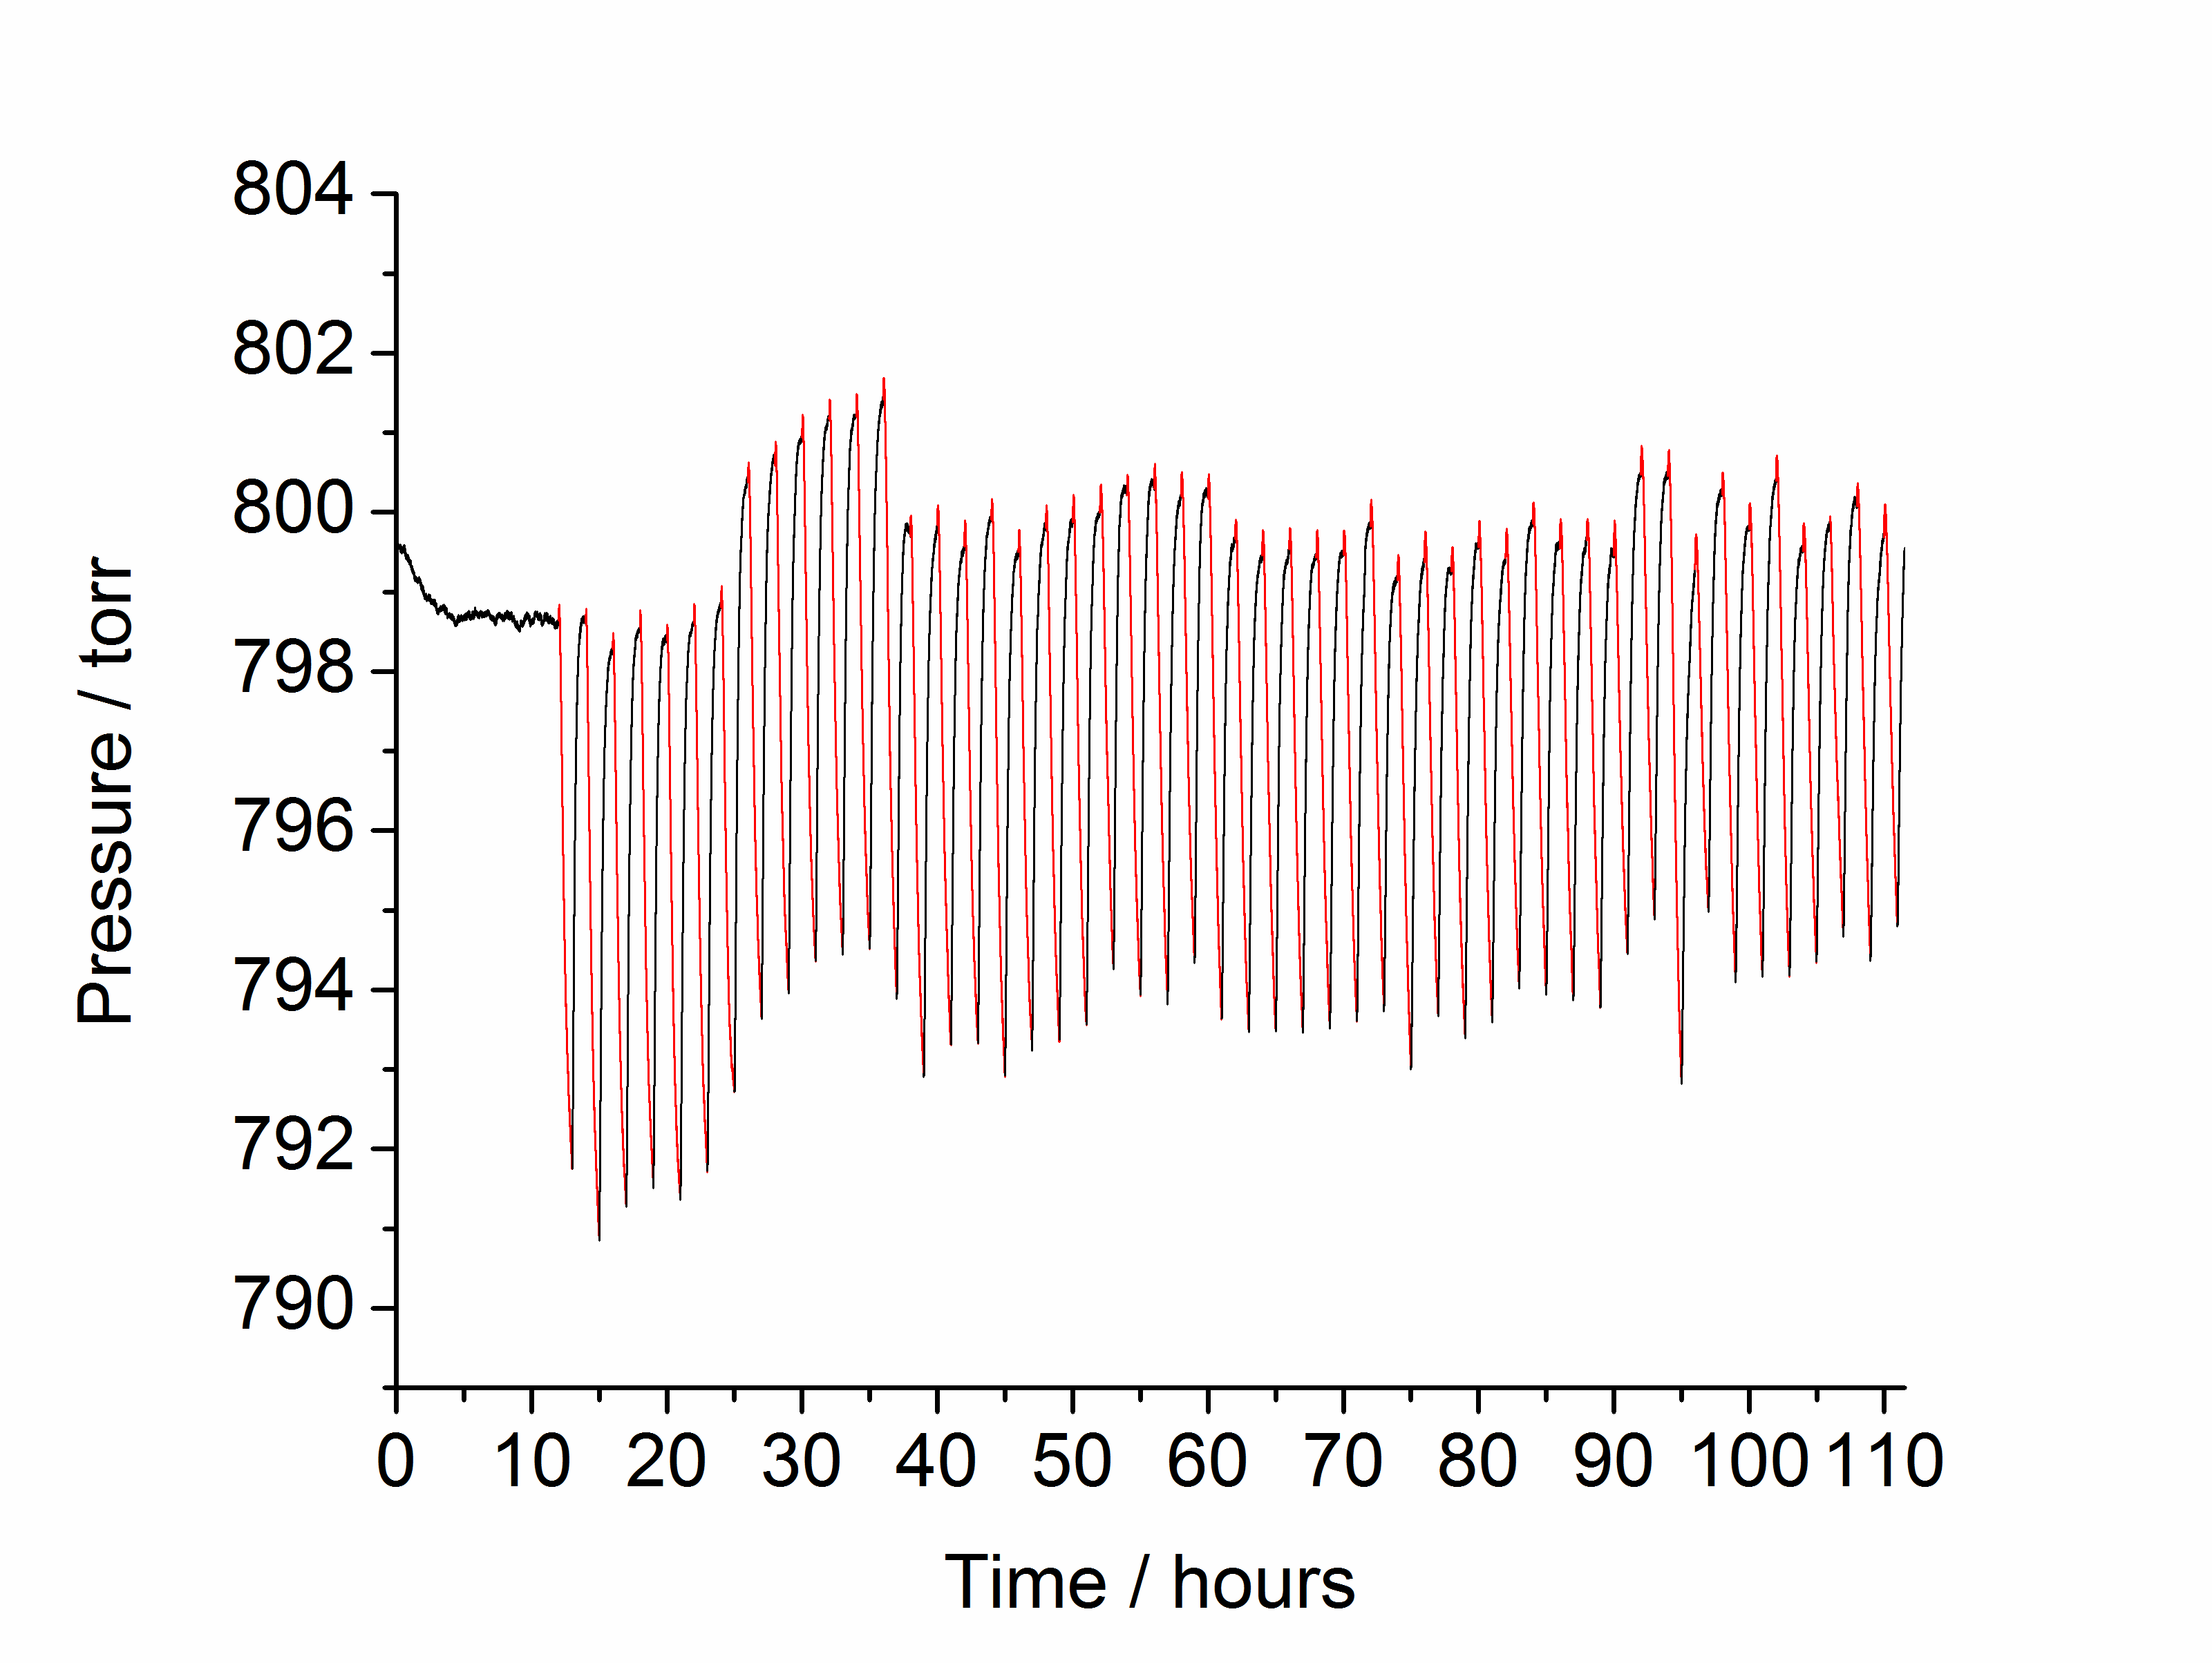
Multicyclability
Voltage source: Constant voltage power supply (1V).
Electrode mass: 3.7 g

Slide 11
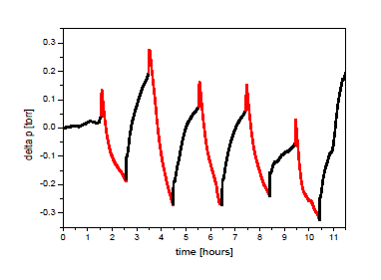
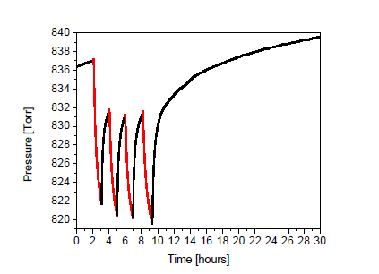
Scalability
Electrode mass: 0.2 g
Electrode mass: 7.5 g
The SSA effect is proportional to the mass of the electrodes.

Slide 12
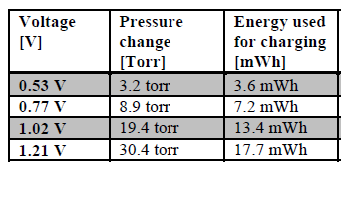
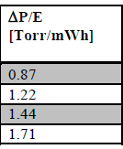
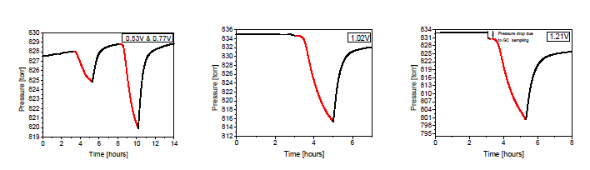
Voltage dependence

Slide 13
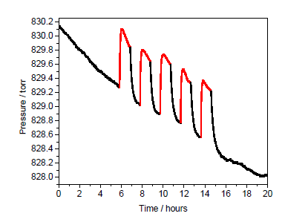
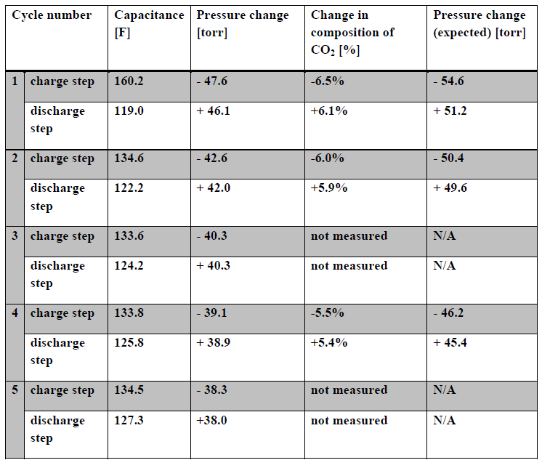
Gas selectivity
Electrode mass: 7.5 g
Voltage 1.2 V
SSA experiment in pure N₂.

Slide 14
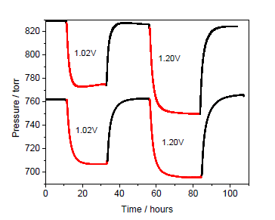
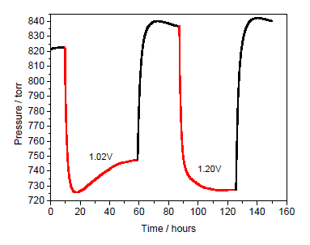
SSA effect in equilibrium
15% CO₂ / 85% N₂
Pure CO₂
ΔP = 55 Torr (1.0 V)
ΔP= 70 Torr (1.2 V)
ΔP = 97 Torr (1.0 V)
ΔP = 109 Torr (1.2 V)
Amount CO₂ adsorbed / kg sorbent:
40 mmol/kg (1V)
70 mmol/kg (1V)
80 mmol/kg (1.2V)
50 mmol/kg (1.2V)
“Native” capacity of BPL carbon: 240 mmol/kg (0.15 atm CO₂)

Slide 15
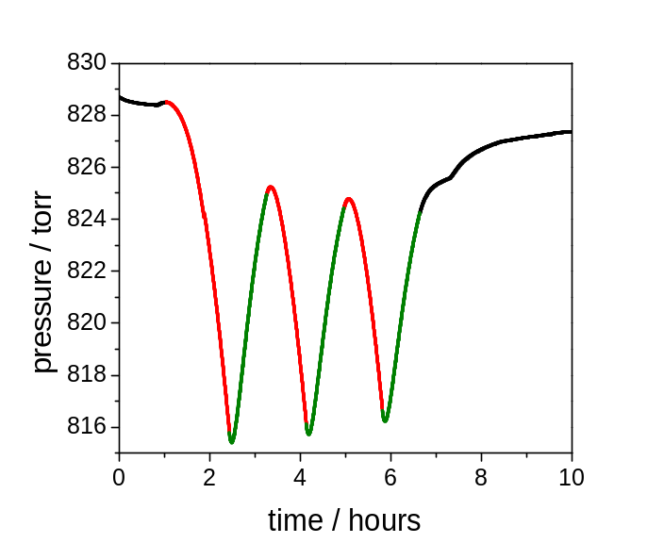
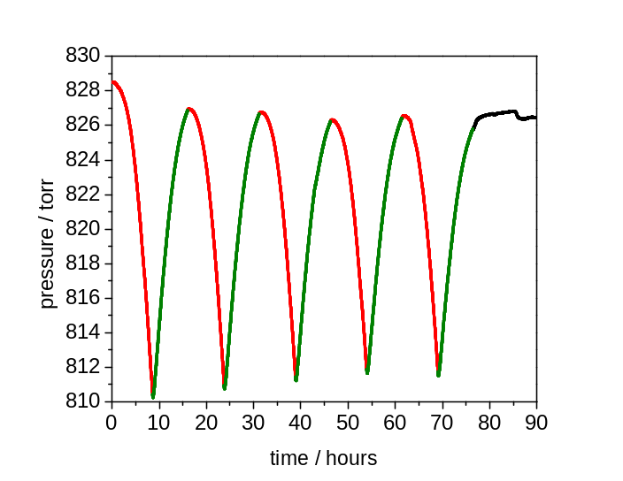
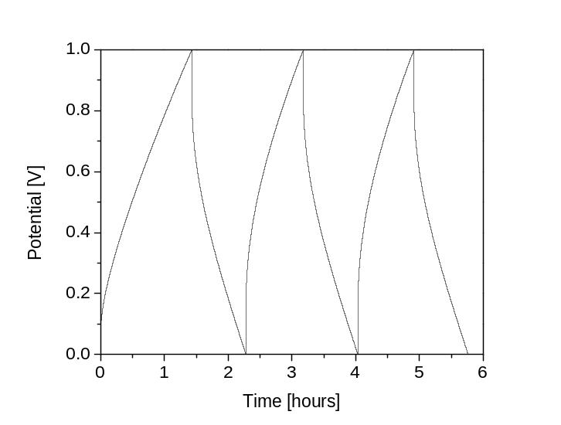
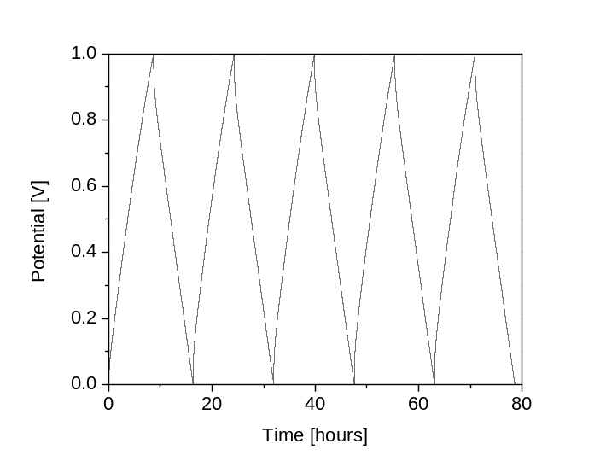
SSA – GCD coupled experiment
10 mA
2 mA
15% CO₂ / 85% N₂
E = V x I x t
42% energy efficiency
74% energy efficiency
Amount of energy required to adsorb 1 mol CO₂: 104 kJ/mol CO₂
Notes:
Red: Charge-curve . Green: Discharge-curve.

Slide 16
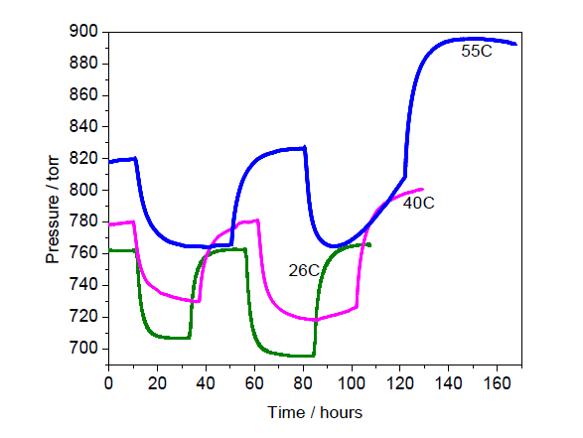
Temperature dependence
15% CO₂ / 85% N₂
1V
1.2 V

Slide 17
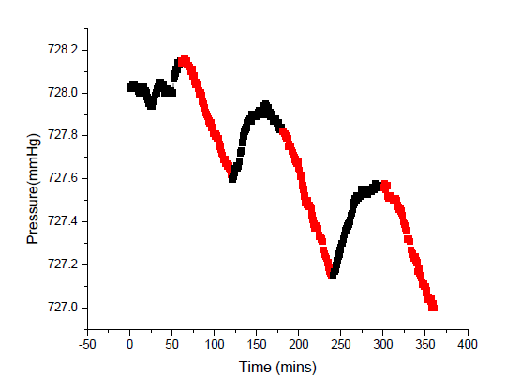
SSA effect in ionic liquids
V = 1V

Slide 18
Conclusions
A fundamentally new electrical effect has been discovered.
The SSA effect is able to separate CO₂/N₂ gas. Potentially, other gas mixtures can be separated.
The SSA effect can be observed for different electrolyte systems.
The SSA effect increases with voltage.
The SSA effect increases disproportionally with the CO₂ partial pressure.
The SSA effect barely decreases with temperature.

Slide 19
Acknowledgements
DOE ARPA-E
PA Nanocommericalization Center
Dr. David T. Moore
Dr. Paritosh Mohanty
Berenika Kokoszka
Cong Liu
Nina K. Jarrah

Slide 20
Let Us Meet Again
We welcome you all to our future conferences of OMICS Group International
Please Visit:
www.omicsgroup.com
www.conferenceseries.com
www.pharmaceuticalconferences.com

