Slide 1
Medical ergonomics: product development based on collaboration between medicine and engineering.
Kageyu NORO¹, Hideki OYAMA², and Kouichiro TOYODA³
1Waseda University/ Ergoseating Co.,Ltd.
2Graduate School of Biomedical Engineering, Tohoku University
3Toyota Orthopedic Clinic

Slide 2
Initiated by claims from patients:
Uncomfortable feelings during waiting
Increased low back pain caused by long waiting time
Proposals from a doctor motivated by a desire to improve seat comfort

Slide 3
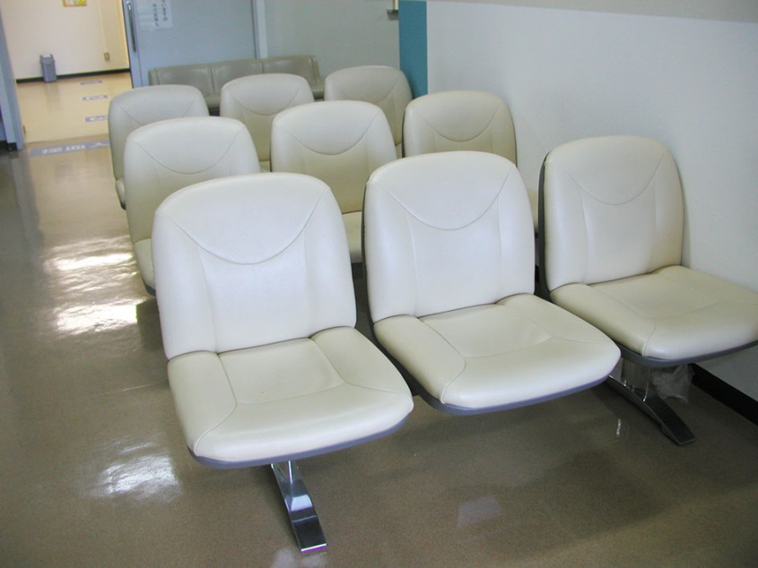
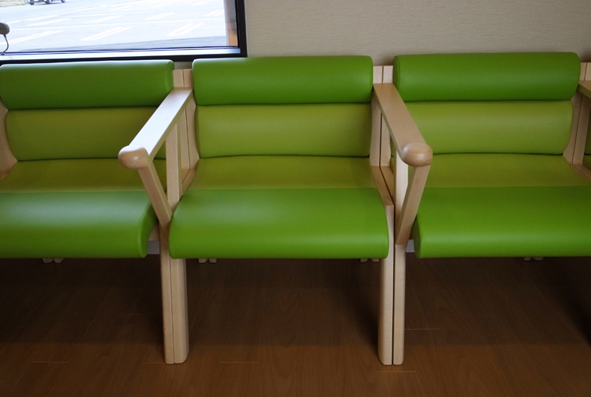
Development of A Comfort Chair for Low Back Pain Patients
Past chairs The marketed products

Slide 4
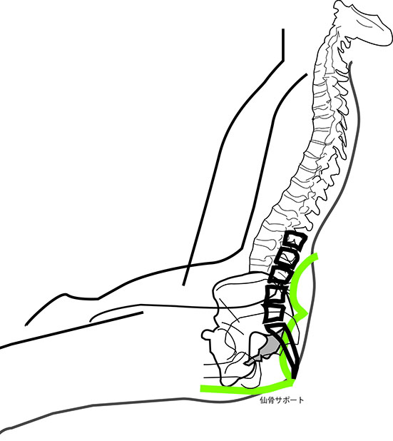
two lumbar supports and one sacral support（wedge)
Hypothesis-based product development
：A chair equipped with a combination of:

Slide 5
Development process
Step 1
Proposals from a medical doctor
Step 2
Formation of a participatory development team including a medical doctor
Step 3
Experiments with the participation of patients

Slide 6
Platform for Experiments: Develop a mechanism to correctly support skeletal system equipped two lumbar supports and one sacral support

Slide 7
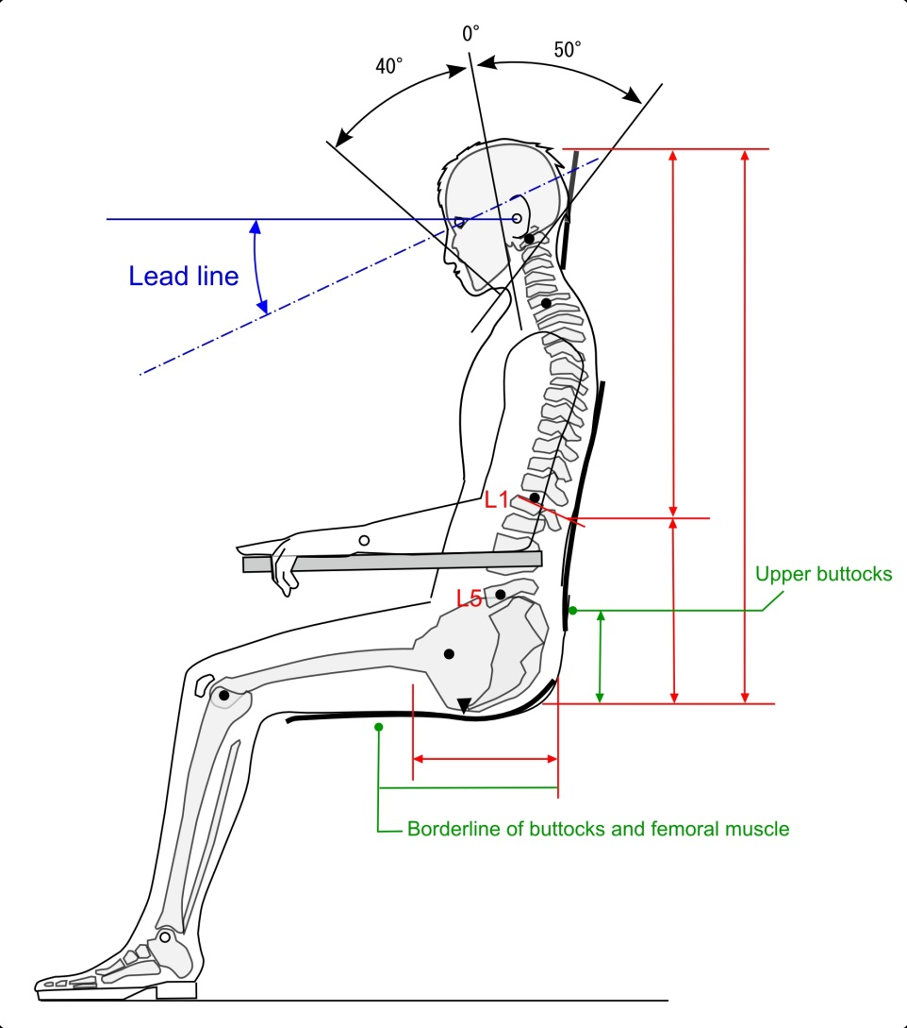
Anthropometric investigation of sitting posture of a Japanese person

Slide 8
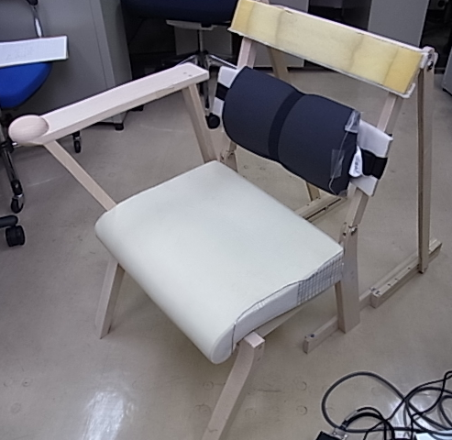
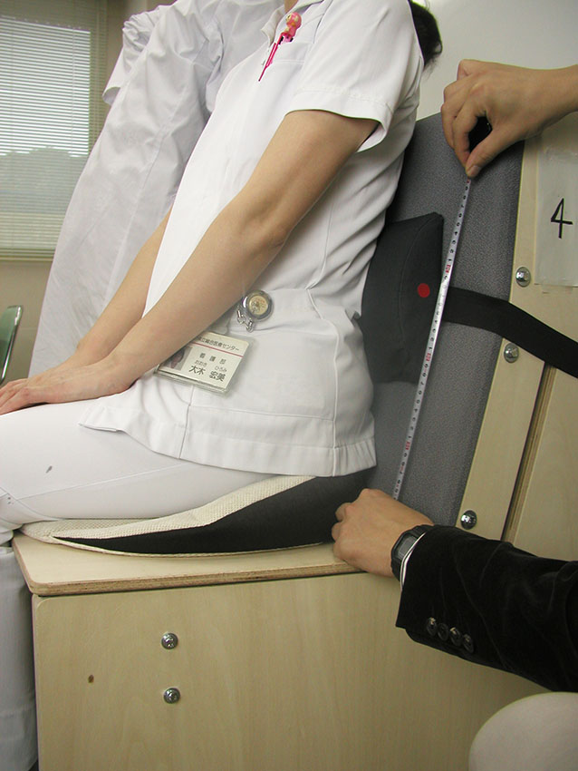
Creation of a mockup with a level-adjustable lumbar support（A)
Measurement thereby of lumbar position of subjects（B)
The angle of the pelvis is
measured with a gyro sensor.
(A)
(B)

Slide 9
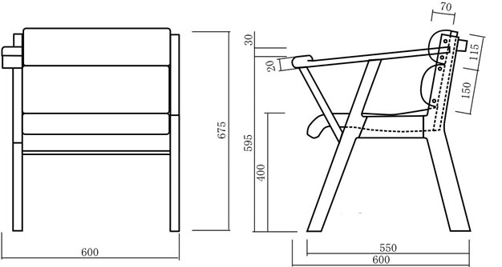
A mass-manufacture drawing based on the findings from above experiments.

Slide 10
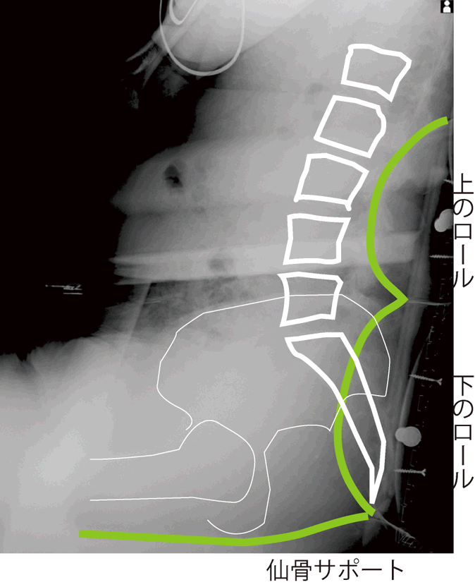
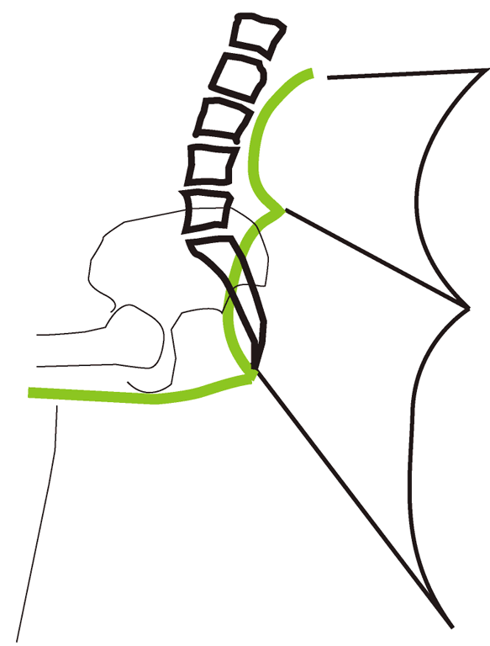
Confirmation through X-ray imaging of
positional relationships between rolls, lumbar
and pelvis
A wedge
Two lumbar supports

Slide 11
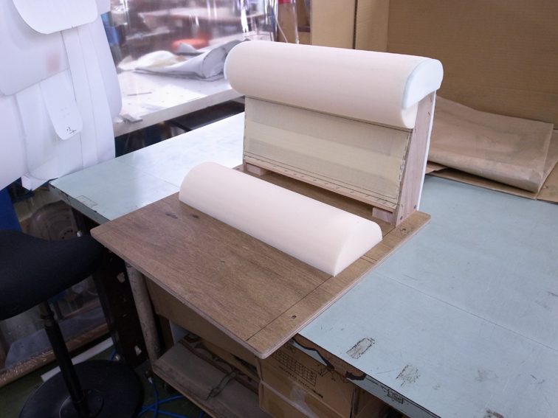
Shop fabrication of lumbar rolls for a chair

Slide 12
Results： marketed products
price of a mass-produced model of chairs for the waiting room of clinics

Slide 13
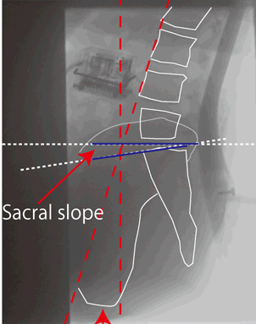
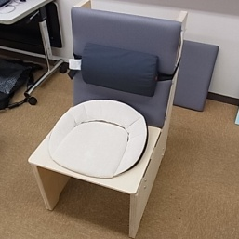
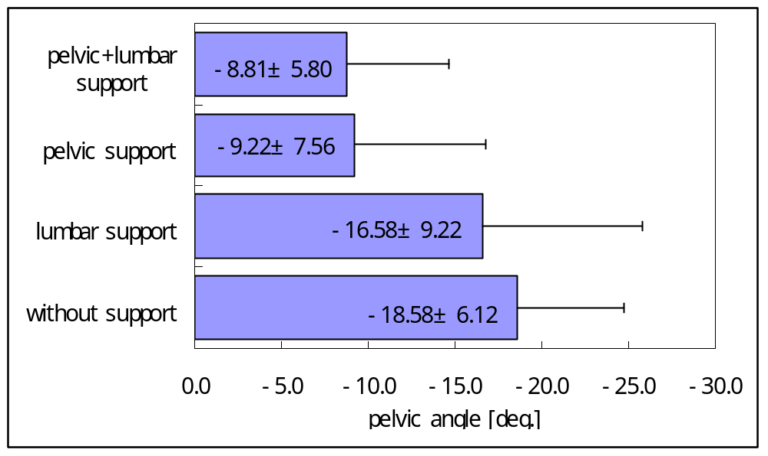
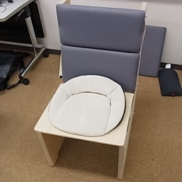
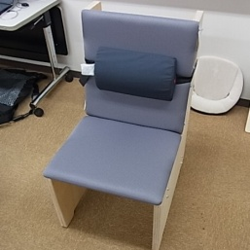
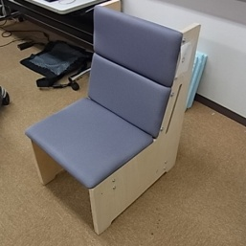
Cross-checking by X-ray imaging and gyroscopic sensing to verify correctness of sitting posture
Pelvic angle
Pelvic angle (deg.)

Slide 14
Evaluation of comfort by means of VAS, a method conventionally used for pain assessment in surgical medicine
Visual Analog Scale (VAS)

Slide 15
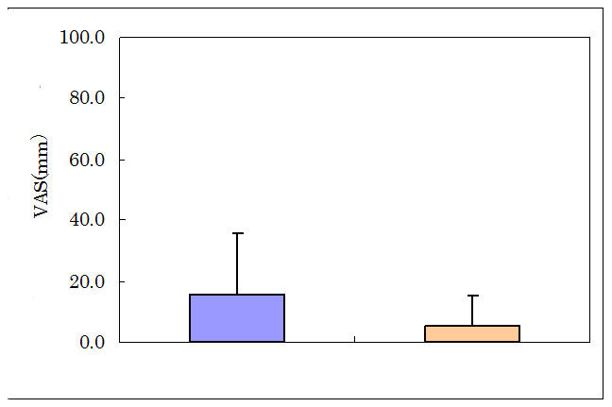
Albeit no statistically-significant difference obtained, symptoms of improvement in pain level were observed.
painful
No. of Subjects: 12（M４，F８），
Age : 62.4±18.8
Height : 158.0±7.4cm
not painful
at al
Before
After

Slide 16
Product features and benefits
A chair equipped with a combination of two lumbar supports and one sacral support（wedge)
Benefits:
Decrease of uncomfortable feeling
Prevention of musculoskeletal disorder

Slide 17
Conclusion:
Based on collaboration between medicine and engineering.
From an engineering viewpoint, information gained from X-ray images has come to be used for chair design, thereby resulting in successful development of chairs contributing to health promotion and disease prevention.

Slide 18
References
Wu, C., Miyamoto, H., Noro, K., 1998. Research on pelvic angle variation when using a pelvic support. Ergonomics. 41(3) 317-327.
Oyama, H.,Noro, K. andToyoda, K.2013.
Prototyping of A Comfort Chair for Low Back Pain Patients:Evaluation Based on X-ray Images.
Geselllschaft für Arbeitswissenschaft,
Frühjahrskongress 2013

