Slide 1


Nocardia in Spinal Epidural Abscess: A Surprise Guest
Vinayak I kadlimatti¹, Madhuri Kulkarni ², K.V Shivanand Reddy³
1.Assistant Professor Dept Of Neurosurgery ,JSS Hospital Mysore.
2.Professor & HOD, Dept Of Microbiology,JSS Hospital Mysore.
3.Post Graduate Dept of General Surgery,JSS Hospital Mysore.

Slide 2
Introduction
Spinal epidural abscess (SEA) is a rare neurosurgical emergency condition which accounts for 2.5 – 3 cases per 10 000 hospital admissions per year¹.
Early diagnosis and treatment has better outcome.
Delayed diagnosis or inadequate treatment results in long term severe or disabling neurological deficits.

Slide 3
The reason for recent rise in incidence of spinal epidural abscess includes, the growth of elderly population, multiple chronic medical conditions, intravenous drug abuse, indwelling intravenous catheters, increase in transplant recipients and use of immunosuppressive drugs.
Spinal epidural abscess is primarily a bacterial infection, Staphylococcus aureus being the most common causative agent.

Slide 4
Other organisms such as Staphylococcus epidermidis, Streptococcus viridians, Strptococcus pneumoniae, E. faecalis, Propionibacterium and Gram negative organisms such as Escherichia coli, Pseudomonas, Salmonella, Enterobacter, Klebsiella, Haemophilus, Proteus also cause SEA².
Nocardiosis of CNS is a very rare.

Slide 5
Nocardia:
Nocardia is a Gram positive aerobic actinomycete which belongs to the genus Nocardia.
Named after Edmond Nocard, in 1888 described the organism in cattle with bovine farcy.
First human case of nocardiosis was reported in 1890 by Eppinger.

Slide 6
Classification
Gram-positive bacteria.
On microscopy have branching filamentous cells. Members of the group are often only distantly related phylogenetically.
Part of a subgroup, the aerobic nocardiform actinomycetes that includes Mycobacterium, Corynebacterium, Nocardia, Rhodococcus, Gordona, and Tsukamurella and the cause of Whipple's disease (Tropheryma whippeli).

Slide 7
Classification
Standard laboratory techniques are limited in their ability to differentiate these organisms.
Molecular genetics have identified at least 30 species, 13 of which cause human infection.
The more common human pathogen are Nocardia asteroides sensu stricto, Nocardia farcinica, Nocardia nova, Nocardia brasiliensis, Nocardia pseudobrasiliensis, Nocardia otitidiscaviarum, and Nocardia transvalensis.
Rarer human pathogens include but are not limited to Nocardia abscessus, Nocardia africana ,Nocardia cyriacigeorgica, Nocardia paucivarans, and Nocardia veterana. A medline will reveal many others.

Slide 8
Epidemiology
Nocardia is everywhere in the environment: soil, organic matter, and water.
Human infection usually occurs from minor trauma and direct inoculation of the skin or soft tissues or by inhalation. It is also a common animal infection.
Outbreaks in oncology and transplant wards and surgical wounds have occurred from fomites, hospital construction with resultant contaminated dust, and health care worker hands.

Slide 9
Microbiology
Branching, beaded, filamentous bacteria
Can cause "Sulfur granules" like actinomycosis, in nocardial mycetomas.
Stains acid fast in tissue unlike the Actinomyces.

Slide 10
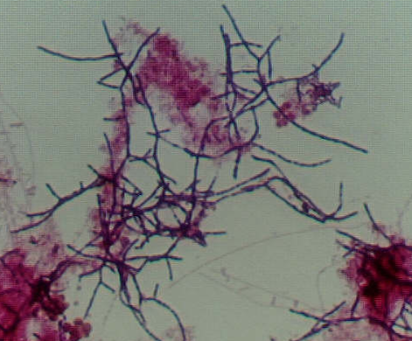
Picture of Nocardia
from: www.englewoodgov.org/home/index.asp?page=187

Slide 11
Virulence Factors
Virulent strains are relatively resistant to neutrophil-mediated killing.
Organisms in the logarithmic growth phase are more toxic to macrophages.
Inhibit phagosome-lysosome fusion more successfully in vitro, which gives rise to L-forms, which can survive in macrophages for days
L-forms have been found human and animal infections and perhaps account for treatment failure.
L forms, as you may remember, are cell wall deficient organisms

Slide 12
Virulence Factors
There are species tissue tropism's:
  N. asteroides complex including N. farcinica cause 80% of noncutaneous invasive disease and for most systemic and CNS disease.
  N. brasiliensis: cutaneous and lymphocutaneous disease.
  N. pseudobrasiliensis: systemic infections, including the CNS.
  N. transvalensis and N. otitidiscavarium: Noncutaneous disease

Slide 13
Diagnosis
Let the lab know you are looking for Nocardia or it can be missed.
Stains show gram-positive, beaded, branching filaments, that are usually acid fast.
Standard blood culture media will growth of Nocardia organisms, but prolonged incubation (2 weeks) and blind subcultures may be required for their detection; Bacteremia is rare except in central venous catheter infection.
Nocardia spp. will grow on most nonselective media used routinely for culture of bacteria, fungi, and mycobacteria but....

Slide 14
Diagnosis
Specimens with mixed flora can over grow the nocardia colonies.
Selective media may increase yield:
  Thayer-Martin agar with antibiotics
  paraffin agar.
  Buffered charcoal-yeast extract (BCYE) medium
  Decontamination methods used for mycobacterial culture kill Nocardia and may decrease culture yield.

Slide 15
Clinical Syndromes: CNS
CNS involvement in 44% of cases of systemic nocardiosis.
25% of reported nocardial disease other than mycetoma involves the CNS
50% involving the CNS alone.
Classic signs and symptoms of pyogenic infections absent .
Indolent presentations lead to a diagnosis of cancer
The usual cancer treatment of steroids NOT beneficial

Slide 16
Treatment
I&D depending of the location.
Reversal of immunosuppression
Sulfas the mainstay of therapy, but susceptibilities vary; for example N. farcinica usually resistant to third generation cephalosporins.
Sulfonamide mono therapy in immunoin competent or severe disease has a 50% mortality rate
In vitro sensitivity and resistance does not predict in vivo response send for susceptibility testing is reasonable

Slide 17
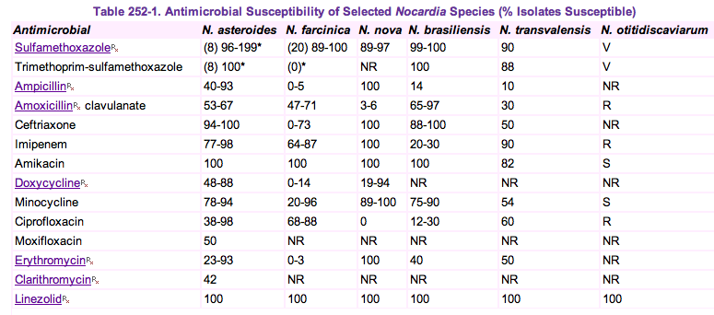
Treatment
From Mandel et al The Principals and Practice of Infectious disease Copyright © 2006 Elsevier

Slide 18
Treatment
For uncomplicated cutaneous disease 5 mg/kg/day of TMP/Sulfa (Bactrim®, Septa®, Cotrim®).
CNS and severe or disseminated disease should be treated with 15-20 mg/kg/day in divided doses, plus standard doses of amikacin and beta lactam

Slide 19
Treatment: duration
Expect a clinical response in 3 - 10 days.
Duration is until cure.
Often 3-6 months total, after 2 month can be changed to po.
Cutaneous disease usually is cured in a month or two.
Non CNS disease is usually treated for 6 months; CNS disease is treated for a year.
Relapses can occur up to a year after stopping therapy; AIDS patient and perhaps other immuno incompetent should be maintained on lifelong suppressive TMP/SULFA

Slide 20
Outcomes
Cure rates of almost 100% are found in patients with skin or soft tissue disease.
90% in pleuropulmonary disease.
63% in disseminated infection.
30- 50% in brain abscess.
The longer the delay in diagnosis, the more extensive the disease and the worse the immunosuppression, the worse the outcome.

Slide 21
Improvement in recent diagnostic techniques has helped in isolation of the organism more frequently.
Magnetic resonance imaging(MRI) has markedly enhanced the ability to detect these conditions, allowing earlier diagnosis, thereby avoiding complications.

Slide 22
CASE REPORT
HISTORY:
A 22 year old male patient was admitted to our hospital with chief complaints of fever, cough and breathlessness of 2 weeks duration.
Patient was a known case of nephrotic syndrome since 5 years and was on regular treatment with steroids. He was diagnosed to have bilateral pleural effusion.
Pleural fluid was drained and was sent for microbiological analysis. Gram stain was reported as containing plenty of inflammatory cells but cultures did not yield any growth and patient was treated medically.

Slide 23
At the time of admission patients general condition was good with vitals being stable and power of all the four limbs was 5/5.
Patient had Cushingoid facial features, with both lower limb oedema. Respiratory system examination revealed bilateral decreased breath sounds.

Slide 24
Pulmonologist and nephrologist consultation was sought with regard to bilateral pleural effusion and nephrotic syndrome.
Right side Intercostal drain was inserted and pleural fluid was sent for microbiological analysis and was reported as containing plenty of inflammatory cells but cultures did not yield any growth.
With all this, diagnosis of Nephrotic syndrome with bilateral pleural effusion with empyema of right lower lobe with cushing's syndrome due to chronic steroid use was made.

Slide 25
Examination:
Patient gradually developed weakness of both lower limbs with power of the limbs being 2/5 for which neurosurgery consultation was sought.

Slide 26
Investigations:
MRI revealed cervico-dorsal tracking down of exudative fluid from the pleural space into the fascial planes posteriorly and also into the diaphragmatic recess and into the cord canal from D 6 to D 12 approximately 10 cm fluid quantity about 450 ml.
Patient was advised surgery and evacuation of the abscess. Patient deteriorated rapidly in his neurological condition (lower limb power 0/5).

Slide 27
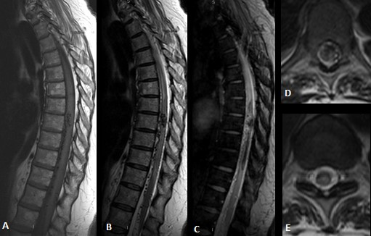
Fig 1 : Epidural abscess from D6 to D 12.

Slide 28
Treatment:
Patient underwent D6 to D12 decompressive laminectomy with evacuation of the abscess.
Pus was sent for microscopy, culture and sensitivity.

Slide 29
Post-Surgery Investigations:
Gram stain of the sample revealed plenty of inflammatory cells with plenty of Gram positive, branching filamentous bacteria.
They were partially acid fast on staining by modified Ziehl Neelsens technique.
Culture on Blood agar, Saborauds dextrose agar and Lowenstein medium yielded dry, chalky white colonies after 24 hours incubation.
The organism was identified as Nocardia asteroides by biochemical tests.

Slide 30
The isolate was sensitive to ampicillin, erythromycin, ceftriaxone, cotrimaxazole amikacin and imipenem.
Other laboratory parameters included erythrocyte sedimentation rate (ESR) of 55 mm per hour, and white blood cell count of 15,600 cell/cmm.
Two sets of blood cultures remained sterile after 2 weeks incubation.

Slide 31
The patient improved dramatically after the initial irrigation and debridement, eliminating the need for subsequent procedures.
He was started on ceftriaxone and metronidazole. After the preliminary report of Nocardia species was received, antibiotic treatment was changed to cotrimaxazole, Amikacin and linezolid.
Nocardia asteroides was confirmed via the final report. The patient was continued on antibiotics while in the hospital and on discharge. He had an unremarkable course on discharge with both lower limbs power 2/5.

Slide 32
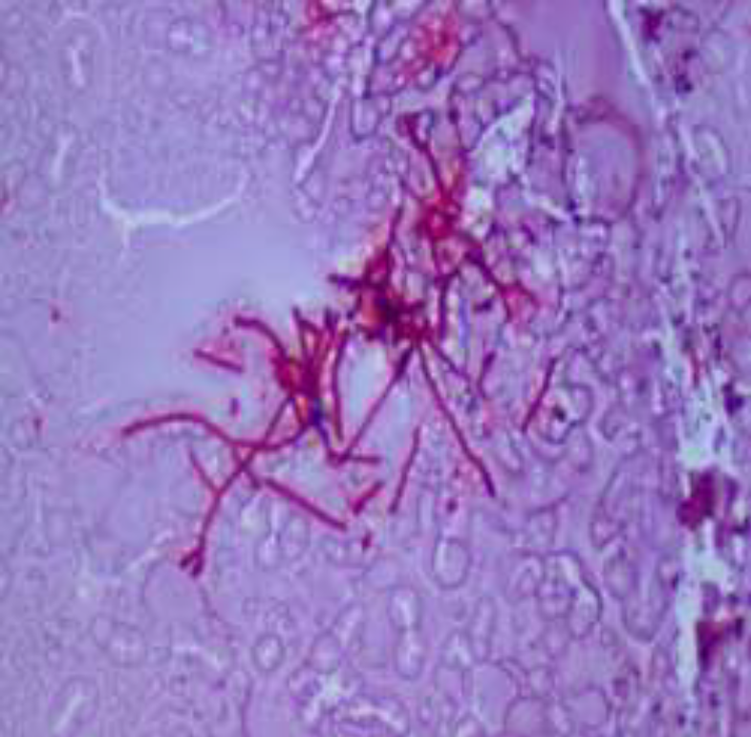
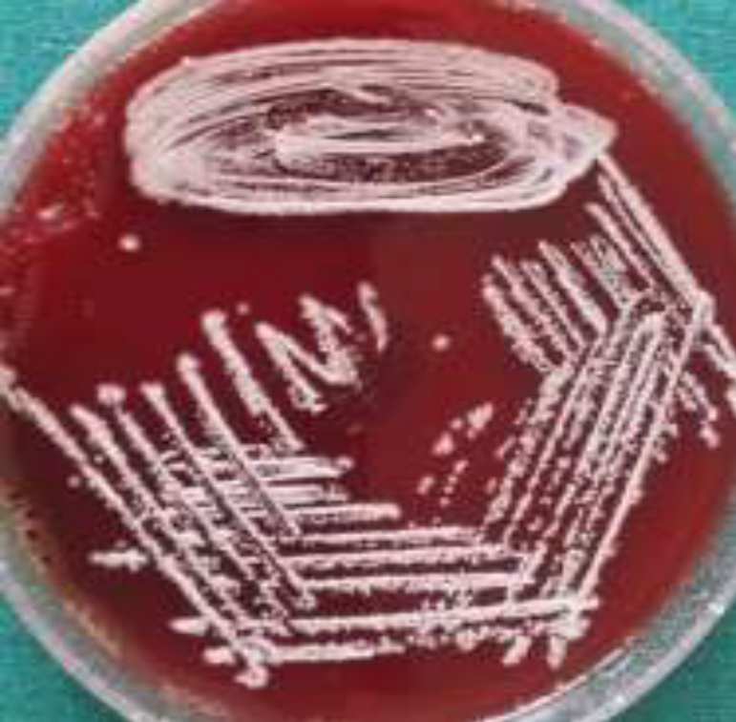
Modified ZN staining showed branching
Acid fast bacilli
Blood agar- chalky white dry colonies

Slide 33
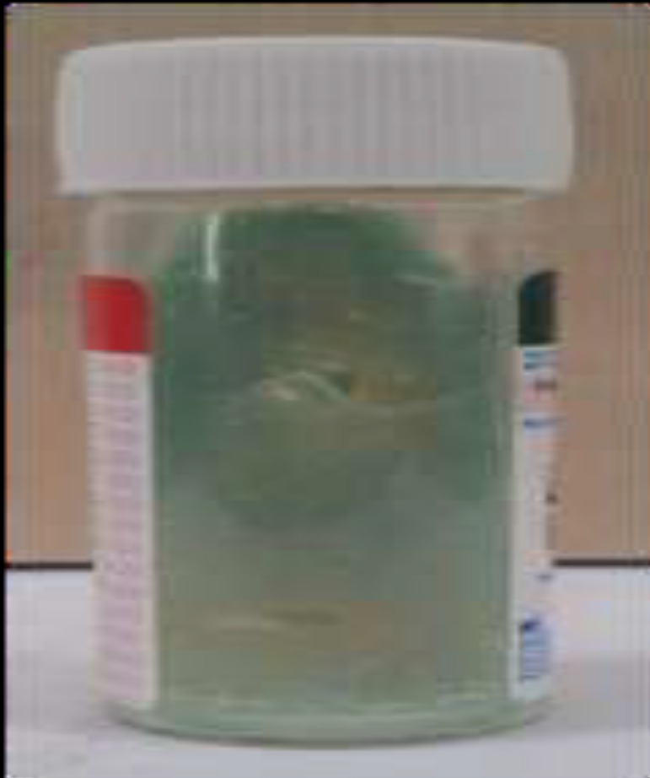
LJ media- yellow pigmented colonies

Slide 34
DISCUSSION:
Nocardia is a rare cause of neuroinfection, usually only affecting immunocompromised patients.
It is most commonly found in soil, decaying vegetable matter, and aquatic environments.
This infection is typically transmitted via inhalation of dust particles or direct contact penetrating past the natural human protective barriers.

Slide 35
The most common species to cause infection is one of the variants of the N asteroides complex, which consists of N asteroides sensu strico, N farcinica, and Nocardia nova ³.
The 3 main types of disease caused by Nocardia (nocardiosis) are cutaneous disease, pulmonary disease, and disseminated disease.
Nocardia farcinica is the most virulent form and is more frequently found to cause disseminated disease⁴.

Slide 36
Disseminated disease is also more prevalent in immunocompromised patients.
Nocardia brasiliensis is the most common to cause cutaneous disease, often leading to the development of a mycetoma over months to years.
The presentation in our patient is unknown (3,4,5). The patient’s only recollection of a potential source was an epidural pain block that he received approximately 2 months prior to identification of the abscess.

Slide 37
When a patient presents with back pain, a spinal epidural abscess is a rare cause and not likely to be in the initial differential diagnosis.
An indicator that an abscess could be present is when a patient presents with the classic triad of fever, spinal pain, and neurologic deficit.
Fever often leads clinicians to include a spinal epidural abscess in the differential diagnosis because it is typically absent in the more common presentations of back pain.

Slide 38
Once a spinal epidural abscess is determined as the cause, the aetiological agents in order of likelihood range from Staphylococcus aureus (approximately two-thirds of the total cases), Gram negative bacilli, streptococci, coagulase negative staphylococci (mostly in patients with previous spinal instrumentation), and anaerobes.
Nocardia is another potential cause of epidural abscess. The likelihood of infection with this type of bacteria is minimal but should be considered.

Slide 39
Increased concerns for nocardiosis typically involves patients with depressed cellular immunity or humorally immunocompromised patients, such as those with acquired immune deficiency syndrome, hematologic and solid organ malignancies, prolonged systemic steroid therapy, and transplant recipients⁵.
However, immunocompetent individuals are still capable of developing an infection.

Slide 40
The overall incidence of nocardiosis is often not reported in literature, with the most frequently cited study in the United States reporting 500 to 1000 new cases per year between 1972 and 1974. (10)
These numbers have likely increased since then due to the increase in immunocompromised individuals and likely lack reporting in the initial count because it is not a reportable disease.
Although the incidence is limited, it should remain in the differential diagnosis, especially when cultures are still negative after a few days and the clinical suspicion of infection is high.

Slide 41
It is difficult to diagnose Nocardia because of its long incubation period⁶.
The typical time frame for growth can be as early as 4 days, but it can take several weeks for the colonies to develop.
In our case, it took 2 days for the colonies to grow, with a final report after 8 days for speciation of the isolate.
Correspondence with the laboratory is vital when Nocardia is being considered to ensure that cultures are kept long enough to allow for ample growth periods⁶.

Slide 42
Nocardia is grown in the laboratory using common fungal (ie, Sabouraud dextrose agar) or mycobacterial isolation media (ie, Middlebrook synthetic agar and Lowenstein-Jensen medium).
Selective media, such as Thayer-Martin agar, can be used to increase the yield. The stains that are used to differentiate Nocardia from Actinomyces are the Kinyoun acidfast stain or a Ziehl-Neelsen acid-fast stain(1).

Slide 43
The Lysozyme test can also be used to identify Nocardia species that is beneficial for those species which are not acid fast. Nocardia is identified as weakly acid-fast positive vs its counterpart, Actinomyces, which is an acid-fast negative⁷.
The property that causes the differentiation of Nocardia is the varying amounts of mycolic acid within its cell wall causing the acid-fast staining.
Antibiotics are the treatment of choice, except when surgery is initially indicated, with antibiotics still given postoperatively.

Slide 44
Sulfonamides have been the preferred antibiotic used for treatment for many years.
Due to resistance developing to sulfonamides in many variants of Nocardia, a combination therapy is often given, especially in severe or disseminated disease.
To ensure coverage of all isolates of Nocardia in severe cases, a 3-drug regimen of trimethoprim-sulfamethoxazole, amikacin, and either ceftriaxone or imipenem should be started because no resistance has been reported to this combination(4-5).

Slide 45
Nocardia farcinica has also shown resistance to third-generation cephalosporins. Linezolid has demonstrated effective in vitro activity against most species and strains, but clinical data are limited(9).
It has promising results as a potential option in the replacement of the current treatment regimens when resistance is a concern.

Slide 46
Conclusion:
Intravenous therapy treatment must be continued for several weeks with an eventual transition to oral therapy.
Duration of treatment is dependent on type of disease and organ involvement.
Spinal epidural abscess due to Nocardia is an extremely rare condition, and a high index of suspicion, prompt collection and microbiological analysis of the exudate is warranted for accurate diagnosis.

Slide 47
Treatment involving a combination of surgical debridement and prolonged sulphonamide administration comes in as the mainstay of managing these patients.
When treating patients with a possible spine infection, one should include Nocardia in the differential diagnosis.

Slide 48
References:
1. P. Sendi t. Bregenzer and w. Zimmerli Spinal epidural abscess in clinical practice q j med 2008; 101:1–12. Youmans text book.
2. Farida Hamdad,1* Barbara Vidal,2 Youcef Douadi et al. Nocardia nova as the Causative Agent in Spondylodiscitis and Psoas Abscess. JOURNAL OF CLINICAL MICROBIOLOGY, Jan. 2007 Vol. 45, No. 1. p. 262–265,
3. | KRISTOFFER R. WEST, MD; ROBERT C. MASON, MS; MIKE SUN, MD, Nocardia Spinal Epidural Abscess: 14-year Follow-up. JANUARY 2012 | Volume 35 • Number 1.e128-130.
4. Ilad Alavi Darazam 1, Masoud Shamaei 1, Mandana Mobarhan 1, Shahin Ghasemi 2, Payam Tabarsi 1, Masoud Motavasseli 1, Davood Mansouri 1, *Nocardiosis: Risk Factors, Clinical Characteristics and Outcome. Iranian Red Crescent Medical Journal Iran Red Crescent Med J. 2013;15(5)p436-438.
5. V. Lakshmi, C. Sundaram,* A.K. Meena,** J.M.K. Murthy**. Primary Cutaneous Nocardiosis with Epidural AbscessCaused by Nocardia brasiliensis : A Case Report. Neurol India, 2002; 50 : 90-92.

Slide 49
6. Saubolle MA, Sussland D. Nocardiosis: a review of clinical and laboratory experience. J Clin Microbiol. 2003; 41(10):4497-4501.
7. Epstein S, Holden M, Feldshuh J, Singer JM. Unusual cause of spinal cord compression: nocardiosis. N Y State J Med. 1963; 63:3422- 3427.
8. Vander Heiden T, Stahel PF, Clutter S, et al Nocardia osteomyelitis: a rare complication after intramedullary nailing of a closed tibial shaft fracture. J Orthop Trauma. 2009; 23(3):232-236.
9. Goodfellow M, Williams ST. Ecology of actinomycetes.Annu Rev Microbiol. 1983; 37:189-216.
10. Satterwhite TK, Wallace RJ Jr. Primary cutaneous nocardiosis. JAMA. 1979; 242(4):333- 336. Chen WC, Wang JL, Wang JT, Chen YC, Chang SC. Spinal epidural abscess due to Staphylococcus aureus: clinical manifestations and outcomes. J Microbiol Immunol Infect. 2008; 41(3):215-221.
11. Davis DP, Wold RM, Patel RJ, et al. The clinical presentation and impact of diagnostic delays on emergency department patients with spinal epidural abscess. J Emerg Med. 2004; 26(3):285-291.
12. Curry WT Jr, Hoh BL, Amin-Hanjani S, Eskandar EN. Spinal epidural abscess: clinical presentation, management, and outcome. Surg Neurol. 2005; 63 (4):364-371.

Slide 50

THANK YOU

