Slide 1
Long-term clinical and self-reported health outcomes in kidney donors
Käthe Meyer
Anders Hartmann
Marit Helen Andersen
Division of Transplant Medicine
Nephrologists 2017
We have no conflict of interest

Slide 2

Colourbox

Slide 3
Background
Ways to expand the living donor pool
    Surgical techniques
    Wider selection criteria
      Altruistic donation/paired donation
      More elderly donors
      Higher BMI
      Hypertension?
      Lower eGFR?
        (Caliskan et al. 2012; Davis 2011; de Klerk et al. 2011; Delmonico et al. 2007; Horvat et al. 2009; Maple et al. 2014; O'Brien et al. 2012; Romagnoli J et al. 2015; Segev et al. 2012; Young et al. 2011)

Slide 4
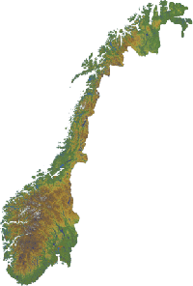
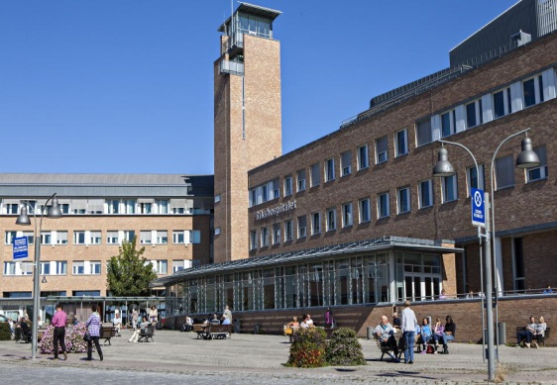
The Norwegian context
Local nephrology centre (N=26)
Oslo University Hospital (OUS);
the national centre for organ transplantation and donation

Slide 5
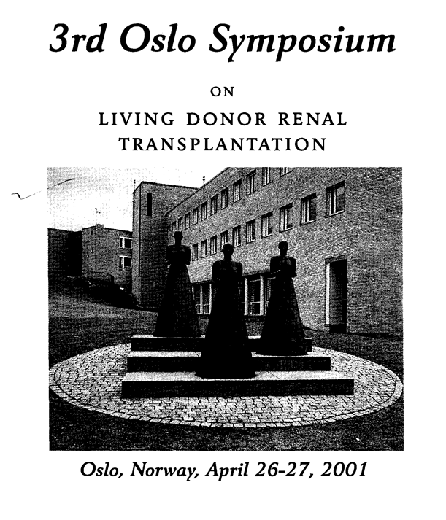
Background
A long tradition for live kidney donation
Approximately 40% of all kidney transplants are from live donor world wide
In 2016 live donors represented 20% of all kidney transplantations in Norway

Slide 6
Background
A safe procedure considered the best treatment for end-stage renal disease
Uncertainty about clinical and psychosocial long- term consequences
(Biancone 2015; De Groot 2013; Dols 2010, 2014; Gross 2013; Mjøen 2009, 2011, 2012, 2014; Muzaale 2014; Tong 2012; Watson 2013; Wirken 2015)

Slide 7
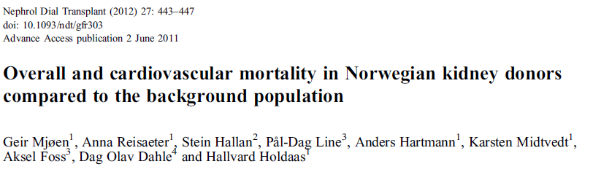
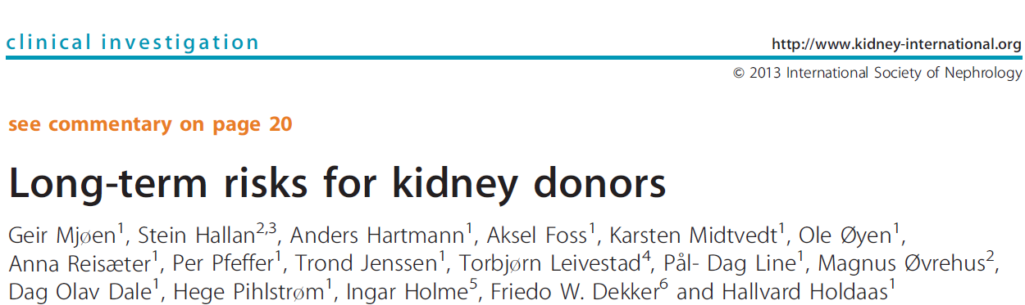

Slide 8
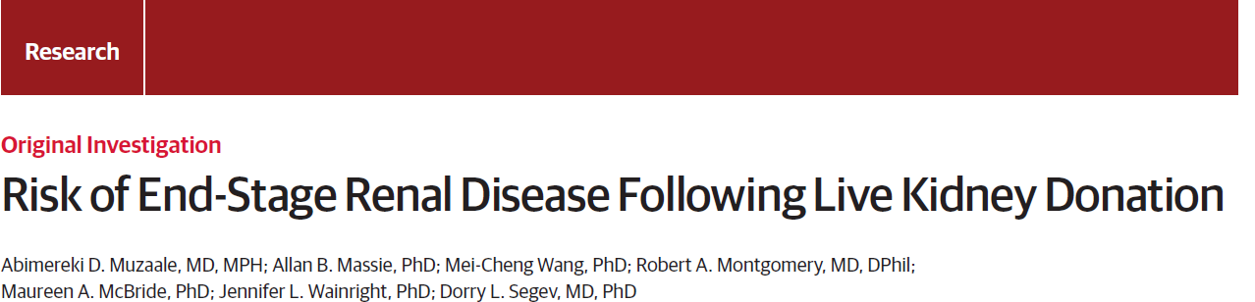

Slide 9
A need for comprehensive knowledge of LKDs
long-term health status and experiences
    Ensure high-quality organs and safety for both live organ donors and recipients
    Non-coerced informed consent
    Evidence-based practice

Slide 10
Health status and concept domains on a continuum
Personal factors; demographic, developmental, psychlogical and biological
Biological and physiological variables
(clinical outcomes; parameters associated with kidney function )
Symptoms
(Self-reported outcomes; QoL, fatigue and donor specific factors)
Functional status
(Self-reported outcomes; QoL, fatigue and donor specific factors)
General health perceptions
(Self-reported outcomes; QoL, fatigue and donor specific factors )
Overall quality
of life
(self-reported outcomes; satisfaction with life)
Environmental factors; relationship and social support
A modified version of Wilson and Cleary’s conceptual model of patient outcomes

Slide 11
Aim
To investigate associations between clinical variables and self-reported health outcomes long-term
Q1: What is the donors’ self-reported health outcomes?
Q2: Which donor specific factors are associated with self-reported health outcomes?
Q3: What are the links between clinical and self-reported outcomes and donation-specific factors ten years post-donation?

Slide 12
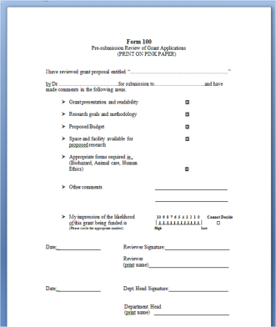
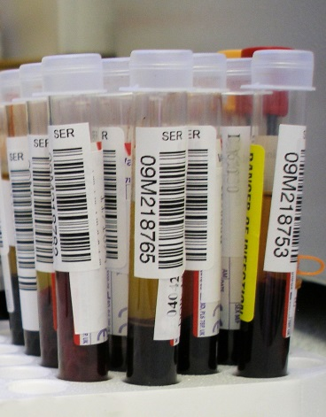
Design
Cross-sectional survey
217 (63%) of the Norwegian donors donating a kidney at OUS between 2001-2004
Self-reported health; quality of life (SF-36v2), fatigue (MFI) and donor specific questions
Median follow-up 10 ys
Clinical parameters
202 donors (93%)
Baseline data
  LD-registry, Scandiatransplant
10 ys follow-up data
  local nephrologist
Median follow-up 11 ys

Slide 13
Self-reported outcomes
Short Form-36v2 (QoL)
Multidimensional Fatigue Inventory
physical functioning
role physical
vitality
mental health
role emotional
social functioning
general health
bodily pain
Physical (PCS) and mental (MCS) component scale
general fatigue
physical fatigue
reduced activity
reduced motivation
mental fatigue

Slide 14
Donor specific factors and clinical outcomes
Donor specific factors
Clinical parameters
regret donation
recipient outcome
economic problems
regular follow-up
recognition for being a donor from family and/or friends
recognition for being a donor from health professionals
weight
systolic and diastolic BP
use of antihypertensive drugs and statins
smoking status
hemoglobin
plasma creatinine
parathyroid hormone (PTH)
estimated glomeruli filtration rate (eGFR)
urinary albumin/creatinine ratio

Slide 15
Population
LKD at Oslo University Hospital 01.01.2001-31.12.2004 (n=365)
Excluded due to death or living abroad (n=14)
Eligible for inclusion (n=351)
Unsuccessful contact attempts (n=5)
Invited to participate (n=346)
Not able to answer questionnaires due to age (n=2)
Reminder sent (n=123)
Consent to participation (n=262)
Received qustionnaire booklet
Did not return questionnaire booklet (n=45, incl. 1 death)
Responded to reminder (n=48)
Returned questionnaire booklet (n=217)
Clinical data available (n=202)

Slide 16
Donor demographics and relation to recipient (n=217)
 | n | %
Gender Females | 138 | (63.6%)
Age < 70 yrs (<60 yrs at donation) | 183 | (84.3%)
Donor’s relation to recipient
Siblings | 73 | (33.6%)
Parents | 53 | (24.4%)
Spouse | 37 | (17.1%)
Offspring | 23 | (10.6%)
Other | 31 | (14.3%)

Slide 17
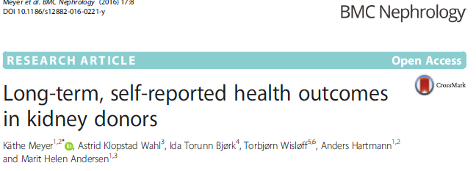
Resultat studie 1
Selvrapportert helse
    High scores on QoL (mean 63.9 - 91.4)
    Low scores on fatigue (mean 7.3 - 8.8)
      Gender difference; female donors scored lower on
      QoL and higher on fatigue than male donors
      No significant difference between younger and
      older donors(<70 år vs ≥ 70 år)

Slide 18
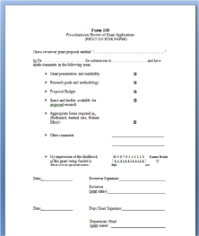
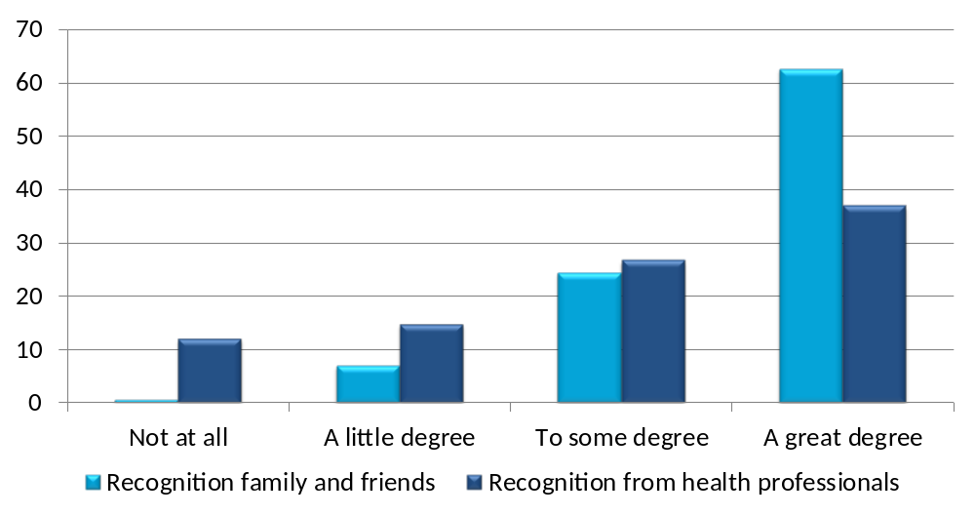
Donors’ perception of recognition
Percent
P< 0.001
Notes:
Det var signifikant forskjell på i hvor stor grad de opplevde å få anerkjennelse for det å være donor fra familie og venner eller helsepersonell. De aller fleste hadde opplevd anerkjennelse fra sitt nære miljø .

Slide 19
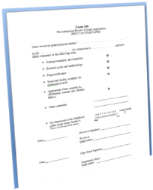
Quality of life; SF-36v2

Slide 20
Fatigue; MFI
Association between self-reported fatigue and recipient status (All donors)
P<0.05
P<0.01
P<0.05
P<0.05
NS

Slide 21
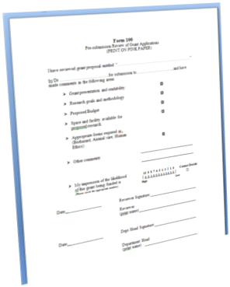
Fatigue; MFI

Slide 22
Clinical outcomes at 10 years medical follow-up
 | Mean (SD) | n (%)
Age | 60,6 ys (10,6) | 202 (100%)
Females |  | 127 (62,9)
Medical follow – up post-donation | 11,3 ys (1,5) | 202 (100%)
Low eGFR (> 60 ml/min/1.73m²) |  | 54 (27%)
Hypertensive donors |  | 67 (33%)
Statins |  | 52 (26%)

Slide 23
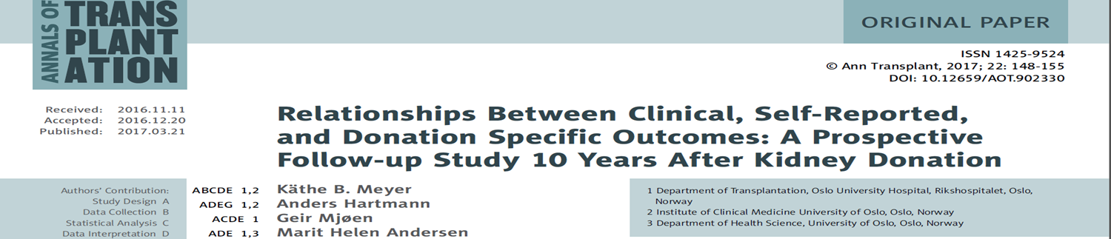
Predictors for self-reported health?
Linear regression analysis
  End points; QoL (PCS, MCS) and fatigue (5 domains)
  Clinical parameters; BMI, eGFR, medical treatment, hemoglobin and smoking status
  Covariates; gender and age
  No significant associations

Slide 24
Donation specific factors and clinical parameters
 | All (N=202) | eGFR < 60 ml/min/1.73m² (N=54) |  | Hypertension (N=67)
 | n | n | p | n | p
Recognition health personnel |  |  | 0.71 |  | 0.02*
To a great extent-to a little extent | 158 | 44 |  | 51
Recognition family and friends |  |  | 0.24 |  | 0.71
To a great extent-to a little extent | 190 | 49 |  | 61
Donation harmful to own health |  |  | 0.21 |  | 0.38
To a great extent-to a little extent | 39 | 8 |  | 10
Would have donated again |  |  | 0.43 |  | 0.01*
No/ unsure | 12 | 2 |  | 8

Slide 25

Implications for clinical practice
Uniform information about long-term consequences
  Address both physical and psychosocial issues in post donation follow-up
Facilitate an atmosphere for expressing both pride and worries
Identifying and following donors who are at risk
Systematic education of health professionals

Slide 26

Conclusions
The majority of the donors reported good health at ten years after donation
Hypertension and reduced kidney function was identified in a minority
Recipient health, worries about own health and worsened relationship with the recipient influenced willingness to donate in retrospect
Our results advocates for a mandatory long-term follow-up
Illustration: colour box

