Slide 1
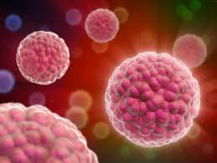


PHOTODYNAMIC CANCER THERAPY OF Ag@ZrO₂ CORE-SHELL
NANOPARTICLES IN VITRO
Dr. K. S. Meena
PG & Research Department of Chemistry
Queen Mary’s College
Chennai-600 004
Tamil Nadu
India.

Slide 2

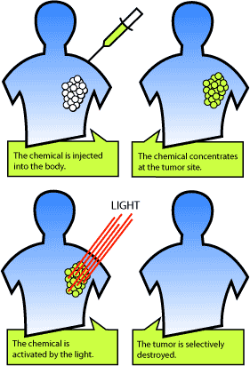
INTRODUCTION
Photodynamic therapy (PDT) is one of the emerging cancer treatment modality
that takes the advantage of the interaction between light and a photosensitizing
agent to initiate cell death.

Slide 3
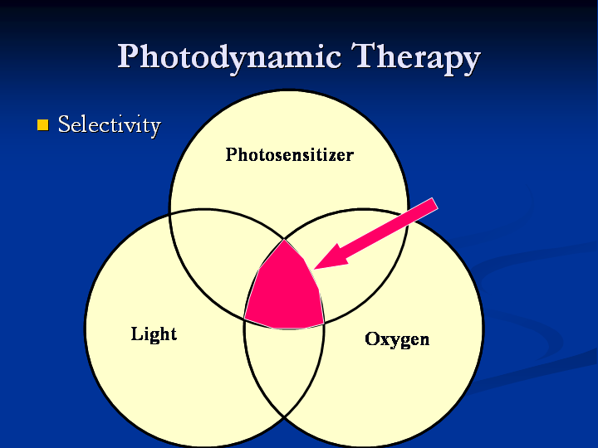
Principle of PDT
Two individually nontoxic components brought together to cause harmful effects on cells and tissues

Slide 4
Photosensitizers
The conventional photosensitizers viz., diheamatoporphyrin ester, protoporphyrin–IX, phthalocyanines and nanpahthalocyanines have their own limitations.
In this context, to overcome such drawbacks of conventional photosensitizers, many researchers in recent years have considered the possibility of using the non-toxic semiconducting nanoparticles in PDT and it is often referred as nano-PDT.

Slide 5

Advantages of PDT
PDT is Selective. Photosensitizing agent selectively accumulates in cancer cells and not in normal cells.
It can be given before, after or adjuvantly with other standard therapies, with no known contraindications.
It has minimum side effects
Low cost
PDT is repeatable.

Slide 6

Why Nano-PDT ?
Nanoparticles have the following advantages over the conventional photosensitizers.
They are photostable and nontoxic.
They have also large absorption cross section, good photoluminescence quantum yields and long emission lifetimes.
Due to their adjustable surface chemistry, they can be modified to become water soluble, biocompatible and target specific.
Core-shell particles can be a better choice in biomedical sciences because of their highly controlled optical properties.

Slide 7
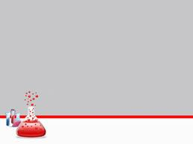
Synthesis of Ag@ZrO₂ core-shell nanoparticles
Zr (IV) iso propoxide 20mM
AgNO₃ 10mM
Acetylacetone 20mM
5ml Milli-Q-water
30ml of Isopropanol
20ml DMF
Solution I
Solution II
Stirred for 10min & refluxed for 1hr at 60ºC
Greenish black precipitate
Dispersed by Sonication
Washed with Toluene
Precipitate redissolved in Iso propanol
Solvent evaporated to get greenish black powder of Ag@ZrO₂

Slide 8

Photohemolysis
Erythrocyte suspension (0.5%) was prepared.
Light from LED source at 415 nm was used for irradiating the sample.
The microtitre plates having wells of 2.5 cm diameters containing 1 ml
of the sample were irradiated at different light doses and concentrations
of Ag@ZrO₂ nanoparticles.
The irradiated cell suspension was centrifuged at 1500 rpm and the supernatant was pipetted out and its O.D at 413 nm was measured using a spectrophotometer to quantify the percent hemolysis.

Slide 9
Cell viability
Cell viability was assessed using MTT assay method
Cell viability study was carried out in HeLa cell lines (Human cerivical cancer) using different light dose (LED) and concentration of nanoparticles.

Slide 10

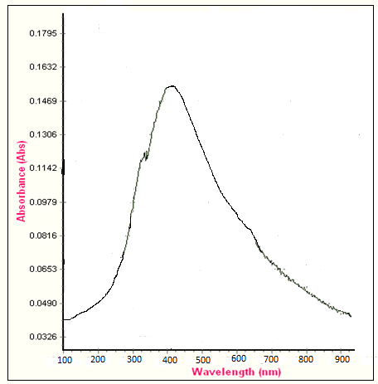
Results and Discussion
Characterization of Ag@ZrO₂ core-shell nanoparticles
UV–Visible absorption spectral characterization
The absorption spectrum of Ag@ZrO₂ is shown in Fig.
It has a broad band centered at 425 nm. The peak red shifts as the silver cluster surface is covered with an oxide layer.

Slide 11
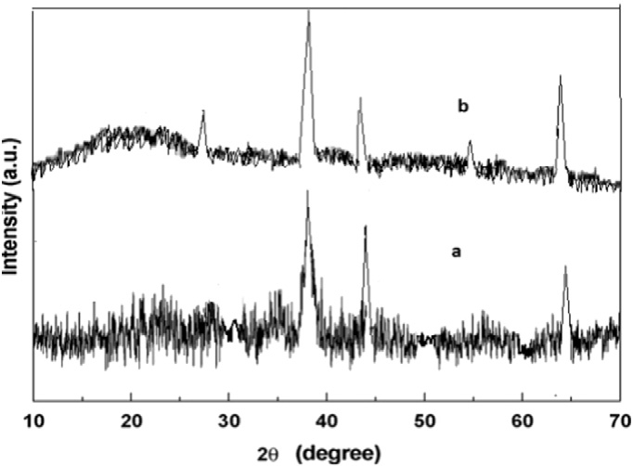
XRD Analysis
The X-ray diffractogram of air dried Ag@ZrO₂ core-shell nanoparticles (Fig. (a)) displays three characteristic peaks at 2θ values of 38.09, 44.28 and 64.20° corresponds to the (111), (200) and (220) crystalline planes of Ag crystal respectively, which are typical of a face centered cubic structure of silver.
Fig.(b) shows the diffraction patterns of monoclinic ZrO₂ and the noble metal Ag. The peaks found at 2θ = ~27.05 and 55.02° are originated from (-111) and (202) monoclinic ZrO₂ respectively.

Slide 12
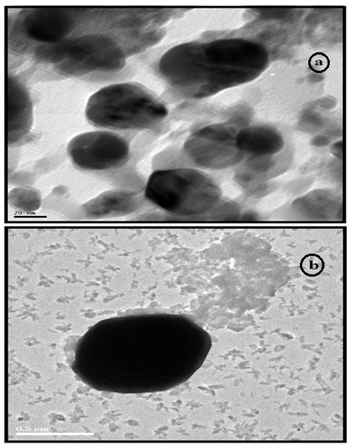
HR-TEM
The HR-TEM images of Ag@ZrO₂ are shown in Fig. ( a & b) nearly well defined spherical morphology is observed.
The size distributes between 40 – 50 nm with an average of about 45 nm and typical shell thickness is 2 - 3 nm.

Slide 13
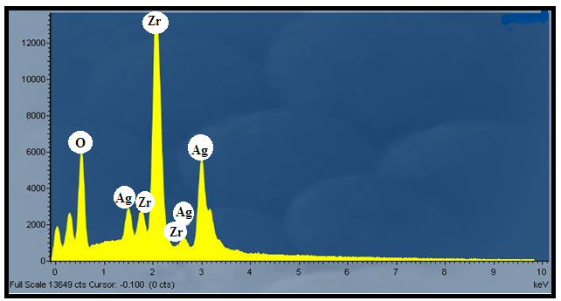
EDX
EDX spectrum shows that successful deposition ZrO₂ nanoparticles on the Ag surfaces. The EDX result of the coated Ag core with zirconia shell confirms the existence of Ag, Zr and O.

Slide 14

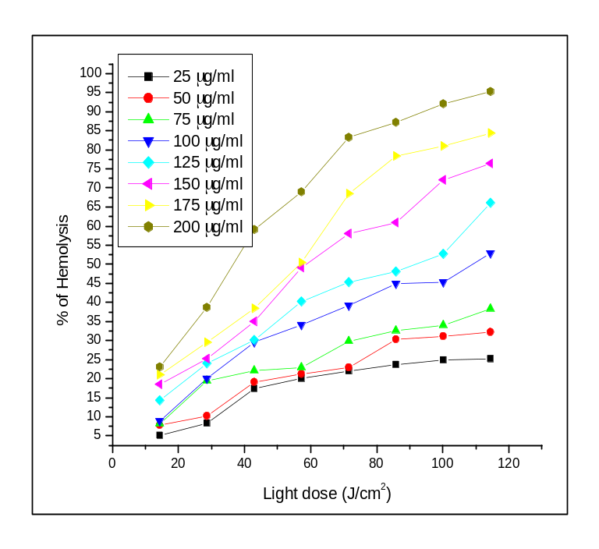
Photohemolysis as the function of fluence
Fig. shows the variation of photohemolysis with the light dose at a fixed concentration of Ag@ZrO_{2.}
The LD₅₀ (Lethal Dose for 50 % hemolysis) was found to be 108.72, 91.38, 59.07, 57.28 and 36.58 J/cm² for 100, 125, 150, 175 and 200 μg/ml concentration respectively.
From this it is clearly observed that the light dose is reduced when the sensitizer concentration is increased.

Slide 15
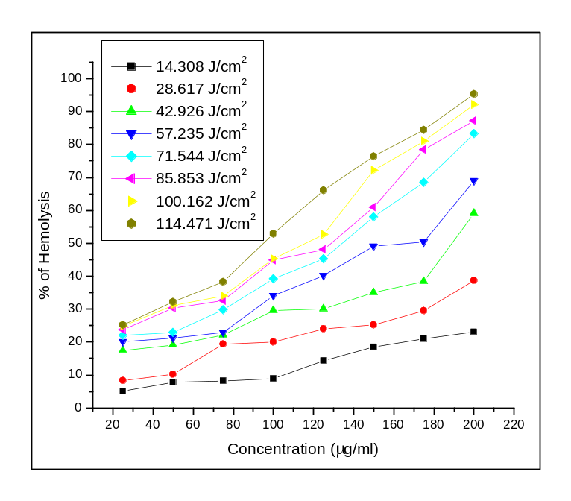
Photohemolysis as the function of concentration
Fig. shows the variation of photohemolysis with the concentration of Ag@ZrO₂at a fixed . light dose.
The LC₅₀ values are 188.43, 170.60, 134.09, 128.58, 115.51 and 94.13 μg/ml for light doses 42.926, 57.235, 71.544, 85.853, 100.162 and 114.471 J/cm².

Slide 16

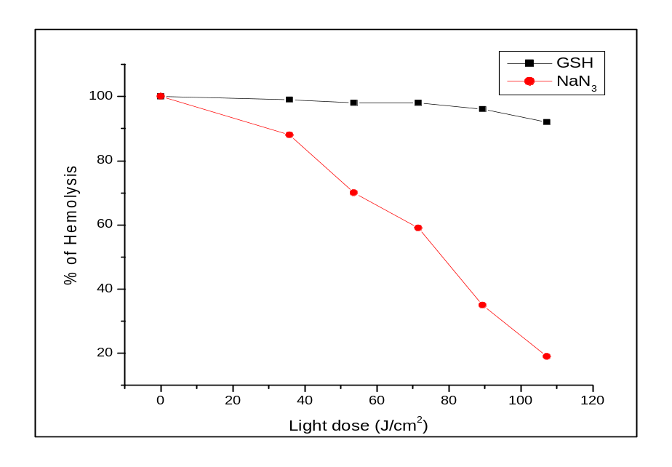
Effect of scavengers
In order to know the mechanism of photohemolysis we carried out photohemolysis in the presence of scavengers such as GSH and NaN₃ which are the best known quenchers for superoxide anion and ¹O₂ respectively.
Fig. shows the role of scavenger such as GSH and NaN₃ for different light dose at a fixed concentration of Ag@ZrO₂ core-shell NPs.
When the hemolysis was carried out in the presence of NaN₃, the photohemolysis was retarded by 81 %, which shows the formation of singlet oxygen is predominant.
The percent hemolysis largely remained invariant due to the presence of GSH, which shows there is not much formation of superoxide anion.

Slide 17
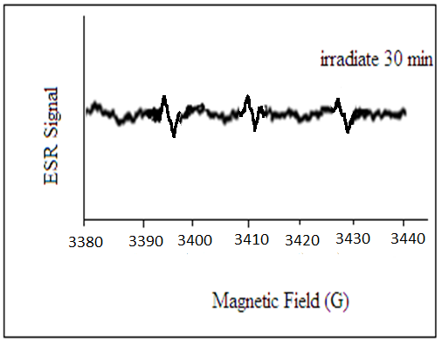
Electron spin resonance spectroscopy
We have further employed an ESR technique to detect the photogeneration of ¹O₂ by Ag@ZrO₂ using 2,2,6,6-tetramethyl piperidine (TEMP) as the spin trap under 420 nm LED light source illumination.
As shown in the Fig, the characteristic ESR spectra, containing three equal-intensity lines from nitro oxide radical (TEMPO), were determined during LED light source illumination.

Slide 18
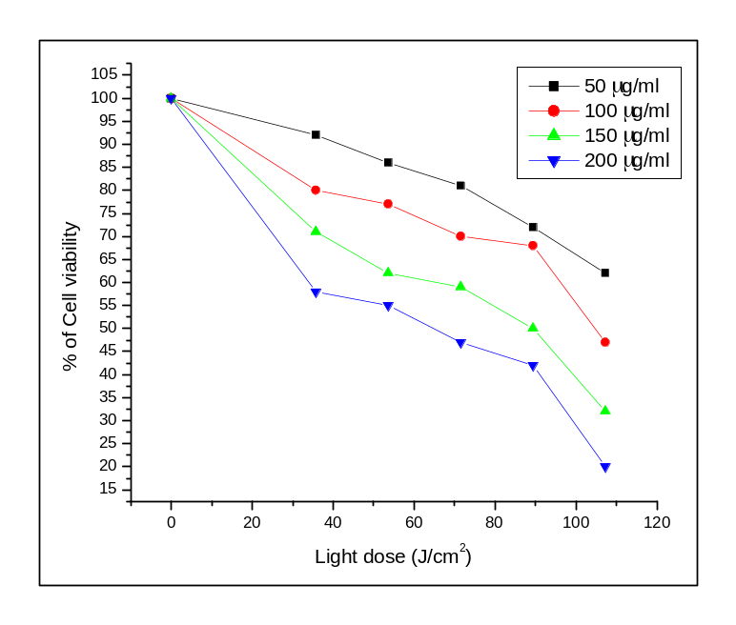
Cell viability
The rate of cell viability decreases with increase in concentration of nanoparticles.
In the presence of 200 µg/ml, the cell viability remarkably decreased depending on the light dose and 80 % of cancer cells are found to be dead in this concentration for 107.31 J/cm² of light dose.
LD₅₀ was found to be 104.80, 89.13 and 64.39 J/cm² for 100, 150 and 200 µg/ml concentration respectively.
Also, by increasing the period of irradiation at all concentrations of nanoparticles, the toxic effect was increased

Slide 19

Conclusion
The photohemoysis study shows human erythrocyte cells were effectively killed by photoexcited core-shell type Ag@ZrO₂ nano-photosensitizers.
The percentage of hemolysis was considerably increased with an increase in both the sensitizer concentration and fluence.
The role of scavengers shows that the formation of singlet oxygen was dominant over that of superoxide anion radical.
The visible photogeneration of singlet oxygen was confirmed by ESR technique. Therefore the photodynamic activity of Ag@ZrO₂ favours Type II mechanism.
Cell viability studies in HeLa cell lines, shows that cell viability was retarded by increasing concentration as well as light dose.
From the above studies it is concluded that Ag@ZrO₂ core-shell nanoparticles can be a convenient substitute for the conventional photosensitizers such as organic dyes.

Slide 20
Acknowledgement
Thankful University Grants Commission (UGC) for funding

Slide 21


