Slide 1
About OMICS Group
OMICS Group is an amalgamation of Open Access Publications and worldwide international science conferences and events. Established in the year 2007 with the sole aim of making the information on Sciences and technology ‘Open Access’, OMICS Group publishes 500 online open access scholarly journals in all aspects of Science, Engineering, Management and Technology journals. OMICS Group has been instrumental in taking the knowledge on Science & technology to the doorsteps of ordinary men and women. Research Scholars, Students, Libraries, Educational Institutions, Research centers and the industry are main stakeholders that benefitted greatly from this knowledge dissemination. OMICS Group also organizes 500 International conferences annually across the globe, where knowledge transfer takes place through debates, round table discussions, poster presentations, workshops, symposia and exhibitions.

Slide 2
OMICS International Conferences
OMICS International is a pioneer and leading science event organizer, which publishes around 500 open access journals and conducts over 500 Medical, Clinical, Engineering, Life Sciences, Pharma scientific conferences all over the globe annually with the support of more than 1000 scientific associations and 30,000 editorial board members and 3.5 million followers to its credit.
OMICS Group has organized 500 conferences, workshops and national symposiums across the major cities including San Francisco, Las Vegas, San Antonio, Omaha, Orlando, Raleigh, Santa Clara, Chicago, Philadelphia, Baltimore, United Kingdom, Valencia, Dubai, Beijing, Hyderabad, Bengaluru and Mumbai.

Slide 3

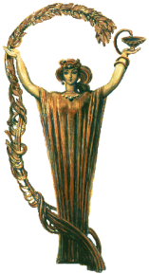
Dr. Karen Mulkijanyan
Head of the Department of Pharmacological Research of Tbilisi State Medical University
I.Kutateladze Institute of Pharmacochemistry, Tbilisi, Georgia
World Congress on Pharmacology
Brisbane , 20-22 July
Novel Biologically Active Polyethers from Different Species of Boraginaceae Family and Their Synthetic Derivatives: Prospective Therapeutic Agents.

Slide 4
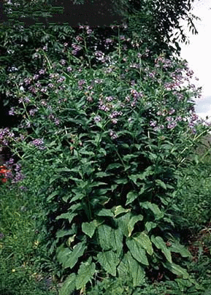
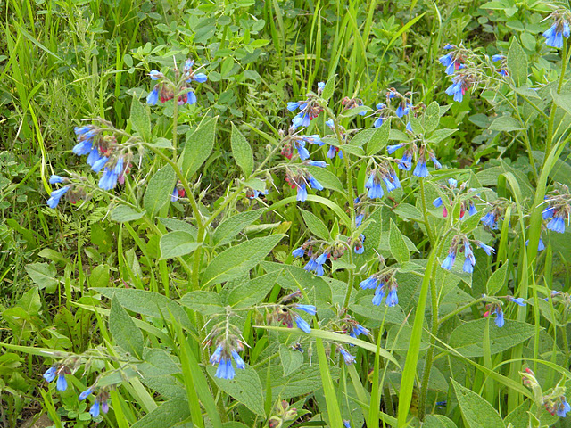
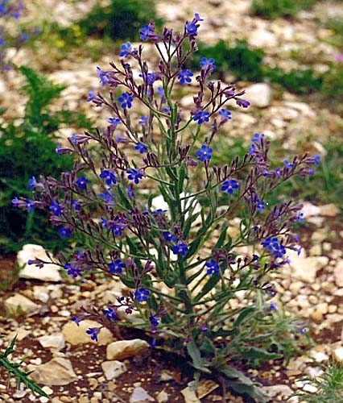
Boraginaceae species
Anchusa italica
(Italian bugloss)
Symphytum asperum
(prickly or rough comfrey)
Symphytum caucasicum
(Caucasian comfrey)

Slide 5
Introduction
Extracts from the plants belonging to Boraginaceae family – Symphytum asperum, S.caucasicum and Anchusa italica have been used in folk medicine for treatment of different kinds of disorders and wounds due to analgesic, antimicrobial and anti-inflammatory effects. Aforenamed extracts contain allantoin, claimed to be a cell proliferation-stimulating agent responsible for the wound-healing properties of Symphytum, and, on the other hand, hepatotoxic pyrrolizidine alkaloids which strongly restrict internal use of comfrey extracts.
The first representative of a new class of natural polyethers - regular dihydroxycinnamate-derived polymer
POLY[OXY-1-CARBOXY-2-(3,4-DIHYDROXYPHENYL)ETHYLENE (POCDPE)
has been detected in high-molecular watersoluble fractions of roots, stems and leaves of Comfrey - Symphytum asperum (SA) S. caucasicum (SC), S. officinale (SO) and Bugloss (Anchusa) – Anchusa italica (AI).
In addition a monomer of POCDPE – 3-(3,4-dihydroxyphenyl)glyceric acid (SM) has been synthesized
Some of the results concerning the biological activity of POCDPE and SM are presented below.

Slide 6
Extraction and fractionation of SA, SC, SO and AI polysaccharides from raw material
The fractionation procedure by ultrafiltration allows to remove most ballast polysaccharides and to obtain water-soluble high-molecular (>1000 kDa) preparations (HMP).

Slide 7
Poly[oxy-1-carboxy-2-(3,4-dihydroxyphenyl)ethylene
Symphytum asperum, S.caucasicum R=H;
Anchusa italica R=H, CH₃.
Symnthetic monomer
V.Barbakadze et al. Molecules, 2005, V. 10, N 9, P. 1135-1144; V.Barbakadze et al. Chem. Nat. Compds. 2009, V. 45, N 1, P. 6-10.

Slide 8
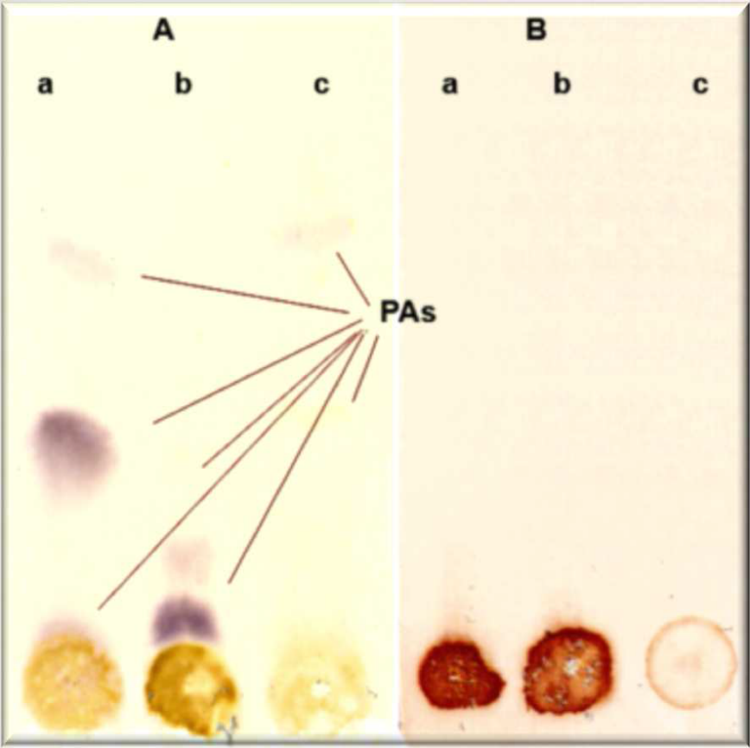
TLC detection of pyrrolizidine alkaloids in raw material (A) and highmolecular fractions (B)
a – roots, b – stems, c - leaves
Solvent system : chloroform-methanol-25% ammonia (85:14:1, v/v/v)
Detection: UV light (λ254 nm);
Spray: Ehrlich’s reagent

Slide 9
WOUND HEALING
Mouse excisional wound model. Two 1 cm diameter skin rags are cut out on depilated dorsal skin area. Operation is carried out under ether anesthesia. Treatment of animals began through 24 h after the injury. Wounds are treated with 0.1 ml of ointment per wound once a day.
Mouse skin burn model. Area and depth standardized skin burns are caused on depilated skin area under ether anesthesia using special device with the temperature controller and contact electrical heater (1 sm² square copper plate). The temperature of a contact plate - 150⁰С, exposition time – 10 sec. At these conditions burn corresponds to IIIA-degree in accordance with clinical classification of burns. Treatment of animals began through 24 h after burn induction.
Wound healing effect was estimated by the reduction of injured area in relation to initial and calculated under the formula:
D = (S_{exp} / S_{in}) х 100 %, where
S _{in} - initial wound area on day 1.
S _{exp} - wound area on day of measurement.
The obtained data were processed statistically using Student’s t-test

Slide 10
Healing effect of 2,5% POCDPE ointment
(skin burn model in rats)

Slide 11
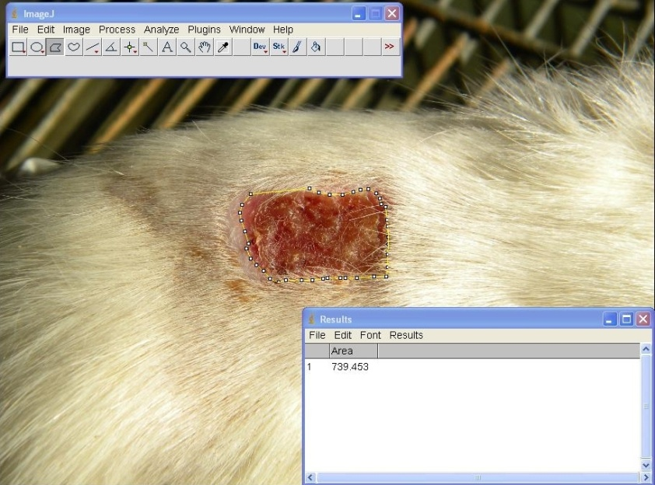
Estimation of wound area

Slide 12
Healing effect of 2,5% POCDPE and 2,5% SM ointments (excisional wounds in mice)

Slide 13
Healing effect of 10% POCDPE dry ointment (burn wounds in mice)

Slide 14
Comparison of dry and dressing ointments containing POCDPE
Burn wound
Excisional wound

Slide 15
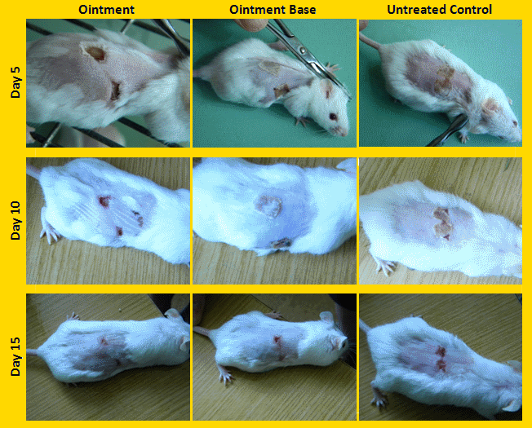
Healing effect of 2.5% BNB dry ointment (burn wounds in mice)

Slide 16
Suggested mechanism of wounnd healing and anti-inflammatory action of BNB
Besides generation of superoxide anions by stimulated PMNs, these radicals may also arise in chronic wounds where ischemic conditions may convert the enzyme xanthine dehydrogenase into xanthine oxidase (XO) which catalyses the conversion of oxygen into superoxide anions causing tissue damage. During this process XO converts hypoxanthine (HX) to xanthine and subsequently to uric acid. So, scavenging of superoxide anions either produced by PMNs or through XO is regarded beneficial for wound healing and in inflammatory process.

Slide 17
In vitro anti-cancer efficacy of BNB from Symphytum asperum (SA) and S.caucasicum (SC)
a
b
In androgen-dependent (LNCaP) and -independent (22Rv1 and PC3) human prostate cancer (PCa) cells SA treatment (100 mcg/ml for 48h) decreases the live cell number by 65, 64 and 35% (a) and increases the cell death by 16, 8 and 12 folds (b) in LNCaP, 22Rv1 and PC3 cells, respectively. Similarly, SC treatment (100 mcg/ml for 48h) decreased the live cell number by 87, 25 and 33% and increased the cell death by 19, 10 and 9 folds in LNCaP, 22Rv1 and PC3 cells, respectively.
S. Shrotriya et al. American Association for Cancer Research 100th Annual Meeting, Denver, Colorado, USA. Abstracts. 2009, N 921.

Slide 18
In vivo anti-cancer efficacy of BNB from Symphytum asperum (SA) and S.caucasicum (SC)
Oral gavage feeding of SA (2.5 and 5.0 mg/Kg body weight) and SC (2.5 and 5.0 mg/Kg body weight) 5 days/week for 5 weeks caused a marked time-dependent inhibition in 22RV1 tumor xenograft growth which accounts for 46% and 59% decrease in SA treated animals and 75% and 88% decrease in SC treated animals, respectively.
S. Shrotriya et al. Carcinogenesis. v.33 no.8 pp.1572–1580, 2012

Slide 19
TNF-a secretion and B16M cell adhesion in B16M-CM-treated HSE cells in vitro.
*
% B16M Cell Adhesion to HSE Cells
**
The BNB significantly induced TNF-α production from normal and tumor-activated HSE cells, supporting its potential as immune defense modulator.
*
*
TNFalpha Concentration
(pg/10⁶ cells)‏
*
Polymer
1µg/ml
Polymer
1µg/ml
Untreated
HSE Cells
B16M-CM-Treated
HSE Cells
Differences in the percent of adhering cells and TNF-a production versus untreated HSE cells (*) and versus VEGF-treated HSE (**) P<.001 by ANOVA

Slide 20
TNF-α secretion and B16M cell adhesion in VEGF-treated HSE cells in vitro.
*
BNB completely abrogated the adhesion of murine B16 melanoma cells to tumor-activated HSE, without any detectable effect on basal condition-cultured HSE. Consistent with these anti-adhesive effects, the BNB also prevented melanoma cell adherence to recombinant VEGF-treated HSE
% B16M Cell Adhesion to HSE Cells
**
*
*
TNFalpha Concentration
(pg/10⁶ cells)‏
*
Differences in the percent of adhering cells and TNF-a production versus untreated HSE cells (*) and versus VEGF-treated HSE (**) P<.001 by ANOVA
Polymer
1µg/ml
Polymer
1µg/ml
Untreated
HSE Cells
VEGF-Treated
HSE Cells

Slide 21
Stimulation of leucopoiesis in experimental cyclophosphamide induced leucopenia
BNB

Slide 22
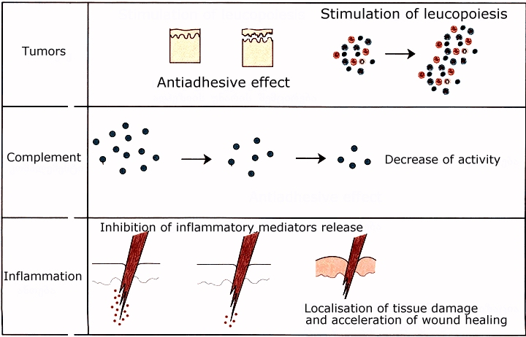
Established effects of BNB

Slide 23
Established major effects of POCDPE
Burn and wound healing effect due to the shortening of the second phase of wound healing - the inflammatory response.
K.Mulkijanyan et al. Bull. Georg. Natl. Acad. Sci. 2009, V. 3, N 3, P. 114-117.
The strong efficacy against prostate cancer cells suggesting their high potential in prostate cancer patients.
S. Shrotriya et al. Carcinogenesis. v.33 no.8 pp.1572–1580, 2012
Abrogation of the adhesion of melanoma cells to tumor-conditioned medium- and VEGF-activated endothelial cells.
V.Barbakadze et al. Bull. Georg. Natl. Acad. Sci. 2008, V. 2, N 3, P. 108-112.
Haematopoietic efficacy of polymer: in mice drug-induced leukopenia the polymer caused significant stimulation of leucopoiesis.
M. Moistsrafishvili, et al. Investigation of Georgian biologically active compounds of plant and mineral origin. Tbilisi, 2010, Issue 2(17) p.91-93.
Antioxidant activity and anticomplementary activity due to the inhibition of xantine oxidase and complement convertase, respectively .
V.Barbakadze et al. Pharmaceutical Chemistry J. 2007, V.41, N 1, P. 14-16.

Slide 24
Conclusion
Pre-clinical investigation of BNB revealed wide spectrum of biological activity including, but not limited to antiinflammatory, burn and wound healing, and anticancer.
Strong efficacy of BNB in different experimental models suggests its high therapeutic potential.

Slide 25
Acknowledgements
I would like to express my gratitude to :
Dr. V.Barbakadze, Dr. M.Merlani, Dr. L.Amiranashvili, Dr. L.Gogilashvili, Dr. Zh.Novikova, Dr. M.Sulakvelidze, and M.Moisttrafishvili, (Tbilisi State Medical University Institute of Pharmacochemistry, Tbilisi, Georgia);
Prof. A.Bakuridze, Prof. D.Berashvili, Dr.G.Mikaia, Dr.N.Kurdiani, and S.Gokadze (Tbilisi State Medical University Faculty of Pharmacy, Tbilisi, Georgia);
Prof. F.Vidal-Vanaclocha (Basque Country University, Bizkaia, Spain);
Prof. R.Agarwal, Dr. G.Deep, S.Shrotriya, and N.Walia (Colorado University, Denver, USA);
and
Civil Research & Development Foundation (USA), Georgian Research & Development Foundation, Sh. Rustaveli National Science Foundation for financial support in frame of grant projects CRDF-GRDF-GEB-3344-TB-06; GNSF-ST08-6-469 and SRNSF- AR/109/8-403/11

Slide 26
Thank you for your attention

Slide 27
Some known constituents of Symphytum and Anchusa responsible for biological activity

Slide 28
Overview of toxic pyrrolizidine alkaloids found in Symphytum and Anchusa
R₁
R₂
symphytine
tiglic
(-)-viridofloric
lycopsamine
(-)-viridofloric
7-acetyllycopsamine
acetic
(-)-viridofloric
intermedine
necic acid(s)
A – pyrrolizidine, the necine moiety of PAs
B – retronecine;
PAs of Symphytum are mono- or di-esters of retronecine
(+)-trachelanthic
7-acetylintermedine
acetic
(+)-trachelanthic
symviridine
cenecioic
(-)-viridofloric

Slide 29
Synthesis of (+)-(2R,3S)-2,3-dihydroxy-3-(3,4-dihydroxyphenyl)propionic acid (7) and
(–)-(2S,3R)-2,3-dihydroxy-3-(3,4-dihydroxyphenyl)propionic acid (8)

Slide 31
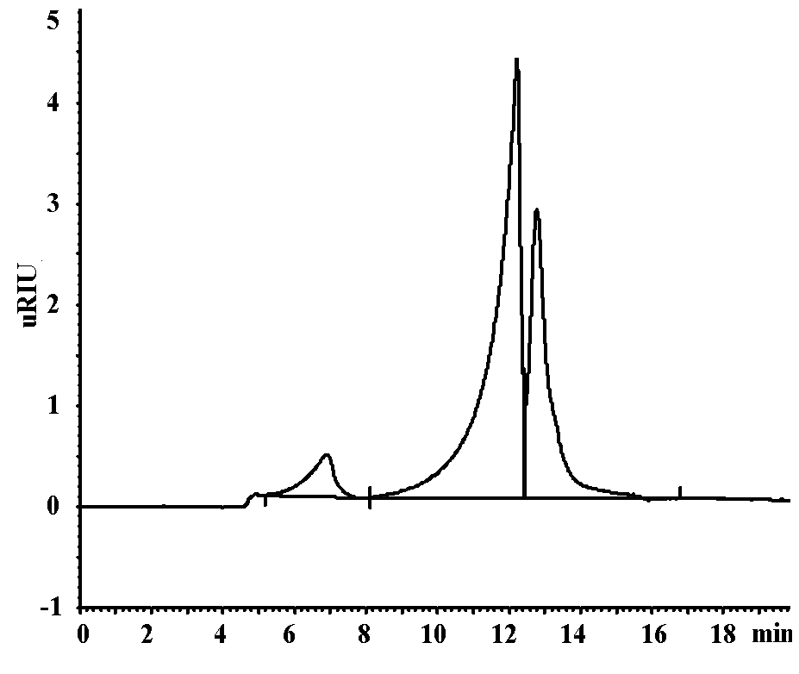
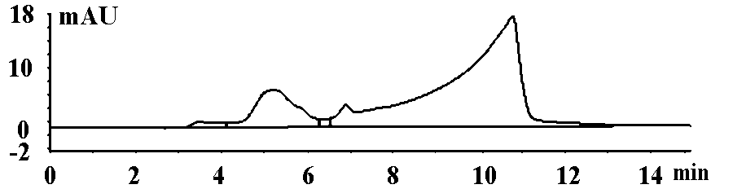
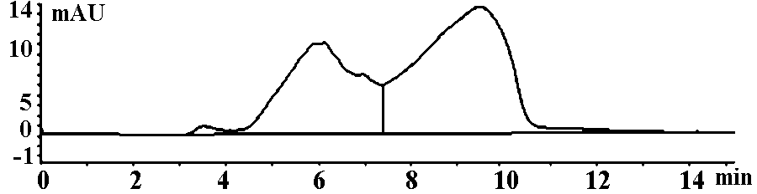
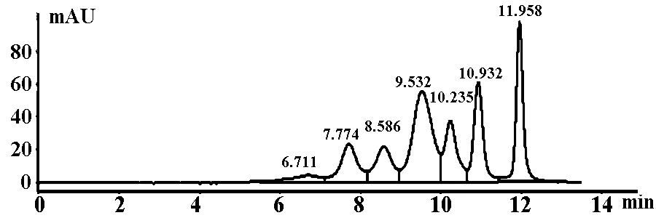
HPLC analysis of HMP-SA on column Polysep 6000; injection – 9 ul; detection – RI.
Separation by HPLC on Polysep 6000 confirmed our previous supposition that polysaccharides contents are not covalently bounded with phenolic polymer. However it is very difficult to completely separate by GFC the polysaccharides from polymer. This phenomenon can be explained due to the presence of hydrogen bonds between phenolic polymer and residual polysaccharides which will hold the polysaccharides together with the phenolic polymer during fractionation by ultrafiltration and GFC. The polymer is chemically simple, but its molecules can form with each other and with the molecules of residual polysaccharides complex macromolecular associates up to their supramolecular organization due to hydrogen bonds
HPLC analysis of HMP-SA (top) and HMP-AI (bottom) on column Biosep 4000; injection - 20 ul; detection – RI.
HPLC analysis of mixture of standard proteins on column Biosep 4000; injection - 5 ul; detection – UV.

Slide 34
Mechanism of action of SA & SC phenolic polymers
Molecular studies suggested that the anti-cancer effects of SA and SC phenolic polymers are mainly through decreasing androgen receptor, enhancing CDK inhibitors expression, and inducing apoptosis in PCA cells.
SA and SC caffeic acid-derived polymer suppressed the growth and induced death in PCA cells, with only marginal cytotoxicity towards non-neoplastic human prostate epithelial cells. New phenollic polymer of SC caused G1 arrest in PCA cells through modulating the expression of cell cycle regulators, especially an increase in CDK inhibitors (p21 and p27). In addition, SA and SC high molecular phenolic polymers induced apoptotic death by activating caspases, and also strongly decreased AR and PSA expression. In vivo, SC phenolic polymer feeding, strongly inhibited 22Rv1 tumors growth by 76 and 88% at 2.5 and 5 mg/kg body weight doses, respectively, without any toxicity, together with a strong decrease in PSA level in plasma; and a decrease in PCNA, AR, and PSA expression but increase in p21/p27 expression and apoptosis in tumor tissues from SC phenolic polymer-fed mice.

Slide 35
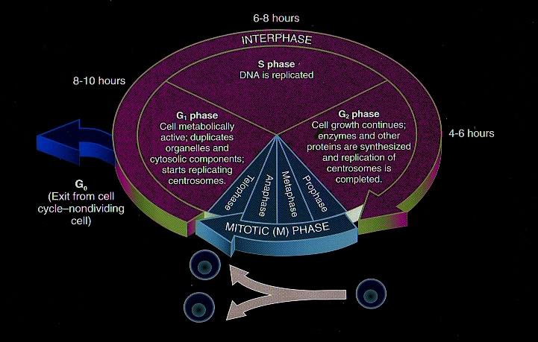
SA and SC modulate cell cycle progression in PCA cells and induce apoptosis
 | PC3 |  |  |  | LNCaP
 | G1 | S | G2 | M | G1 | S | G2 | M
SA | +++ | ++ |  |  | +++ | ++
SC |  | +++ |  |  | ++ |  | +++ | +++
Fluorescence Activated Cell Sorting (FACS) analysis showed that the growth inhibition by these compounds was associated with a strong induction of cell cycle arrest in PCA cells. FACS analysis showed that these compounds differentially modulate the cell cycle progression in PCA cells, which was based upon the dose, treatment duration and cell type. SA treatment (1-100 μg/ml) resulted in a significant G1-phase arrest after 24 and 48h of treatment accompanied with a decrease in S-phase population in both PC3 and LNCaP cells. SC treatment (1-100 μg/ml) for 72h in PC-3 cells resulted in a strong S-phase arrest; while in LNCaP cells SC treatment for 24 and 48h caused a moderate G1-phase arrest at lower doses (1-50 μg/ml), and a strong G2/M-phase arrest at higher dose (100 μg/ml). In 22Rv1 SC (100 μg/ml) caused G2/M arrest at 24 h, and S and G2/M phase arrest at 48 h. SA and SC induce cell cycle arrest in human PCA cells LNCaP and 22Rv1 via modulating the expression of key cell cycle regulatory molecules, which regulate G1/S/G2M phase of cell cycle. Treatment of LNCaP and 22Rv1 cells with SA and SC resulted in decrease the expression of cyclins D1, D3, A, and E along with cdk4 at 48h (50-100 μg/ml), however all the compounds increased the level of p21 and p27. Besides, these compounds have inhibitory effect on p53 level in prostate cancer cells, and we are examining the mechanistic details underlying this biological effect. SA and SC induced 42, 70% apoptosis in 22RV1 cells and 65, 70% apoptosis in LNCap cells when analyzed by AnnexinV/PI. SA and SC induced apoptosis involves caspase-3, caspase-9 and PARP cleavage in LNCaP and 22Rv1 cells.
S. Shrotriya et al. American Association for Cancer Research 100th Annual Meeting, Denver, Colorado, USA. Abstracts. 2009, N 921.

Slide 36
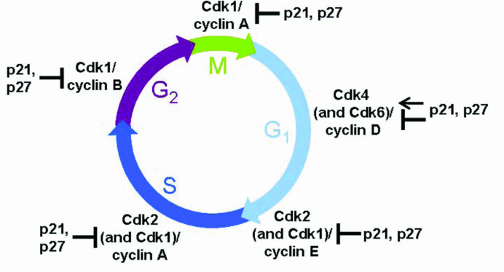

Slide 37
Effect of BNB on the inflammatory response of tumor-activated hepatic sinusoidal endothelium
The polymer abrogates the adhesion of melanoma cells to tumor-conditioned medium- and VEGF-activated endothelial cells.
This antiadhesive effect occurs in the presence of high concentrations of TNF-α suggesting that the compound block down-stream the effect of other proadhesive mediators of tumor factor- or VEGF-induced effects.

Slide 38
Methods:
B16 Melanoma (B16M) cell adhesion assay to primary cultured hepatic sinusoidal endothelial (HSE) cells. B16M cells were labeled with 10 μg/ml 2',7'-bis-(2-carboxyethyl)-5,6-carboxyfluorescein-acetoxymethylester (BCECF-AM) solution. This non-fluorescent sterase substrate BCECF-AM is accumulated by tumor cells and hydrolyzed to the fluorescent product BCECF which becomes trapped inside the live cells. After gently washing,2x105 cells/well were added to 24-well plate primary
cultured HSE cells and 8 minutes later, the wells were washed three times with fresh medium. Cell adherence was calculated from absorbance at 485 nm using a fluorometric microplate reader (Multiskan Ascent, Thermo Labsystems). The number of adhered cells (registered in fluorescence arbitrary units) was expressed as percentage of the initial number of cells, and calculated for each
well as follows: Fluorescence after well washing/(Fluorescence before washing – non-specific fluorescence before tumor cell addition)
Quantification of TNF-α. Release of TNF-α from primary cultured HSE cells was measured using the
ELISA kit from R&D Systems based on anti-mouse TNF-α monoclonal antibody, as suggested by the manufacturer (R&D Systems, Minneapolis, MN). Cultured HSE cells were incubated in the presence or absence of B16M-CM or 10 ng/ml murine VEGF for 8 hours. In some experiments, both untreated and treated HSE cells received 1 μg/ml PDGA, 30 minutes before B16MCM or VEGF (A). Cell adhesion assays were performed as described in Methods. (B) HSE supernatants were removed before cell adhesion and TNF-α concentration was measured by ELISA. Data represent the mean ±SD of 2 separate experiments performed using 2 different preparations of HSE cells, each in 3 replicates (n=6).
Differences in the percent of adhering cells and TNF-α production versus untreated HSE cells (*) and versus B16M-CM or VEGF-treated HSE (**) were statistically significant (P<.001) by ANOVA and Bonferroni´s posthoc test.

Slide 39
Let us meet again..
We welcome you all to our future conferences of
OMICS International
3rd World Congress on Pharmacology
On
August 08-10, 2016 at Birmingham, UK http://pharmacology.pharmaceuticalconferences.com/

