Slide 1
COMMON DISEASES ENCOUNTERED IN BACK YARD POULTRY
Dr.K.Lakshmi
Dept of Veterinary Medicine
College of Veterinary Science
Rajendranagar.

Slide 2
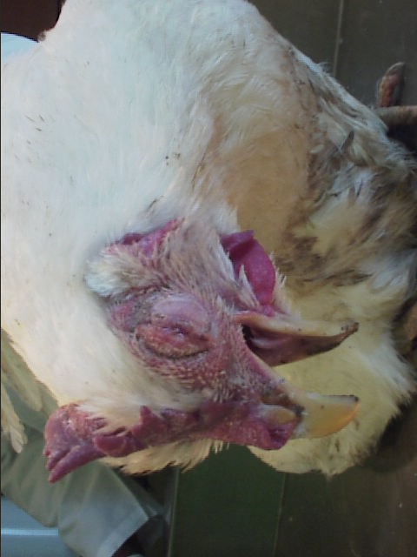
What is a disease
Any condition that results in deviation from
normal function

Slide 3
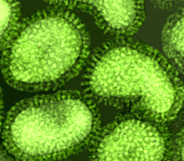
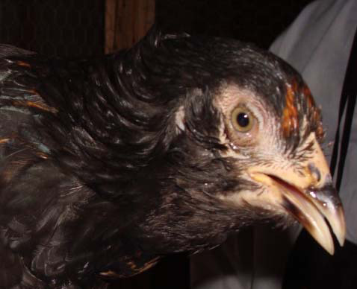
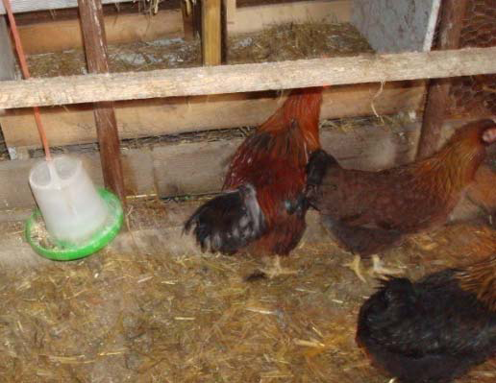
How do diseases occur?
AGENT
HOST
ENVIRONMENT

Slide 4
ETIOLOGY
Infectious Agents
Non-infectious agents
Bacteria
Viruses
Parasites
Fungi
Chemical
Physical
Lack or excess of certain vitamins and minerals
Toxins

Slide 5
General Signs of Disease
Poor appetite
Huddling
Depression
Runting/stunting
poor uniformity
Ruffled feathers
Coughing, sneezing,
oculo-nasal discharge,
difficult breathing
Bloody or wet litter
Increased mortality

Slide 6
VIRAL DISEASES

Slide 7
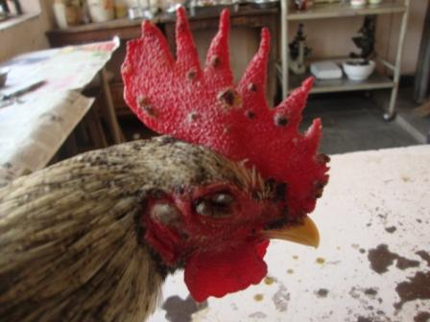
FOWL POX
Viral disease of domestic fowl
development of nodular proliferative Skin lesions on the featherless parts of the body.
fibrino necrotic and proliferative lesions in the mucous membranes

Slide 8
ETIOLOGY
Family: Pox viridae
Genus: avipoxvirus
Double stranded DNA

Slide 9
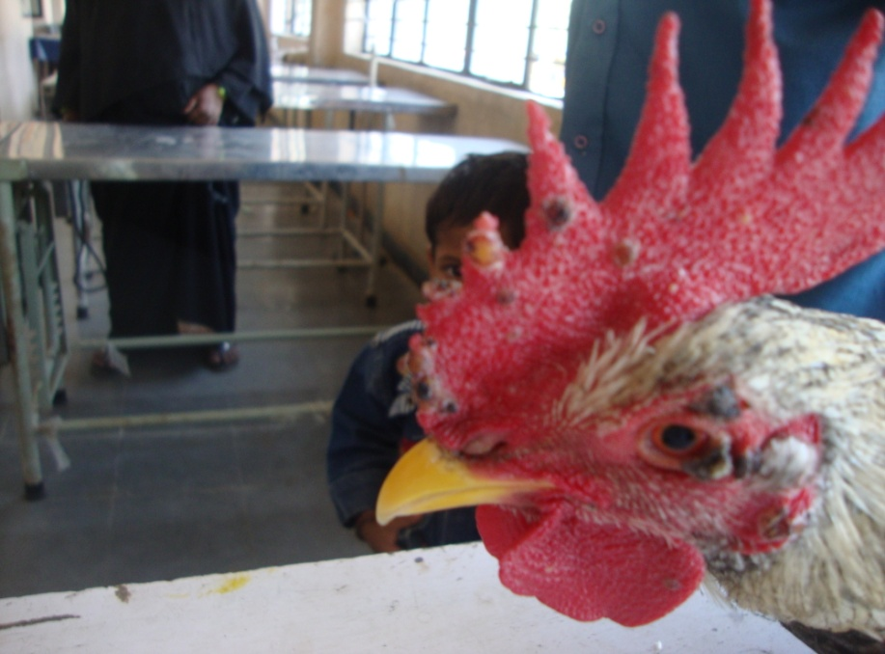
CLINICAL SIGNS
Appearance of nodular lesions
combs
wattles
eyelids
other unfeathered areas of the body.

Slide 10
PREVENTION AND CONTROL
Prophylactic vaccination
Fowl pox vaccine at 4-6 weeks of age
Second dose at 12-14 weeks of age.

Slide 11
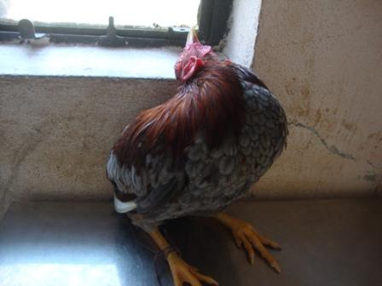
RANIKHET DISEASE
New castle disease
Viral disease of domestic fowl is characterised by
respiratory signs
often associated with nervous and digestive disorders
high mortality.

Slide 12
ETIOLOGY
Paramyxoviridae
Paromyxovirus-1

Slide 13
CLINICAL SIGNS
opisthotonus
Listlessness
Increased respiration
Weakness
Edema around the eyes
Torticolis
Paralysis of legs

Slide 14
Prevention and control
Prophylactic vaccination
Lentogenic strain (F or B1)
day old chicks
intranasal
intraocular route
drinking water.
Mesogenic strain (R2B)
6-8 weeks of age
intramuscular
Subcutaneous route.

Slide 15
BACTERIAL DISEASES

Slide 16
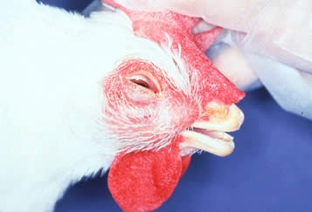
INFECTIOUS CORYZA
FOWL CORYZA
Highly contagious
acute disease of upper respiratory tract of chickens,
turns into a chronic respiratory disease.

Slide 17
ETIOLOGY
Haemophilus paragallinarum
Small cocoid or gram negative rod
Non motile
Exhibits bipolar staining

Slide 18
CLINICAL SIGNS
Serous to mucoid nasal discharges with foul smelling
Facial edema
Conjunctivitis
Swollen wattles
Diarrhoea
Reduced feed and water consumption.

Slide 19
Treatment and control
Gentamicin
Penicillin
streptomycin
delivered in feed or drinking water.
Proper Disinfection

Slide 20
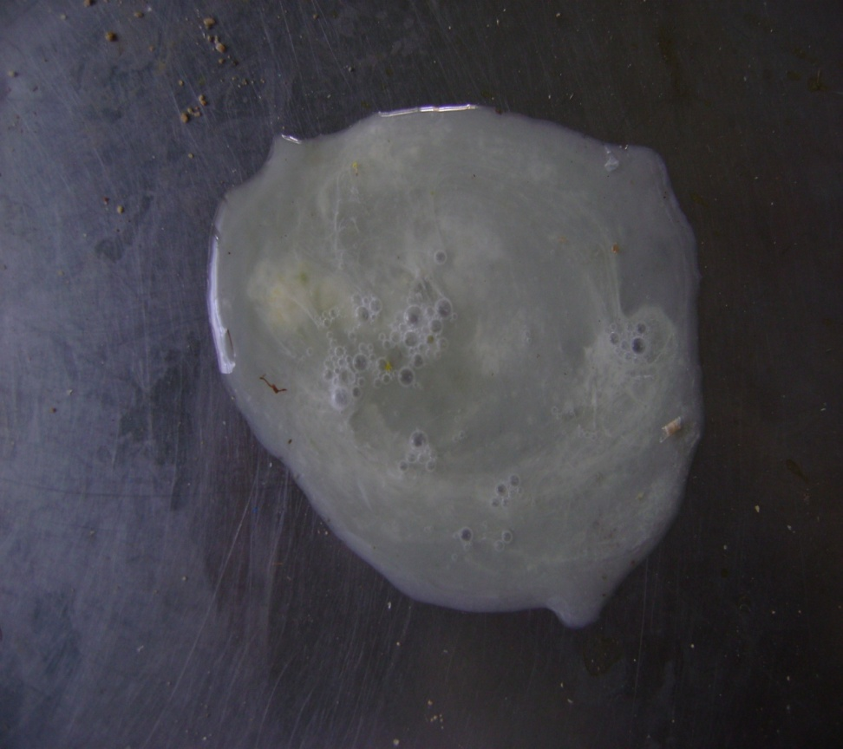
BACILLARY WHITE DIARRHOEA
PULLORUM DISEASE
Fatal septicemia of young chicks .
Salmonella.pullorum

Slide 21
CLINICAL SIGNS
Somnolecence
Weakness
Loss of appetite
Chalky white diarrhoea
Stained greenish brown(sometimes) in and around vent

Slide 22
TREATMENT
Enrofloxacin
Parenteral injections
Oral liquids
Supportive therapy

Slide 23
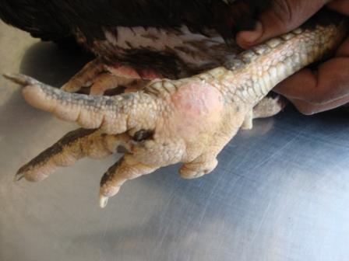
BUMBLE FOOT
PODODERMATITIS
Injury to the lower
surface of the foot and
subsequent infection with
Staphylococcus bacteria

Slide 24
Common causes of injury:
• Rough perches
• Splinters
• Wire floors
• Poor litter or bedding
quality

Slide 25
CLINICAL SIGNS
Lameness
Swelling of the foot pad
Hard, pus‐filled abscess on foot pad

Slide 26
TREATMENT
Soak foot in warm water and Epsom salts.
disinfect with alcohol.
If skin is open, drain pus from abscess.
Flush abscess cavity with hydrogen peroxide to cleanout pus and debris.
Pack the cavity with antibiotic ointment .
wrap the footwith gauze and elastic bandage.
Repeat daily until foot heals.

Slide 27
PREVENTION AND CONTROL
Provide good quality litter or bedding.
Keep bedding clean, dry, and deep.
Keep perches less than 18 inches from the
floor to prevent foot damage due to impact
from jumping.
Remove potential sources of injury such as
sharp objects and/or surfaces.

Slide 28
DEFECIENCY DISEASES

Slide 29
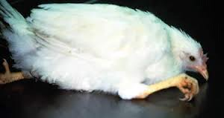
CURLED TOE PARALYSIS
Defeciency of Riboflavin
Poor growth
Weakness
Emaciation and diarrhoea
unable to walk as their toes are turned inwards
Drooping of wings

Slide 30
TREATMENT
Riboflavin @3.6 mg/kg of feed in chicks
Riboflavin @ 1.8 mg/kg of feed in growers
Riboflavin @ 2.2mg/kg of feed in layers

Slide 31
THANKYOU

