Slide 1


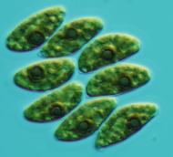
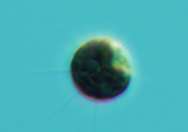
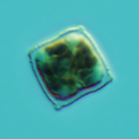
Microalgal Biotechnology: the Future of Aquaculture
AProf. Kirsten Heimann
College of Marine and Environmental Sciences
James Cook University, Townsville, QLD 4811 kirsten.heimann@jcu.edu.au

Slide 2
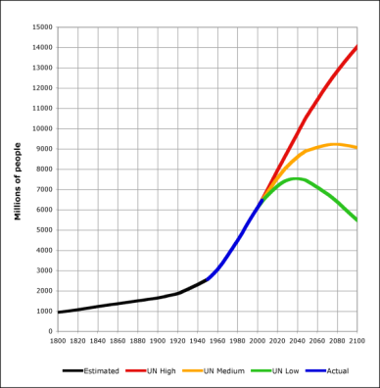
Global Challenges
2005 Global industrial CO_{2e} emissions
44.2 billion tons (Herzog, WRI 2009)
Energy security
Water scarcity
Food security
Nitrogen
Peak Phosphorous
Population growth
Australian Perspective:
Arable land: 6%
Limited freshwater resources
Large amounts of polluted water resources
Cobb 2008 GFDL
Notes:
WRI: world resources institute
IEA: international energy agency
GFDL” GNU Free Documentation Licence
Cobb 2008: based on UN 2005 projections & US Census Bureau Historical Estimates

Slide 3
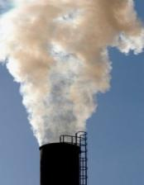
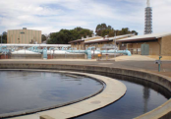
Algae Bio-Products
Problem
Process
Products
Benefitting Industries
Coal-fired Power Stations
Underground coal mines
Metal refineries
Waste water remediation
Animal feeds
CO₂
NO_{x}
Algal biofuels
Fertilizer/Biochar
Algae Cultivation
Biorefining
Waste gases
Nutraceuticals
Outcomes
GHG emission abatement
Water recycling
Nutrient remediation
Bioremediation (metals)
N, P
Metals
Carotenoids
Waste water

Slide 4
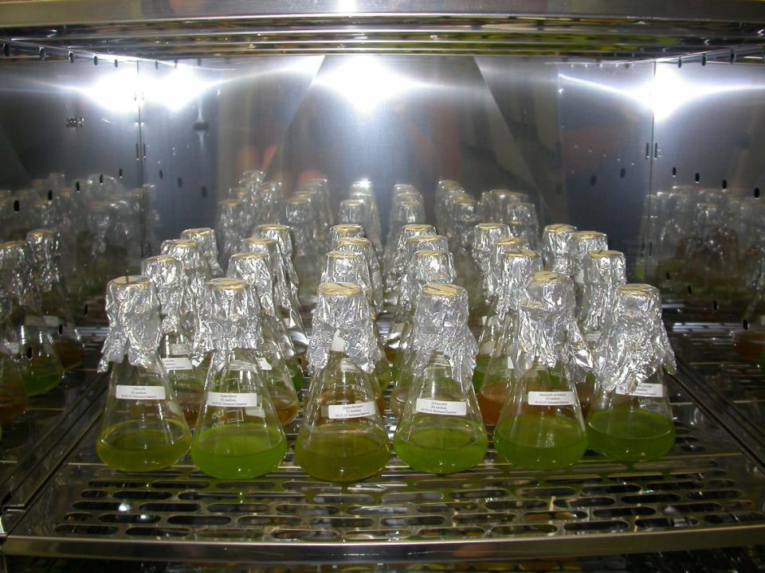
Microalgae are the backbone
of the Aquaculture Industry
Notes:
Choosing to the right microalgal strains is vital for the success and survival of the Aquaculture industry.
Even if you are not doing aquaculture, the information provided in this lecture is also of fundamental importance in ecological studies, freshwater or marine.

Slide 5
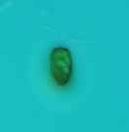
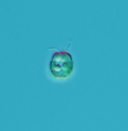
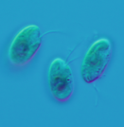
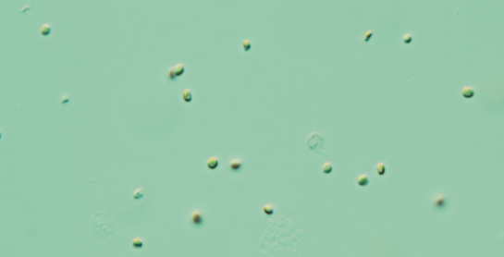
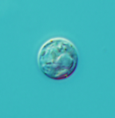

Microalgae
Unicellular (0.2-1mm), some photosynthetic
50% of global primary productivity
16 phyla (including heterotrophs) –
27,000 – 10 million species
Marine and freshwater
Some flagellated, some coccoid (predation cues)
Differ in their photosynthetic pigments
(pigment enrichment, antioxidants)
Differ in biochemical composition
(nutritional profile)
Differ in size (ingestibility)
Differ in cell wall components (digestibility)

Slide 6
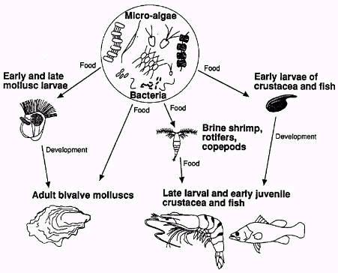
Microalgae as Feed
Traditional uses of microalgae in Aquaculture
Food for:
All growth stages of bivalves
Crustacean
some larval stages
Some fish larvae
Zooplankton
used as food for
larval crustaceans
and fish
Fatty acid enrichment of zooplankton

Slide 7



Algae business in Australia
Macro
Micro &
Microbes
Notes:
Aurora Algae, mit Sitz in Perth, arbeitet an der Entwicklung von hoch-technischen Bioreaktoren für Mikroalgen. Die Demonstrationsanlage ist in Karratha, Western Australia.
BASF hilft ihren Kunden mit weltweiter Erfahrung, langjährigen Erkenntnissen, und leading-edge Lösungen gröβere Sustainability zu erzielen.
Das Murdoch University ALGAE R&D Centre ist eine Einrichtung, die speziell zur Algenforschung und Entwicklung, Algenkultivierung, und Entwicklung von Algenkultursystemen eingerichtet ist. Das Hauptziel ist die Entwicklung von Algenproduktion im komerziellen Rahmen.
Muradel, mit Sitz in Adelaide, ist ein australisches start-up Unternehmen für die Entwicklung von erneuerbaren Treibstoffen aus Mikroalgen. Die Demonstrationsanlage befinddet sich in Whyalla, und die Forschung wird durch die joint venture zwischen der University of Adelaide, die SQC, ebenfalls mit Sitz in Adelaide, die Technologieentwicklung zur Sequestration von Kohlenwasserstoff betreibt und Murdoch University, Western Australia unterstützt.
Die Forschung am Centre for Environmental Risk Assessment and Remediation, CERAR, ist allgemein auf Umweltschutz ausgerichtet wozu die Begrenzung von negativen Auswirkungen des Klimaweandels im sozialen-, ökonomischen- und gesundheitlichen Bereich gehört.
South Australian Research and Development Institute scientists create opportunities to position agriculture, food, aquatic and bioscience industries as internationally competitive and ecologically sustainable.
SARDI
We are a dynamic group leading cutting-edge research into marine biodiscovery, novel product development and sustainable production technologies. We develop marine bioprocesses and bioproducts for sustainable and profitable seafood, pharmaceutical and preventative nutrition, cosmetics, aquafeeds, agri-chemicals, biomaterials and biofuels industries. The Centre has led multi-million dollar industry projects in microalgae biofuels and biorefinery that produce biofuels as well as high value co-products, and bioproduct discovery from macroalgae, marine sponges and sponge associated bacteria, and other marine organisms.
Centre for Marine Bioproducts Development
MBD has factored production of various forms of algae-based animal feed and high-value human foods into the delivery of a number of waste stream bioremediation projects.
MBD Energy
Cognis is a leading Manufacturer and supplier of natual-source vitamins extracts and ingredients for nutritional suppliments, functional food fortification, food colour and animal nutrition.
Cognis Australia is the world's largest producer of algal beta-carotene and carotenoids, branded as Betatene Natural Mixed Carotenoids.
COGNIS
King Island Kelp Industries is a factory and site for receiving, drying and milling stormcast Bull Kelp (Durvillea Pototorum) for local Australian customers and for export to Scotland & Norway.
King Island Kelp Industries
Marinova is a progressive Australian biotechnology company dedicated to the development and manufacture of high purity seaweed extracts for the betterment of human health. Marinova supplies fucoidan to world-renowned research institutions and some of the world’s largest pharmaceutical and nutraceutical companies.
Marinova
he Institute for Marine and Antarctic Studies (IMAS) pursues multidisciplinary and interdisciplinary work to advance understanding of temperate marine, Southern Ocean, and Antarctic environments. Institute for Marine and Antarctic Studies
Australian National Algae Culture Collection - this unique bank of Australian biodiversity contains marine and freshwater microalgal classes sourced from tropical Australia to Antarctica.
CSIRO - Australian National Algae Culture Collection
Through research and vertical communication to industry and other partners, support the development of seaweed and microalgae applied research & development in Australia.
Shoalhaven Marine & Freshwater Centre
Algae.Tec uses an enclosed modular high-yield algae growth manufacturing system to produce sustainable and renewable oil for fuel.
Algae.Tec
Research work with the Royal Botanic Gardens & Domain Trust has resulted in the discovery of more than 50 new species of seaweeds. With 2000 different species of seaweeds in Australia it is the continent with the richest seaweed flora on earth.
Sydney Royal Botanic Gardens
A database for the phycologist and scientist to search for all the seaweed genera and species we have in our collection here at the National Herbarium of NSW at the Royal Botanic Gardens in Sydney.
Aussie Algae PlantNET
SIMS conducts multidisciplinary marine research across five core research themes - Urbanisation, Biodiversity, Climate Change, Ocean Resources, and Marine Management.
SIMS
Development of sustainable high efficiency microalgae production systems for fuel, food and high value products. University of Queensland Solar Biofuels Consortium
Fisheries, offshore oil and gas, mining, reef tourism and aquaculture industries have all benefited from AIMS research that is geared towards the protection and sustainable development of marine resources. Australian Institute of Marine Science
The Macroalgal Biofuels and Bioproducts project will provide the research, development and demonstration of macroalgal biofuels and co-products (fertiliser, animal feed, human food and nutraceuticals), while providing cost-effective reductions of CO2 emissions from major carbon emitters in Australia.
James Cook University
Biological know-how, engineering and infrastructure inputs are key to a new partnership project between the MCRC, James Cook University and the private sector, aimed at solving the biological and technical problems associated with remediation of coal mine methane (CMM).
JCU Microalgae Methane Remediation Project

Slide 8

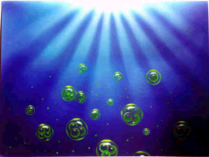
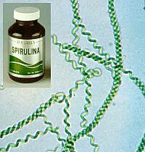
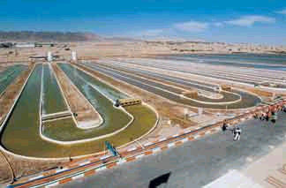
Commercial Cultivation
Semi-extensive:
In ponds: 1 ha or
In raceways: 50 x 5 x 1 m
Used for the cultivation of
Dunaliella
Spirulina
Chlorella
Chlorella food supplement
Spirulina (cyanobacterium)
(food supplement)
Raceway cultivation of Dunaliella salina
Eilat (Israel)
Notes:
Raceway culturing facility in Eilat in Israel. Prof Ben Amotz leads the facility.

Slide 9
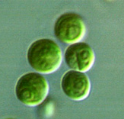
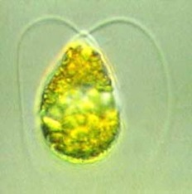
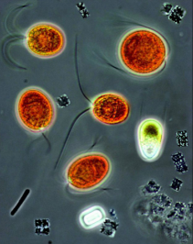
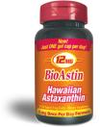
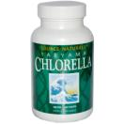

Microalgae as Nutraceuticals
Nutraceuticals and pigments/ antioxidants:
Human health supplements (e.g. Chlorella, Spirulina)
Pigments/ antioxidants
Dunaliella commercial β-carotene producer
Haematococcus astaxanthin
Fish oil
Isochrysis, Crypthecodinium,
Schizochytrium (DHA)
Pavlova (EPA, DHA)
Diatoms, Nannochloropsis (EPA)
Notes:
Some microalgae have distinctive morphological features.

Slide 10
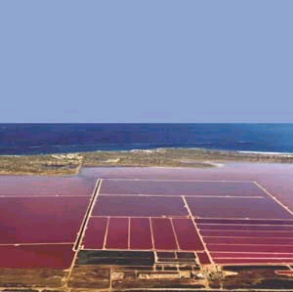
Extensive Raceway/Pond Productions
Eilat (Israel)
Western Australia
Dunaliella salina
β-carotene
Only case where natural pigment is less expensive than
synthetic forms

Slide 11
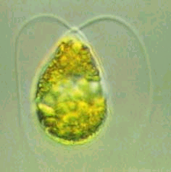
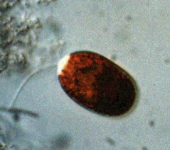
β-Carotene – Dunaliella salina
Growth conditions:
salinity 30-300 ppt
(good for contamination control, but corrosion of equipment)
temperature 30-40 °C
β-carotene induction by N-limitation; salinity changes
β-carotene: a carotenoid precursor for
Vitamin A (required for growth and reproduction)
Markets
food and feed, neutraceutical
cosmetics, colourant, antioxidant
Challenges
Culture densities low: 2x10⁵ cells/mL
Pigment loss due to removal of salt
Hutt Lagoon (WA) – open pond
Dunaliella salina β-carotene production
Notes:
Dunaliella prefers salinity of 25% NaCl and 30-40 degrees C WA production in 250 ha open ponds
Growth rate: 1-2 g/m2/day
Culture density: 2 x 105 cells/mL = 0.25 g/L
No cell wall: prone to sheer stress
High salinity environment (corrosion of equipment, but good for contamination control
a carotenoid pigment used in the food, animal feed, nutraceutical and cosmetics industries. b-carotene is a precursor to the biosynthesis of vitamin A with essential nutritional activities in growth and reproduction. β-carotene also has well documented anti-oxidant and is used extensively in the nutraceutical market.

Slide 12
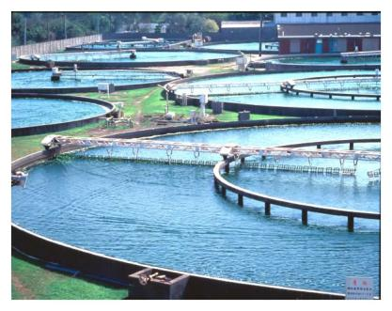
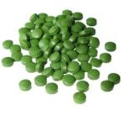
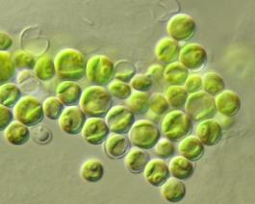
Health Supplement – Chlorella spp
Growth conditions:
freshwater
high nutrients
phototrophic & heterotrophic
Market:
production 2000t/yr
$44/kg
high in protein and carbohydrate
Potential Market
renewable fuels
Challenges
Tough cell wall = low digestibility
hinders mechanical extraction for oil-based fuels
Notes:
Chlorella as a human health supplement accounted for about 2000 tons per year. The current market value for Chlorella is $44 per kilogram. - See more at: http://www.oilgae.com/non_fuel_products/chlorella.html#sthash.cIBOBeHU.dpuf

Slide 13
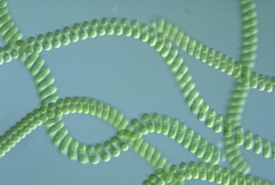

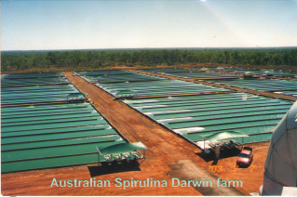
Health Supplement – Arthrospira spp
Growth conditions:
fresh- to marine, marshes, thermal springs
alkaline waters, high pH (10.6)
high conductivity 20-70 g NaCl/L
high temperature (>30 °C)
Market:
high in Vitamin B12
high in protein (60-70% of DW)
chlorophylla a
phycobiliproteins
(phycocyanin, phycoerythrin)
Challenges
Complex, time-consuming process for desalting
Athrospria synonym
Spirulina
Notes:
Spirulina thrives in extreme alkaline and high pH environments.
ftp://ftp.fao.org/docrep/fao/011/i0424e/i0424e00.pdf
http://www.sciencedirect.com/science/article/pii/0144456588900595 Mass Production of the Blue-green Alga Spirulina:
An Overview Avigad Vonshak & Amos Richmond 1988

Slide 14
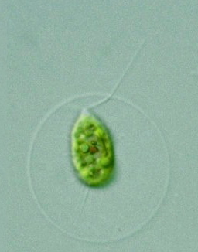
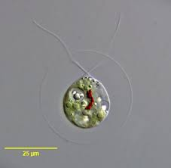
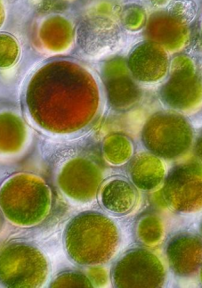
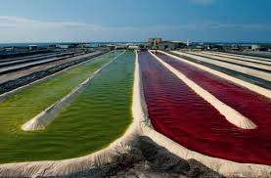
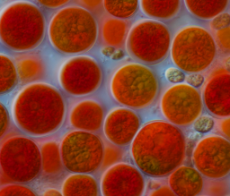
Astaxanthin Market
Haematococcus pluvialis (Chlorophyta)
Freshwater
Sensitive
< 28 °C
prone to contamination
salinity intolerant
Complex life history
$100 – 500 kg⁻¹ DW microalgae
Crop: 5 g L⁻¹
Microzooids
Macrozooids
Aplanospores
Palmelloids

Slide 15
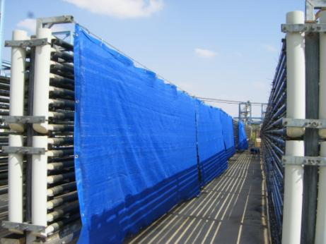
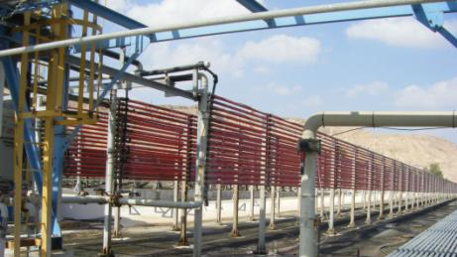
Haematococcus challenges
Fastest market growth
Market not saturated
Challenges
Sensitive
wall-less vegetative stages
light sensitive
(vegetative stages)
< 28 °C
prone to contamination
salinity intolerant
Up-scaling: 2-stage process
nutrient management
Astaxanthin extraction and drying
reactive to O₂
difficult from cysts

Slide 16
Microalgae Market Overview
ω3-Market (global)
2004:
690 M USD
annual growth 12%
ω3-Asian Market
2012:
596 M USD
EPA Market (global)
2014:
300 M USD
DHA Market (global)
1.5 B USD
ω3-Global demand
2006:
baby and infant food: 350 M USD
Alga | annual production (ton dry weight) | annual production (ton DHA oil)
Chlorella | 2500
Spirulina | 4000
Dunaliella salina | 2000
Haematococcus pluvialis | 200-300
Scizochytrium |  | 10
Crypthecodinium cohnii |  | 240
*excluding biomass for aquaculture feed
Source: Lucas and Southgate 2012
Notes:
the annual production of DHA in the form of oil is estimated to be 240 tons from Cryptotheconidium cohnii and 10 tons from Scizochytrium. (Source: FAO) -
In 2004, the global Omega-3 fatty acid market was worth US$ 690 million, and growing at about 12%. The Asian Omega-3 polyunsaturated fatty acids (PUFA) ingredients market alone is expected to reach $596.6 million in 2012 (Sources: Seambiotic, Frost & Sullivan).
Today, the global market for EPA is estimated to be $300 million and that of DHA is $1.5 billion.
Global demand for Omega-3 in baby and infant food is estimated at $350 million per year. The total global market for Omega-3 for all end products estimated to be over $750 million (2006).

Slide 17
Microalgae from Domestication to Market
A
Strain Selection
B
Products
Biochemistry
C
Engineering
Scale-up
Neutraceuticals
Food
Antioxidants
Specialist Chemicals
Pigments
ω-3 Fatty acids
Product value
Market volume
Animal feed
Aquaculture
Agriculture
Bioenergy
Biofuel
Biochar

Slide 18
Microalgal Cultivation Methods
Overview
Culture type | Advantages | Disadvantages
Indoors | High degree of control (predictable) | expensive
Outdoors | Cheaper | Less predictable
Closed | Contamination less likely | Expensive
Open | Cheaper | Contamination more likely
Axenic | Less prone to crashes | Expensive, difficult
Non-axenic | Cheaper, less difficult | Prone to crashes
Notes:
Indoor/Outdoor. Indoor culture allows control over illumination, temperature, nutrient level, contamination with predators and competing algae, whereas outdoor algal systems make it very difficult to grow specific algal cultures for extended periods.
Open/Closed. Open cultures such as uncovered ponds and tanks (indoors or outdoors) are more readily contaminated than closed culture vessels such as tubes, flasks, carboys, bags, etc.
Axenic (=sterile)/Xenic. Axenic cultures are free of any foreign organisms such as bacteria and require a strict sterilization of all glassware, culture media and vessels to avoid contamination. The latter makes it impractical for commercial operations.

Slide 19
Microalgal Cultivation Principles
Culture type | Advantages | Disadvantages
Continuous | Efficient, provides a consistent supply of high quality cells, automation, highest rate of production over extended periods of time | Difficult, usually only produces small quantities, complex, equipment costs may be high
Semi-continuous | Easier, somewhat efficient | Sporadic quality, less reliable
Batch | Easiest, most reliable | Least efficient, Quality can vary dramatically
Notes:
Batch, Continuous, and Semi-Continuous. These are the three basic types of phytoplankton culture which will be described in the following sections

Slide 20
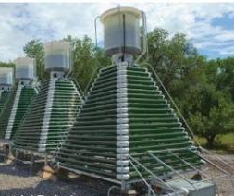
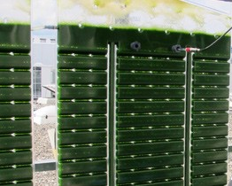
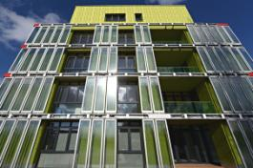
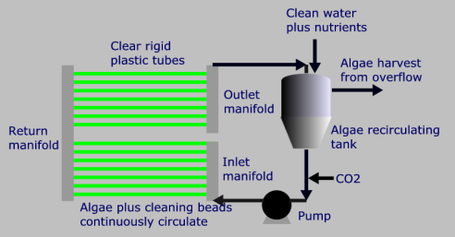
Commercial Continuous Systems
Photo-bioreactors
Flat Panel
Tubular
Disadvantages:
Biomass fouling
(light limitation)
Oxygen build up in light
compartment
Expensive
The BIQ House
Hamburg
flat panel facades
Notes:
In a transparent tank, or algal bag system for growing algae the organisms pick up light whilst in the few centimetres near the tank wall or surface where they react with carbon dioxide and nutrients and photosynthesis occurs. Once they move away from that surface then light cannot penetrate and photosynthesis ceases. However, this dark area allows more complex protein building to occur within the algae. By the very nature of a tank the ratio of light to dark area is small and so algal growth is limited.
Tubular/ flat panel reactors get round this problem by using narrow diameter tubes that allow the light to penetrate to the centre of the tube. This maximises the surface area available for photosynthesis. Because there is still a requirement for algae to spend time away from the light the tubing is connected to a tank and the algae is constantly recirculated from the tank round the tube and back to the tank. This manifold system is expandable.

Slide 21
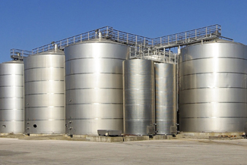
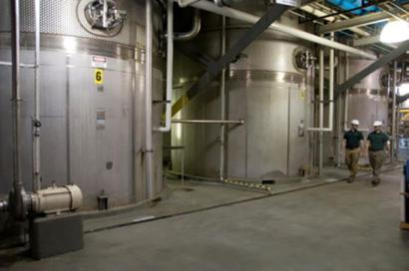
Heterotrophic Fermenter Cultivation
Dinophyta
Schizochytrium
Crypthecodinium
(Martek, USA)
Chlorophyta
Chlorella
Tetraselmis
Technology Advantages
large prior knowledge
existing hardware for automation
large scale and globally available
low unit operation costs
high culture densities (>50 g L⁻¹)
Challenges
axenic cultures (sterile, no bacteria)
oxygen demand
Notes:
Fermenter technology advantages:
Large pre-existing knowledge base
Sophisticated hardware for automation
World-wide large-scale availability
Relatively low unit operation cost
Cell concentrations of over 50g /L
However, needs to be sterile
Providing enough oxygen is often the single most limiting factor
96-well plate assays with different carbon sources in the wells → straightforward tests to see if your isolated organism can grown heterotrophically
Chlorella and Tetraselmis are grown heterotrophically in fermenters
http://www.ncbi.nlm.nih.gov/pubmed/19087364 n-3 Oil sources for use in aquaculture – alternatives to the unsustainable
harvest of wild fish Matthew R. Miller1,2*, Peter D. Nichols1 and Chris G. Carter3 2008

Slide 22
Microalgal Cultivation Technology
Ponds
Aquaculture production
Low control
Optional nutrient addition
Raceways
Aquaculture production
Control over mixing
Optional nutrient addition
Vertical bags
Aquaculture feed production
High control
PBRs/fermenters
Full environment control
Axenic cultures
Genetically modified organisms
Light
Temperature
Nutrients
Carbon (pH)
Management Intensity
Biomass productivity
(g DW m⁻² d⁻¹)

Slide 23
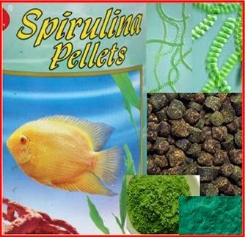
Factors Affecting Biochemical Profiles
Factors
Light (photo-period and intensity)
Temperature
Nutrient-status (nitrogen availability)
Nutrition (media)
Salinity
Carbon availability (CO₂)
Growth phase
Affect the biochemical
composition and therefore
bioproduct potential of microalgae

Slide 24
Potential for other cultivation
strategies
Despite the proven value of microalgae bioproducts, the
general problems associated with traditional cultivation
methods ask for other strategies to overcome the
economic disadvantages
Dried microalgae
Microalgae concentrates
Advantages:
Can be produced in central locations and distributed to hatcheries
Disadvantage:
Expense will not really change

Slide 25
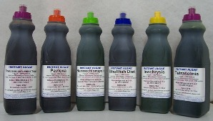
Microalgal Concentrates
Problems with concentrates
shelf-life limited
problems with transportation
Commercial production in the USA
Reed Mariculture (www.seafarm.com);
Shelf life: 12-14 weeks at 4 °C, 2 years at -20°C
Can be shipped to Australia
Good range of species, incl. Pavlova, Isochrysis)
3-4.6 billion cells mL⁻¹, but not live and not viable
1 mL ‘Instant Algae is equivalent to 1800 L @ 2.17 million cells mL⁻¹
Advantages (as per advertisement):
Cells intact (although not viable retains the nutritional value)
Cost savings (no infrastructure, labour, trained personnel requirements)
No worries about culture crashes; cells disperse instantly in water
No culture timing requirements (phytoplanton timed with zooplankton production),
‘Instant Algae”
www.Instant-Algae.com
www.Microalgae.com

Slide 26
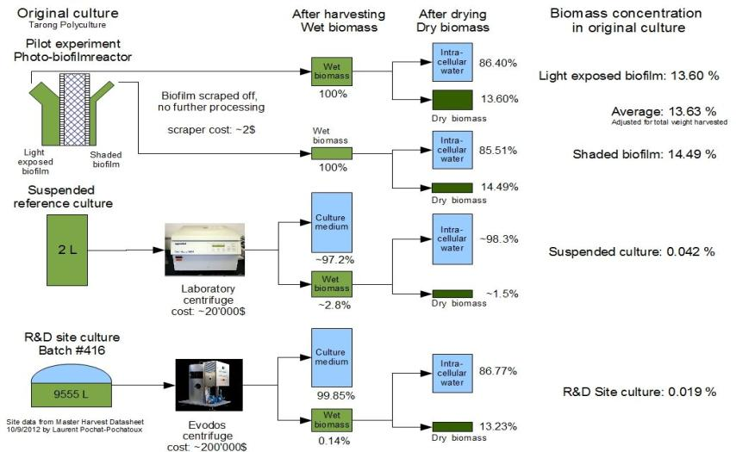
Phototrophic Biofilms
Berner, F. and Heimann, K.

Slide 27
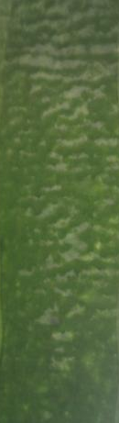
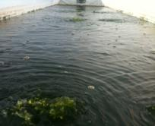
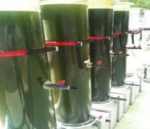
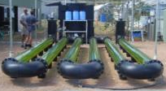
Biofilm vs. Suspension Culture
Parameter | BF | SC
Energy (E)
Resupension | - | +
Dewatering | - | +
CO₂ delivery | - | +
Water
volumes | small | large
E recirculation | + | ++++
Gas-exchange
oxygen | good | poor
CO₂ delivery | diffusion | Venturi
System costs
open | low | low
closed | + | ++++
Harvest handling | scraping | technical
Biofilm
(BF)
Suspension
Cultures
(SC)

Slide 29




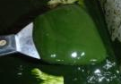


Conclusions
CO₂
NO_{x}
+
+
=
+
+
+
Biomass productivity and carbon – wastewater remediation potential:
Achievable and superior to terrestrial crops
simple commercially viable systems exist to produce sufficient biomass today
Oil yield and end product suitability:
Pigments are great bioproducts but market size is limiting
Fatty acid profiles are suitable for biopolymers, biodiesel without alterations to
existing biomass extraction and refining processes
High PUFA – omega-3 fatty acid content of some strains is commercially attractive
$ ,000s

Slide 30



Microalgal Biotechnology – The Future
Inputs:
Water source?
Self-established
local algae
consortia
Recycling
waste gases
CH₄ to CO₂
Wastewater
At scale:
heating,
electricity
Processes
Anaerobic
Digestion
wet biomass
liquid fertiliser
compost
(sludge)
biogas
(CH₄, CO₂)
Pyrolysis
dried biomass
biochar
pyrolysis oil
gas (CO₂)

Slide 31


The Team
AProf. Kirsten Heimann
Postdocs:
Obuli Kartik (methane)
Samuel Cires (cyano)
RAs: PhD students
Stan Hudson (project logistics) Ali Razaghi (CH₄)
Saravanan Nadarajan (methane) Karthigeyan Padmavathy (CP; CH₄)
Carlos Alvarez Roa (cyano) Chinnathambi Velu (cyano)
G. Subaschandrabose (Gobi, micro)
Nick von Alvensleben (micro) Florian Berner (micro) Prashant M. Nair (micro)
Martino Malerba (micro)
Danilo Malara (micro)
Visiting Research Fellow:
Virginia Loza

