Slide 1
About OMICS Group
OMICS Group International is an amalgamation of Open Access publications and worldwide international science conferences and events. Established in the year 2007 with the sole aim of making the information on Sciences and technology ‘Open Access’, OMICS Group publishes 400 online open access scholarly journals in all aspects of Science, Engineering, Management and Technology journals. OMICS Group has been instrumental in taking the knowledge on Science & technology to the doorsteps of ordinary men and women. Research Scholars, Students, Libraries, Educational Institutions, Research centers and the industry are main stakeholders that benefitted greatly from this knowledge dissemination. OMICS Group also organizes 300 International conferences annually across the globe, where knowledge transfer takes place through debates, round table discussions, poster presentations, workshops, symposia and exhibitions.

Slide 2
About OMICS Group Conferences
OMICS Group International is a pioneer and leading science event organizer, which publishes around 400 open access journals and conducts over 300 Medical, Clinical, Engineering, Life Sciences, Phrama scientific conferences all over the globe annually with the support of more than 1000 scientific associations and 30,000 editorial board members and 3.5 million followers to its credit.
OMICS Group has organized 500 conferences, workshops and national symposiums across the major cities including San Francisco, Las Vegas, San Antonio, Omaha, Orlando, Raleigh, Santa Clara, Chicago, Philadelphia, Baltimore, United Kingdom, Valencia, Dubai, Beijing, Hyderabad, Bengaluru and Mumbai.

Slide 3



Dy-FREE HIGH STRENGTH, HIGH COERCIVITY Nd₂Fe₁₄ PERMANENT MAGNETS
K.A. Gschneidner, Jr.
The Ames Laboratory and Department of Materials Science and Engineering
Iowa State University, Ames, Iowa, 50011 USA
3rd International Conference and Exhibition on Materials and Engineering
San Antonio, Texas, USA
October 6, 2014
Research supported by the U.S. Department of Energy, Advanced Research Projects Agency-Energy ,
Rare Earth Alternatives in Critical Technologies for Energy (REACT)
IOWA STATE UNIVERSITY
OF SCIENCE AND TECHNOLOGY

Slide 4
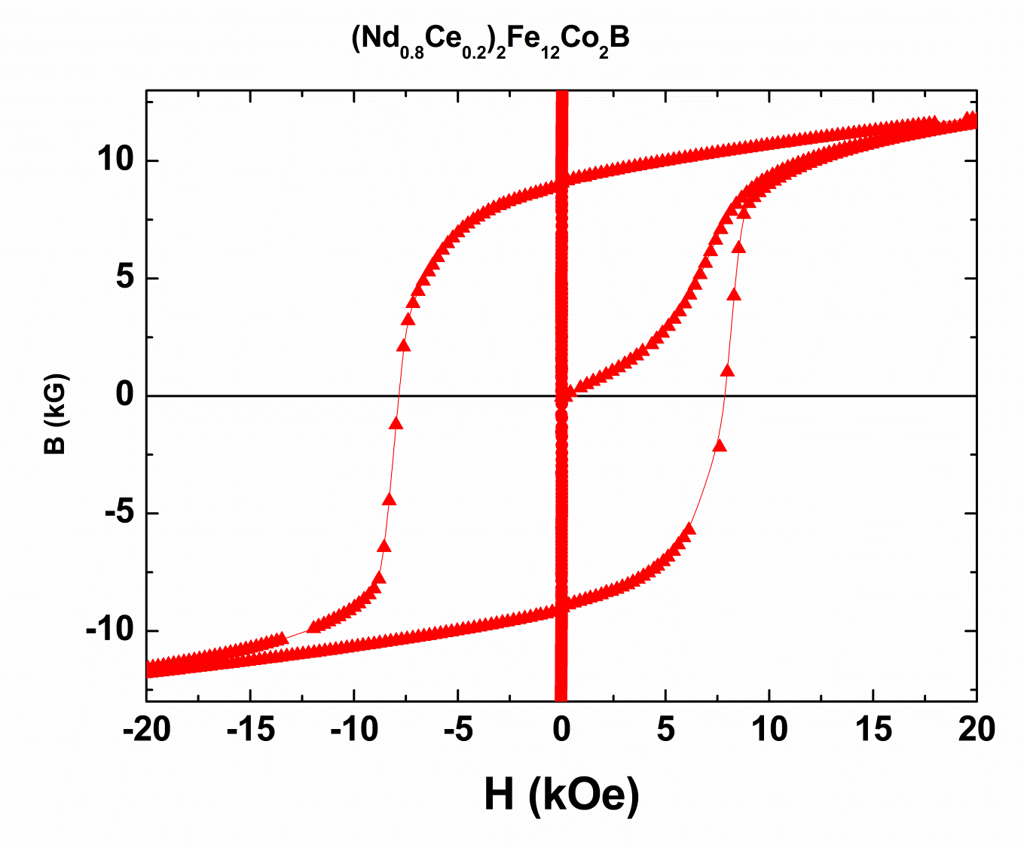
BASIC DEFINITIONS – I
B vs. H Curves

Slide 5
BASIC DEFINITIONS – II
B_{r}, H_{c}, H_{ci}, BH_{max}
B = 4πM + H
14
Spindle Magnet (M)
Spindle Magnet (B)
CEA-1-55 (M)
B_{r}
12
CEA-1-55 (B)
Speaker Magnet (M)
10
Speaker Magnet (B)
BH_{max} = -28.7 MGOe
8
M, B (kG)
BH_{max} = -8.8 MGOe
6
BH_{max} = -5.1 MGOe
4
2
0
H_{c}
H_{ci}
-14
-12
-10
-8
-6
-4
-2
0
Magnetic Field, H (kOe)
Area under curve
B_{r} Remanence (kG)
H_{c} Coercivity (kOe) (line with data point)s
H_{ci} Intrinsic Coercivity (kOe) (solid line)
BH_{max} Maximum Energy Product (MGOe) (largest area under curve)

Slide 6
NEODYMIUM-IRON-BORON PERMANENT MAGNETS Nd₂Fe₁₄B
Strongest permanent magnet
Fe – magnetic properties due to iron
Nd – locks the iron magnetic moments, keeps them from rotating
(coercivity)
Applications
electric motors (cars, wind turbines, elevators)
spindle magnet of computers
speakers (ear buds)
magnetic refrigerators
Role of Dy
added to Nd₂Fe₁₄B to further increase the coercivity (1 to 10%)
increases the high temperature useful limit

Slide 7
DYSPROSIUM
USEFULLNESS
Magnet weighs less for the same strength compared to magnets
without Dy (automobiles – CART requirements)
Improves high temperature performance
DRAWBACKS
Supply of Dy in the world is limited
One of Dept. of Energy’s critical elements (most critical)
Expensive
DOE’s ARPA-E REACT PROGRAM
Rare Earth Alternatives in Critical Technology for energy
Get rid of Dy, or reduce the amount needed
Reduce Nd content, or replace it with new non-rare earth magnets

Slide 8
WHY CERIUM
Most abundant rare earth
Ce needs to be removed to get at the other rare earth
elements in the separation process
50% excess Ce supply over demand
General Motors found that in La₂Fe₁₄B-Nd₂Fe₁₄B
pseudo binary system two phases formed after high
temperature anneal – will Ce do the same?
Ce is a mixed valent metal with a history of doing
unusual and strange things
The Ce valence is 3.4 in Ce₂Fe₁₄B

Slide 9
FIRST SURPRISE IN
(Nd_{1-x}Ce_{x})₂Fe₁₄B SYSTEM
An anomaly in the c lattice parameter vs. Ce
concentration plot at ~20% Ce substitution
for Nd!
An increase in coercive field at ~20% Ce
concentration (Slide 8)!

Slide 10
BH_{MAX}, B_{r}, H_{c}, H_{A} AND M_{S} OF
(Nd_{1-x}Ce_{x})₂Fe₁₄B RIBBONS
0.2
0.2

Slide 11
SECOND SURPRISE IN
(Nd_{1-x}Ce_{x})₂Fe₁₄B SYSTEM
The drop-cast ingots of (Nd_{1-x}Ce_{x})₂Fe₁₄B are two
phase alloys, with micron size Ce-rich grains in
Nd-rich matrix (Slide 10)!
The two-phase region extends from x ~0.15 to x ~0.4 (Slide 10).

Slide 12
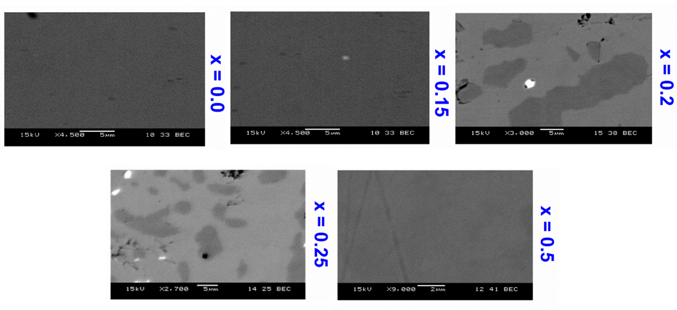
SEM IMAGES OF (Nd_{1-x}Ce_{x})₂Fe₁₄B
DROP CAST ALLOYS

Slide 13
THIRD SURPRISE – THE EFFECT OF COBALT ADDITIONS
Cobalt was added to increase the
ordering temperature – which it does
But it squares up the BH loop (Slide 12)!
Wow!

Slide 14
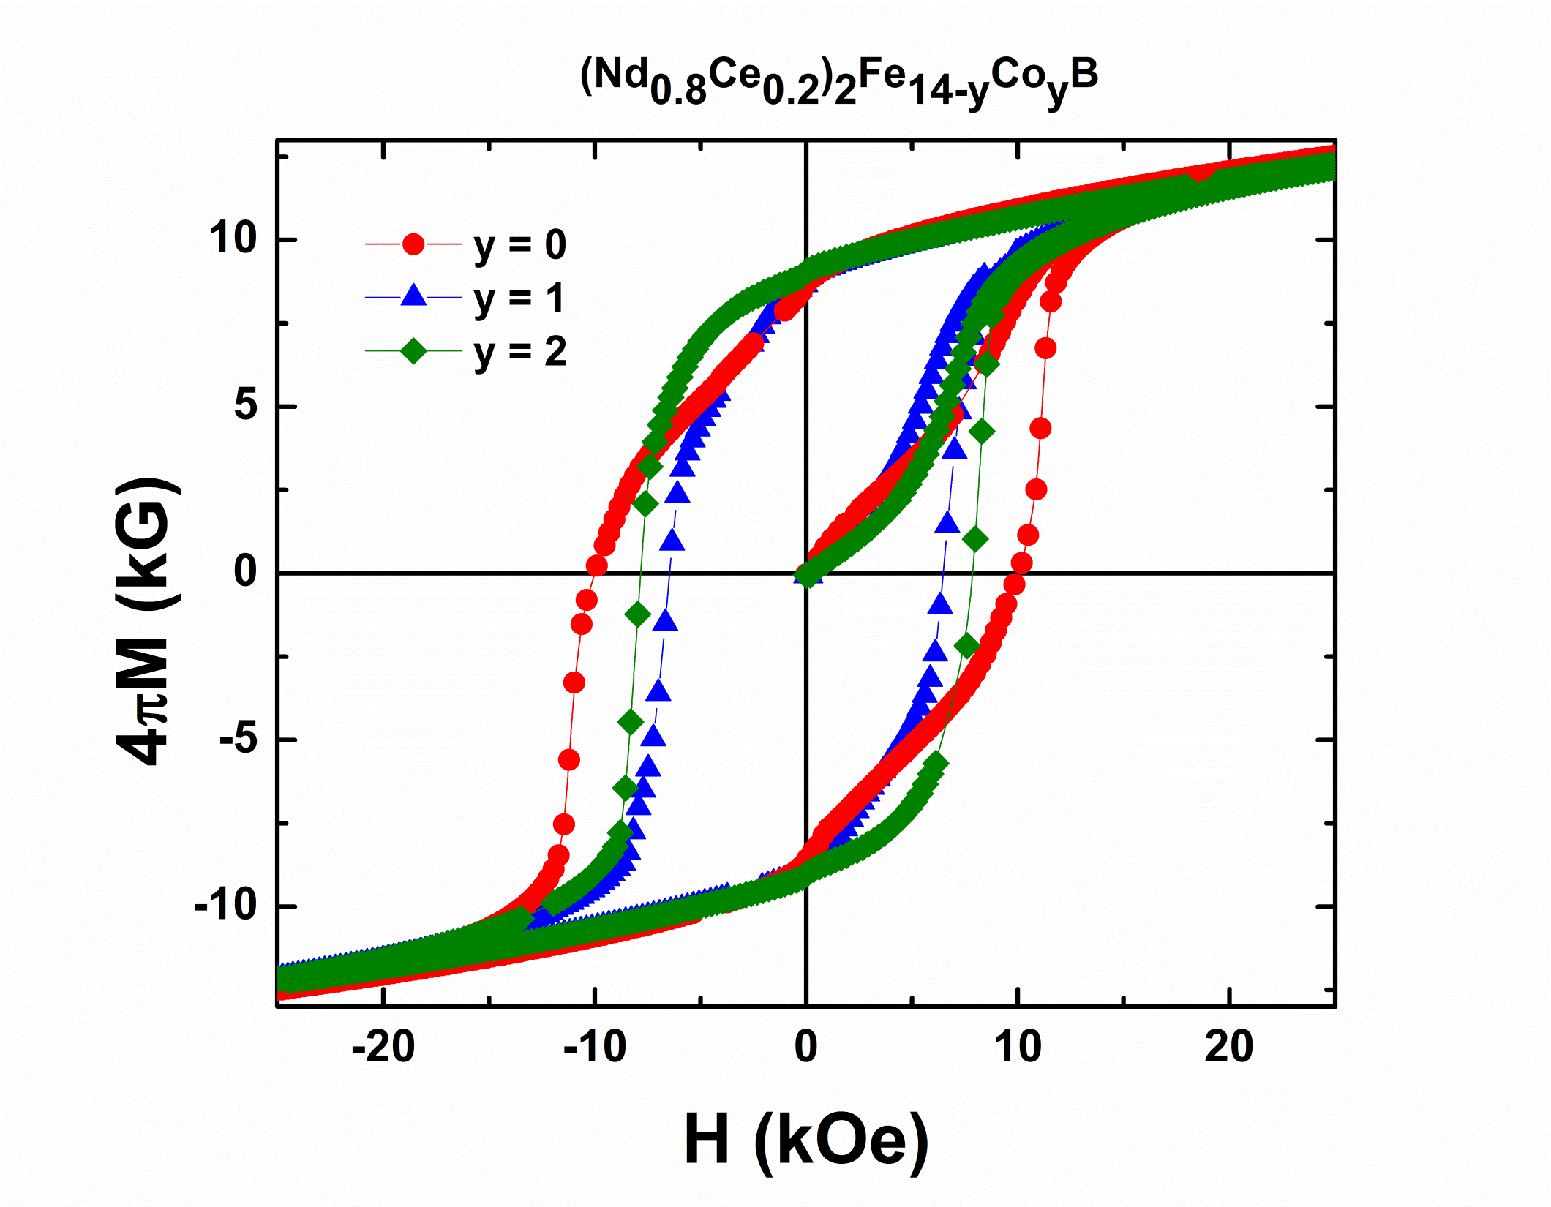
MAGNETIZATION VS. FIELD FOR (Nd_{0.8}Ce_{0.2})₂Fe_{14-y}Co_{y}B ALLOYS

Slide 15
ADDITION OF TiC OR ZrC GRAIN REFINERS
Increased BH_{max} as expected (Slide 14)
ZrC is better than TiC

Slide 16
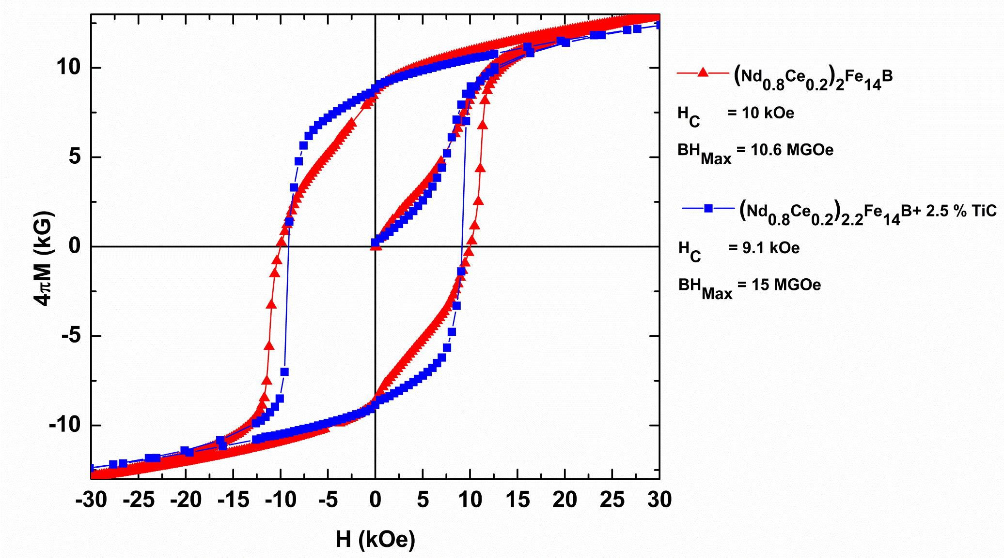
MAGNETIZATION VERSUS FIELD OF (Nd_{0.8}Ce_{0.2})_{~2}Fe₁₄B WITH AND WITHOUT ADDED TiC MELT SPUN RIBBONS
Shape of blue curve is just
what the magnet design
engineers want in the
second quadrant

Slide 17
FOURTH SURPRISE – TEMPERATURE DEPENDENCE OF H_{c}
The temperature dependence of the coercivity
drops much slower than that of a sintered
Nd-Dy-Fe-B alloy (Slide 16)! Wow!
At ~500 K (~225°C) H_{c} is larger than that of a
sintered Nd-Dy-Fe-B alloy (Slide 16)!
Wow! Wow!
The temperature under the hood of an automobile
may reach 475 K (200°C) during a hot summer day.

Slide 18
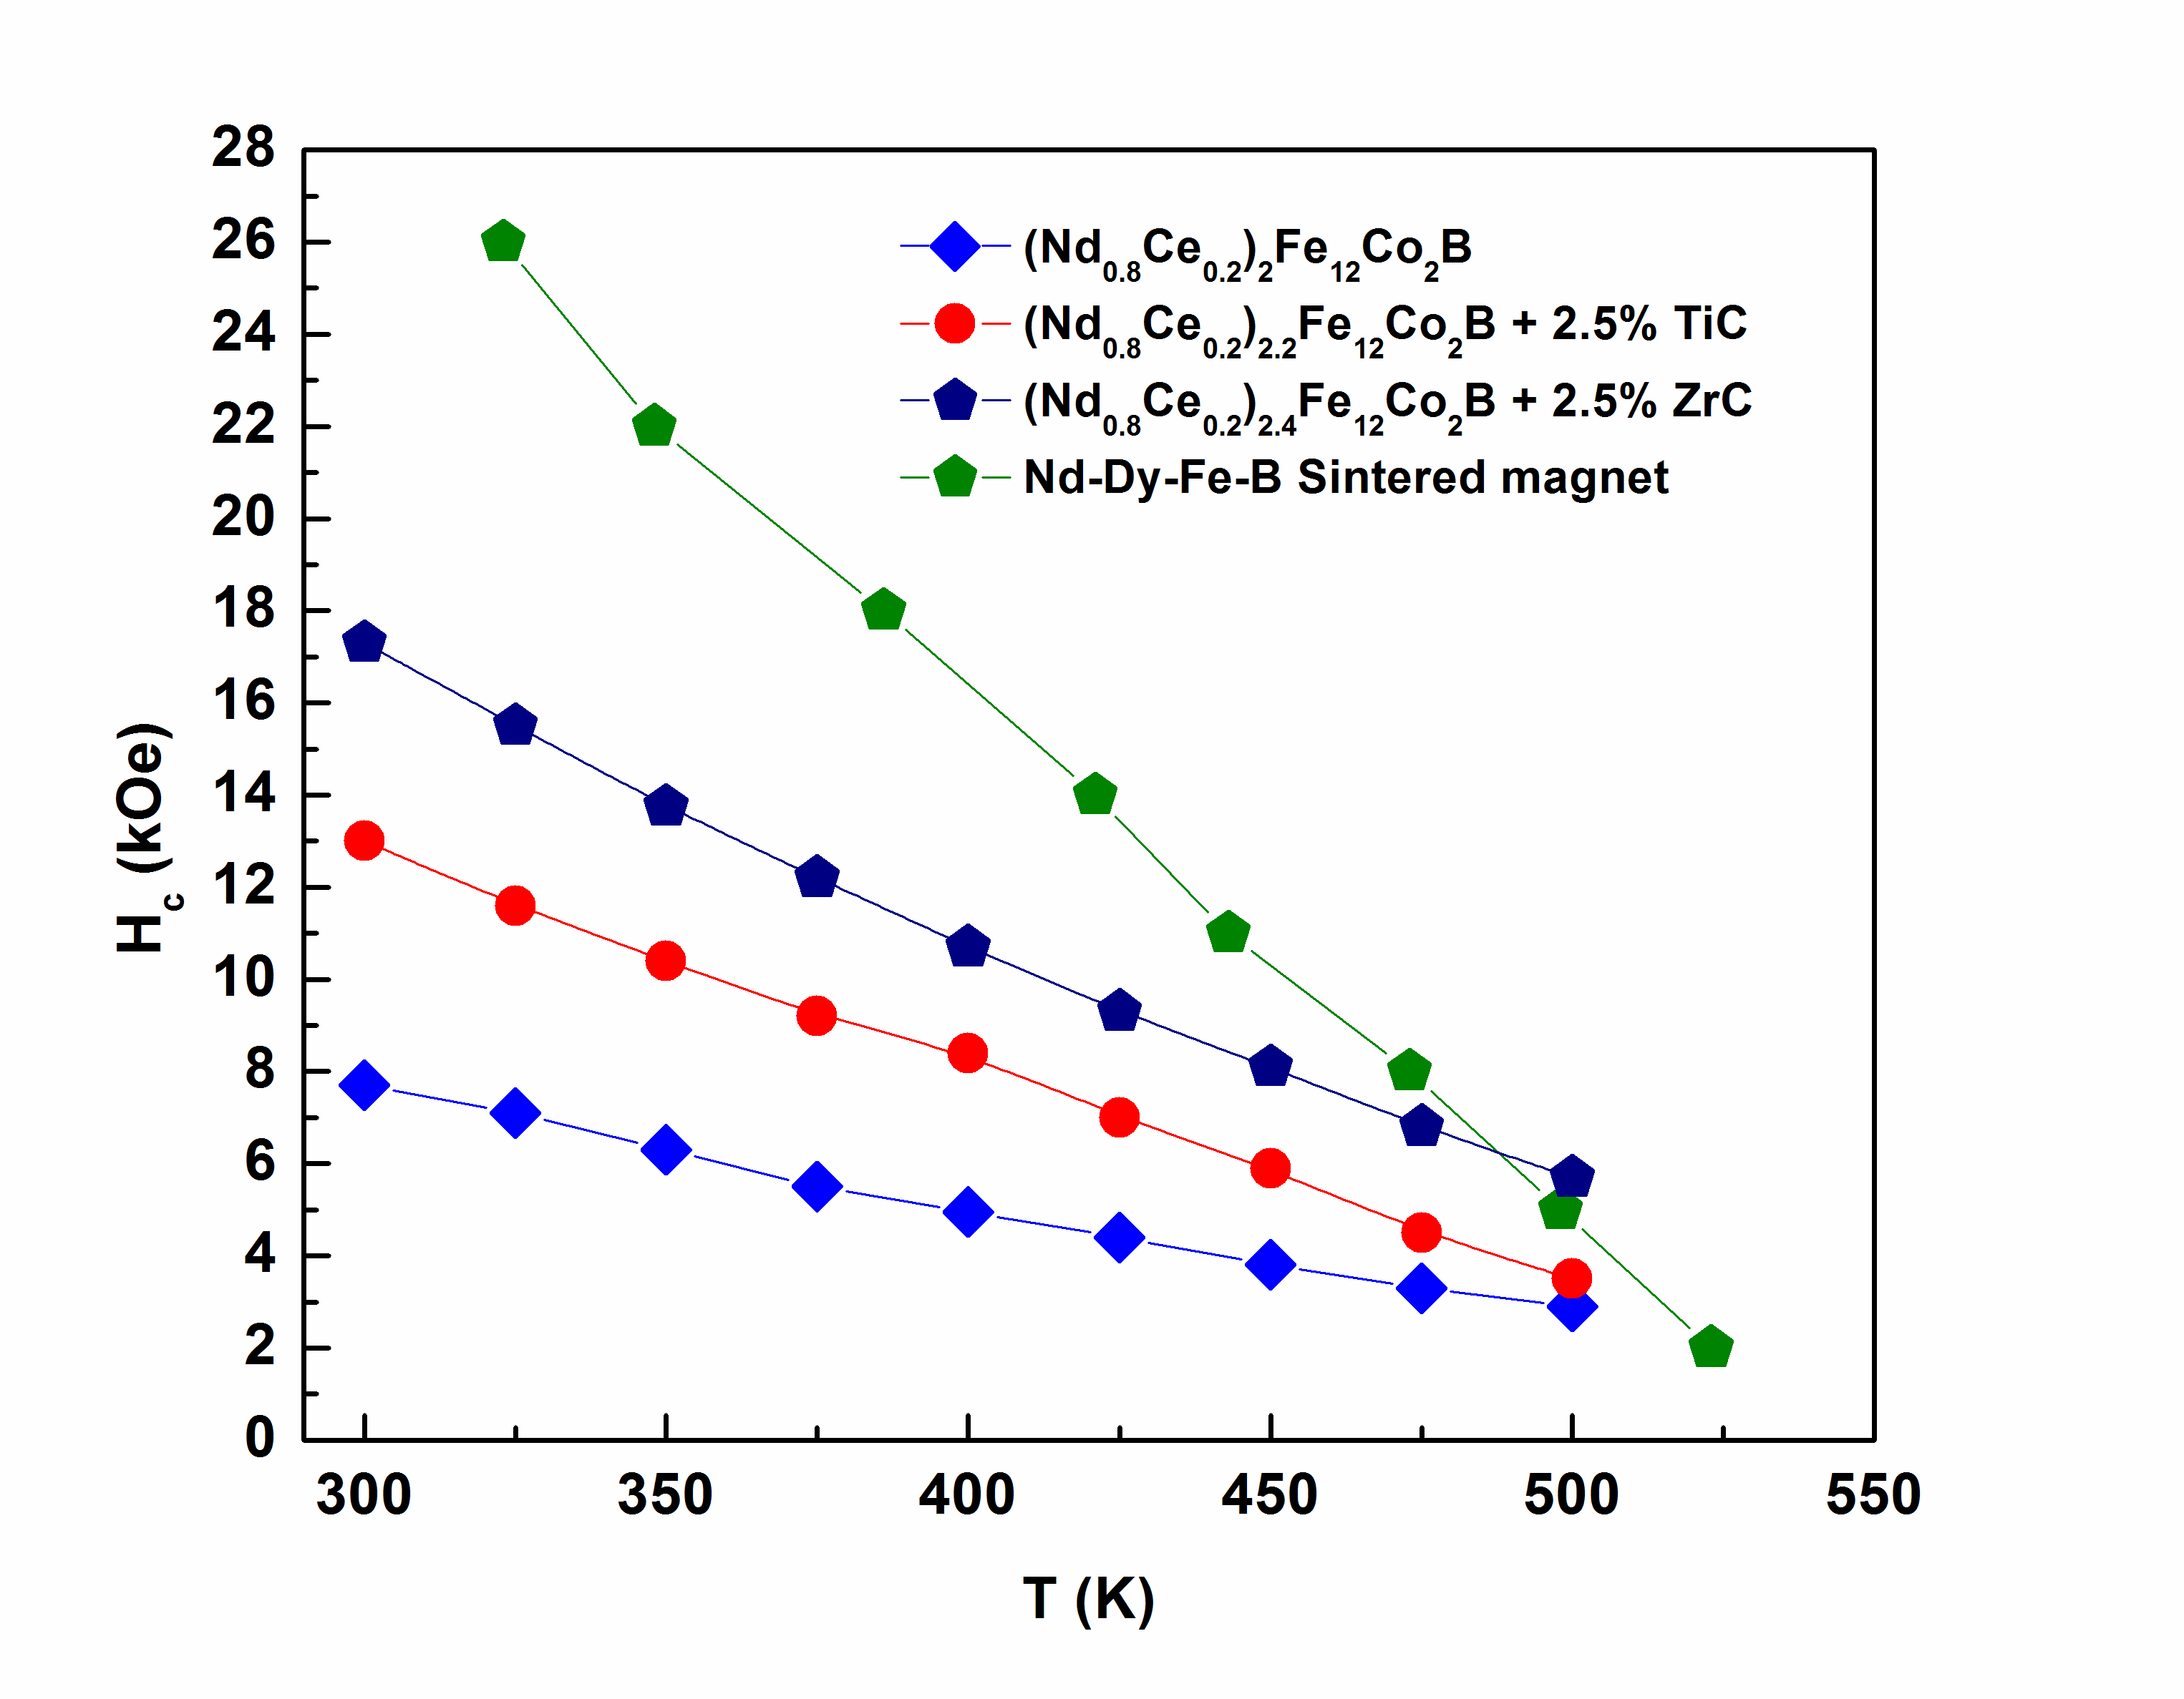
COERCIVITY AS A FUNCTION OF TEMPERATURE FOR (Nd_{0.8}Ce_{0.2})_{2+z}Fe₁₂Co₂B RIBBONS WITH EXCESS RARE EARTH AND/OR TiC, ZrC AS A FUNCTION OF TEMPERATURE.
Note cross-over

Slide 19
SYNERGISM BETWEEN MIXVALENT
Ce AND Co
Cobalt addition:
Increases T_{c} as expected
Increases both H_{c} and BH_{max} Wow!
Smaller temperature dependence of H_{c} and BH_{max};
These are better than sintered Nd-Dy-Fe-B magnet
above ~475 K (~200°C); i.e. magnetic properties
of co-doped Ce,Co better than sintered Dy
containing magnets
Ce and Co occupy adjoining crystallographic sites in
Nd₂Fe₁₄B structure (Slide 18)

Slide 20
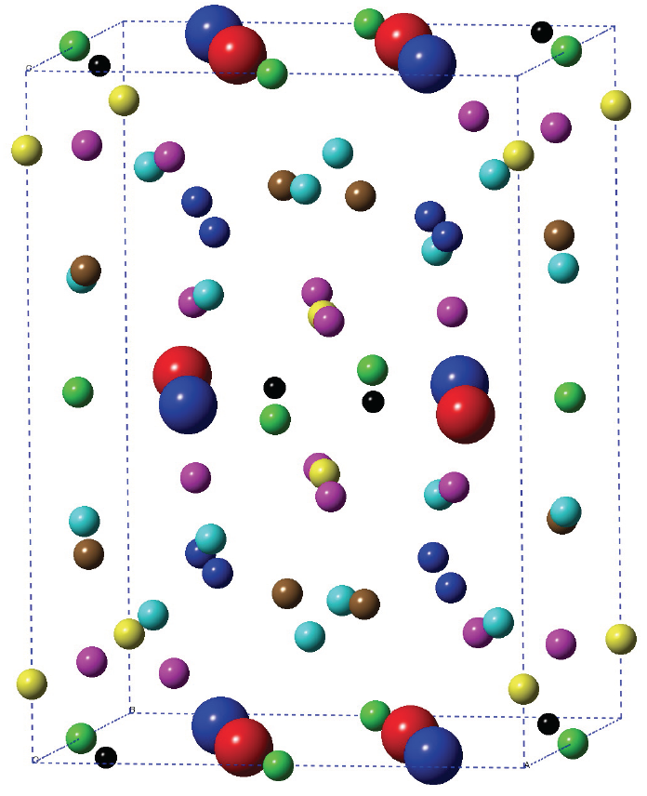
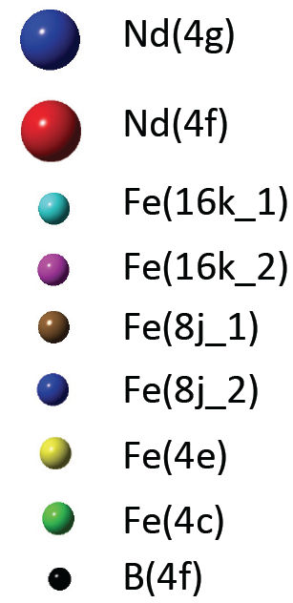
Nd₂Fe₁₄B STRUCTURE
Ce occupies Nd(4f) sites; and Co occupies Fe(4c) sites
Ref.: L. Ke, D. Kukusta, V. Antropov, Ames Laboratory Seminar, March 2014.

Slide 21
PROCESSING COMMERCIAL (Nd_{0.8}Ce_{0.2})_{2.4}Fe₁₂Co₂B
Ce and Nd – commercial grade metals (~98 at.% pure)
Ferrous boron – commercial grade (~2 at.% non-
ferrous impurities)
MQ1(1) melt spun ribbons – isotropic grains
MQ2(2) hot pressed magnet (ingot) – isotropic
grains
MQ3(3) die upset magnet ingot – anisotropic

Slide 22
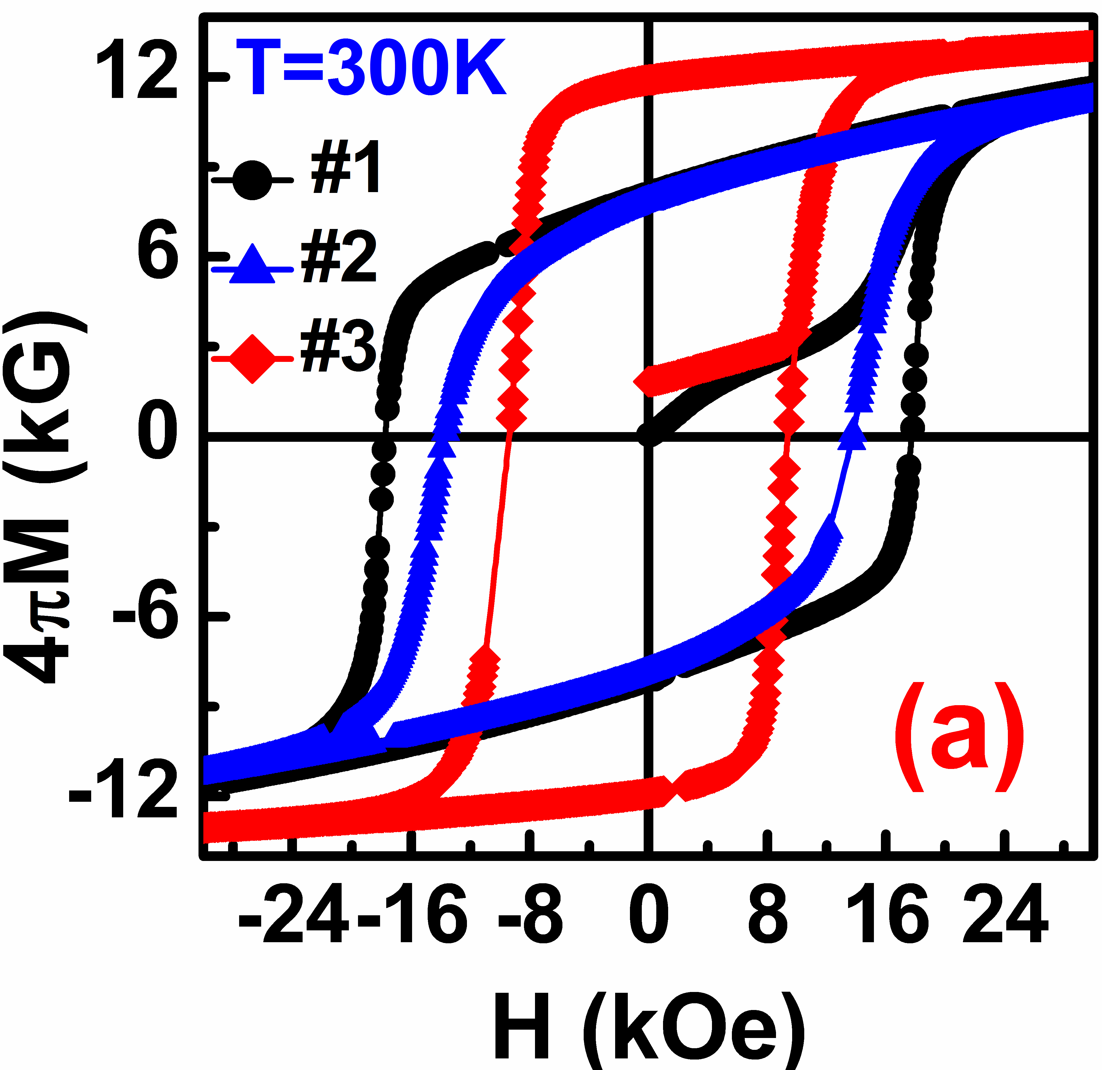
B-H CURVES (Nd_{0.8}Ce_{0.2})_{2.4}Fe₁₂Co₂B
#1 – ribbons
#2 – hot pressed
#3 – die upset

Slide 23
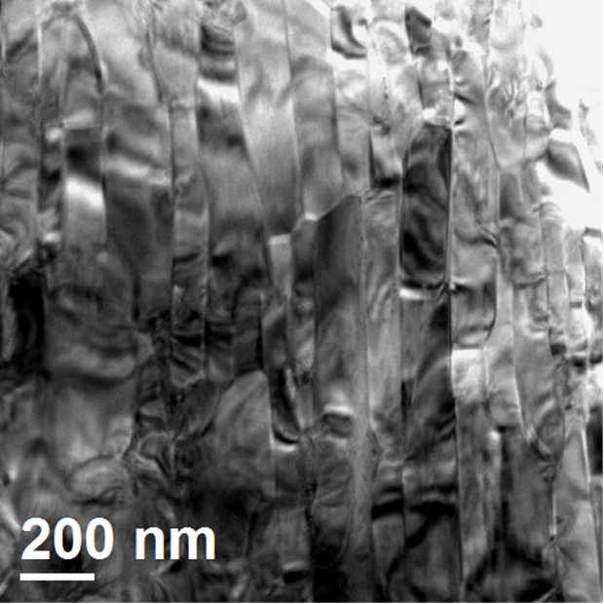
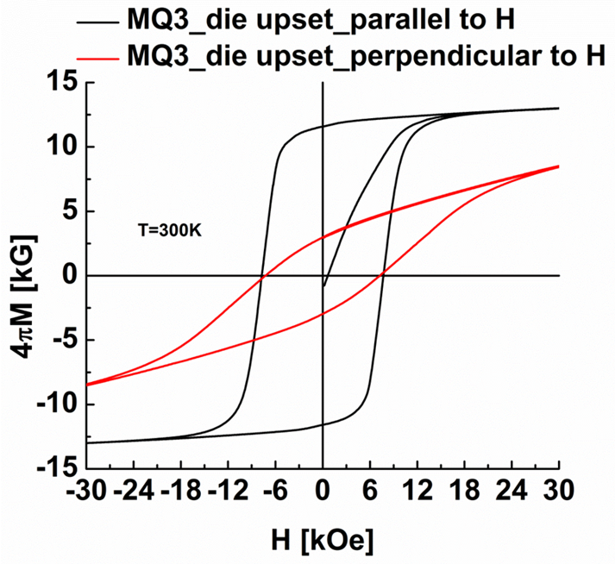
(Nd_{0.8}Ce_{0.2})_{2.4}Fe₁₂Co₂B: DIE UPSET
Bright-field TEM images

Slide 24
(Nd_{0.8}Ce_{0.2})_{2.4}Fe₁₂Co₂B

Slide 25
CONCLUSIONS
The co-doped Ce,Co Nd₂Fe₁₄B Permanent Magnets are:
Competitive with some Dy-doped sintered magnets, especially at T > 475 K (>200°C)
Larger H_{c}(H_{ci}) and BH_{max} values using commercial
grade rare earths, and lower purity ferrous boron
Will help reduce the strain on Dy markets
Will relieve the demand for Nd
Will help utilize some of the Ce surplus
Mixed valent Ce still has some amazing tricks up her sleeve!

Slide 26
ACKNOWLEDGEMENTS
The Ames Laboratory and Department of Materials Science and Engineering and Iowa State University, Ames, Iowa, 50011 USA
R.W. McCallum
M. Khan (Current address: Department of Physics, Miami University, Oxford, Ohio, USA)
A.K. Pathak
V.K. Pecharsky
L. Zhou
K. Sun
K.W. Dennis
M.J. Kramer
Molycorp Magnequench, Singapore
D. Brown
MEDA Engineering and Technical Services, Southfield, MI
C. Zhou
General Motors R&D Center, Warren, MI
F.E. Pinkerton
REFERENCE: “Dy-free, Reduced Nd, High Performance Nd₂Fe₁₄B-based Permanent Magnets,” Proceedings 23rd International Workshop on Rare Earth and Future Permanent Magnets and Their Applications (REPM 2014), G.C. Hadjipanayis, C.H. Chen, J.P. Liu, editors, pp. 403-406, Annapolis, Maryland, USA (August 17-21, 2014)

Slide 27
Let Us Meet Again
We welcome you all to our future conferences of OMICS Group International
Please Visit:
http://materialsscience.conferenceseries.com/
Contact us at
materialsscience.conference@omicsgroup.us
materialsscience@omicsgroup.com

