Slide 1
Alle spør hva som er meningen med livet, men ingen hva som er meningen med døden
Sitat fra Sorgenfri av Jo Nesbø
Translation:
Everyone wants to known the meaning of life, but none ask about the meaning of death.
Notes:
Takk at du kom.

Slide 2
Occurrence and spread of influenza A(H1N1)pdm09 virus infection in Norwegian pig herds based on active serosurveillance from 2010 to 2014
Chiek Er^{1*}, E. Skjerve², Edgar Brun¹, Tore Framstad²,,Bjørn Lium³
National Veterinary Institute, Oslo, Norway,
Norwegian University of Life Sciences
Pensjonist
Notes:
Forekomst og spredning av influensa A (H1N1) pdm09 virus infeksjon i norske grisebesetninger basert på aktive serosurveillance 2010-2014

Slide 3
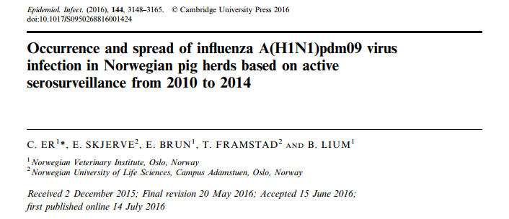

Slide 4
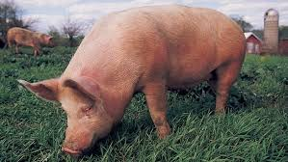
National surveillance and control program of reportable diseases in Norwegian pigs
(Between 500 and 750 pig herds tested every year)
TGE
PRRS
AD
PRCV
PED
Influenza A virus
swIAVs endemic in European pigs (H1N1, H1N2, H3N2)
Notes:
Norge har en onging aktiv seroveilance av spesifikk gris virussykdom som Norge er fri. Slik at målet for løpende overvåkning er å dokumentere frihet og for deteksjon i tilfelle o angrepet.

Slide 5
Serosurveillance of influenza A virus in pigs began
Human cases reported in Norway
23 +ve pig farms
Approx. 1500 or 75% pig herds tested
Cumulative herd prevalence – 53%
1997
jun 09
23 okt 09
31st des 14
apr 09
10 okt 09
31st des 09
H1N1pdm09 detected in humans in USA & Mexico
Pig farm zero confirmed
91/215 or 42%
Tested positive in targeted surveillance
Notes:
Tidslinje av nasjonal serosurveillance av influensa A virus infeksjon. Overvåking av influensa A virus hos gris begynte i 1997, mer enn et tiår før 2009. Denne viktige, konsekvent negative påvisning av influensavirus bekreftet at norske grisen befolkningen var naiv.
Første påvisning var i humane tilfeller i USA og Mexico
menneskelige tilfeller også rapportert i Norge i juni 2009

Slide 6
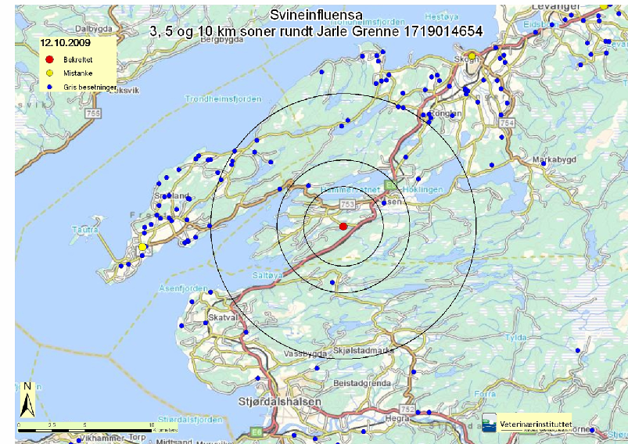
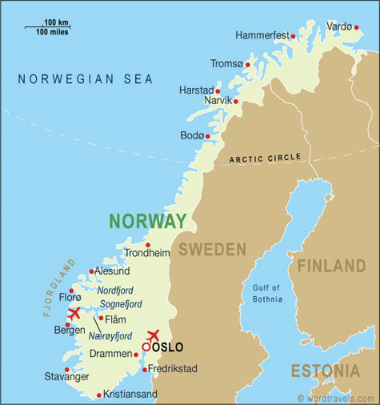
Pig Farm Zero
Notes:
Farm null diagnostisert på 12 oktober 2009

Slide 7
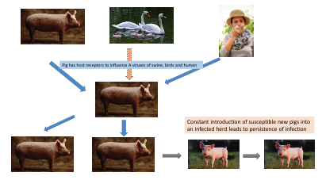
Infection dynamics

Slide 8
Intervention measures
None directly applied to pigs.
Pig farmers to refrain from working with pigs if they have Influenza like illnesses.
Annual vaccination of pig farmers against human influenza viruses to prevent new infection in pigs
Reduce probability of coinfections in pigs of different strains of influenza virus and hence reassortments.
Notes:
Ingen tiltak ble iverksatt ,
innledende forsøk på å utrydde infeksjonen ved slakting ble forlatt etter at det ble kjent at infeksjonen var utbredt over hele Norge.
Ingen vaksinasjon
Ingen direkte brukes til griser.
Gris bønder til å avstå fra å arbeide med griser dersom de har influensalignende sykdommer.
Årlig vaksinasjon av svinebønder mot menneskelige influensavirus for å hindre ny infeksjon hos gris
Redusere sannsynligheten for coinfections i griser av ulike stammer av influensavirus og dermed reassortments.

Slide 9
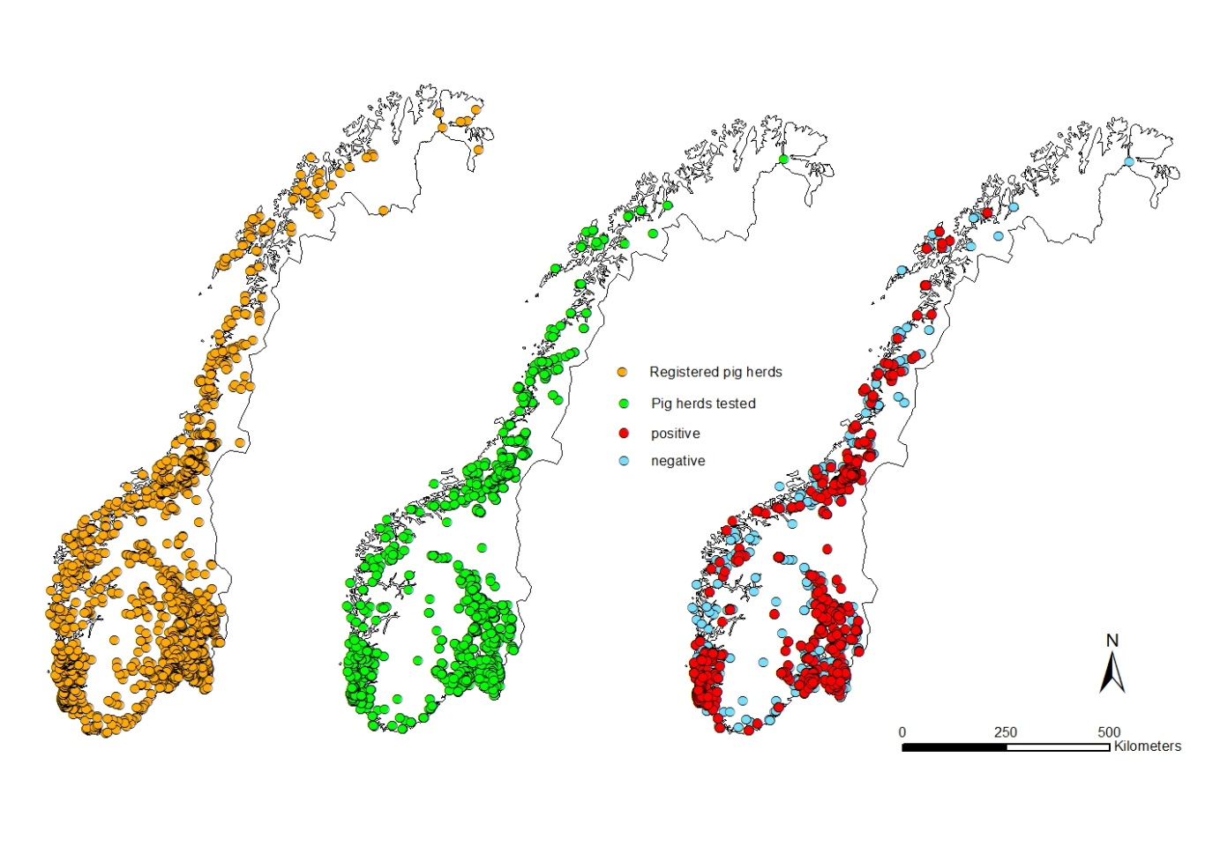
2010 - 2014
Sow herds: approx 1,100 ; Sows: 80,000
Fattening herds: approx 900; Pigs slaughtered: 1.6 million

Slide 10
Epidemiological profiling
Variables
Herd Prevalence
Herd Incidence
Animal prevalence
Herd sensitivity
Infection Dynamics
Year
  2010, 2011, 2012, 2013, 2014
Production types
  Nucleus, multiplier, conventional sow herds, sow pools & fattning
Herd size
  Small
  Medium
  Large

Slide 11
H1N1pdm09 diagnosis is a 2 step process
Screening test = ELISA test for antibodies against influenza A viruses (93% sensitive, 99% specific)
Hemaglutinnation inhibition test to identify specific antibodies against 4 specific antigens
  H1N1pdm09
  swH1N1
  H1N2
  H3N2
Notes:
PRCV= porcine respiratory corona viru

Slide 12
Top down pyramid structure of breeding and pig production
Nucleus
Multiplier
Conventional sow herds (integrated and piglet producing herds) and sow pools
Fattening herds

Slide 13
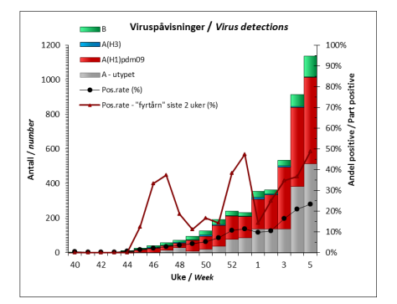
Human influenza surveillance in Norway by FHI
during 2015-2016 flu season

Slide 14
Number of pig herds tested, by production class from 2010 to 2014
Production class | 2010 | 2011 | 2012 | 2013 | 2014 | Total
Fattening | 50 | 79 | 64 | 65 | 47 | 305
Nucleus | 52 | 79 | 78 | 82 | 71 | 362
Multiplier | 73 | 117 | 152 | 148 | 137 | 627
Conv. sow herd | 302 | 950 | 996 | 1047 | 798 | 4093
Sow pool | 13 | 63 | 71 | 59 | 50 | 256
Total | 490 | 1288 | 1361 | 1401 | 1103 | 5643

Slide 15
Data – Hierachichal with 3 levels
county
Herd A
Testdate 1
Testdate 2
Herd B
Testdate 3
Testdate 1
Testdate 2
Testdate 3
N=5865
N=1568
N=19

Slide 16
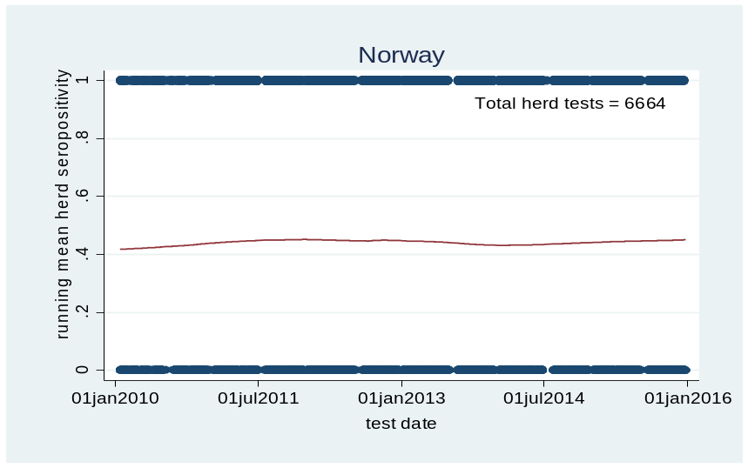
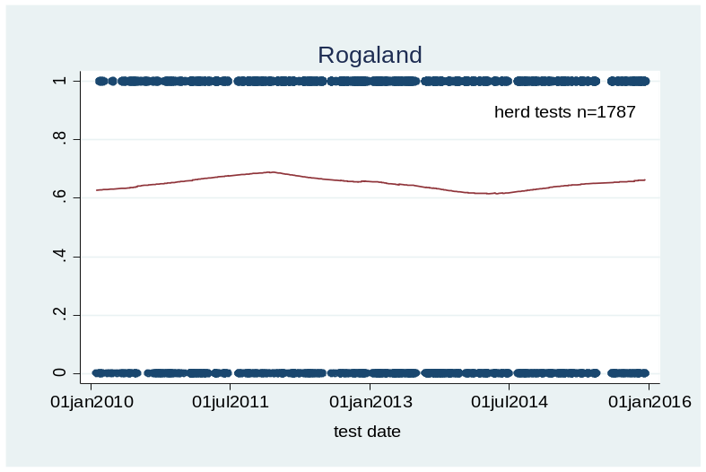
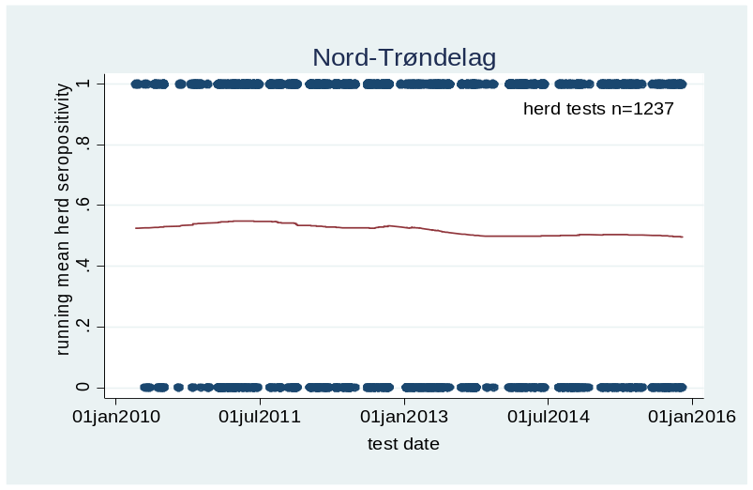
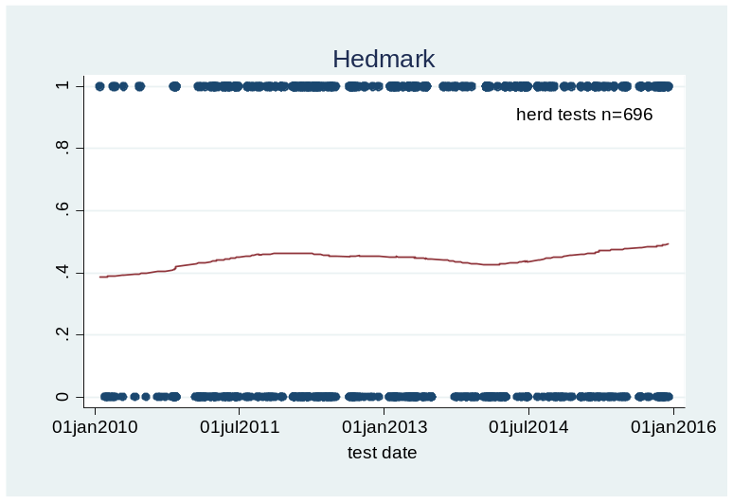
Herd seroprevalence – temporal & spatial

Slide 17
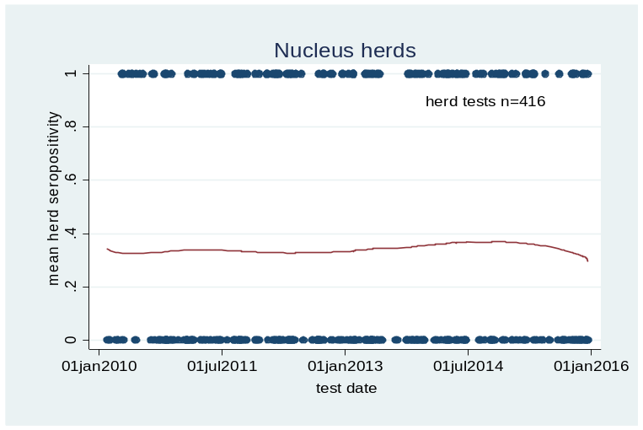
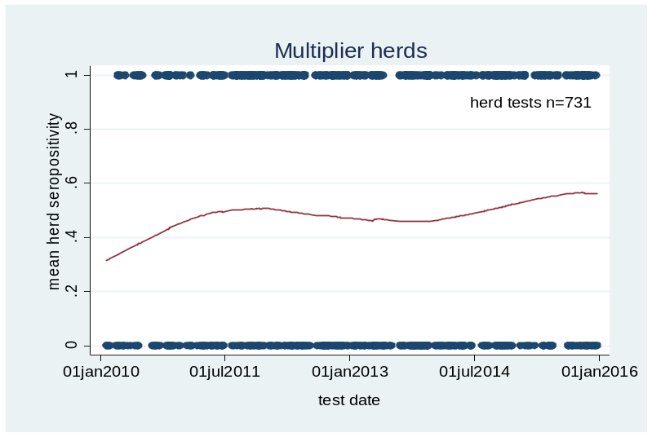
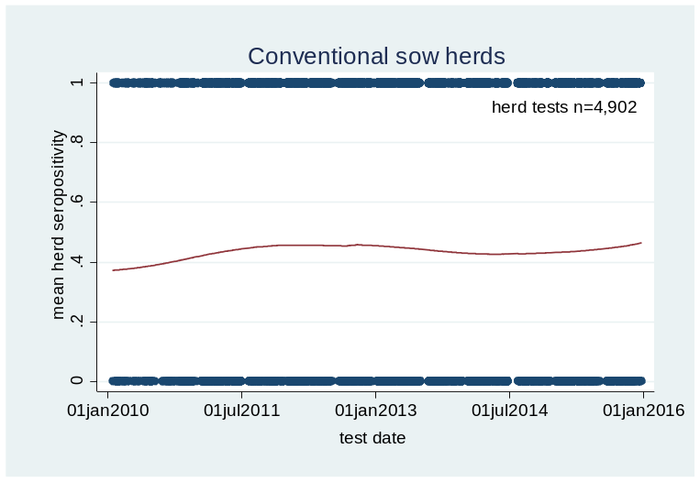
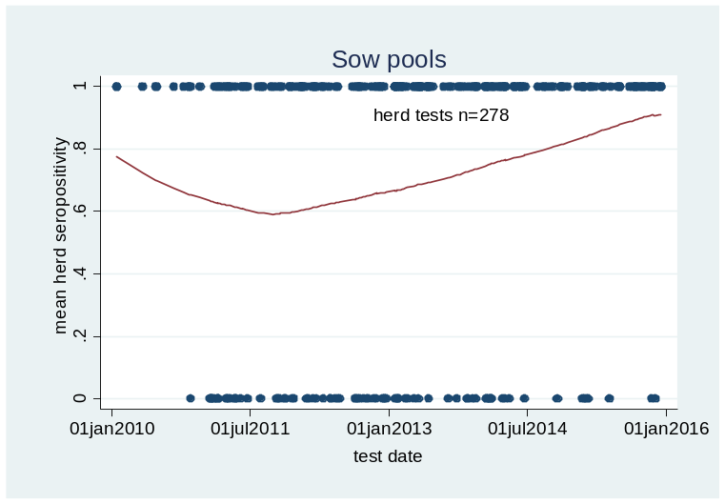
Herd seroprevalence, temporal patterns by production class

Slide 18
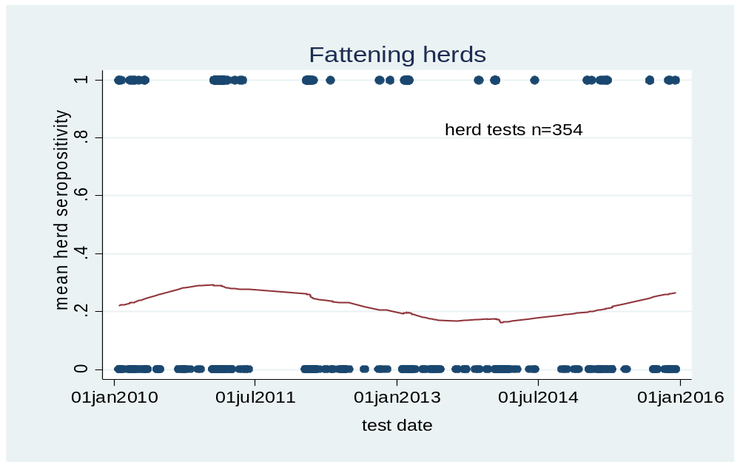
Herd seroprevalence, temporal patterns in fattening herds

Slide 19
Mixed logistic regression on binary outcome of seropositivity in a herd test
Number of observations (n=5643) | Fixed effects | Odds Ratio | P values
 | Year of test (n=5)
490 | 2010 | 1
1288 | 2011 | 1.02 | 0.89
1361 | 2012 | 1.07 | 0.62
1401 | 2013 | 0.82 | 0.14
1103 | 2014 | 0.88 | 0.35
 | Production class (n=5)
305 | Fattening | 1
362 | Nucleus | 2.78 | <0.001
627 | Multiplier | 4.72 | <0.001
4093 | Conventional | 2.63 | <0.001
256 | Sow pool | 24.04 | <0.001
 | Herd size (3 quantiles)
1679 | small | 1
1909 | medium | 1.85 | <0.001
1851 | large | 1.63 | <0.001
Notes:
Mixed logistic regression of binomial outcome that a herd test was positive for antibodies against influenza A(H1N1)pdm09 measuring the three categorical fixed effects – 1. Year of test, 2. Production class, and 3. Herd size. County and herd ID were included as random effects to account for non-fixed effects associated with county and the individual herd.
Table 3: Please consider adding a column with group sizes (n)

Slide 20
Incidence risk by production class

Slide 21
Incidence risk – mixed logistic regression positive next year / negative this year
N herds | Fixed effects | Odds Ratio | P values
 | Year of test (n=5)
174 | 2010 | 1
406 | 2011 | 1.29 | 0.59
358 | 2012 | 5.7 | <0.001
389 | 2013 | 6.39 | <0.001
 | Production class (n=4)
258 | Fattening | 1
157 | Nucleus | 6.26 | 0.036
155 | Multiplier | 47.95 | <0.001
757 | Conventional | 9.74 | <0.001
 | Herd size (3 quantiles)
399 | small (<350) | 1
405 | (medium) 350-665 | 6.31 | 0.001
469 | large (>665) | 9.24 | <0.001
 | Constant | 0.00043 | <0.001

Slide 22
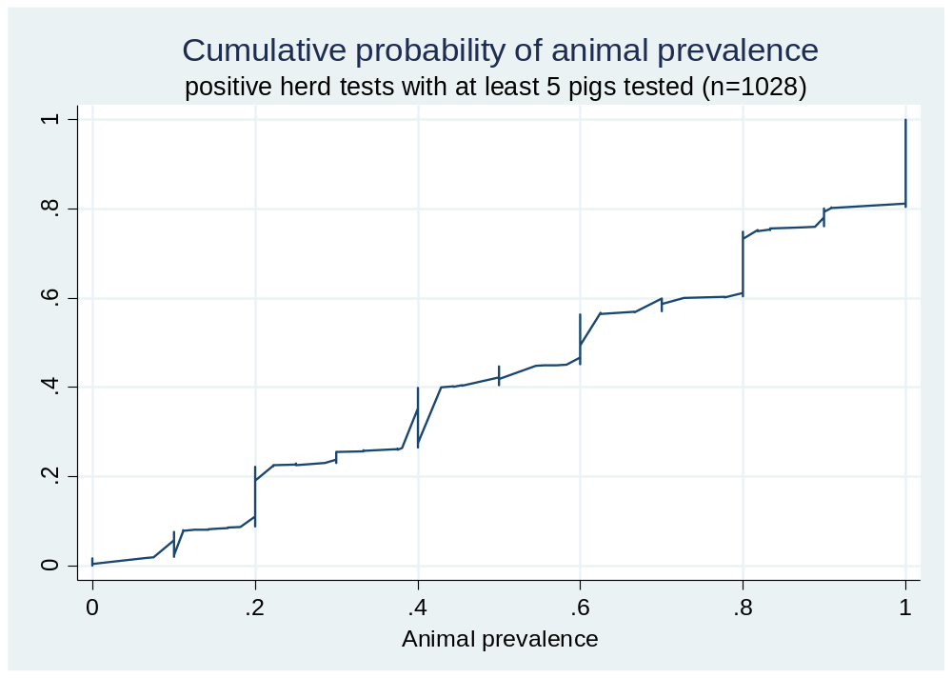

Slide 23
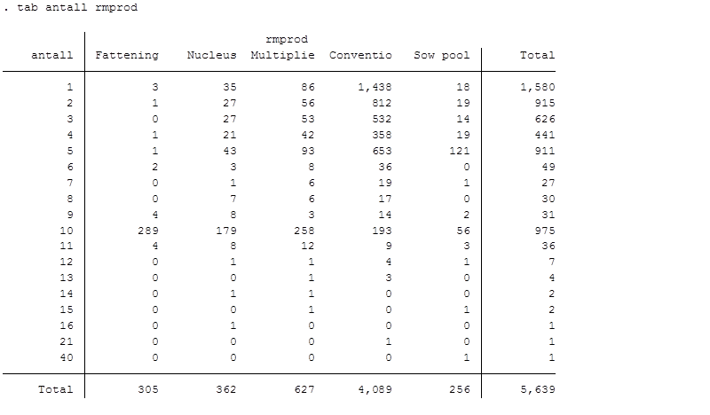
Sample size per herd test

Slide 24
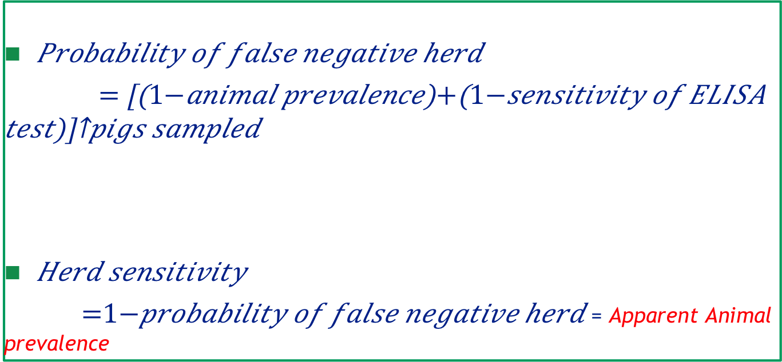
Herd test sensitivity
$Probability of false negative herd$
$=$ ${\left[\left(1−animal prevalence\right)+\left(1−sensitivity of ELISA test\right)\right]}^{pigs sampled}$
$Herd sensitivity$
$=1−probability of false negative herd$ = Apparent Animal prevalence

Slide 25
Apparent animal prevalence /Herd test sensitivity
 | Animal prevalence (percentile)
# Pigs sampled | 20% (10th) | 30%(25th) | 60% (median) | 81% (75th) | 100%(90th)
1 | 13 % | 23 % | 53 % | 74 % | 93 %
2 | 24 % | 41 % | 78 % | 93 % | 100 %
3 | 34 % | 54 % | 90 % | 98 % | 100 %
4 | 43 % | 65 % | 95 % | 100 % | 100 %
5 | 50 % | 73 % | 98 % | 100 % | 100 %
6 | 57 % | 79 % | 99 % | 100 % | 100 %
7 | 62 % | 84 % | 99 % | 100 % | 100 %
8 | 67 % | 88 % | 100 % | 100 % | 100 %
9 | 71 % | 90 % | 100 % | 100 % | 100 %
10 | 75 % | 93 % | 100 % | 100 % | 100 %

Slide 26
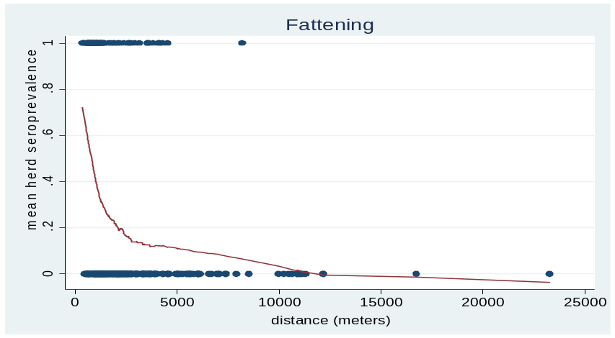
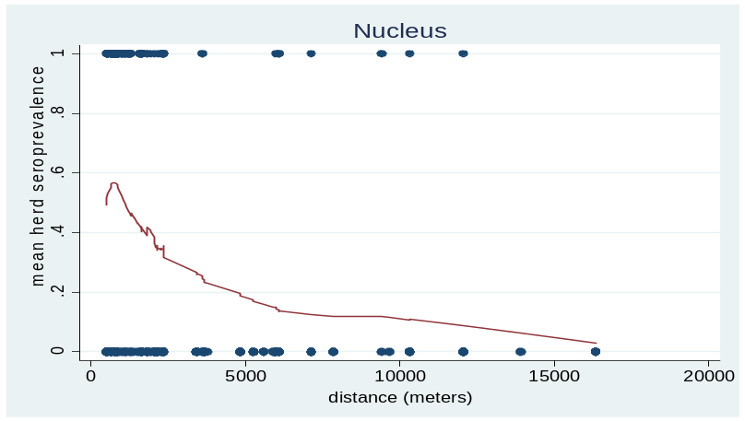
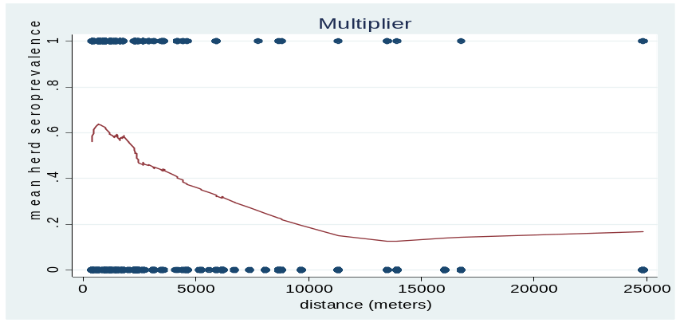
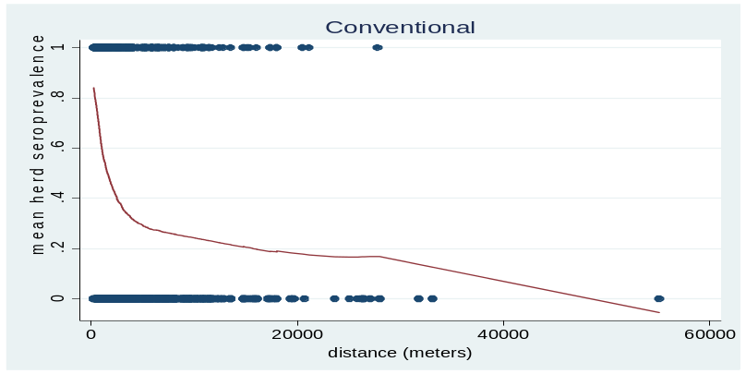
Pig farming density – mean distance to four nearest pig herds

Slide 27
“If you know the enemy and know yourself, you need not fear the result of a hundred battles.”
― Sun Tzu, The Art of War

