Slide 1
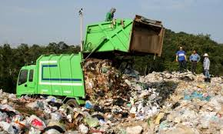

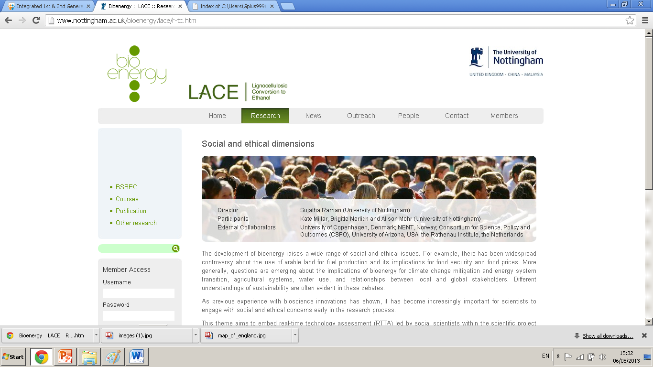
Optimizing conditions for sugar release from municipal solid wastes (MSW) for biofuel production
Jwan J. Abdullah
University of Nottingham
Supervised by:
Prof G. Tucker
C. DU

Slide 2
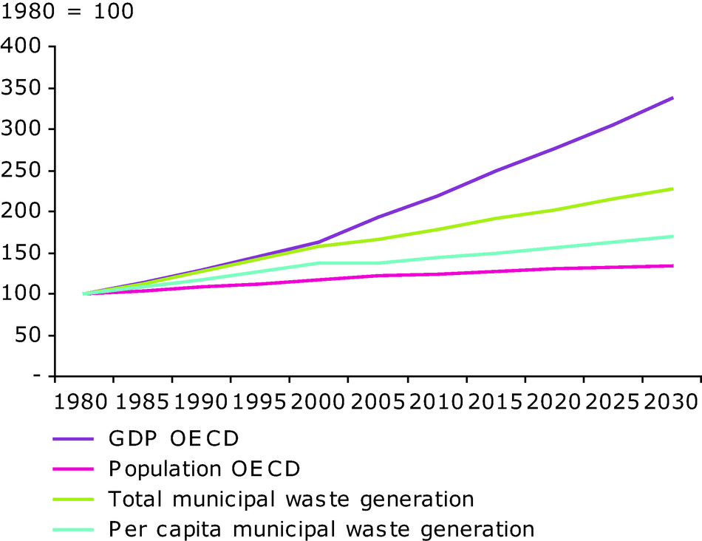
Municipal solid waste

Slide 3
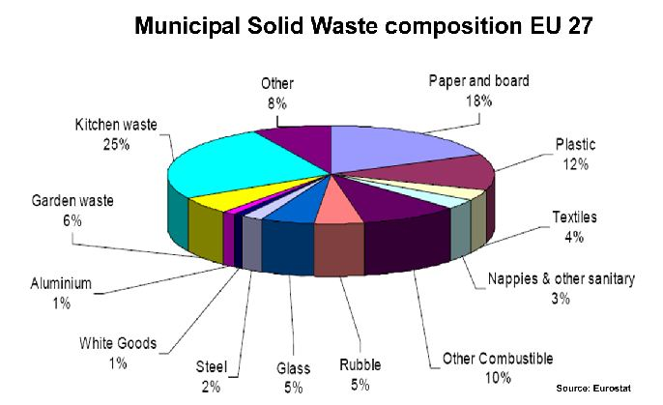
MSW composition in 27the EU countries , 2013

Slide 4
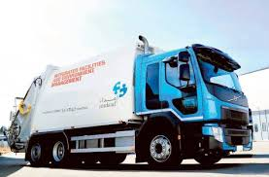
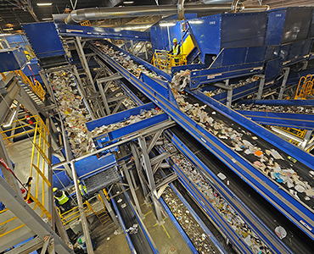
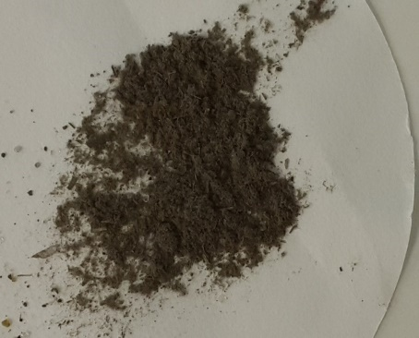
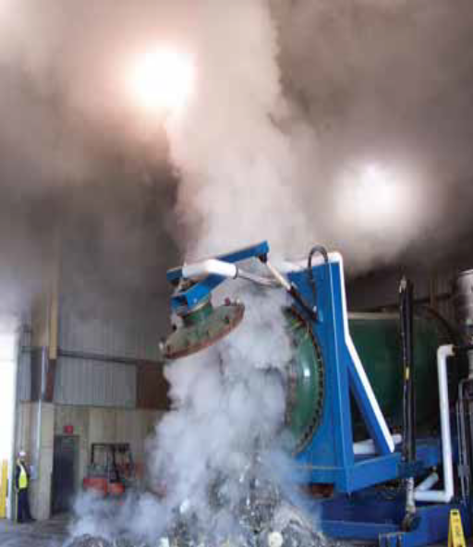
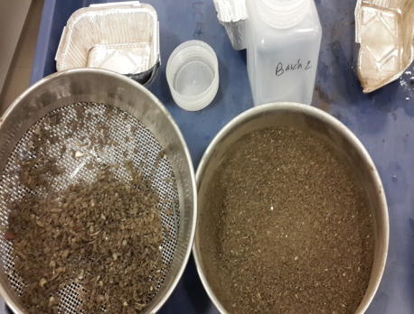
2. Sterilisation using Autoclave
1. Unsorted municipal solid wastes
3. Sorting or separation
4. Incinerated MSW

Slide 5
Chemical composition of municipal solid waste. Mean + SD (n=3).
Structural component | g/100g
Cellulose | 27.8 ± 0.1
Hemicellulose | 15.45 ± 0.07
Lignin | 17.7 ± 0.05
Starch | 6.2 ± 0.002
Lipid | 11.2 ± 0.1
Protein | 5.9 ± 0.2

Slide 6
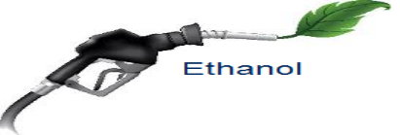
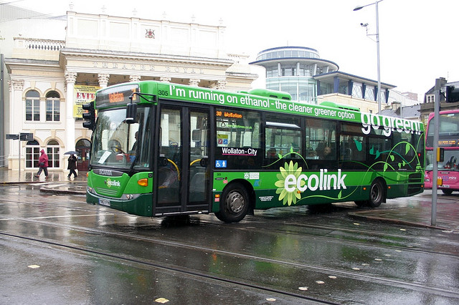
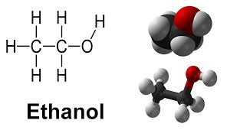

The research plan
MSW
Acid / alkaline pretreatment
Enzyme hydrolysis
Yeast
Fermentation
Hydrolysate
Bacterial Fermentation

Slide 7
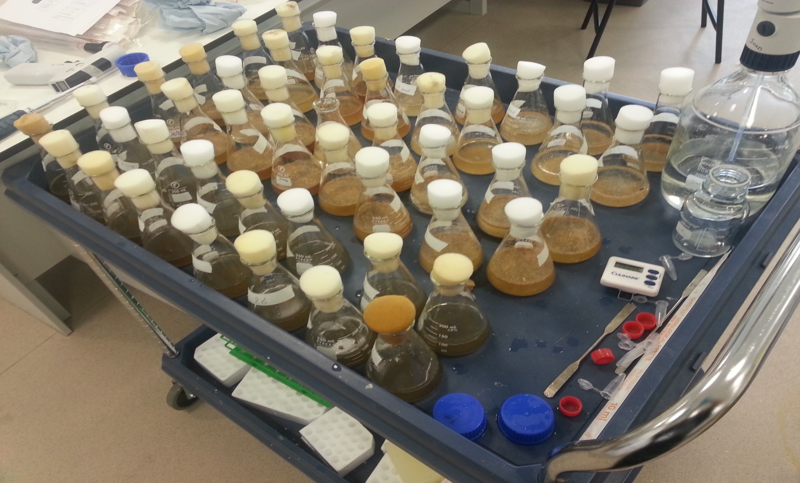
Enzyme hydrolysis for MSW

Slide 8
Figure 1: Amount of glucose (%) in a hydrolysate (A) un-autoclaved or (B) autoclaved and microbial agent. Mean + SD (n=3).

Slide 9
Figure 2: Amount of glucose (%) following use of various enzyme loading rates for pre-treating MSW (A) time course, and (B) bar chart Mean + SD (n=3).

Slide 10
Figure 3: Amount of Sugar (%) following using various surfactants for enzyme hydrolysate MSW (A) time course (B) barchart

Slide 11
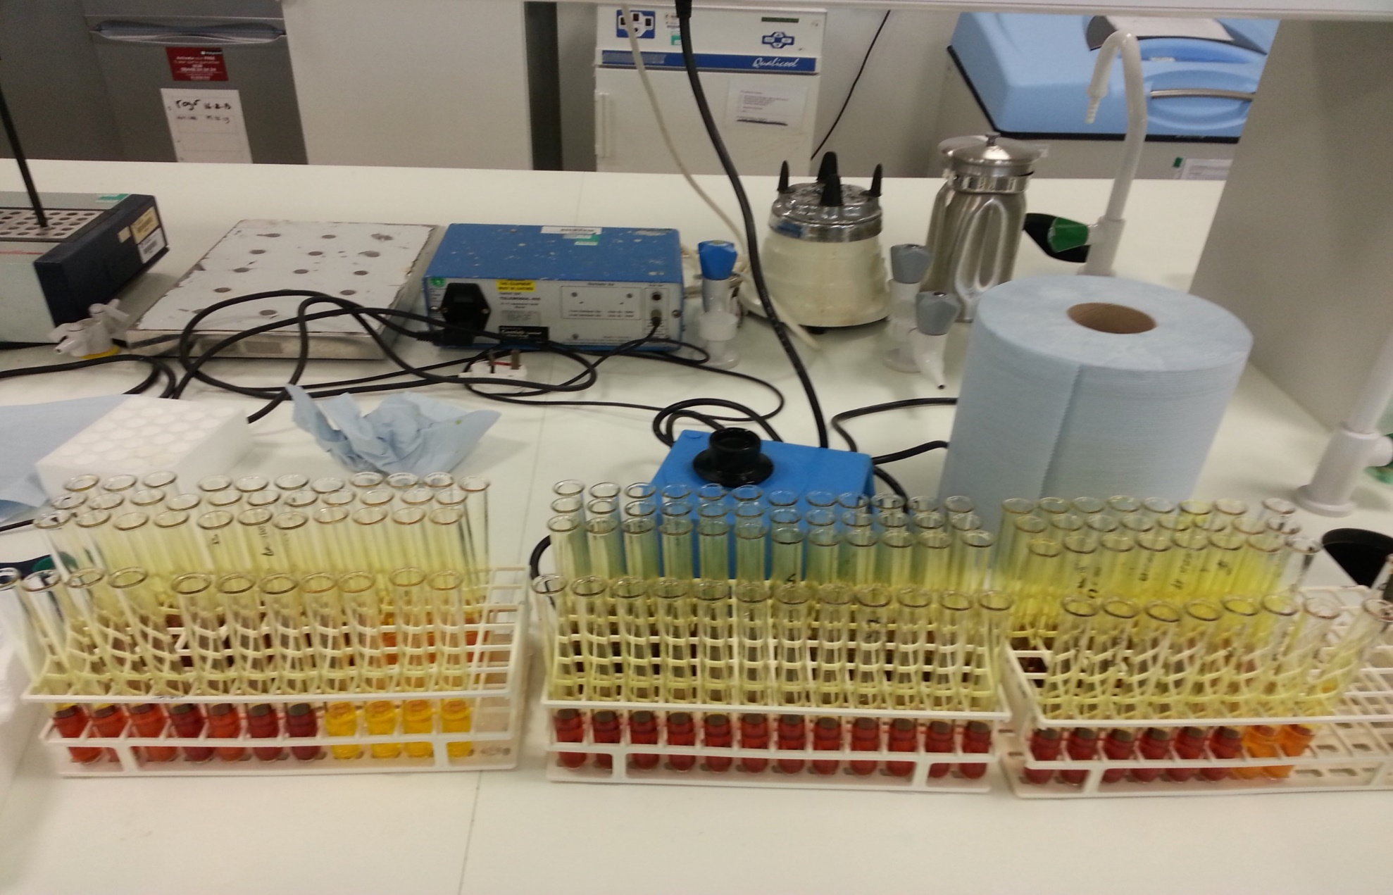
Acid pretreatment of MSW

Slide 12
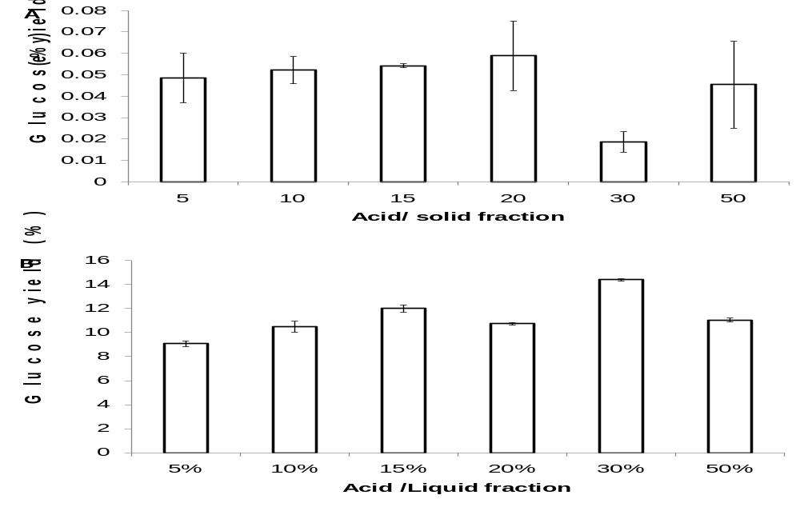
Figure 4: Amount of glucose yield % concentrations using 2% MSW various strong sulphuric acid concentrations in a (A ) Solid and (B) liquid

Slide 13
Figure 5: Amount of glucose yield % concentrations using 2% MSW various weak sulphuric acid concentrations in a Solid fraction

Slide 14
Figure 6: Amount of glucose yield % concentrations using 2% MSW various weak sulphuric acid concentrations using microwave in a Solid fraction

Slide 15
Figure 7: Enzyme hydrolysis using weak acid pretreated solid residue 30 FPU for pretreated solid 2% solid liquid ratio MSW. using autoclaving (30 min autoclaving with 1% sulphuric acid ) and using microwave( 1% acid , 10 minutes at 160oC )to release fermentable sugars from MSW and comparing with control )

Slide 16
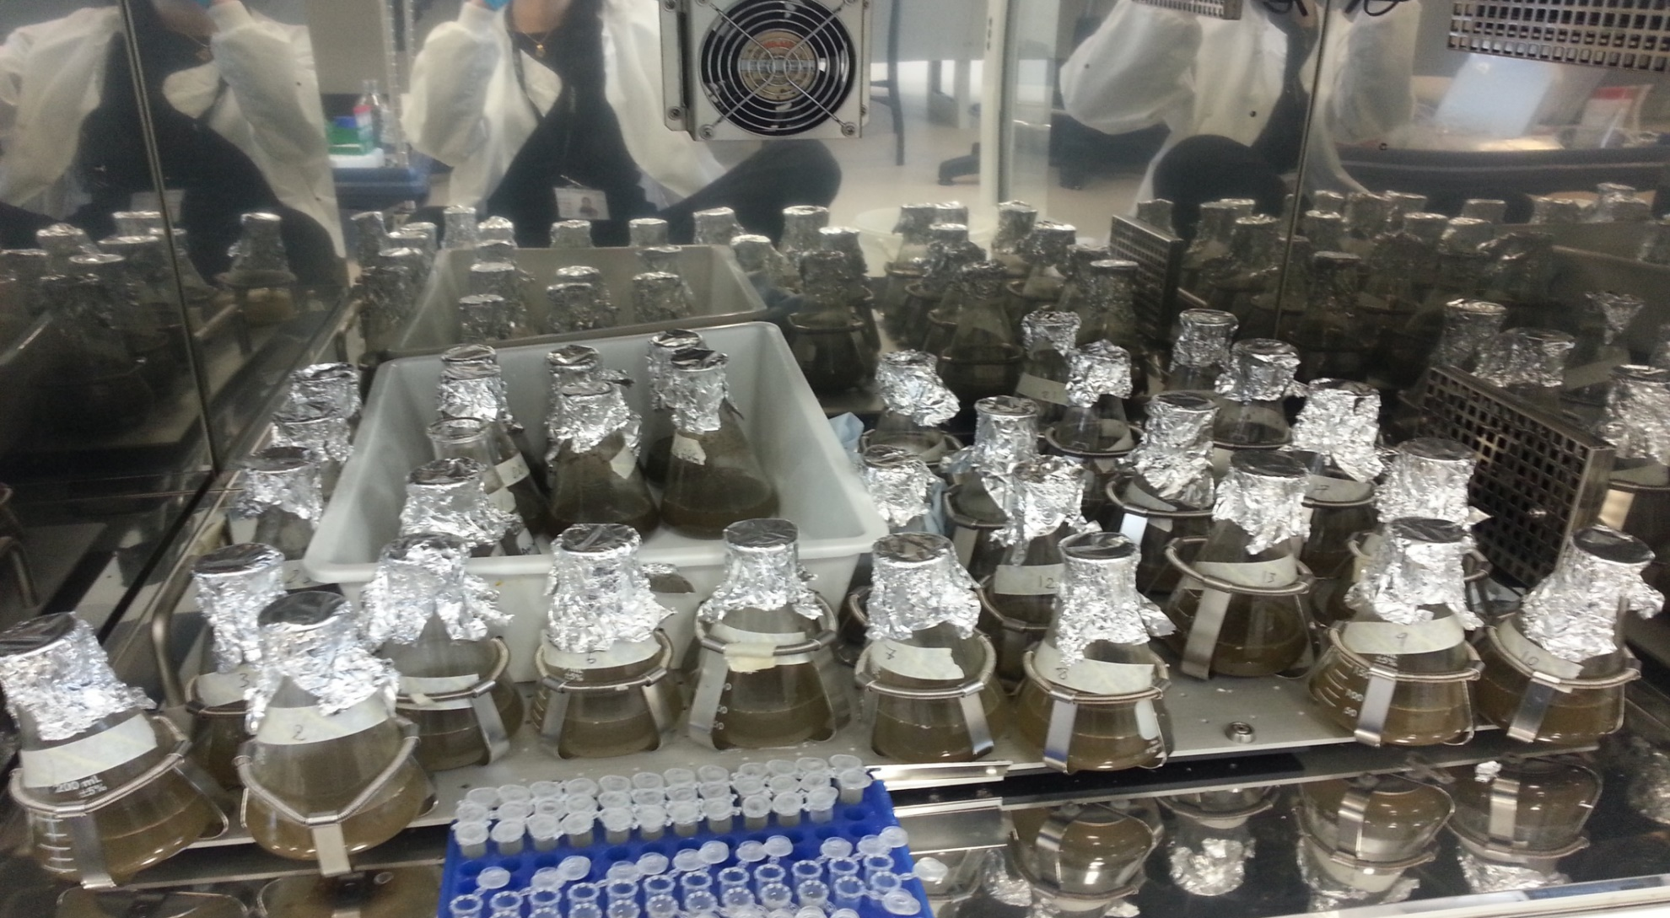
Alkali pretreatment of MSW

Slide 17
Figure 8: Amount of glucose yield % concentrations using 2% MSW (autoclaving ) various alkaline concentrations in a Solid
Figure 9: Enzyme saccharification for sugar releasing from MSW at 2% alkaline concentrations and 30 minutes autoclaving.

Slide 18
Figure 10: Amount of glucose residue (%) following use of sodium hidroxide (5-50%) for pre-treating MSW at room temperature. Mean + SD (n=3).
Figure 11: Comparing acid and alkali optimised condition for sugar releasing from MSW.

Slide 19
Conclusion
Acid did not increase the sugar yield.
Alkali was better than acid pretreatment .
Enzyme for un pretreated MSW showed better performance in terms of sugar releasing.

Slide 20
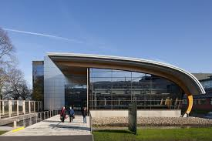
Thanks for your attentions

