Slide 1
Enzymes and biotechnology: could we overcome modern challenges?
2nd International Conference on Genomics & Pharmacogenomics
Dr. Junio Cota
VTT Brasil LTDA
Notes:
- Present myself, education, research experience... Professional experience (CTBE, VTT)

Slide 2
SUMMARY
What is VTT?
The OMICS Era
New Enzyme Discovery
Protein Engineering
Notes:
- Go briefly through topics to be adressed.

Slide 3
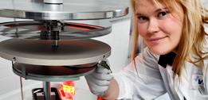
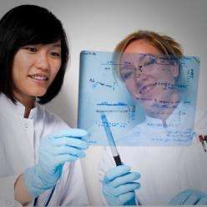
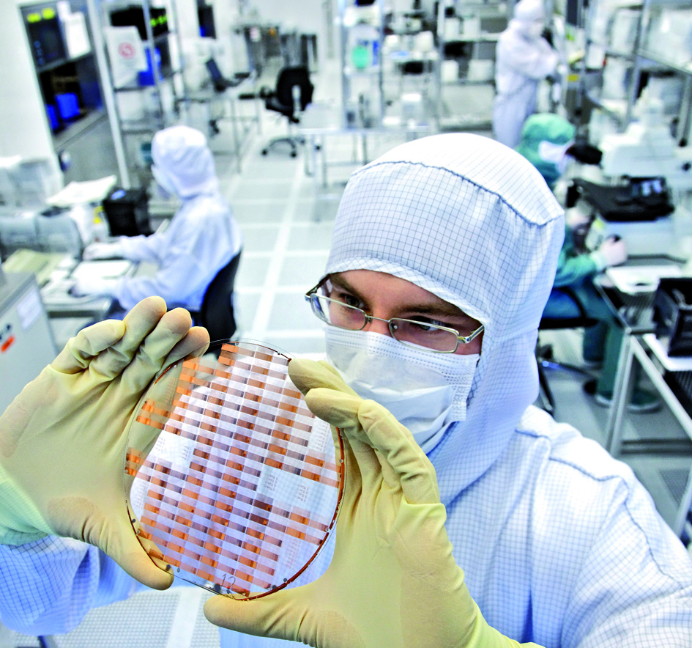
VTT Group in brief
Turnover 292 M€ (2010)  Personnel 3,167 (1.1.2011)
Customer sectors
Biotechnology, pharmaceutical and food industries
Electronics
Energy
ICT
Real estate and construction
Machines and vehicles
Services and logistics
Forest industry
Process industry and environment
Focus areas of research
Applied materials
Bio- and chemical processes
Energy
Information and communication technologies
Industrial systems management
Microtechnologies and electronics
Services and the built environment
Business research
VTT’s operations
Research and Development  Strategic Research  Business Solutions  IP Business  Group Services
VTT’s companies
VTT Expert Services Ltd (incl. Labtium Ltd, Enas Ltd)  VTT Ventures Ltd  VTT International Ltd  VTT Memsfab Ltd
Notes:
VTT is a Finnish Group.
VTT has more than 3000 employees.
Mention quickly VTT areas.
VTT Group is a rather diverse Research Institution.

Slide 4
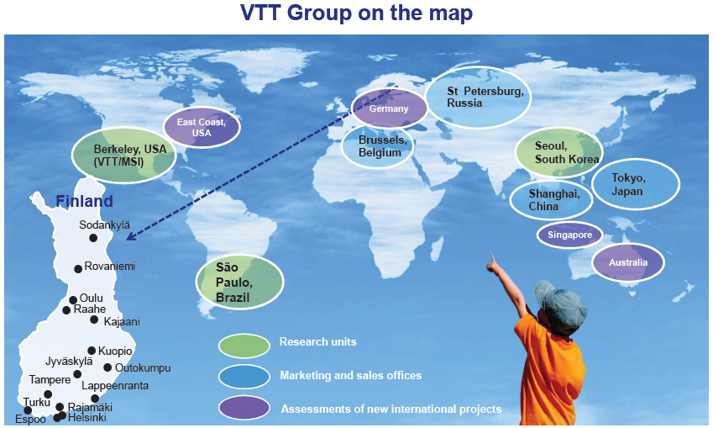
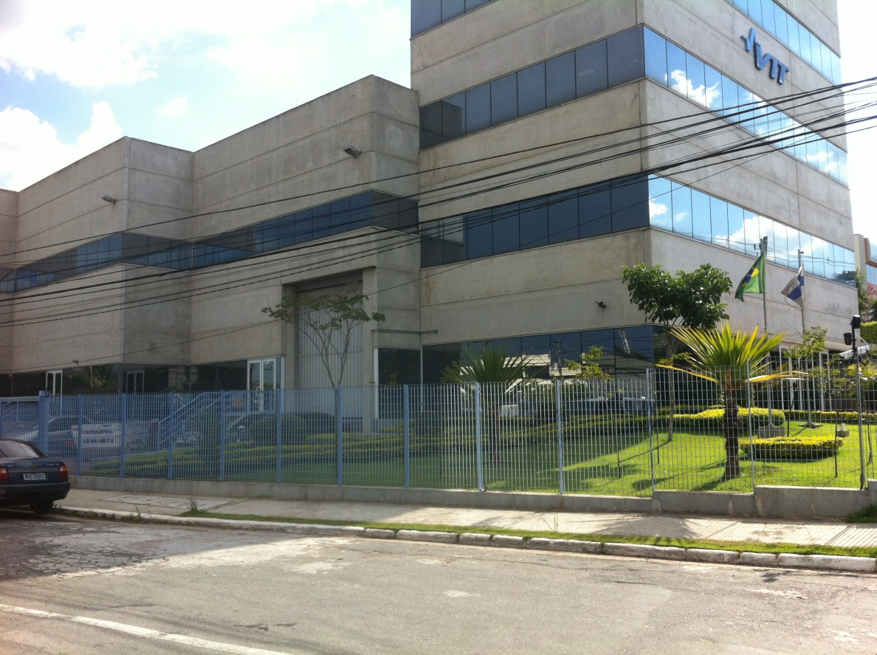
Notes:
Show VTT facilities around the world.
Point VTT Brasil in São Paulo as a potential Research Center in Brazil.

Slide 5
BIOREFINERY
Brazilian biomass raw material
Process
Wood and fibre processing
Biotechnical processing
Energy production
Sector
Pulp, paper & Packaging
& Solid wood
Bio & Chemistry
Energy
Multi-technology
solutions &
pilot scale infrastructure
Biotechnical
conversion
technologies
Thermal fuel
& waste conversion
technologies
Key service
& offering
Fibre processing,
Paper making, Coating,
Modelling & Simulation
Biomass hydrolysis,
Enzymes &
Cell factories
Gasification, pyrolysis &
combustion technologies
Key
technologies
Novel fibre based products
& Advanced wood products
Chemicals,
Bio alcohols
& Biomaterials
Biofuel, Electricity
& Heat
End products
Notes:
BIOREFINERY is a focus for Brazilian market.
VTT has a lot EXPERTISE in BIOMASS utilization.
It is important to HIGHLIGHT Enzymes for Biomass Conversion and production of Chemicals and other Biomaterials.

Slide 6
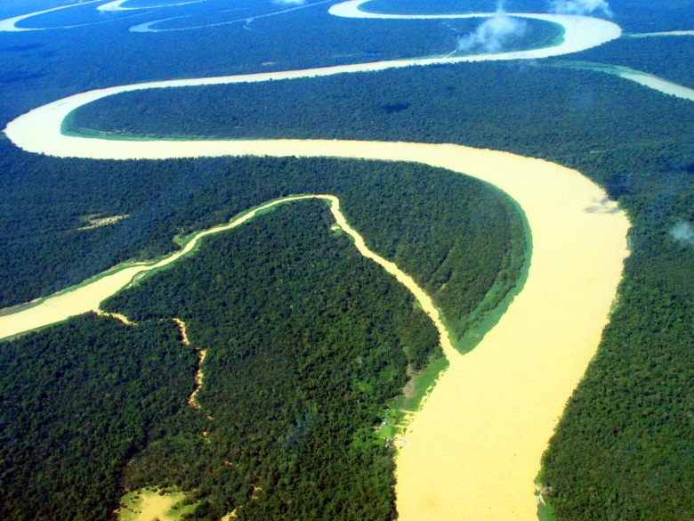
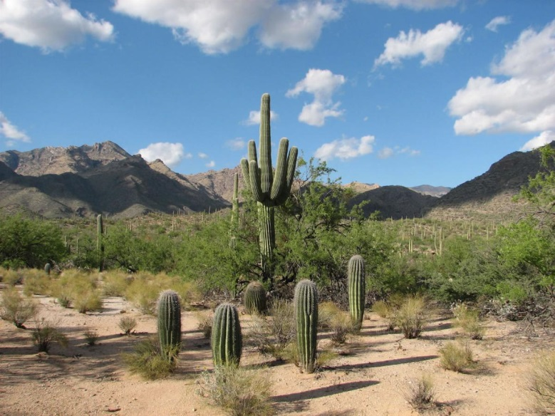
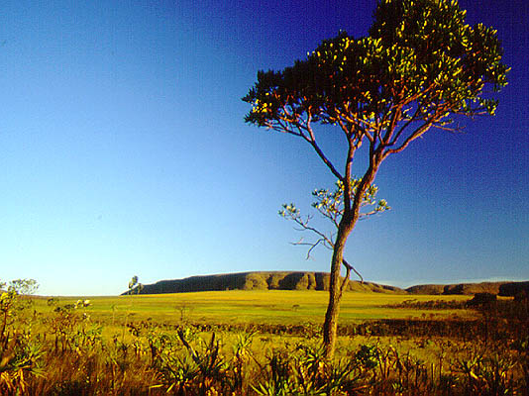
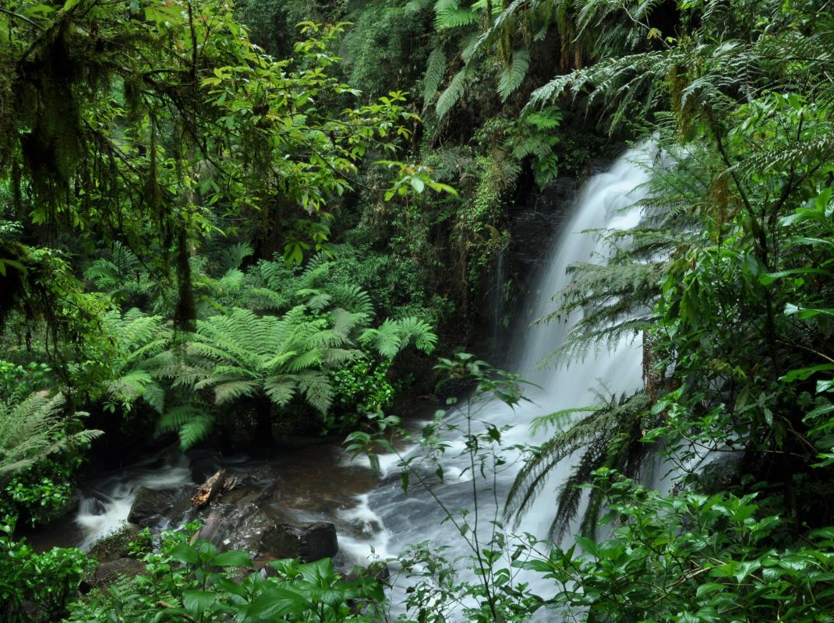
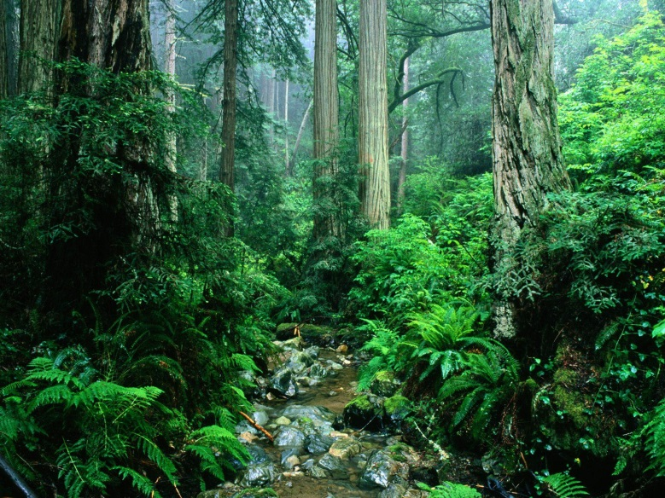
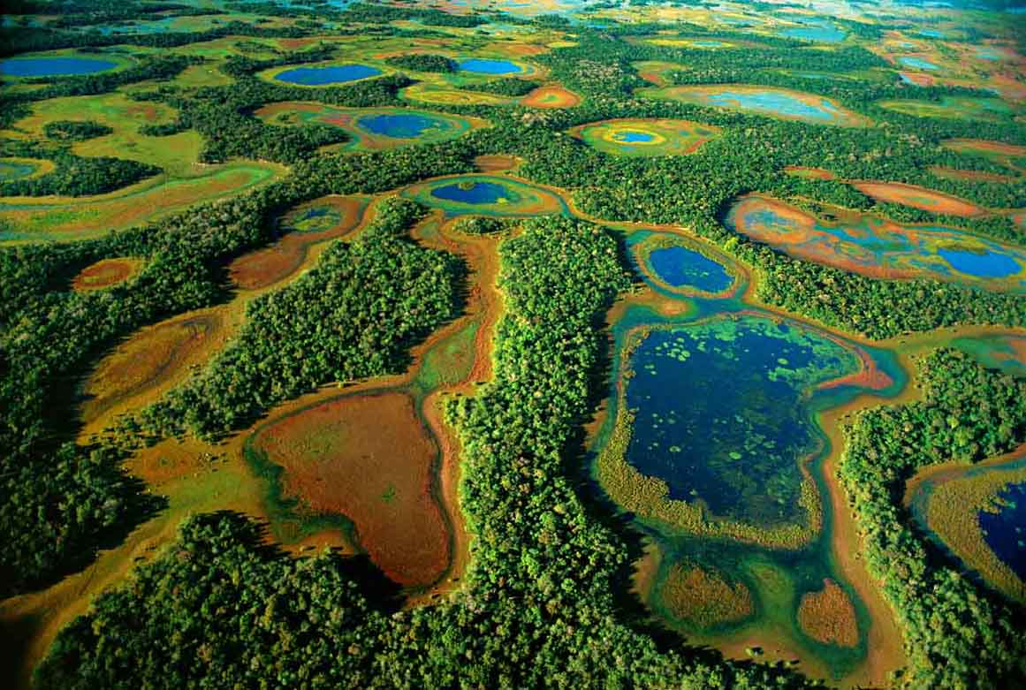
BRAZIL
Notes:
In this way, Brazil figures between the highest potential places in the world to develop Biotech Processes.
Brazil is very rich in NATURAL RESOURCES.
We have a really powerfull scientist board.
In nowadays a rich BIODIVERSITY is a key point for the development of many fields of science, such genomics, pharmacology, biomaterials, bioenergy and others.

Slide 7
SUMMARY
What is VTT?
The OMICS Era
New Enzyme Discovery
Protein Engineering
Notes:
- The OMICS Era.

Slide 8
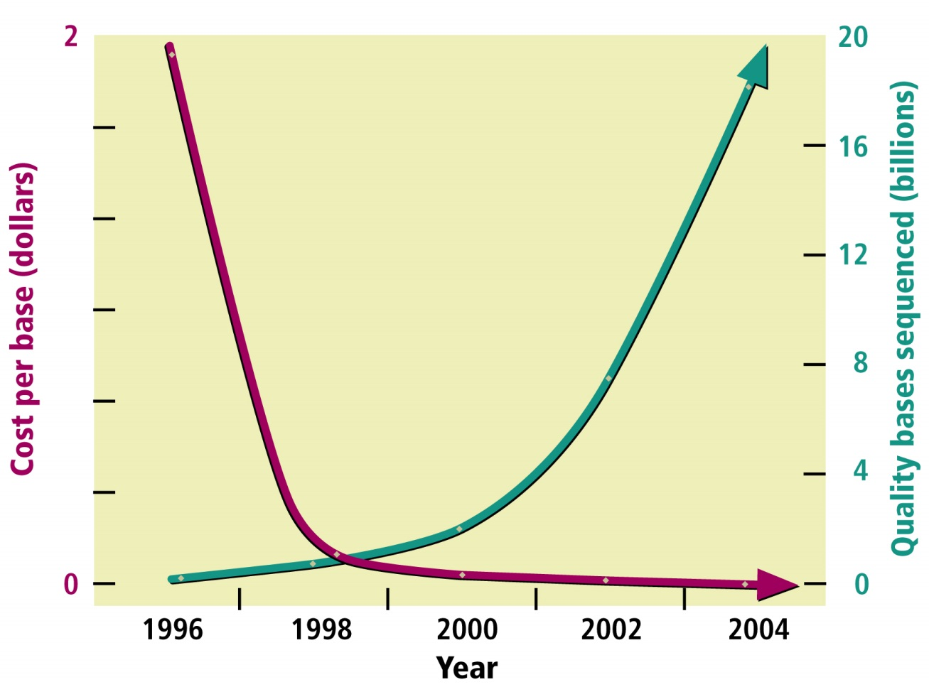

Human Genome Project
1990 - 2003
http://web.ornl.gov/sci/techresources/Human_Genome/project/whydoe.shtml
Notes:
A new era of sequencing and molecular approachs started with HGP.
Since 1984, the U.S. Department of Energy (DOE), National Institutes of Health (NIH), and international groups held meetings about studying the human genome.
After the atomic bomb was developed and used, the U.S. Congress charged the Department of Energy's (DOE) predecessor agencies (the Atomic Energy Commission and the Energy Research and Development Administration) with studying and analyzing genome structure, replication, damage, and repair and the consequences of genetic mutations, especially those caused by radiation and chemical by-products of energy production.
Finally, in 1990, NIH and DOE published a plan for the first five years of an expected 15-year project.
It is impressive how the cost per base decreased exponentially and bases sequenced increased exponentially.
HGP was a driving force for the development of modern sequencers.

Slide 9
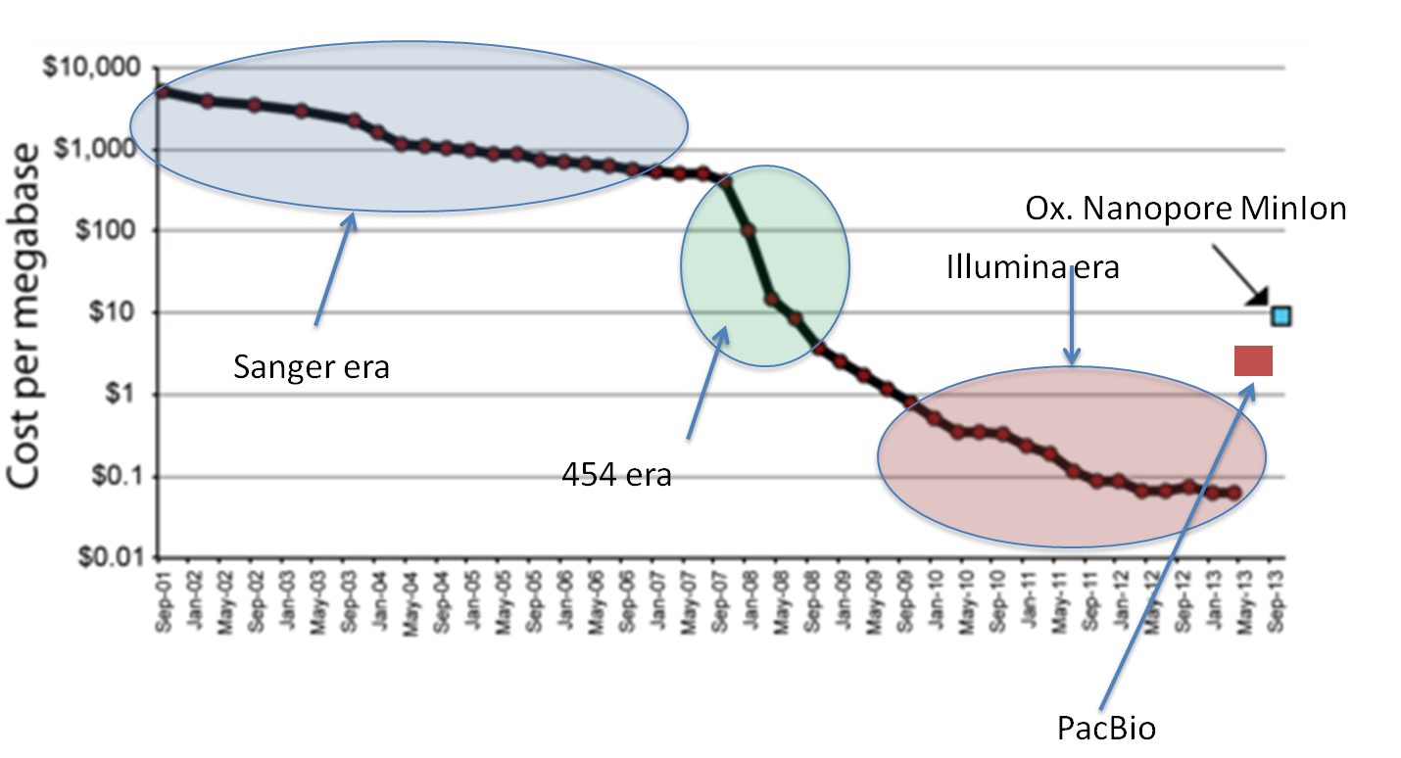
Evolution of Cost per Megabase
http://evomics.org/2014/01/sequencing-technology-wheres-my-minion/
Notes:
Since 2001 (Sanger era) the price per megabase has reduced approximately hundred thousands times!
A milestone in the evolution of sequencing techniques was Pyrosequencing (454 era).
Illumina technologies have demonstrated high quality results and high processivity.
Now Third generation sequencers (Pacific) can sequence a single DNA molecule.

Slide 10
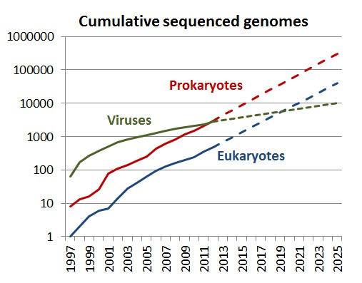
Evolution of Whole-Genome Sequencing
Su, Andrew (2013): Cumulative sequenced genomes. figshare.
Notes:
The chart shows data of sequenced genomes per year.
It is impressive how quickly the number of sequenced genomes was increasing exponentially in the last two decades.
Especially Eukariotes whole-genome sequencing were driven by HGP.

Slide 11
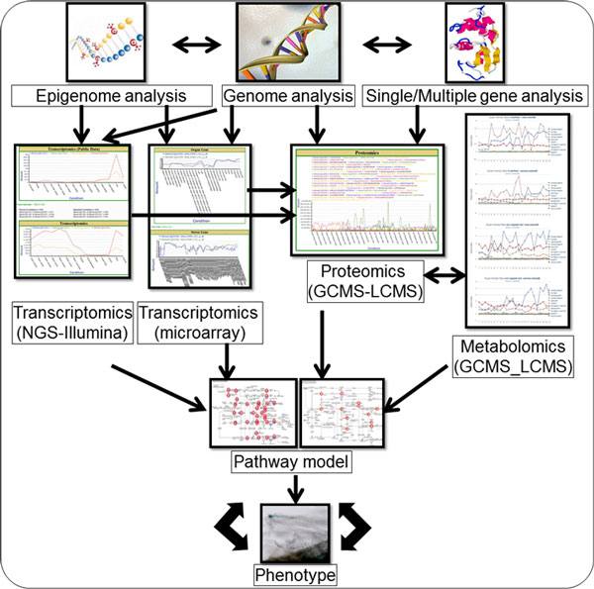
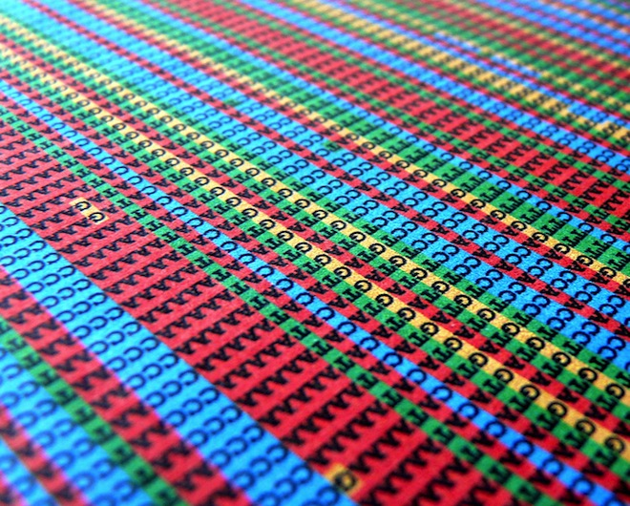
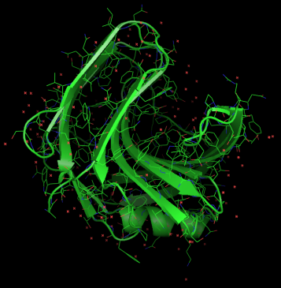
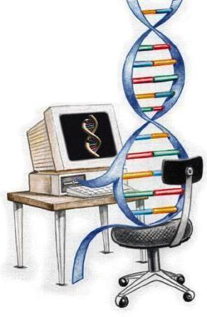
Bioinformatics: a Modern Challenge
Big Data, Genome Assembling, Gene Annotation, Computer Modeling
Notes:
One of modern challenges is: how to handle big data?
Today we have thousands of genomes to be assembled and milions of genes to be annotated.
Also computer based modeling approaches requires a great computational power.
Another big challenge is the INTEGRATION of OMICS data, in order to establish system networks and metabolic pathways.

Slide 12
SUMMARY
What is VTT?
The OMICS Era
New Enzyme Discovery
Protein Engineering
Notes:
- New Enzyme Discovery.

Slide 13
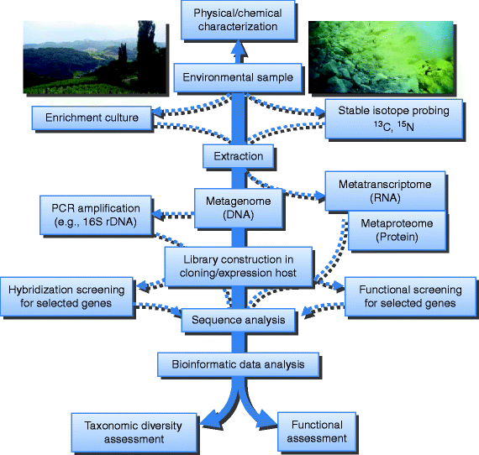
Enzyme discovery in the OMICS Era
Liebl, Wolfgang (2011): Metagenomics
Notes:
There are basically two ways to get better enzymes: (1) find a new one in the nature or (2) do protein engineering.
In this way OMICS are excellent tools to search new genes/proteins with defined features in nature.
Using these approaches like metagenomics, metatranscriptome and metaproteome it is possible to evaluate a pool of genomes, genes, transcripts and proteins from different organisms.

Slide 14
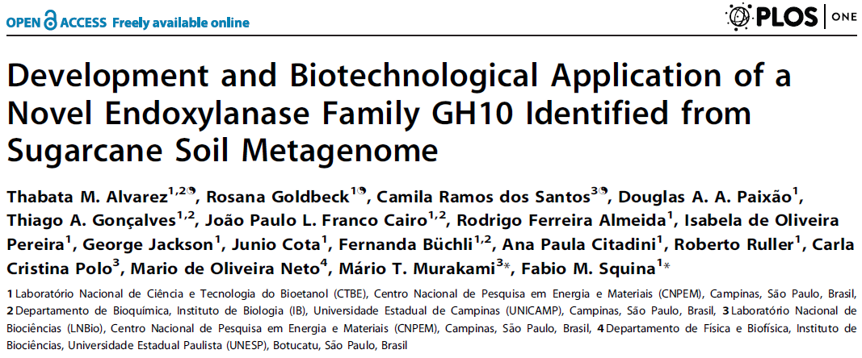
New Enzymes for Biofuels: GH 10 Xylanase

Slide 15
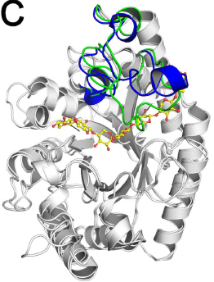
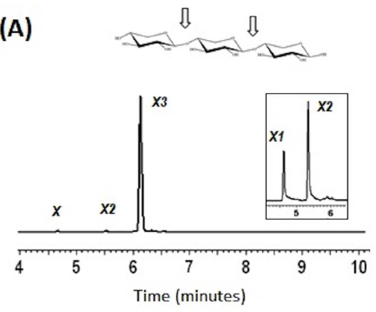
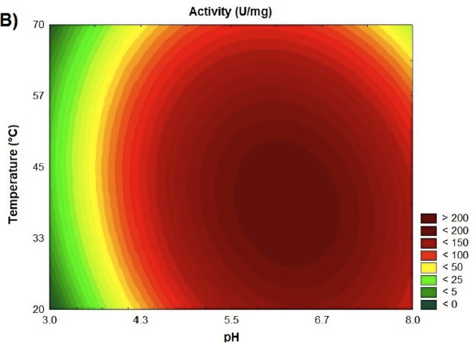
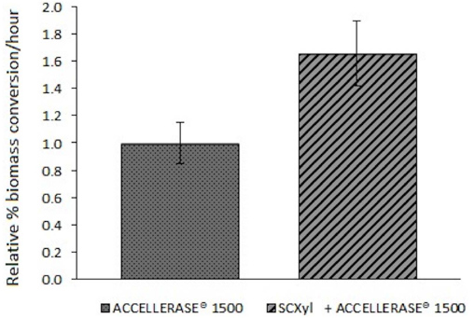
New Enzymes for Biofuels: GH 10 Xylanase

Slide 16
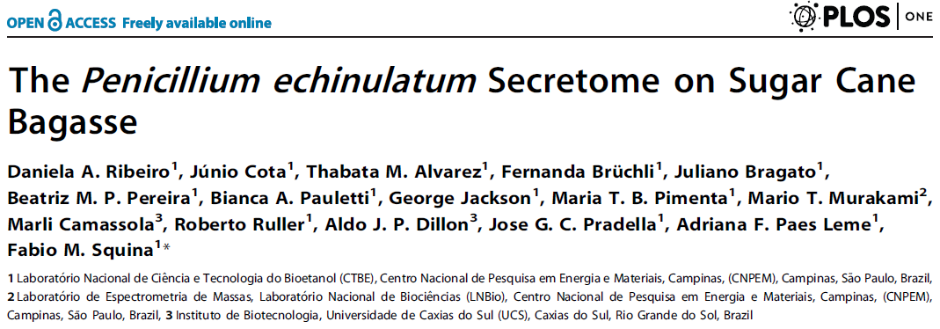
Proteomics: Secretome of Penicillium equinulatum

Slide 17
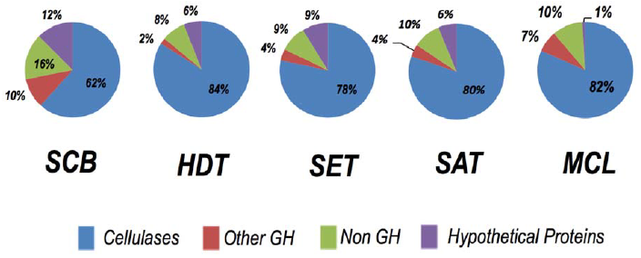
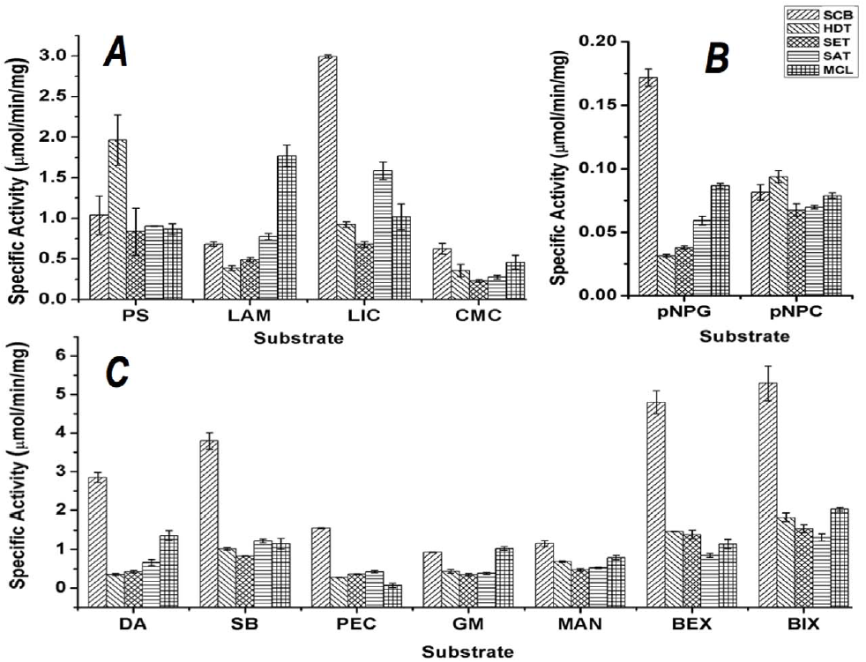
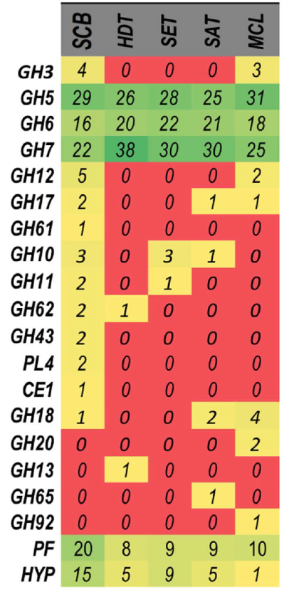
Proteomics: Secretome of Penicillium equinulatum
SCB: Sugar Cane Bagasse
HDT: Hydrothermal Treatment
SET: Steam Explosion Treatment
SAT: Sulfuric Acid Treatment
MCL: Microcrystalline Cellulose

Slide 18
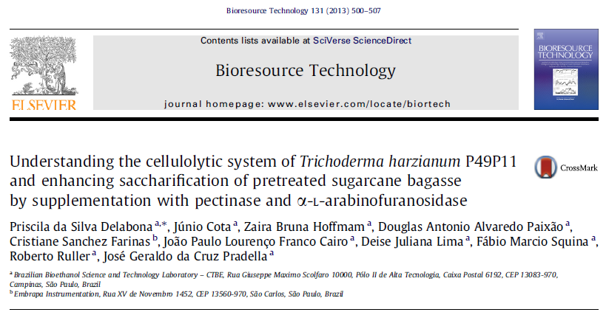
Proteomics: Secretome of Trichoderma harzianum

Slide 19
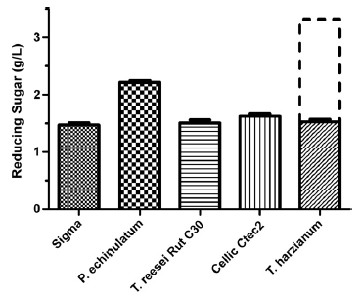
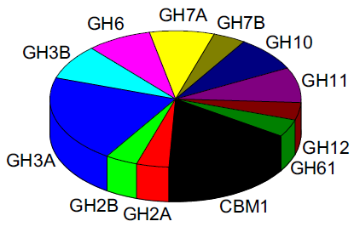
Proteomics: Secretome of Trichoderma harzianum

Slide 20
SUMMARY
What is VTT?
The OMICS Era
New Enzyme Discovery
Protein Engineering
Notes:
- Protein Engineering.

Slide 21
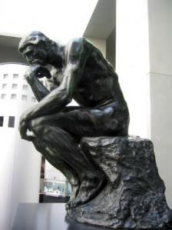


Protein Engineering is a tailor-made process
What’s on your mind?
What’s your need?
Notes:
The Waters’ Trademark is a good definition of what is possible to do using protein engineering.
Currently enzyme engineering is a driving force for industrial biotechnology.
Enzyme engineering is a tailor-made process. So What’s your need?
And it can support overcoming of modern challenges for industrial application, such as enzyme specificity for a given substrate, thermostability and cost of production.

Slide 22
Protein Engineering: Rational or Non-rational Design?
Current Paradigms
Mechanism-based
(Rational)
Detailed structural analysis
Empiricism-based
(Non-rational)
Libraries based
X
Notes:
- It depends a lot on what you want to change. For instance, it is difficult to change thermostability by doing single mutations, but it could be suitable for altering enzyme specificity or affinity by a given substrate.

Slide 23
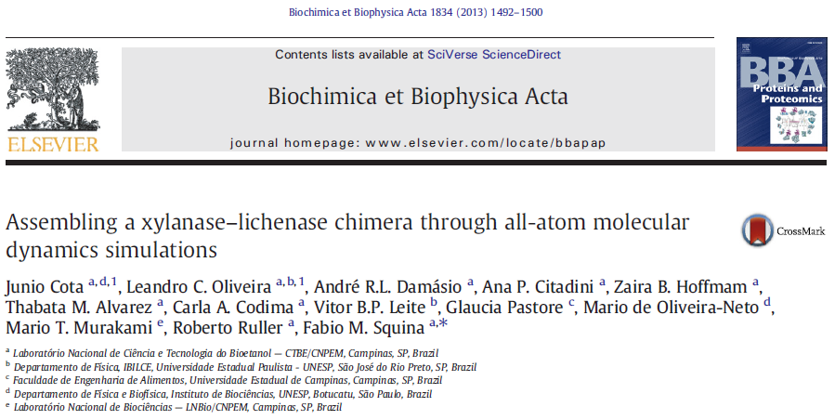
Building a Xylanase – Lichenase Chimera

Slide 24
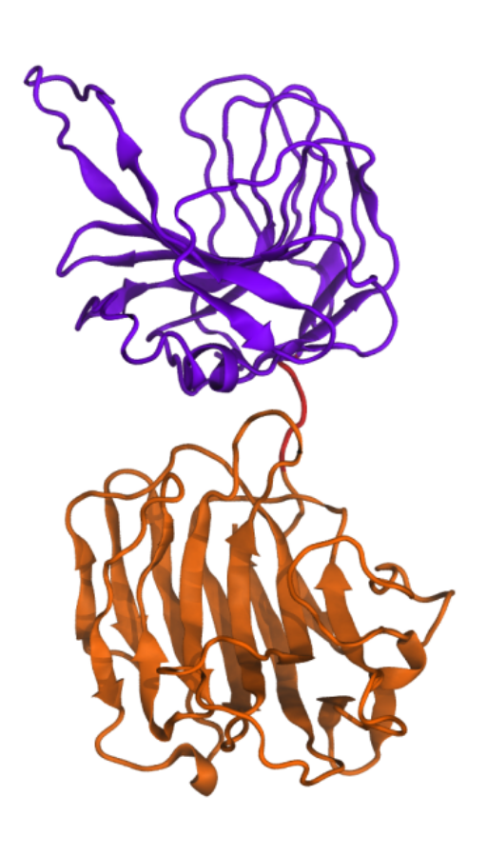
Chimeras: Multidomain Proteins
  Multidomain/multifunctional proteins can reduce costs with enzyme load;
  End-to-end fusion between the N and C termini of the parental enzymes can result in nonfunctional chimeras.
S.Y. Hong et al., Biotechnology Letters, 29, 931-936 (2007)

Slide 25
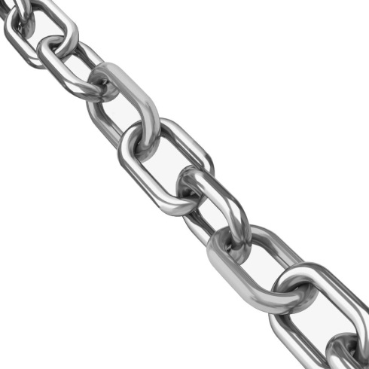
Chimeras: Multidomain Proteins
  The selection of the linker sequence is particularly important for the construction of functional fusion proteins
?

Slide 26
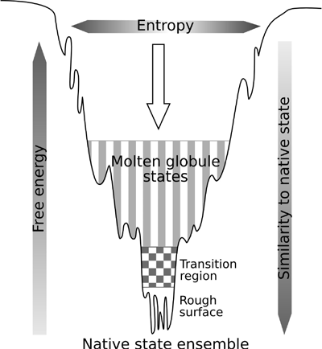
Building Chimeras: Molecular Dinamics
  Energy Landscape Theory
  Structure Based Models
  The topology could drives the protein folding
  Save computational time
X. L. Ji, and S. Q. Liu. J. Biomol Struct Dyn 28, 621-623 (2011)
Notes:
Descrição estatística do processo de enovelamento que mostra o balanço entre energia e entropia conformacional ao longo do processo de enovelamento.
SB são modelos simplificados.
O estado nativo é suficiente para reproduzir o estado de transição.
O estado e transição é o estado mais importante no enovelamento.
Phi values é uma medida de energia da contribuição de cada resíduo no estado de transição.

Slide 27
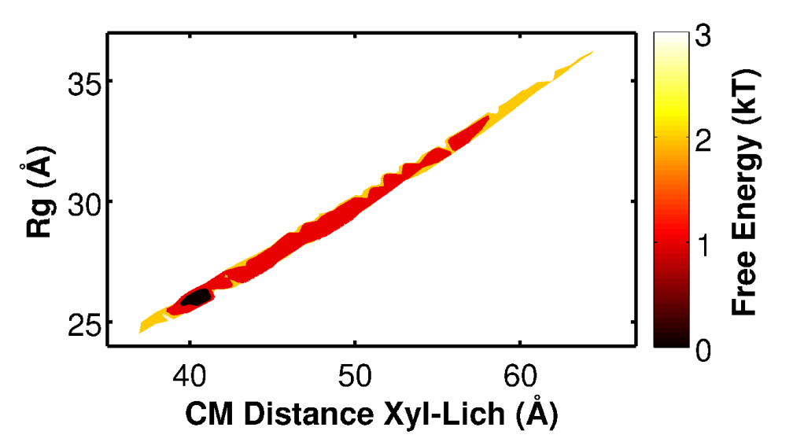
Structure Based Models (SB)
The unique Free Energy basin suggests a group of structures candidates: simulations are mainly driven by the entropy of the system
Notes:
Characterization of XylLich using Structure Based Models (SB) and Molecular Dynamics (MD) simulations. (A) The figure on the top shows a Free Energy profile as a function of the Radius of Gyration (Rg) and the distance between the center of mass of the domains Xylanase and Lichenase. Free energy is given in units of kT presented in the color scale. The figure was obtained from a long simulation (100ns) with no intra-domain interactions (see methods). The unique Free Energy basin suggests a group of structures candidates that should represent the chimera in solution, once the simulations are mainly driven by the entropy of the system.

Slide 28
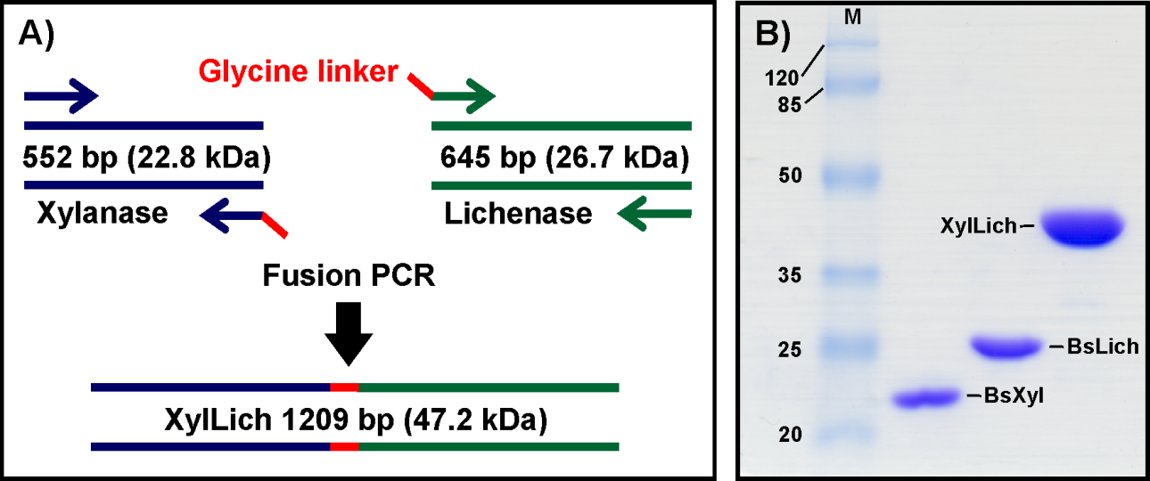
Building Chimera
Overlap PCR
SDS-PAGE
Notes:
Flow chart and SDS-PAGE of chimera building. (A) Drawn scheme showing the process of fusion PCR to assemble the chimeric DNA of XylLich. (B) SDS-PAGE gel of the chimera and wild type proteins electrophoresis, indicating that the fused enzyme Xylanase-Lichenase has the foreseen molecular weight. The protein molecular weight marker is showed in first lane (M) and the values are displayed in kDa. All the proteins are identified in each lane of the gel.

Slide 29
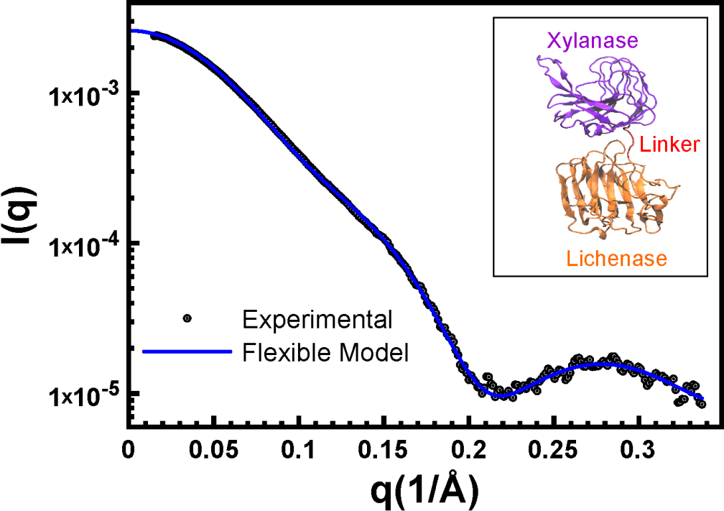
SAXS experimental and theoretical curves
Representative structure taken from the Free Energy basin with χ²=2.80, Rg=26.0Å and CM distance=40.7Å inset
Theoretical scattering curve was generated in CRYSOL and the representation in VMD
Notes:
(B) Below, the Small-Angle X-Ray Scattering profile for the theoretical and Experimental evaluation of XylLich and a representative structure taken from the Free Energy basin with χ²=2.80, Rg=26.0Å and CM distance=40.7Å inset (C). The scattering intensity is showed in a logarithm scale as a function of the momentum transfer, q. (C) Cartoon representation of the predicted chimera being Xylanase presented in purple, the linker in red and Lichenase in orange. CRYSOL was employed to generate the theoretical curve and VMD (Humphrey et al., 1996) to the representation.

Slide 30
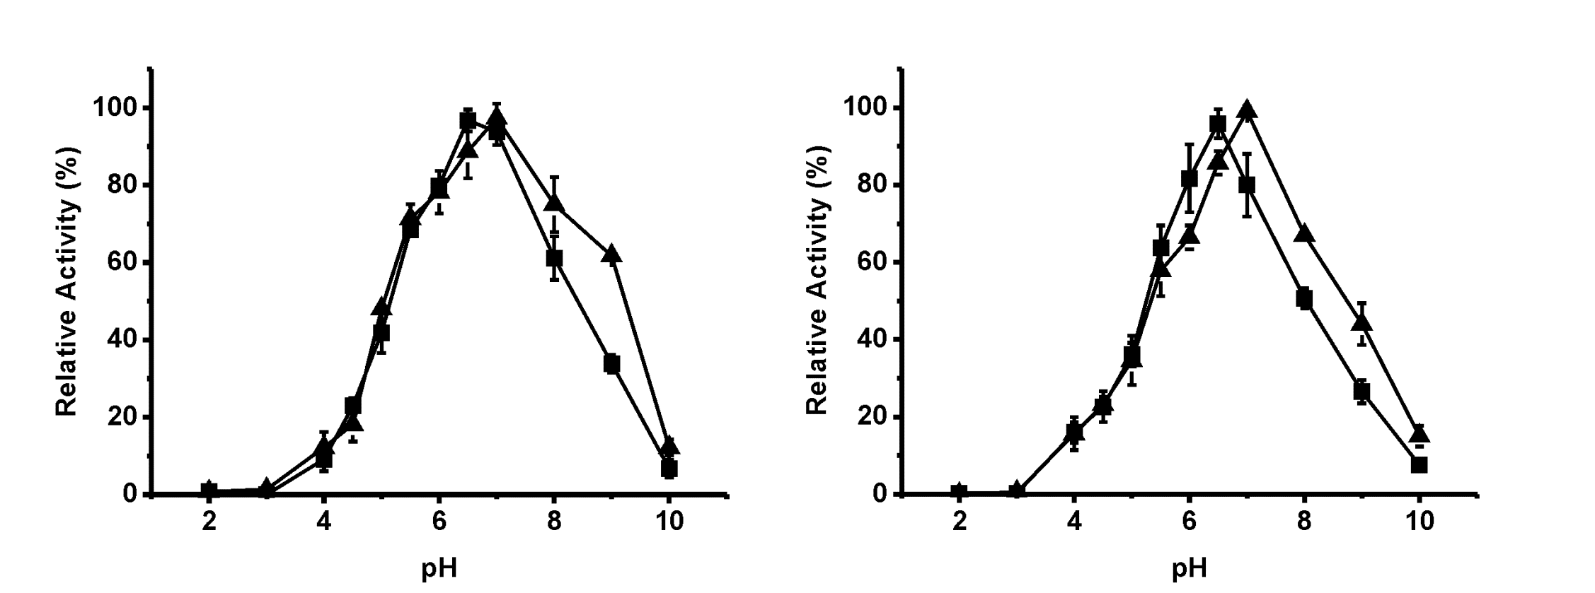
Optimal pH
Xylan
Lichenan
▲ Parental enzyme
■ Chimera

Slide 31
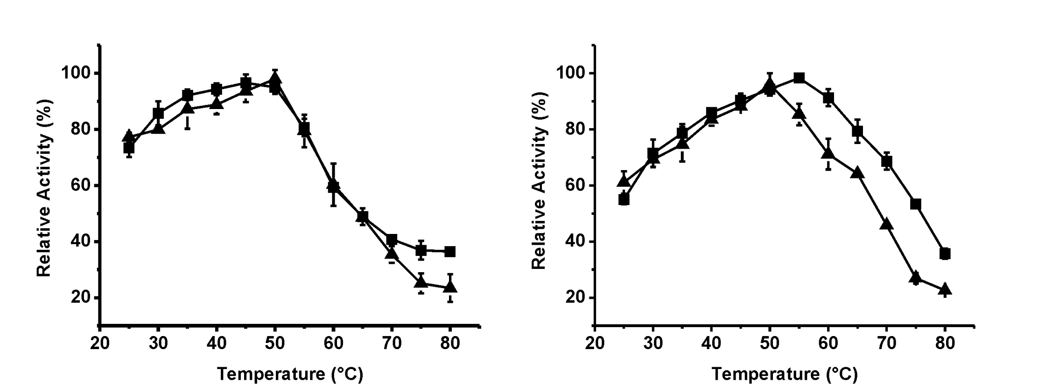
Optimal Temperature
Xylan
Lichenan
▲ Parental enzyme
■ Chimera

Slide 32
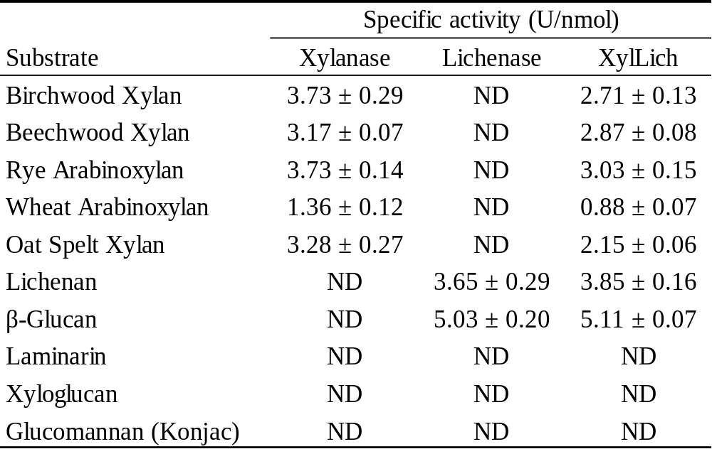
Substrate Specificity

Slide 33
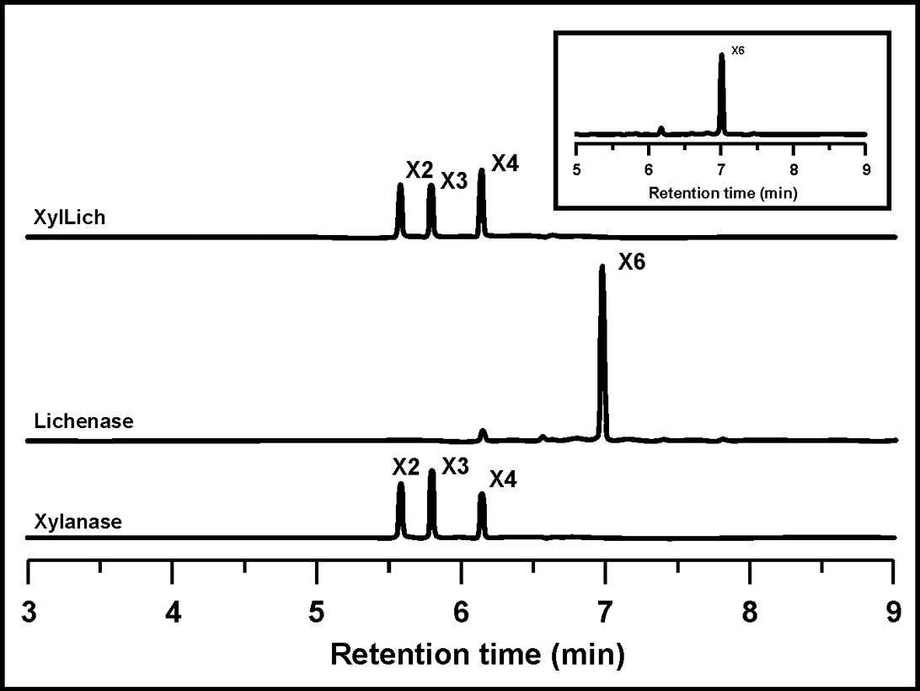
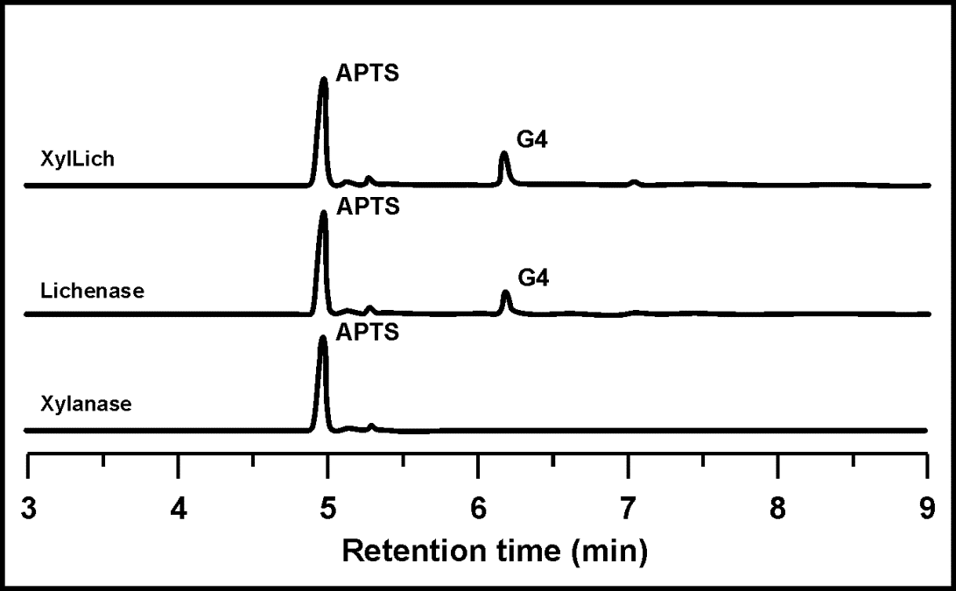
Capillary Electrophoresis
Xylohexaose
Lichenan

Slide 34
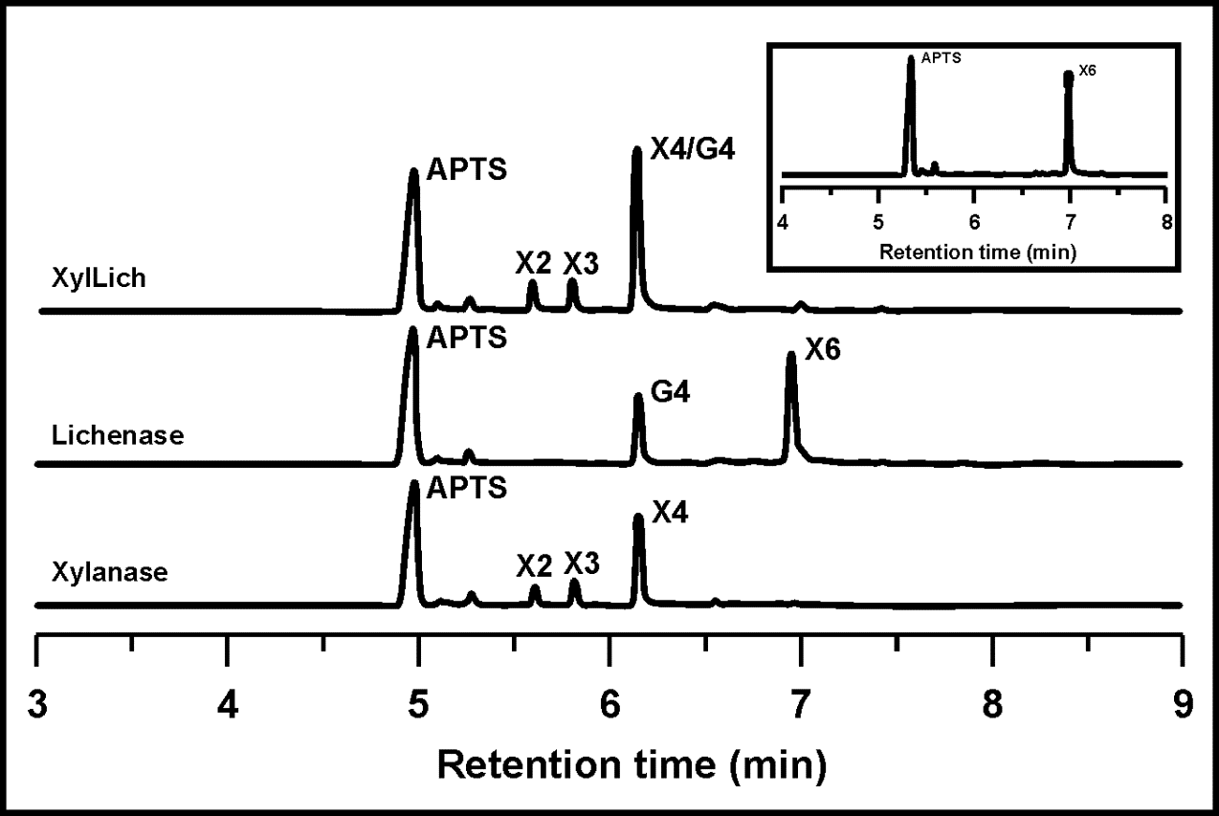
Capillary Electrophoresis
Xylohexaose + Lichenan

Slide 35
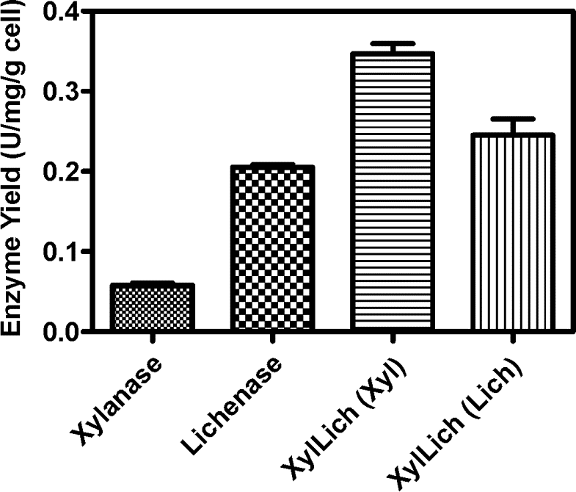
Enzyme Yield
6 times greater
20% greater

Slide 36
Conclusions
This work presented a novelty way to predict the disposal of chimera domains in solution before experimental assays;
A potential tool for screening and development of enzyme cocktails for second generation biofuels;
The expansion of hydrolase activities in an unique protein could be a route for increase cost-effective of biomass saccharification;
Enzyme production data suggests an advantage on producing the fused protein instead the wild type ones separated.

Slide 37

Protein Engineering: Typical Challenges
Design proteins with certain function;
Design proteins which bind novel ligands;
Alter binding affinity and specificity of proteins;
Increase activity of enzymes;
Change thermal tolerance, pH stability;
Alter allosteric regulation;
Decrease inhibition of enzymes;
Increase protease resistance;
Reactivity in nonaqueous solvents;
Eliminate cofactor requirement.

Slide 38
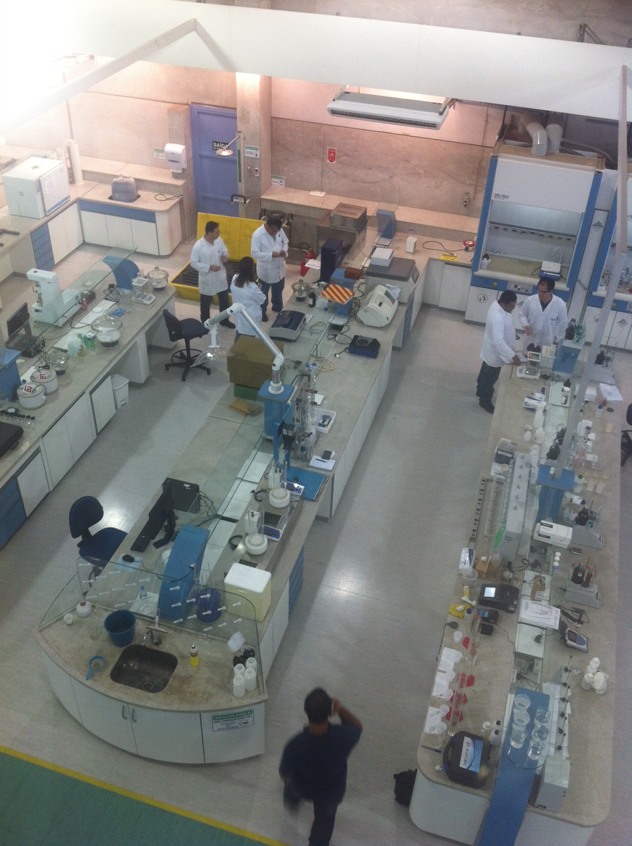
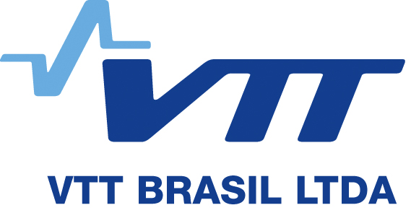





Acknowledgements

Slide 39

junio.silva@vttbrasil.com
juniocs@gmail.com

