Slide 1

Proteolytic maturation of Drosophila Neuroligin3 by TACE regulates locomotor activity
Jun Wu Ph.D student
wudream@seu.edu.cn
18th July 2016

Slide 2
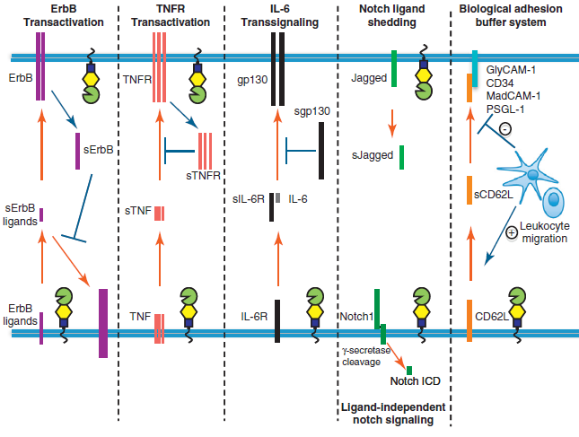
Protein ectodomain shedding and signal transduction
J. Scheller et al., Trends Immunol (2011)

Slide 3
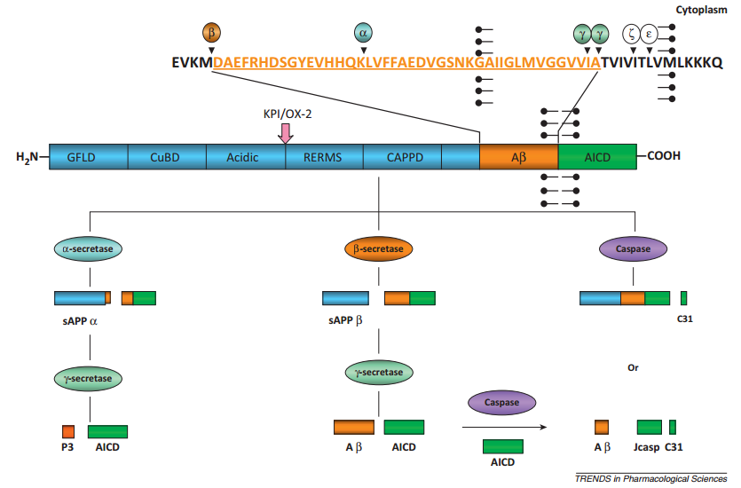
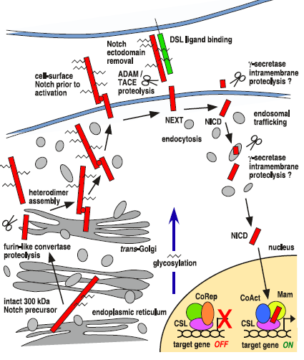
Classical examples of protein cleavage
APP signaling
Notching signaling
H. Wang et al., Trends Pharmacol Sci (2013)
M. E. Fortini, Developmental cell (2009)

Slide 4
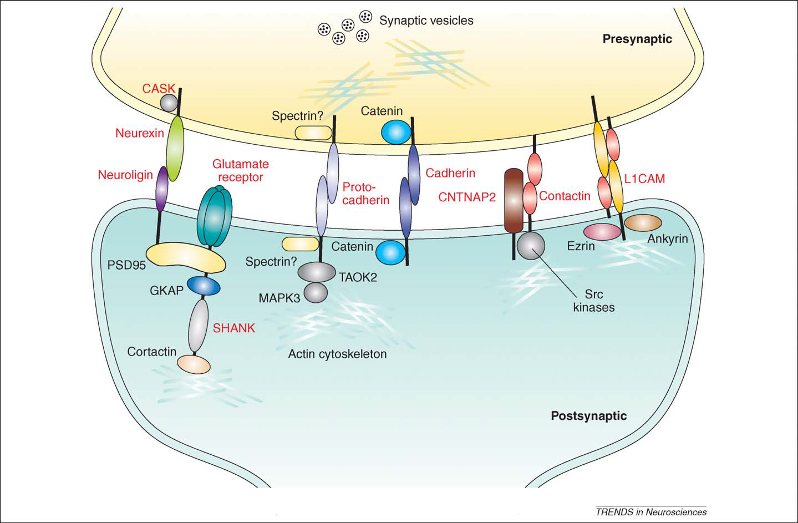
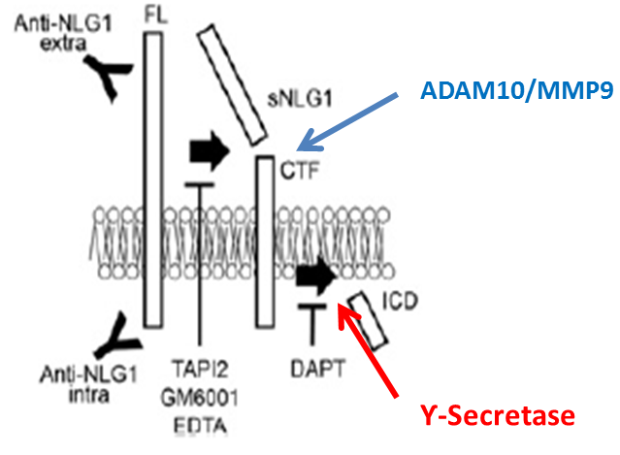
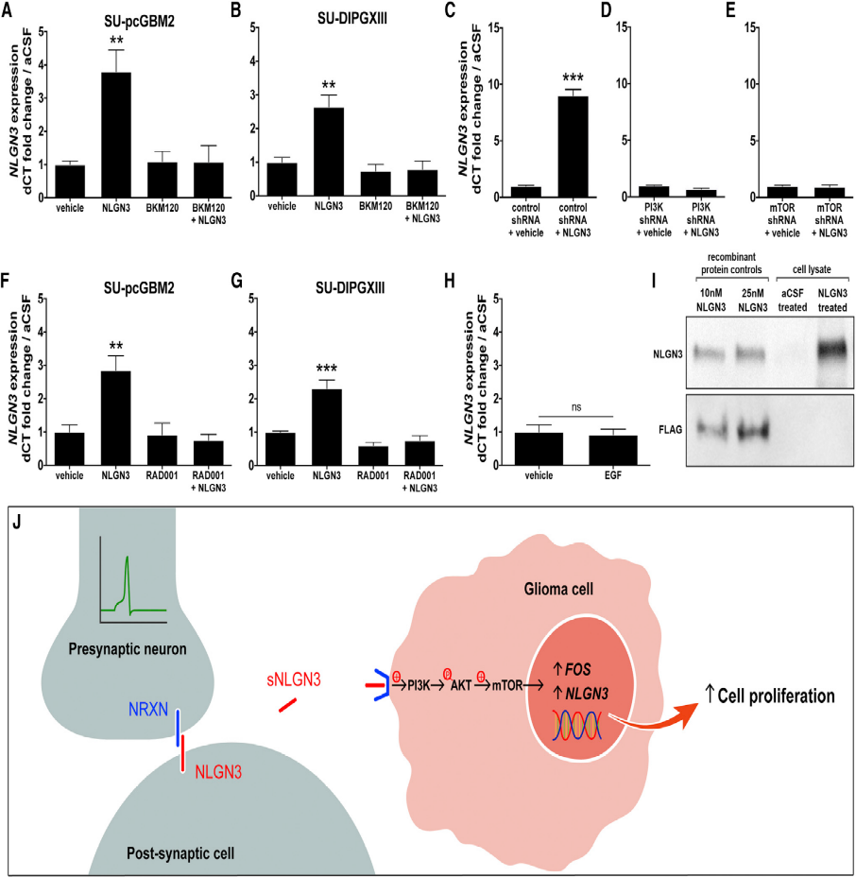

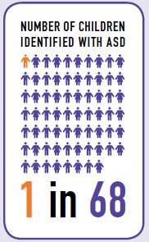
Proteolytic cleavage of autism-associated Nlgs
R. T. Peixoto et al., Neuron (2012)
K. Suzuki et al., Neuron (2012)
C. Betancur et al., Trends Neurosci (2009)
Community Report on Autism • 2014
S. S. Mitra et al., Cell (2015)

Slide 5
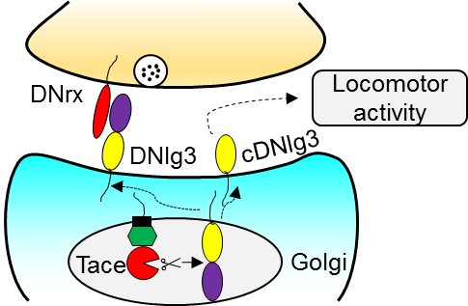
The highlight of our study

Slide 6
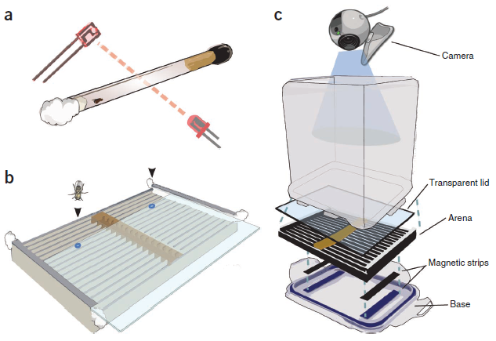
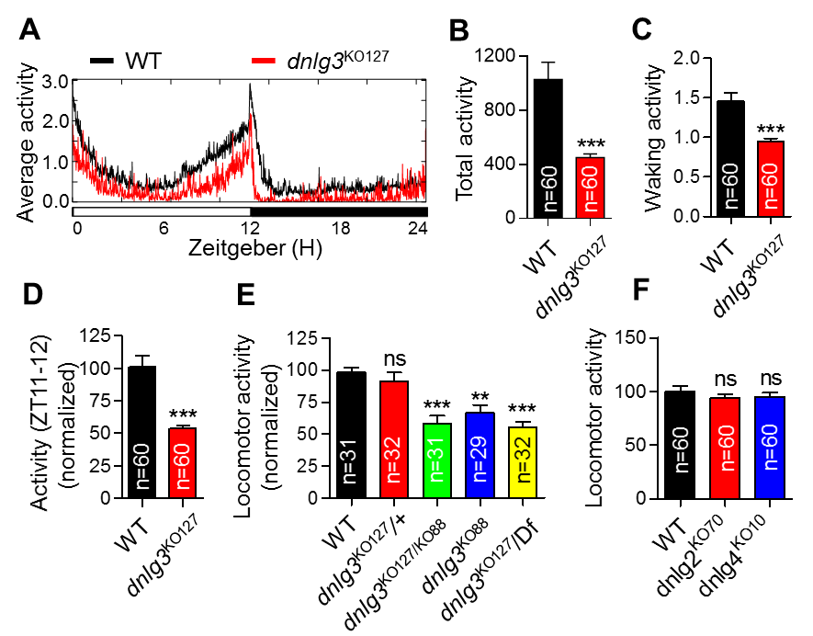
dnlg3 mutants exhibit reduced locomotor activity
Giorgio F Gilestro. Nat protoc. (2012)

Slide 7
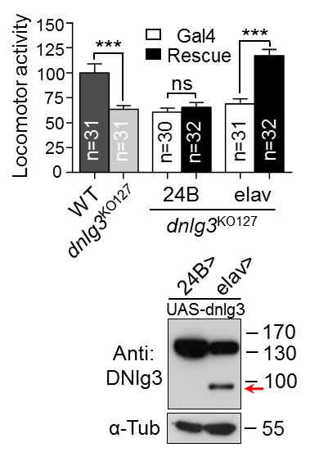
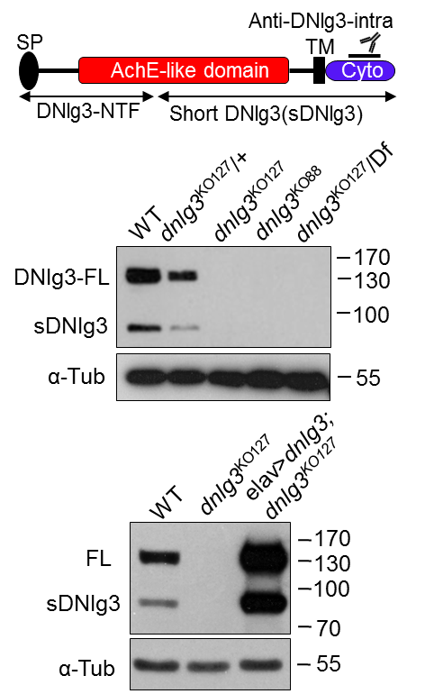
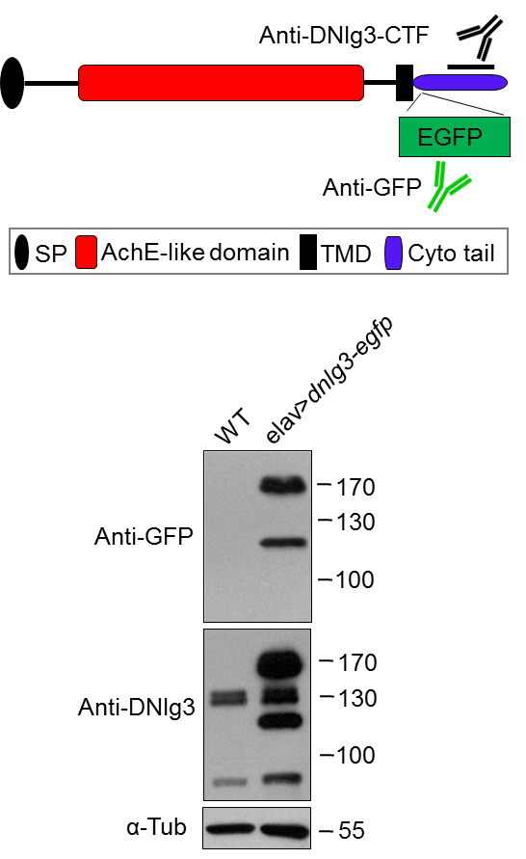
Neuronal DNlg3 undergoes proteolytic cleavage
A
B
C

Slide 8
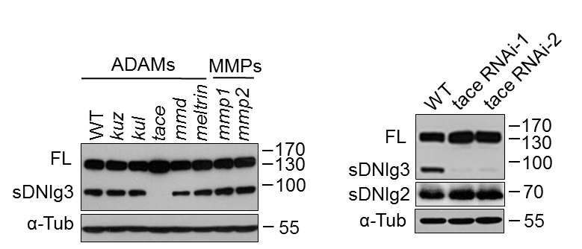
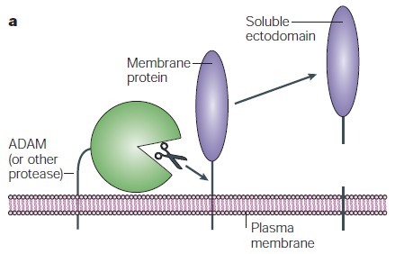
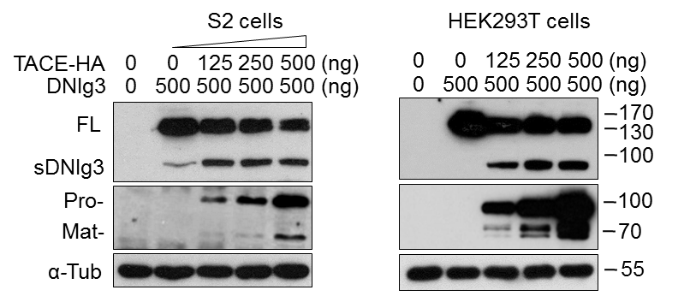
DNlg3 is cleaved by TACE in vivo and in vitro
A
B
C

Slide 9
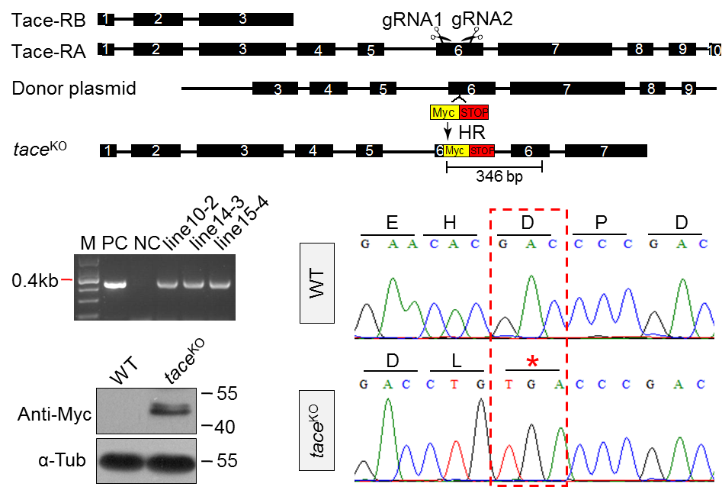
Genetation of tace mutant by CRISPR-Cas9
A
B
C
D

Slide 10
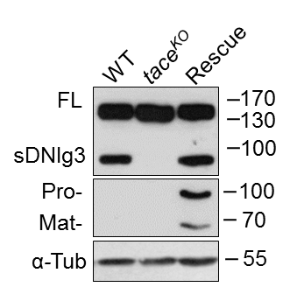
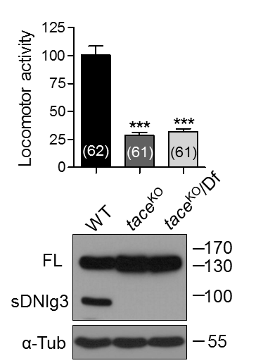
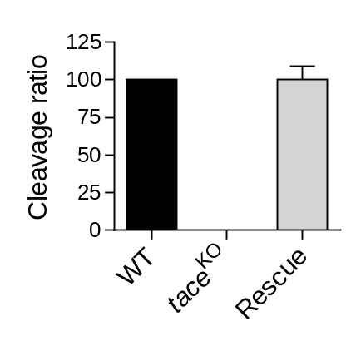
tace mutants show similar inactivity phenotype
A
B

Slide 11
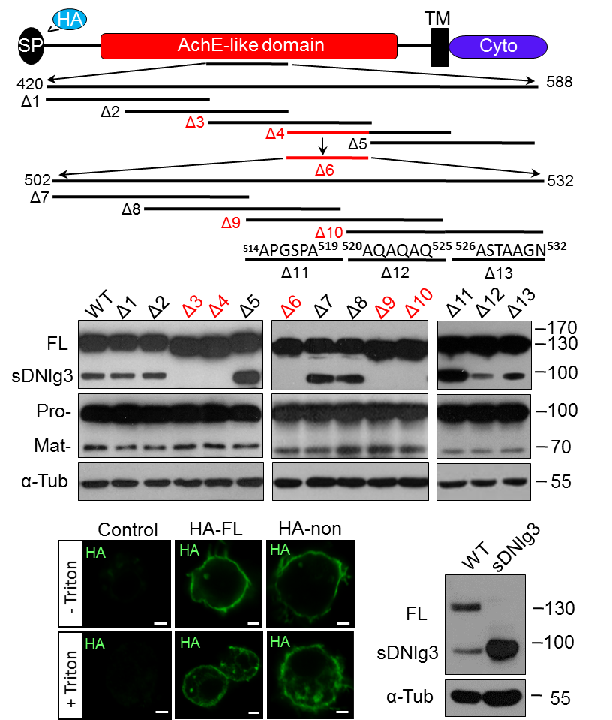
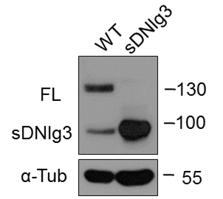
DNlg3 is cleaved at AchE-like domain during A522 and N532 region
A
C
B
D

Slide 12
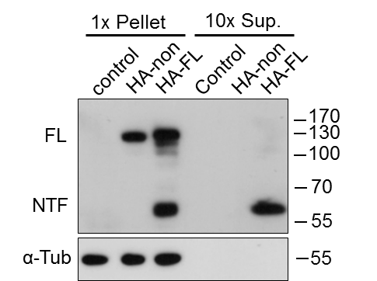
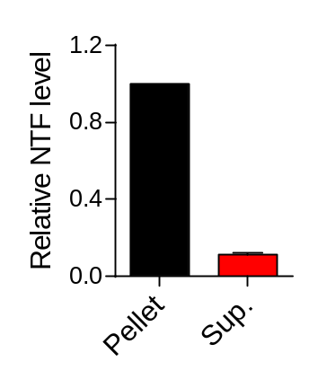
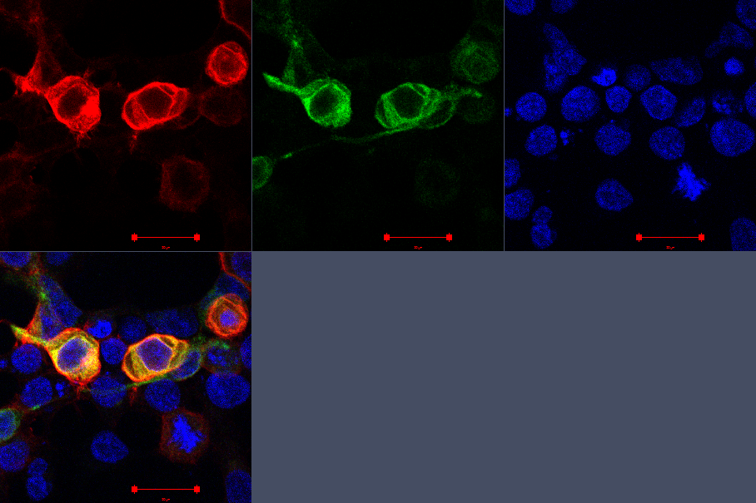
DNlg3 is cleaved by TACE intracellularly
A
B
C
HA-DNlg3
D
DNlg3
TACE
DNlg3 TACE DAPI
DNlg3 TACE

Slide 13
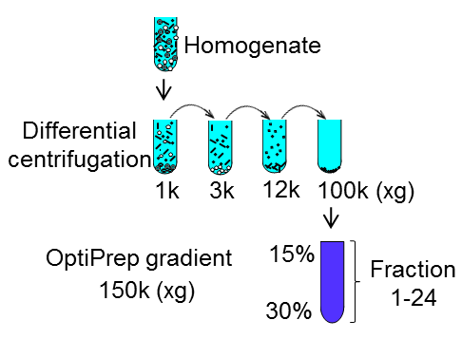
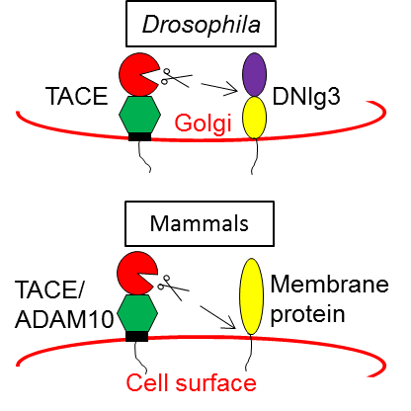
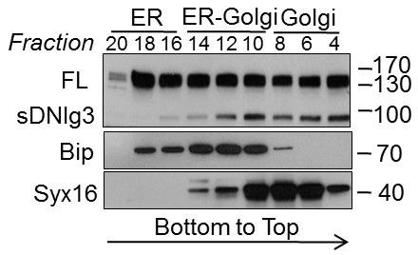
DNlg3 is cleaved at Golgi apparatus
A
B
(ER)
(Golgi)

Slide 14
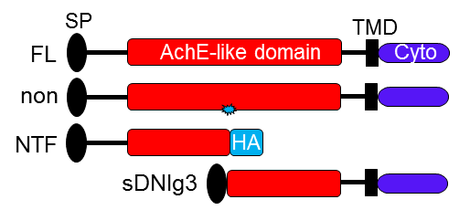
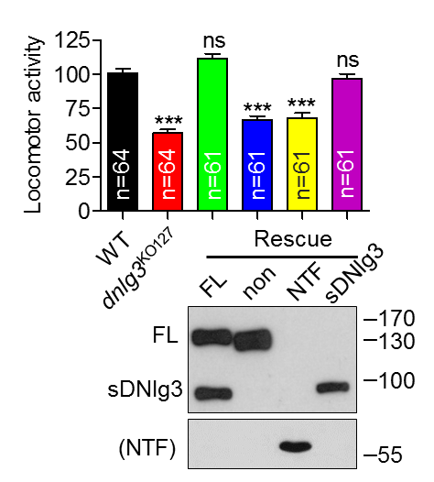
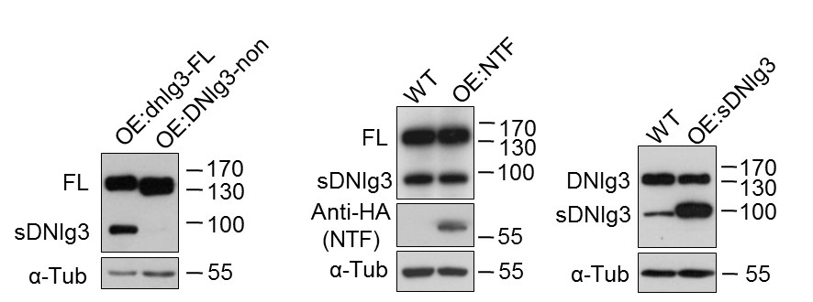
DNlg3 cleavage is essential for locomotor activity

Slide 15

Working model

Slide 16

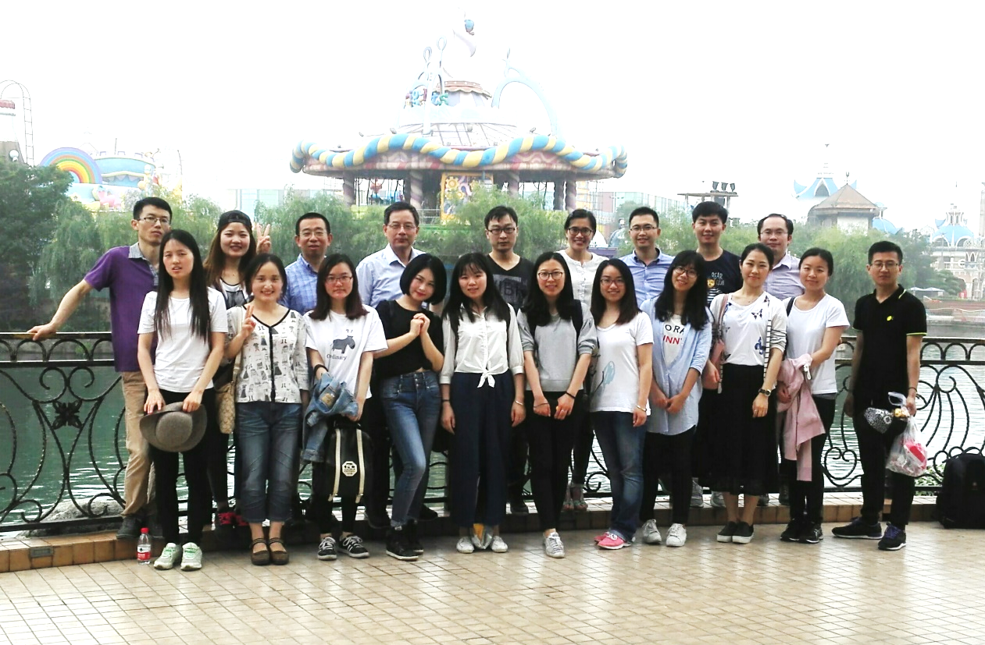
Acknowledgements
Wei Xie lab
http://webplus.seu.edu.cn/_s222/12560/list.psp

Slide 17

Thanks for your attention!

