Slide 1
Thermochemical Recycling of Municipal Solid Waste
Juma Haydary
Department of Chemical and Biochemical Engineering
Institute of Chemical and Environmental Engineering
Faculty of Chemical and Food Technology
Slovak University of Technology in Bratislava, Slovakia

Slide 2

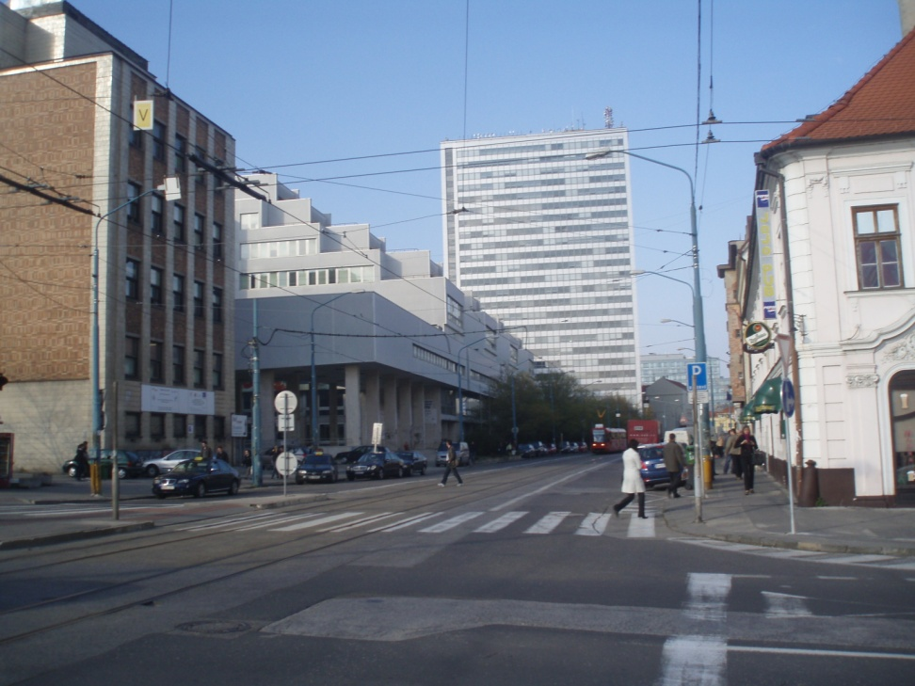

Slovak University of Technology in Bratislava
Faculty of Chemical and Food Technology

Slide 3
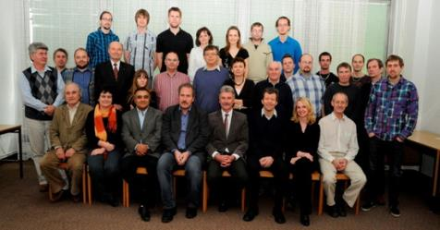
Institute of Chemical and
Environmental Engineering
Reactor Engineering Reaserch Group
National center for research and application of renewable energy sources
Experimental study and mathematical modeling of fuel thermal processes
Pyrolysis, gasification and combustion of solid fuels
Biomass, polymer waste, MSW, and coal thermal and catalytic processing for production energy and materials

Slide 4








Energy
Mechanical recycling loop
Energy
Thermochemical recycling loop
Energy

Slide 5
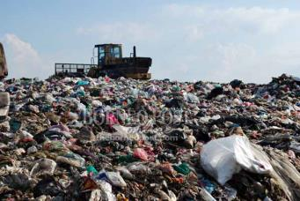
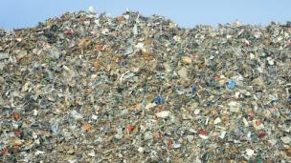
Refuse-Derived Fuel (RDF)
MSW
RDF
Biodegradables
Metals
Inorganics
Hazardous wastes

Slide 6
RDF composition
Component | Material | w_{i} [kg/kg]
Paper | White paper, recycled paper | 0,6317
Foil | LDPE, HDPE | 0,1578
Plastics | Rigid plastics, polystyrene, polyurethane | 0,1910
Textile | Polyamide, polyester, cotton , wool | 0,0194

Slide 7
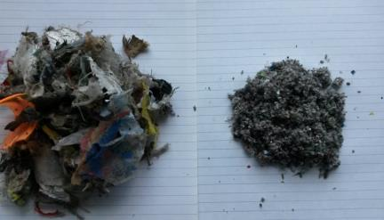
Proximate and Elemental Composition of RDF
Com. | Mois. | VM* | FC* | ASH* | C | H | N | S | O**
Wt. % | 10 | 75.5 | 8.9 | 15.6 | 51.7 | 5.9 | 0.9 | 0.4 | 25.5
*moisture free basis
**calculated to 100%

Slide 8
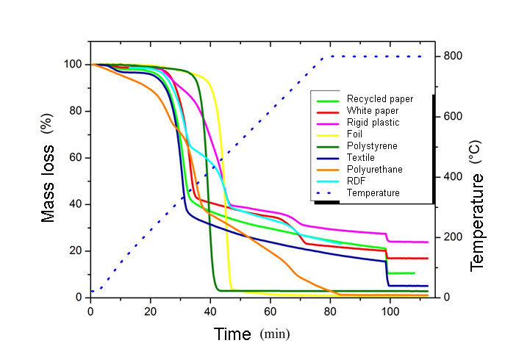
Behaviour of Thermal decomposition

Slide 9
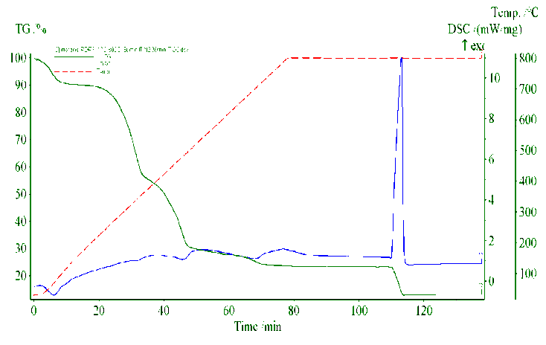
Behaviour of Thermal decomposition

Slide 10
Heating value of RDF
Component | Heating value [kJ/kg]
Paper | 13410
Foil | 43860
Plastics | 33570
Textile | 19770
Mixed RDF | 20810

Slide 11
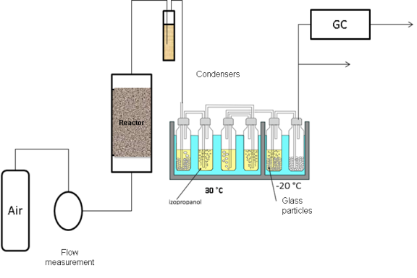
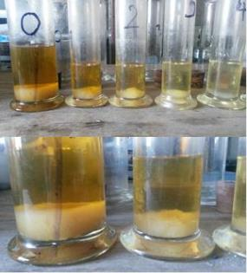
Tar content measurement

Slide 12









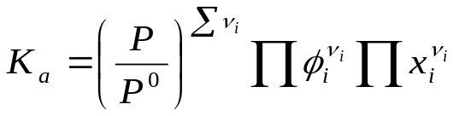
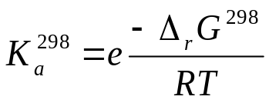





Gasification Model
Global material balance of RDF gasification
Assumptions:
Steady state flow is considered inside the gasifier
No temperature and concentration gradient exist inside the reactor
The residence time is enough long to reach complete decomposition of RDF and unreacted part of RDF is only carbon.
Only the major species are considered in the product gases, i.e CO, CO₂, H₂, CH₄ , H₂O, NH₃, H₂S, N₂ and Tar
RDF
TAR
Reactions:
Equilibrium constant:
,

Slide 13
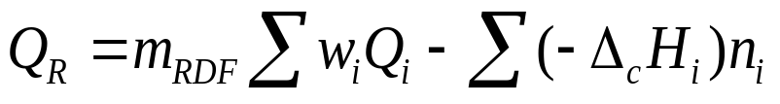
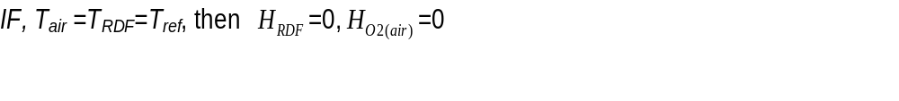
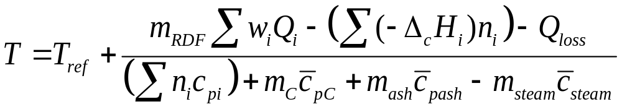
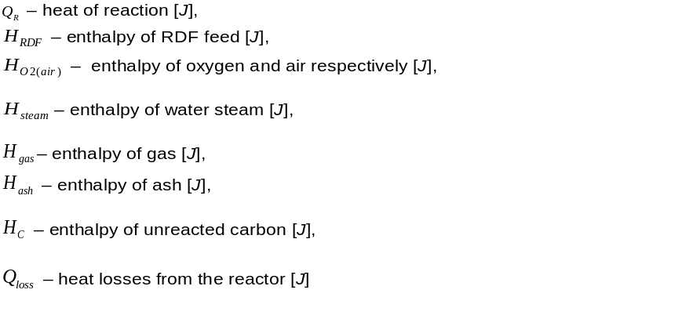
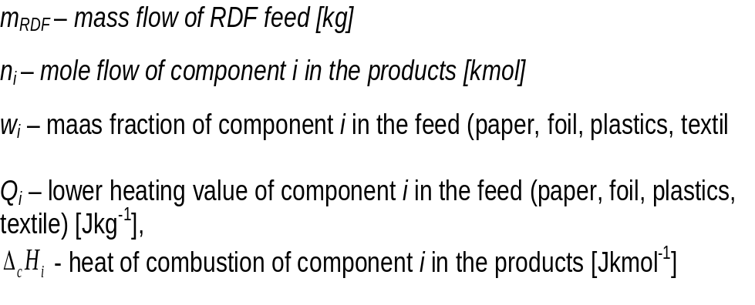
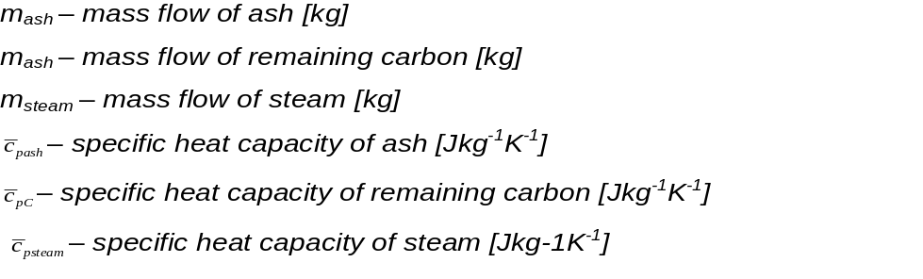
Enthalpy balance:

Slide 14
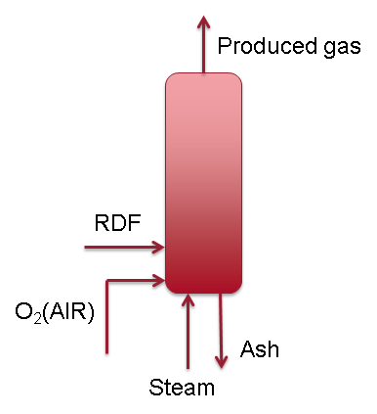
Results of modelling RDF gasification
Observed parameters:
Conversion of RDF
Reactor Temperature
Gas composition
Content of pollutants (NH3, H2S, TAR)
Variables:
Oxygen (air) to RDF mass ratio
Steam to RDF mass ratio

Slide 15
Air Gasification

Slide 17
Gasification of RDF Using O₂

Slide 18
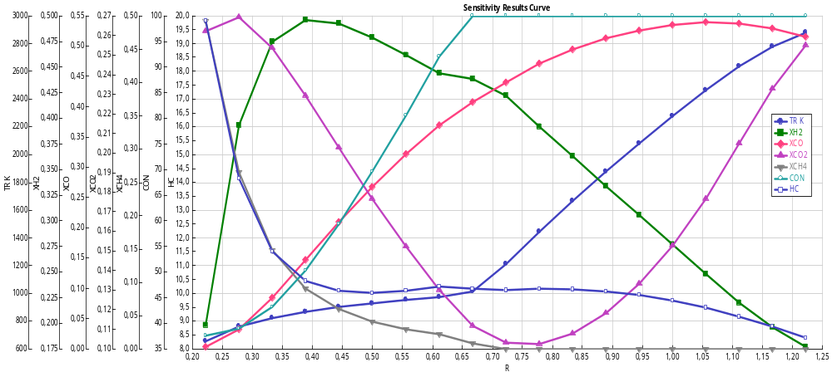
Effect of RDF composition
Com. | Wt. %
Mois | 10
VM | 75.5
FC | 8.9
ASH | 15.6
C | 51.7
H | 5.9
N | 0.9
S | 0.4
O | 25.5
Com. | Wt. %
Mois | 1.2
VM | 80.22
FC | 5.23
ASH | 13.34
C | 51.66
H | 8.82
N | 0.66
S | 0.08
O | 25.42

Slide 19
Effect of Steam in RDF Gasification

Slide 20
Conclusion
For RDF studied in this work,100% of RDF conversion in gasification by air was reached at m_{air}/m_{RDF}=2,2. However, the gas heating value was 4,4 MJ/Nm³
Gasification of RDF using Oxygen enables production of a gas with heating value around 10 MJ/Nm³ at m_{O2}/m_{RDF}=0,45
Elemental Composition of RDF has a crutial effect on riquired m_{air}/m_{RDF}
Raw untreated gas tar content was 3.3 mass %; tar fraction content a solid phase insoluble in isopropanol
By increasing the m_{steam}/m_{RDF} the content of H2 and CO₂ increased, However, the content of CO, reactor temperature and gas heating vale decreased

Slide 21

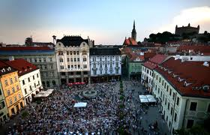
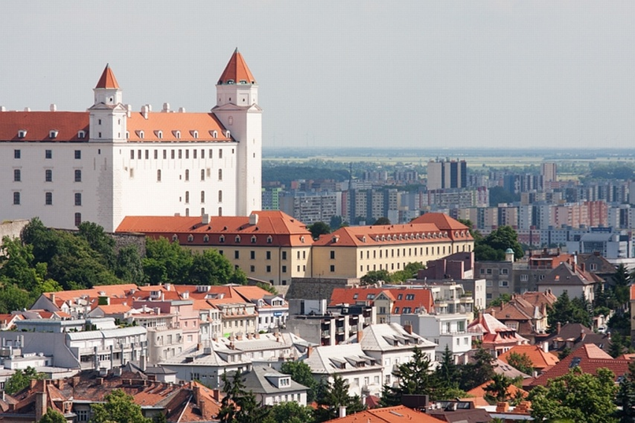
Thank you for attention

