Slide 1


Extreme confinement and propagation regimes of tHz surface waves on planar metallic waveguides
J. Mangeney¹, D. Gacemi³, R. Colombelli² and A. Degiron²
¹Laboratoire Pierre Aigrain, UMR 8551, Ecole Normale Supérieure, France
²Institut d’Electronique Fondamentale, UMR 86622, CNRS, Univ-Paris Sud, France
³ Laboratoire Matériaux et Phénomènes Quantiques, UMR 7162, CNRS, Université Paris, France

Slide 2
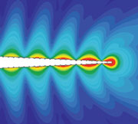
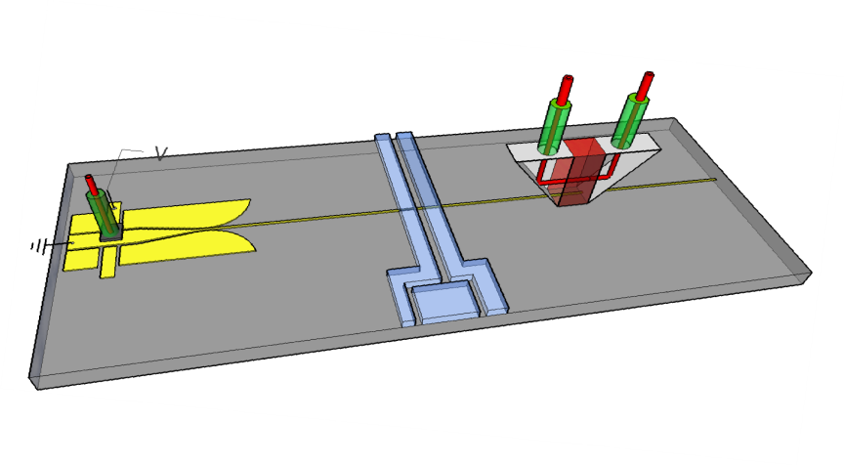
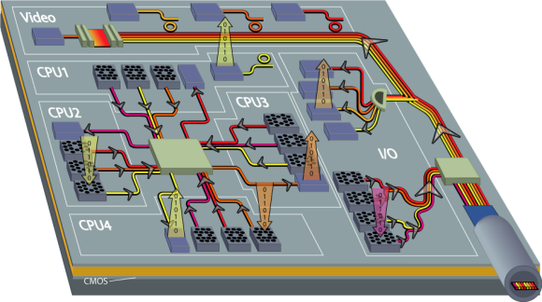
Confinement of THz waves
Requirement of highly confined THz waves
Integrated THz technology (high-speed electronic circuits,…)
Imaging and spectroscopy of small objects
Biological sensing
…
Microfluidic channel
Diffraction limit of THz waves ~150 µm
Plasmonic for confining THz waves (<λ)
Plasmonic Concepts -> Sub-λ confinement at optical frequencies
Surface waves propagating at the interface between a dielectric and a conductor.
Can sub-λ confinement be achieved at THz frequencies ?

Slide 3
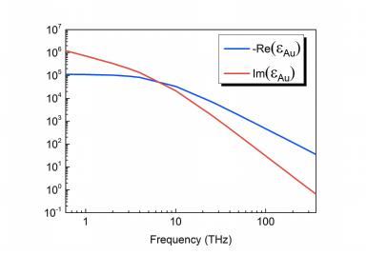
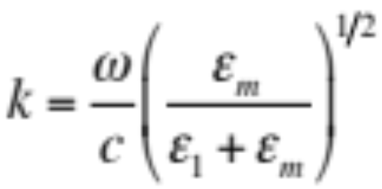
Dispersion relation
Surface waves at the interface of metal and dielectric :
THz
Optics
Surface wave’s properties highly change from optics to THz

Slide 4

Dispersion relation
Re(ω/c)
Surface Plasmon Polariton
ω=ck
375 THz (λ=450 nm)
δ_{diel}=0.18 µm < λ
Optical range
Zenneck waves
1 THz (λ=300 µm)
THz range
δ_{air}=63 mm >> λ
k
Challenge : achieve sub-λ confinement of the THz surface waves

Slide 5
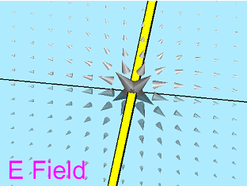
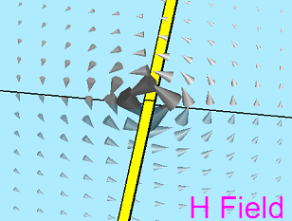
Planar metallic waveguide
Single conductor deposited on thin dielectric layer
`
Yansheng Xu et al., MOTL. 43, 290, (2004).
Christopher Russell, et al., Lab Chip, to be published 2013
Treizebre, A, Int. J. Nanotechnol. 5, 784-795 (2008).
Akalin at al, IEEE VOL 54, N°6,2762 (2006).
Extremey simple geometry adapted for complex integrated
schemes with high functionalities
Physical mechanisms that bind the surface wave to the surface :
1/ Coupling between EM fields and the free electrons at the metal surface
2/ Interaction of the EM fields with the metal surface modified by the thin dielectric layer.

Slide 6
Outline
    Study of planar metallic waveguides to achieve electric field confinement
  Planar metallic waveguides based on the coupling between EM fields and free electrons at the metal surface (Simulation)
  Planar metallic waveguides based on the interaction of the EM fields with a metal surface modified by the thin dielectric layer (Simulation)
  Planar metallic waveguides based on hybrid mode (Experiments)
    Study of the propagation regimes of planar metallic waveguides

Slide 7
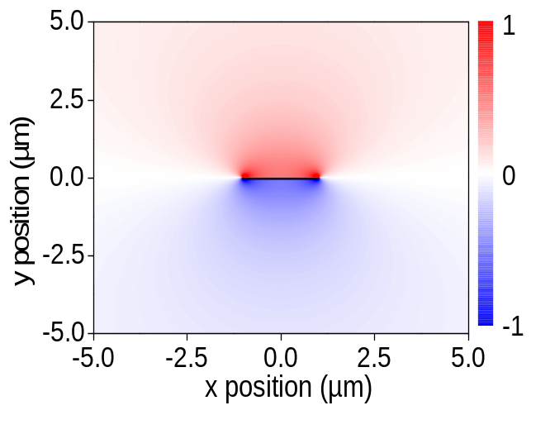
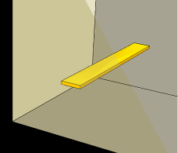
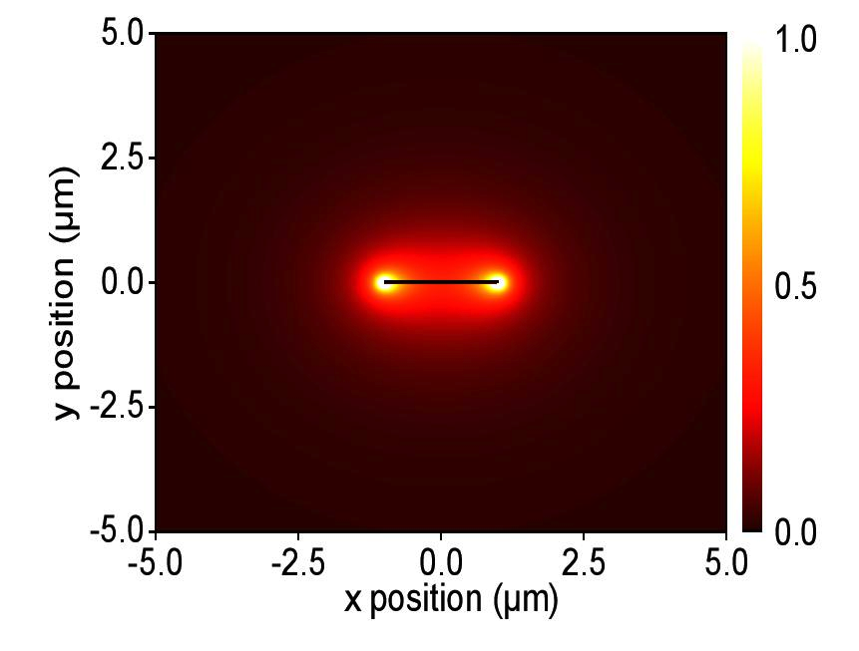
Single Au stripe
1/ Coupling between EM fields and the free electrons at the metal surface
Single Au stripe embedded in a homogeneous medium
Au: metal with finite conductivity
1 THz
Comsol MultiPhysics :
- Cross Section of the power
- Effective index of propagating modes
Existence of only one mode at 1 THz : radial field distribution

Slide 8
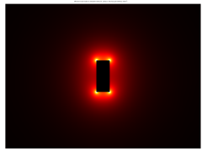
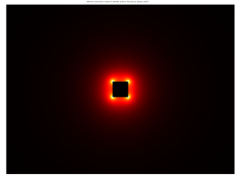
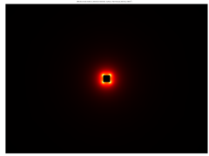
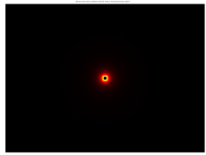
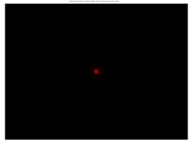
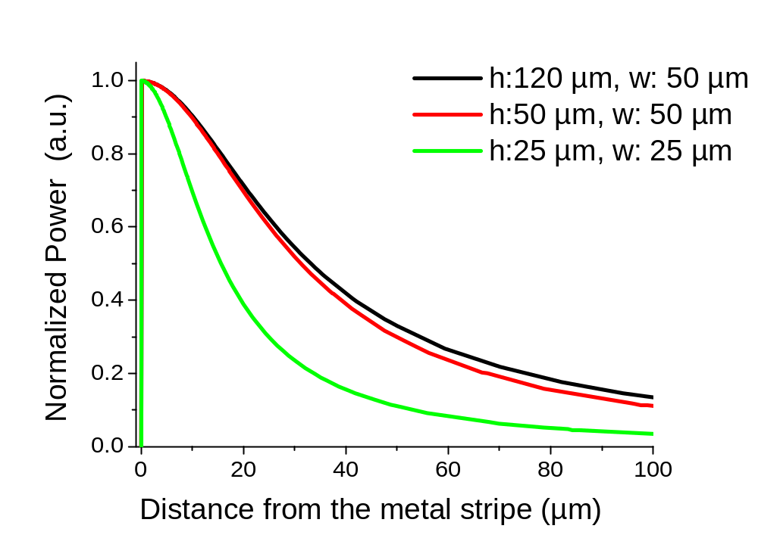
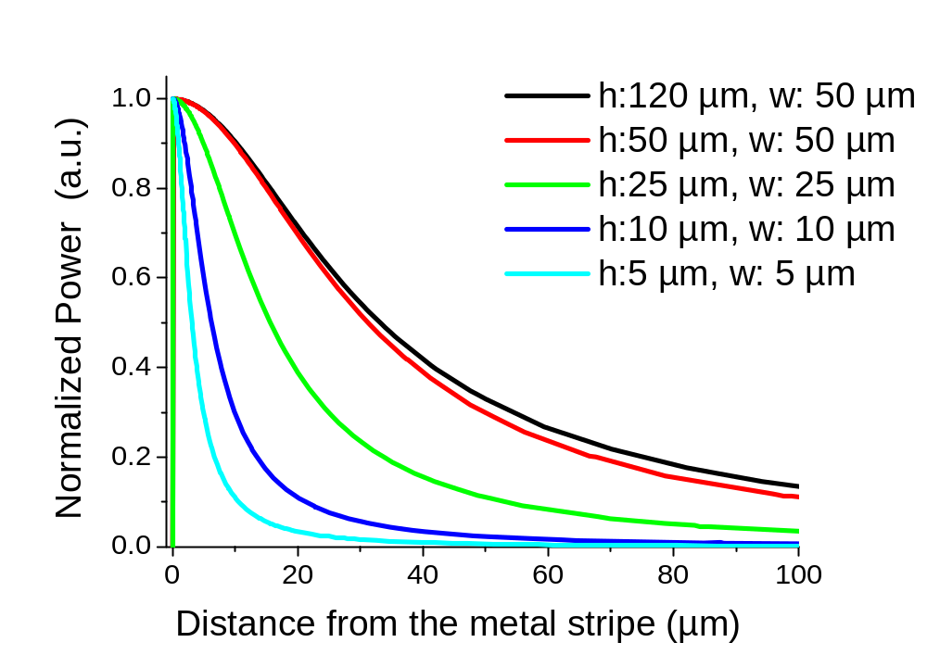
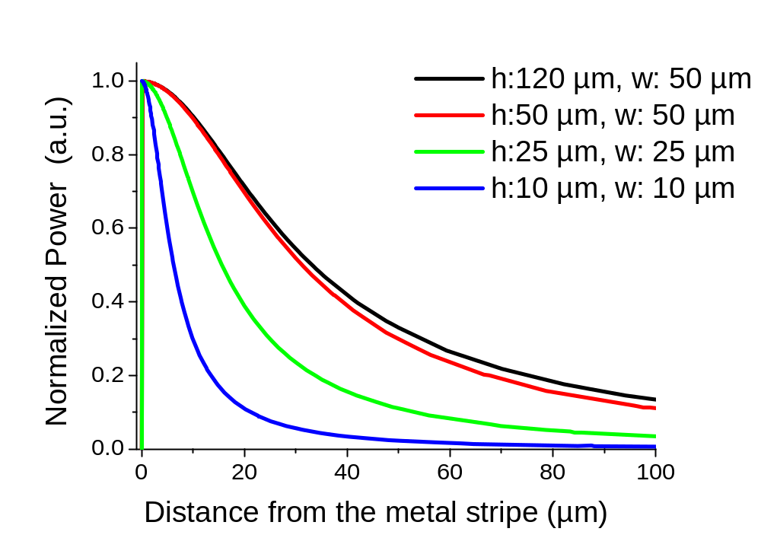
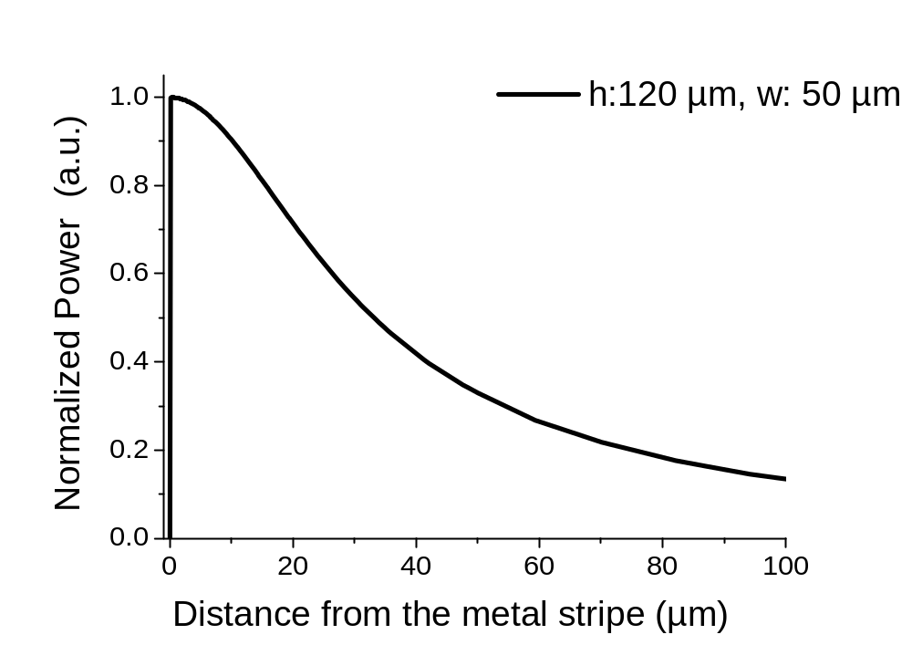
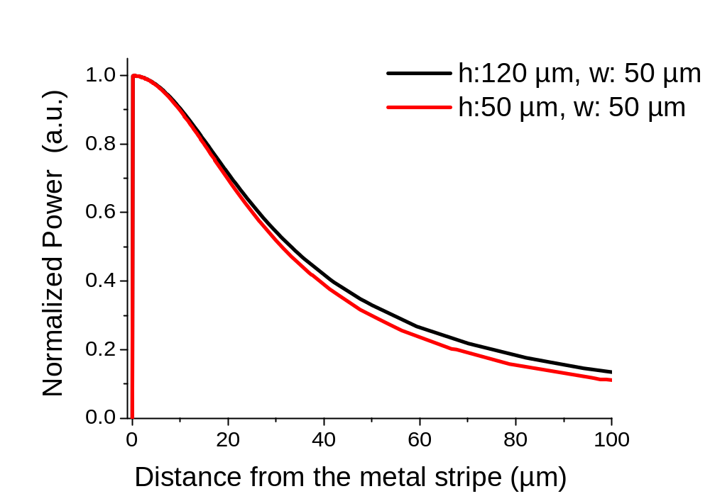

tranverse size of metal stripe
h=120 µm, w=50 µm
h=50 µm, w=50 µm
h=25 µm, w=25 µm
h=10 µm, w=10 µm
h=5 µm, w=5 µm
h
w

Slide 9
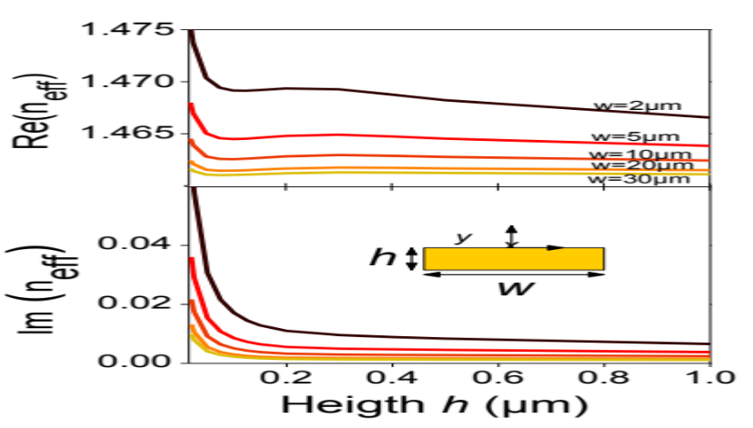

Influence of the stripe size
Frequency : 1 THz
Re(neff)  Field confinement 
Im(neff)  Field confinement 
The mode evolves into a highly confined solution as the transverse dimensions of the metal waveguide tend to zero

Slide 10
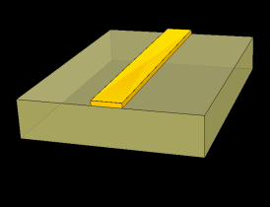
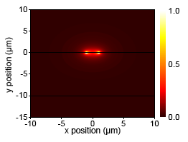
A perfectly conducting stripe supported by a dielectric layer
2/ Interaction of the EM fields with the metal surface modified by the thin dielectric layer
1 THz
Perfect electric
conductor
Existence of only one mode at 1 THz : : radial field distribution

Slide 11
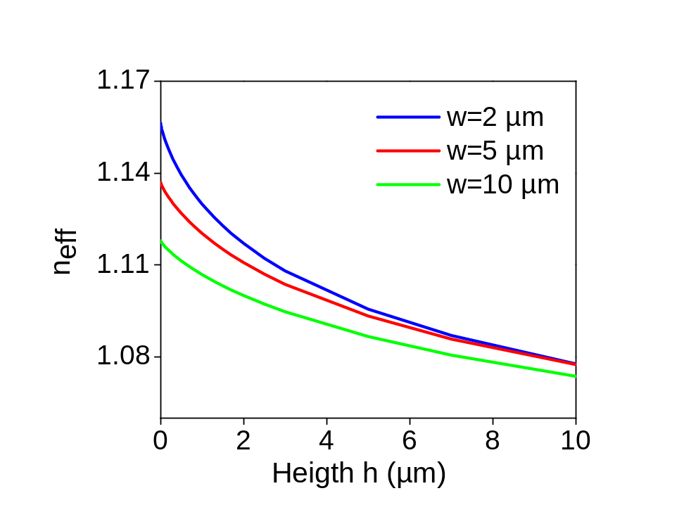
Influence of the stripe size
Frequency : 1 THz
neff  -> Field confinement 
Shrinking the transverse size of perfect conducting stripe increases the electric field confinement at THz frequencies

Slide 12


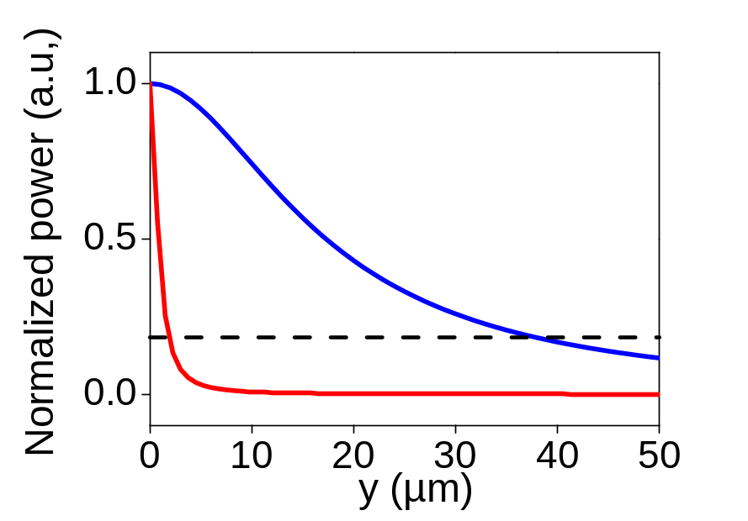
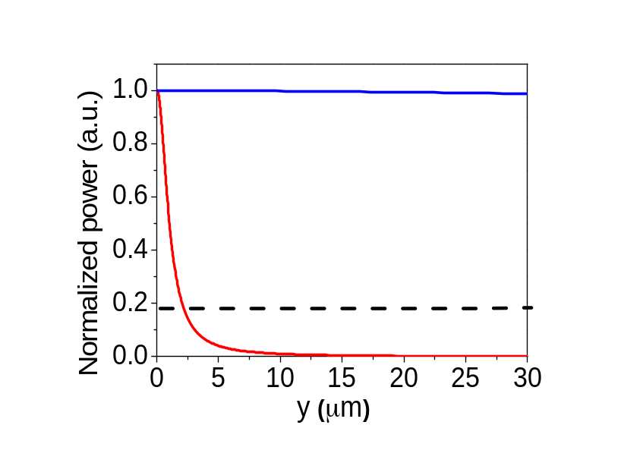
Transverse Size role
A :
w=30µm, h=10µm
B :
w=2µm, h=20nm
A
A
407µm>λ
38µm ~ λ /5
B
B
2.2µm ~ λ /93
2.2µm ~ λ /136
Frequency : 1 THz
Frequency : 1 THz
Extreme confinement (sub-λ ) of the electric field at THz frequencies whatever the binding mechanisms
D. Gacemi et al., Scientific Reports 3, 1369 (2013)

Slide 13
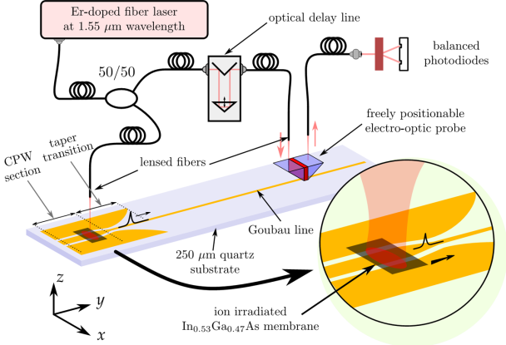
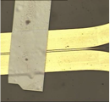
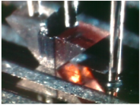
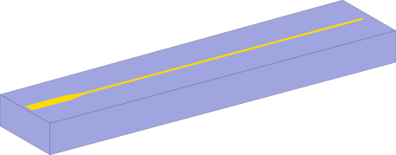
Experimental study
Guided –wave time domain THz spectroscopy
3/ Hybrid Mode : a combination of both mechanisms
metal stripe
1/ Coupling between EM fields and the free electrons at the metal surface
2/ Interaction of the EM fields with the metal surface modified by dielectric layer.
dielectric layer

Slide 14
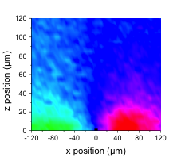
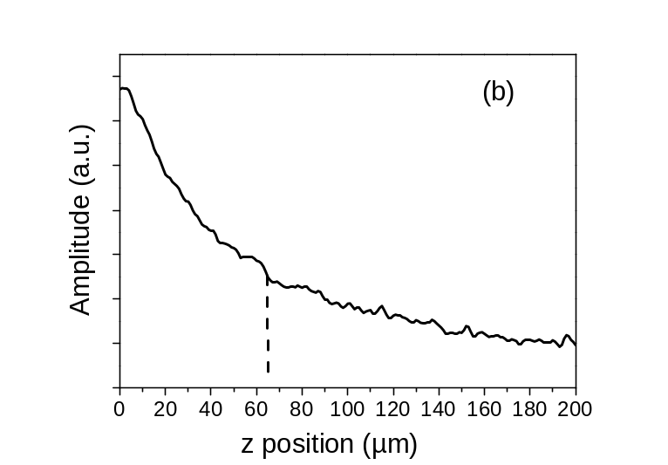
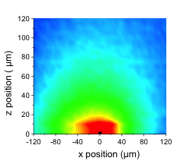
Surface mode properties
Horizontal component of E
w=10 µm , t=200 nm, quartz substrate 250 µm
D. Gacemi et al. Optics Express 20, 8466 (2012)
Vertical component of E
L_{1/e}=64.5 µm
Experimental determination of the mode confinement ~ λ/10

Slide 15
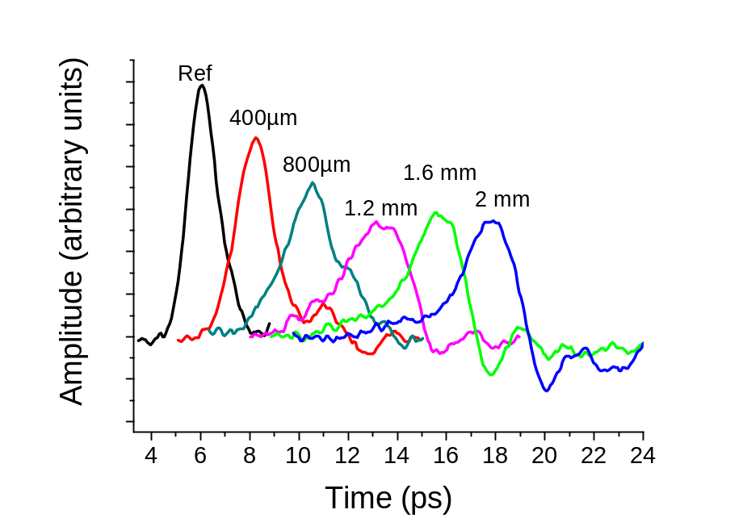
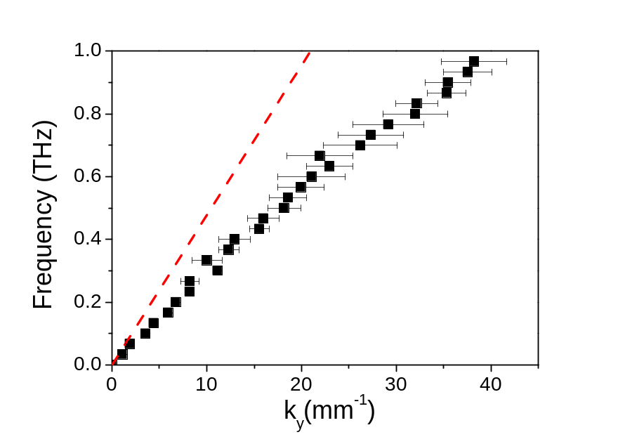
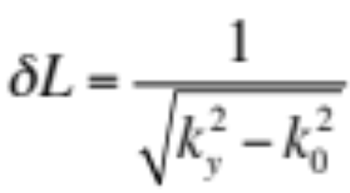
Propagation characteristics
Decay Length
at 0.5 THz, δL= 54 µm
Experimental determination of the mode confinement ~ λ/10

Slide 16
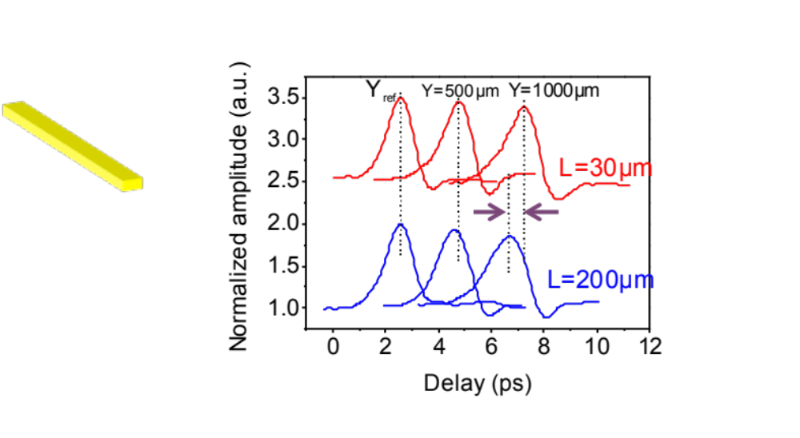
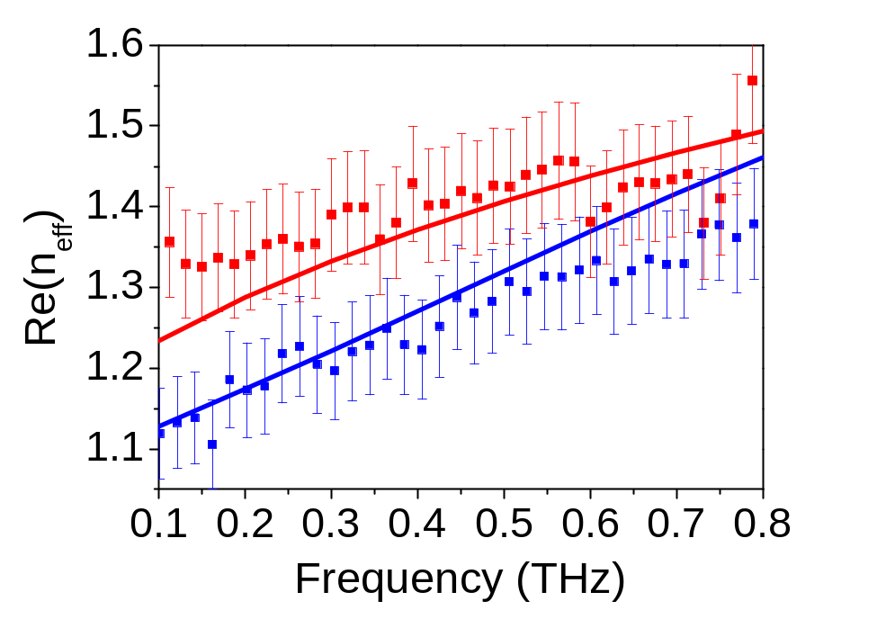
Influence of the stripe width
200 µm
30 µm
D. Gacemi et al. , Scientific Reports 3, 1369 (2013)
Reducing transverse size of a metallic structure provides a powerful tool for confinement of THz surface waves

Slide 17
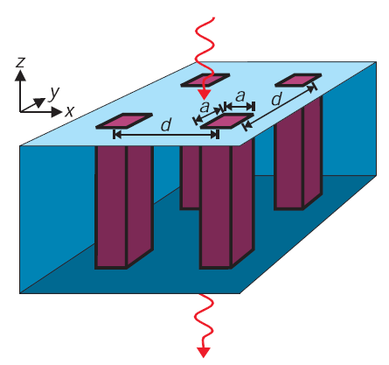
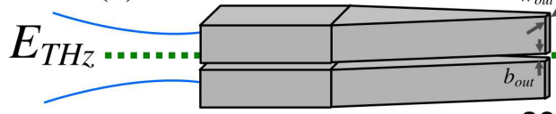
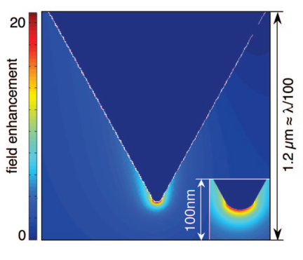
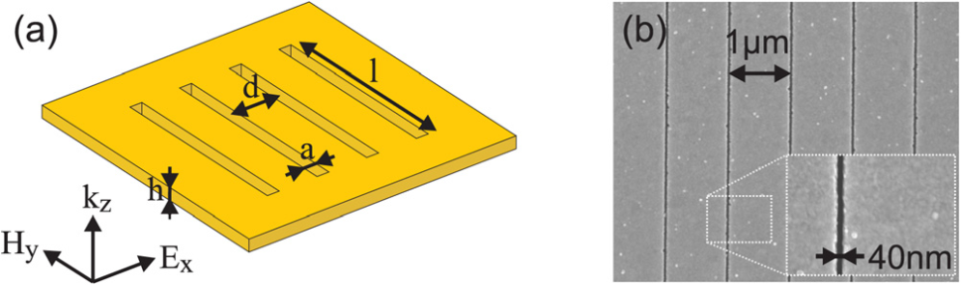
State of the art
corrugated metal
parallel-plate waveguides
~λ
λ/250
Astley, V., App. Phys. Lett. 95, 031104-031106 (2009).
Liu, J. Appl. Phys. Lett. 100, 031101-031103 (2012).
Zhan, Opt. Express 18 ,9643-9650 (2010).
Zhan, H., JOSA B, 28, 558-566 (2011).
J. B. Pendry et al., Science 305, 847 (2004)
C. R. Williams et al., Nature Photonics 2 (2008)
metal tip apexes
metallic nanoslits
λ/3000
λ/25
A.J. Huber, Nano Lett. 8, 3766-3770 (2008)
J.A. Deibel, Proc. of IEEE 95 1624-1640 (2007)
Seo M. A. et al., Nature Photon. 3, 152-156 (2009).
Sholaby M. et al, Appl. Phys. Lett. 99, 041110-041112 (2011).
All design strategies involved reduced dimensions of metal structures

Slide 18
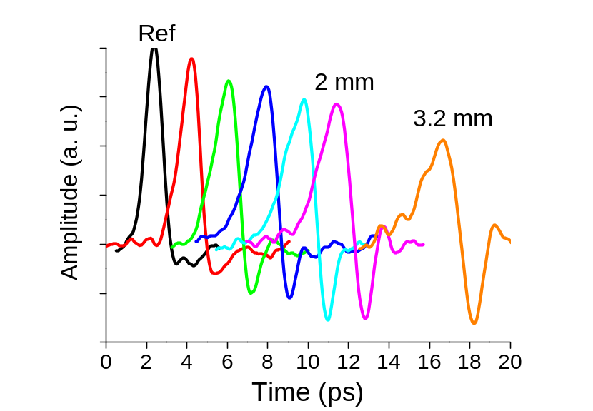
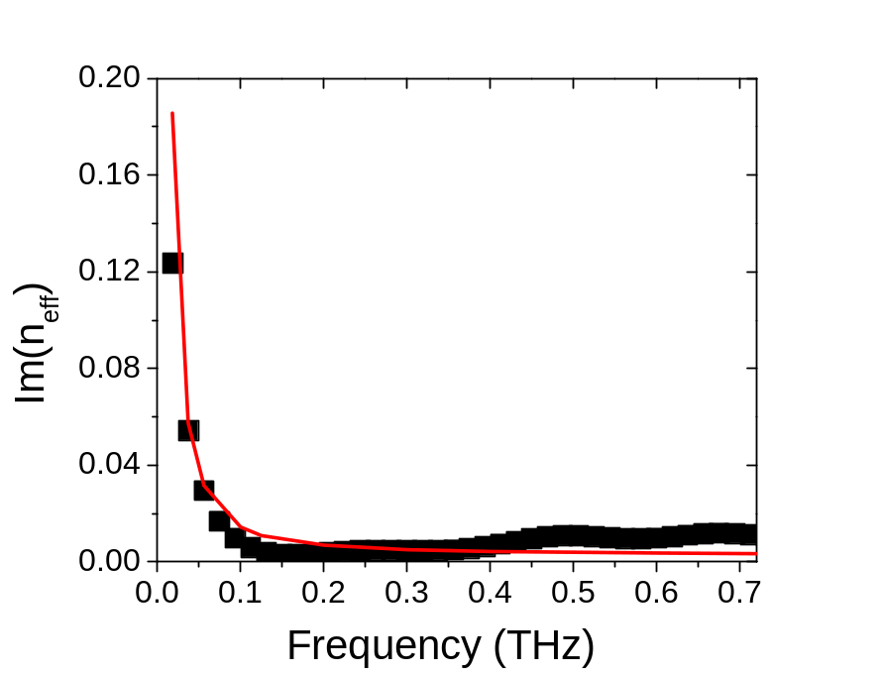
Dielectric layer properties
58 µm
200 µm
Dispersion coefficient of 0.28 ps/mm
Low losses (< 0.4 mm⁻¹) up to 0.8 THz
Performances of these single conductor waveguides are fully compatible with key THz applications

Slide 19

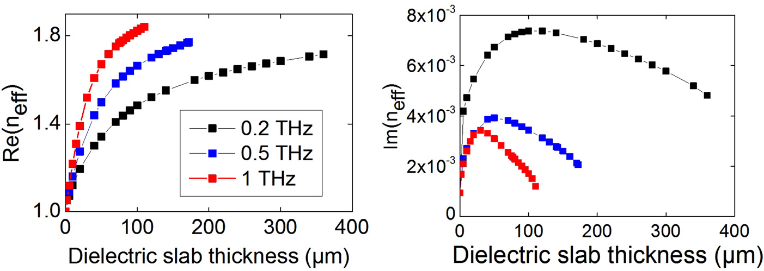
Distinct propagation regimes
D. Gacemi et al. APL 191117 (2013)
e=0, the mode is bound to the metal stripe because of its finite conductivity
a variant of a Sommerfeld wave
e ->λ_{eff}/4, the dielectric film provides additional confinement to the mode.
a Goubau mode
e>λ _{eff} /4, the mode looses its confinement to the point that it ceases to be bound beyond a certain cut-off condition.
  cut-off frequency

Slide 20
Conclusions
Size effects can be used as a simple formidable tool for high electric field confinement at THz frequencies (smaller than λ/100).
Au planar single conductor supported by thin layers of dielectric show remarkable performances
Further works :
  to generalize this result into a unified theory (universality).
  Develop Bends, Mach-Zender, Y-splitting

Slide 21


`collaborations
Institut d’Electronique Fondamentale
P. Crozat
Institut d'Electronique de Microelectronique et de Nanotechnologie
T. Akalin, J-F. Lampin, C. Blary
Laboratoire Ondes et Matière d’Aquitaine
R. Yahiaoui
Funding support from:
EMRP Researcher Grant NEW07
Research Project ‘THz Security’

Slide 22
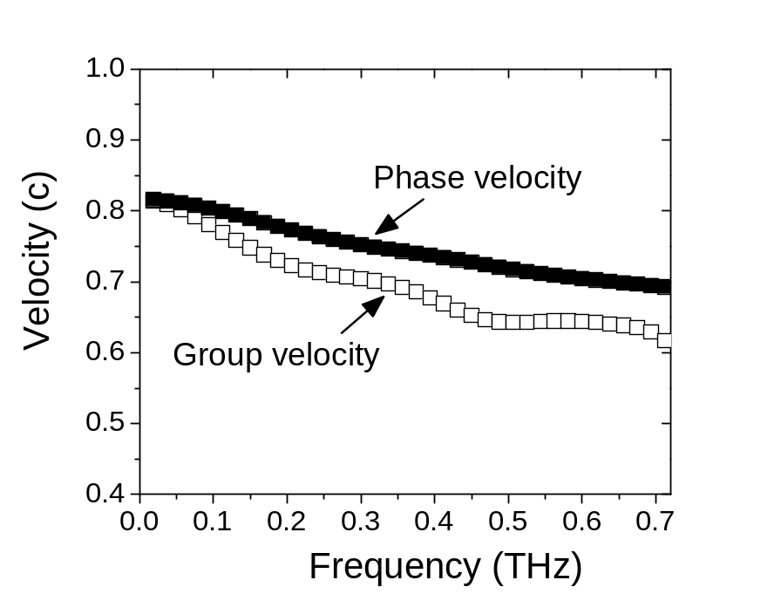
Dispersion relation
Maximum GVD of 5.6x10⁻²² s²/m
Low Losses

