Slide 1


Catch up growth：
A New Insight of Insulin Resistance
Juan Zheng, MD PHD
Nutrition and Food Science, Texas A & M university
Department of Endocrinology, Union Hospital, Tongji Medical College, Huazhong University of Science and Technology

Slide 2
T2DM is rapidly spreading in Asia
List of countries with the highest numbers of estimated cases of diabetes for 2000 and 2030
 | 2000 |  | 2030
Ranking | Country | People with diabetes (millions) | Country | People with diabetes (millions)
1 | India | 31.7 | India | 79.4
2 | China | 20.8 | China | 42.3
3 | U.S. | 17.7 | U.S. | 30.3
4 | Indonesia | 8.4 | Indonesia | 21.3
5 | Japan | 6.8 | Pakistan | 13.9
6 | Pakistan | 5.2 | Brazil | 11.3
7 | Russian Federation | 4.6 | Bangladesh | 11.1
8 | Brazil | 4.6 | Japan | 8.9
9 | Italy | 4.3 | Philippines | 7.8
10 | Bangladesh | 3.2 | Egypt | 6.7
DIABETES CARE, 2004,27
Notes:
The diabetes epidemic will affect mostly developing countries. The top four countries of people with diabetes are the same in 2000 and 2030, namely India, China, USA and Indonesia, three of them are Asian countries. The World Health Organization predicts there will be 160 million Type 2 diabetics in Asia by 2025, mostly in India and China.
人数众多
在糖尿病人口最多的五个国家中，美国排列第3位，其他4个国家均在亚洲
目前亚洲地区糖尿病患者人数有9000万左右，占全球糖尿病患者总数的三分之二左右，其中多数患者为二型糖尿病。预计到2010年，亚洲地区糖尿病患者将增至1.2亿人，而到了2025年，这一数字将逼近2亿大关。
目前，全球大约有1.5亿人受到糖尿病的困扰，据预测，到2025年，这个数字将升至3亿人，患者数量的增长大部分会来自发展中国家。据统计，全球糖尿病人口最多的10个国家是印度、中国、美国、印度尼西亚、日本、巴基斯坦、俄罗斯、巴西、意大利和孟加拉国。
List of countries with the highest numbers of estimated cases of diabetes for 2000
and 2030

Slide 3
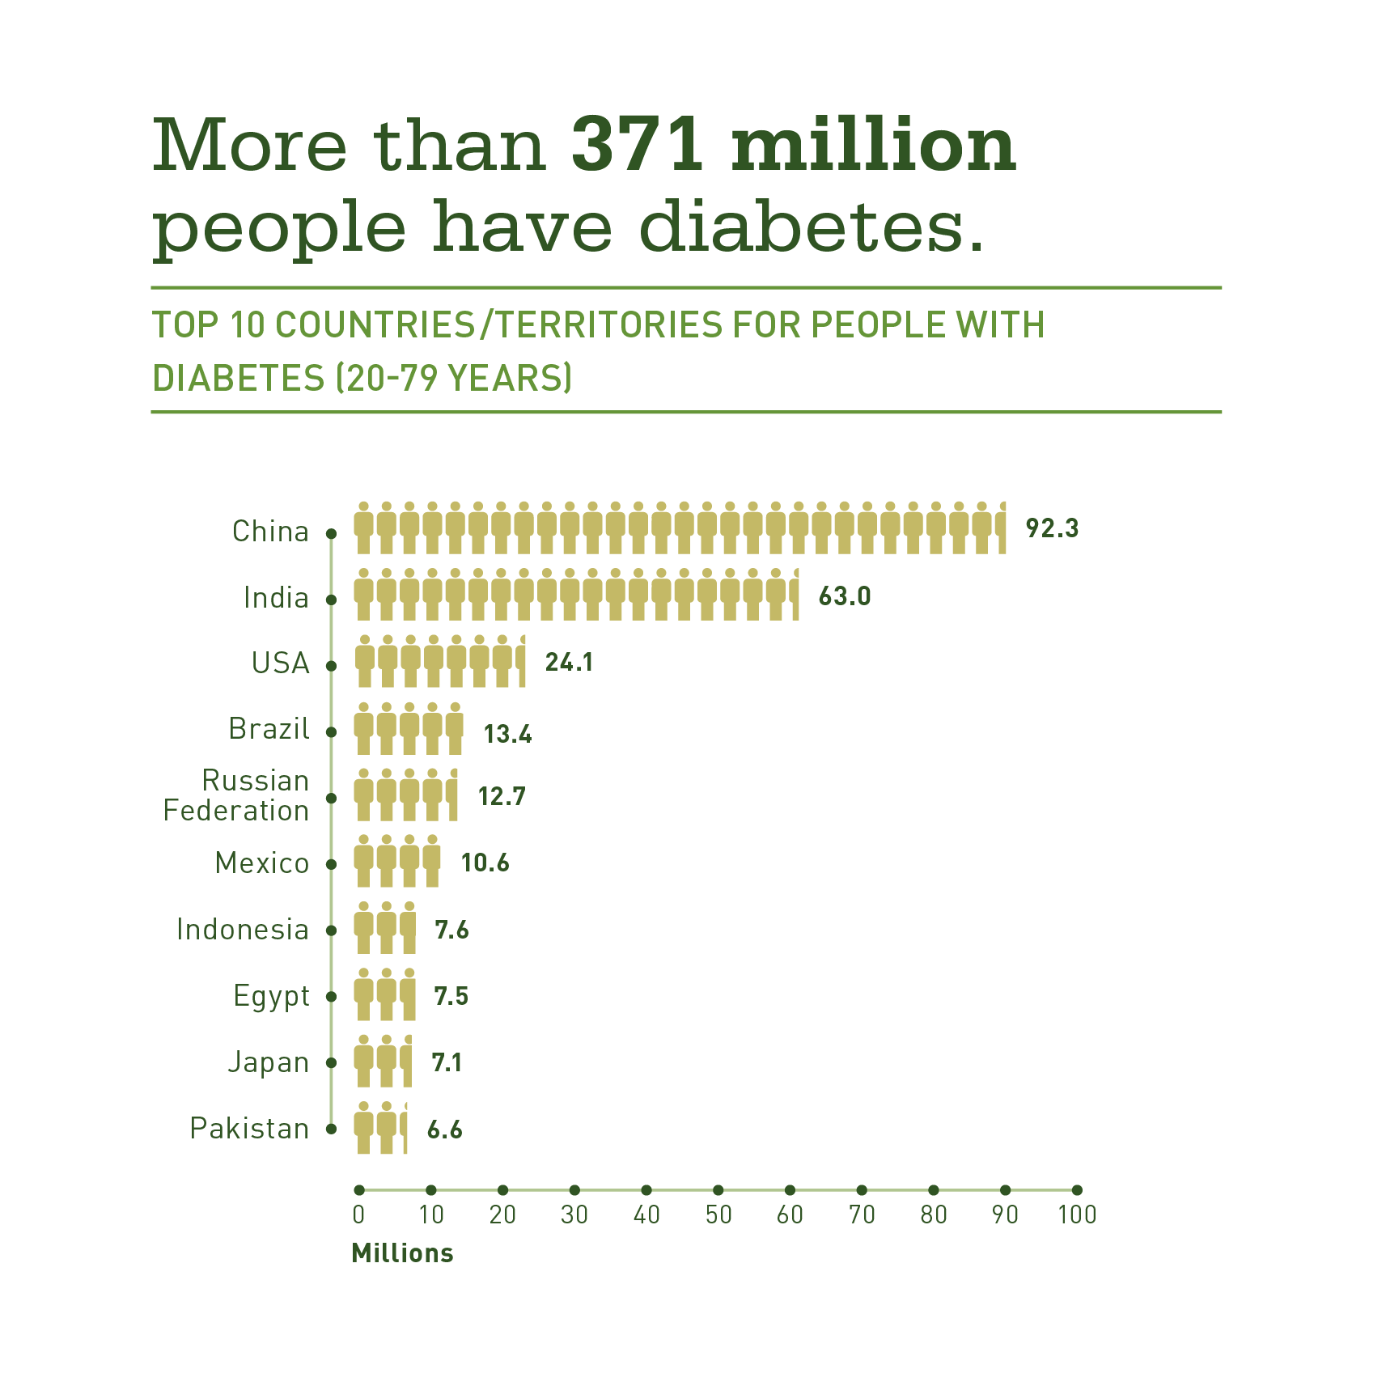
T2DM is rapidly spreading in Asia
IDF diabetes atlas 2012.
Yang W, et al. N Engl J Med. 2010; 362(12): 1090-101.

Slide 4
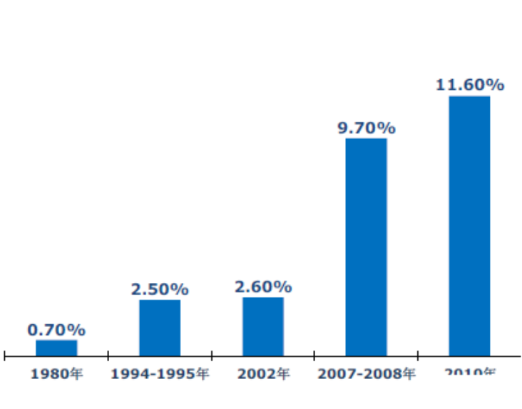
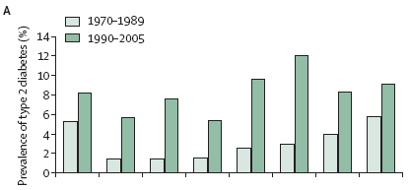

Characteristics of the T2DM Epidemic in Asia
Comparison of prevalence rates of diabetes in selected countries between 1970–1989 and 1990–2005
Comparison of prevalence rates of diabetes in China between 2010
1980 1994-1995 2002 2007-2008 2010
Yoon KH, et al. Lancet, 2006,368:1681-8.
Xu Y JAMA. 2013 Sep 4;310(9):948-59.
Notes:
亚洲增长迅猛
图注解： In the USA, the prevalence of type 2 diabetes has doubled—from 4% to 8% during the past 40 years. But although this is dramatic, increases in newly developed and developing countries in Asia have been even greater.
In Chinese adults, the prevalence tripled between 1980 and 1996, from about 1·0% to 3·2%.
The data from the Indian subcontinent are equally disconcerting, and the same trend can be seen in other countries in the region. For example, the prevalence rates of type 2 diabetes in Korea, Indonesia, and Thailand have also increased three-fold to fi ve-fold
during the past 30 years.
Thus, although the prevalence of type 2 diabetes in Asian countries is currently similar to (or only slightly higher than) that in the USA, the rate at which diabetes has increased during the past three decades and the likelihood that it will continue to increase at this rate, provide substantial grounds for concern.
Figure 1: Comparison of prevalence rates of diabetes in selected countries
between 1970–1989 and 1990–2005
(A) Prevalence of diabetes in selected nations. (B) Multiplication factor（倍增系数？）for
change in prevalence of diabetes in selected nations between 1970–1989 and
1990–2005.
台湾当前状况就是中国大陆的未来发展趋势。
In subsequent national surveys conducted in 1994 and 2000-2001, the prevalence of diabetes was 2.5% and 5.5%, respectively.

Slide 5
Rapid recovery of nutrient status in China
≈230%
≈ 24%
≈ 350%
≈ 80%
Food consumption (kcal/day)
T2D in adult
≈ 250%
≈ 20%
Trends in the dietary supply of fat fold change in 30 years(kcal/day)
http://www.who.int/nutrition/topics/3_foodconsumption/en/index.html
Notes:
柱形图重新做，去掉world，增长率标出
对比糖尿病患病率增加情况
我想把east Asia改成中国，把industrialized 改成北美
5

Slide 6


Catch up growth ------ in Concentration Camps
Starvation
Refeeding
Refeeding
Metabolic
Diseases
(Catch-up growth in adult, CUGA)
the importance of weight recovery in the associations between weight fluctuations and later cardiovascular risk
Dulloo AG. Acta Physiol Scand 2005; 184: 295–307 Stapleton T. Lancet 1946; 1: 850– 851.
Notes:
the importance of weight recovery in the associations between weight fluctuations and later cardiovascular risk factors may be reflected in the phenomenon of ‘Refeeding Metabolic Diseases’ . Episodes of hypertension were observed in malnourished British prisoners of war during the period of recovery from semi-starvation。The incidence of the disease increased markedly in all age groups, and could not be
accounted for by changes in age and sex distribution。
二战期间，关押在集中营Concentration Camps的人们营养状况变得极其糟糕，这些人在战争结束后营养状况得到改善，表现出明显的追赶生长，令当时代科学家惊奇的是，该类人群相对更易罹患胰岛素抵抗相关的代谢性疾病，并且发病速度非常之快。

Slide 7
Catch up growth
Nutritional rehabilitation after malnutrition could motivate catch-up growth, which is characterized by rapid growth following a temporary period of growth retardation.
The term was first introduced by Prader in 1963. Induced by famine and disorders such as anorexia nervosa, renal disease, Cushing’s syndrome, celiac disease, and hypothyroidism.
Now it is confirmed that catch-up growth is closely correlated with insulin resistance.
Good or bad?

Slide 8
Types of catch-up growth
Early catch up growth Intrauterine growth restriction (IUGR)
  Born small but catch up in weight and height in infancy or early childhood
Late catch up growth
  Children who may or may not be born small, but became stunted in infancy, childhood or adulthood and catch up later in weight, becoming ‘stunted-obese’
  Wars and famine
  Rapid economic development in developing countries
  Migration from rural to urban settings
  Rehabilitation from chronic diseases; refeeding hypertension
  Yo-yo phenomenon (weight suppression by low caloric diet, and weight rebound later)
Paul Ernsberger JAMA. 1993;269(9):1116.
Victora CG, Barros FC. Int J Epidemiol, 2001, 30:217-220.
Notes:
As the rapid economic development or migration from rural to urban settings, malnourished children in poor countries are increasing exposed to Western diets in adults, and have a higher risk of obesity-related diseases.

Slide 9
Correlation between catch-up growth and metabolic syndrome
Exposure to the 1958-1961 Chinese famine(estimated the number of famine victims to be between 20 and 43 million) increased the risk of metabolic syndrome in later life
Urban -- Urban
Rural -- Urban
Rural to urban
Urban
IGT
T2D
Hypertension
Ms
Dyslipidemia
≥3 risk factor
* P<0.05; Δ P<0.01
BMC Public Health 2012, 12:675
HAINAN MEDICAL JOURNAL 2013, 6, 899-903

Slide 10

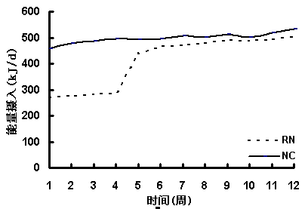
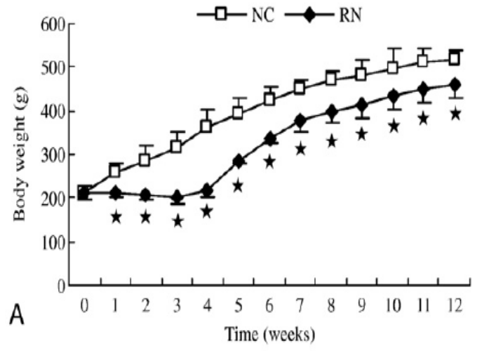

Animal model
追赶生长
Food intake(kcal)
正常生长
CR
CR 4 weeks
refeeding
Normal chow and HFD

Slide 11
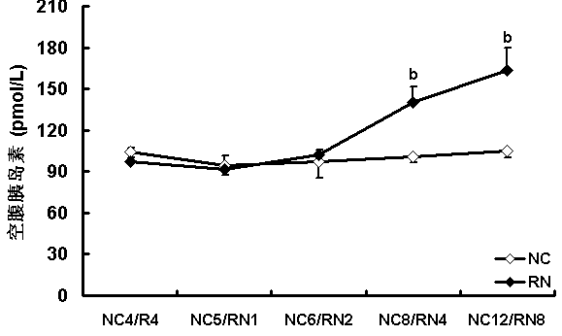
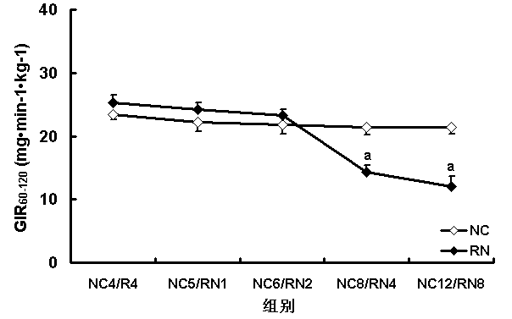
Insulin resistance without overweight
Food intake(kcal)
Insulin ( pmol/L)
GIR60-120(mg.min-1.kg-1
weeks
Body weight(g)
weeks
ªp<0.05 vs. NC; ^{b}p<0.01 vs. NC
Notes:
Body weight The body weight increased moderately in NC groups, while its growth was retarded during caloric restriction and elevated rapidly and dramatically after refeeding in RN groups(★P<0.05）.
Body length RN groups did not display any obvious changes in their body length either after caloric restriction for 4 weeks or refeeding for 1 week, while a swift growth was observed after refeeding for 2, 4, 8 weeks. Their body length is significantly lower than that of NC groups in the whole process of caloric restriction and refeeding(★P<0.05）.
Lee index The Lee index in RN groups was remarkably higher than that in NC groups while refeeding 1, 2 weeks after caloric restriction (★P<0.05）.

Slide 12
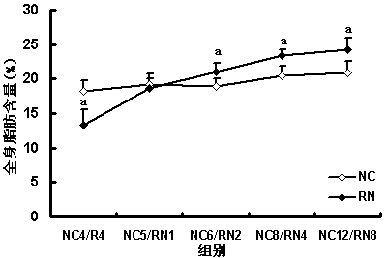
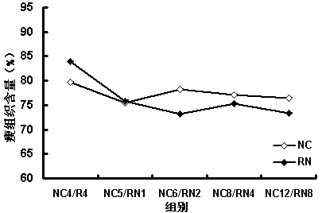
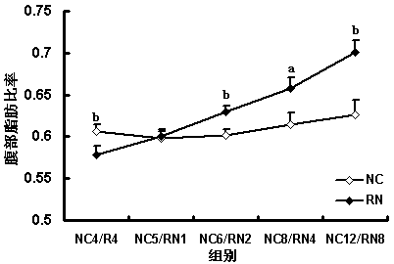
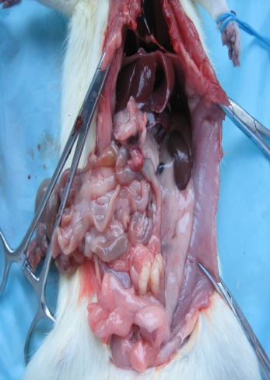
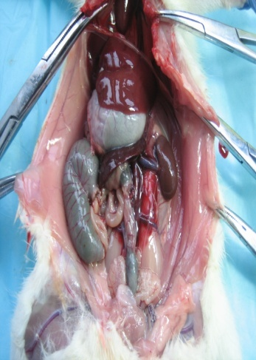
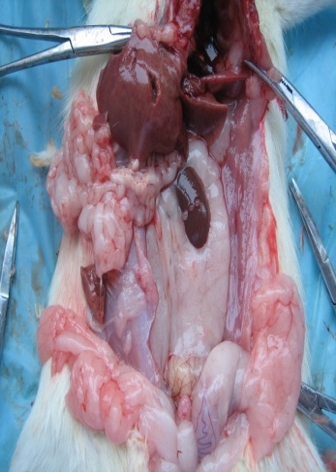
Catch up fat---dual x-ray absorptiometry (DEXA)
Lean mass
Fat mass
Lean mass
NC
R4
RN
ªp<0.05 vs. NC; ^{b}p<0.01 vs. NC
Notes:
Body fat percentage of visceral adipose tissue The body fat percentage of visceral adipose tissue in RN groups was much lower after caloric restriction for 4 weeks while greater after refeeding for 2, 4, 8 weeks compared with NC groups（★P<0.05）.
Body fat percentage of subcutaneous adipose tissue RN and NC animals displayed no differences in body fat percentage of subcutaneous adipose tissue（P>0.05）.
Constituent ratio of various adipose tissue depots The constituent ratio of various adipose tissue depots (subcutaneous, Perirenal, Epididymal) gradually decreased, increasingly elevated, and stood still individually during the course of refeeding.

Slide 13
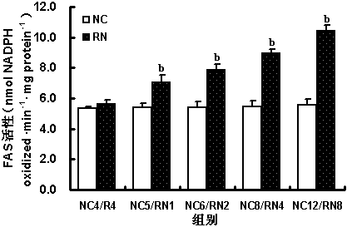
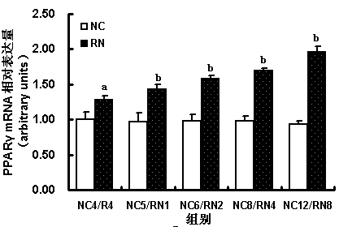
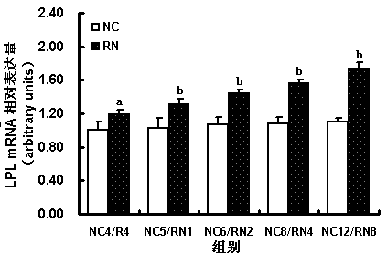
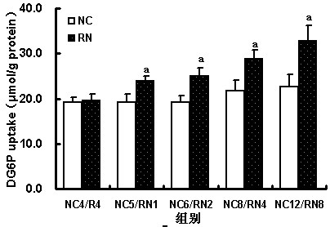
Increased WAT lipogenesis
FAS activity (nmol of NADPH oxdized.min-1mg protein)
PPARγ mRNA expression (fold change)
LPL mRNA expression (fold change)
ªp<0.05 vs. NC; ^{b}p<0.01 vs. NC

Slide 14
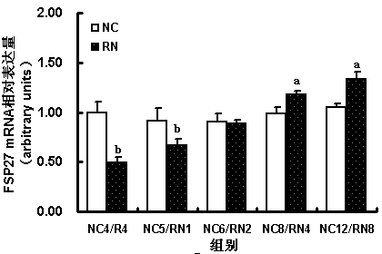
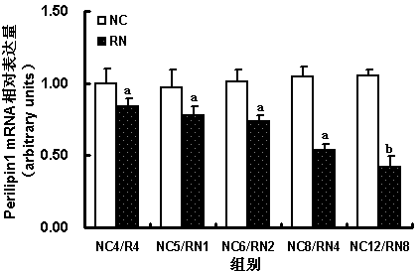
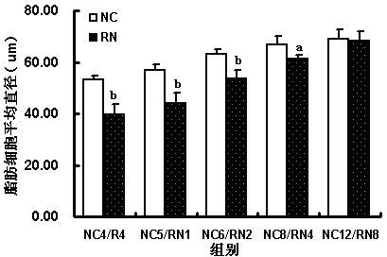
lipid storage –decreased by CR increased after refeeding
FSP27 mRNA expression (fold change)
Perilipin1 mRNA expression (fold change)
Average diameter of Adipocytes
ªp<0.05 vs. NC; ^{b}p<0.01 vs. NC
Notes:
lipid droplet-associated protein
lipid droplet formation

Slide 15
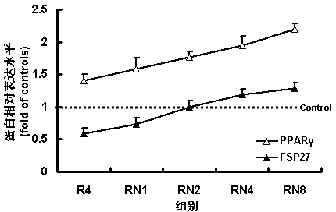
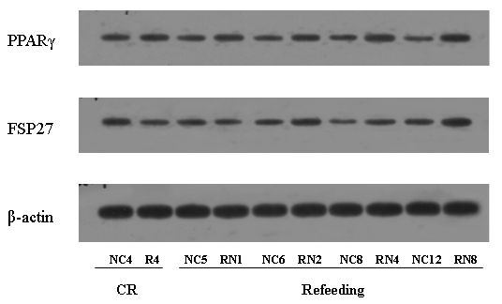

Slide 16
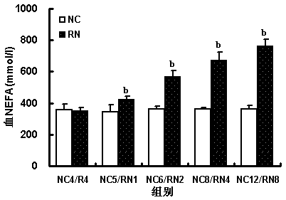
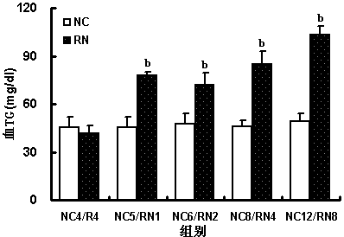
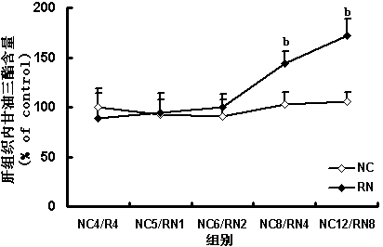
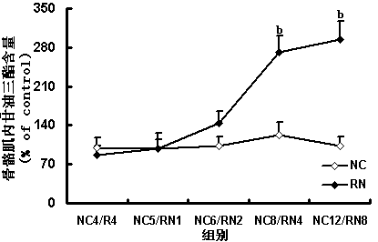
ectopic lipid deposition
Blood NEFA (mmol/L)
Blood TG (mg/dl)
muscle TG( %of control)
liver TG( %of control)
ªp<0.05 vs. NC; ^{b}p<0.01 vs. NC

Slide 17
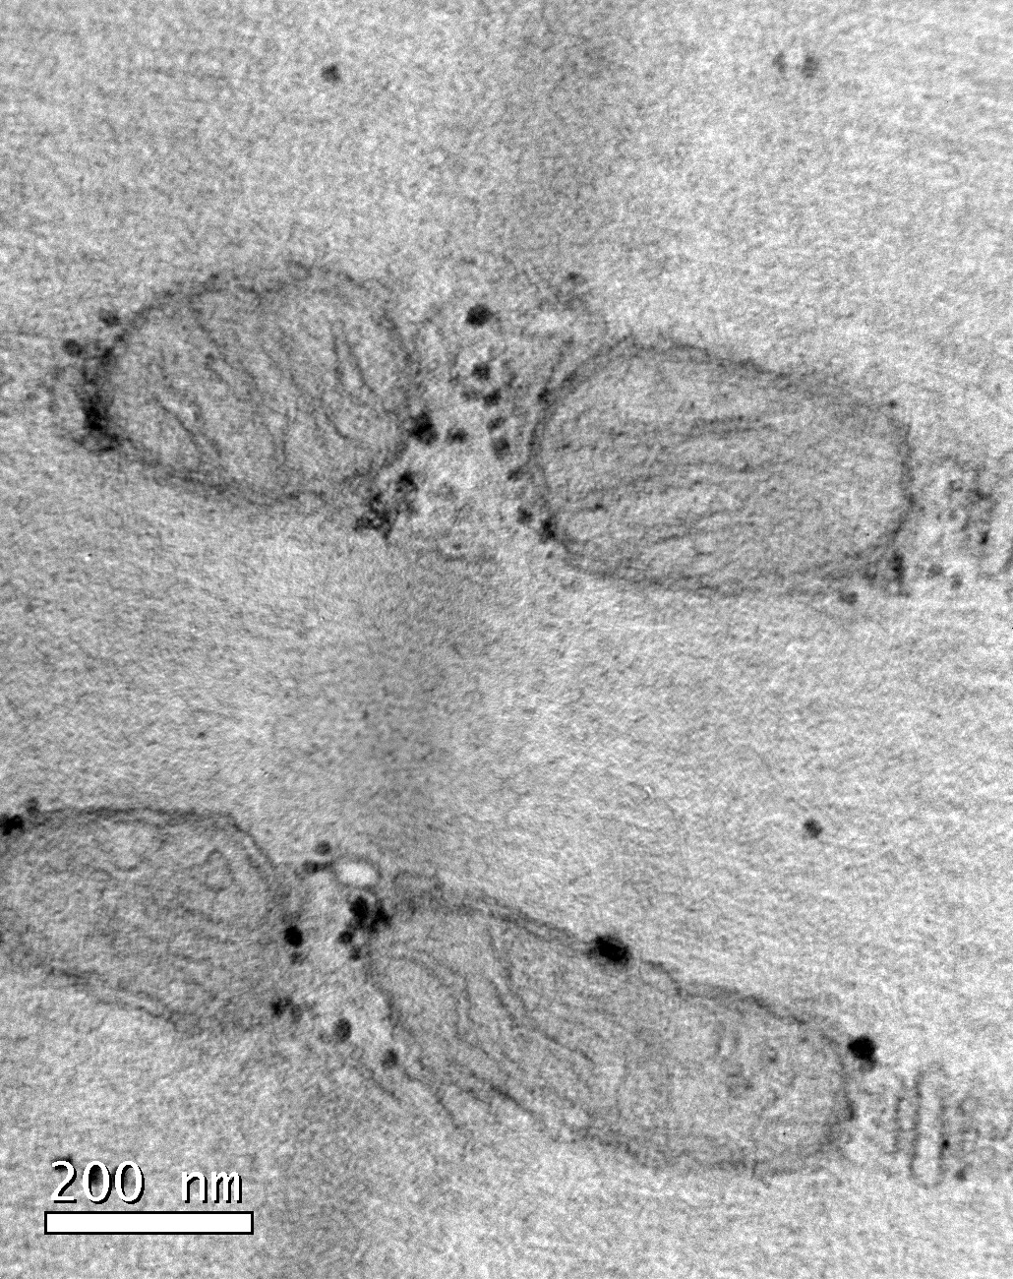

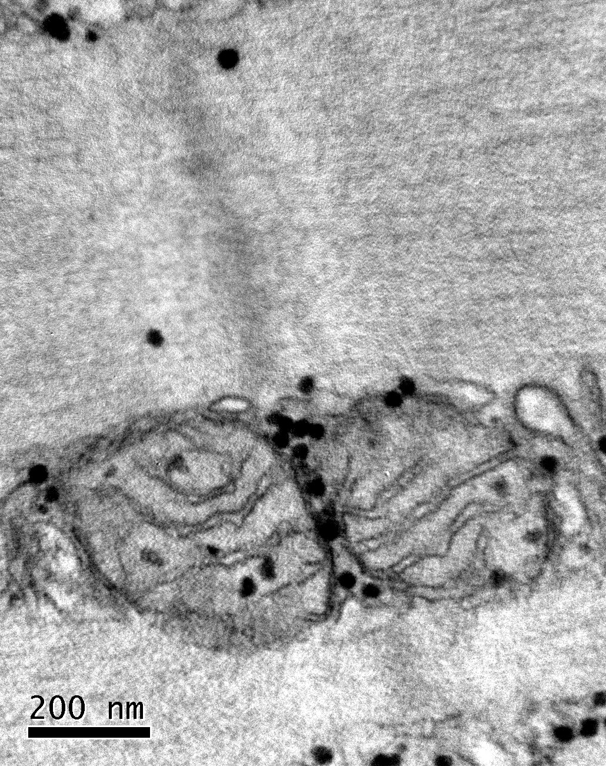

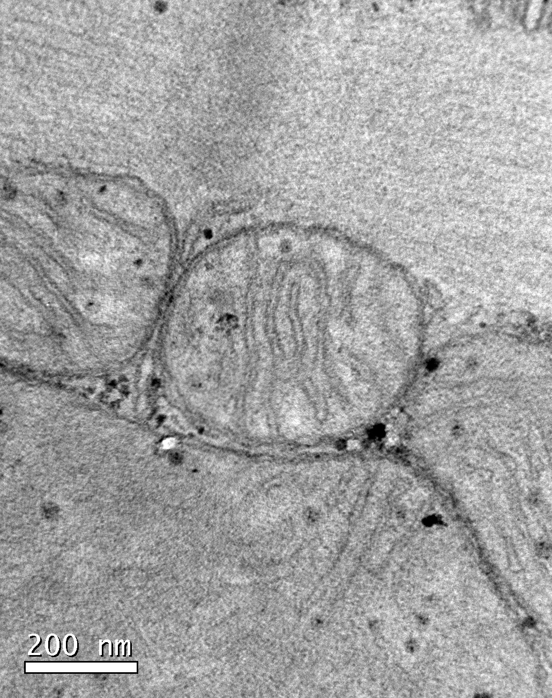
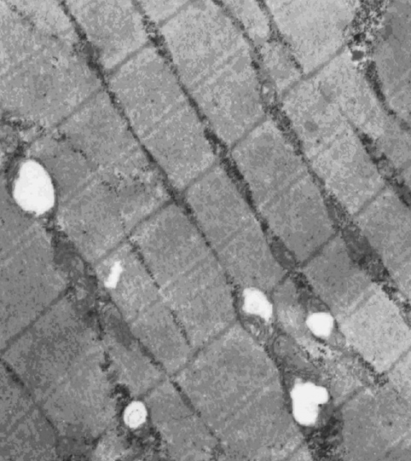
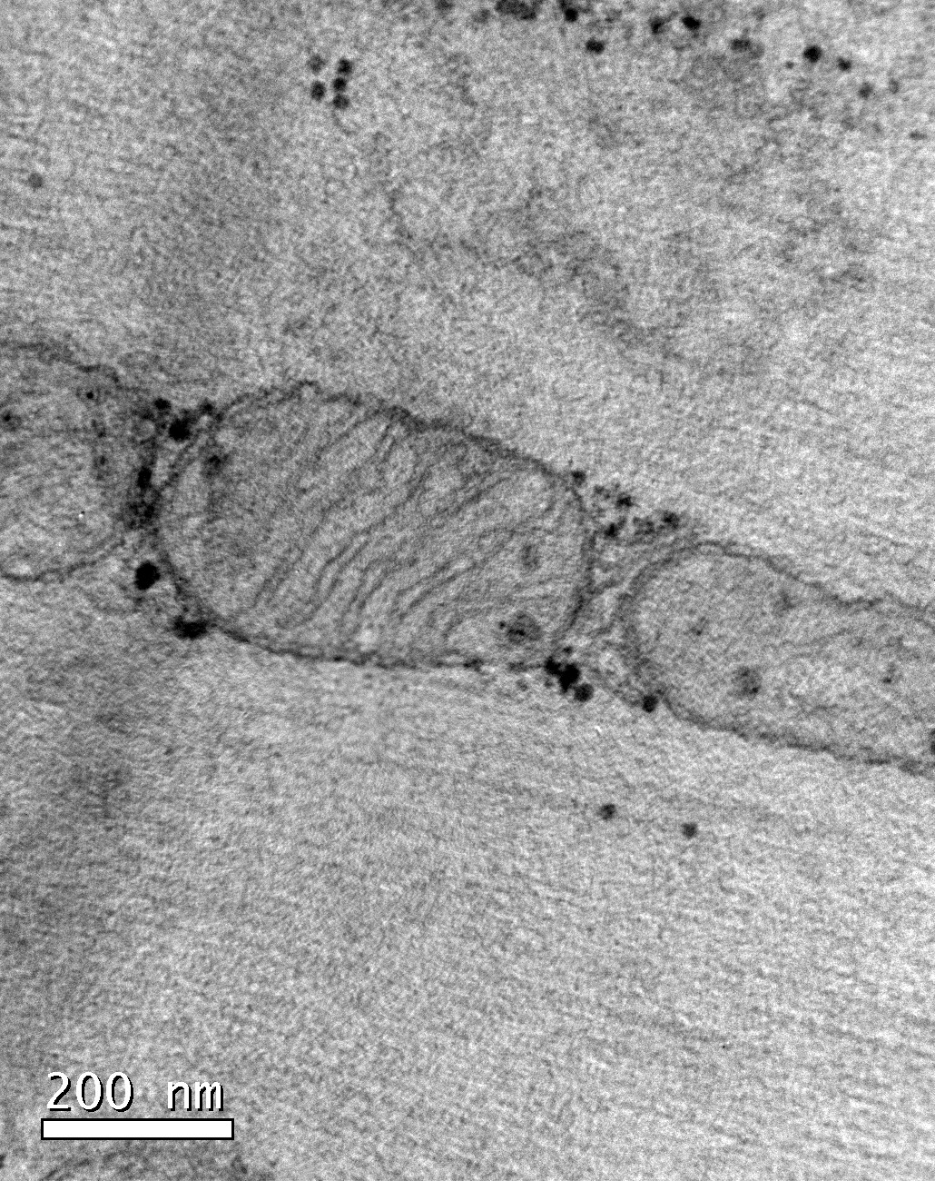
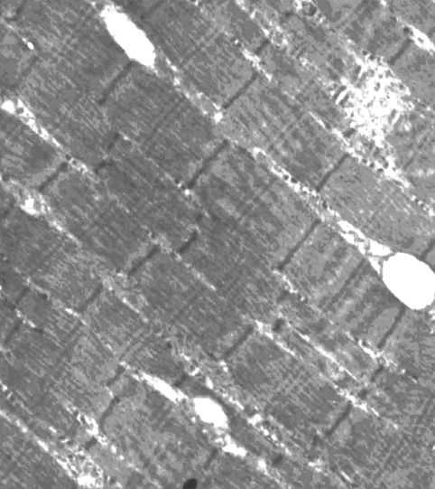
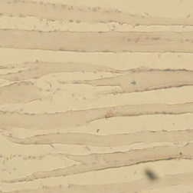

Decreased skeletal muscle mitochondrian
Transmission electron microscopy
grids count
NC: Normal chow controls CR: Caloric restriction
*
*
*
Catch-up growth for 2 weeks Catch-up growth for 4 weeks
NC
*
*
Oil red O staining
*
CUG
Juan Zheng, et al. Metabolism. 2012 Jul;61(7):954-65
* P<0.05;

Slide 18
Decreased skeletal muscle mitochondrial biogenesis

Slide 19
SOD, CAT activity and MDA level in skeletal muscle
oxidative stress might participate in the development of insulin resistance during the catching-up model
★ P<0.05 vs. age-matched NC groups
Notes:
SOD(Superoxide Dismutase) and CAT(Catalase) are known as the key enzymes that can clean the free radicals. So the activity of SOD and MDA could reflect the the level of oxidative stress. MDA (malonaldehyde) is the end production of the lipid oxidation and reflect the degree of lipid accumulation.
与正常组相比，追赶2周时SOD和CAT活性显著下降，且于追赶4周和8周持续存在并加重。于追赶4周和8周MDA 水平也出现显著升高
the activities of SOD and CAT were significantly lower in R4N2 group than N6 group,and during late catching-up time the expression of their activities declined gradually;and the level of MDA catch-up groups was higher than their control groups separately .
We found that during the late catching-up time the acivity of SOD and CAT in muscle were significantly declined,but the level of MDA in skeletal muscle was increased, coinstantaneous with the insulin resisitance. It indcated with oxidative stress might participate in the development of insulin resistance during the catching-up model.

Slide 20
Characteristics of insulin resistance induced by Catch-up growth
Four weeks refeeding （Normal diet with age-matched calorie） after caloric restriction could induce insulin resistance.
Normal weight, with obvious lipid accumulation, especially visceral fat.
Catch-up growth, which is widely spread and serious across the planet, is probably of utmost importance as a causative factor in increasing diabetes prevalence.

Slide 21
Probable mechanism of Catch-up growth & insulin resistance
The persistent imbalance of lipogenesis/fat storage capacity induced by CR might promote lipid overflow and ectopic lipid accumulation during refeeding, which induces the development of insulin resistance in catch-up growth
Mitochondria loss (decreased during caloric restriction, and did not restore after refeeding) induced impaired substrate oxidation and bioenergetic support mitochondrial : particular relevance.
Damaged antioxidant system and enhanced oxidative stress: important pathogenesis.

Slide 22

THANKS

