Slide 1
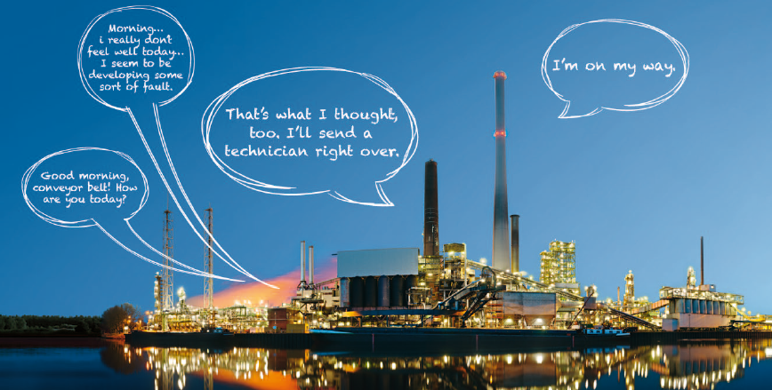

Internet de las Cosas
Internet des Objects
Internet der Dinge
The Internet of Things (IoT)

Slide 2
Context Aware Systems for Unstructured Environments Based on WSNs
Dr. Juan R. Pimentel
Professor, Kettering University
CEO, LeSoft LLC

Slide 3
What is the IoT ?
Whatever it is, The Internet of Things (IoT) changes Everything!
It is a game changer.
It will be HUGE !
“IoT will change the way people live, work and play.”
"It will be bigger than anything that's ever been done in high tech."
John Chambers, Cisco Chief Executive Officer.

Slide 4
How big will it be ?
By 2020 there will be 212 Billion interconnected devices.
Or about 18 devices per person by that date.
By 2020 the IoT will be a 8.9 Trillion Dollar Industry.
Or about x 2.4 the current U.S. Federal budget
Source: www.zdnet.com

Slide 5
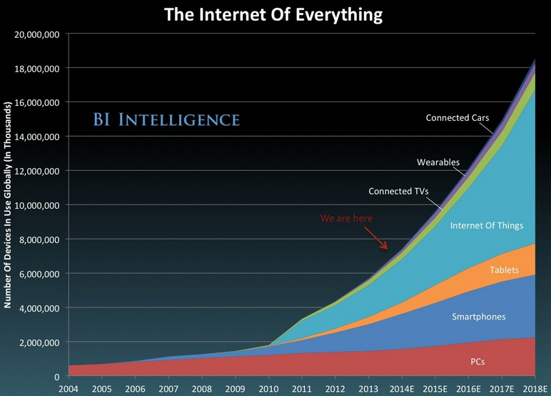
How big will it be ?

Slide 6
Why Does it Matter?
The IoT is connecting new places–such as manufacturing floors, energy grids, healthcare facilities, and transportation systems–to the Internet.
When an object can represent itself digitally, it can be tracked, monitored, and controlled from anywhere → SMART OBJECTS
This connectivity means more data, gathered from more places, with more ways to increase efficiency and improve safety and security.
Source: www.cisco.com

Slide 7
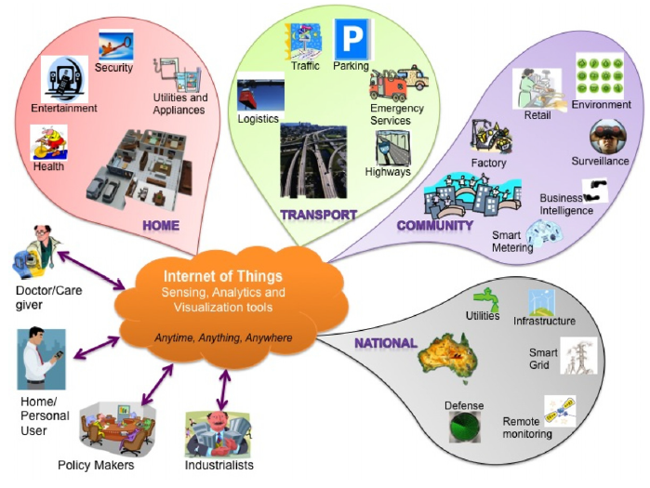
IoT Smart Objects

Slide 8
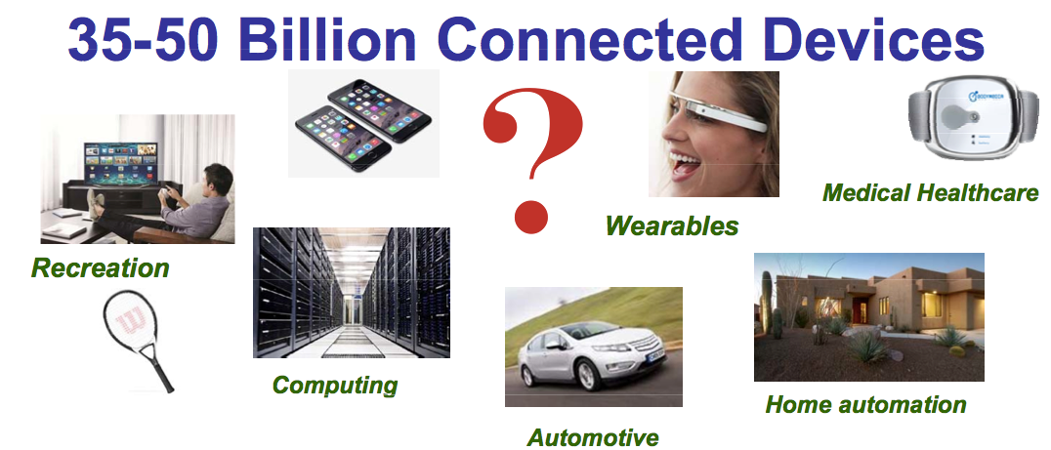
IoT Applications
Jim Feldhan, Semico Research, Market Dynamics Driving the Internet of Things, Presented to Semicon Japan, December 4, 2014

Slide 9
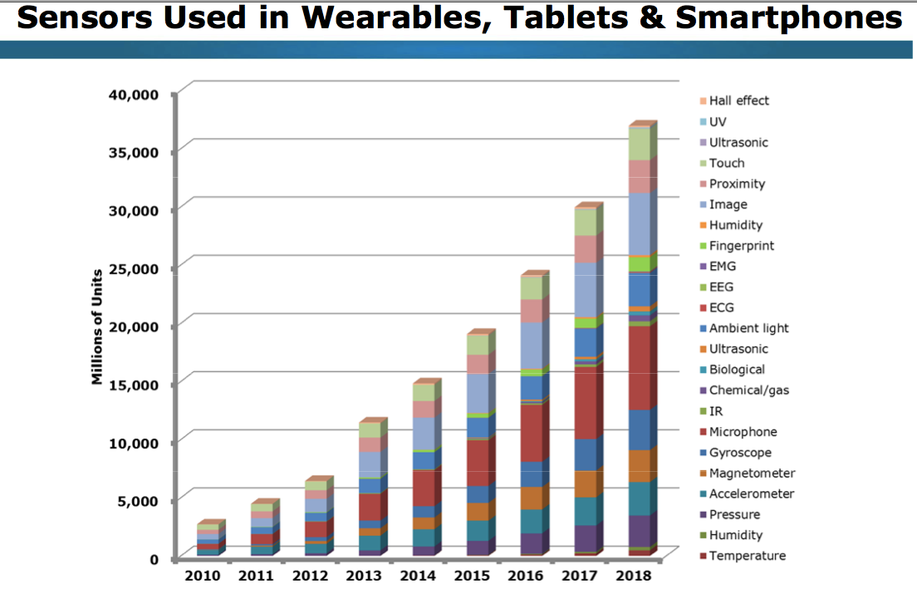
Sensors Are Part of IoT
Jim Feldhan, Semico Research, Market Dynamics Driving the Internet of Things, Presented to Semicon Japan, December 4, 2014

Slide 10
Key Technologies Behind the IoT
Tiny sensors with incorporated rf links
Small sensors
Low cost computers with Internet links
Instrumentation
Smart phones, tablets
Wireless networks: WSN, Industrial networks
Cloud computing
Service oriented architectures and products
Context Aware
SDN
SDR
Internet security & safety
IPv6

Slide 11
IoT Environments
STRUCTURED
Homes, Building, Factories, Hospitals, Automobile
UNSTRUCTURED
Anything else
However the characteristics of these environments are quite different.
This has implications on how they are designed and deployed, particularly the IoT DEVELOPMENT PLATFORM

Slide 12
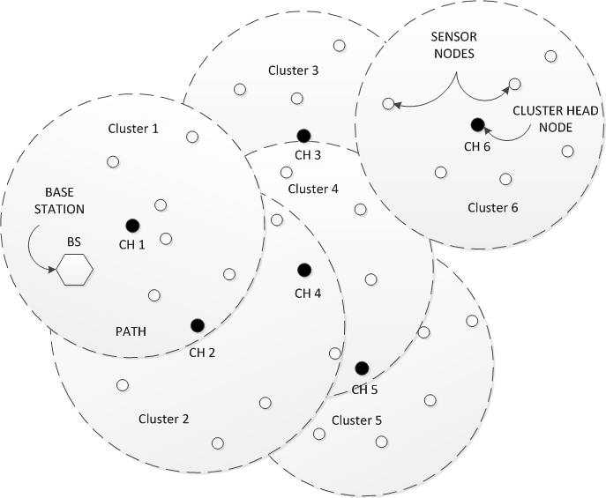
Unstructured IoT Environments: WSNs
Wireless Sensor Networks

Slide 13
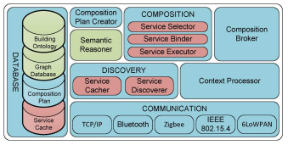
Features of a Building Automation Development Platform
Device type
Communication
  protocol
Service Discovery
Service composition
Context Aware
Dynamic Composition
Semantic Database
Semantic Web
Intelligence
  Reasoning
HAN et al.: SEMANTIC CONTEXT-AWARE SERVICE COMPOSITION FOR BUILDING AUTOMATION SYSTEM, IEEE Trans. Ind. Informatics, Feb. 2014.

Slide 14
Features of a Factory Automation Development Platform
Process modules (e.g., control systems, beyond devices)
Module web service interface
Variable and signal discovery
Variable mapping
Protocol stack mapping
Web services

Slide 15
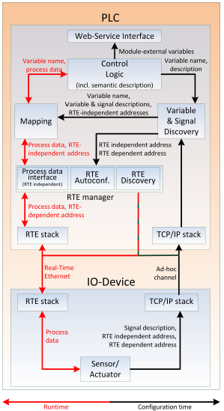
Features of a Factory Automation Development Platform
L. DURKOP et al.: A field level architecture for reconfigurable SOA-based real-time automation systems, IEEE Int. Symp. On Industrial Systems, June. 2014.

Slide 16
Comparison of Structured and Nonstructured Environments
 | Sensors | Access Networks | Operations | Processing Entity | SOA | Web Services | Platform
STRUCT | Well known | Well known | Specific | Device | Yes | Yes | Fixed
UNSTRUCT | Wide variety | Wide Variety | Generic | Event | Yes | Yes | Flexible
CONCLUSION: Non Structured IoT Environment need IoT Development Platforms that deal with:
Complex
Flexible
Context Aware
Dynamic networks of mobile users with unpredictable and unstable behaviors.

Slide 17
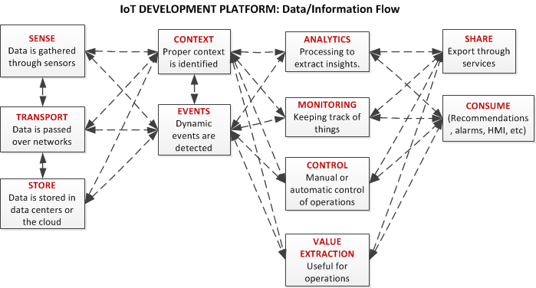
Features of a IoT Development Platform for Unstructured Environments

Slide 18
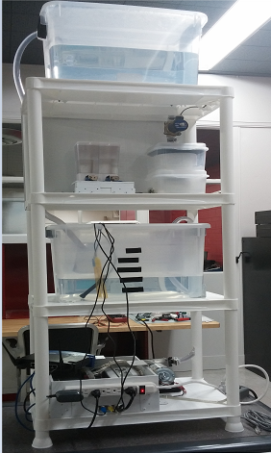
Example Projects Implemented on IoT Platform for Unstruct. Env.
A Test Bed for a Water Treatment Process (WTP) featuring:
Wireless communications
Sensor array
  pH
  ORP
  DO
  Water Flow
pH Automatic Control
SCADA: Monitoring and Control
Mobile Apps
  Process App
  Operator/Teaching App

Slide 19
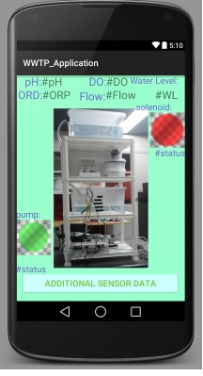
Example Projects Implemented on IoT Platform for Unstruct. Env.
A Test Bed for a Water Treatment Process (WTP) featuring:
Wireless Communications
Sensor array
  pH
  ORP
  DO
  Water Flow
pH Automatic Control
SCADA: Monitoring and Control
Mobile Apps
  Process App
  Operator/Teaching App

Slide 20
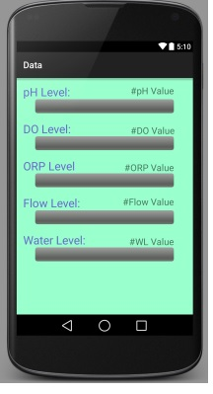
Example Projects Implemented on IoT Platform for Unstruct. Env.
A Test Bed for a Water Treatment Process (WTP) featuring:
Wireless Communications
Sensor array
  pH
  ORP
  DO
  Water Flow
pH Automatic Control
SCADA: Monitoring and Control
Mobile Apps
  Process App
  Operator/Teaching App

Slide 21
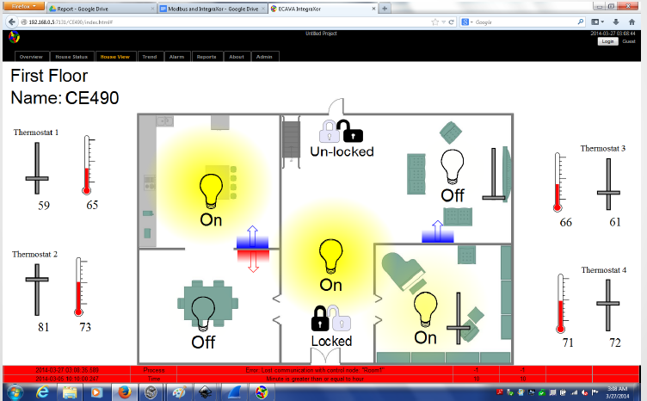
Example Projects Implemented on IoT Platform for Unstruct. Env.
Smart Home

Slide 22
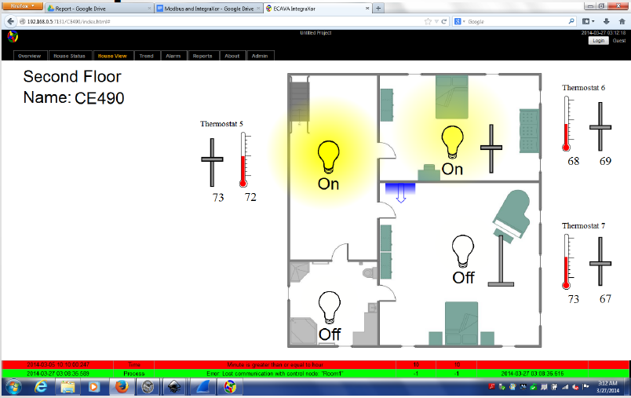
IExample Projects Implemented on IoT Platform for Unstruct. Env.
Smart Home

Slide 23
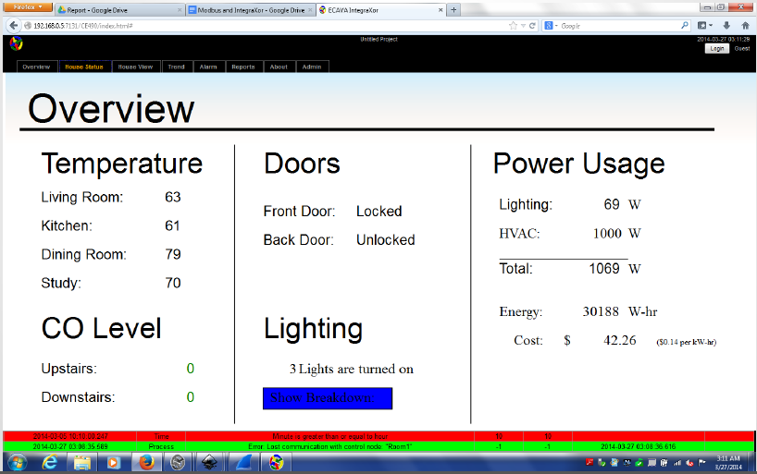
Example Projects Implemented on IoT Platform for Unstruct. Env.
Smart Home

Slide 24
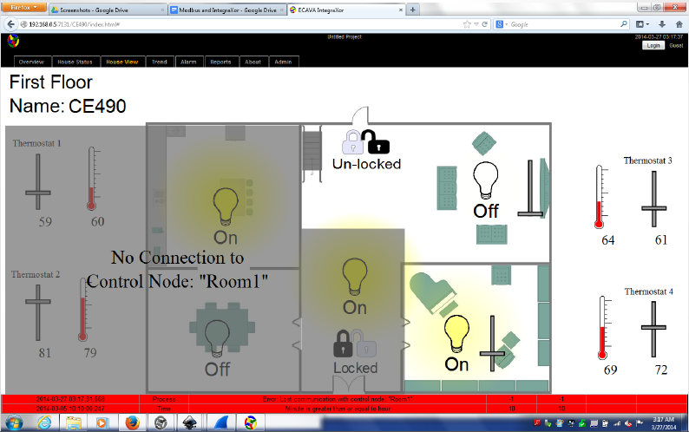
Example Projects Implemented on IoT Platform for Unstruct. Env.
Smart Home: Connection Fault

Slide 25
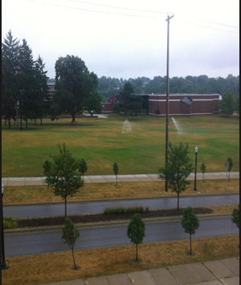
Example Projects Implemented on IoT Platform for Unstruct. Env.
Smart Irrigation System
Sensors:
Ground humidity
Line pressure
Flow rate
Actuator
Solenoid Valve
Other
Weather channel

Slide 26
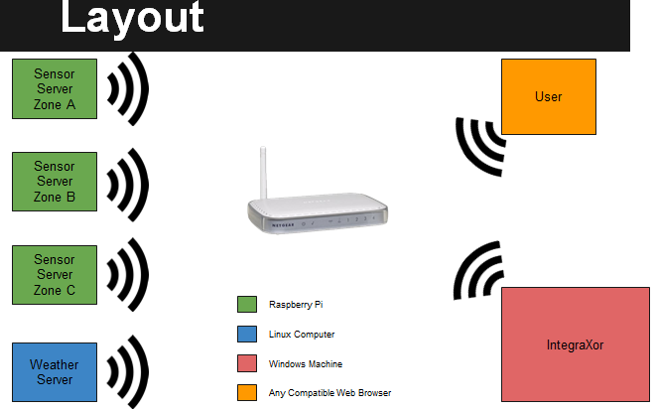
Example Projects Implemented on IoT Platform for Unstruct. Env.
Smart Irrigation System

Slide 27
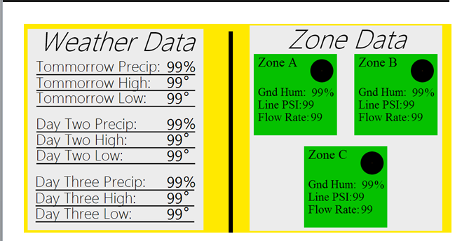
Example Projects Implemented on IoT Platform for Unstruct. Env.
Smart Irrigation System: GUI

Slide 28
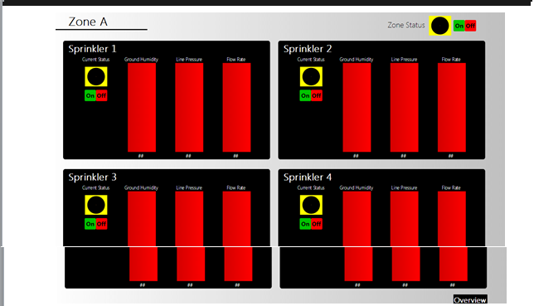
Example Projects Implemented on IoT Platform for Unstruct. Env.
Smart Irrigation System: GUI

Slide 29
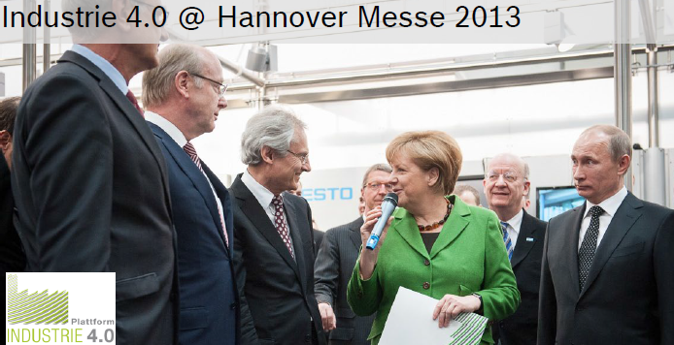

Opportunities !

