Slide 1

Stigma and Childbearing in times of HIV/AIDS.
Experiences of HIV-Positive Women in Cameroon
Joyceline Ntoh Yuh
University of Oldenburg
Germany.

Slide 2
Presentation Outline.
1)Third major phase of HIV epidemic.
2)Stigma process
3)Impact of stigma
4)Childbearing in times of HIV/AIDS.
5)Research Problem & questions.
6)Methodology & Findings.
7)Conclusion & Recommendations.

Slide 3
.
Third phase of HIV epidemic
Jonathan Mann founder of the World Health Organization's Global Program on AIDS and great advocate.
Causes of HIV-related Stigma
a) Incurable nature of the disease.
b) Sexual nature & mode of transmission.
c) Gendered concept.
d) Other factors such as legal environment,situational context,medical knowledge,Social media etc also influence HIV stigma
-

Slide 4
Social process
HIV stigma could be seen as a social process of ordering,blaming and shaming(often called symbolic stigma)
i)Differential stigmatization(construction of blame)
ii)PLWA have often been stigmatized for being part of a specific group that is already defined negatively(sex+HIV=promiscuity)
Erving Goffman:Spoiled identity & social devaluation.
HIV stigma should be seen as problem of fear & blame without resorting to individualism or functionalism.(Harriet Deacons)
Power:The stigmatizer represents the dominant group exercising their power and influence over the stigmatized.

Slide 5
Impact of Stigma.
Hinders VCT even where treatment is available
Cause of secrecy(disclosure),denial,non-adherence to treatment
Fear of stigma may inhibit the use of condoms
Isolation,rejection & discrimination
Discrimination
Negative effects on motherhood.
i)Cause pregnant women to avoid HIV testing
ii)May force HIV+ mothers to expose babies to infection.

Slide 6
Childbearing in times of HIV.
Research Problem.
HIV is affecting the cultural and social familial life of different ethnic groups in the region. Investigating in particular how the inability of having children is changing family status and lineage; which might alter one of the most important cultural values of procreation in future.
Research Question.
How do women living with HIV/AIDS perceive and experience child bearing in the context of HIV?
i) What are the different responses of single and married women living with HIV to their changing sense of identity as mothers and members of their community?

Slide 7
Methodology & findings.
In depth interviews were conducted with single,married and divorced HIV+ Women.
Interviews were also conducted with health workers & Religious leaders.
Findings
HIV+ Women had low self esteem.
Fear of transmission.
HIV+ Women are uninformed about possibilities of bearing children and discouraged by some medical personnel.
Disparity between the different categories of HIV+ Women e.g single,married and divorced.
Financial constraints.
Some health care workers found issues pertaining to childbearing complex & challenging.
While Religious leaders had diverse views on the subject.

Slide 8
Conclusion & Recommendations.
Breaking the silence
a) Bearing children is a key social and cultural need yet the stigma and health risks makes that need a major challenge for women living with HIV
b) Financial,Medical,Social and cultural aspects stands as hinderance for HIV+ Women to fulfil their dreams as mothers.
i) HIV+Women actually become over burden because of gender in equality and limited financial means to sustain themselves considering that they need adequate health check ups, caesarean sections, artificial baby’s milk after delivery.
c) Most HIV-positive Women are uninformed about their chances & possibilities to conceive.
Recommendations.
a) Adoption which is not a common practice in the region should be promoted.
b) Need for effective service delivery for PLWHA because they need to be well informed.
-

Slide 9
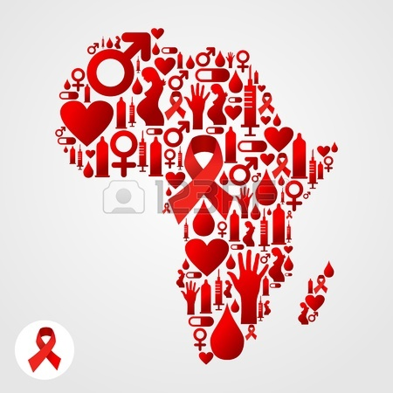
Thank you.

