Slide 1



Metabolomic Discoveries GmbH
Dr. Josephine Worseck
@mdiscoveries
@mykenkodo
@DrWorseck
www.kenko.do www.metabolomicdiscoveries.com
Kenkodo® is a brand of Metabolomic Discoveries GmbH

Slide 2
“We Discover the Metabolome”
@mdiscoveries www.kenko.do
@mykenkodo www.metabolomicdiscoveries.com
@DrWorseck Kenkodo® is a brand of Metabolomic Discoveries GmbH
The metabolome refers to the complete set of small-molecule chemicals found within a biological sample to a given time point.
Das Metabolom beschreibt die Gesamtheit detektierbarer niedermolekularer Substanzen einer biologischen Probe zu einem bestimmten Zeitpunkt.

Slide 3
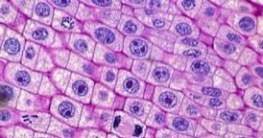
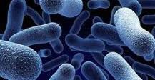

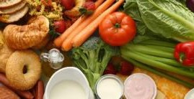

FOOD
Sugar beet Tomato Wheat Corn Mango Cucumber Asparagus Potato Kiwi
[…]
BODYFLUIDS
Blood Sweat Urine Sperm CSF
Faeces
MICROORGANISMS
Staphylococcus Legionella Mycobacterium
C. acetobutylicum
S. cerevisiae
E. coli
P. aeruginosa Chlorella Chlamydomonas Synechocystis
B. animalis Bacillus Lactobacillus Corynebacterium Xanthomonas […]
BIOTECHNOLOGY
Bioprocesses
Analysis
Pathway fluxes
Media Optimization
TISSUES
Muscle
Kidney
Metabolic Engineering
Compound Identification
BEVERAGE
Beer Milk […]
CELLS
Astrocytes Hepatocytes CHO
[…]

Slide 4


Y O U R L I F E . L I V E I T W E L L .
M a p p i n g Y o u r B i o c h e m i c a l
S t a t e
t o a H e a l t h i e r
L i f e !
Dr. Josephine Worseck
@mdiscoveries
@mykenkodo
@DrWorseck
www.kenko.do www.metabolomicdiscoveries.com
Kenkodo® is a brand of Metabolomic Discoveries GmbH

Slide 5


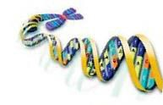
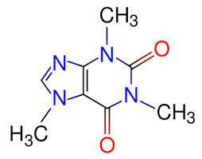
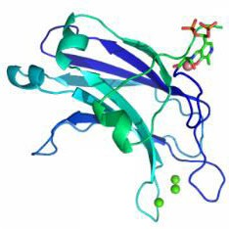
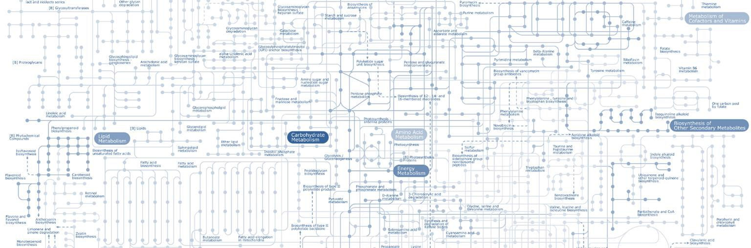
You cannot change your Genome
GENOME
„What can happen“
PROTEOME
„What makes it happen“
METABOL ME
„What actually happens“
“Genomics and proteomics tell you what might happen, but metabolomics
tells you what actually did happen". - Bill Lasley, University of California
M a p p i n g Y o u r B i o c h e m i c a l S t a t e t o a H e a l t h i e r L i f e !

Slide 6
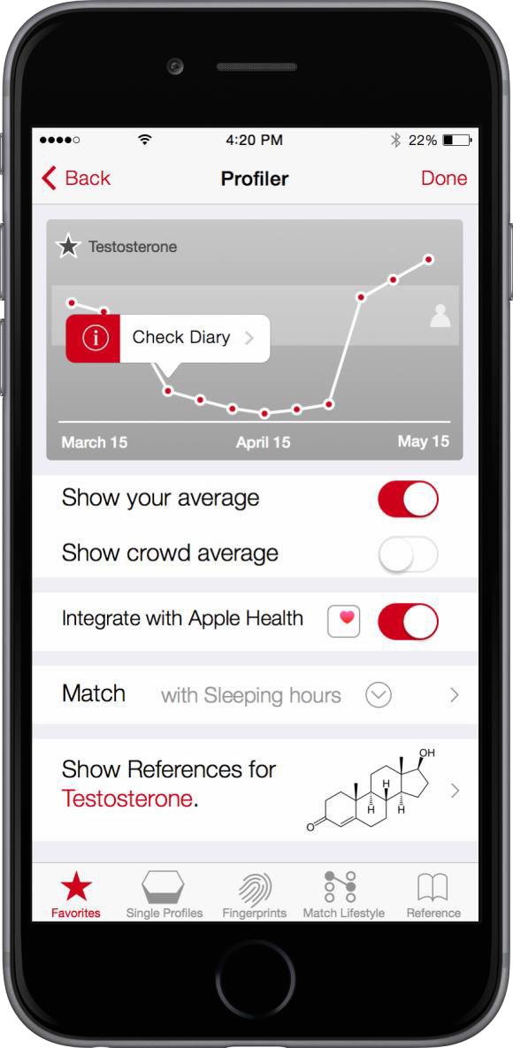





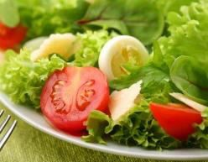

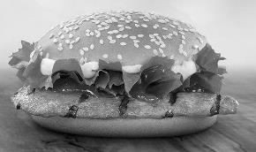
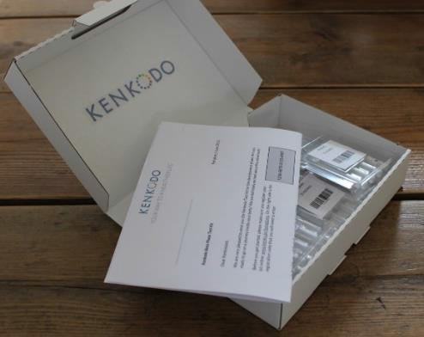
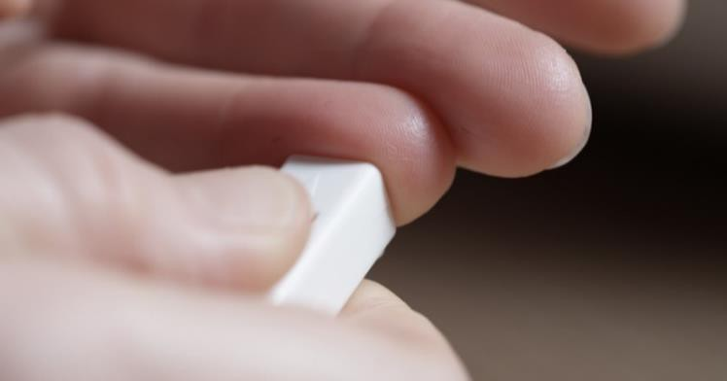
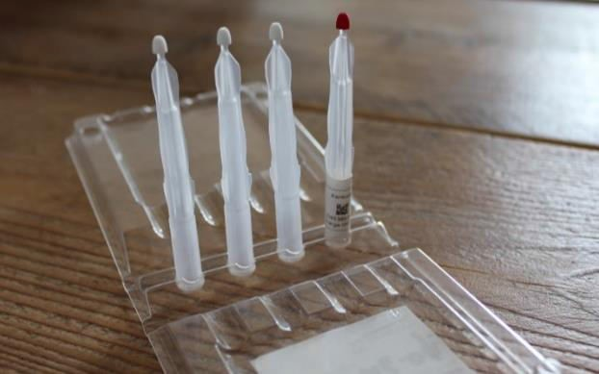
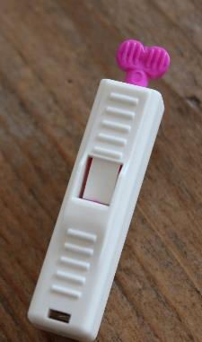

Our Technology
The technology is a unique combination of
A physical @home blood sampling kit,
A lifestyle tracking app,
Cutting-edge blood analytics.
Fall
Winter
Spring
Metabolomic Discoveries proprietary mass spectrometry platform is based on 10 years metabolomics experience & data.
Fall
Winter
Spring
Painless (!) Blood Draw at Home
Easy Shipment
Mobile Companion

Slide 7
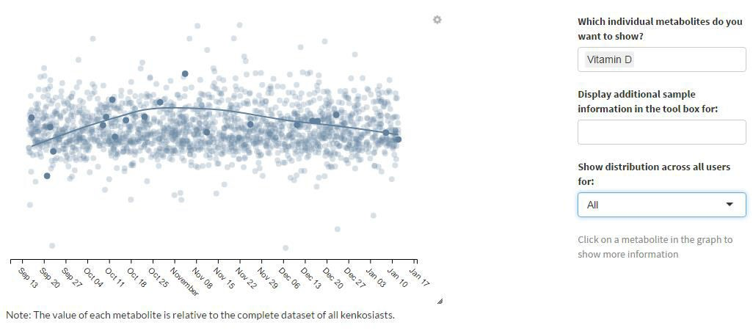
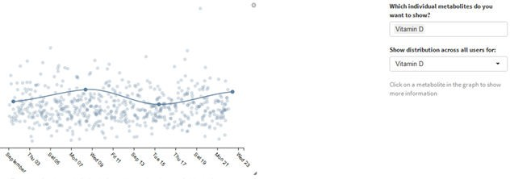
I n d i v i d u a l
v s . C o m m u n i t y
L e v e l s
17-01-2016
Vitamin D
95 Percentile

Slide 8
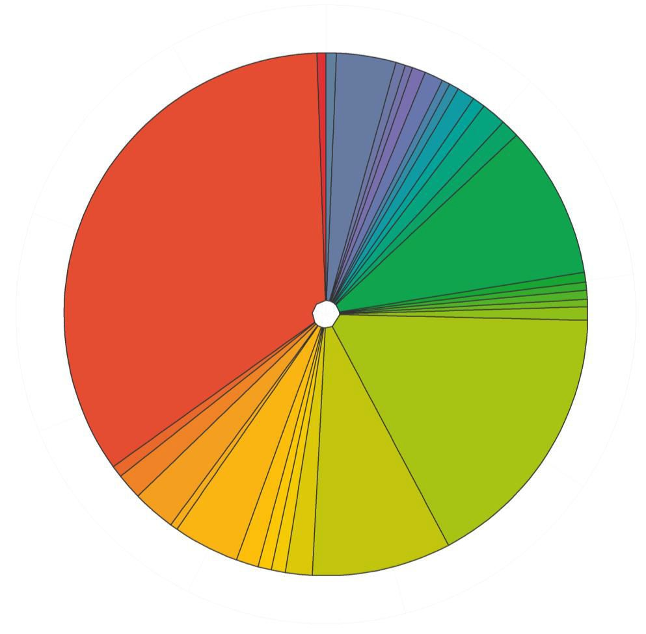
B l o o d
C o m p o s i t i o n
AMINO ACIDS
ORGANIC ACIDS
UNKNOWNS+
GLYCEROLIPIDS
NUCLEOSIDES+
STEROIDS
PRENOL LIPIDS
UNCHARACTERIZED
~ 2000 METABOLITES
~ 40% UNIDENTIFIED

Slide 9

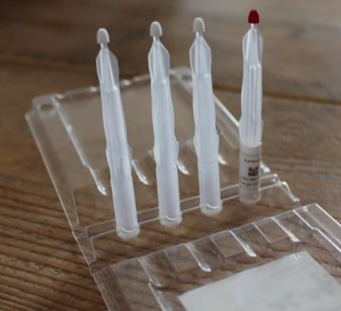
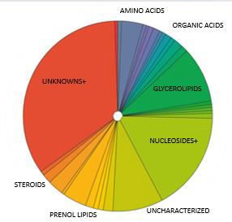
B i g D a t a
?
80 Questions
50 Lifestyle & Health
30 Sample specific
400 Users
5.2000 Samples
2000 Metabolites

Slide 10
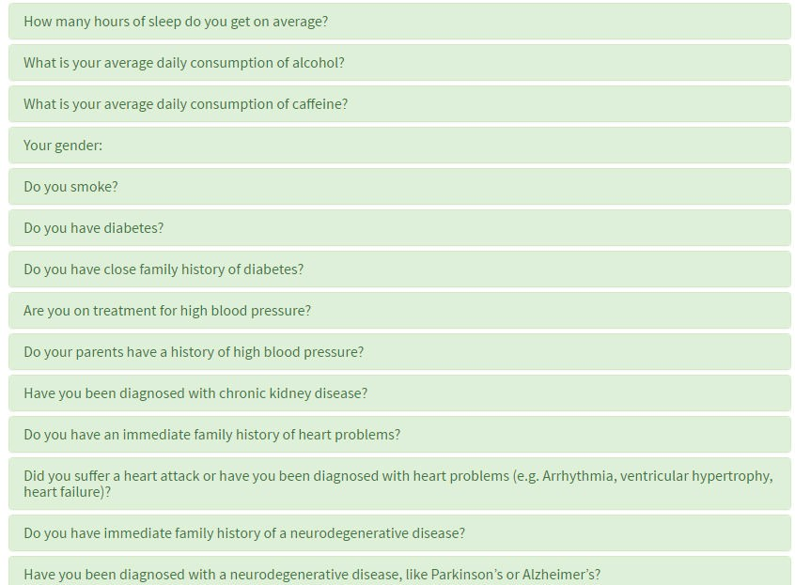
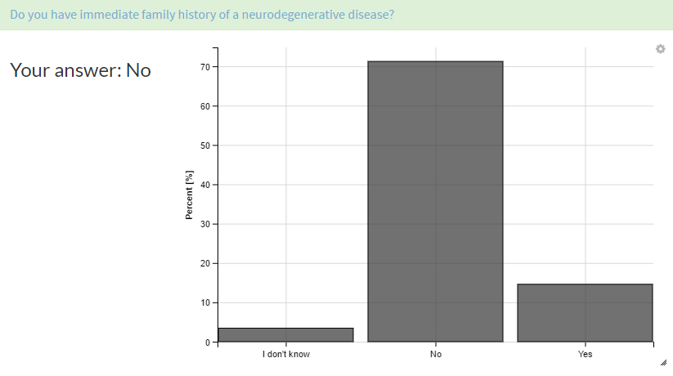
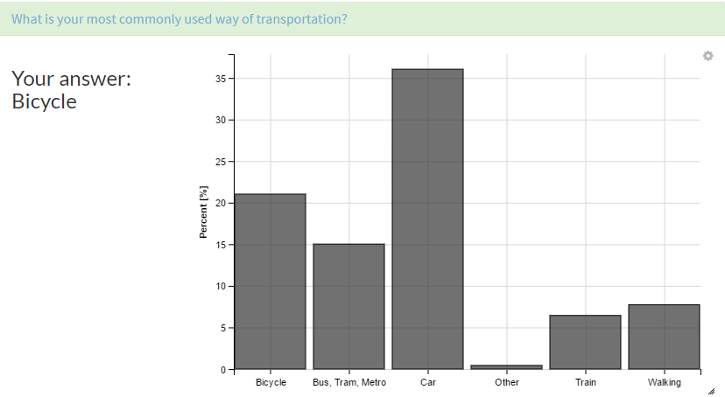
L i f e s t y l e
& H e a l t h
D a t a
?
80 Questions
50 Lifestyle & Health

Slide 11
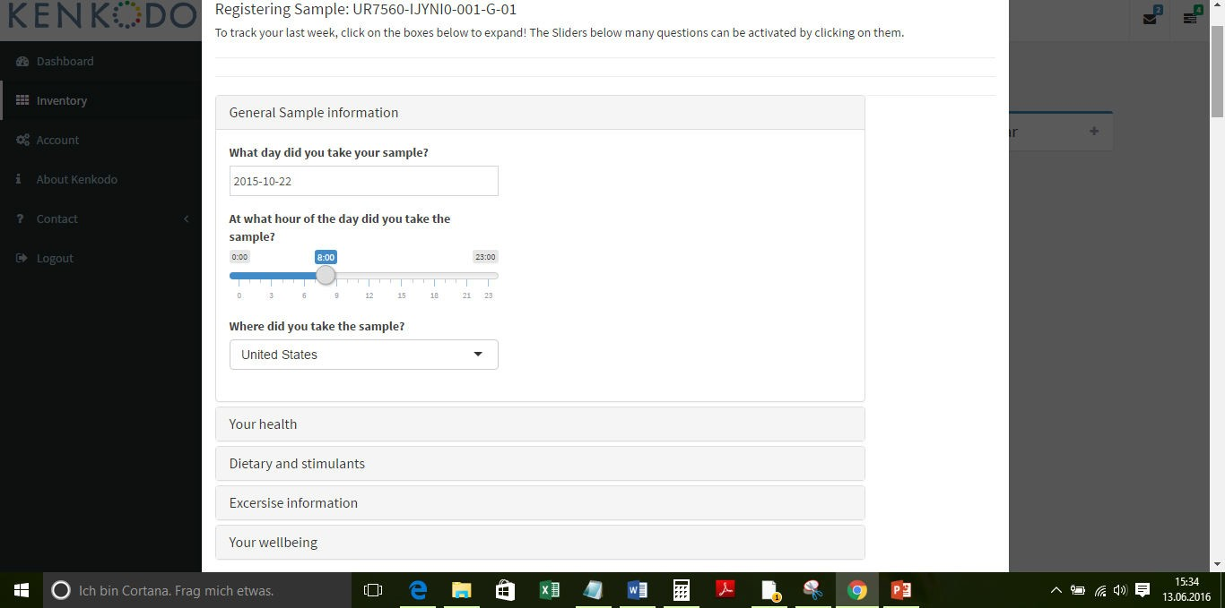
S a m p l e
S p e c i f i c
D a t a
We currently provide testosterone, lactic acid, glucose, creatine, GABA, vitamin D, vitamin C, omega-3 fatty acids and cortisol levels to our users in the Beta-Phase. The panel will increase over the time.
?
80 Questions
30 Sample specific

Slide 12
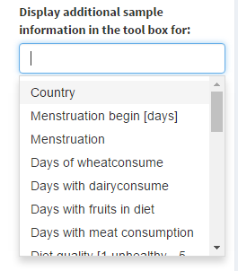
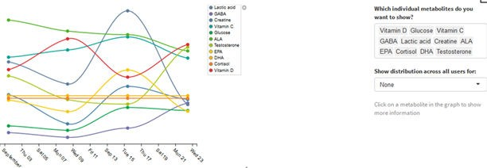
S a m p l e
S p e c i f i c
D a t a
We currently provide testosterone, lactic acid, glucose, creatine, GABA, vitamin D, vitamin C, omega-3 fatty acids and cortisol levels to our users in the Beta-Phase. The panel will increase over the time.

Slide 13
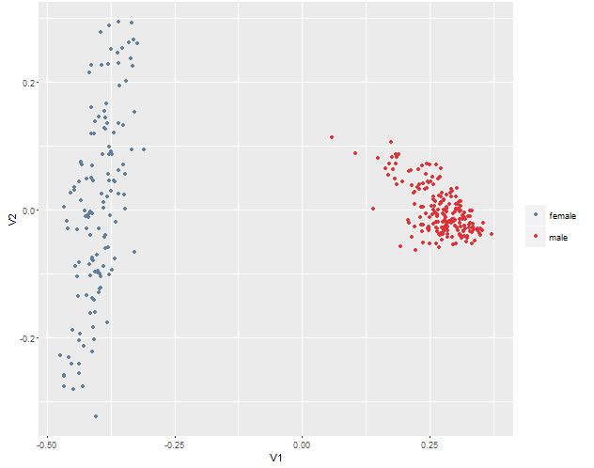
G e n d e r
C l a s s i f i c a t i o n
Male
Female

Slide 14
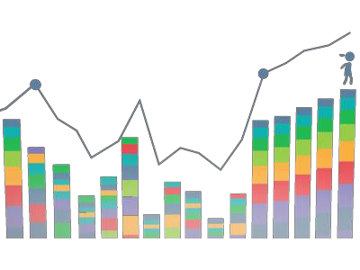
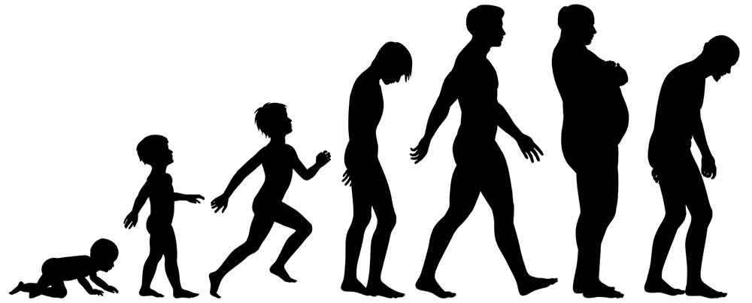

The Problem & Our Solution
Is it inevitable that you're going to get sick when you get older?
Stay healthy, keep in shape, perform & feel better by
recognizing changes before symptom onset…

Slide 15
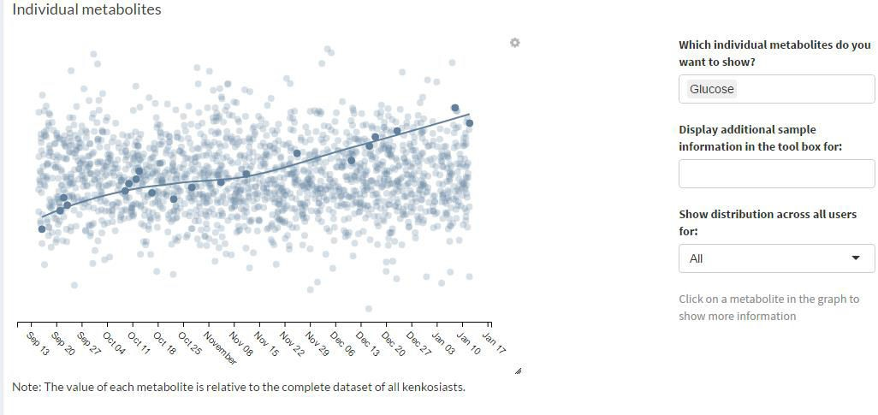



D i e t
i n d u c e d
c h a n g e s

Slide 16
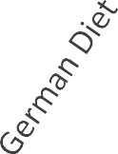
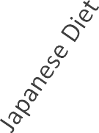
D i e t
i n d u c e d
c h a n g e s
FA 18:0
Saturated Fatty Acids
PC52:4 PE48:1
Unsaturated Fatty Acids
Data based on daily profiling over three weeks

Slide 17
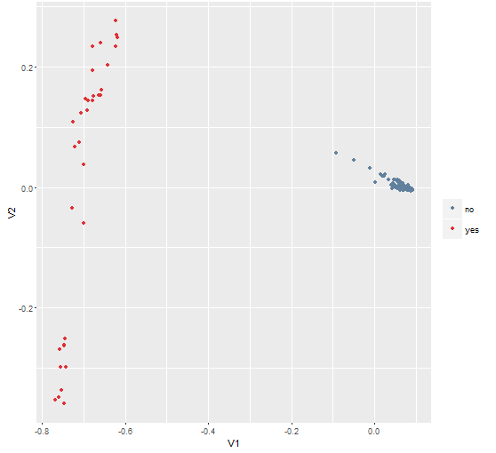
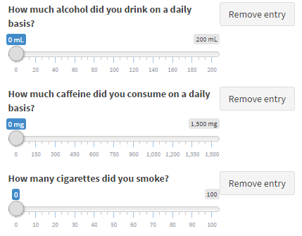
S m o k i n g
i n d u c e d
c h a n g e s
Smoker
<15cigs/day
Stopped smoking
as a challenge
Smoker
15+ cigs/day

Slide 18








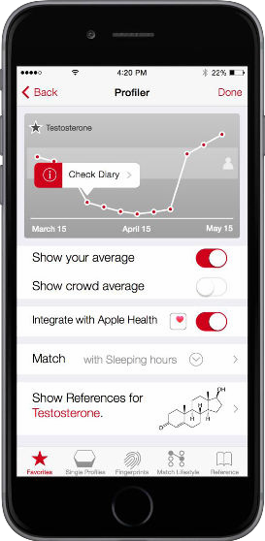








Coming soon…
Diabetes
Your Biomarker Profile
Fitness
Your Biomarker Profile
Fertility
Your Biomarker Profile
Nutrition
Your Biomarker Profile
Age Vitality
Your Biomarker Profile
?
Your Biomarker Profile
Painless Accurate Affordable Time Saving
Health Monitoring
?

Slide 19
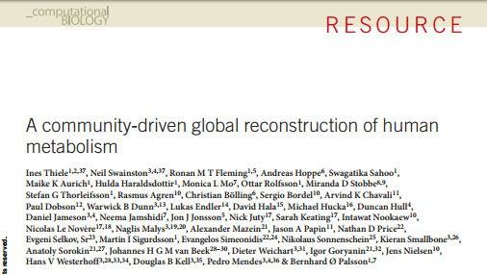
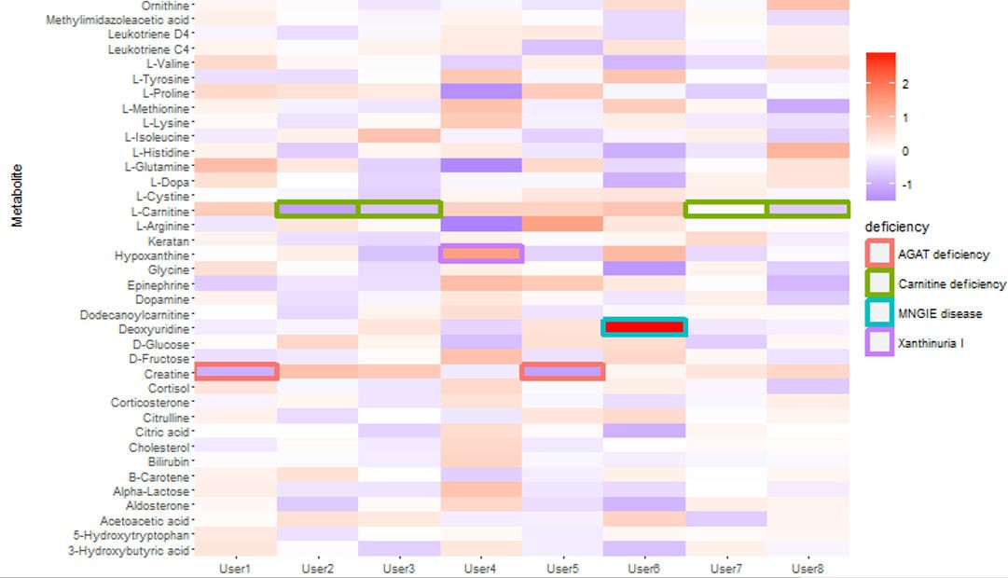
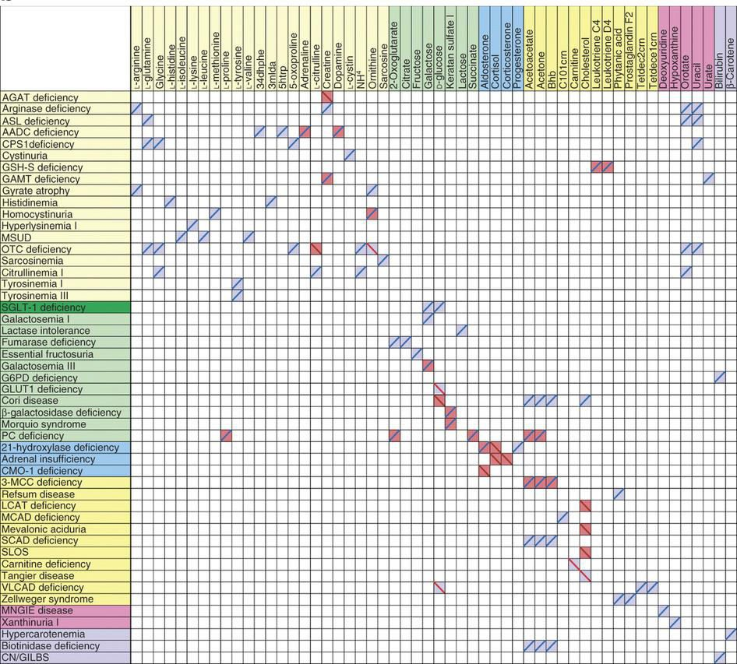


I E M S c r e e n i n g

Slide 20



Yo u r
W a y t o a H e a l t h i e r
L i f e
@mykenkodo
kenkodo www.kenko.do
igg.me/at/kenkodo

