Slide 1
Diabetes is not an homogeneous risk: The role of coronary calcium score in the reclassification of cardiovascular risk in diabetic patients
JOSEPH SHEMESH MD
The Grace Ballas Cardiac Research Unit
Sheba Medical Center
Israel
Joseph.shemesh@sheba.health.gov.il
12th European Diabetes Congress, Berlin Germany 2016

Slide 2

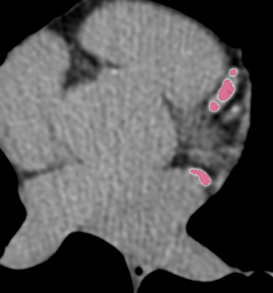
From Categorial Risk factors….
…….. To Individual AS Quantification
Coronary calcium Score
Has the best prognostic value for CV events and mortality compare to novel Risk factors
Coronary calcium Score
From risk category to individual Cardiac risk

Slide 3
What is CAC?
Coronary calcification is a surrogate marker of the total burden of coronary AS
In asymptomatic, CAC signify subclinical CAD

Slide 4
What is coronary artery calcification?
  An unequivocal marker of intimal atherosclerosis: CAC is the result of many complex biologic processes and appears in the advanced forms of AS: Healing? Stabilization?
  For each quantity of CAC there is 5 times higher quantity of non calcified soft plaques.
  Mild CAC with predominant soft plaques in younger and in acute coronary syndrome
  More extensive and diffuse CAC in older and in those with documented chronic CAD

Slide 5

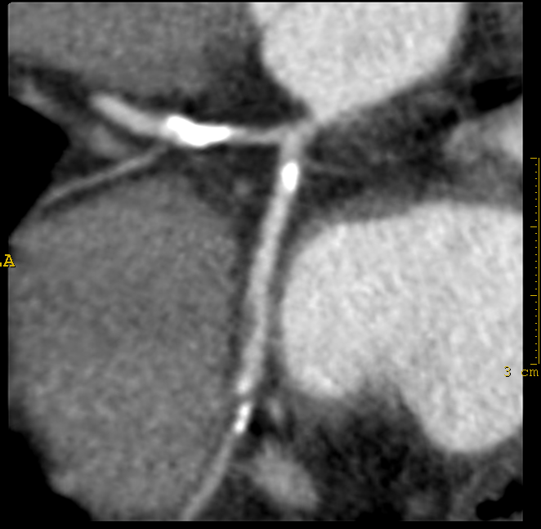
CT for CAC score
From Categorial to Individual risk in primary prevention
CORONARY CTA obstructive CAD
Incremental prognostic value over traditional and novel risk factors
Re-stratify substantial number of asymptomatic and high risk populations
For acute CP in the ER
Soft plaques can be seen but not quantified
Vulnerable plaques can not be identify

Slide 6
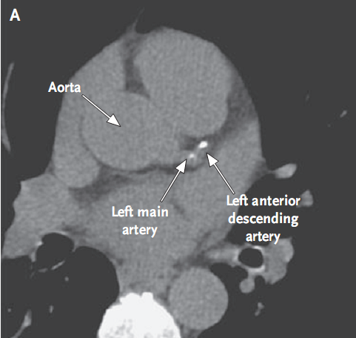
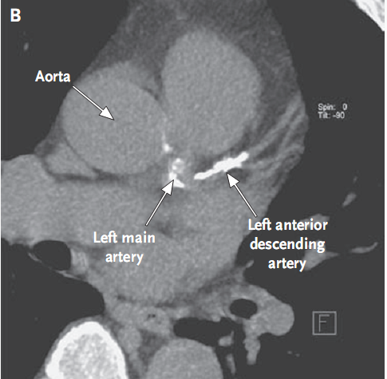
CAC score = 80
CAC score = 1054
CAC can be detected by all CT devices
Radiologists should report CAC routinely on low dose chest CT
Can be reported as none, mild, moderate or severe

Slide 7
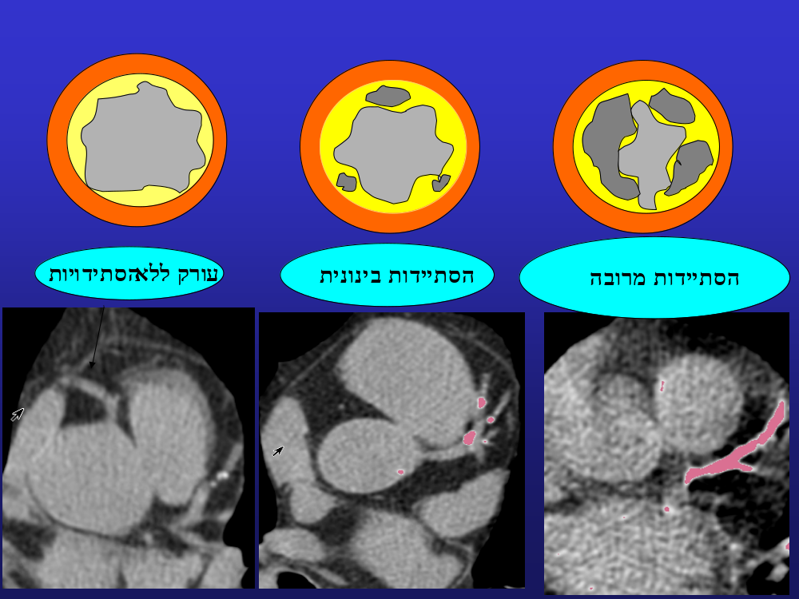
Lesion score=Area x CT Density of each lesion
Total Calcium Score= Sum of all score lesions
Stary I
Stary II-IV
Stary V-VII
Non calcific AS
Severe CAC
TCS 400-1000
Heavily calcified artery
TCS>1000
Mild TCS <100
Moderate 100-400
Detect subclinical AS for primary prevention

Slide 8
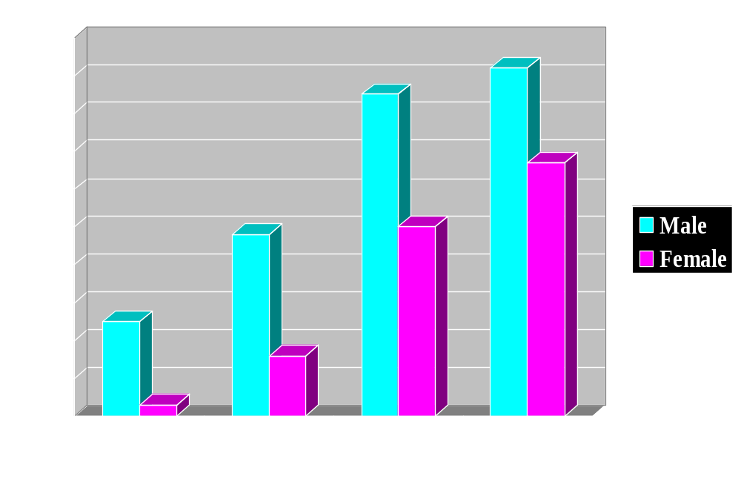
Prevalence of Coronary Calcium in Asymptomatic Subjects
%
  The prevalence and quantity of CAC increase with age
  and accelerate in men over 50 and women over 60 years.

Slide 9
Absence of CAC and all-cause mortality
Blaha M et al J Am Coll Cardiol Img 2009;2:692-700
Annualized all-cause mortality rates were assessed in 44,052 consecutive asymptomatic patients referred for CAC testing
  Frequency Annualized % of death
  TCS = 0 in 45% 0.09
  TCS =1-10 in 12% 0.19
  TCS > 10 in 43% 0.75
Mean follow-up 5.6±2.6 years (range 1-13)
The absence of CAC : Very helpful information
  Predicts excellent survival
  Classify those with intermediate risk into a lower risk category: statin treatment may be avoided or less intensively given

Slide 10
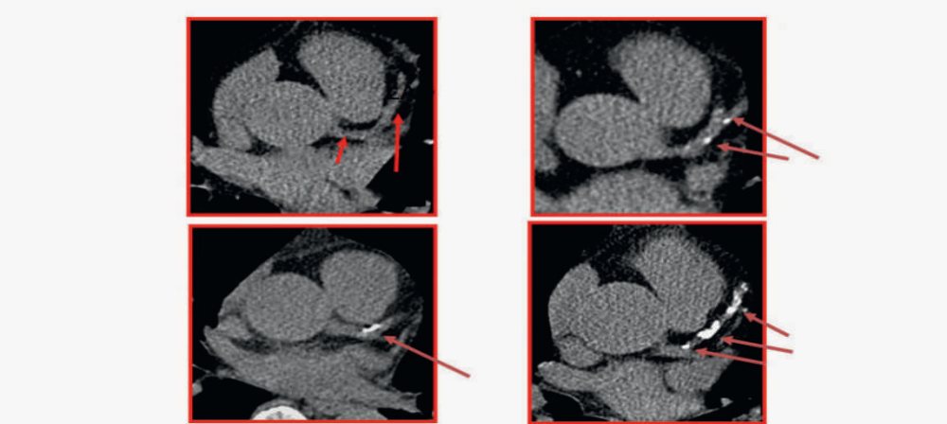
Absence of CAC in diabetics
Indicate excellent prognosis
Reclassifying diabetics into much lower risk

Slide 11
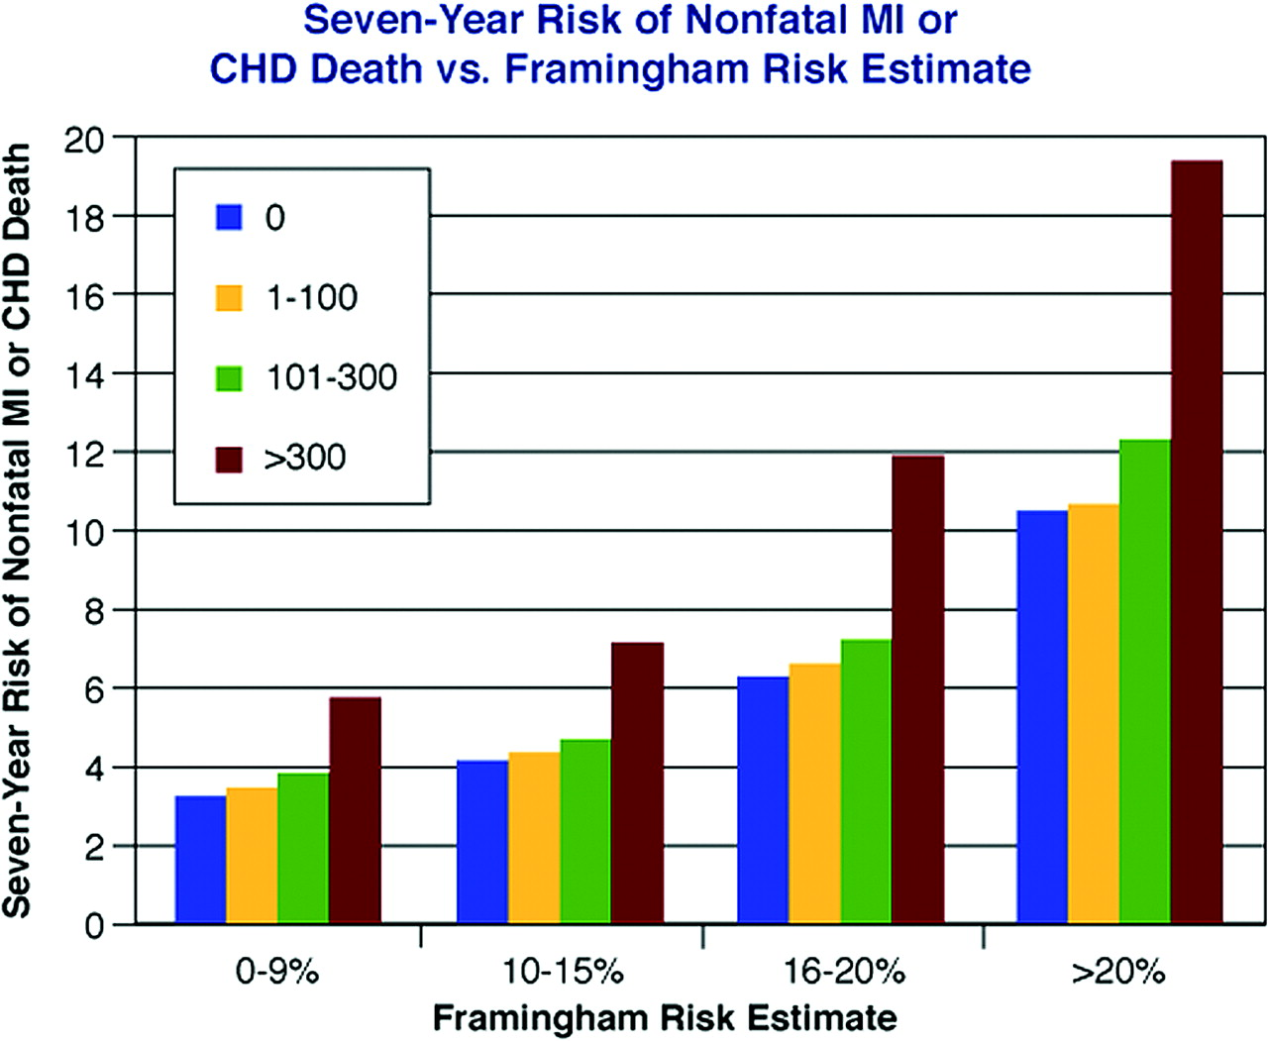

Seven-year risk of nonfatal myocardial infarction (MI) or death from coronary heart disease (CHD) based on Framingham Risk Score, stratified by CAC score
Greenland P et al JAMA 2004;291:210-215
1461 Asymptomatic,
>45y , at least1 RF
Copyright ©2008 American Heart Association

Slide 12
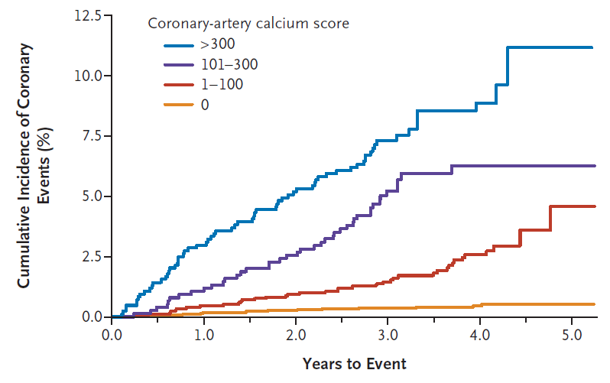
Coronary calcium as a predictor of coronary events
The Multi-Ethnic Study of Atherosclerosis (MESA) study – 6722 subjects who had no clinical CV disease at entry and were followed for 3.8 years
Detrano R et al. N EJM 2008;358:1336-45
Multi-Ethnic Study of Atherosclerosis (MESA)

Slide 13
Coronary risk stratification, discrimination, and reclassification improvement based on quantification of subclinical coronary atherosclerosis: The Heinz Nixdorf Recall study.
Erbel R et al J Am Coll Cardiol 2010;56:1397-406
OBJECTIVES:
The purpose of this study was to determine net reclassification improvement (NRI) and improved risk prediction based on coronary artery calcification (CAC) scoring in comparison with traditional risk factors.
METHODS:
4,129 subjects age 45 to 75 years, 53% female,
without overt CAD at baseline, traditional risk factors and CAC scores were measured.
Their risk was categorized into low, intermediate, and high according to the Framingham Risk Score (FRS) and National Cholesterol Education Panel Adult Treatment Panel (ATP) III guidelines,
reclassification rate based on CAC results was calculated.

Slide 14
Coronary risk stratification, discrimination, and reclassification improvement based on quantification of subclinical coronary atherosclerosis: the Heinz Nixdorf Recall study.
Erbel R et al J Am Coll Cardiol 2010;56:1397-406
Among those at intermediate risk:
  The 14% who should be reclassified to a high risk based on high CAC scores had an event rate of >8% over five years.
  The 63% who should be reallocated to a low-risk group—because of CAC scores under 100—had an event rate of just 1% over 5 Y y
  Adding CAC scores to the FRS improved the area under the curve from 0.681 to 0.749 (p < 0.003) and to the National Cholesterol Education Panel ATP III categories from 0.653 to 0.755 (p = 0.0001).

Slide 15
CAC contributes also to risk stratification in high risk patients
ELDERLY
HYPERTENSION
DIABETES MELLITUS
HYPERLIPEMIC
SMOKERS
CKD

Slide 16
Coronary calcium measurement improves prediction of cardiovascular events in asymptomatic patients with type 2 diabetes: the PREDICT study. et al Eur Heart J. 2008 Sep;29(18):2244-51 Elkeles RS
  A prospective cohort study that was specifically designed to evaluate CAC as a predictor of CV events in type 2 diabetes.
  589 patients (median age 63.1 years), with established diabetes and with no history of CV disease
  Median Follow Up 4 years.
  23.4% had CAC score of 0-10 with an event incidence of 0.02% per year. A 6 times increase was observed in the incidence of event in the next CAC score category of 11-100 AU
  A doubling of CAC score was associated with 32% increase in risk of CV event.

Slide 17
Coronary calcium measurement improves prediction of cardiovascular events in asymptomatic patients with type 2 diabetes: the PREDICT study. et al Eur Heart J. 2008 Sep;29(18):2244-51 Elkeles RS
  CAC in that study had greater predictive value for CV endpoints than a broad range of conventional and novel risk factors and added to the predictive power of the Framingham or UKPDS risk scores

Slide 18
Prognostic value of coronary artery calcium screening in subjects with and without diabetes mellitus
Raggi P et al JACC 2004;43:1663-9
10,377 patients, 903 diabetics: 57±10, 57% male
Average follow-up 5.0±3/5 y
End points – All cause mortality
Annual death rate: 0.7% vs 0.4% with and without DM
Mortality from all causes is increased in asymptomatic diabetics in proportion to the baseline CAC score.
The absence of measurable AS appears to be an important modifier of outcome: 30% of the diabetic patients had no CAC and demonstrated a survival similar to that of non diabetics: 98.8% and 99.4% p=0.5
Screening for CAC is a useful tool to risk stratify asymptomatic diabetics with the ultimate goal to conduct a more or less aggressive therapy tailored to the individual rather than the disease state.

Slide 19
Hypertensive adults with diabetes mellitus can be stratified into lower or higher
CV risk by coronary artery calcification :
15 years follow-up
Shemesh et al Am J Cardiol March 2012
Conclusions
Hypertensive-diabetic patients can be stratified for cardiovascular risk by CAC measurement.
Those without CAC had low risk for CV event similar to those without diabetes and without CAC.

Slide 20
Impact of subclinical atherosclerosis on cardiovascular disease events in individuals with metabolic syndrome and diabetes: the multi-ethnic study of atherosclerosis
Malik S. et al. Diabetes Care 2011;34:2285–2290
6,603 people aged 45–84 years were assessed for CAC and CIMT in MESA.
1686 had metabolic syndrome (Mets).
881 had DM.
4036 no Mets, no DM
Follow-up – 6.4 years.
Cox regression examined the association of CAC and CIMT with coronary heart disease (CHD) and CVD.

Slide 21
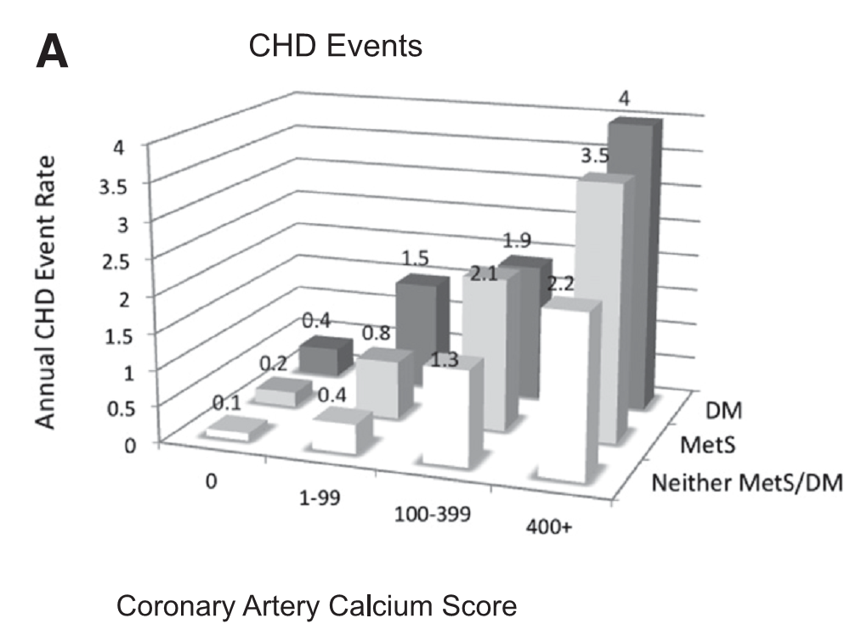
:CAC in Diabetic patients:
CHD Events
Malik S. et al. Diabetes Care 2011;34:2285–2290

Slide 22
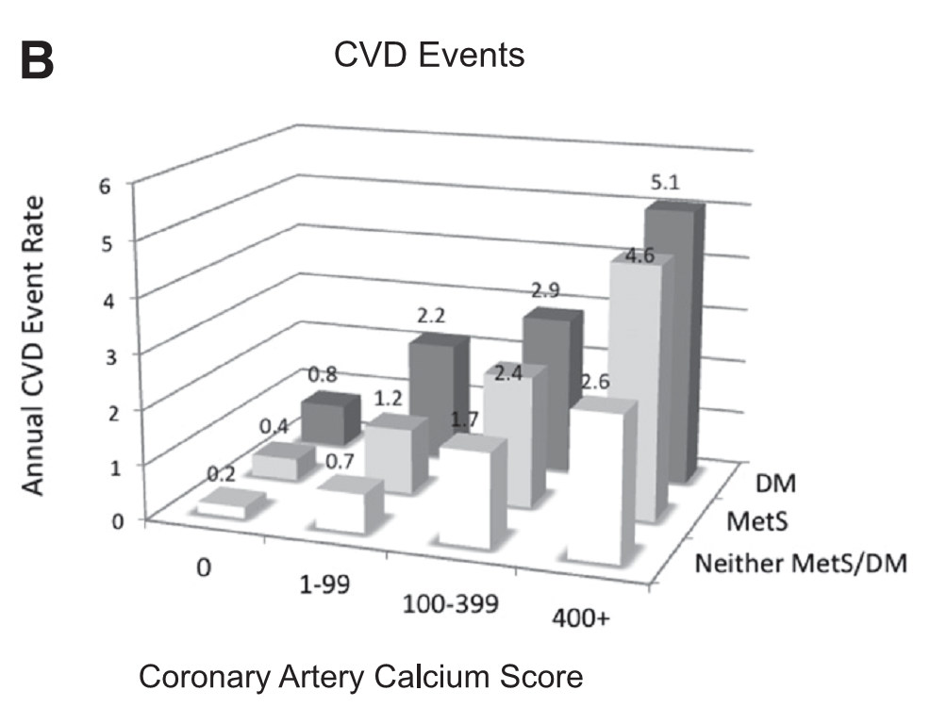
:CAC in Diabetic patients:
CVD Events
Malik S. et al. Diabetes Care 2011;34:2285–2290

Slide 23
Impact of subclinical atherosclerosis on cardiovascular disease events in individuals with metabolic syndrome and diabetes: the multi-ethnic study of atherosclerosis.
Malik S. et al. Diabetes Care 2011;34:2285–2290
CONCLUSIONS:
Individuals with MetS or diabetes have low risks for CHD when CAC is not increased.
Screening for CAC can stratify risk in people with MetS and diabetes and support the latest recommendations regarding CAC screening in those with diabetes.

Slide 24
ACCF/AHA Practice Guideline
2010 ACCF/AHA Guideline for Assessment of Cardiovascular Risk in Asymptomatic Adults
Diabetics - Class IIa
In asymptomatic adults with diabetes, 40 years of age and older, measurement of CAC is reasonable for cardiovascular risk assessment. (Level of Evidence: B)
Diabetics are not at homogeneous risk and can be reclassified by CAC SCORE!
J Am Coll Cardiol 2010;56;50-103

Slide 25
CAC prediction for all cause mortality and CV events in
people with type II DM : systematic review and meta-analysis
Kramer CK et al. BMJ 2013;346:f1654
In people with type 2 diabetes, a CAC score of ≥10 predicts all cause mortality or CV events, or both, and CV events alone.
Clinically, the finding of a CAC score of < 10 may facilitate risk stratification by enabling the identification of people at low risk within this high risk population.

Slide 26
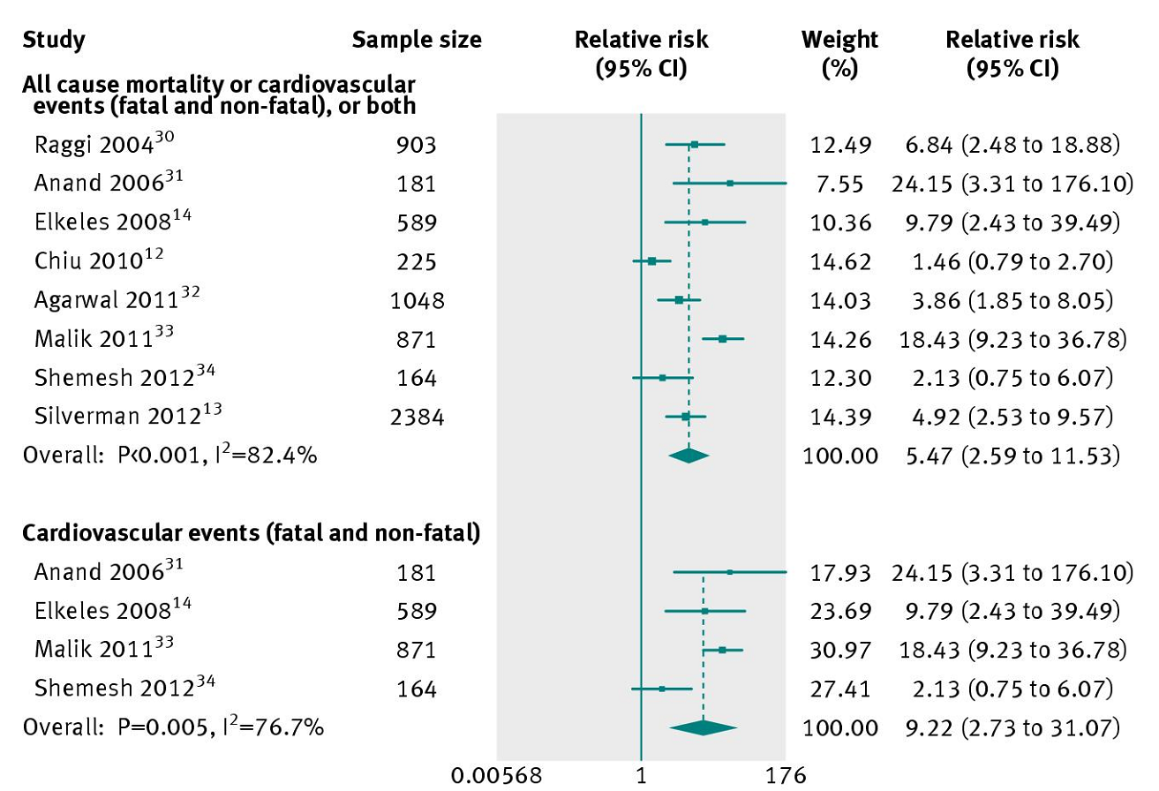
8 studies,n=6521
F-U-5.8 years
Kramer CK et al. BMJ 2013;346:f1654

Slide 27
Potential implications of coronary artery calcium testing for guiding aspirin use among asymptomatic individuals with diabetes
Silverman MG Diabetic care 2012 Mar;35(3):624-6
2,384 individuals with diabetes of 44,052 asymptomatic individuals referred for CAC score
Subjects were followed for a mean of 5.6 ± 2.6 years for the end point of all-cause mortality.
There were 162 deaths (6.8%) in the population. CAC was a strong predictor of mortality across age-groups (age <50, 50-59, ≥60), sex, and risk factor burden (0 vs. ≥1 additional risk factor).
In individuals without a clear indication for aspirin per current guidelines, CAC stratified risk, identifying patients above and below the 10% risk threshold of presumed aspirin benefit.

Slide 28
New risk class in the updates ESC guidelines:
VERY HIGH CARDIOVASCULAR RISK
need active management of all risk factors CVD
  Type II diabetes /patients with type I diabetes with target organ damage (such as microalbuminuria).
  Moderate to severe Chronic kidney disease
  The risk of this class to die is >10% in 10 years!
  SHOULD GET: ROSUVASTATIN 20-40 orATORVASTATIN 40-80
ESC/EAS Guidelines for the management of dyslipidaemias. European Heart Journal (2011) 32, 1769–1818

Slide 29
Guideline on the Treatment of Blood Cholesterol to Reduce Atherosclerotic Cardiovascular Risk in Adults: A Report of the American College of Cardiology/American Heart Association Task Force on Practice Guidelines.
Circulation. 2013 NovStone NJ, Robinson J, Lichtenstein AH, et al. 2013 ACC/AHA
4 major statin benefit groups
Clinical ASCVD,
Primary elevations of LDL–C >190 mg/dL,
*Diabetes aged 40 to 75 years with LDL–C 70-189 mg/dL and without clinical ASCVD
Without clinical ASCVD or diabetes with LDL–C 70 to189 mg/dL and estimated 10-year ASCVD risk >7.5%.
*Not at homogeneous risk , can be reclassified by CAC SCORE!

Slide 30
Guideline on the Treatment of Blood Cholesterol to Reduce Atherosclerotic Cardiovascular Risk in Adults: A Report of the American College of Cardiology/American Heart Association Task Force on Practice Guidelines. Circulation. 2013 NovStone NJ, Robinson J, Lichtenstein AH, et al. 2013 ACC/AHA
Definitions
10 y Risk for CV
Statin not-recommended <5%
Statin considered 5-7.5%
Statin recommended 7.6-20%

Slide 31
Implications of Coronary Artery Calcium Testing Among Statin Candidates According to American College of Cardiology/American Heart Association Cholesterol Management Guidelines: MESA (Multi-Ethnic Study of Atherosclerosis).
Nasir K, et al.J Am Coll Cardiol. 2015 Oct 13;66(15):1657-68
The American College of Cardiology (ACC)/American Heart Association (AHA) cholesterol management guidelines have significantly broadened the scope of candidates eligible for statin therapy.

Slide 32
Implications of Coronary Artery Calcium Testing Among Statin Candidates According to American College of Cardiology/American Heart Association Cholesterol Management Guidelines: MESA (Multi-Ethnic Study of Atherosclerosis).
Nasir K, et al.J Am Coll Cardiol. 2015 Oct 13;66(15):1657-68
Objectives
This study evaluated the implications of the absence of coronary artery calcium (CAC) in reclassifying patients from a risk stratum in which statins are recommended to one in which they are not.
Results
4,758 participants , Age 59 ± 9 y; 47% males.
A total of 247 (5.2%) ASCVD and 155 (3.3%) hard coronary heart disease events occurred over a median (interquartile range) follow-up of 10.3 (9.7 to 10.8) years.

Slide 33
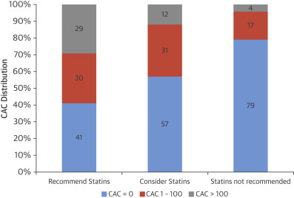
CAC Distribution Across Statin Eligibility Groups
CAC scores at baseline across statin-eligible groups according to the ACC/AHA Cholesterol Management Guidelines.
The absence of CAC was noted in 44% (1,316 of 2,966) of statin candidates (considered or recommended)

Slide 34
Results
The new ACC/AHA guidelines recommended 2,377 (50%) MESA participants for moderate- to high-intensity statins; the majority (77%) was eligible because of a 10-year estimated ASCVD risk ≥7.5%.
Of those recommended statins: 41% had CAC = 0 and had 5.2 ASCVD events/1,000 P/Y
Among 589 participants (12%) considered for moderate-intensity statin, 338 (57%) had a CAC = 0, with an ASCVD event rate of 1.5 per 1,000 P/Y
Of participants eligible (recommended or considered) for statins, 44% (1,316 of 2,966) had CAC = 0 at baseline and an observed 10-year ASCVD event rate of 4.2 per 1,000 person-years.

Slide 35
Implications of Coronary Artery Calcium Testing Among Statin Candidates According to American College of Cardiology/American Heart Association Cholesterol Management Guidelines: MESA (Multi-Ethnic Study of Atherosclerosis).
Nasir K, et al.J Am Coll Cardiol. 2015 Oct 13;66(15):1657-68
Conclusions
Nearly one-half of patients without established atherosclerosis, who are classified as eligible for statin therapy according to the 2013 ACC/AHA blood cholesterol guidelines, have no detectable CAC, suggesting that their 10-year risk of clinical events may be lower than those for whom statin use is generally recommended.
Among candidates for statin therapy, clinicians should consider the role of CAC testing in shared decision-making processes to facilitate informed choices for flexible treatment goals.

Slide 36
Measuring Atherosclerosis
Rational
Non – invasive measuring of the atherosclerosis sequelae of long-life global exposure to all known and unknown risk factors.
Sub-clinical and early stages of AS can be detected and measured.
Individualized risk and treatment according to the total burden of AS combined with conventional RF.

Slide 37
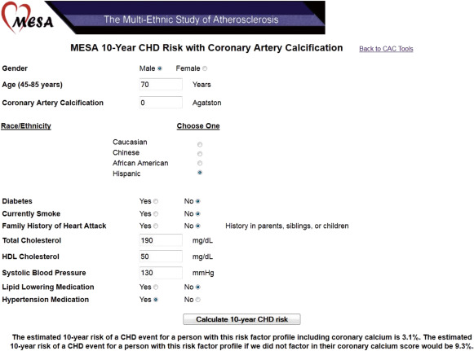
What is the MESA Risk Score?

Slide 38
10-Year Coronary Heart Disease Risk Prediction Using Coronary Artery Calcium and Traditional Risk Factors : Derivation in the MESA (Multi-Ethnic Study of Atherosclerosis) With Validation in the HNR (Heinz Nixdorf Recall) Study and the DHS (Dallas Heart Study)
J Am Coll Cardiol 2015, Vol 66 ,Pages 1643–1653
The MESA CHD risk score is the first available algorithm incorporating CAC with traditional risk factors for 10-year risk prediction.
large, modern, community-based multiethnic cohort and the use of statistical techniques to provide a model that performs well when applied outside of the development cohort.
Independent validation of the model in 2 contemporary cohorts—1 international from Germany and 1 U.S.-based multiethnic study—provides evidence of external validity.

Slide 39
10-Year Coronary Heart Disease Risk Prediction Using Coronary Artery Calcium and Traditional Risk Factors : Derivation in the MESA (Multi-Ethnic Study of Atherosclerosis) With Validation in the HNR (Heinz Nixdorf Recall) Study and the DHS (Dallas Heart Study)
J Am Coll Cardiol 2015, Vol 66 ,Pages 1643–1653
It can be used by radiologists and cardiologists when interpreting and reporting CAC scores.
Scan readers can now calculate and provide a “post-test” 10-year CHD risk after CAC scanning based on the MESA risk score.
This updated 10-year risk could be used to help make therapeutic decisions, such as the decision to start statin or aspirin therapy in primary prevention.

Slide 40
older man with fairly favorable risk factor profile but 0 CAC.
Under a risk score without CAC, 10-year estimated CHD risk is 9.3%,
due in large part to his age.
Once we factor in that he has no detectable CAC, estimated risk is only 3.1%.

Slide 41
A 60 Y old male , diabetic
TC=285, HDL=38, SBP=125
MESA risk score without CAC, 10-year estimated CHD risk is 14.5%,
Once we factor in that he has no detectable CAC, estimated risk is only 5.1%.

Slide 42
A 50 Y old Female , diabetic
TC=220, HDL=45, SBP=130
MESA risk score without CAC, 10-year estimated CHD risk is 4.7%,
Including Coronary Calcium:
estimated risk TCS=0 2.9%.
TCS=140 10.9%.

Slide 43
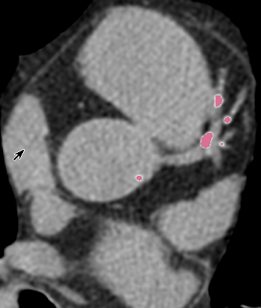
The MESA Risk Score
Future guidelines from the Society of Cardiovascular Computed Tomography might consider recommending this practice in routine CAC score reporting.
Future iterations of U.S. international prevention guidelines may consider use of the MESA risk score as an alternative risk score

Slide 44
Summary
CAC is a marker of atherosclerosis that can be identified on low dose chest CT.
CAC predicts death and CV events in asymptomatic and Diabetics better than all current risk calculation methods
Measurement of CAC can identify a subgroup within diabetic smokers and hypertensive patients with lower CV risk.
Radiologists should report the Presence of Coronary Artery Calcification (CAC) in Routine Thoracic CT
Thank you !

