Slide 1
FROM EXTREMOPHILIC MICROBES TO POSSIBILITIES OF LIFE
Joseph Seckbach
Hebrew University of Jerusalem
joseph.seckbach@mail.huji.ac.il
Preformed in Berlin (July 2016)

Slide 2
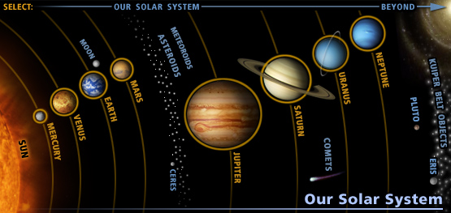
SOLAR SYSTEM

Slide 3
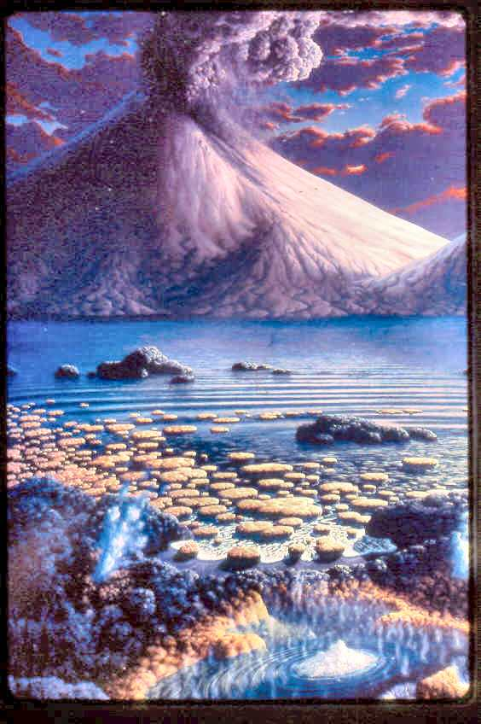
STROMATOLITES

Slide 4

*THE EXTREMOPHILES & POLYEXTREMOPHILES
* TEMPERATURE [High-Low]
* pH EFFECTS
(Acidophiles Vs. Alkaliphiles)
* PRESSURES
(Barophiles, Piezophiles)
* UV EFFECTS
* LIFE IN GASES (CO₂, NH₃, CH₄)

Slide 5
NEW DISCOVERY OF UNDERSURFACE BACTERIA
The discovery of solitary little CRITTERS DEEP BENEATH EARTH'S SURFACE. A community of bacteria was found 2.8 kilometers below ground in a gold-mine and it lives completely alone and completely independent of any other life forms. It also subsists without sunlight or oxygen. They represents the kind or organism that could survive below the Earth surfacesor some satellits.

Slide 6
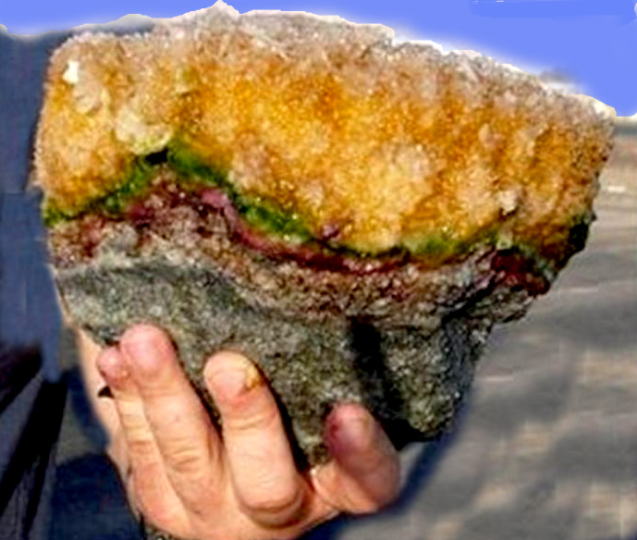
Microbial mats – Eilat IL

Slide 7
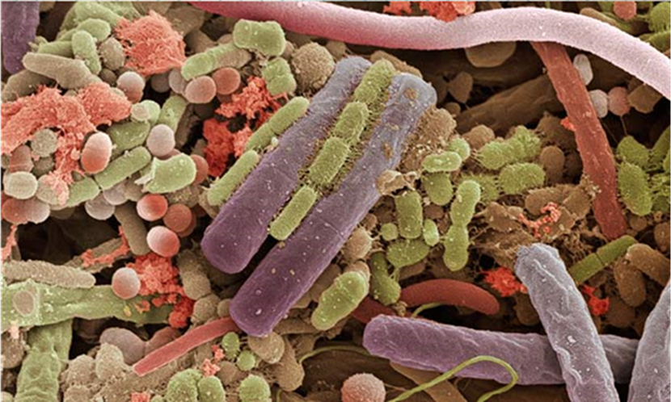
THE MICROORGANISMS LIFE [June 27, 2016]
THE MICROORGANISMS WORLD

Slide 8
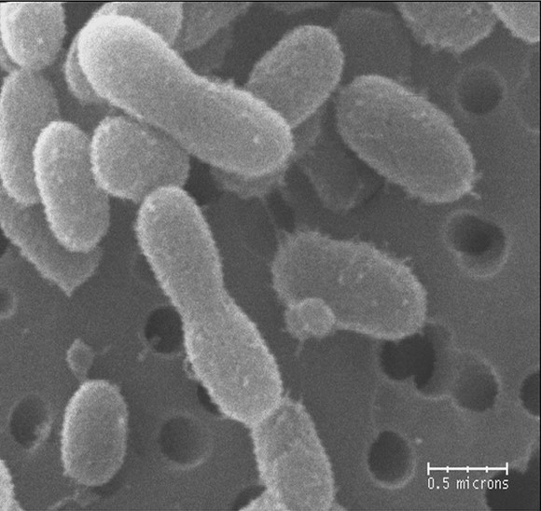
Bacteria revived after over 120,000 years from Greenland frozen glaciers

Slide 9
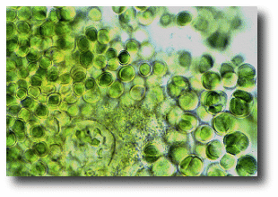
Chroo-coc-cidiopsis (-20C -->+20C, Cyanobacteria-desiccation, candidate for Astrobiology)

Slide 10
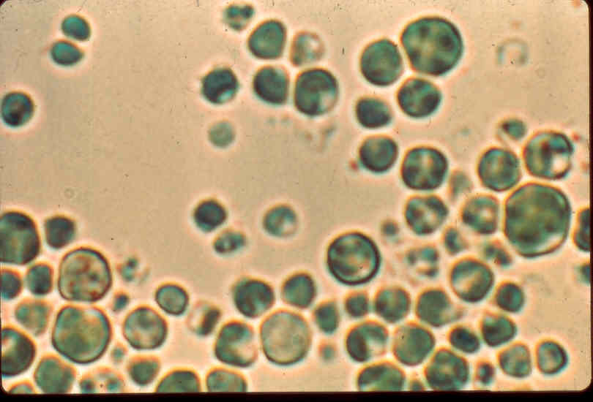
Galdieria sulphoraria
[red algae]

Slide 11
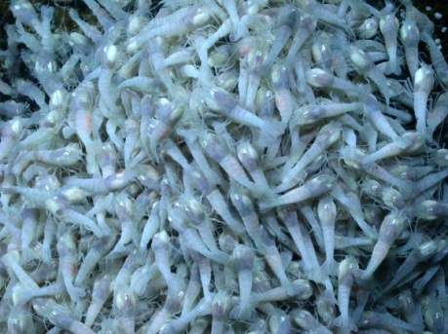
shrimps that lives in hydrothermal vents
Live in hydrothermal vents (areas of hot water) in the Caribbean.

Slide 12
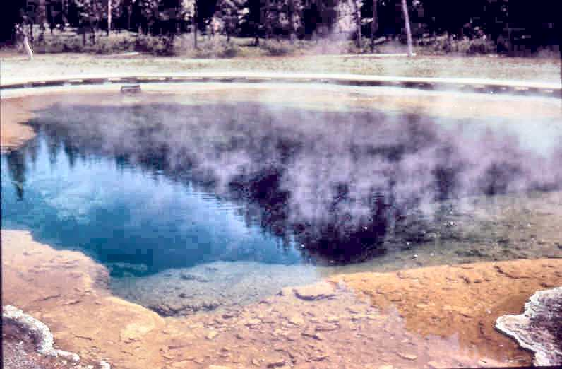
at Yellowstone Hot Spring

Slide 13
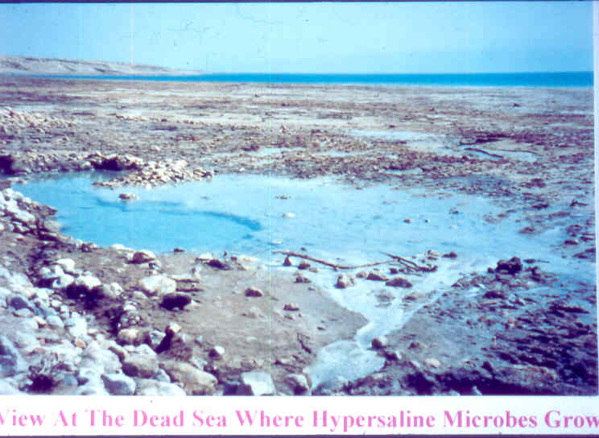
Dead Sea (Israel) where halophiles are growing

Slide 14
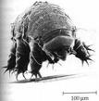

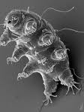
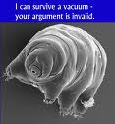
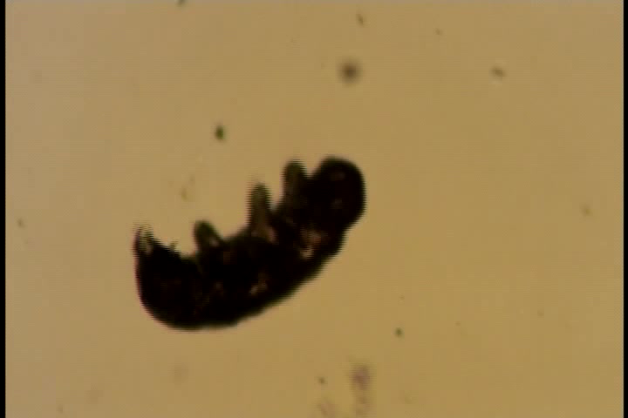

Tardigrades [water bears] Multi-segmented Extremophilic microbes

Slide 15
Tardigrade-[water bear] a Multicellular Extremophile;Tolerate 90C to – 272C
(Horikawa et al 2008, 2012; Schulze-Makuch&Seckbach 2013)

Slide 16
TARDIGRADES – Water Bears- FEATURES,
TARDIGRADES – Water Bears- FEATURES,
Minute animals of 4 segments, length < 1 mm.
Sent to space and survived out of Earth atmosphere [the only organism resisted in space without protection]
Unique distribution in land and waters
Resist cryobiosis of minus 272C and up to plus 180C.
Tolerates vacuum of space.
Could resist the temperature of Mars
Resists dryness and desiccation
Tolerate pressure of 4000 m under sea level and 6000 m at high ranges.
Enters into unhydrobiosis (dormancy for a long period)
Tolerate high irradion doses
May stay in anaerobic condition.

Slide 17
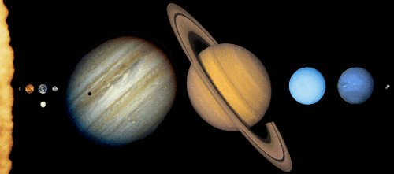
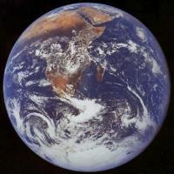
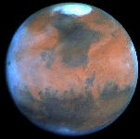
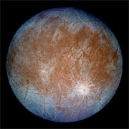
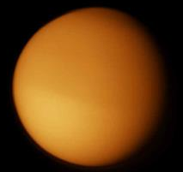
EARTH MARS EUROPA TITAN

Slide 18
CONDITIONS ON MARS
1) DRY
2) COLD
3) UV RADIATION
4) LIQUID WATER
5) CO2 and METHANE [CH4]2 +
LIFE ON MARS? PAST AND PRESENCE ON SUBSURFACE??

Slide 19
New Findings Say Mars Methane Comes from Life or Water — or Both
METHANE could be generated by either
LIFE or WATER, or maybe even BOTH.
MICROORGANISMS living in the Martian
soil could be producing methane gas as a
by-product of their metabolic processes, or
methane might be created as a result of
reactions between volcanic rock and water.
Either way, the prospect is exciting.

Slide 20
ANCIENT LIFE ON MARS ?
EVIDENCE FROM NASA IMAGES OF THE RED PLANET
CONTOURS OF RIVERS,
CANYONS, CRATERS, FLOWING AND RUNNING WATER.

Slide 21
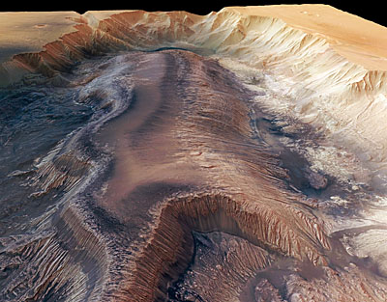
Groundwater May Have Played Important Role in Shaping Mars

Slide 22
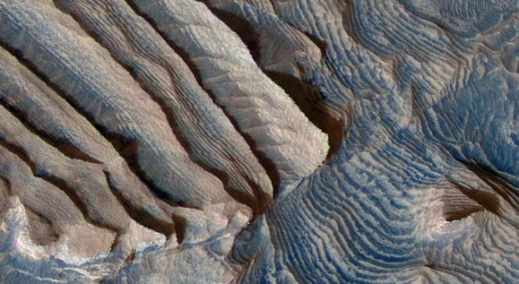
STAIRWAYS ON MARS

Slide 23
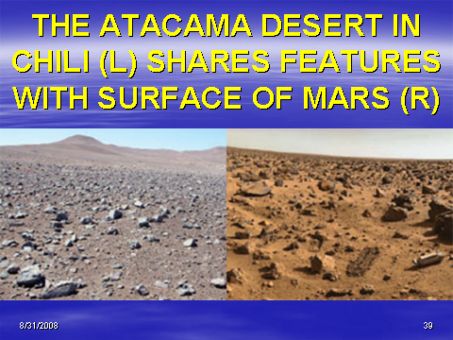
Atacama desert vs. Mars surface

Slide 24
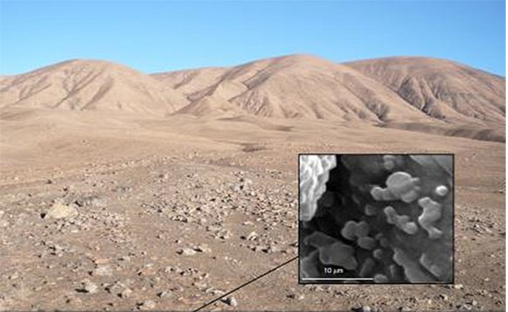
Under Atacama desert is life

Slide 25
From EXTREMOPHILE to EXTRA-TERRESTRIAL LIFE
  THE CHALLENGES
  1) DRY CONDITIONS;
  2) TEMPERATURE EFFECTS
  (HYPER-THERMOPHILES vs.
  PSYCHROPHILES) PRESENT IN
  VARIOUS PLACES, (ANTARCTICA,
  SIBERIA, AND PERMAFROST)

Slide 26
EXTREMOPHILES ~ EXTRATERRESTRIL LIFE
COMPARING EXTREME HABITATS on EARTH with other PLANETS and some SATELLITES [MARS, Europa, Titan, Venus]
THE EXTREMOPHILES as ANALOGUES for LIFE FORMS in CELESTRIAL WORLDS

Slide 27
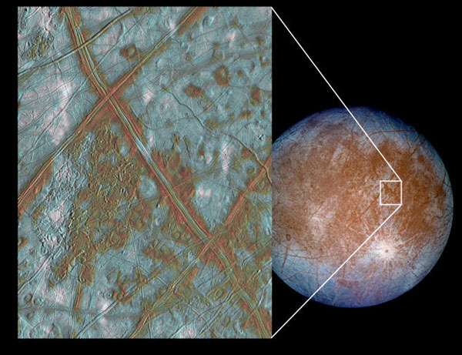
Surface of Europa with moving lines

Slide 28
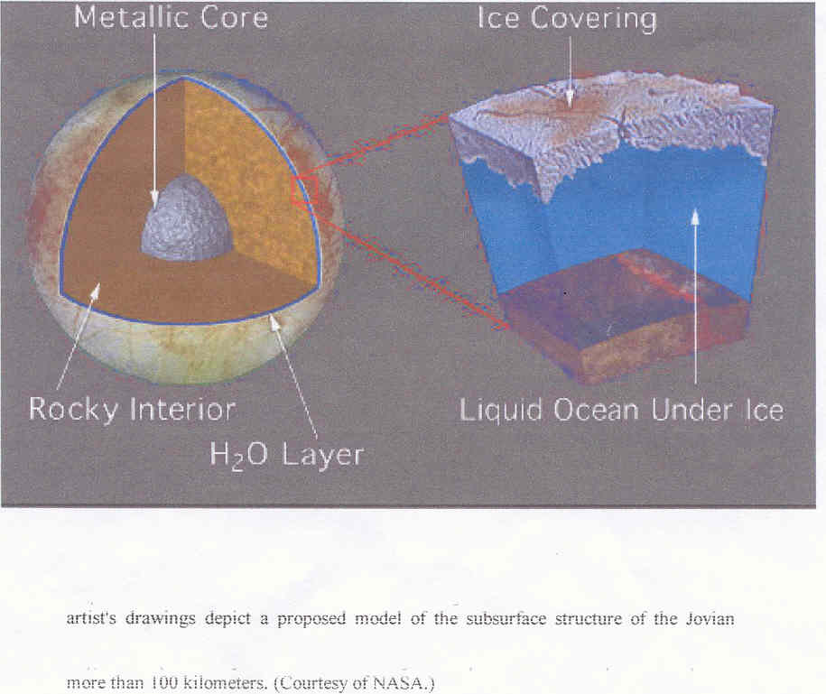
moon EUROPA

Slide 29
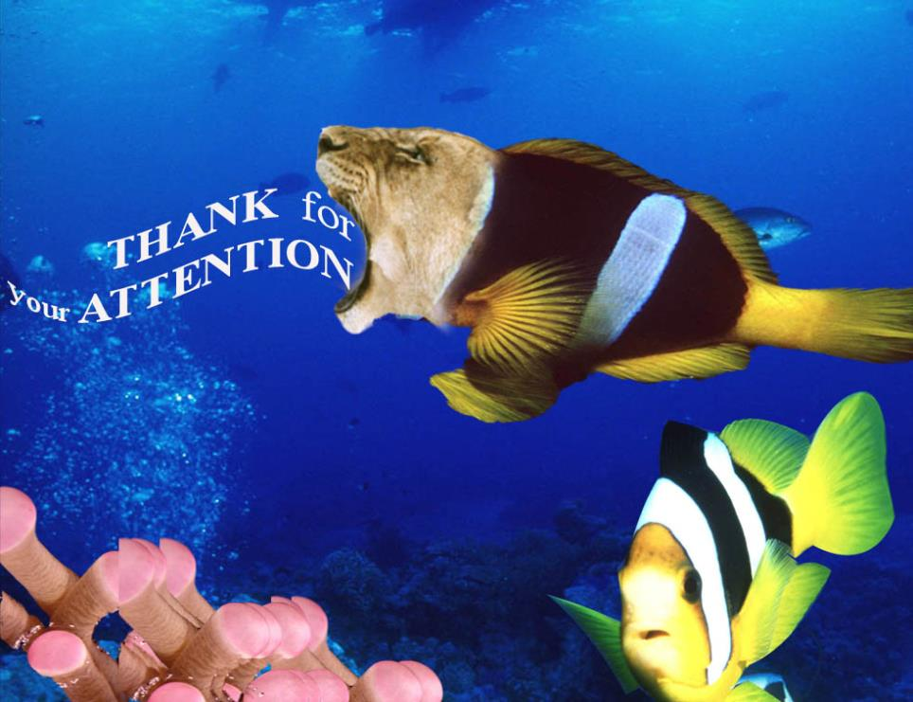

Slide 30
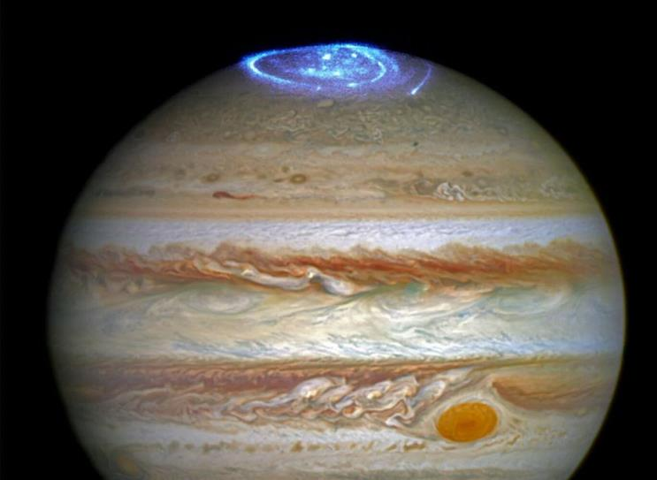
Aurora Jupiter North Pole (Hable Telescope)

Slide 31
SUBSURFACE LIQ. WATER LAKE? SIMILAR TO VOSTOK
IT IS ASSUMED THAT AT THE SUBSURFACE OF MARS AND EUROPA THERE ARE LIQUID WATER LAKES WARMED UP BY THERMO-VOLCANIC SOURCES.

Slide 32
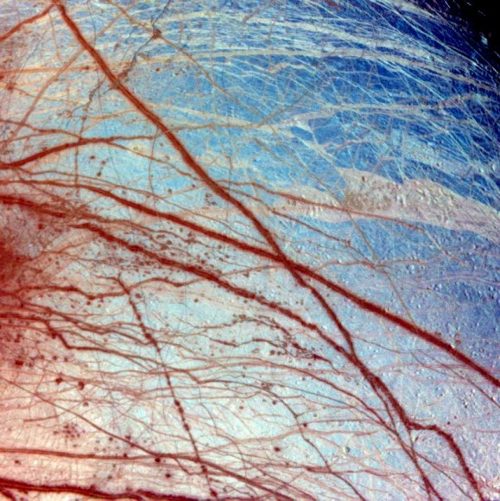
EUROP0A SURFACE

Slide 33
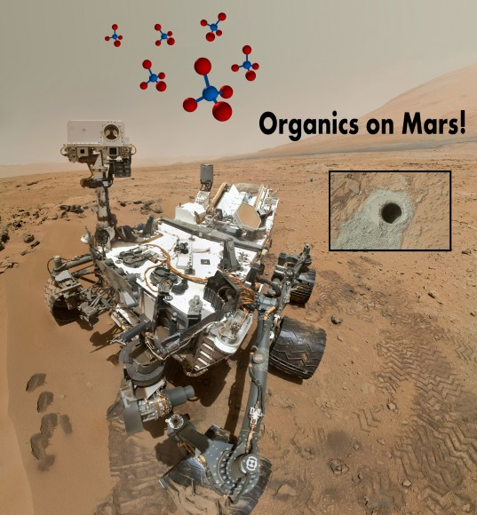
Methane on Mars?
NASA’s Curiosity Rover detects Methane, Organics on Mars ­­­­­­ June 19, 2016

Slide 34
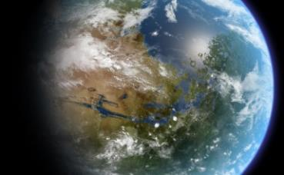
How Do We Terraform Mars?
June 26, 2016
As part of our continuing "Definitive Guide To Terraforming" series, Universe Today is happy to present our guide to terraforming Mars.
At present, there are several plans to put astronauts and ever settlers on the Red Planet. But if we really want to live there someday, we're going to need to do a complete planetary renovation.

Slide 35
Nature 457, 384-385 (22 January 2009)
Is there life on Europa?
Europa: The Search for Life
on Jupiter's Ocean Moon
by Richard Greenberg

Slide 36
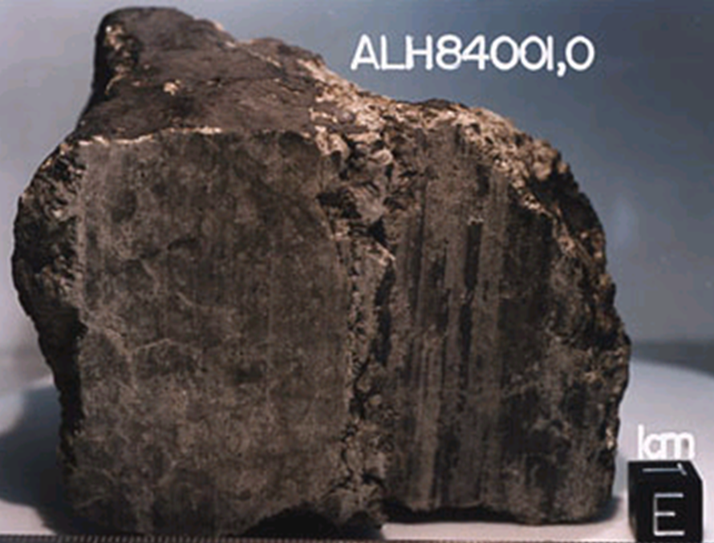
meteorite - from Antarctica
1996
originated from Mars

Slide 37
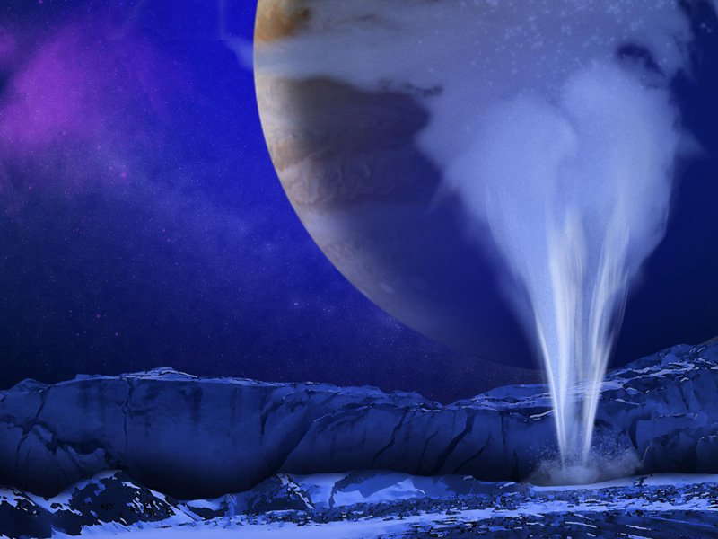
How Could We Detect Life in Europa’s Geysers?
Artist's concept of a water vapor plume on Europa. (NASA/ESA/K. Retherford/SWRI)

Slide 38
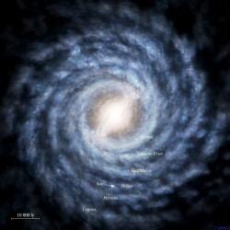
Our Galaxy
SUN

Slide 39
EUROPA OCEAN WORLD
Icy Hot: Europa’s Frozen Crust Could Be Warmer Under its Surface [sub-icy layer]

Slide 40
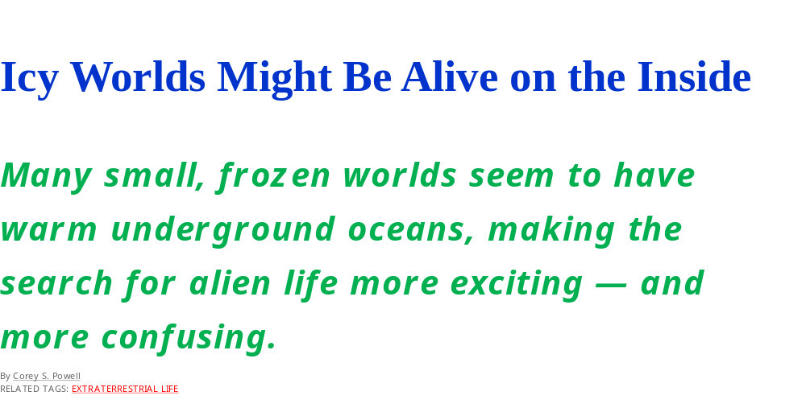
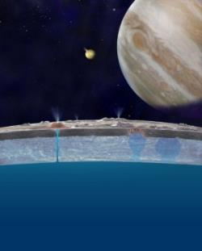

Slide 41
The global ocean on Jupiter’s moon Europa contains about twice the liquid water of all the Earth’s oceans combined. There may be plenty of oxygen available in that ocean to support life, a hundred times more oxygen than previously estimated.

Slide 42
VOSTOK LAKE
(ANTARCTICA)
AT DEPTH OF 4 KM IS A LIQUID WATER LAKE.
DRILLINGS THROUGH ICY LAYERS [UP TO 3.8 KM] HAVE EXPOSED VARIOUS GENERA OF PROKARYOTES & EUKARYOTIC MICROORGANISMS .

Slide 43
CONCLUSIONS
    If Earth microbes can thrive in extreme environments, could it not be that in the future similar microorganisms might also be observe in the above mentioned celestial bodies?
    Furthermore, if bacteria are known to survive for millions of years below glaciers in Antarctica, and in other places on Earth, why would they not thrive underneath the ice caps of Mars, and on the Europan Oceans?
    All the above facts serve to encourage us to intensify our search for biomarkers on the nearby planets and on some of their satellites.

Slide 44
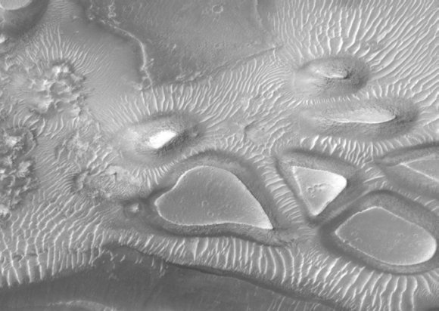
February 15, 2012
With Love from Universe Today
This image from the Mars Global Surveyor shows a heart-shaped crate amid other 'box of chocolates' shapes. Credit: Malin Space Science Systems

Slide 45
Extremophiles under us in land
The discovery of solitary little CRITTERS DEEP BENEATH EARTH'S SURFACE has set the world of microbiology on its head while exciting astrobiologists about the possibility of LIFE ON OTHER PLANETS. A community of BACTERIA WAS FOUND 2.8 KILOMETERS BELOW GROUND IN A GOLDMINE and it lives completely alone and completely independent of any other life forms. It also SUBSISTS WITHOUT SUNLIGHT OR OXYGEN. The species Candidatus Desulforudis audaxviator is an amazing discovery, and represents the kind or Organism that could survive below the surface of mars or saturn's sixth largest moon enceladus.

Slide 46
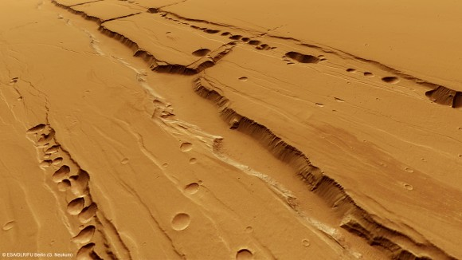
Could There Be Life In Them Thar Pits?
Computer-generated perspective of the Tractus Catena pit chains. Credit: ESA/DLR/FU Berlin

Slide 47
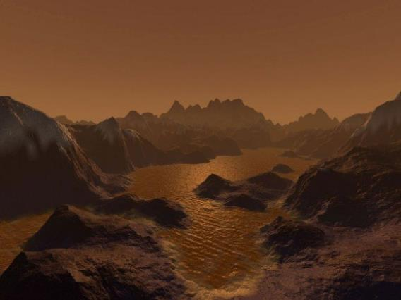
Storms and Lakes on Titan Revealed by Computer Modeling
November 14, 2012
An artist's imagination of hydrocarbon pools, icy and rocky terrain on the surface of
Saturn's largest moon Titan. Image credit: Steven Hobbs (Brisbane, Queensland, Australia).

Slide 48
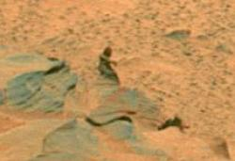
BIG FOOT ON MARS

Slide 49
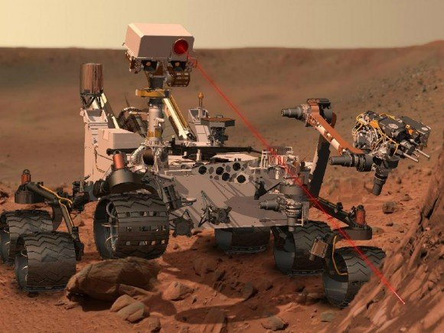
NASA’s Curiosity Search for Signs [Ingredients] of Martian Life work in Gale crater firing a laser on Mars

Slide 50
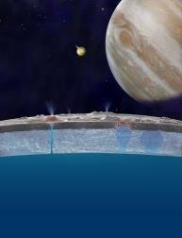
Icy Worlds Might Be Alive on the Inside
Many small, frozen worlds
seem to have warm under-
ground oceans, making the
search for alien life more
exciting — and more confusing.

Slide 51
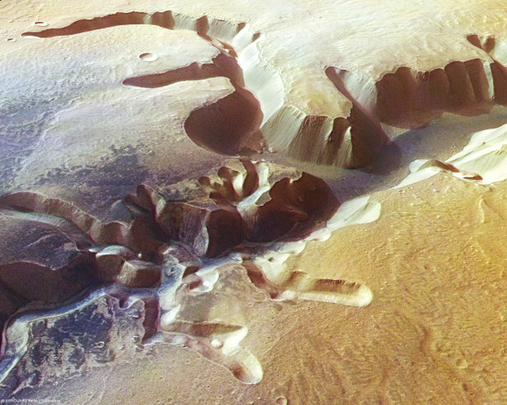
LANDSCAPE ON MARS
E
ese valleys on Mars come from gushes of water from past rainfall, or groundwater springs, or could they have possibly been formed from magma flows on Mars surface?

Slide 52
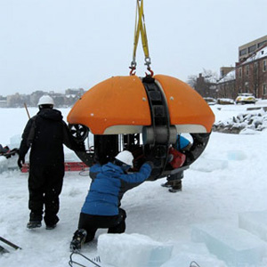
Europa Submarine Prototype
G

Slide 53
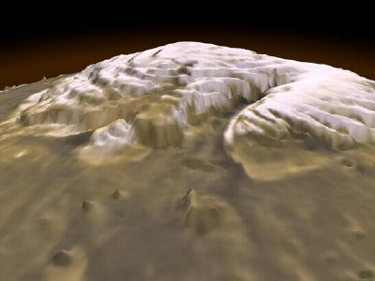
LOTS OF PURE WATER ICE AT MARS NORTH POLE

Slide 54
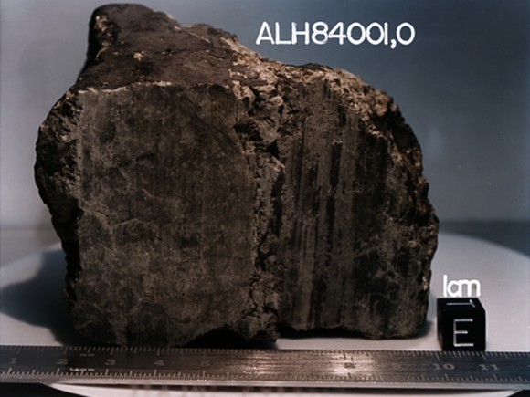
Univers Today – June 21, 2012
Organics Found in Mars Meteorites, But Nothing Biological

Slide 55
Microbes recently discovered 1.6 kilometres (1 mile) below the seabed off the coast of Canada. The living conditions are cramped, environment is a searing 100°C (212F), and yet these hardy cells appear to be thriving.
This new discovery of life so deep below the Earth's surface may set some new limits on just how extreme life can be on other planets…

Slide 56
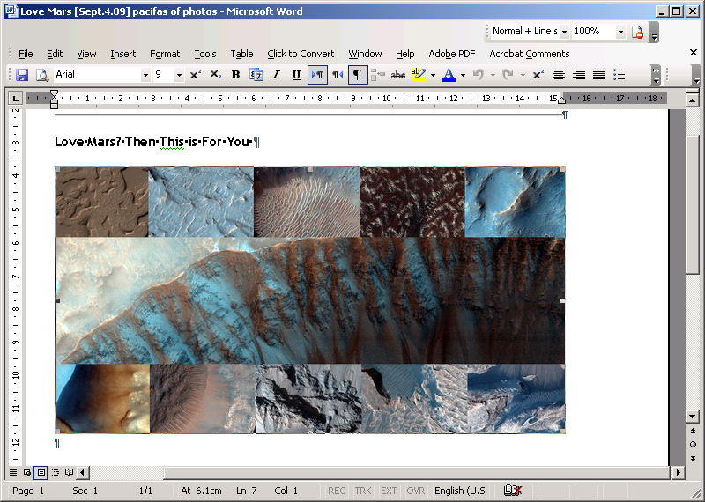
Love Mars? Then This is For You

Slide 57
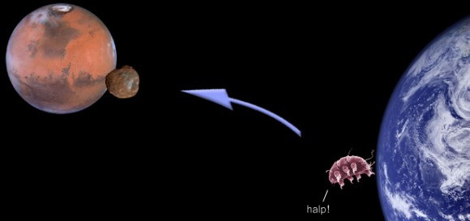
Russian Space Agency send Terrestrial Life to Phobos (Marsia Moon)

Slide 58
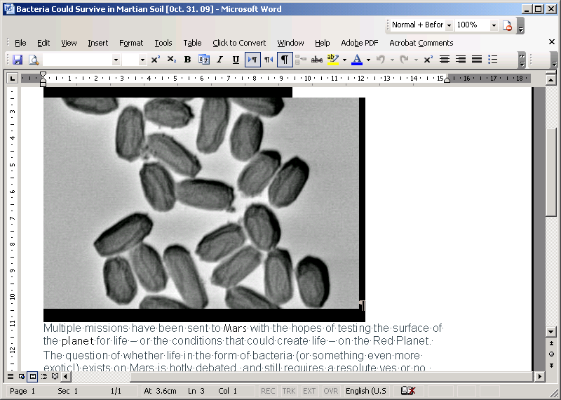
Bacteria can
survive on
Mars

Slide 59
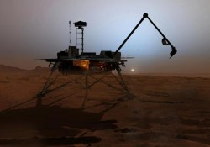
Imminent Discovery of Life On Mars?

Slide 60
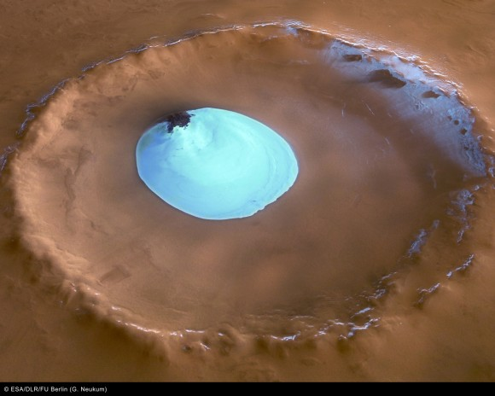

ICE AND WATER ON MARS in a North Pole crater.

Slide 61


Slide 62
Russia delays Lake Vostok drill (press)
Antarctica's hidden water will keep its secrets for another year.
Lake Vostok lies thousands of metres below Vostok Station, the coldest recorded place on Earth.

Slide 63

Archaean Halophiles
Halorhodopsin

Slide 64

TITAN TIDES SUGGESTS A SUBSURFACE OCEAN

Slide 65

Storms And Lakes On Titan Revealed By Computer Modeling

Slide 66


Slide 67


Slide 68

Three genera of the Cyanidia

Slide 69

Dunaliella salina
Green algae around salt x’tals

Slide 70

Titan (satellite of Saturn) organic seas

Slide 71

meteorite

Slide 72

8 YEARS ROVER ON MARS

Slide 73

Ancient Domes Reveal 3.45-billion-year-old
Life History
Rare, paleo-surface view of how conical stromato
lites would appear if one SNORKELED IN THE SHALLOWS
OF A REEF. Ancient, dome-like rock structures contain
clues that life was active on Earth 3.45 billion years
Ago, according to new research — and the findings
could help shed light on life's history on Earth and
other planets, including Mars.

Slide 74
Europa Capable of Supporting Life, Scientist Says
The global ocean on Jupiter’s moon Europa contains about twice the liquid water of all the Earth’s oceans combined. New research by Richard Greenberg of the University of Arizona suggests that there may be plenty of oxygen available in that ocean to support life, a hundred times more oxygen than previously estimated.

Slide 75


Slide 76


Phoenix: "It Must Be Ice"

Slide 77

STENLEY MILLER EXPERIMENT (1953)

Slide 78

Indian scientists flying a giant balloon experiment have announced the discovery of three new species of bacteria from the stratosphere.

Slide 79


Slide 80

Recurring glaciers on the surface of Mars
Mars Was Recently Blanketed By Glaciers

Slide 81

Antarctica’s “Blood Falls” Shows How Aliens Might Live on Ice Worlds

Slide 82

image of a water-carved channels on Mars

Slide 84


Slide 85

An illustration of a dust storm on Mars.

Slide 86
Chroococcidiopsis candidate for Martian inhabitation

Slide 87


Slide 88
QUESTIONS ABOUT ORIGINS
EVIDENCE FOR THE LIFE ON EARTH?
THE STATE OF EARTH ATMOSPHERE
WHEN WAS THE ORIGIN OF LIFE ON EARTH?
WAS: REDUCED? HIGHLY REDUCED? NEUTRAL? OXIDIZED?
WERE ASTROIDS & COMETS SOURCES
OF ORGANICS?

Slide 89
QUESTIONS ABOUT ORIGINS
5) WHEN WAS OXYGEN PHOTOSYN-
THESIS INVENTED?
6) WHEN DID EUKARYOTES ORIGINATE?
7) WAS THERE AN RNA WORLD?
8) WHAT WAS THE SITE OF THE ORIGIN OF LIFE? POND? OCEAN? HYDRO-THERMAL VENTS? SUBSURFACE, PANSPERMIA? MINERAL SURFACE? OR MARINE SHORELINE?

Slide 90
QUESTIONS ABOUT ORIGINS
9) WAS THE FIRST ORGANISM HETERO-
THROPH OR AUTOTHROPH?
10) WAS THE FIRST CELL THERMO-
PHILE or MESOPHILE or PSYCHROPHILES?
11) IS THERE LIFE IN OUR SOLAR SYSTEM
OUTSIDE EARTH?

Slide 91

Martian Settlers May Need Chickens To Conquer The Red Planet
If humanity ever intends upon on settling Mars (by settling We mean a one way trip with no plans on returning back to Earth), they are going to need a whole lot of chickens if they want to survive–let alone thrive–upon the red planet.

Slide 92
Europa Submarine Prototype Gets Another Test
A submersible probe that could possibly be used on Jupiter's icy moon, Europa is taking the next step to test its capabilities. The Environmentally Non-Disturbing Under-ice Robotic Antarctic Explorer, also known as ENDURANCE, will swim untethered under ice, and collect data to create three-dimensional maps of underwater environments. The probe also will take samples of microbial life. Now it will plunge under a permanently ice covered lake in Antarctica that is 40 meters deep.

Slide 93

Dunaliella metabolism

Slide 94

Mars vs. Atacama in Chile

Slide 95

Evidence of water (ice) on Mars ?

Slide 96


Slide 97



Slide 98


Slide 99

Life Found a Mile Below Terrestrial Seabed;
Implications For Life on Mars

Slide 100

Chroococcidiopsis [CB] in rocks (Negev IL)

Slide 101


Slide 102

Dunaliella rich carotene
(as osmotic balance)

Slide 103



TARDIGRADE [water bear]
a Multicellular Extremophile

Slide 104

Salt Deposits on Mars Might Be the Right Place to Search for Life

Slide 105

Phoenix Camera Snaps Frost on Mars

Slide 106


Slide 107


Slide 108

Are Gas-Formed Gullies the Norm on Mars?

Slide 109

Courtesy of Professor Mauro Messerotti – Trieste

Slide 110

Halophiles, Alkaliphiles & Acidophiles
Alkaliphiles
ACIDOPHILES
HALOPHILES

Slide 111
Life on Mars Theory Boosted by New Methane Study
Scientists have ruled out the possibility that methane is delivered to Mars by meteorites, raising fresh hopes that the GAS MIGHT BE GENERATED BY LIFE on the RED PLANET, in research published in Earth and Planetary Science Letters
Science Daily (Dec. 8, 2009)

Slide 112

NASA Finds Shrimp Where No Advanced Life Should Be: 600 Feet Beneath Antarctic Ice

Slide 113

MOTHER EARTH-OUR PLANET

Slide 114


Slide 115

THE CYANIDIUM BOOK

Slide 116

Movement of Tardigrade

Slide 117

.
Credit: NASA/JPL-Calech/University of Arizona
600 Million Year Drought Makes Life on Surface of Mars Unlikely
View of Mars' surface near the north pole from the Phoenix lander

Slide 118

Curiosity Starts First Science on Mars Sojurn –
How Lethal is Space Radiation to Life’s Survival
NASA's Mars Science Laboratory Curiosity rover is currently cruising
to Mars and is already investigating the lethality of the interplanetary
space radiation environment to humans. After touchdown, Curiosity will
investigate Mars' past or present ability to sustain microbial life.
Credit: NASA/JPL-Caltech

Slide 119
Chroo-coc-cidiopsis (-20C -->+20C, desiccation, candidate for Astrobiology)

Slide 120


Slide 121

“YOGI” rock on Mars (5 m)

Slide 122


Blood Falls at Antarctica’s Taylor Glacier.

Slide 123

STROMATOLITES FROM AUSTRALIA

Slide 124

HYDOROTHERMO VENTS

Slide 125


Slide 126
HOSTILE VOLCANIC LAKE TEEMS WITH LIFE
Microbes thriving in salty, alkali waters containing arsenic.
Published online 2 April 2010 [ Nature ]

Slide 127


Slide 128
MICROBIAL DIVERSITY
HALOPHILES
SALINITY (g/l)
0 350
< Eukaryotes – Prokaryotes >
F.W. ORGANISMS EXTREME HALOPHILES
Brackish,marine
Salt lakes
Dead Sea

Slide 129

Mother Earth

Slide 130


NANOBACTERIA FROM MARS
BIOFOSSILS OR INORGANIC MINERALIZATION?

Slide 131
GREENING OF THE RED PLANET [Terraforming]
A hardy microbe from Earth might one day transform the barren ground of Mars into arable soil.

