Slide 1
FROM EXTREMOPHILIC MICROBES TO POSSIBILITIES OF LIFE
Joseph Seckbach
Hebrew University of Jerusalem
joseph.seckbach@mail.huji.ac.il
Preformed in Barcelona, May 12, 2017)

Slide 2
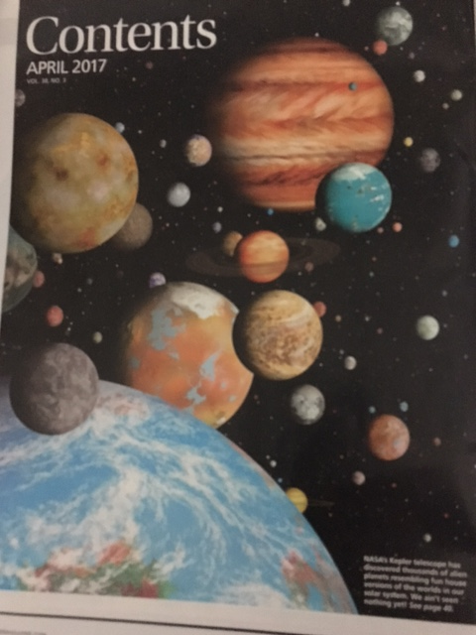

Slide 3


Slide 4
Hydrothermal Vents on Enceladus [satellite of Saturn] release hydrogen Molecules -Hint at Life Beyond Earth
The Cassini spacecraft found chemicals associated [H₂] with life‑giving hydro-thermal activity.

Slide 5
New solar system found to have 7 Earth-size planets
Three may even orbit in the ‘Goldilocks’ zone
The distance to this newly found system is ~ 40 light years.
by ASHLEY YEAGER – science magAZINe. FEB 23, 2017

Slide 6

Algae and Cyanobaeteria in the Extreme Environments
Edited by J.Seckbach

Slide 7
Hydrothermal Vents on Enceladus
[satellite of Saturn] release [H2] hydrogen Molecules -Hint at Life Beyond Earth.
The Cassini spacecraft found chemicals associated [H₂] with life‑giving hydro-thermal activity.
[Discover Mag. APRIL 20, 2017]

Slide 8
AMONG THE poly-EXTREMOPHILES SURVIVING IN HARSH CONDITIONS ARE:
HALOPHILES and hyper saline environments (salt lovers)
TEMPERATURE ( high and low)
PH RANGES (acidophilic and alkaliphiles)
PRESSURES Barophiles (living under high pressure in deep sea vents) deep life on Earth. Microorganisms found 633 m. below sea floor and under 2833 m of ocean waters (in N.W. USA).Microbial life in deepest spot on Earth (Mariana Trench)
CAPNOPHILES [organism loving CO2, such as Cyanidium caldarium]
OSMOPHILES (surviving in high sugar environment)
ANAEROBIC HABITATS lacking oxygen
XEROPHILES (living in hot desert with little water)
ENDOLITES-dwelling on rocks and caves.
TOLERATES RADIATION (Reinococcus radiodorans)

Slide 9
MISCELLANEOUS – microorganisms survival
Among extremophiles are: Archea-bacteria-Eukaryotes as fungi-Lichen-spores – worms-animals
Bacteria spores of >40 million year old - found in Earth.
Microorganisms lasted in outer Space
Mars possible survival of microorganisms inside rocks (play the song of Green Fields)

Slide 10
PLACES ON EARTH FOR EXTREMOPHILES
Hypersaline lakes
Arid region
Deep sea
Acidic sites [thermo acidic lakes] Rio Tinto river (ES); Yellowstone NP, Antarctica,
Cold and dry Polar region and permafrost
EXTREMOPHILES COULD SERVE POSSIBLE AS MODEL OR FOR EXTRATERRESTRIAL LIFE.
POMPEII WORMS-Alvinella pompejana, the Pompeii worm, is a species of deep-sea polychaete worm (commonly referred to as "bristleworms"). It is an extremophile found only at hydrothermal vents in the Pacific Ocean, discovered in the early 1980s off the Galápagos Islands by French marine biologists.
ANTARCTICA KRIL (crustacean)

Slide 11
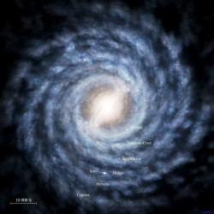
Our Galaxy
SUN

Slide 12
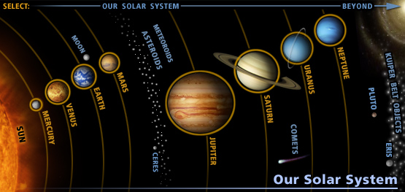
SOLAR SYSTEM

Slide 13

*THE EXTREMOPHILES & POLYEXTREMOPHILES
* TEMPERATURE [High-Low]
* pH EFFECTS
(Acidophiles Vs. Alkaliphiles)
* PRESSURES
(Barophiles, Piezophiles)
* UV EFFECTS
* LIFE IN GASES (CO₂, NH₃, CH₄)

Slide 14
NEW DISCOVERY OF UNDERSURFACE BACTERIA
The discovery of solitary little CRITTERS DEEP BENEATH EARTH'S SURFACE. A community of bacteria was found 2.8 kilometers below ground in a gold-mine and it lives completely alone and completely independent of any other life forms. It also subsists without sunlight or oxygen. They represents the kind or organism that could survive below the Earth surfacesor some satellits.

Slide 15
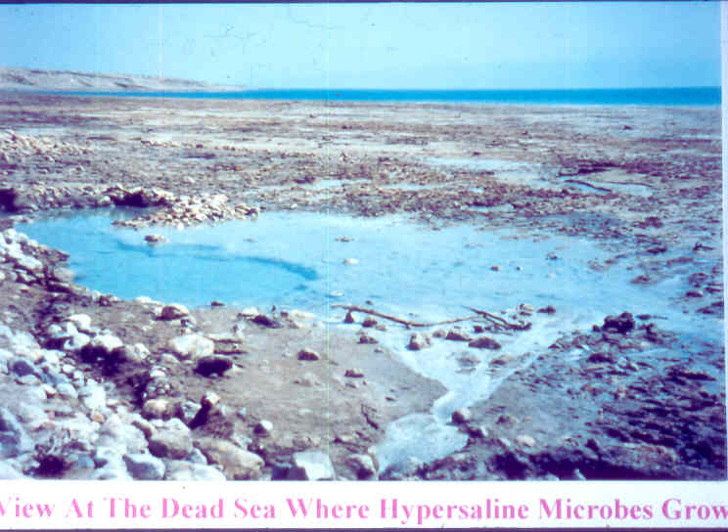
Dead Sea (Israel) where halophiles are growing

Slide 16
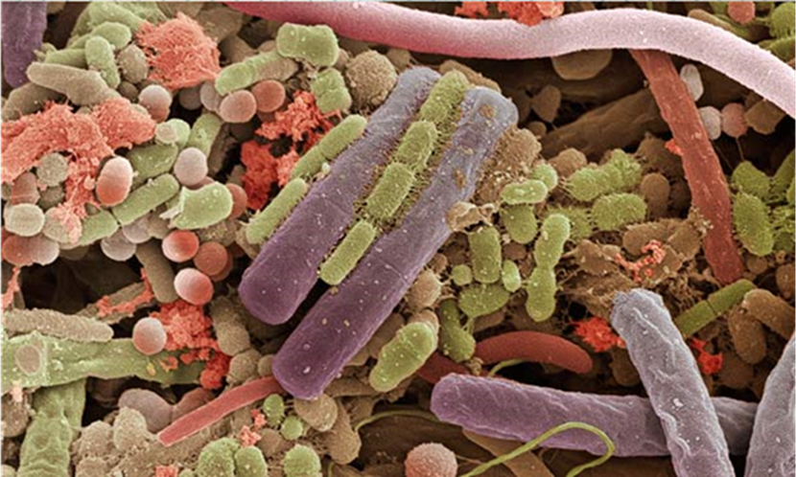
THE MICROORGANISMS LIFE [June 27, 2016]
THE MICROORGANISMS WORLD

Slide 17
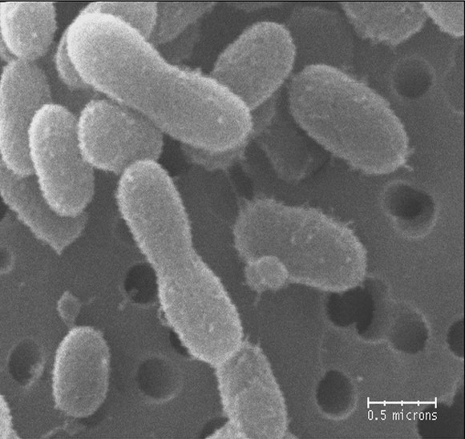
Bacteria revived after over 120,000 years from Greenland frozen glaciers

Slide 18
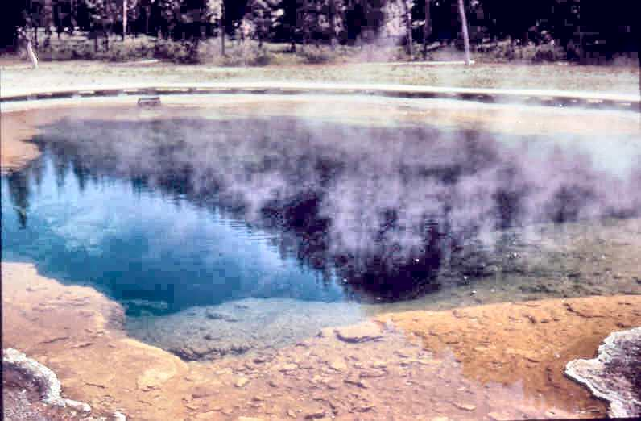
at Yellowstone Hot Spring

Slide 19
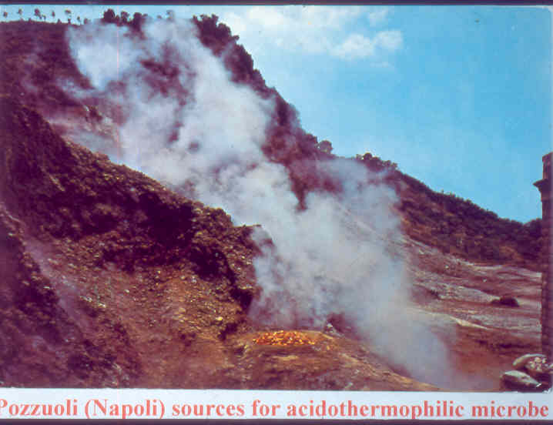

Slide 20
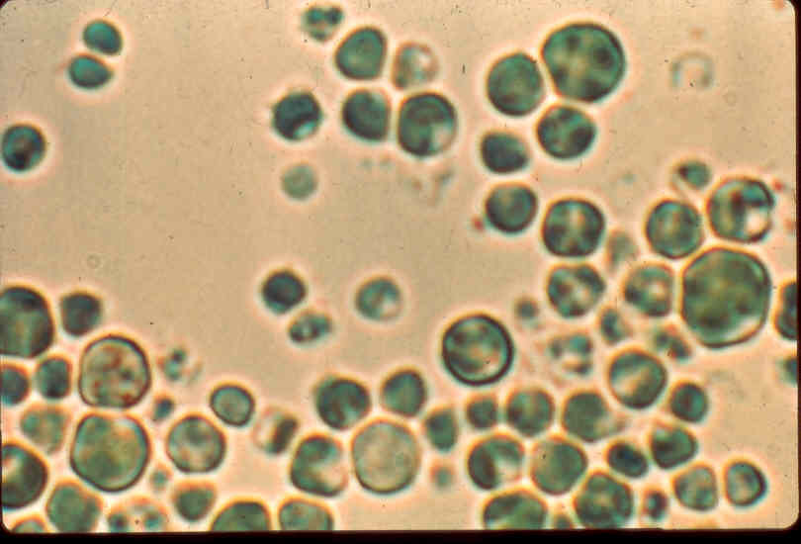
Galdieria sulphoraria
[red algae]

Slide 21
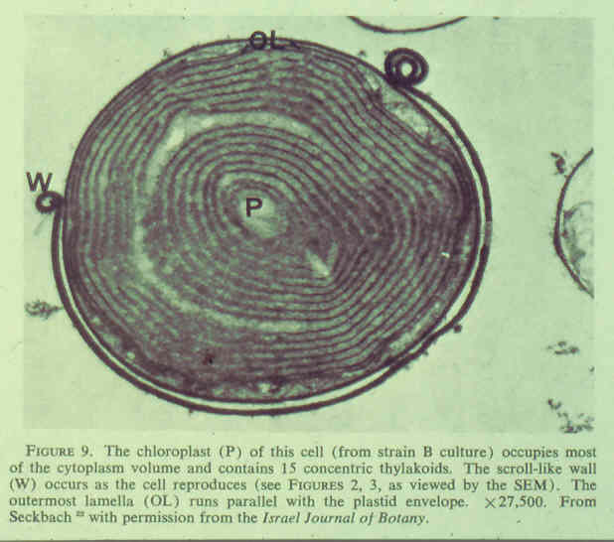

Slide 22
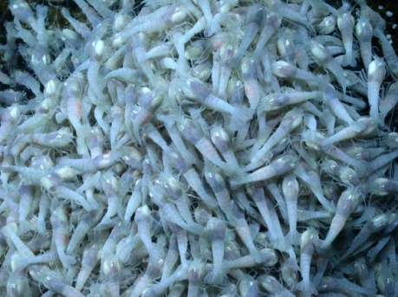
shrimps that lives in hydrothermal vents
Live in hydrothermal vents (areas of hot water) in the Caribbean.

Slide 23
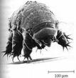

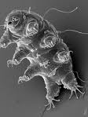
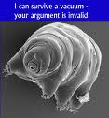
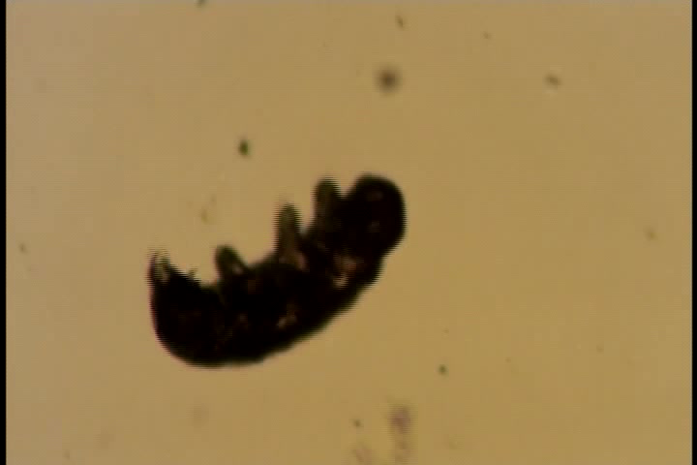

Tardigrades [water bears] Multi-segmented Extremophilic microbes

Slide 24
Tardigrade-[water bear] a Multicellular Extremophile;Tolerate 90C to – 272C
(Horikawa et al 2008, 2012; Schulze-Makuch&Seckbach 2013)

Slide 25
TARDIGRADES – Water Bears- FEATURES,
TARDIGRADES – Water Bears- FEATURES,
Minute animals of 4 segments, length < 1 mm.
Sent to space and survived out of Earth atmosphere [the only organism resisted in space without protection]
Unique distribution in land and waters
Resist cryobiosis of minus 272C and up to plus 180C.
Tolerates vacuum of space.
Could resist the temperature of Mars
Resists dryness and desiccation
Tolerate pressure of 4000 m under sea level and 6000 m at high ranges.
Enters into unhydrobiosis (dormancy for a long period)
Tolerate high irradion doses
May stay in anaerobic condition.

Slide 26
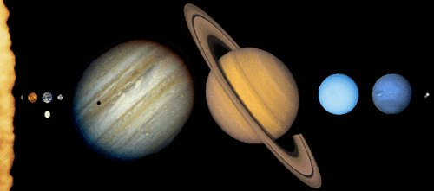
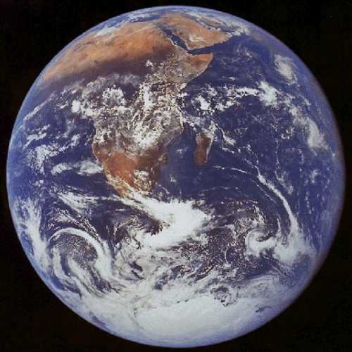
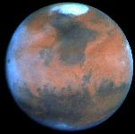
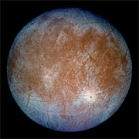
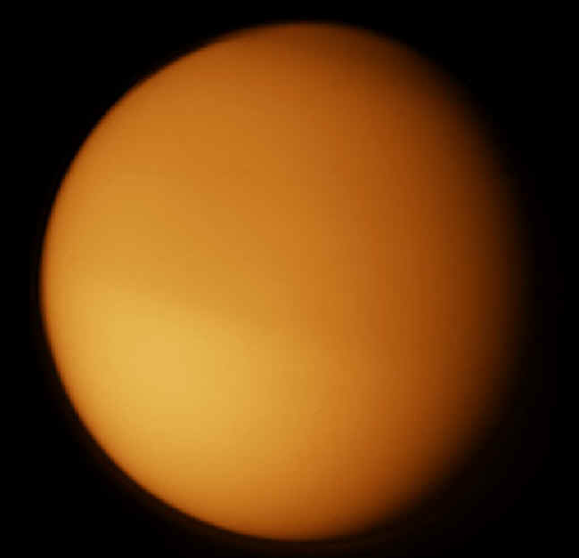
EARTH MARS EUROPA TITAN, ENCELADUS

Slide 27
CONDITIONS ON MARS
1) DRY
2) COLD
3) UV RADIATION
4) LIQUID WATER
5) CO2 and METHANE [CH4]2 +
LIFE ON MARS? PAST AND PRESENCE ON SUBSURFACE??

Slide 28
ANCIENT LIFE ON MARS ?
EVIDENCE FROM NASA IMAGES OF THE RED PLANET
CONTOURS OF RIVERS,
CANYONS, CRATERS, FLOWING AND RUNNING WATER.

Slide 29
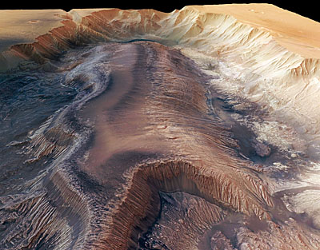
Groundwater May Have Played Important Role in Shaping Mars

Slide 30
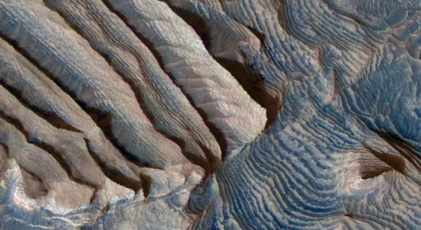
STAIRWAYS ON MARS

Slide 31
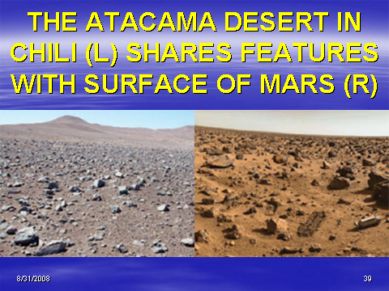
Atacama desert vs. Mars surface

Slide 32
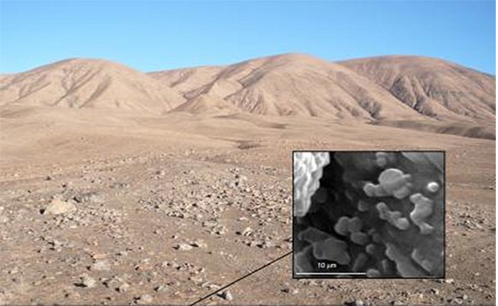
Under Atacama desert is life

Slide 33
From EXTREMOPHILE to EXTRA-TERRESTRIAL LIFE
  THE CHALLENGES
  1) DRY CONDITIONS;
  2) TEMPERATURE EFFECTS
  (HYPER-THERMOPHILES vs.
  PSYCHROPHILES) PRESENT IN
  VARIOUS PLACES, (ANTARCTICA,
  SIBERIA, AND PERMAFROST)

Slide 34
EXTREMOPHILES ~ EXTRATERRESTRIL LIFE
COMPARING EXTREME HABITATS on EARTH with other PLANETS and some SATELLITES [MARS, Europa, Titan, Enceladus, Venus]
THE EXTREMOPHILES as ANALOGUES for LIFE FORMS in CELESTRIAL WORLDS

Slide 35
SUBSURFACE LIQ. WATER LAKES SIMILAR TO VOSTOK
AT THE SUB-ICY DEAPH OF MARS AND SATELLITES [AS EUROPA & ENCELADUS] ARE LIQUID WATER LAKES WARMED UP BY THERMO-VOLCANIC SOURCES. LIFE?

Slide 36
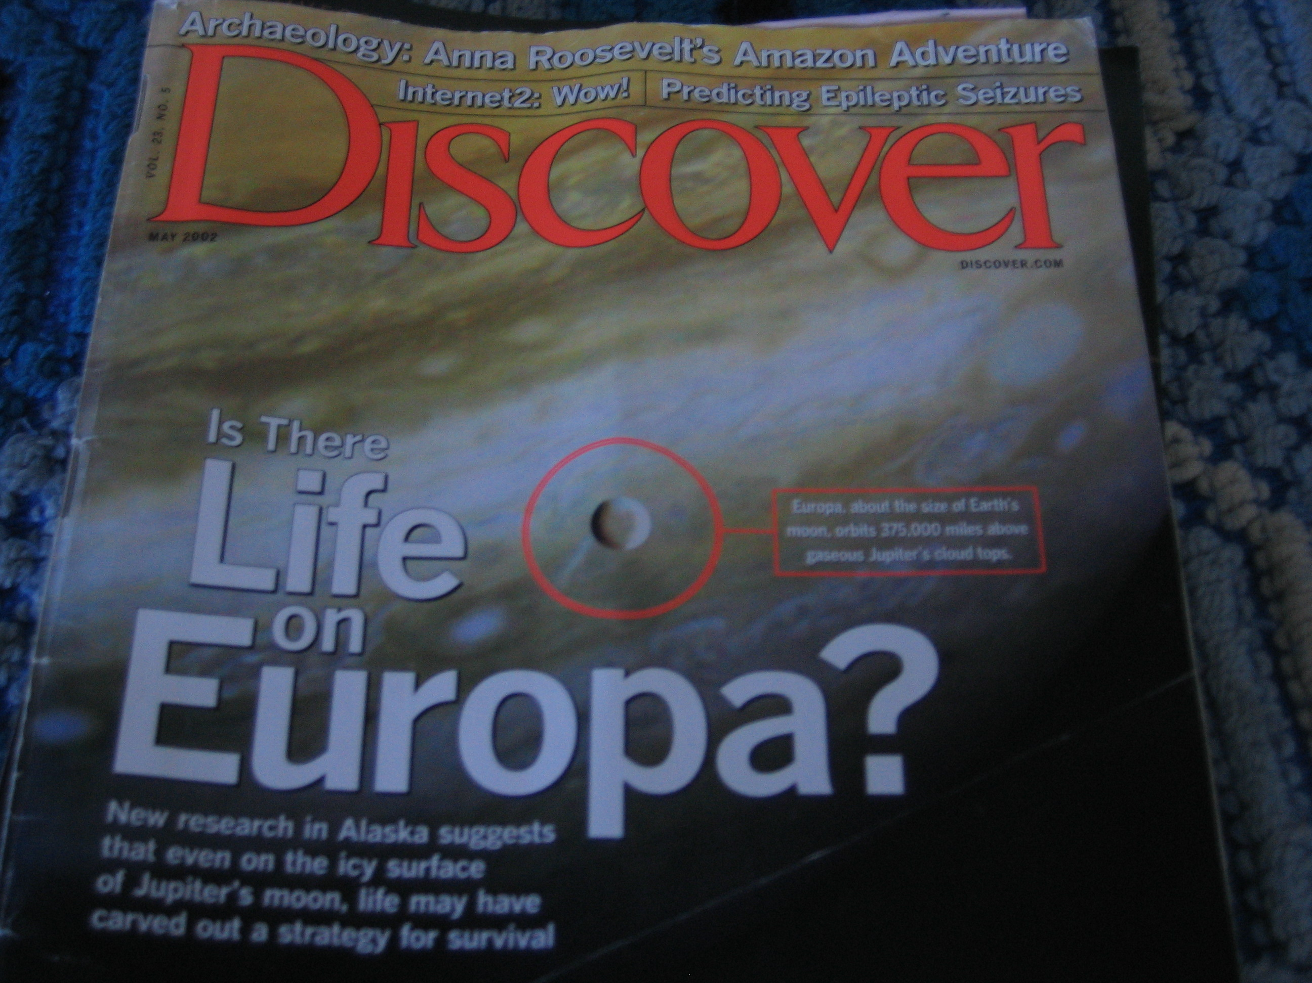

Slide 37
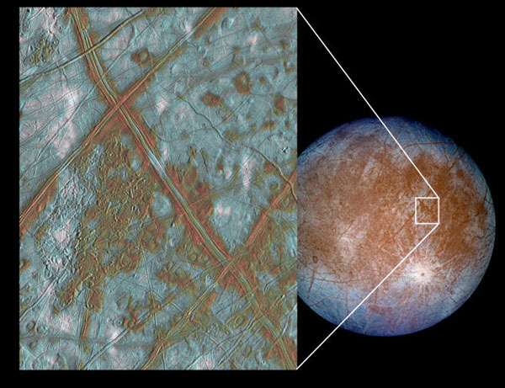
Surface of Europa with moving lines

Slide 38
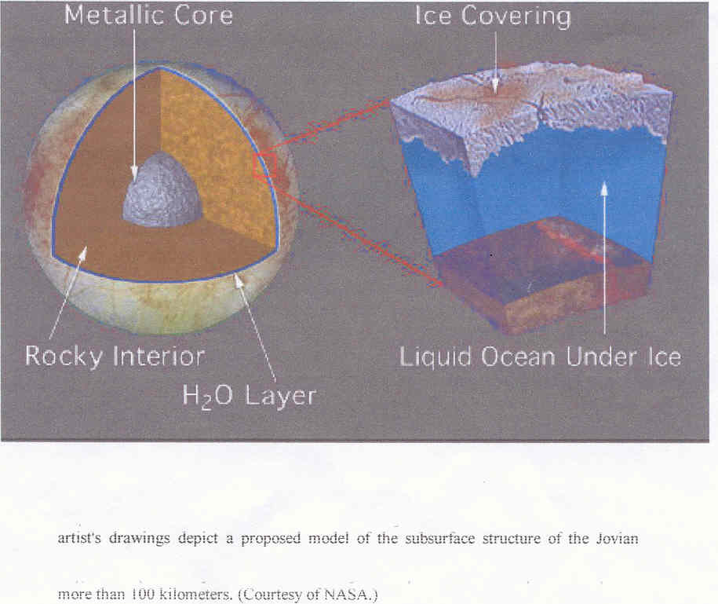
moon EUROPA

Slide 39
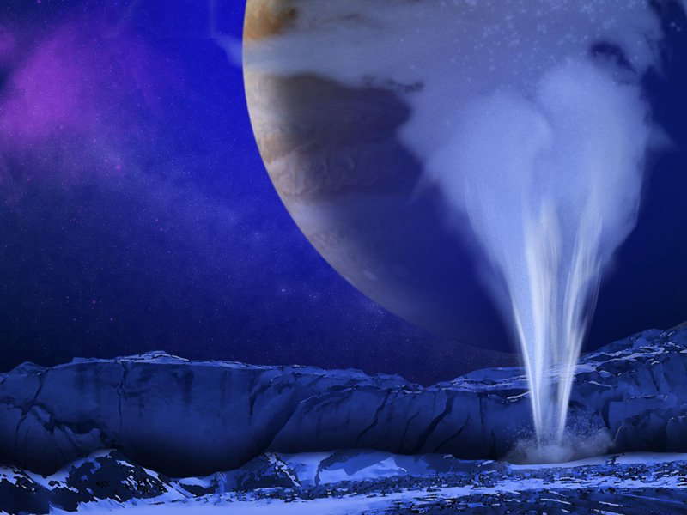
How Could We Detect Life in Europa’s Geysers?
Artist's concept of a water vapor plume on Europa. (NASA/ESA/K. Retherford/SWRI)

Slide 40
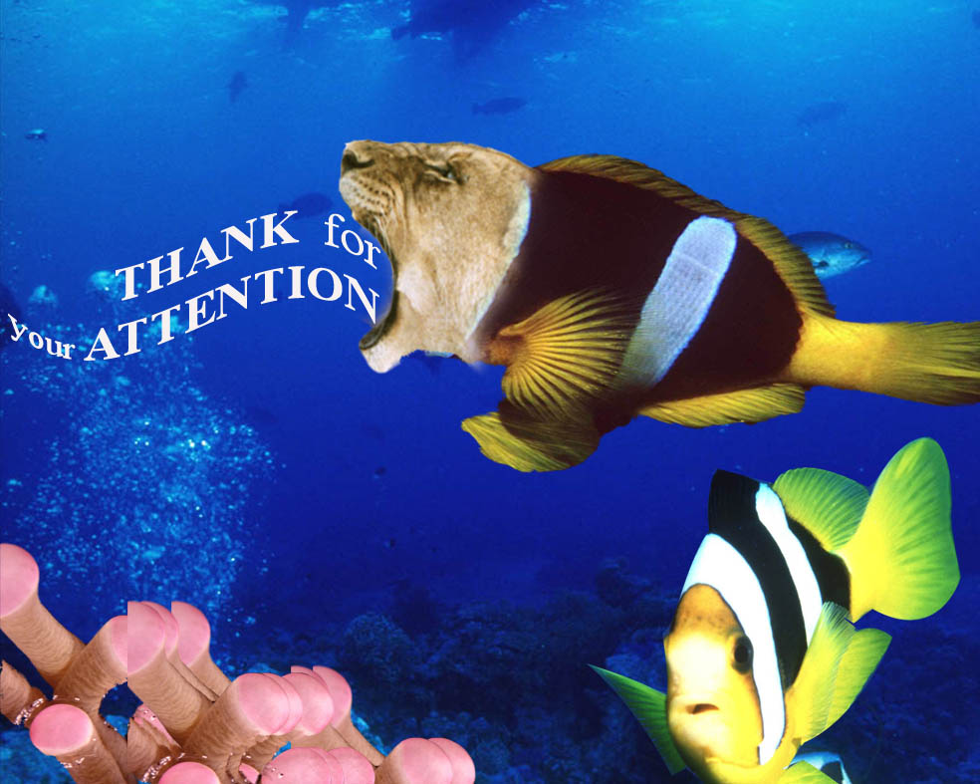

Slide 41
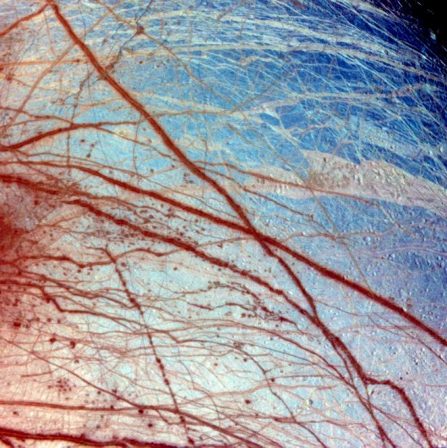
EUROP0A SURFACE

Slide 42
New Findings Say Mars Methane Comes from Life or Water — or Both
METHANE could be generated by either
LIFE or WATER, or maybe even BOTH.
MICROORGANISMS living in the Martian
soil could be producing methane gas as a
by-product of their metabolic processes, or
methane might be created as a result of
reactions between volcanic rock and water.
Either way, the prospect is exciting.

Slide 43
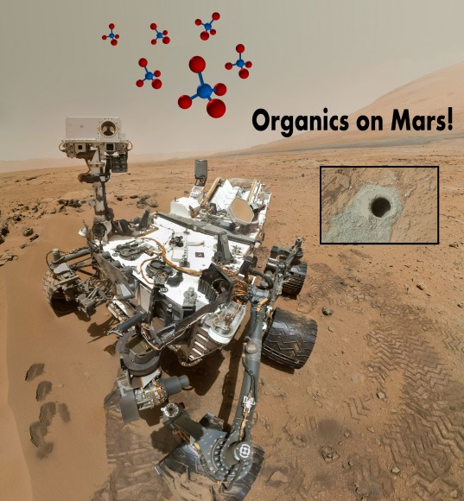
Methane on Mars?
NASA’s Curiosity Rover detects Methane, Organics on Mars ­­­­­­ June 19, 2016

Slide 44
VOSTOK LAKE
(ANTARCTICA)
AT DEPTH OF 4 KM IS A LIQUID WATER LAKE.
DRILLINGS THROUGH ICY LAYERS [UP TO 3.8 KM] HAVE EXPOSED VARIOUS GENERA OF PROKARYOTES & EUKARYOTIC MICROORGANISMS .

Slide 45
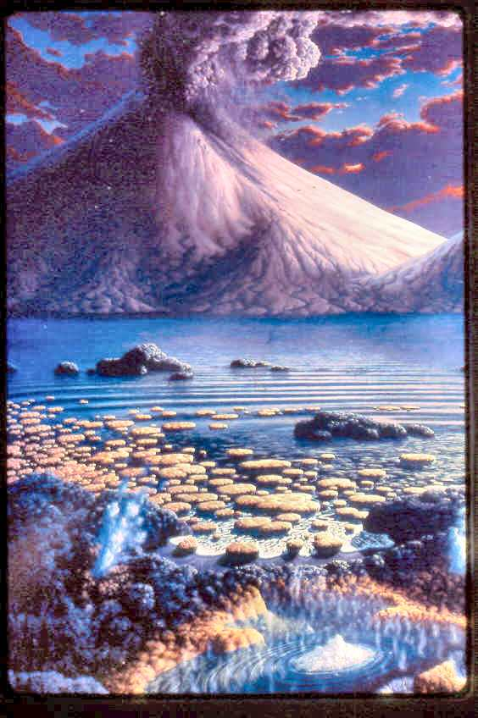
STROMATOLITES

Slide 46
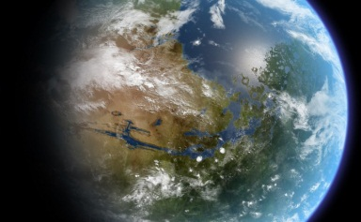
How Do We Terraform Mars?
June 26, 2016
As part of our continuing "Definitive Guide To Terraforming" series, Universe Today is happy to present our guide to terraforming Mars.
At present, there are several plans to put astronauts and ever settlers on the Red Planet. But if we really want to live there someday, we're going to need to do a complete planetary renovation.

Slide 47
Nature 457, 384-385 (22 January 2009)
Is there life on Europa?
Europa: The Search for Life
on Jupiter's Ocean Moon
by Richard Greenberg

Slide 48
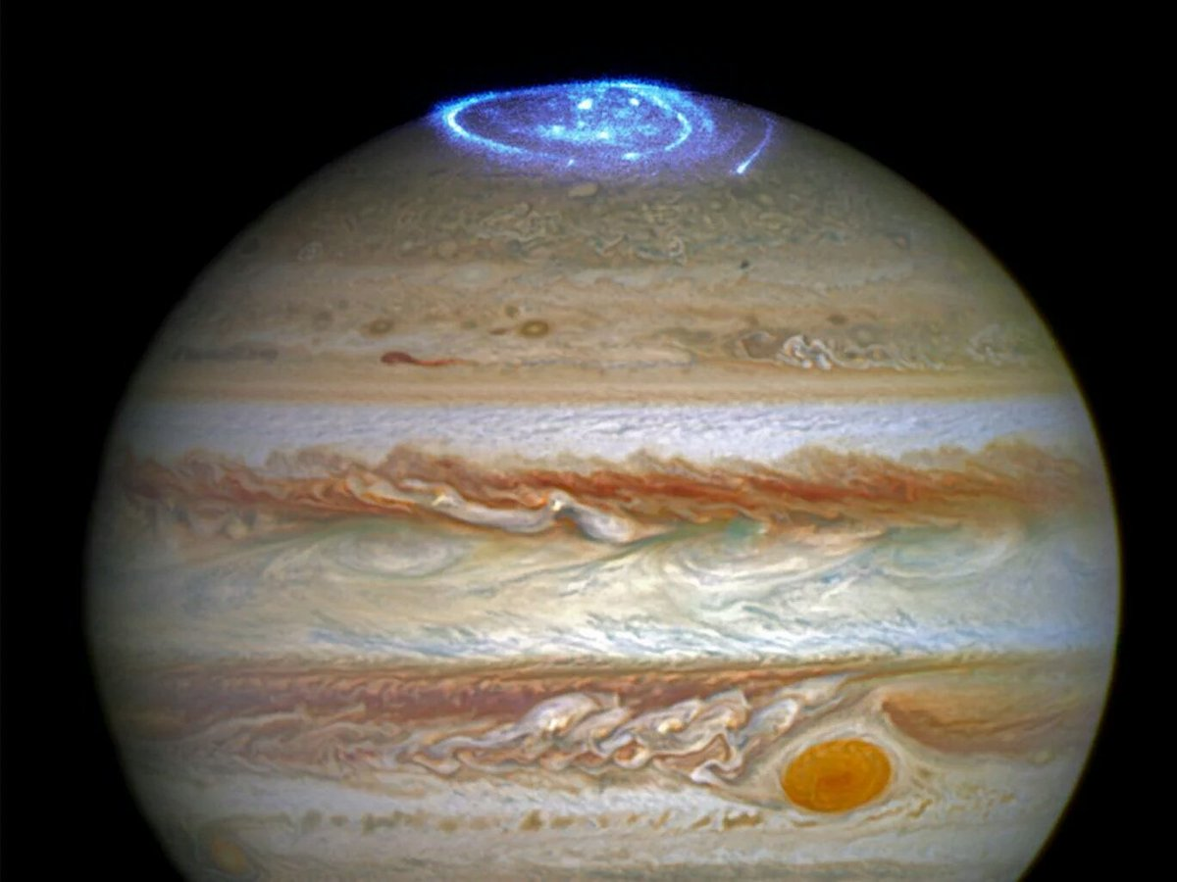
Aurora Jupiter North Pole (Hable Telescope)

Slide 49
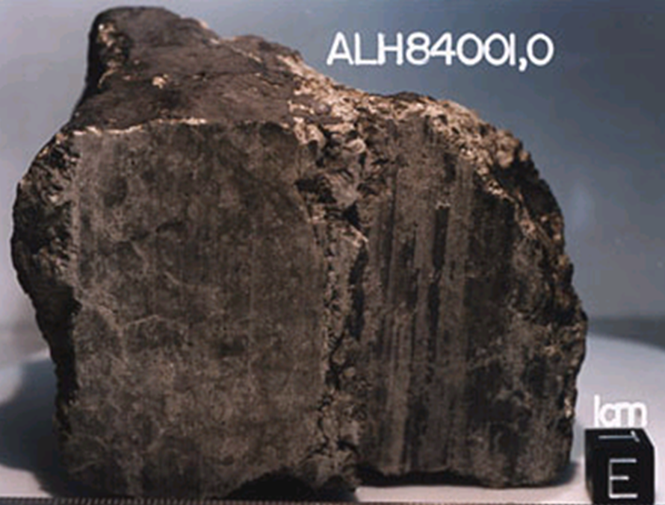
meteorite - from Antarctica
1996
originated from Mars

Slide 50
Tardigrades Multisegmented Extremophilic microbes

Slide 51
EUROPA OCEAN WORLD
Icy Hot: Europa’s Frozen Crust Could Be Warmer Under its Surface [sub-icy layer]

Slide 52
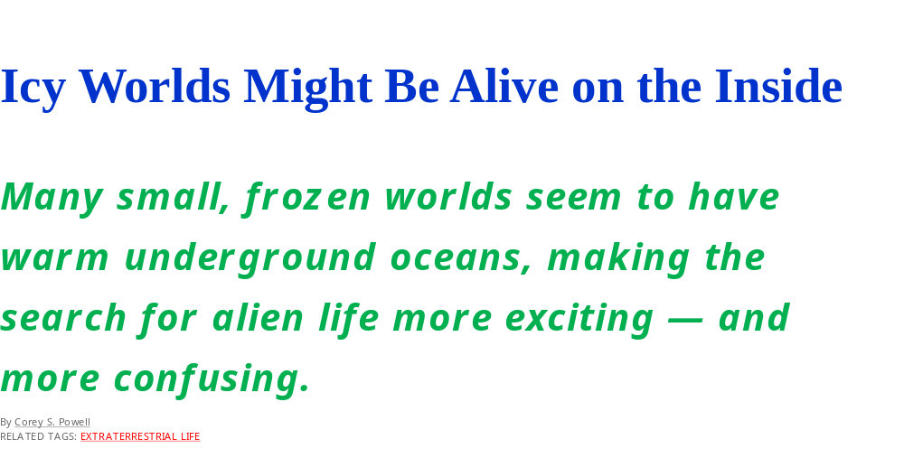
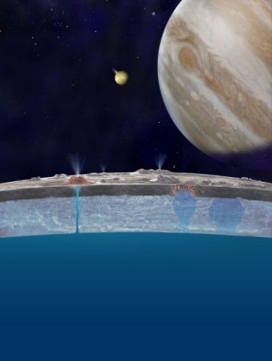

Slide 53
The global ocean on Jupiter’s moon Europa contains about twice the liquid water of all the Earth’s oceans combined. There may be plenty of oxygen available in that ocean to support life, a hundred times more oxygen than previously estimated.

Slide 54
CONCLUSIONS
    If Earth microbes can thrive in extreme environments, could it not be that in the future similar microorganisms might also be observe in the above mentioned celestial bodies?
    Furthermore, if bacteria are known to survive for millions of years below glaciers in Antarctica, and in other places on Earth, why would they not thrive underneath the ice caps of Mars, and on the Europan Oceans?
    All the above facts serve to encourage us to intensify our search for biomarkers on the nearby planets and on some of their satellites.

Slide 55
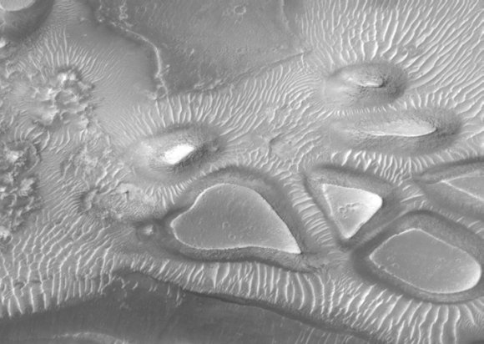
February 15, 2012
With Love from Universe Today
This image from the Mars Global Surveyor shows a heart-shaped crate amid other 'box of chocolates' shapes. Credit: Malin Space Science Systems

Slide 56
Extremophiles under us in land
CRITTERS DEEP BENEATH EARTH'S SURFACE has set the world of microbiology on its head while exciting astrobiologists about the pof LIFE ON OTHER PLANETS. A community of
BACTERIA WAS FOUND 2.8 KILOMETERS BELOW GROUND IN A GOLDMINE SUBSISTS WITHOUT SUNLIGHT OR OXYGEN. The species Candidatus Desulforudis audaxviator is an amazing discovery, and or Organism that could survive below the surface of mars or saturn's sixth largest moon enceladus.

Slide 57
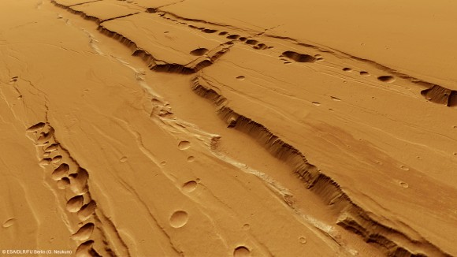
Could There Be Life In Them Thar Pits?
Computer-generated perspective of the Tractus Catena pit chains. Credit: ESA/DLR/FU Berlin

Slide 58
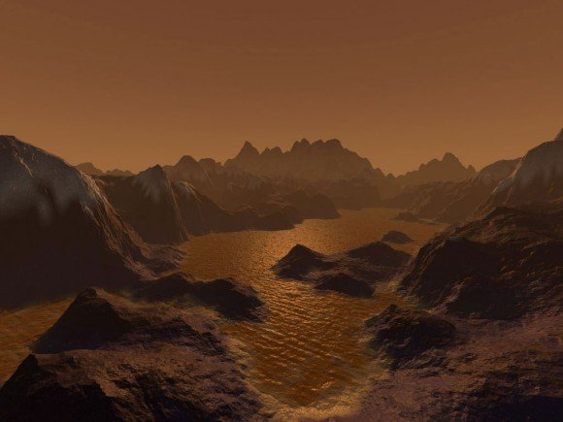
Storms and Lakes on Titan Revealed by Computer Modeling
November 14, 2012
An artist's imagination of hydrocarbon pools, icy and rocky terrain on the surface of
Saturn's largest moon Titan. Image credit: Steven Hobbs (Brisbane, Queensland, Australia).

Slide 59
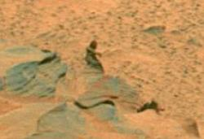
BIG FOOT ON MARS

Slide 60
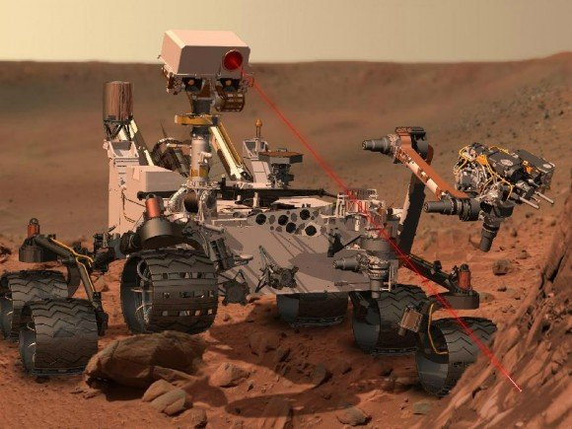
NASA’s Curiosity Search for Signs [Ingredients] of Martian Life work in Gale crater firing a laser on Mars

Slide 61

Icy Worlds Might Be Alive on the Inside
Many small, frozen worlds
seem to have warm under-
ground oceans, making the
search for alien life more
exciting — and more confusing.

Slide 62
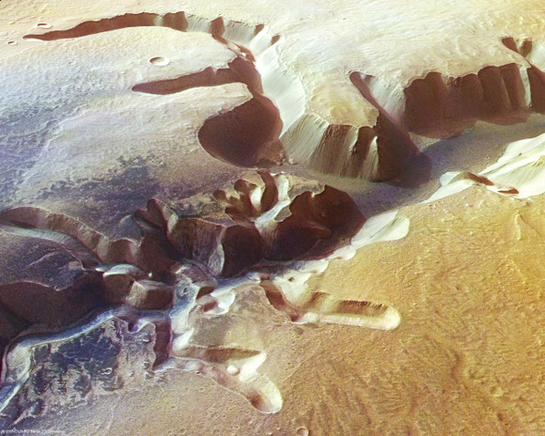
LANDSCAPE ON MARS
E
ese valleys on Mars come from gushes of water from past rainfall, or groundwater springs, or could they have possibly been formed from magma flows on Mars surface?

Slide 63
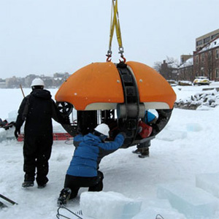
Europa Submarine Prototype
G

Slide 64
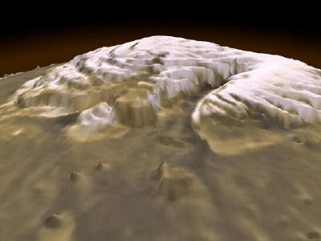
LOTS OF PURE WATER ICE AT MARS NORTH POLE

Slide 65
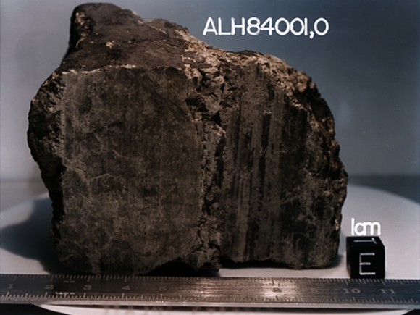
Univers Today – June 21, 2012
Organics Found in Mars Meteorites, But Nothing Biological

Slide 66
Microbes recently discovered 1.6 kilometres (1 mile) below the seabed off the coast of Canada. The living conditions are cramped, environment is a searing 100°C (212F), and yet these hardy cells appear to be thriving.
This new discovery of life so deep below the Earth's surface may set some new limits on just how extreme life can be on other planets…

Slide 67
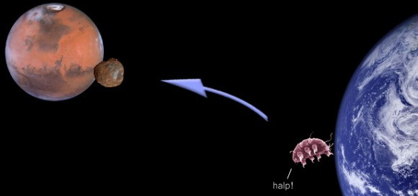
Russian Space Agency send Terrestrial Life to Phobos (Martian Moon)

Slide 68
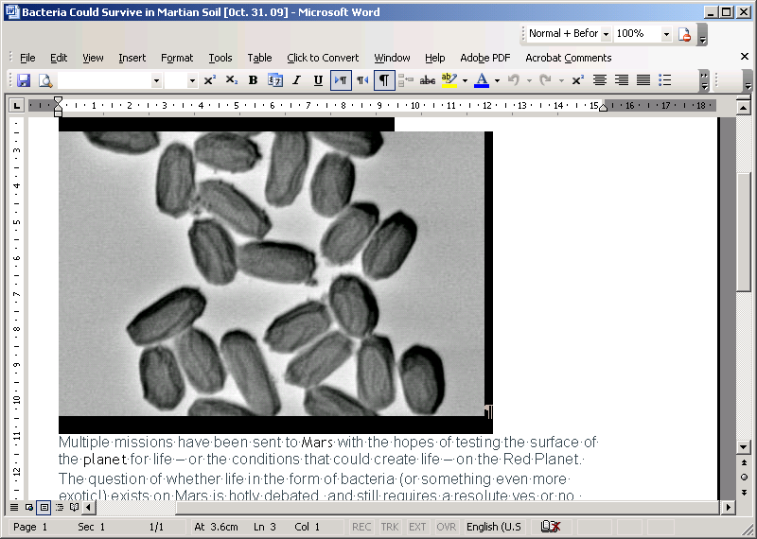
Bacteria can
survive on
Mars

Slide 69
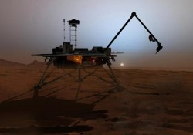
Imminent Discovery of Life On Mars?

Slide 70
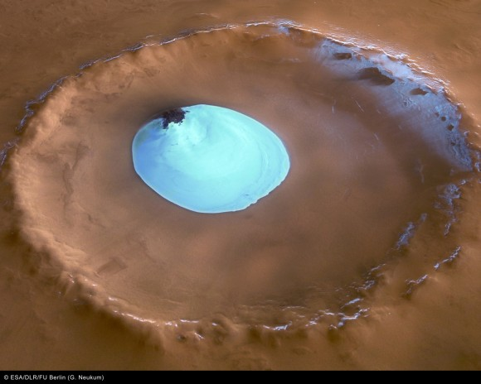

ICE AND WATER ON MARS in a North Pole crater.

Slide 71


Slide 72
Russia delays Lake Vostok drill (press)
Antarctica's hidden water will keep its secrets for another year.
Lake Vostok lies thousands of metres below Vostok Station, the coldest recorded place on Earth.

Slide 73

Archaean Halophiles
Halorhodopsin

Slide 74

TITAN TIDES SUGGESTS A SUBSURFACE OCEAN

Slide 75
Storms And Lakes On Titan Revealed By Computer Modeling

Slide 76


Slide 77

Three genera of the Cyanidia

Slide 78

Dunaliella salina
Green algae around salt x’tals

Slide 79

Titan (satellite of Saturn) organic seas

Slide 80

meteorite

Slide 81

8 YEARS ROVER ON MARS

Slide 82

Ancient Domes Reveal 3.45-billion-year-old
Life History
Rare, paleo-surface view of how conical stromato
lites would appear if one SNORKELED IN THE SHALLOWS
OF A REEF. Ancient, dome-like rock structures contain
clues that life was active on Earth 3.45 billion years
Ago, according to new research — and the findings
could help shed light on life's history on Earth and
other planets, including Mars.

Slide 83
Europa Capable of Supporting Life, Scientist Says
The global ocean on Jupiter’s Moon Europa contains about twice the liquid water of all the Earth’s oceans combined. New research by Richard Greenberg of the University of Arizona suggests that there may be plenty of oxygen available in that ocean to support life, a hundred times more oxygen than previously estimated.

Slide 84


Slide 85


Phoenix: "It Must Be Ice"

Slide 86

STENLEY MILLER EXPERIMENT (1953)

Slide 87

Indian scientists flying a giant balloon experiment have announced the discovery of three new species of bacteria from the stratosphere.

Slide 88


Slide 89

Recurring glaciers on the surface of Mars
Mars Was Recently Blanketed By Glaciers

Slide 90

Antarctica’s “Blood Falls” Shows How Aliens Might Live on Ice Worlds

Slide 91

image of a water-carved channels on Mars

Slide 93

An illustration of a dust storm on Mars.

Slide 94

Chroococcidiopsis candidate for Martian inhabitation

Slide 95


Slide 96
QUESTIONS ABOUT ORIGINS
EVIDENCE FOR THE LIFE ON EARTH?
THE STATE OF EARTH ATMOSPHERE
WHEN WAS THE ORIGIN OF LIFE ON EARTH?
WAS: REDUCED? HIGHLY REDUCED? NEUTRAL? OXIDIZED?
WERE ASTROIDS & COMETS SOURCES
OF ORGANICS?

Slide 97
QUESTIONS ABOUT ORIGINS
5) WHEN WAS OXYGEN PHOTOSYN-
THESIS INVENTED?
6) WHEN DID EUKARYOTES ORIGINATE?
7) WAS THERE AN RNA WORLD?
8) WHAT WAS THE SITE OF THE ORIGIN OF LIFE? POND? OCEAN? HYDRO-THERMAL VENTS? SUBSURFACE, PANSPERMIA? MINERAL SURFACE? OR MARINE SHORELINE?

Slide 98
QUESTIONS ABOUT ORIGINS
9) WAS THE FIRST ORGANISM HETERO-
THROPH OR AUTOTHROPH?
10) WAS THE FIRST CELL THERMO-
PHILE or MESOPHILE or PSYCHROPHILES?
11) IS THERE LIFE IN OUR SOLAR SYSTEM
OUTSIDE EARTH?

Slide 99

Martian Settlers May Need Chickens To Conquer The Red Planet
If humanity ever intends upon on settling Mars (by settling We mean a one way trip with no plans on returning back to Earth), they are going to need a whole lot of chickens if they want to survive–let alone thrive–upon the red planet.

Slide 100
Europa Submarine Prototype Gets Another Test
A submersible probe that could possibly be used on Jupiter's icy moon, Europa is taking the next step to test its capabilities. The Environmentally Non-Disturbing Under-ice Robotic Antarctic Explorer, also known as ENDURANCE, will swim untethered under ice, and collect data to create three-dimensional maps of underwater environments. The probe also will take samples of microbial life. Now it will plunge under a permanently ice covered lake in Antarctica that is 40 meters deep.

Slide 101

Dunaliella metabolism

Slide 102

Mars vs. Atacama in Chile

Slide 103

Evidence of water (ice) on Mars ?

Slide 104


Slide 105



Slide 106


Slide 107

Life Found a Mile Below Terrestrial Seabed;
Implications For Life on Mars

Slide 108

Chroococcidiopsis [CB] in rocks (Negev IL)

Slide 109


Slide 110

Dunaliella rich carotene
(as osmotic balance)

Slide 111



TARDIGRADE [water bear]
a Multicellular Extremophile

Slide 112

Salt Deposits on Mars Might Be the Right Place to Search for Life

Slide 113

Phoenix Camera Snaps Frost on Mars

Slide 114


Slide 115


Slide 116

Are Gas-Formed Gullies the Norm on Mars?

Slide 117

Courtesy of Professor Mauro Messerotti – Trieste

Slide 118

Halophiles, Alkaliphiles & Acidophiles
Alkaliphiles
ACIDOPHILES
HALOPHILES

Slide 119
Life on Mars Theory Boosted by New Methane Study
Scientists have ruled out the possibility that methane is delivered to Mars by meteorites, raising fresh hopes that the GAS MIGHT BE GENERATED BY LIFE on the RED PLANET, in research published in Earth and Planetary Science Letters
Science Daily (Dec. 8, 2009)

Slide 120

NASA Finds Shrimp Where No Advanced Life Should Be: 600 Feet Beneath Antarctic Ice

Slide 121

MOTHER EARTH-OUR PLANET

Slide 122


Slide 123

THE CYANIDIUM BOOK

Slide 124

Movement of Tardigrade

Slide 125

.
Credit: NASA/JPL-Calech/University of Arizona
600 Million Year Drought Makes Life on Surface of Mars Unlikely
View of Mars' surface near the north pole from the Phoenix lander

Slide 126

Curiosity Starts First Science on Mars Sojurn –
How Lethal is Space Radiation to Life’s Survival
NASA's Mars Science Laboratory Curiosity rover is currently cruising
to Mars and is already investigating the lethality of the interplanetary
space radiation environment to humans. After touchdown, Curiosity will
investigate Mars' past or present ability to sustain microbial life.
Credit: NASA/JPL-Caltech

Slide 127
Chroo-coc-cidiopsis (-20C -->+20C, desiccation, candidate for Astrobiology)

Slide 128

“YOGI” rock on Mars (5 m)

Slide 129

Blood Falls at Antarctica’s Taylor Glacier.

Slide 130

STROMATOLITES FROM AUSTRALIA

Slide 131

HYDOROTHERMO VENTS

Slide 132
HOSTILE VOLCANIC LAKE TEEMS WITH LIFE
Microbes thriving in salty, alkali waters containing arsenic.
Published online 2 April 2010 [ Nature ]

Slide 133


Slide 134
MICROBIAL DIVERSITY
HALOPHILES
SALINITY (g/l)
0 350
< Eukaryotes – Prokaryotes >
F.W. ORGANISMS EXTREME HALOPHILES
Brackish,marine
Salt lakes
Dead Sea

Slide 135
Mother Earth

Slide 136


NANOBACTERIA FROM MARS
BIOFOSSILS OR INORGANIC MINERALIZATION?

Slide 137
GREENING OF THE RED PLANET [Terraforming]
A hardy microbe from Earth might one day transform the barren ground of Mars into arable soil.

Slide 138

Microbial mats – Eilat IL

Slide 139
Chroo-coc-cidiopsis (-20C -->+20C, Cyanobacteria-desiccation, candidate for Astrobiology)

