Slide 1

International Conference and Expo on Separation Techniques
August 2015
Modern Methods for the
Separation of Enantiomers
- from Kilos to Tons -
Notes:
Thank you all for joining us this morning and thank you to Mark Alexey and the chemoutsourcing staff for giving us this opportunity to speak to you.
I am Lisa Newton from Chiral Technologies, USA. I’m the national accounts manager and have been with Chiral Tech for almost 10 years.
We’re headquartered in West Chester, PA but also have 4 sister companies around the globe and we’re all wholly-owned subsidiaries of Daicel Group, a very large and diverse chemical company head-quartered in Tokyo , Japan.
Chiral Technologies provides Daicel chiral stationary phases to pharmaceutical and biotechnology companies and these phases are the most widely used in the world. While this is a significant part of our business, I’ll be focusing on the services we offer and, hopefully, demonstrating how our global capabilities can be of value to you.

Slide 2
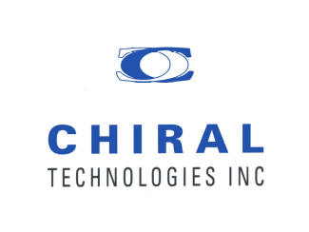
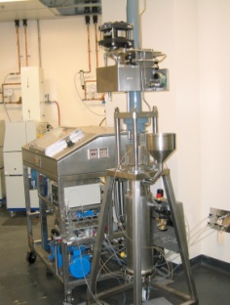
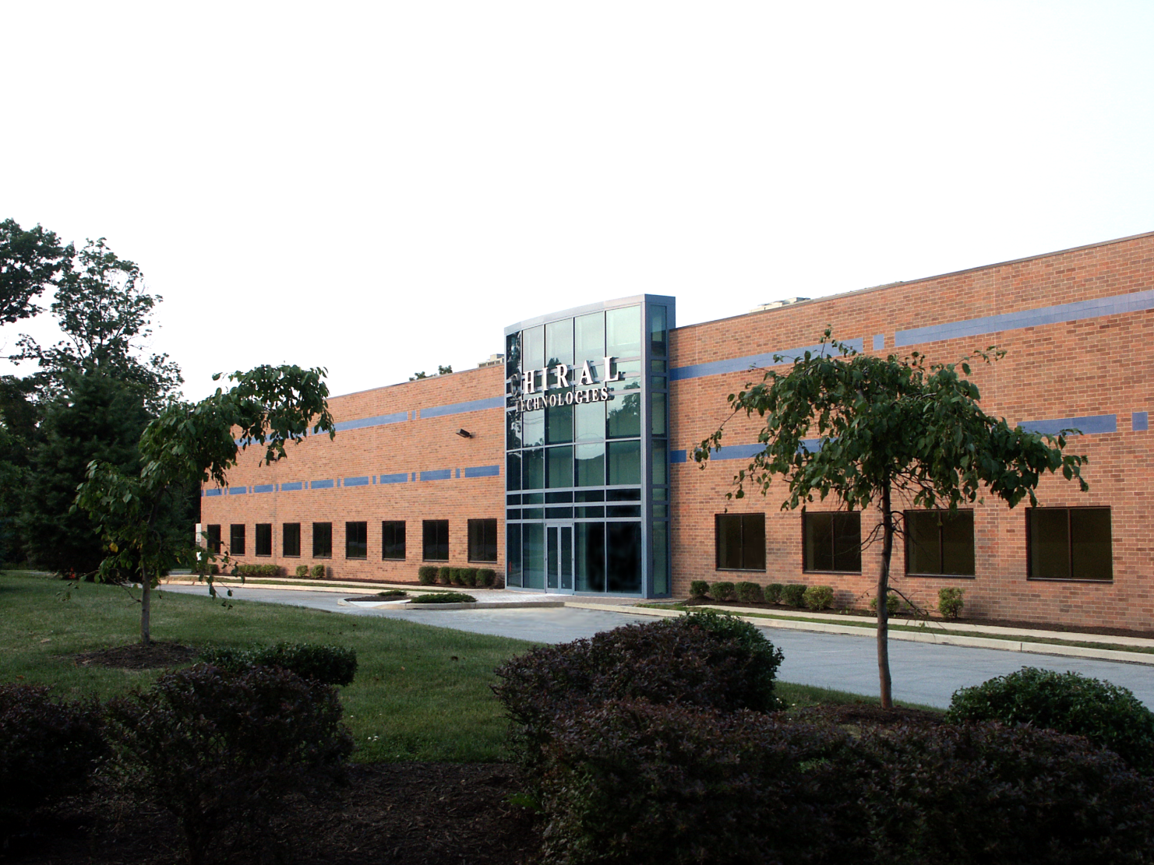
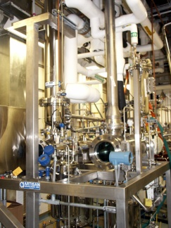
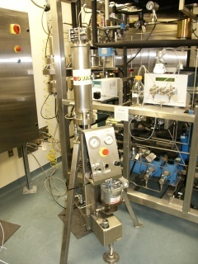
CHIRAL TECHNOLOGIES INC.
West Chester, PA.
Notes:
2

Slide 3
Chirality in Drug Pipeline
  - Over 80% of drug candidates contain at least
  one chiral center
  - Increasingly complex molecules, requiring
  more advanced production methodologies
  -Three General Strategies
  -Chiral Pool
  -Asymmetric Synthesis
  -Resolution

Slide 4
Challenge
Is there an optimal approach to problem?
No – each stage is driven by different imperatives, therefore choices are also different

Slide 5
Pre-Clinical
Short-term Focus
  Speed is key
  Cost less of an issue
Pragmatic approach
  Produce racemate then separate
  Less effort on asymmetric synthesis, chiral pool (only if quick and easy)

Slide 6
Clinical
Long-term focused
  Scalability, cost, efficiency, robustness
“Tool Box” Approach
  Cannot assume that any approach is invalid
  Test all, then run economic feasibility

Slide 7
Chiral Separation
Used at all stages
  Classical Resolution
  Chiral Chromatography

Slide 8
Chiral Separation
Used at all stages
  Classical Resolution
  Chiral Chromatography

Slide 9
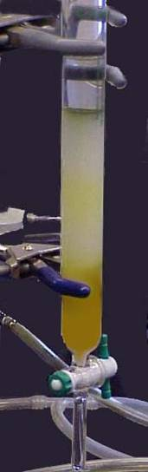
Perceptions of Chromatography
Chromatography is considered to be:
  Last Resort
  Temporary Solution
  Inelegant
  Difficult to Use

Slide 10
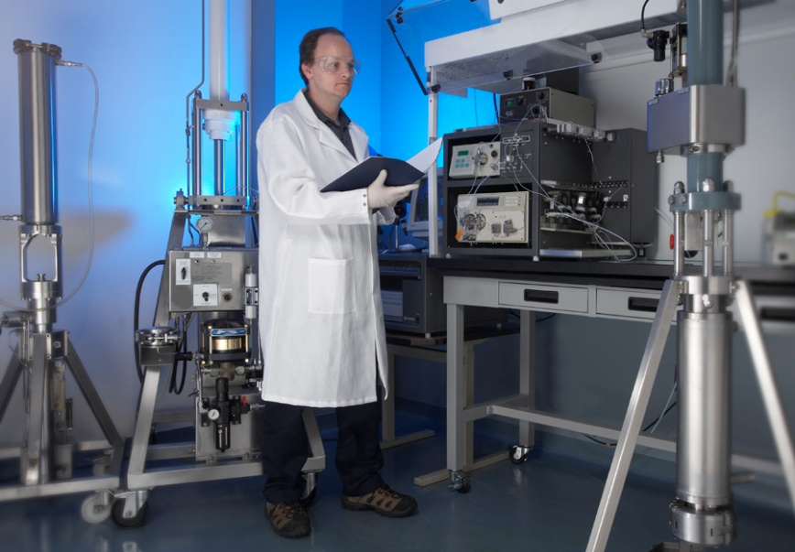
Reality of Modern Chromatography
Chromatography is;
  Cost effective
  Reliable
  Scalable

Slide 11
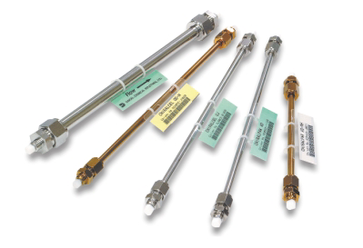
Scalable Technology
Methods are developed on analytical columns
Photo courtesy of AMPAC
Notes:
11

Slide 12
Scalable Technology
Ampac Fine Chemicals
Photo courtesy of AMPAC
Notes:
12

Slide 13
Chiral Chromatography
Method Development
Screen compound
  Chiral Stationary Phase (CSP)
  Mobile Phase
Determine Optimum Combination
Perform Loading Study
Run Stability Tests
Productivity = kg enantiomer/kg CSP/day

Slide 14
Key Points to Consider
Solubility characteristics
Stability (chemical and stereo)
Presence of other impurities
API or intermediate
Ability to racemize non-target enantiomer

Slide 15
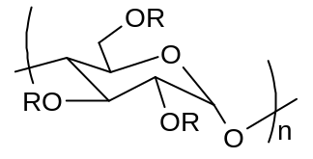
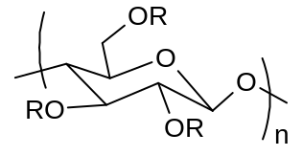
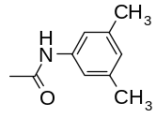
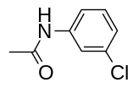
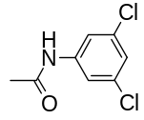
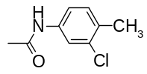
Chiral Stationary Phase
Amylose-based
Cellulose-based
CSP
Nature
-R
CSP
Nature
-R
CHIRALPAK IA
Immobilized
CHIRALPAK IB
Immobilized
CHIRALPAK ID
Immobilized
CHIRALPAK IC
Immobilized
CHIRALPAK IE
Immobilized
CHIRALPAK IF
Immobilized

Slide 16
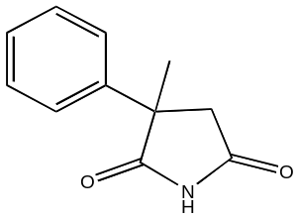
Screening Study α-Methyl-α-Phenylsuccinimide
mAU
120
Multiple separation opportunities
Also separates with conventional solvents. Note, zero THF selectivity
100
THF/Hexane
80
60
CHCl₃
40
EtOAc
MTBE
CHIRALPAK IA, 250 x 4.6 mm
Flow rate 1 ml/min
UV detection 254 nm
20
ACN:IPA 85:15
0
0
5
10
15
20
25
30
35
min

Slide 17
Chiral Separation of EMD-53986
H
O
N
N
S
Analytical injection
3.9
N
0.5
H
EMD-53986
Precursor for Ca-sensitizing drug
0.4
0.3
Absorbance (AU)
8.3
0.2
0.1
0.0
0
1
2
3
4
5
6
7
8
9
10
Dichloromethane/THF 70:30
F = 1 mL/min, 25°C
(Column 25 x 0.46 cm, 5 µm CSP)
Retention Time (min)
Solubility in mobile phase: 45 g/L
Notes:
17

Slide 18
Loading Study for EMD-53986
loading
3.9
0.5
20mg
0.4
16mg
12mg
0.3
8mg
Absorbance (AU)
4mg
8.3
0.2
0.1
0.0
0
1
2
3
4
5
6
7
8
9
10
Dichloromethane/THF 70:30
F = 1 mL/min, 25°C
(Column 25 x 0.46 cm, 5 µm CSP)
Retention Time (min)
Solubility in mobile phase: 45 g/L
Notes:
18

Slide 19
Loading Study for EMD-53986
loading
3.9
0.5
20mg
0.4
16mg
12mg
0.3
8mg
Absorbance (AU)
4mg
8.3
0.2
0.1
0.0
0
1
2
3
4
5
6
7
8
9
10
Dichloromethane/THF 70:30
F = 1 mL/min, 25°C
(Column 25 x 0.46 cm, 5 µm CSP)
Retention Time (min)
Solubility in mobile phase: 45 g/L
Notes:
19

Slide 20
Loading Study for EMD-53986
loading
3.9
0.5
20mg
0.4
16mg
12mg
0.3
8mg
Absorbance (AU)
4mg
8.3
0.2
0.1
0.0
0
1
2
3
4
5
6
7
8
9
10
Dichloromethane/THF 70:30
F = 1 mL/min, 25°C
(Column 25 x 0.46 cm, 5 µm CSP)
Retention Time (min)
Solubility in mobile phase: 45 g/L
Notes:
20

Slide 21
Loading Study for EMD-53986
loading
3.9
0.5
20mg
0.4
16mg
12mg
0.3
8mg
Absorbance (AU)
4mg
8.3
0.2
0.1
0.0
0
1
2
3
4
5
6
7
8
9
10
Dichloromethane/THF 70:30
F = 1 mL/min, 25°C
(Column 25 x 0.46 cm, 5 µm CSP)
Retention Time (min)
Solubility in mobile phase: 45 g/L
Notes:
21

Slide 22
Loading Study for EMD-53986
Estimated productivity:
2.8kg enantiomer/kg CSP/day
loading
3.9
0.5
20mg
0.4
16mg
12mg
0.3
8mg
Absorbance (AU)
4mg
8.3
0.2
0.1
0.0
0
1
2
3
4
5
6
7
8
9
10
Dichloromethane/THF 70:30
F = 1 mL/min, 25°C
(Column 25 x 0.46 cm, 5 µm CSP)
Retention Time (min)
Solubility in mobile phase: 45 g/L
Notes:
22

Slide 23
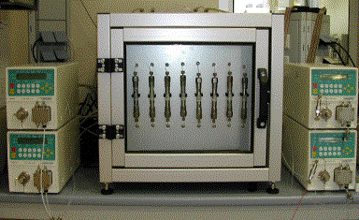
Glutethimide
Productivity:
> 11 kg enantiomer/kg CSP/day
Productivity demonstrated
under SMB conditions
Ethyl acetate 100%
F = 1 mL/min, 25°C
(Column 25 x 0.46 cm, 20 µm CSP)
54 mg
42 mg
36 mg
30 mg
15 mg
0
1
2
3
4
5
6
7
8
9
10
11
Solubility in mobile phase: 300 g/L
min
Notes:
23

Slide 24
Case Studies
Two Clinical Development Projects
    Continuous Enantio-Enrichment
    2) Stage-Appropriate Technology

Slide 25
1) Continuous Enantio-Enrichment
Biogen Idec Alzheimer’s Drug
    - BIIB042
    - Two chiral centers
    - Continuous process developed

Slide 26
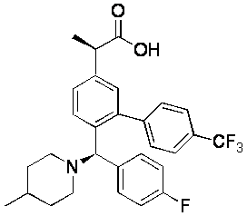
BIIB042 Structure
*
*

Slide 27
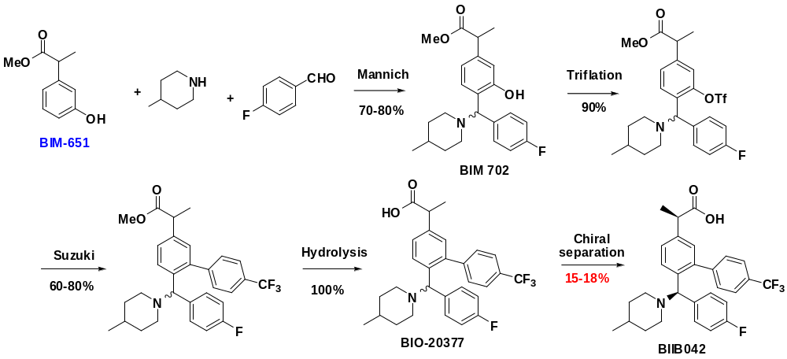
Initial Drug Discovery Approach
The Mannich reaction established the framework for BIIB042 in the first step producing BIM-702, and chiral chromatography was employed to separate the four stereoisomers.

Slide 28
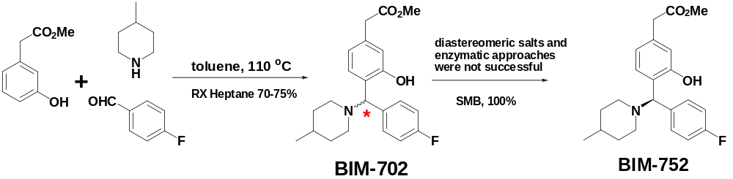
Formation of First Chiral Center

Slide 29
Chiral SMB Approach
Screened against matrix of chiral stationary phases/solvents
    Best method; AD CSP with Hexane/IPA
Determined optimum process parameters
    Yield, %ee

Slide 30
Continuous SMB Process
Racemic BIM702
90 kg
Chiral SMB

Slide 31
Continuous SMB Process
Racemic BIM702
90 kg
Chiral SMB
BIM752
>99.5%ee

Slide 32
Continuous SMB Process
Racemic BIM702
90 kg
Chiral SMB
Non-Target Enantiomer
BIM752
>99.5%ee

Slide 33
Continuous SMB Process
Racemic BIM702
90 kg
Racemization
Chiral SMB
Non-Target Enantiomer
BIM752
>99.5%ee

Slide 34
Continuous SMB Process
Racemic BIM702
90 kg
Racemization
Chiral SMB
Non-Target Enantiomer
BIM752
>99.5%ee

Slide 35
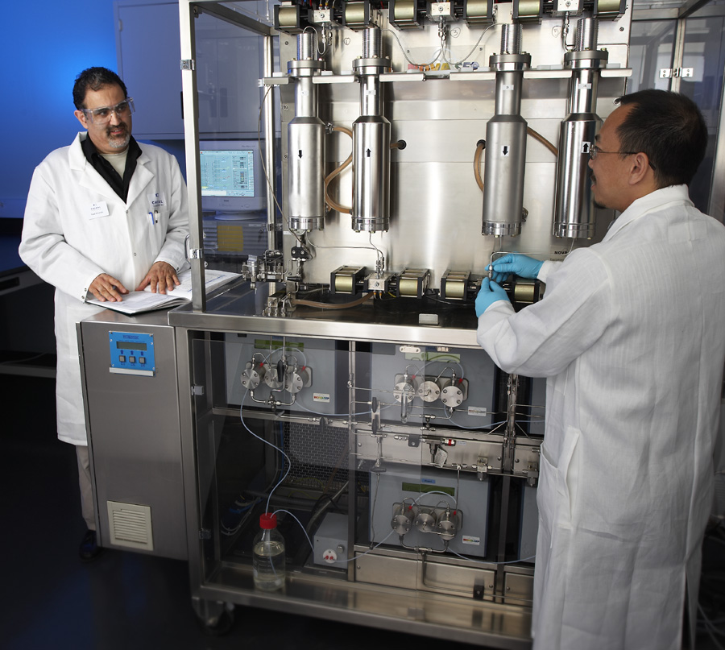
Lab Scale SMB

Slide 36
Second Chiral Center
C
O
M
C
O
H
C
O
H
2
e
2
*
2
R
u
(
B
I
N
A
P
)
,
H
S
o
d
2
i
u
m
4
0
a
t
t
m
r
i
m
e
t
h
y
l
s
i
l
o
n
a
t
e
C
F
e
n
a
n
t
i
o
s
e
l
e
c
t
i
C
F
3
v
e
*
3
C
F
*
3
N
N
N
*
F
F
F
B
I
I
B
B
0
4
2
I
M
-
7
5
7
B
I
M
-
7
9
5
>95% ee via catalytic hydrogenation (Ru)

Slide 37
2) Stage-Appropriate Technology
Development of Armodafinil
Cephalon (Teva)

Slide 38
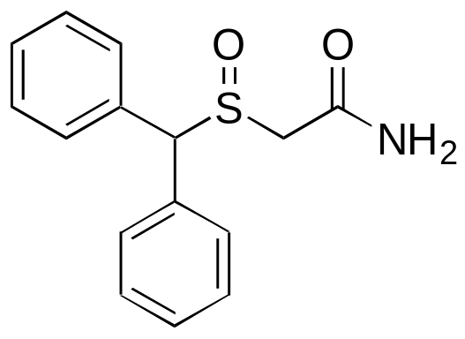
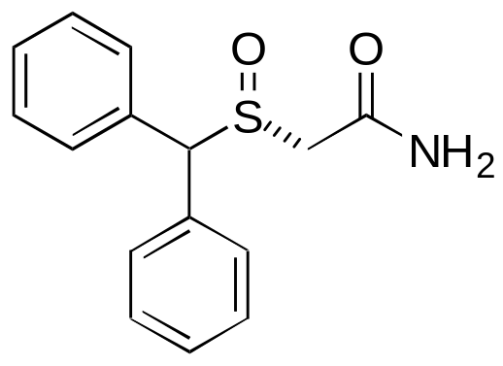
Stage-Appropriate Technology
Modafinil (Provigil)
  Approved for treatment of apnea, narcolepsy, shift work disorder
  Racemic API
Armodafinil (Nuvigil)
  (R)-Enantiomer
  Second generation therapy

Slide 39
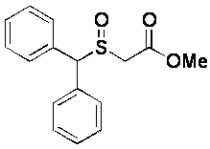
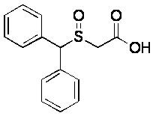
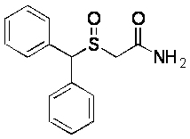
Pre-Clinical Phase
aq. NaOH
aq. HCl, acetone
Na₂CO₃, Me₂SO₄
aq. acetone
NH₃, MeOH
DMSAM
Modafinic Acid
Modafinil
- Modafinic Acid was the best candidate for classical resolution
- Easily converted to R-Modafinil

Slide 40
Pre-Clinical Phase
85 kgs prepared via crystallization
    - ~98% ee
    - Conversion to R-Modafinil
    - Non-ideal system due to
      ● Product degradation
      ● Cost inputs
      ● High labor component

Slide 41
Clinical Phase
Chiral HPLC/SMB study on Modafinil
  Screened CSPs
  HPLC and SMB methods developed
60kg of Phase I material produced
  Single column HPLC
  >99.0%ee
HPLC

Slide 42
Clinical Phase
550kg Phase II/III material produced
    - Chiral SMB
    - Optical purity >99.2%ee
    - Chemical purity >99.7%
Over 10 MT of processed pre-launch via SMB
    - Process ran on 300mm and 450mm systems
    - Stable, robust process

Slide 43
Commercial Launch
Asymmetric Oxidation Results
    - 75% isolated yield
    >99.5% optical purity
Significantly longer development than chromatography
Favorable economics
Launch of Armodafinil was accelerated due to stage-appropriate technologies

Slide 44
Development of Armodafinil
Three different methods employed
Pre-Clinical – Classical Resolution
Clinical Trials – Chiral HPLC/SMB
Commercial Launch – Asymmetric Synthesis
Result – Speed to Market

Slide 45
Conclusions
Chiral Chromatography can offer advantages
  Effective from mgs to MTs
  Predictable scale factors
  Ability to “dial in” desired %ee

Slide 46
Acknowledgement to Our Partners
Ampac
Biogen Idec
Teva (Cephalon)
Novasep

