Slide 1
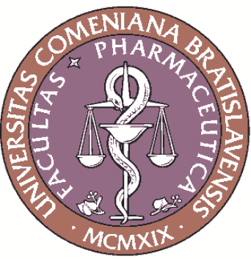
Perspectives of Antifungal Drug Discovery
Josef Jampílek
Department of Pharmaceutical Chemistry
Faculty of Pharmacy
Comenius University in Bratislava, Slovakia

Slide 2

Content
Present situation
Preparation of nanoparticles/nanoformulations
of existing drugs
Combining antifungal drugs with other molecules that together demonstrate synergistic antifungal properties
Inspiration by new modern agricultural fungicides
Design of new antifungal active molecules
Antimicrobial peptides
Vaccines with antifungal effects

Slide 3
FUNGI
are simple eukaryotic organisms that have colonized diverse environments around the planet.
There are approximately 2 million different species on the Earth
Their coexistence with other organisms can vary between mutually beneficial mutualism, commensalism and parasitism.
Higher fungi have a long history of use in national cuisines, brewery, viticulture and folk medicine.
Investigations of isolated secondary metabolites of higher fungi as well as microfungi have resulted in the discovery of bioactive compounds as potential lead structures for the subsequent design and development of new drugs and other biologically active agents.
Fungi are used for production or biotransformation of various agents used in medicine as well as for synthesis of nanoparticles within green nanotechnology.

Slide 4
FUNGI
are ubiquitous in nature and vital for recycling of nutrients contained in organic matter.
The vast majority of the known fungal species are strict saprophytes.
Some of them can attack human, animals and plants (it is estimated that 270,000 fungal species are associated with plants, and 325 are known to infect humans).
The most significant fungal species that cause human infections, allergies and toxicosis include Absidia, Alternaria, Aspergillus, Blastomyces, Candida, Cladosporium, Coccidioides, Colletotrichum, Cryptococcus, Curvularia, Exserohilum, Fusarium, Histoplasma, Microsporum, Mucor, Pneumocystis, Rhizomucor, Rhizopus, Sporothrix and Trichophyton.
➔ fungal diseases are caused by fungi that are common in the environment.

Slide 5
Situation
Fungi can be categorized into 2 groups in regards to infection:
saprophytic fungi – can be opportunistic pathogens that enter via wounds or due to a weakened state of the host
true pathogens that may depend on human tissues for nutrients but can also survive outside of the hosts.
Mycoses = diseases caused by colonization, proliferation and sporulation of fungi in tissues or body fluids
Human fungal infections are classified to:
superficial and cutaneous forms
subcutaneous complicated forms
systemic (frequently fatal) diseases – invasive, systemic infections are caused by genera Aspergillus, Candida, Cryptococcus, Fusarium and Pneumocystis

Slide 6
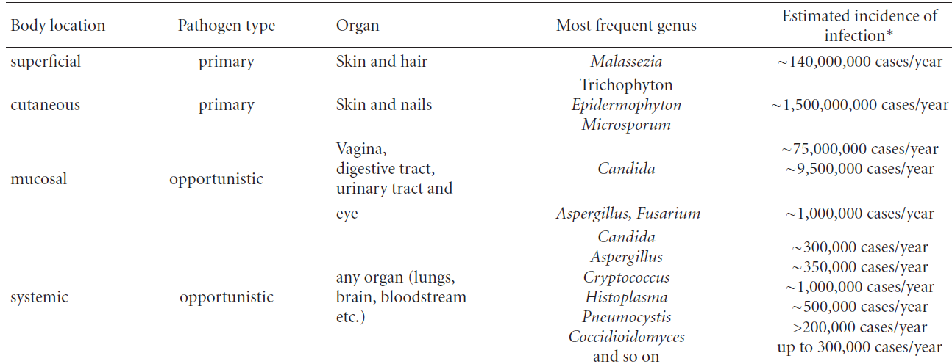
Situation
Human fungal infections generally receive less attention than bacterial and viral diseases, since the incidence of systemic fungal infections is considerably lower than that of superficial infections;
however, mortality rates from invasive fungal infections are very high, often exceeding 50%, despite the use of antifungal drugs.
Characteristics of main fungal infections worldwide
Vandeputte P., et al. Int. J. Microbiol. 2012, 2012, Article ID 713687.

Slide 7
Situation
It is estimated that about 1.2 milliard people worldwide suffer from fungal diseases (substantial part of these infections are invasive or chronic, and such infections are difficult to treat).
Annually, 1.5 to 2 million people die from fungal infections worldwide (which is more than from malaria or tuberculosis).
Genera Candida (C. albicans, parapsilosis, krusei, glabrata, tropicalis) and Malassezia furfur cause mycoses most frequently from among yeast microorganisms.
C. glabrata, the 2nd most frequently isolated candida in the European Union (>10%) and in the USA (>20%) in the last decade, represents a risk due to its high resistance to fluconazole, voriconazole and echinocandins.
Filamentous fungi, such as Trichophyton, Epidermophyton and Microsporum spp. are the most frequent aetiological species of superficial mycoses.
Gauthier G.M. & Keller N.P. Fungal. Genet. Biol. 2013, 61, 146.
Denning D.W. & Bromley M.J. Science 2015, 347, 1414.

Slide 8
Current situation of antifungal drugs
Antifungals are drugs that destroy or prevent the growth of fungi (yeasts, moulds). They can be divided into two main classes:
antifungals i) nonspecific × ii) targeted site-specific.
Nonspecific antifungals are disinfectants-antiseptics especially for superficial/local treatment of skin or mucosa. They are divided into:
aldehydes (e.g., polynoxylin)
acids (e.g., benzoic acid, salicylic acid, 5-bromo-salicylic acid, undecylic acid)
phenols/halogenated phenols (e.g., chlorocresol, 2-chloro-4-nitrophenol, chlorophene, chlorophetanol, chloroxylenol, haloprogin, hexachlorophene, parabens, tetrabromo-o-cresol)
quinolinols (e.g., cloroxine)
amides/amidines (e.g., dimazole, ticlatone)
quaternary ammonium/phosphonium salts (e.g., dequalinium dichloride, dodecyltriphenylphosphonium bromide)
dyes (e.g., methylrosanilinium chloride)

Slide 9
Current situation of antifungal drugs
Clinically used site-specific antifungal drugs can be classified according to the mode of action and their chemical structure as follows:
drugs interacting with cell wall (glucan synthesis inhibitors – echinocandins, pneumocandins),
inhibitors of transport processes (ciclopirox)
inhibitors of nucleic acid synthesis (flucytosine)
inhibitors of protein synthesis (tavaborole)
inhibitors of microtubules synthesis (griseofulvin)
drugs affecting ergosterol (most of the drugs)
– target and inhibit ergosterol-synthesizing enzymes (azoles,
thiocarbamates, naphthylmethylamines,
phenylpropylmorpholines)
– bind to ergosterol in the cell membrane (polyenes)

Slide 10
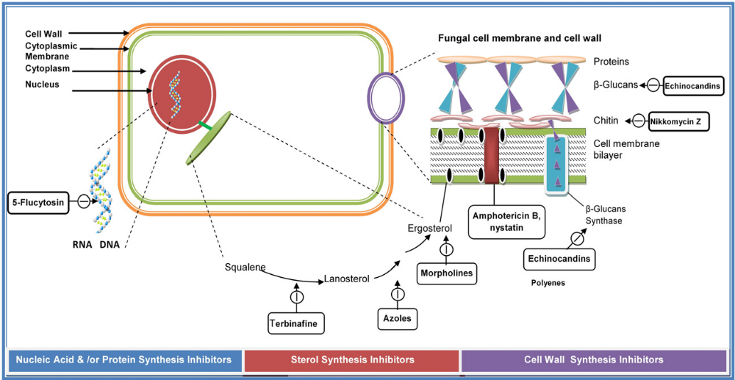
Current situation of antifungal drugs
Kathiravan M.K. et al. Bioorganic. 2012, 20, 5678.

Slide 11
Current situation of antifungal drugs
Unfortunately, most of drugs have been approved for the treatment of mycoses of nails, skin and mucosa especially due to their:
narrow therapeutic window /toxicity
limited bioavailability
drug resistance.
Only 12 drugs have been approved for the treatment of systemic fungal infections:
5 triazoles (fluconazole, isavuconazole, itraconazole, posaconazole, voriconazole)
3 echinocandins (anidulafungin, caspofungin, micafungin)
1 polyene macrolide (amphotericin B)
1 naphthylmethylamine (terbinafine)
1 pyrimidine (flucytosine)
1 benzofuran (griseofulvin)
DrugBank (http://www.drugbank.ca)

Slide 12
Emerging resistance
In general resistance can be classified as follows:
natural resistance (microorganisms lack the target structure of the drug, and all isolates of the species are resistant; e.g., resistance of some non-albicans Candida sp. to azoles, amphotericin B)
acquired resistance (microorganisms obtain the ability to resist the activity of the drug to which it was previously susceptible)
clinical resistance (therapeutic failure caused by drug pharmacokinetics, drug-drug interactions, patient immunity).
The acquired resistance is the most serious. It results from:
mutation of genes involved in normal physiological processes and cellular structures
acquisition of foreign resistance genes
combination of these two mechanisms.

Slide 13
Emerging resistance
Mechanisms of antifungal resistance can be classified as follows:
changes in antifungal transport – i.e. a decrease of effective drug concentration (efflux pumps overexpression or influx decrease; resistance to azoles, naphthylmethylamines and flucytosine)
changes in the target structure (enzyme alterations or deficiency/overproduction of some structural components; resistance to azoles, polyenes, echinocandins and naphthylmethylamines)
use of compensatory mechanisms (metabolic enzyme alterations, metabolic bypasses, toxic-product tolerance; resistance to azoles, polyenes, flucytosine)
biofilm formation (complex mechanisms resulting in total changes of microorganism properties; resistance to azoles, polyenes)

Slide 14
Emerging resistance
Changes in transport inside/outside the cell are the most frequent mechanism of resistance.
Influx conditioned resistance is caused by facilitated diffusion of drugs to fungal cells and changes in the composition of the membrane.
Drug efflux is connected with overexpression of transport proteins; their stimulation causes development of multidrug resistance or cross-resistance.
Both ATP binding cassette (ABC) and major facilitator superfamily (MFS) transporters can be found in the fungal cell membrane.

Slide 15
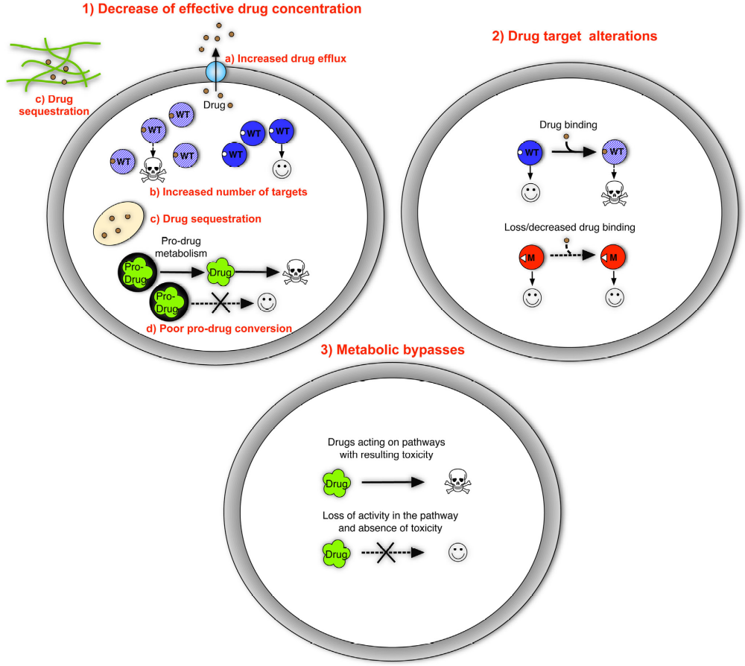
Emerging resistance
Three basic mechanisms of resistance to antifungal drugs.
Symbols: WT, wild type; M, mutant.
Sanglard D. Front. Med. 2016, 3, 11.

Slide 16
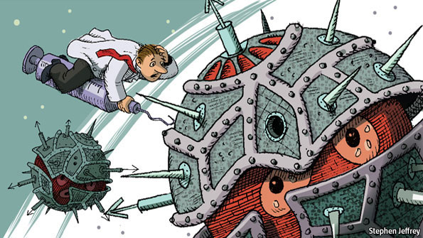
Drug design and development
The increasing resistance refers to the urgency to design and discover antifungals with a new/innovative mode of action, i.e.:
to design new entities from new chemical classes influencing new targets (or to design new multitarget agents)
to design new entities from new chemical classes influencing known targets
to modify known entities to impact new targets.
In addition, to design modulators
of transporters and sensitize
again strains resistant to
clinically used drugs.

Slide 17
New trends in design of antifungal drugs
The discovery procedure of agents with a new mode of action is relatively long and risky.
One of the reasons, why the R&D process of new antifungals is so complex, is the fact that the eukaryotic nature of a fungal cell is very similar to that of a human cell.
Approaches consist in:
preparation of nanoparticles/nanoformulations of existing
drugs
combining antifungal drugs with other molecules that
together demonstrate synergistic antifungal properties
inspiration by new modern agricultural fungicides
design of new drugs
antimicrobial peptides
vaccines with antifungal effects
Jampilek J. Future Med. Chem. 2016, 8, 1393.

Slide 18
New trends in design of antifungal drugs
➔preparation of nanoparticles/nanoformulations of existing drugs
Nanomaterials represent an alternative for treatment and mitigation of infections caused by resistant strains, which are unlikely to develop resistance to nanomaterials.
In contrast to conventional drugs, nanomaterials exert efficiency through various mechanisms; in addition to the drug activity itself, they show “intrinsic effects”, such as damaging membrane morphology, disruption of transmembrane energy metabolism and the membrane electron transport chain, generation of reactive oxygen species, etc.

Slide 19
New trends in design of antifungal drugs
➔preparation of nanoparticles/nanoformulations of existing drugs
Application of nanoformulations enhances the bioavailability of active substances (specific nanoformulations also provide a controlled release system or targeted biodistribution)
Route of administration can be modified.
An increase of the efficacy of individual agents can be also ensured by fixed-dose drug combinations or antifungal-active matrices.
FDA approved nanoformulations of amphotericin B, e.g., Abelcet®, AmBisome®, Amphotec®, Fungizone®.
Nanoformulations of other antifungal drugs or antifungals conjugated with metal or metal oxide nanoparticles for reinforcement of their effect have been investigated.
In addition, nanoformulations of silver, gold, copper, iron or zinc have been extensively tested.

Slide 20
New trends in design of antifungal drugs
➔ combining antifungal drugs with other molecules that together demonstrate synergistic antifungal properties
Combination, especially azoles and amphotericin B with
known drugs (e.g., aminoglycosides (tobramycin, paromomycin, streptomycin, hygromycin), antiprotozoals/antiparasitics (milbemycin), antipsychotics (sertraline, trifluoperazine, clorgiline), calcium channel blockers (amlodipine, nifedipine, benidipine, flunarizine), berberine)
newly designed molecules (calcineurin inhibitors (derivatives of cyclosporine A and tacrolimus), heat shock protein 90 inhibitors (analogues of geldanamycin – tanespimycin, alvespimycin; efungumab), etc.), efflux pump inhibitors
Jampilek J. Future Med. Chem. 2016, 8, 1393.

Slide 21
New trends in design of antifungal drugs
➔ combining antifungal drugs with other molecules that together demonstrate synergistic antifungal properties
Combinations help to enhance or restore antifungal efficiency of drugs against resistant fungal strains.
Main mechanisms of these synergistic effects seem to be:
perturbation of membrane
disturbance of intracellular ion homeostasis
inhibition of efflux pumps
inhibition of vital enzymes
biofilm formation inhibition

Slide 22
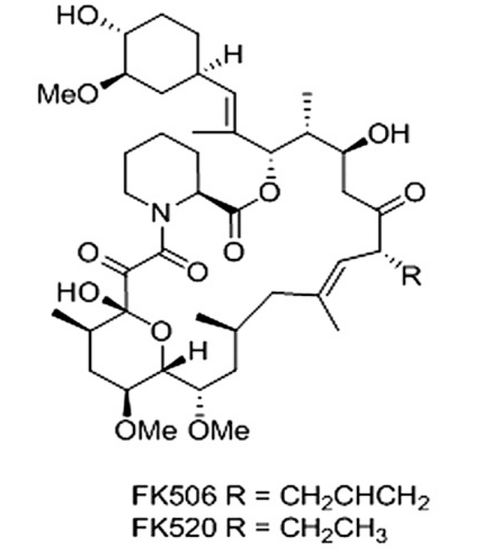
New trends in design of antifungal drugs
➔ combining antifungal drugs with other molecules
2 classes of efflux pump cause azole resistance:
ATP-binding cassette (ABC) multidrug transporter (e.g., Cdr1 protein, powered by ATP hydrolysis)
major facilitator superfamily (MFS) multidrug transporters (e.g., Mdr1 protein- utilizes plasma membrane electrochemical gradient to translocate substrates).
Macrocyclic polyketides FK506, FK520 displayed
fungicidal synergism with azoles in C. albicans
and inhibit drug efflux mediated by
ABC multidrug transporter – Cdr1 protein
Nim S. et al. FEMS Yeast Res. 2014 ,14, 624.

Slide 23
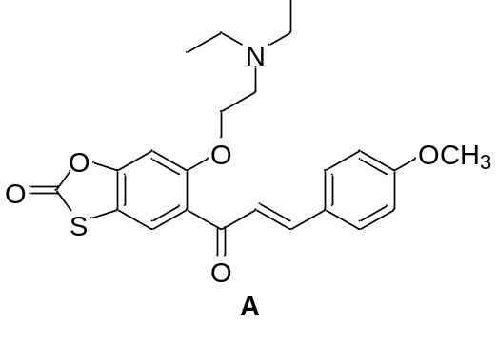
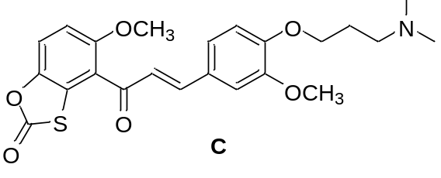
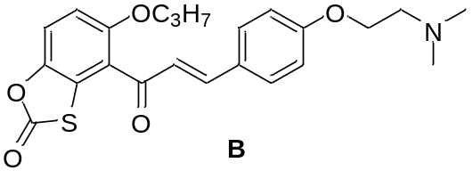
New trends in design of antifungal drugs
➔ combining antifungal drugs with other molecules
oxathiolone fused chalcones are effective chemosensitizers able to restore sensitivity to fluconazole of MDR C. albicans strains.
A reduced resistance caused by overexpressing ABC-type drug transporters CDR1/CDR2
B chemosensitized resistance caused by overexpression of MFS multidrug transporters
C reversed fluconazole resistance mediated by both types of drug efflux pumps
Lacka I. et al. Front.Microbiol. 2015, 6, 783.

Slide 24
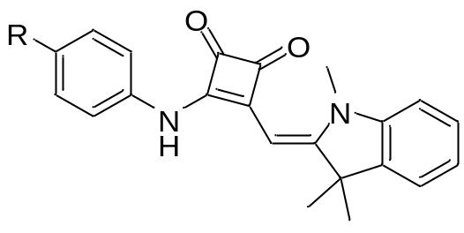
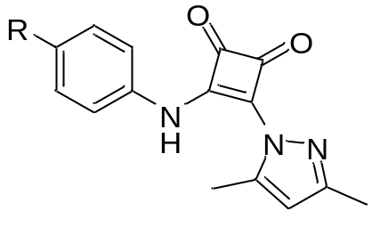
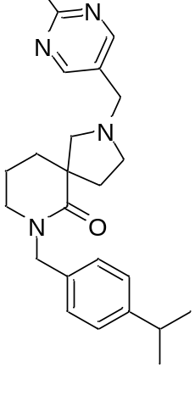
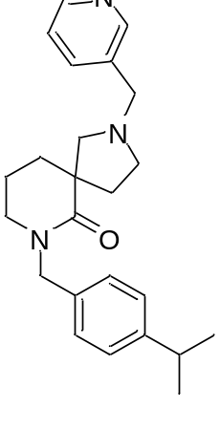
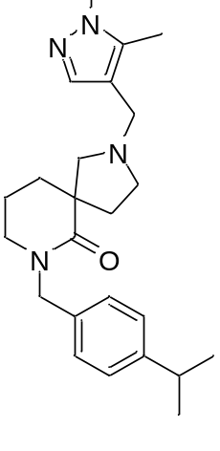
New trends in design of antifungal drugs
➔ combining antifungal drugs with other molecules
- cyclobut-3-ene-1,2-diones inhibit C. albicans Major Facilitator Superfamily Transporter Mdr1p
- series of diazaspiro-decane structural analogues inhibits processes associated with C. albicans virulence,
biofilm formation and filamentation,
without an effect on overall
growth or eliciting resistance.
Keniya M.V. et al. PLoS One 2015 , 10, e0126350.
Pierce C.G. et al. NPJ Biofilms Microbiomes. 2015, 1, 15012.

Slide 25
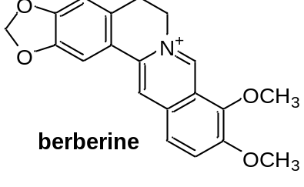
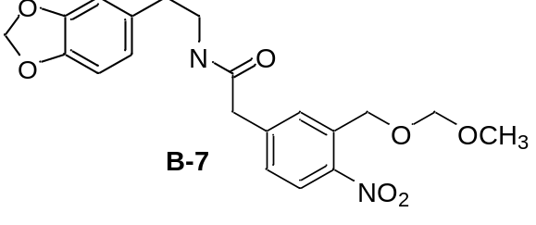
New trends in design of antifungal drugs
➔ combining antifungal drugs with other molecules
The potent synergistic activity of B-7 (ring analogue of berberine), in combination with fluconazole against fluconazole-resistant C. albicans and resistant non-C. albicans species and Cryptococcus neoformans was found
B-7 exhibited much lower cytotoxicity than berberine to human umbilical vein endothelial cells.
It seems that the disruption of protein folding and processing and the weakening of cells’ self-defensive ability contributed to the synergism of fluconazole and B-7.
Li L.P. et al. PLoS One 2015, 10, e0126393.

Slide 26
New trends in design of antifungal drugs
➔ inspiration by new modern agricultural fungicides
Some classes of new modern agricultural fungicides can be used for design of structurally new antifungal drugs, since many of them meet criteria of lead-likeness and/or drug-likeness.
Bioavailability guidelines – summary of relevant rules concerning physicochemical property limits of drugs and agrochemicals
Parameter | Drugs |  | Agrochemicals
 | Lipinski | Carr | Briggs | Tice | Clarke | Hao
MW | ≤ 500 | ≤ 300 | 300±100 | ≤ 500 | 200–400 | ≤ 435
log P | ≤ 5 | ≤ 3 | 3±3 | ≤ 5 | ≤ 4 | ≤ 6
number of H-bond donors | ≤ 5 | ≤ 3 | ≤ 3 | ≤ 3 | ≤ 2 | ≤ 2
number of H-bond acceptors | ≤ 10 | ≤ 3 | – | ≤ 12 | – | ≤ 6
number of rotatable bonds | – | ≤ 3 | – | ≤ 12 | – | ≤ 9
Lipinski C.A. et al. Adv. Drug Deliv. Rev. 1997, 23, 35.
Carr R.A. et al. Drug Discov. Today 2005, 10, 987.
Briggs G.G. Predicting uptake and movement of agrochemicals from physical properties, presentation at
SCI meeting: Uptake of agrochemicals and pharmaceuticals. Belgrave Square, London, UK, 1997.
Tice C.M. Pest Manag. Sci. 2001, 57, 3.
Clarke E.D., Delaney J.S. Chimia 2003, 57, 731.
Hao G. et al. Mol .Inform. 2011, 30, 614. Jampilek J. Expert Opin. Drug Dis. 2016, 11, 1.

Slide 27
New trends in design of antifungal drugs
➔ inspiration by new modern agricultural fungicides
Modern fungicides target active sites with high specificity and affinity (in nanomolar concentrations)
They are subjected to lead optimization and thus fulfil other requirements of lead chemistry such as tractability in structure–activity relationships and lack of reactivity or promiscuous binding
Extensive toxicology evaluation, including mammalian toxicology assays, is routinely performed during the whole discovery and development process
Commercial agricultural fungicides are classified according to their target sites by the international Fungicide Resistance Action Committee (FRAC)
Fungicides show much higher diversity in their chemical structures and modes of action than antifungals.
Jampilek J. Expert Opin. Drug Dis. 2016, 11, 1.

Slide 28
New trends in design of antifungal drugs
➔ inspiration by new modern agricultural fungicides
modern specific-target fungicides can accelerate the process of identification of new modes of action and leads/lead-like structures for a pharmaceutical pipeline to control human fungal pathogens include, for example:
ergosterol biosynthesis inhibitors, such as adenosin-deaminase, cellulose synthase, 3-keto reductase
inhibitors of DNA/RNA synthesis
inhibitors of trehalase- and inositol-synthesis
inhibitors of respiration (especially cytochrome bc1)
inhibitors of melanin biosynthesis in cell wall
agents affecting signal transduction, mitosis and cell division, lipid synthesis and membrane integrity
Jampilek J. Expert Opin. Drug Dis. 2016, 11, 1.

Slide 29
New trends in design of antifungal drugs
➔ design of new drugs
mechanism of action of the majority of antifungals is associated with the cell wall, because they contain components specific for fungal cells
design of inhibitors of transition to the fibrous form by dimorphic pathogens (which leads to a reversible change from a saprophytic to a pathogenic form)
new targets to be affected by agents also include:
biosynthesis of chitin, glycosylphosphatidylinositol, glucosylceramide, heme
inhibition of dihydroorotate dehydrogenase
virulence and mitochondrial functions
Jampilek J. Future Med. Chem. 2016, 8, 1393.

Slide 30
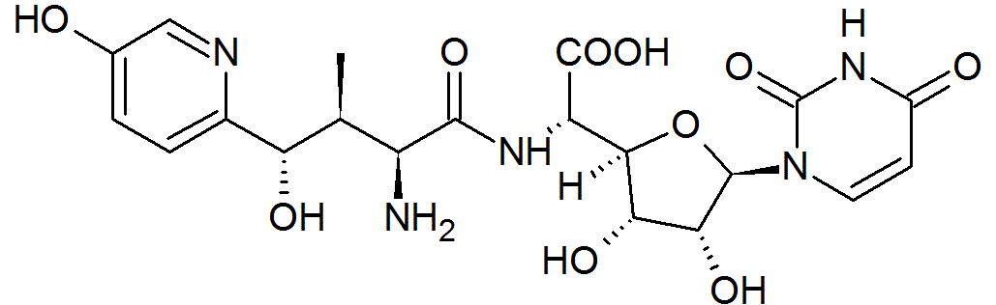
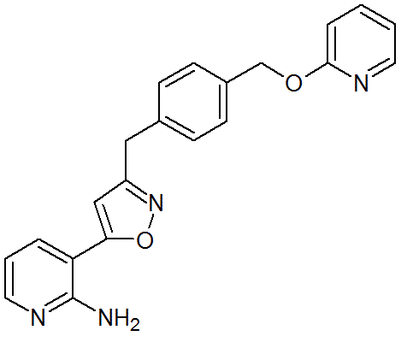
New trends in design of antifungal drugs
➔ design of new drugs
- renewed nikkomycin Z, a competitive chitin synthase inhibitor lacking mammalian toxicity with effect against Coccidioides spp. is under clinical trial
- E1210, 3-(isoxazol-5-yl)pyridin-2-amine derivative, is an orally active broad-spectrum inositol acyltransferase inhibitor with high potency against Candida, Aspergillus and Fusarium suitable
for treatment of disseminated candidiasis
and pulmonary aspergillosis
U.S. National Institutes of Health – ClinicalTrials. https://www.clinicaltrials.gov
Jampilek J. Future Med. Chem. 2016, 8, 1393.

Slide 31
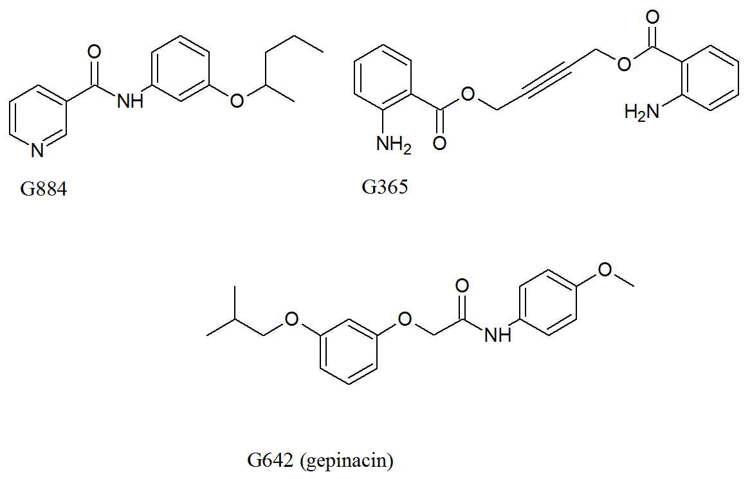
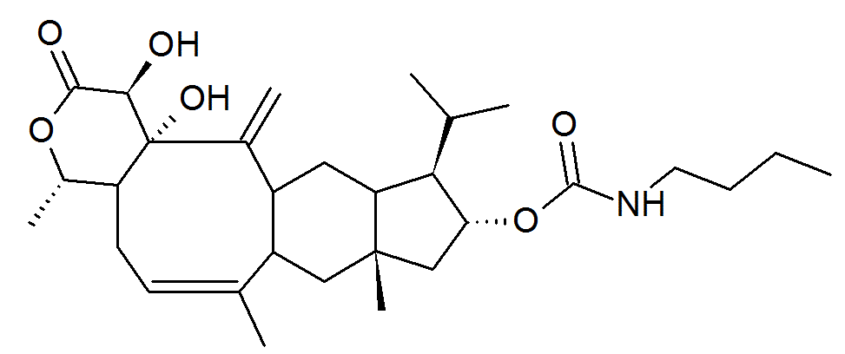
New trends in design of antifungal drugs
➔ design of new drugs
- gepinacin (G642), G365 and G884 are glycosylphosphatidylinositol (Gwt1) inhibitors with an effect against C. albicans and A. fumigatus
- M720 (tetradecahydroindeno[5',6':4,5]cycloocta[1,2-c]pyran-2(1H)-one scaffold) is inhibitor of Mcd4 (endoplasmic reticulum membrane protein essential for glycosylphosphatidylinositol) with potency against Candida sp. and A. fumigatus)
Jampilek J. Future Med. Chem. 2016, 8, 1393.

Slide 32
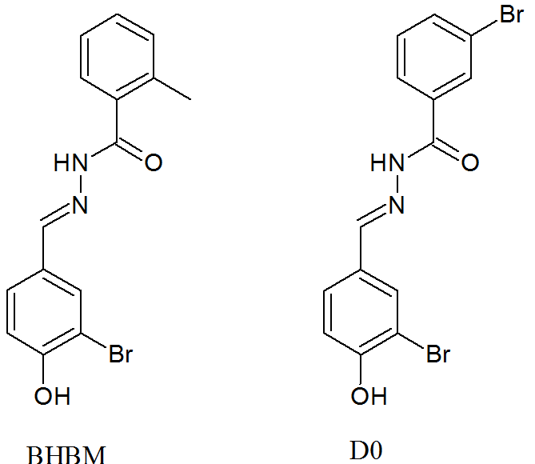
New trends in design of antifungal drugs
➔ design of new drugs
- acylhydrazones BHBM and D0 inhibit
synthesis and transport of glucosylceramide
and show high potency against
Cryptococcus neoformans and
Pneumocystis jiroveci (carinii)
Jampilek J. Future Med. Chem. 2016, 8, 1393.

Slide 33
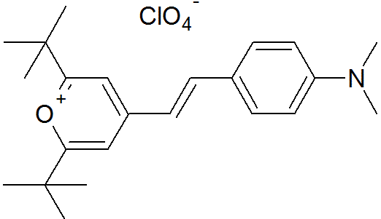
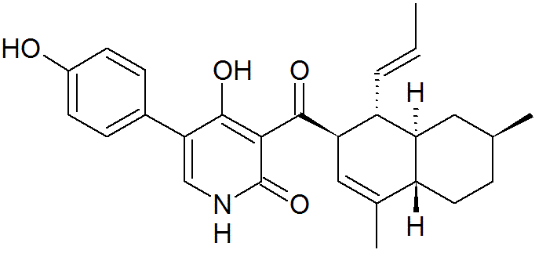
New trends in design of antifungal drugs
➔ design of new drugs
- SM21 (2,6-di-tert-butyl-4-{(E)-2-[4-(dimethylamino)phenyl]ethenyl} pyranium) effective against MDR Candida spp. and Candida biofilms is an agent influencing virulence
(inhibits change morphology between
yeast and filamentous forms).
- ilicicolin H, 4-hydroxypyridin-2(1H)-one derivative, isolated from Gliocadium roseum, with activity against Candida spp., A. fumigatus, and Cryptococcus spp. inhibits mitochondrial cytochrome bc1 reductase
Jampilek J. Future Med. Chem. 2016, 8, 1393.

Slide 34
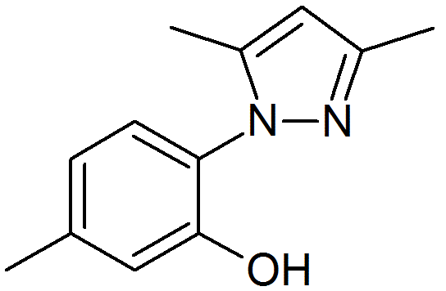
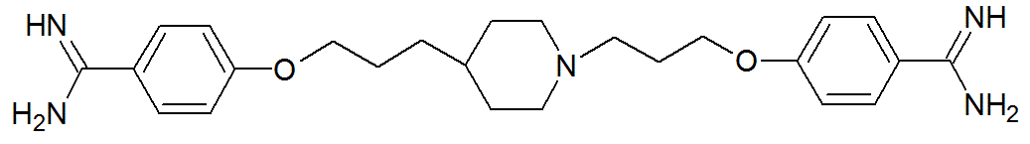
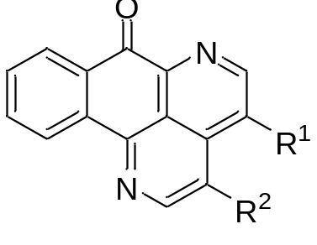
New trends in design of antifungal drugs
➔ design of new drugs
- hydroxyarylpyrazole ME1111 is a selective inhibitor
of succinate-coenzyme Q reductase of Trichophyton sp.
- fungistatic arylamidine T-2307 with activity against Candida spp., C. neoformans and Aspergillus spp. causes a collapse of the mitochondrial membrane; it is in the 1st phase of clinical trials
- copyrine alkaloid sampagine (isolated from Cananga odorata) and its derivatives inhibiting generation of heme and initiating production of free oxygen radicals, showed high
activity against A. fumigatus and C. neoformans.
U.S. National Institutes of Health – ClinicalTrials. https://www.clinicaltrials.gov

Slide 35
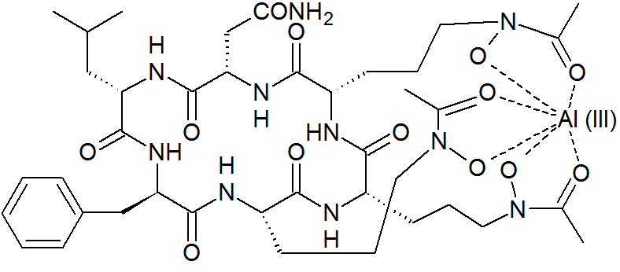
New trends in design of antifungal drugs
➔ design of new drugs
- VL-2397 (ASP2397, isolated from Acremonium spp. ) is a fungicidal antifungal with an unknown mechanism of action.
The siderophore-mediated uptake of VL-2397 to fungal cells causes high selectivity of this compound.
It shows excellent efficiency against MDR A. fumigatus and C. glabrata.
It is in the 1st phase of clinical trials.
U.S. National Institutes of Health – ClinicalTrials. https://www.clinicaltrials.gov

Slide 36
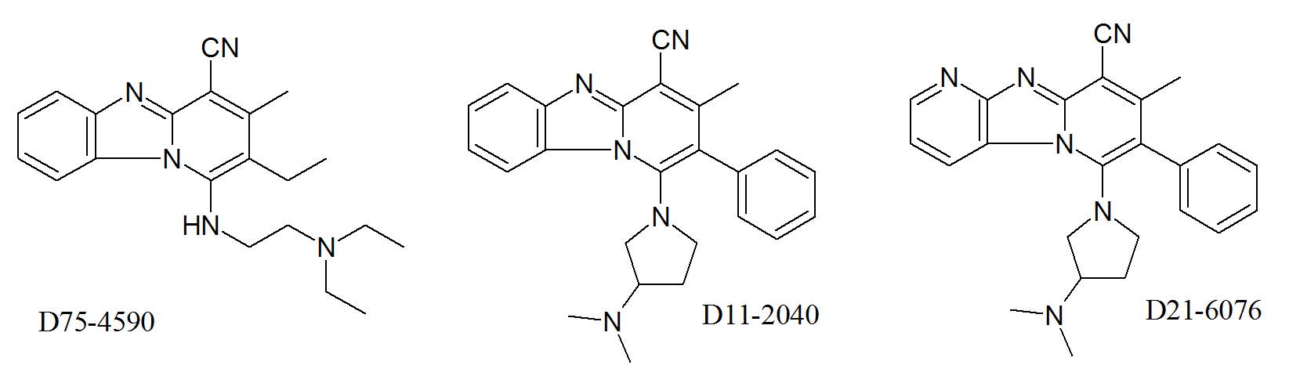
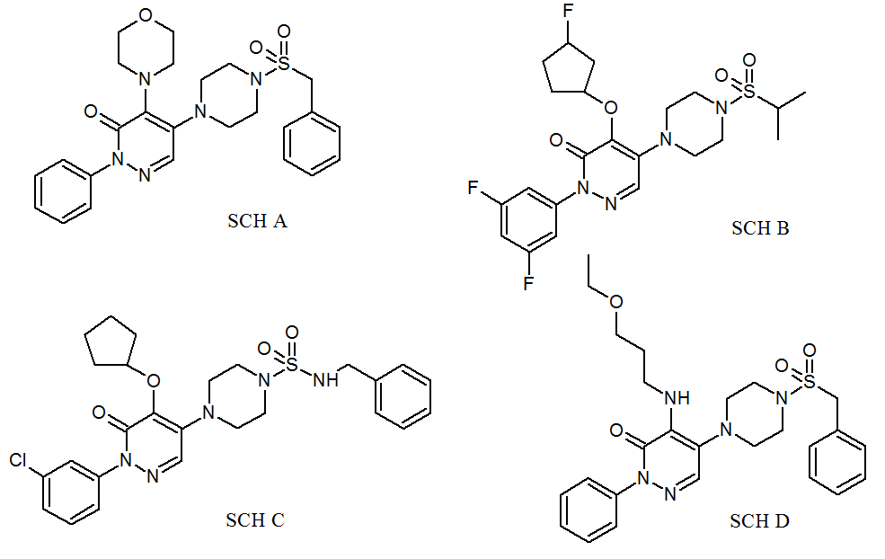
New trends in design of antifungal drugs
➔ design of new drugs
- SCH A–D (5-[4-(sulfonyl)piperazin-1-yl]-2-arylpyridazin-3(2H)-ones) - D11-2040, D21-6076 (1-pyrrolidinyl-pyridobenzimidazole-4-carbonitriles) are new non-echinocandin β-(1,3)- and β-(1,6)-D-glucan synthesis inhibitors.
Jampilek J. Future Med. Chem. 2016, 8, 1393.

Slide 37
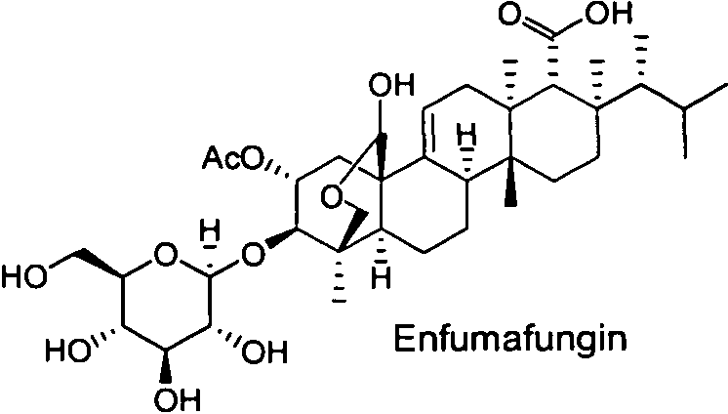
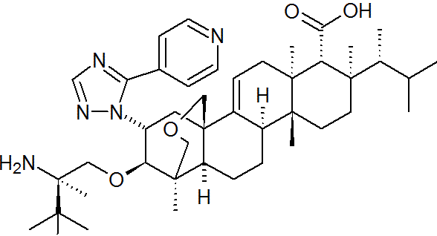
New trends in design of antifungal drugs
➔ design of new drugs
- enfumafungin derivative SCY-078 (MK-3118) is an orally active
β-(1,3)-D-glucan synthesis inhibitor.
Now is in the 2nd phase of clinical trials.
SCY-078
U.S. National Institutes of Health – ClinicalTrials. https://www.clinicaltrials.gov

Slide 38
New trends in design of antifungal drugs
➔ antimicrobial peptides
are cationic endogenous polypeptides produced by metazoans and causing membranolysis of negatively charged surface microbial membranes.
are effective against multidrug resistant pathogens and do not have any potential for development of resistance
peptides effective against Candida sp. and Aspergillus spp. are in the 2nd phase of clinical trials: (CKPV)2 peptide (CZEN-002), lactoferrin 1-11 (hLF1-11), PAC113 (P-113), NP339/NP525 (Novamycin)
Their limitation are as follows:
instability
low bioavailability
high price
U.S. National Institutes of Health – ClinicalTrials. https://www.clinicaltrials.gov

Slide 39
New trends in design of antifungal drugs
➔ vaccines with antifungal effects
seem to be a noteworthy promise to future.
- they could be useful for prevention and decrease of morbidity and mortality and can help to reduce societal costs.
- possible indications include various candidiases of ordinary as well as immunosuppressed patients.
- prophylactic recombinant vaccines such as NDV-3, PEV-7 and rHyr1p-N are in clinical trials.
U.S. National Institutes of Health – ClinicalTrials. https://www.clinicaltrials.gov

Slide 40
Conclusion
Beside the design of structurally new antifungals based on new targets (single- or multi-site antifungal agents), promising strategies to combat antifungal drug resistance seem to be the design of:
efflux inhibitors
chemosensitizers
inhibitors of pH signalling pathways
inhibitors of biofilm formation, filamentation and virulence
and performance of genome-wide studies.

Slide 41
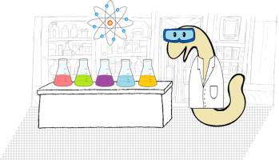
Thank you for your kind attention

