Slide 1
About Omics Group
OMICS Group International through its Open Access Initiative is committed to make genuine and reliable contributions to the scientific community. OMICS Group hosts over 400 leading-edge peer reviewed Open Access Journals and organize over 300 International Conferences annually all over the world. OMICS Publishing Group journals have over 3 million readers and the fame and success of the same can be attributed to the strong editorial board which contains over 30000 eminent personalities that ensure a rapid, quality and quick review process.

Slide 2
About Omics Group conferences
OMICS Group signed an agreement with more than 1000 International Societies to make healthcare information Open Access. OMICS Group Conferences make the perfect platform for global networking as it brings together renowned speakers and scientists across the globe to a most exciting and memorable scientific event filled with much enlightening interactive sessions, world class exhibitions and poster presentations
Omics group has organised 500 conferences, workshops and national symposium across the major cities including SanFrancisco,Omaha,Orlado,Rayleigh,SantaClara,Chicago,Philadelphia,Unitedkingdom,Baltimore,SanAntanio,Dubai,Hyderabad,Bangaluru and Mumbai.

Slide 3
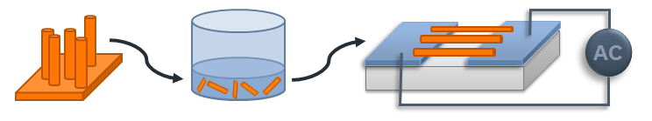
Dielectrophoretic fabrication and characterization of ZnO NW photoconductors and MOS photodiodes
Jose Luis Pau, Ph.D.
Associate Professor, Dpto. Física Aplicada, Universidad Autónoma de Madrid, c/ Fco. Tomás y Valiente 7, Madrid 28049, Spain
e-mail: joseluis.pau@uam.es website: http://jlpau.wordpress.com
Notes:
I would like to thank the workshop organizers for this invitation to present the work of my group at the Applied Physics Department on the dielectrophoretic assembly of NWs for the fabrication of light detectors and gas sensors.

Slide 4
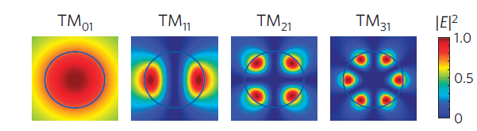
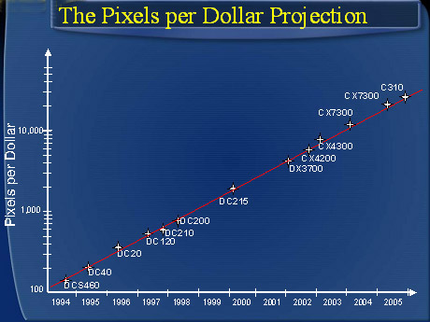
NANOWIRE PHOTODETECTORS
High crystal quality
Enhanced light absorption (optical resonances)
Tunable optical properties (absorption edge) as a function of NW diameter
Near-ballistic transport (reduced scattering rate)
Polarization sensitive detection
Single photon detection (superconducting NWs)
L. Cao et al., Stanford Univ., Nature Mat., 8, 643 (2009)
Hendy’s Law
Notes:
Due to the small size, these structures contain less intrinsic defects than bulk materials.
Their thermal conductivity can be tuned by changing the physical parameters.
Chemical properties are dominated by the large surface-to-volume ratio
There can be ballistic transport what means that there is no carrier scattering
And the light absorption can be enhanced due to the internal charge resonances.

Slide 5
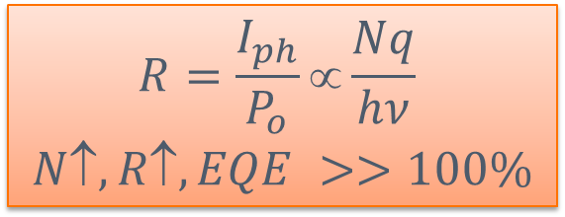
PHOTOCONDUCTIVE GAIN
As surface to volume ratio is increased, reported photoconductive gains seem to enlarge:
  Surface effects (carrier trapping)
  Gas adsorption/desorption processes
Ej: graphene, C nanotubes, metal oxide NWs,…
ZnO NW photoconductor
+
-
A
$$R=\frac{I_{ph}}{P_{o}}∝\frac{Nq}{hν}$$
$$N, R, EQE >>100\%$$
Gas
-
-
-
-
-
-
-
+
-
but…
-
-
-
-
-
-
hν
τ (relaxation time) ↑↑
Notes:
Here, we see the absorption spectra of Ge NWs obtained from photocurrent measurements. As the NW diameter reduces, some of the absorption bands related to different optical resonances disappear shifting the effective absorption edge towards shorter wavelengths. Some recent reports also indicate that through those resonances, it is possible to obtained higher absorption coefficients than in the bulk.

Slide 6
TECHNICAL CHALLENGE:
Reliable and fast processing methods for high throughput fabrication of NW devices.
Common bottom-up approaches
electric or magnetic fields
fluid flows
Langmuir-Blodgett technique
bubble-blown films
mechanical printing
… but creating high-density NW arrays in an efficient and scalable manner remains challenging.
Notes:
Despite all those interesting properties, the devices based on NWs have not reached the market due to the lack of reliable and fast methods to manipulate NWs and integrate them in Si-based CMOS technology.
Different methods have been explored based on electric or magnetic fields, fluid flows, the Langmuir-Blodgett technique, bubble-blown films and mechanical printing, but creating high-density NW arrays in an efficient and scalable manner remains challenging.

Slide 7
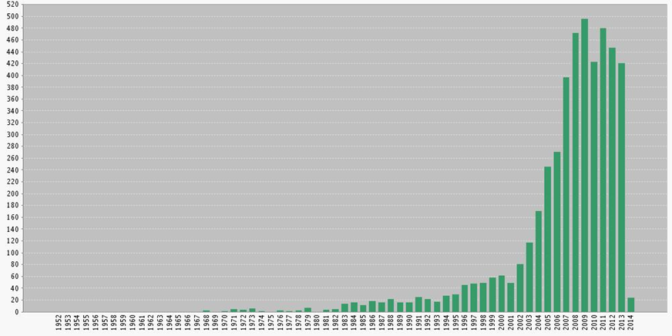
Dielectrophoresis (DEP)
Dielectrophoresis describes the movement of a particle in a non-uniform electric field.
1950s First studies by Prof. Herbert Pohl.
1980s, 90s Widely used in biochemistry to separate cells and study their dielectric properties.
Last decade Manipulation of inorganic nanostructures.
1970
1980
1990
2000
2010
500
Source: Web of Knowledge
400
300
Publications/year
200
100
Notes:
Dielectrophoresis is defined as the discipline that analizes the movement of a particle in a non-uniform electric field.
The first studies were carried out in the fifties by Prof. Pohl at the Naval Research Laboratory. In the 80s and 90s, the technique was widely used to separate cells and study their dielectric properties through their response to AC signals. During the last decade, it has been used to manipulate different types of nanostructures and 2D materials. The number of papers has increased notoriously in those years, reaching a plateau in the last three-four years, suggesting the maturity of the technique.

Slide 8
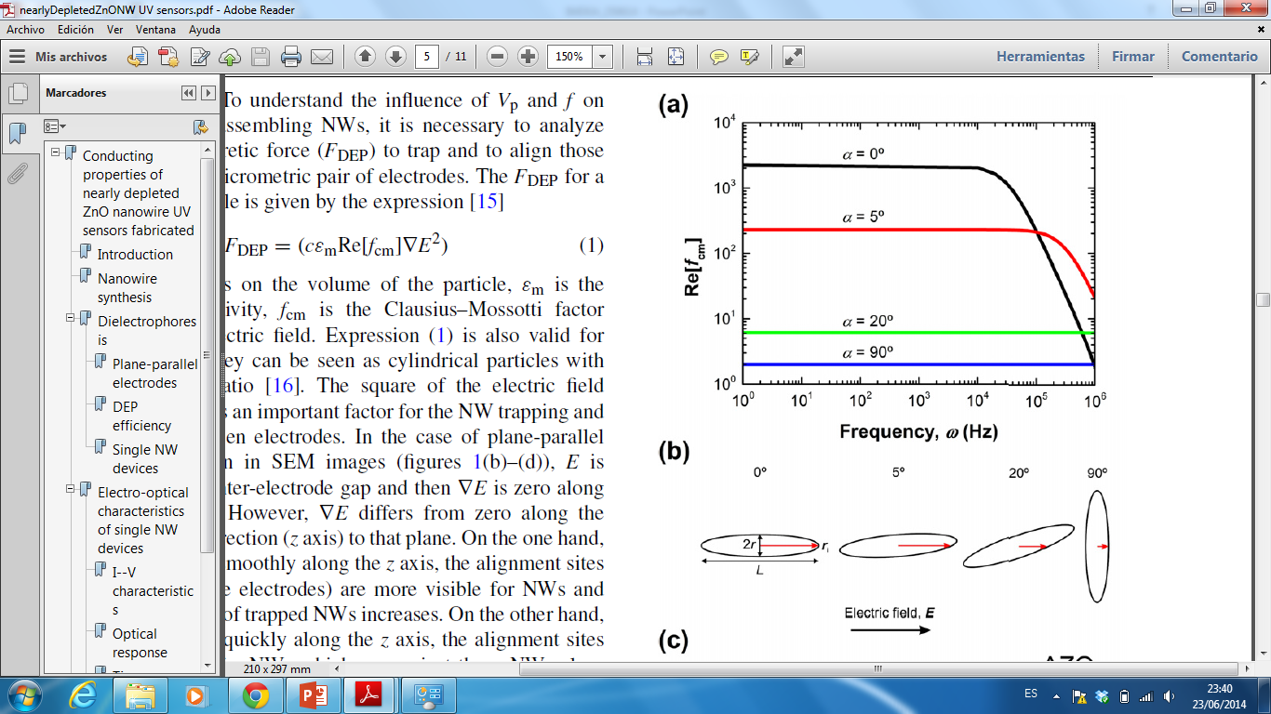
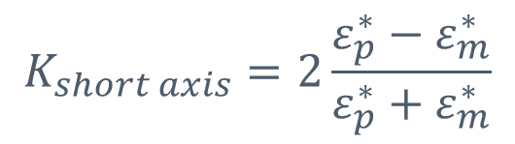
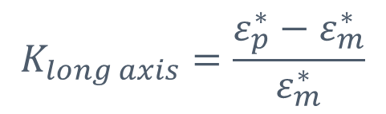
Dielectrophoresis (DEP)
Dielectric permittivity of the solvant
Clausis-Mossotti
factor
Dielectrophoretic
Force
(AC signal)
C. García et al., Nanotechnology 24 (2013) 415702
$$K_{long axis}=\frac{{ε_{p}^{∗}−ε}_{m}^{∗}}{ε_{m}^{∗}}$$
$$K_{short axis}=2\frac{{ε_{p}^{∗}−ε}_{m}^{∗}}{{ε_{p}^{∗}+ε}_{m}^{∗}}$$
Notes:
The dielectric force depends on the volume of the nanoparticle, the dielectric constant of the solvent, the real part of the Clausius-Mosotti factor and the gradient of the squared electric field. As the dielectric constants of the NW and solvent are functions of frequency, the Clausius-Mosotti factor is frequency dependent, which has strong implications in the conditions needed for an effective alignment. In fact, this property has been exploited for the study of the dielectric properties of bioparticles. The strength of the gradient term can be tailored by the proper design of the metal electrodes inside the cell.

Slide 9
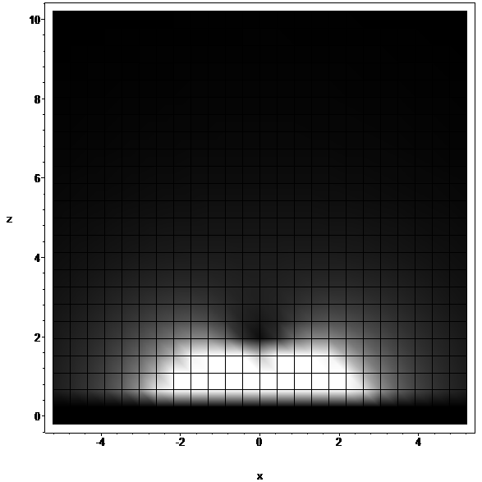
DEVICE FABRICATION
DEP attractive force
IEI²
g
F_{DEP}
F_{g}
F_{vis}
Maximum trapping distance ≈ 50-100 μm
IEI² decays as 1/z² ⇒F_{DEP} decays as 1/z³
Notes:
In a coplanar configuration, the distance between both electrodes determines the strength of the squared electric field. In the far field region, the strength is less influenced by this distance and decays as one over squared z where z is the vertical distance to the electrode plane. As the F_{DEP} depends on the gradient of the squared electric field, this will decay as one over cubic z. In the near-field region, the shorter the interelectrode distance is, the larger E² becomes, enhancing also the maximum F_{DEP} value near the assembly site. This means that the NWs will be attracted with higher velocity as the gap width reduces.
Within this geometry, the distances at which the NWs can be trapped are typically in the 10-100 um range.

Slide 10
DEVICE FABRICATION:
DEVICE CHARACTERIZATION:
NW photoconductors
NW MOS photodiodes
ZnO NW Growth
Preparation of NW dispersions
Dielectrophoresis (DEP)
AC
Notes:
To review our work in the last years, I’ll start describing the ZnO and CuO NW growth to continue with the preparation of NW dispersions ending up the block showing the NW alignment experiments using dielectrophoresis. Towards the end of my talk, I will show the results of device characterization, including results on NW photodetectors and NW gas sensors.

Slide 11
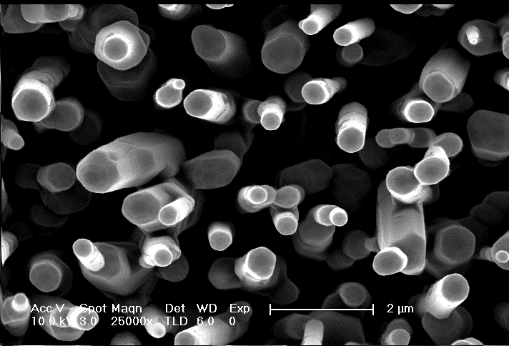
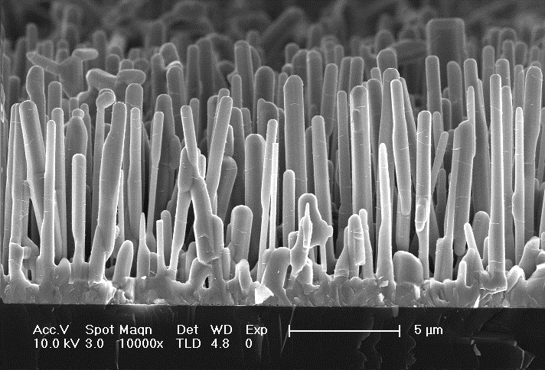
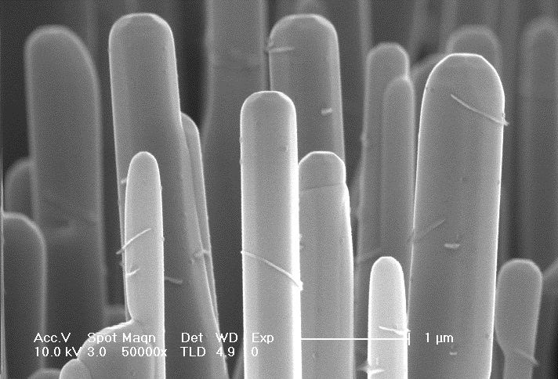
ZnO NANOWIRES
Vapor Phase Transport
Substrate= Si(100) / precleaned in HF:H₂O (1:10)
Zn film nucleation layer (t=20-100Å)
Source: (ZnO,Zn)/graphite powder ZnO(s) + C(s) → Zn(g) + CO(g)
Carrier gas: Ar flux(0-400 sccm)/O₂ flux(10-100 sccm)
Diameters = 100-500 nm
Lengths = 5-20 μm
preferential orientation: [0001]

Slide 12
ZnO NANOWIRES
Transfer process
Donor substrate ⇒ ethanol dispersion
US cavitation

Slide 13
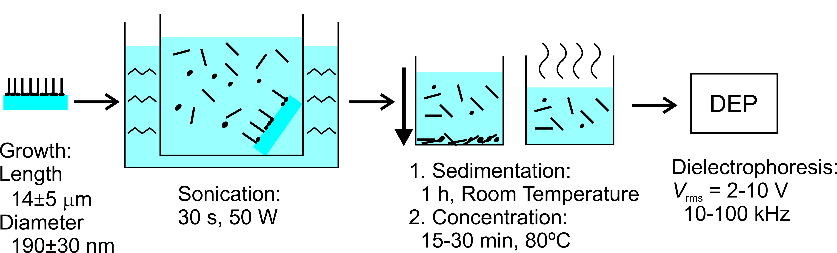
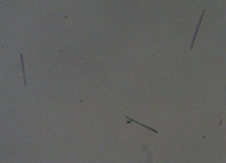
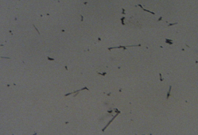
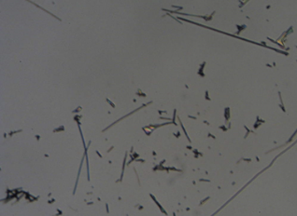
ZnO NANOWIRES
Filtering process
1h
Filtering process based on sedimentation

Slide 14
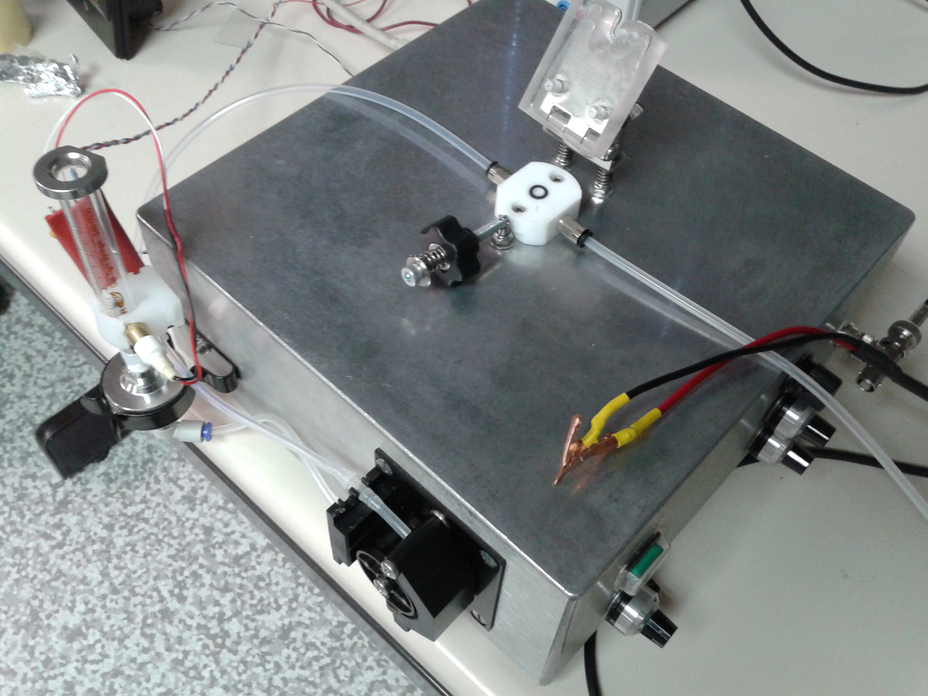
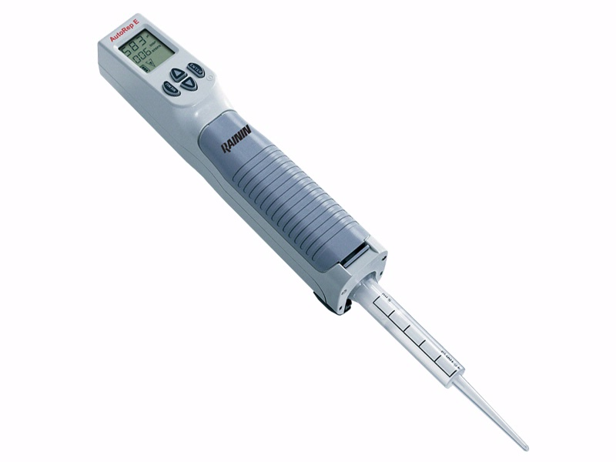
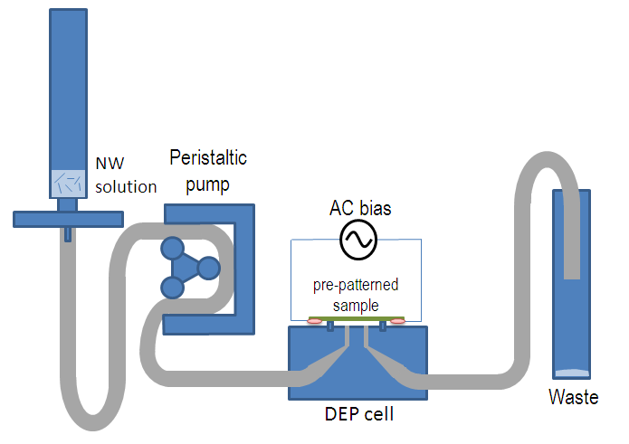
DEVICE FABRICATION
Dielectrophoresis
Droplet DEP
Continuous-flow DEP system
AC

Slide 15
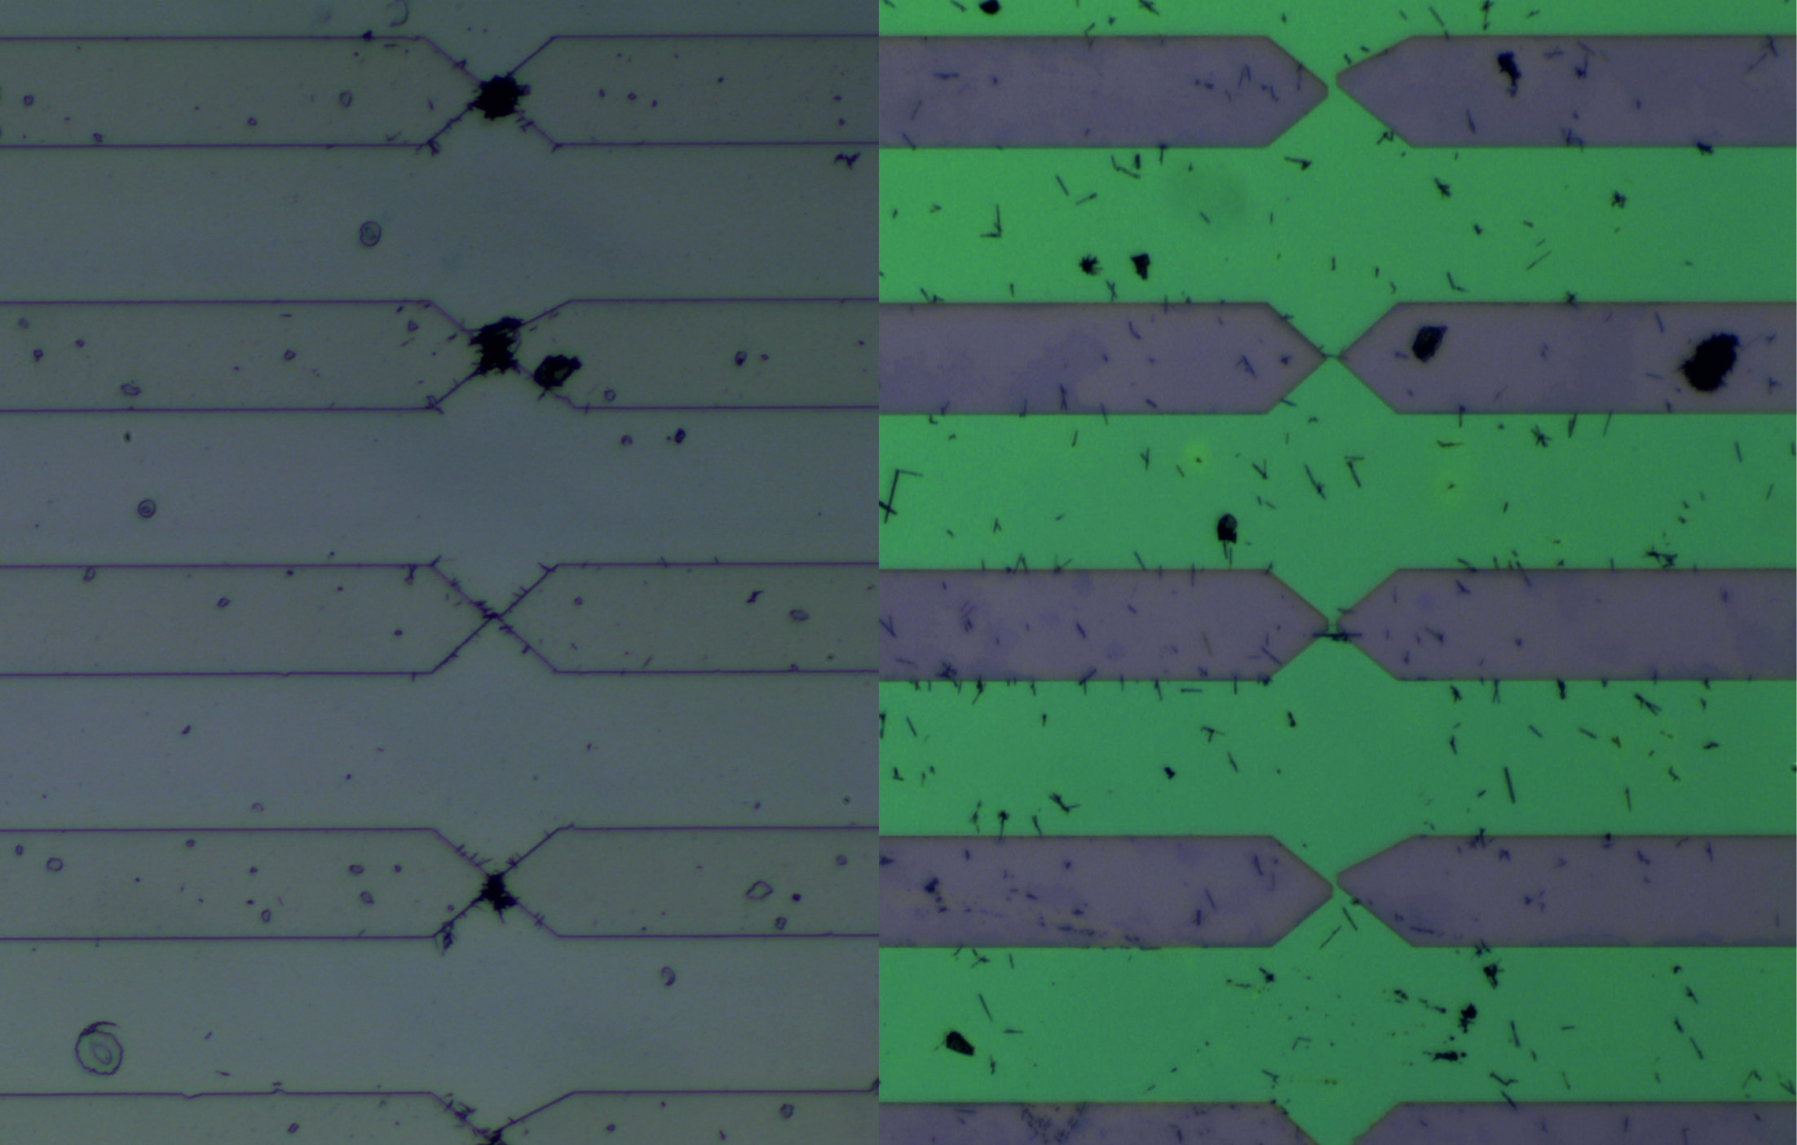
Droplet DEP
Continuous-flow DEP system

Slide 16
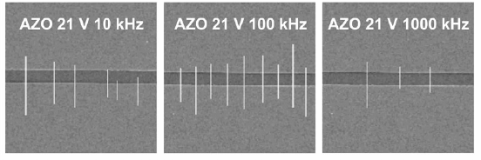
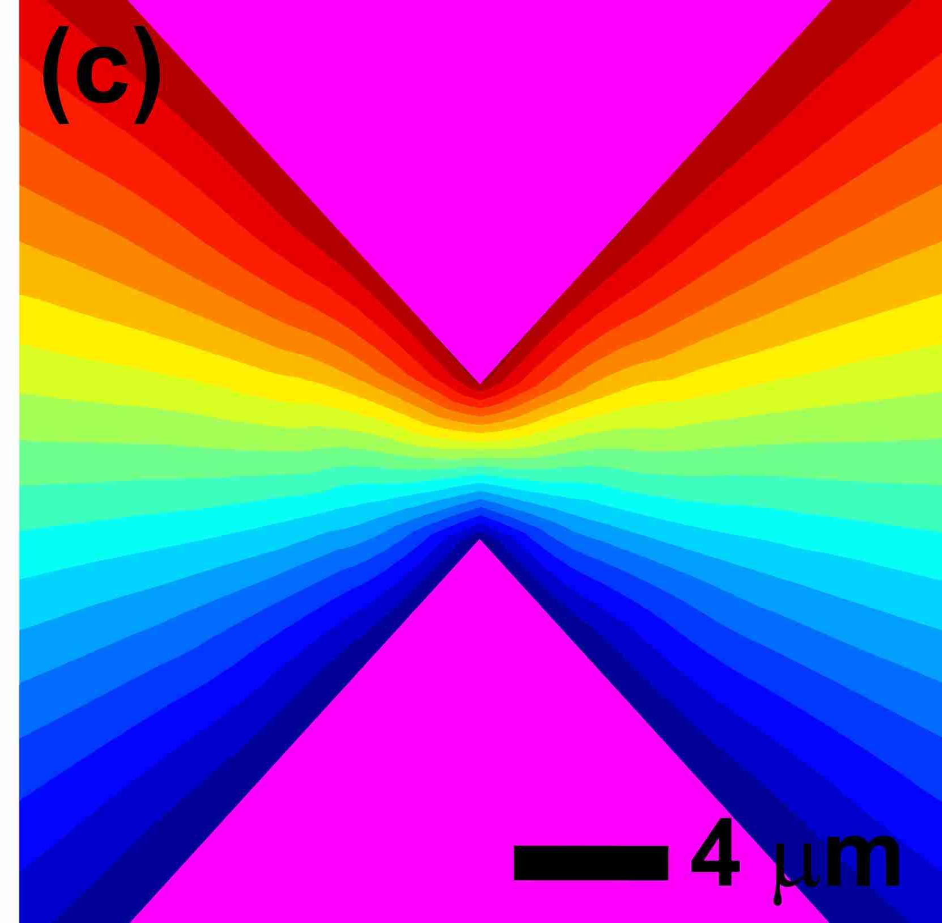
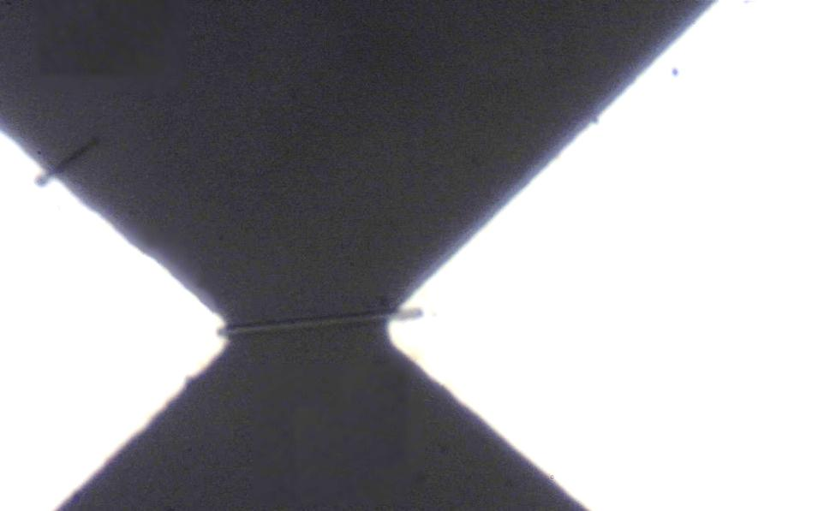
C. García et al., Nanotechnology 24 (2013) 415702
multiNW devices
Receiver chip substrate:
  SiO₂/Si
  Glass
  Printed Circuit Boards
Metal electrodes
  Al
  Au
  Al-doped ZnO (AZO)
  Cu
single NW devices
COMSOL multiphysics

Slide 17
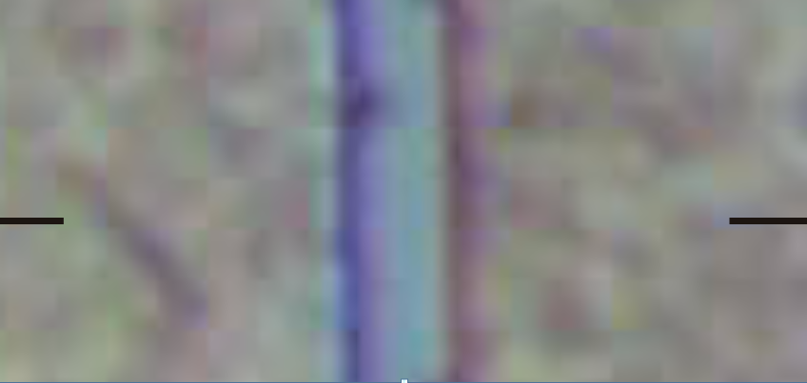

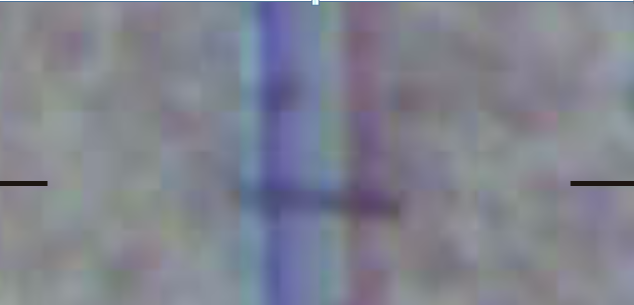
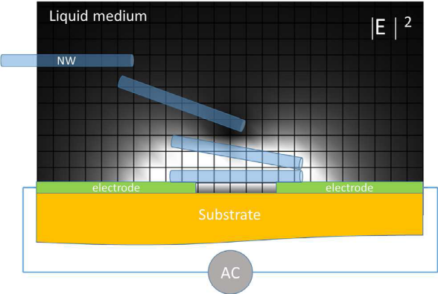
ZnO NW/ethanol
1 mM solution
4μm
gap
Al electrode
Al electrode
f=100KHz, V_{p}=15V

Slide 18
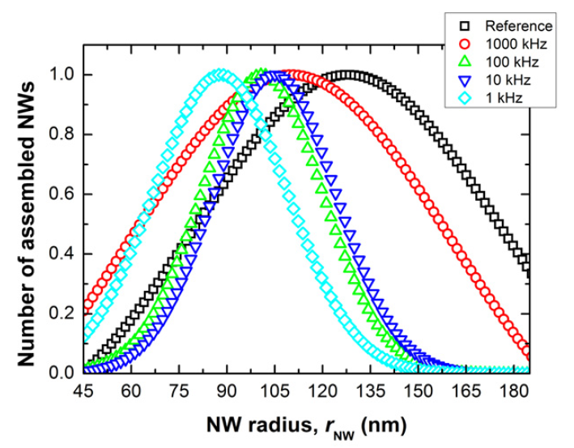
DIELECTROPHORESIS
Size selectivity

Slide 19
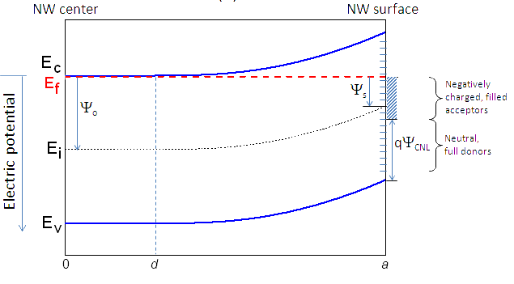
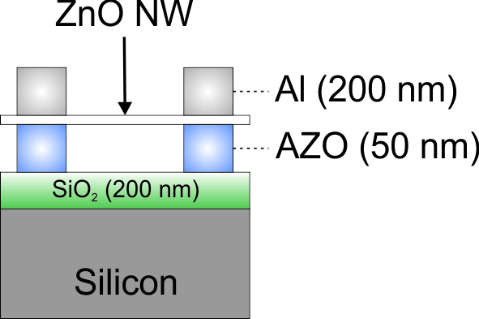
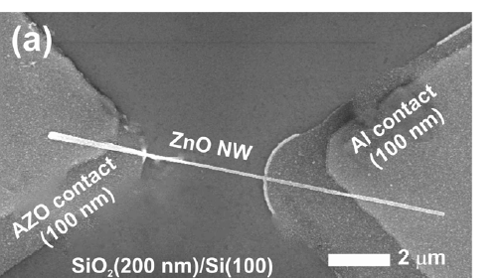
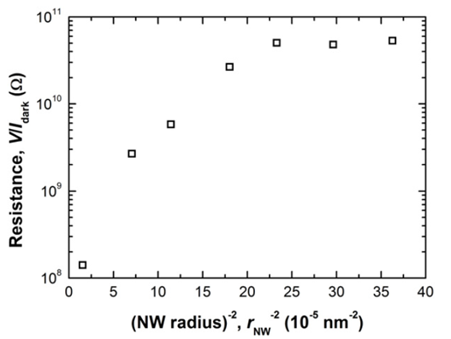
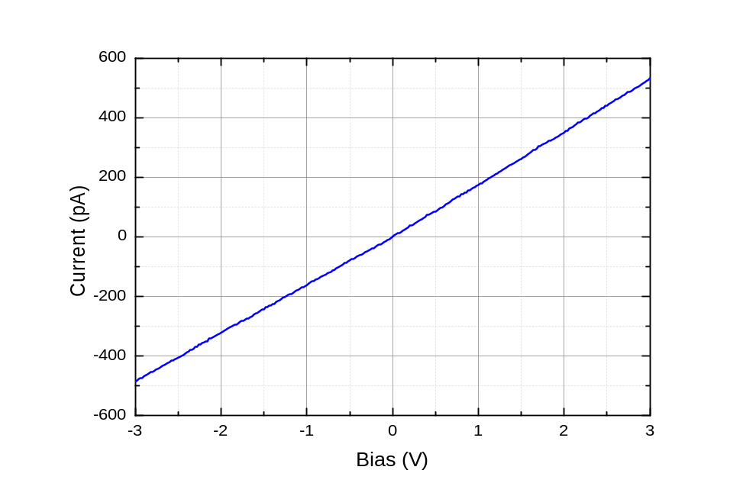
Depleted NWs
Pinch-off
diameter
130 nm
RH≈30%

Slide 20
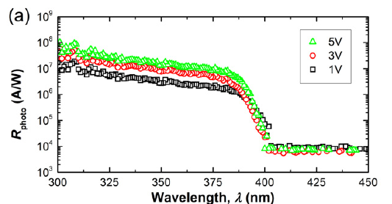
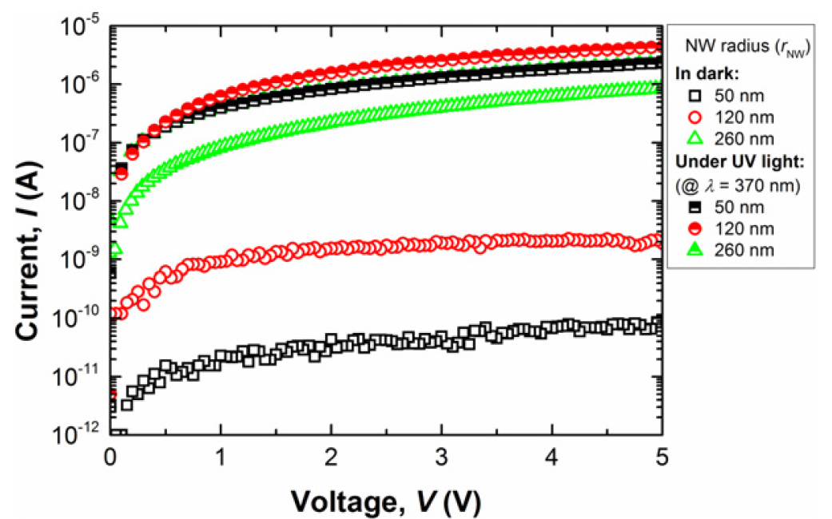
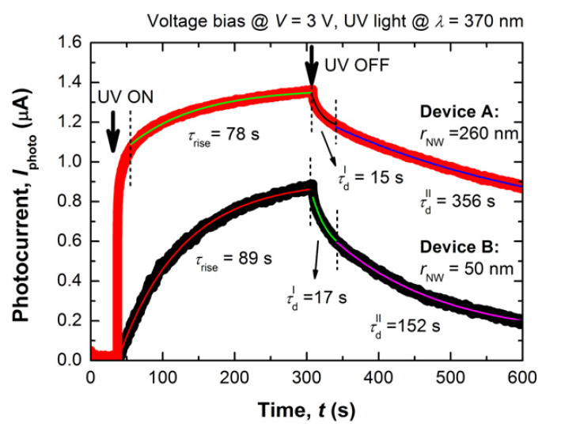
High PC gains (>10⁸)
Visible rejection ratio >10³
P = 551 μW/cm²
λ = 370 nm

Slide 21
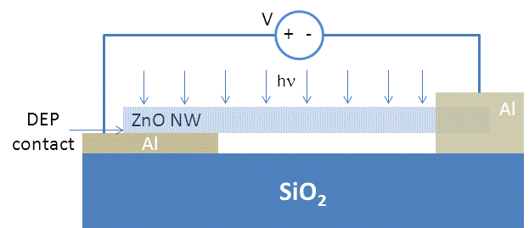
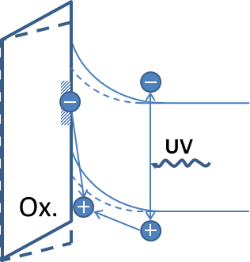
SINGLE NW DEVICES
Blocking contacts
Ohmic contact
ZnO NW
DEP
contact
Al
Al
J. L. Pau et al., Proc. of SPIE 8987 (2014)

Slide 22
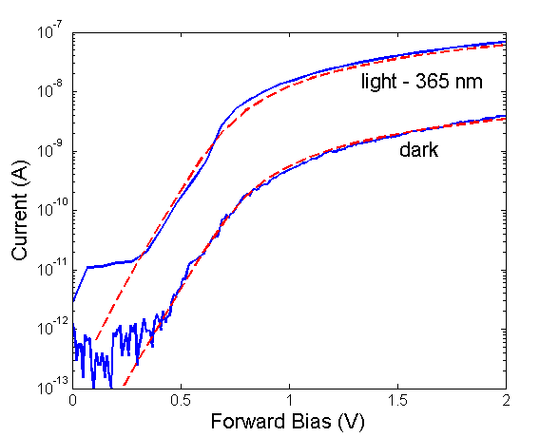
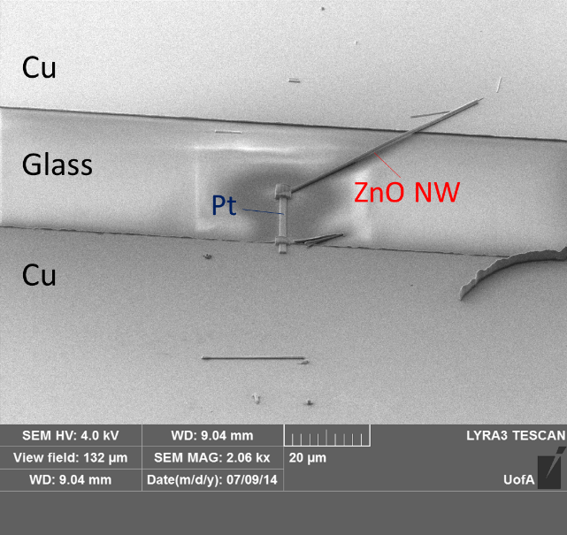
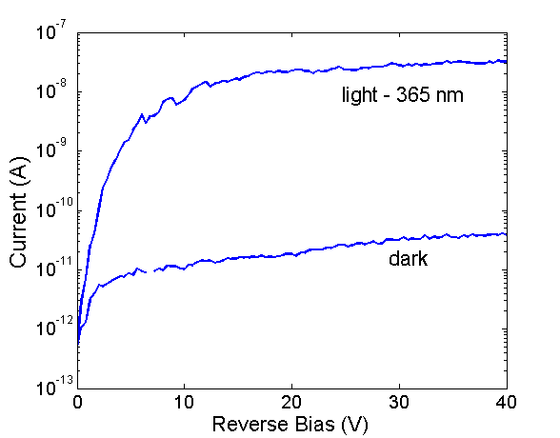
Thermionic emission fitting model
n=2.7, Φ_{B}=0.75-0.85 R_{s}=18-300 G

Slide 23
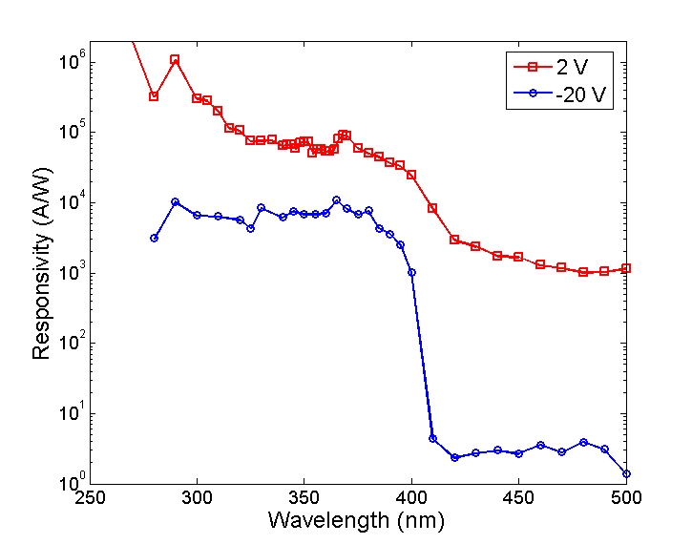
Detection range: 390-280 nm
Responsivity:
2V: 10⁵ A/W
-20V: 10⁴ A/W
UV/visible contrast:
2V: 10²
-20V: >10³
Gain=10⁴-10⁵

Slide 24
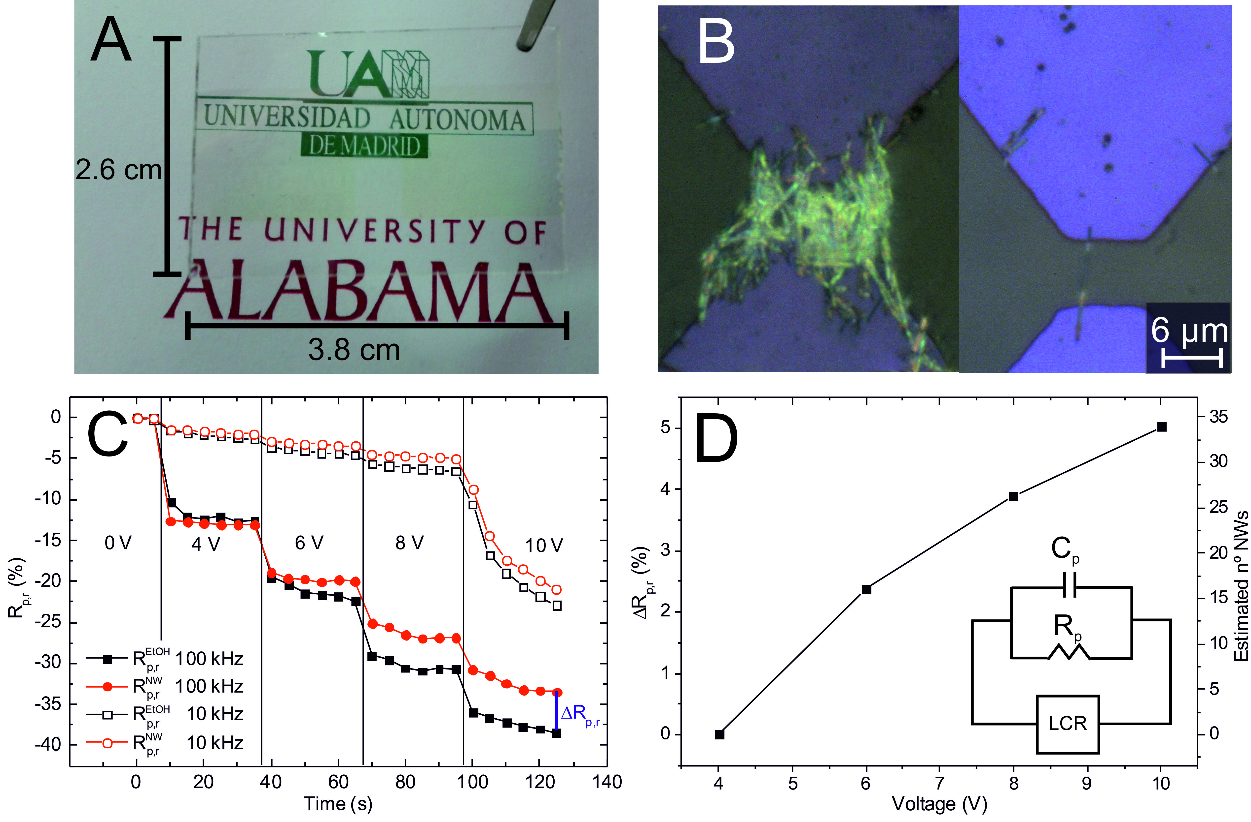
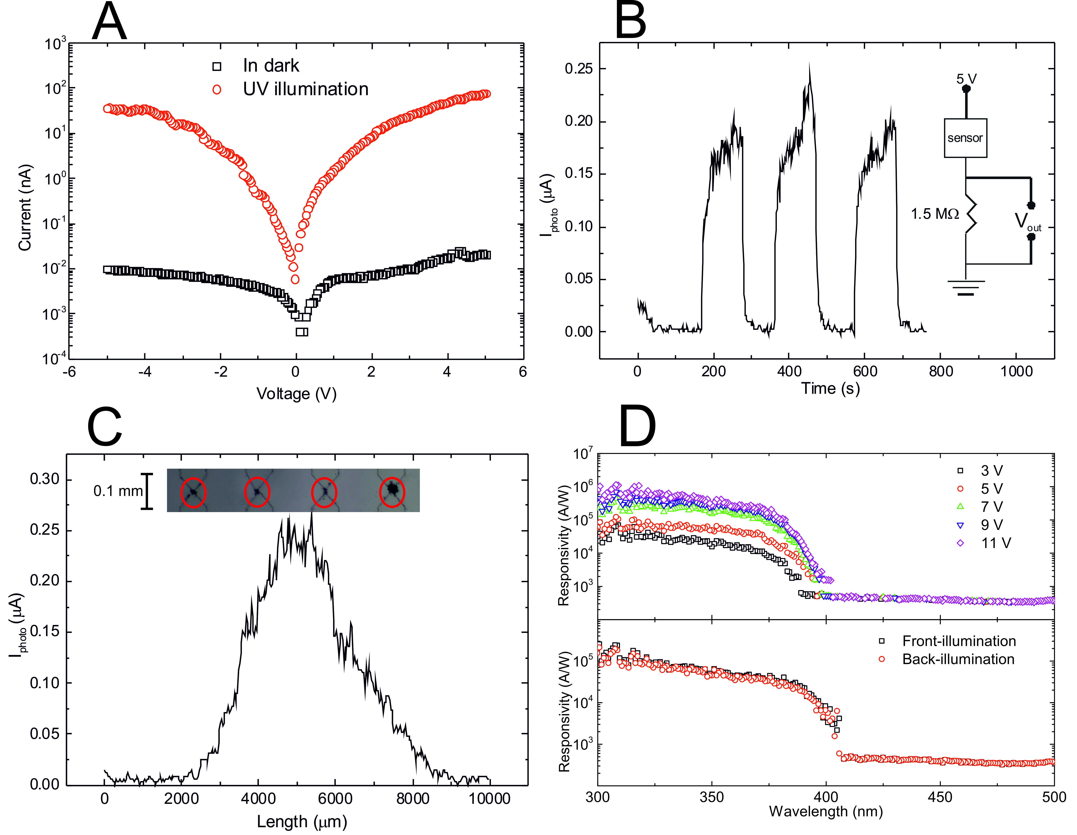
MULTI-NW DEVICES
Blocking contacts
AZO
Glass
Fully transparent sensors
Thermal effects
I_{photo} (μA)
Time (s)
Fast current shutdown (<5% of the signal reached in <1s)

Slide 25
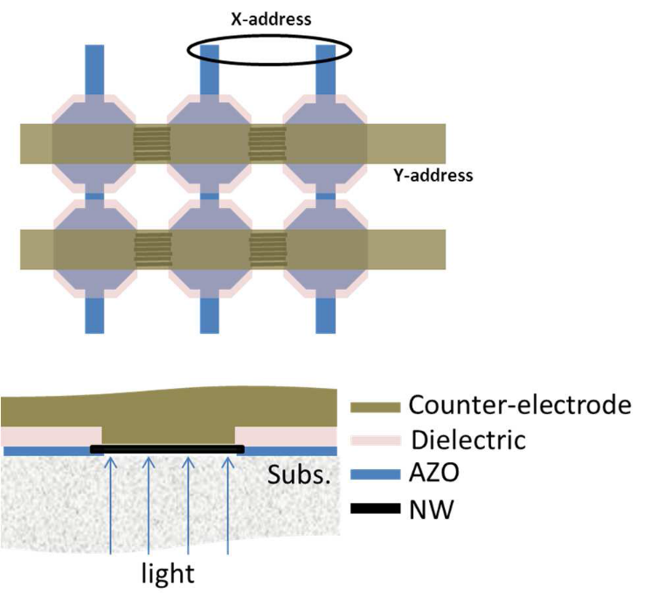
CONCLUSIONS and PROSPECTS
DEP systems for NW integration developed
Industrially scalable procedure for the fabrication of single NW and multi NW devices
UV-visible photodetectors based on contacts formed by DEP have demonstrated to present fast response and very low leakage currents.
FUTURE WORK:
Addressable arrays
Heterogenous DEP - combining different NW technologies.

Slide 26
Rest of team
(PhD students) C. García Núñez, A. García Marín
(Undergrad) C. Guerrero, P. Lanterne
(JdlC post-doc) A. Redondo
(Technicians) E. Ruiz, P. Rodríguez
(Faculty) J. Piqueras
Financial support
MINECO TEC2010-20796 project
Comunidad de Madrid (AVANSENS program, S2009/PPQ-1642).
UAM-Banco Santander US Cooperation Program

Slide 27
Let Us Meet Again
We welcome all to our future group conferences of Omics group international
Please visit:
www.omicsgroup.com
www.Conferenceseries.com
http://optics.conferenceseries.com/

