Slide 1
THE 5-HT₇ RECEPTOR: A KEY MECHANISM OF ENDOCRINE DYSREGULATION IN STRESS-RELATED DISORDERS?
Chronic Stress
José A. Terrón
Depto. de Farmacología
CINVESTAV-IPN
Mexico City
October 2014
X
X
-
-
CRH
ACTH
5-HT₇
Cortisol
5-HT₇
5-HT₇
+
+
5-HT₇
5-HT₇
5-HT₇
Hypothalamus
Pituitary
Adrenal glands

Slide 2
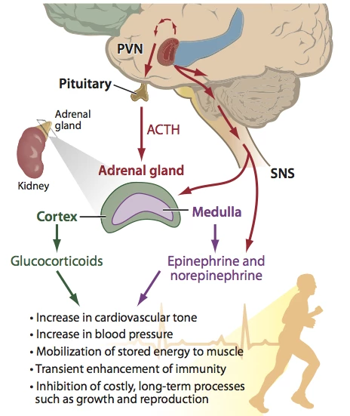

Slide 3


Real and fictitious threats both trigger the alarm reaction
I might fail.
They might think I am not qualified and…

Slide 4
Stress
Thought
(judgment,
complaint, regret, sadness, anger, etc.)

Slide 5



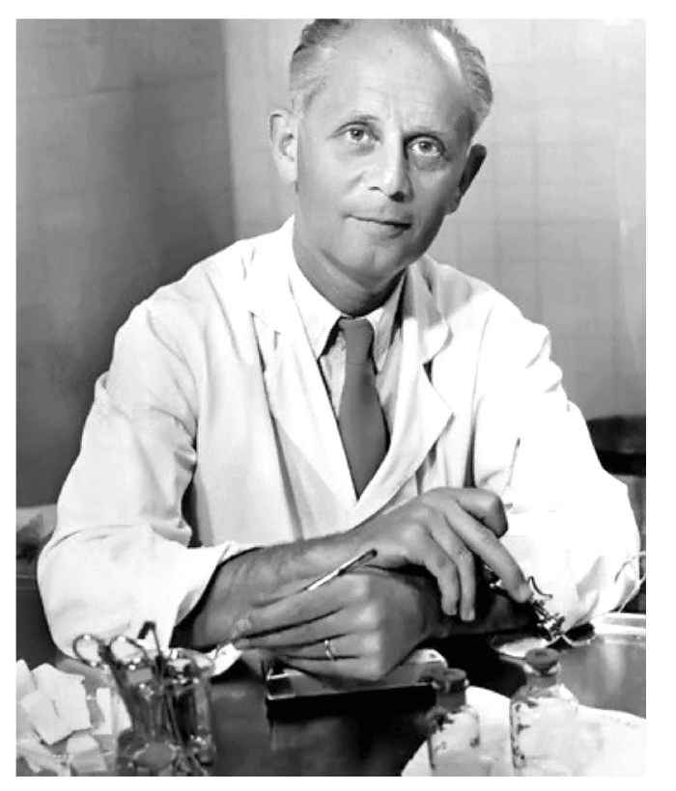


Chronic stress as a cause of disease
ACUTE
Alarm
Homeostasis
STRESS
CHRONIC
(‘short’)
Hans Selye (1907-1982)
Chronic stress
Resistance
Adaptation
Chemical changes
CHRONIC
(‘long’)
Disease
Exhaustion
Disruption

Slide 6
Stress

Slide 7
Stress
Chronic Stress
+
+
-
CRH
X
CRH
-
Hypothalamus
+
?
+
-
ACTH
X
ACTH
-
Pituitary
+
+
Cortisol
Cortisol
Adrenal glands

Slide 8
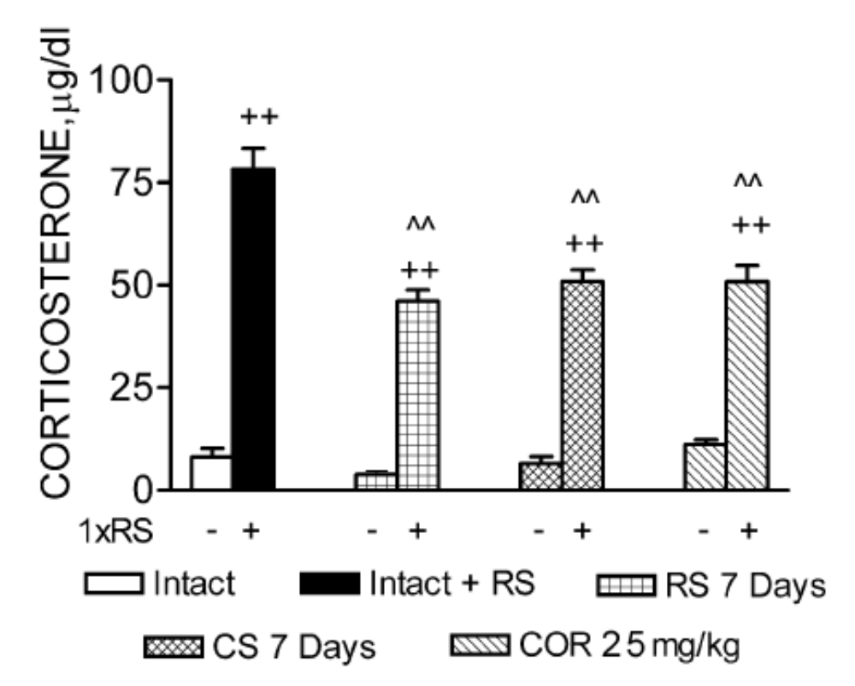
Previous stress experience induces habituated corticosterone responses to restraint in rats
Gadek-Michalska and Bugajski, J. Physiol. Pharmacol., 54(3), 449-459, 2003

Slide 9

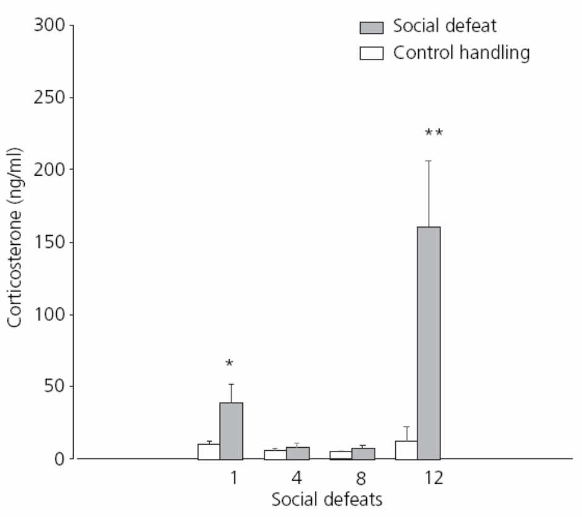

Chronic social defeat promotes disruption of CORT secretion to ‘anticipatory’ stress in mice
Experimental mouse
New aggressor for 4, 8 and 12 days
Keeney et al. J. Neuroendocrinol., 18, 330-338, 2006

Slide 10
Lack of control over stressors increases serotonin release from DRN
Behavioral control
X
Glut
vmPFC
X
5-HT
GABA
Habenula
+
PAG
X
Aversive
stimulation
Locus C.
Amygdala
-
5-HT
BNST
N. Accum.
Others
DRN
PVN
Modified from Maier and Watkins, 2010 (Brain Res., 1355, 52-60)

Slide 11
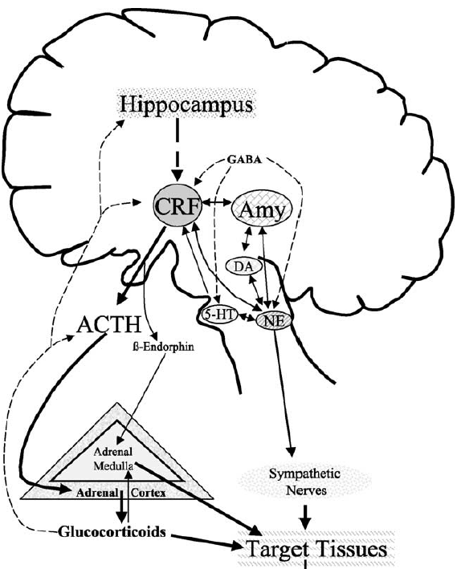
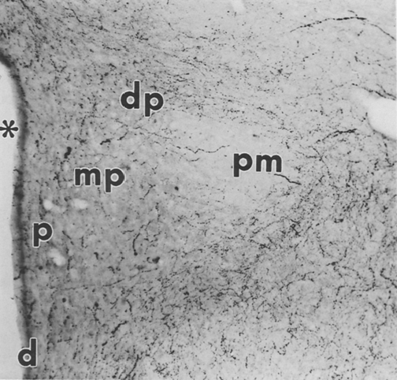
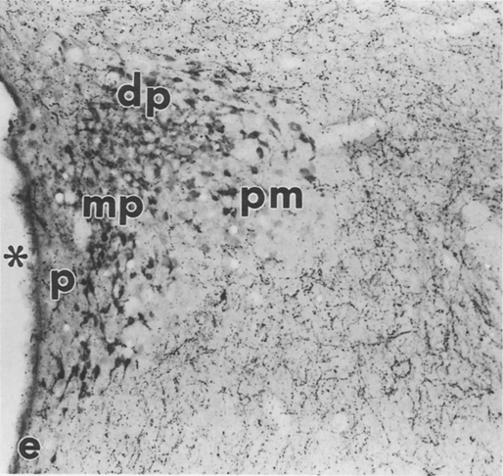
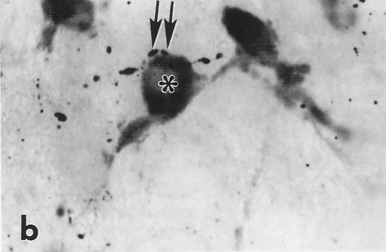

5-HT
5-HT + CRH
Carrasco and Van de Kar, Eur. J. Pharmacol.,463, 235-272, 2005
Liposits et al., Histochemistry 86, 541-549, 1987

Slide 12
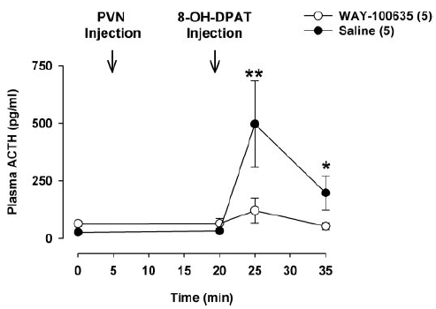
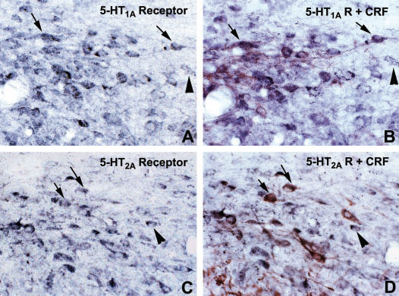

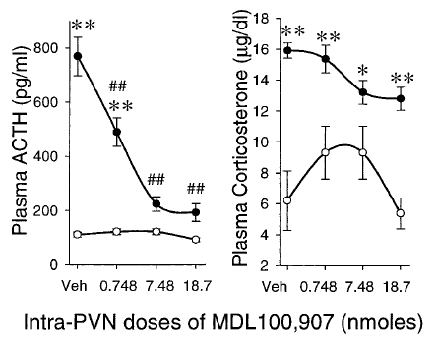
5-HT_{1A} and 5-HT_{2A} receptors are expressed in the PVN
Osei-Owusu et al. J. Pharmacol. Exp. Ther., 313, 1324-1330, 2005
Zhang et al. J. Pharmacol. Exp. Ther., 310, 59–66, 2004
Zhang et al., J. Neurosci., 22(21), 9635-9642, 2002

Slide 13
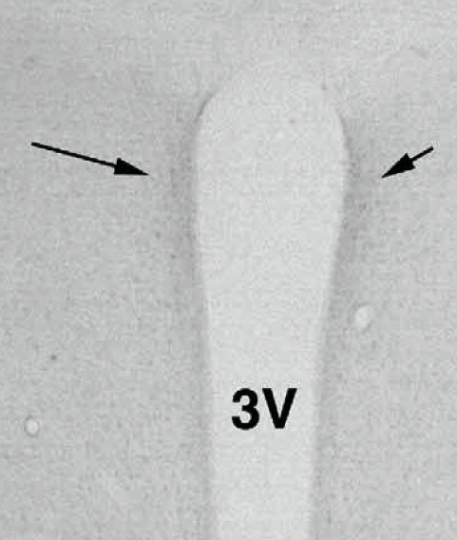
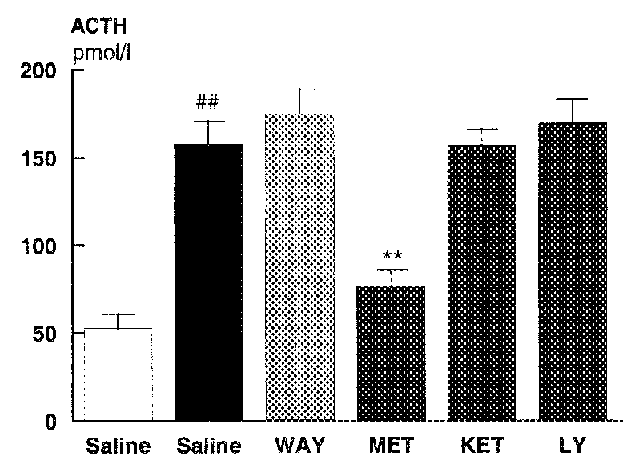
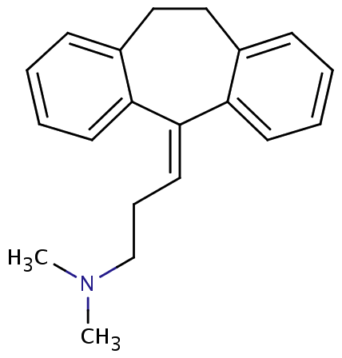
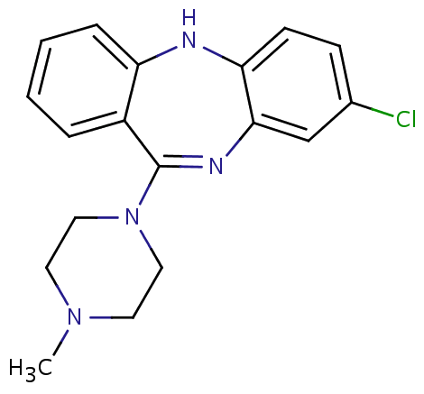
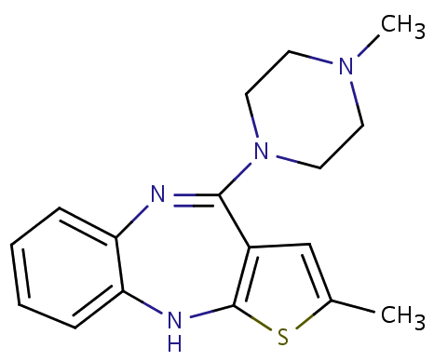
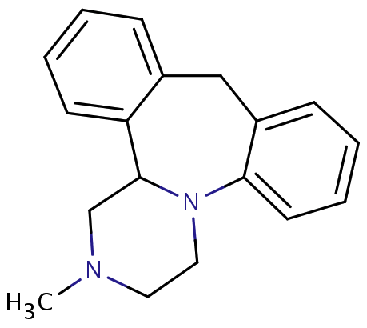
5-HT₇ receptors in the PVN
Muneoka and Takigawa (2003). Int. J. Dev. Neurosci., 21, 133-143
5-CT
Jorgensen et al. (1999). J. Neuroendocrinol., 11, 283-290.
Drug | Ki (nM)
Amitriptyline | 93
Mianserin | 37
Clozapine | 40
Olanzapine
Clozapine
Amitriptyline
Olanzapine
Shen et al. (1993). J. Biol. Chem., 268, 18200-18204.
Mianserin

Slide 14
Is the 5-HT₇ receptor involved in chronic stress-induced HPA axis dysregulation?

Slide 15
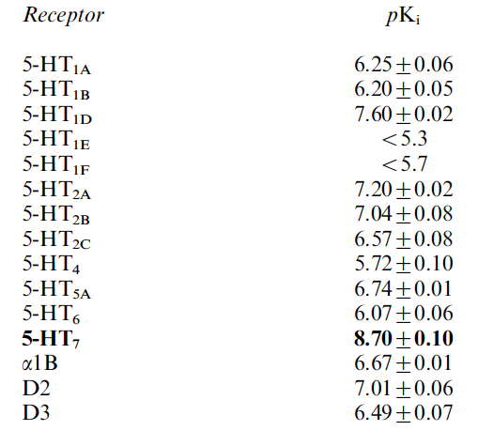
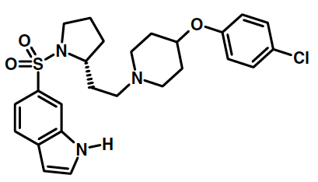
Experimental protocol
ACTH and CORT levels after acute restraint
HOME CAGE CONTROL (CTRL; 20 sec/day TL)
TREATMENT (i.p.)
VEH (n=30/group)
SB (n=30/group)
CHRONIC RESTRAINT STRESS (CRS; 20 min/day)
0
10
30
60
120
Time of restraint (min)
1
Days
14
Day 15
SB-656104 (SB)
Thomas et al. (2003). Br. J. Pharmacol., 139, 705-714.

Slide 16
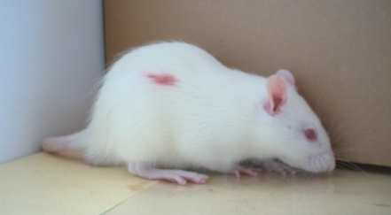
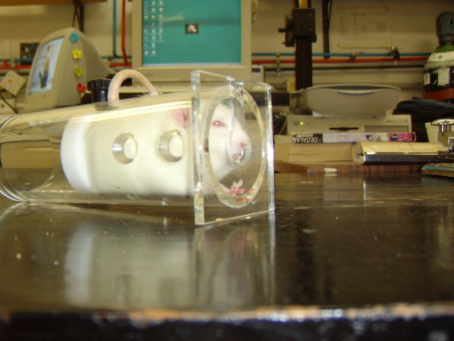
Experimental protocol
HOME CAGE CONTROL (CTRL; 20 sec/day TL)
Somatometric measurements
5-HT₇-R in PVN and adrenals
5-HT in adrenals
TPH in adrenals
NO TREATMENT
(no injection)
CHRONIC RESTRAINT STRESS (CRS; 20 min/day)
1
Days
14
Day 15

Slide 17
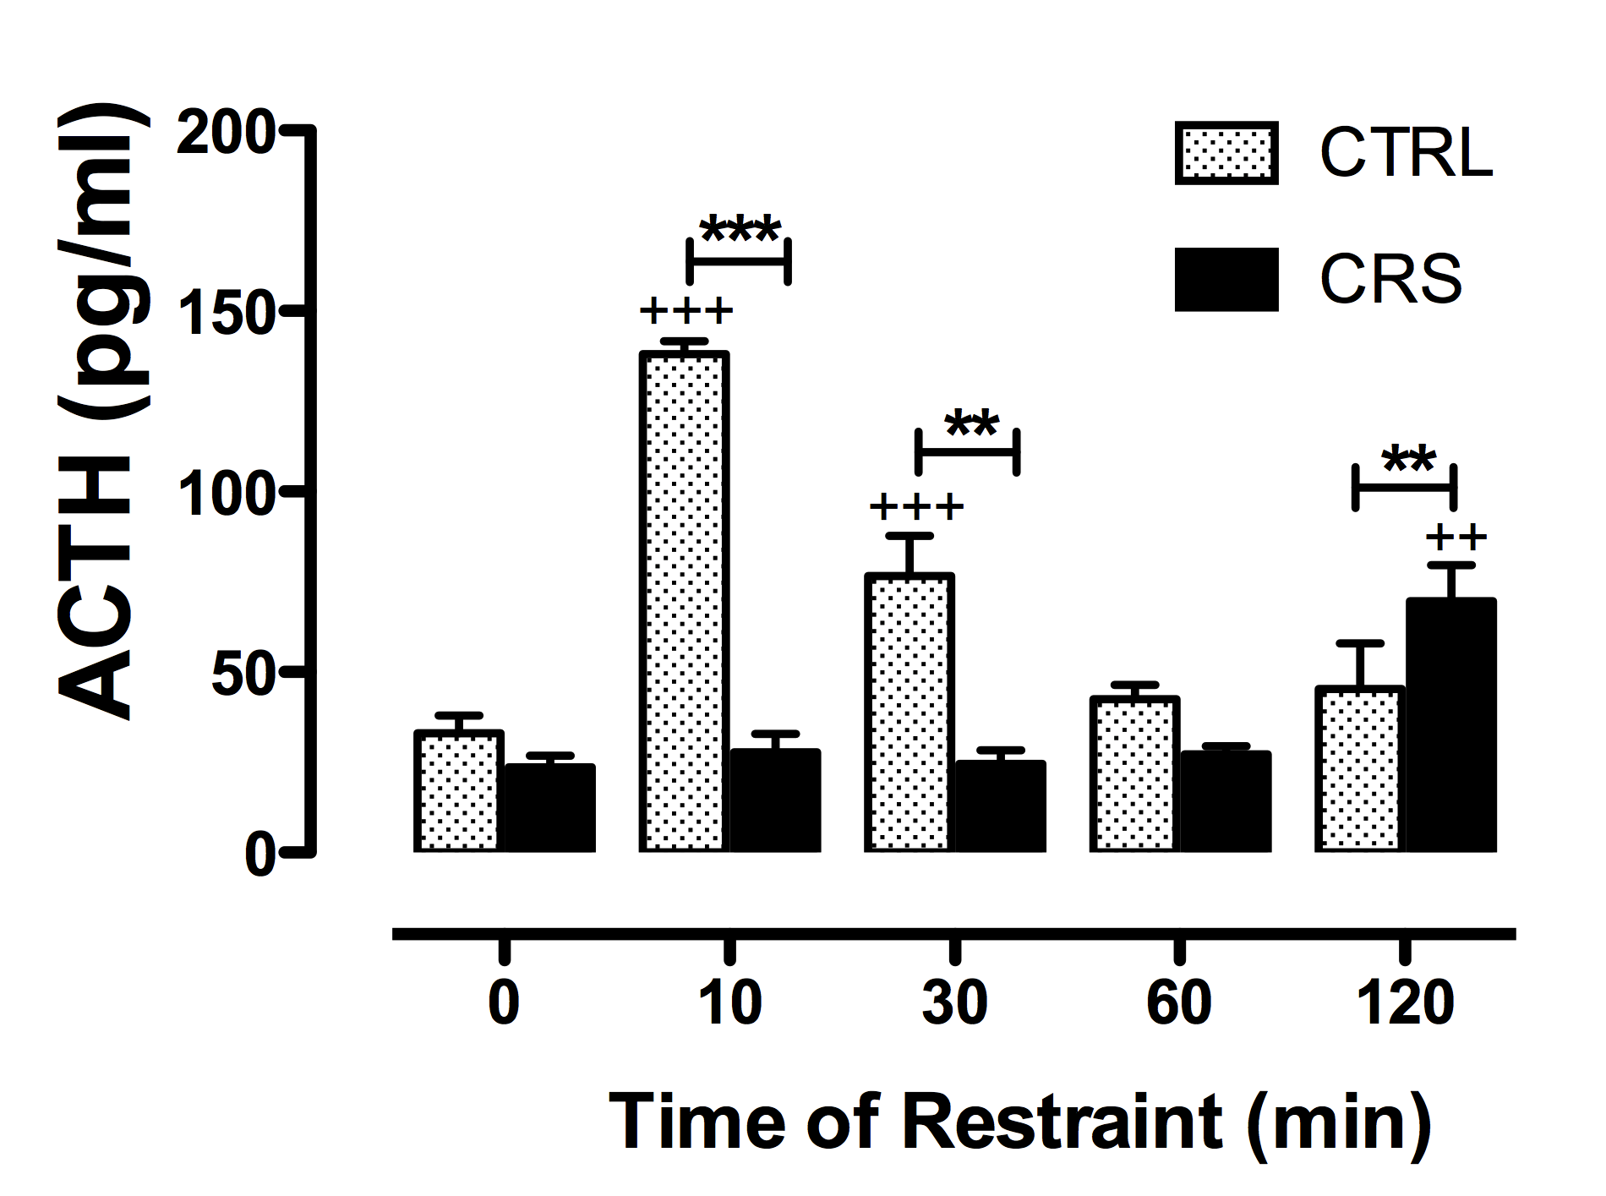
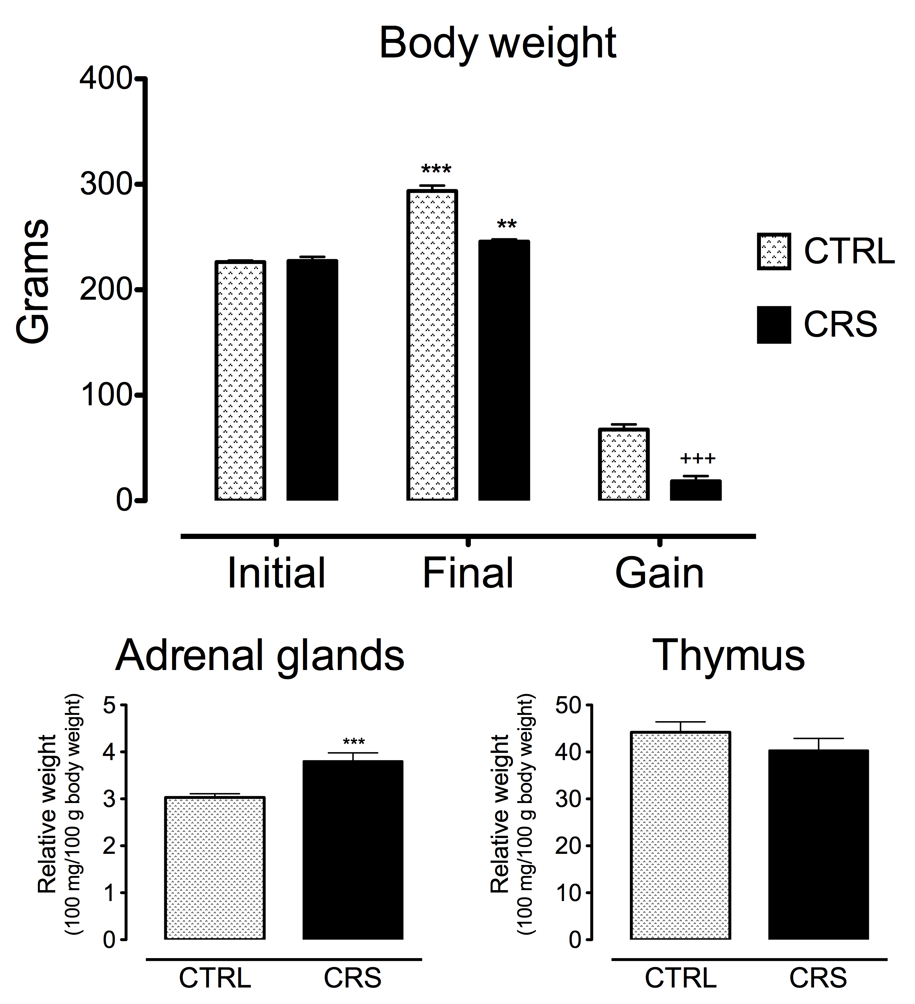
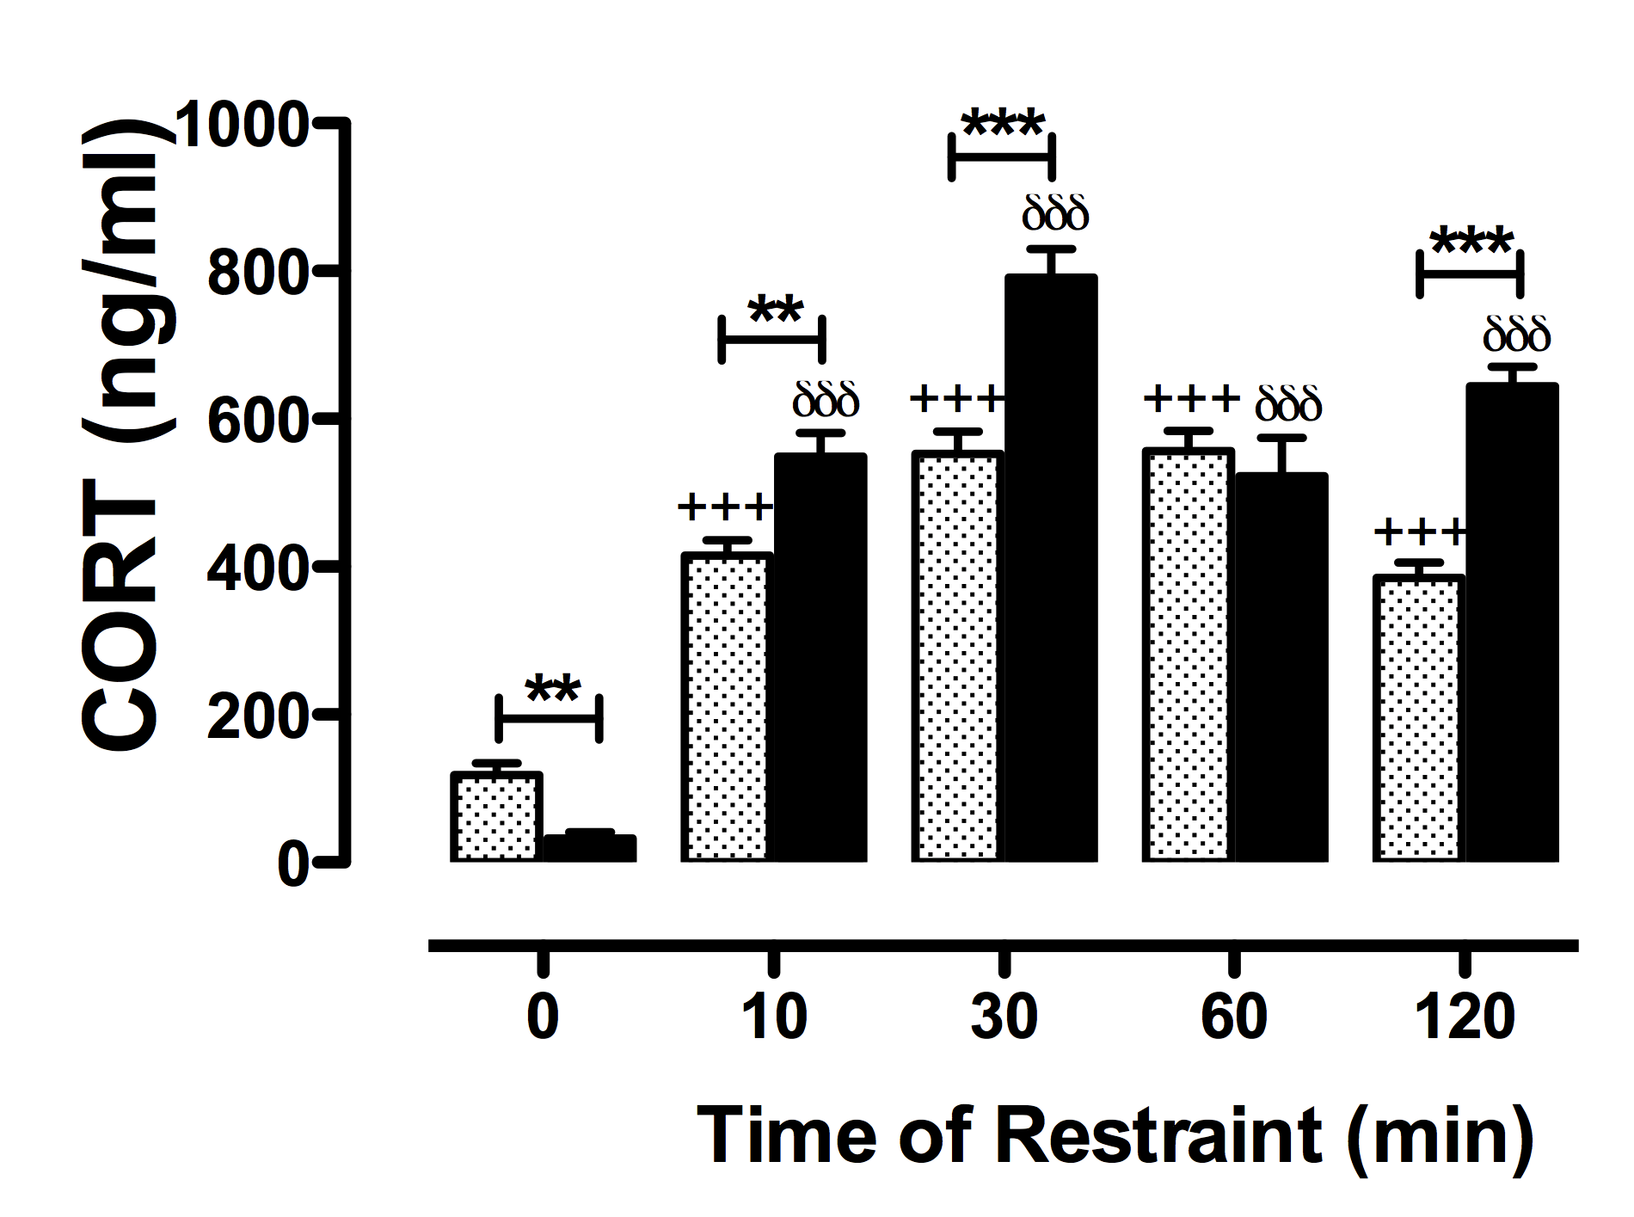
Chronic restraint-induced endocrine dysregulation

Slide 18
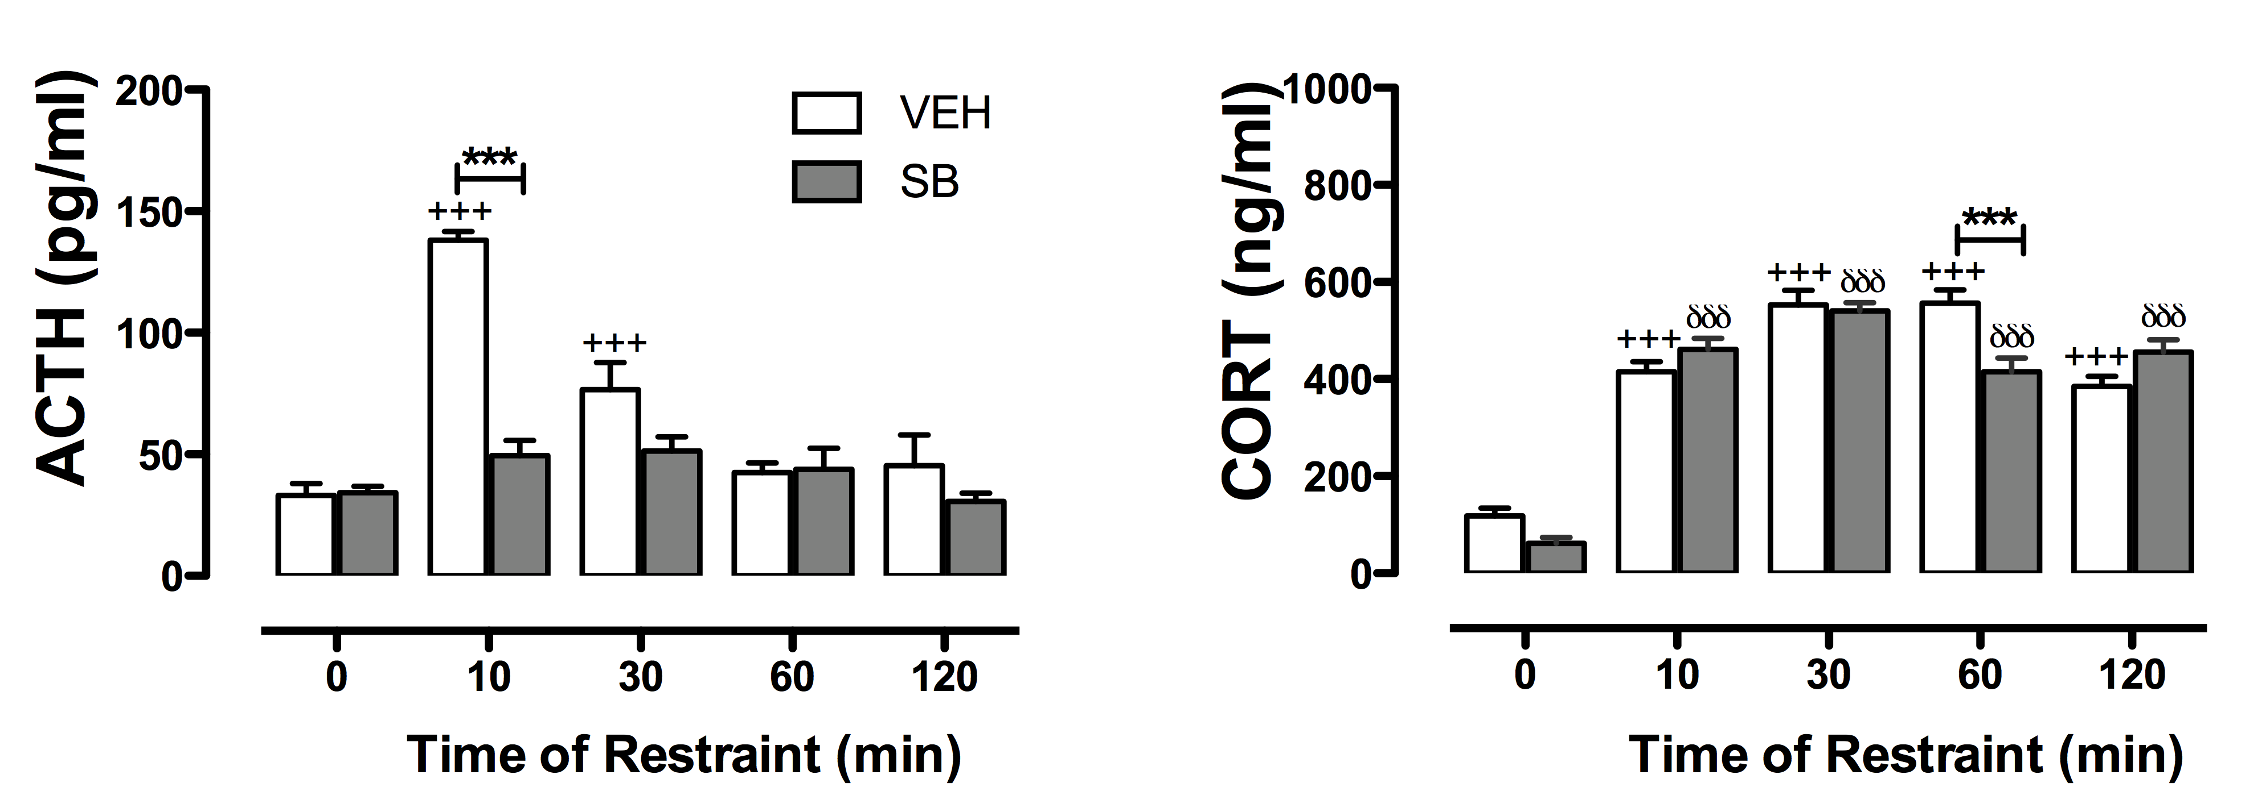
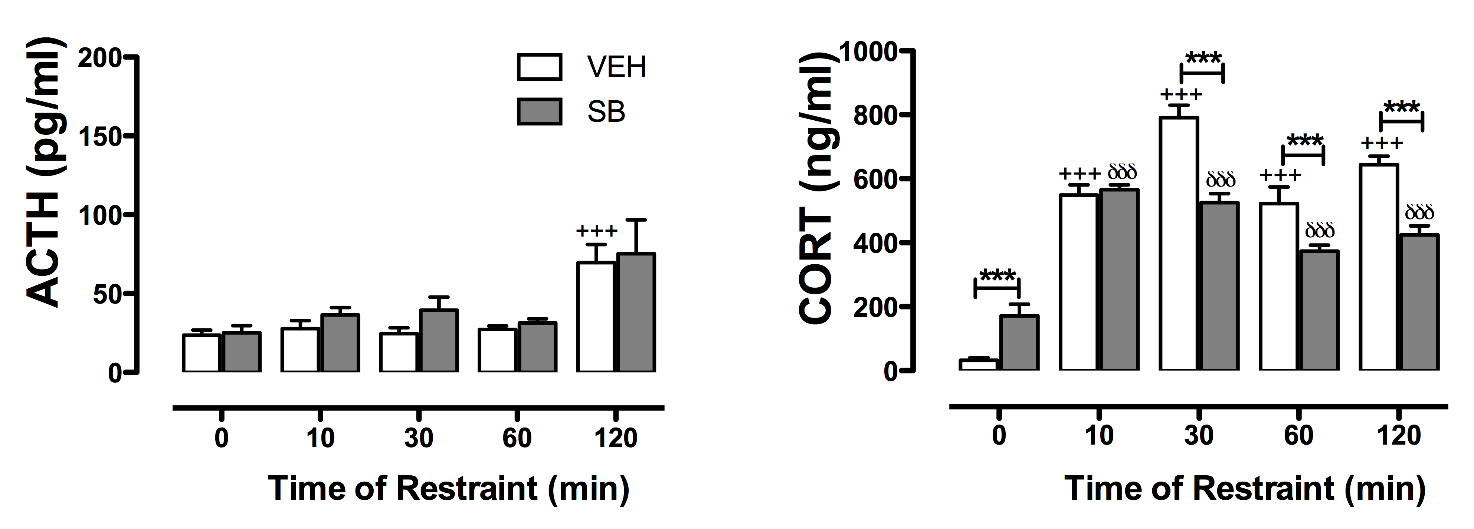
Blockade of 5-HT₇ receptors on restraint-induced hormone secretion
CTRL
CRS

Slide 19
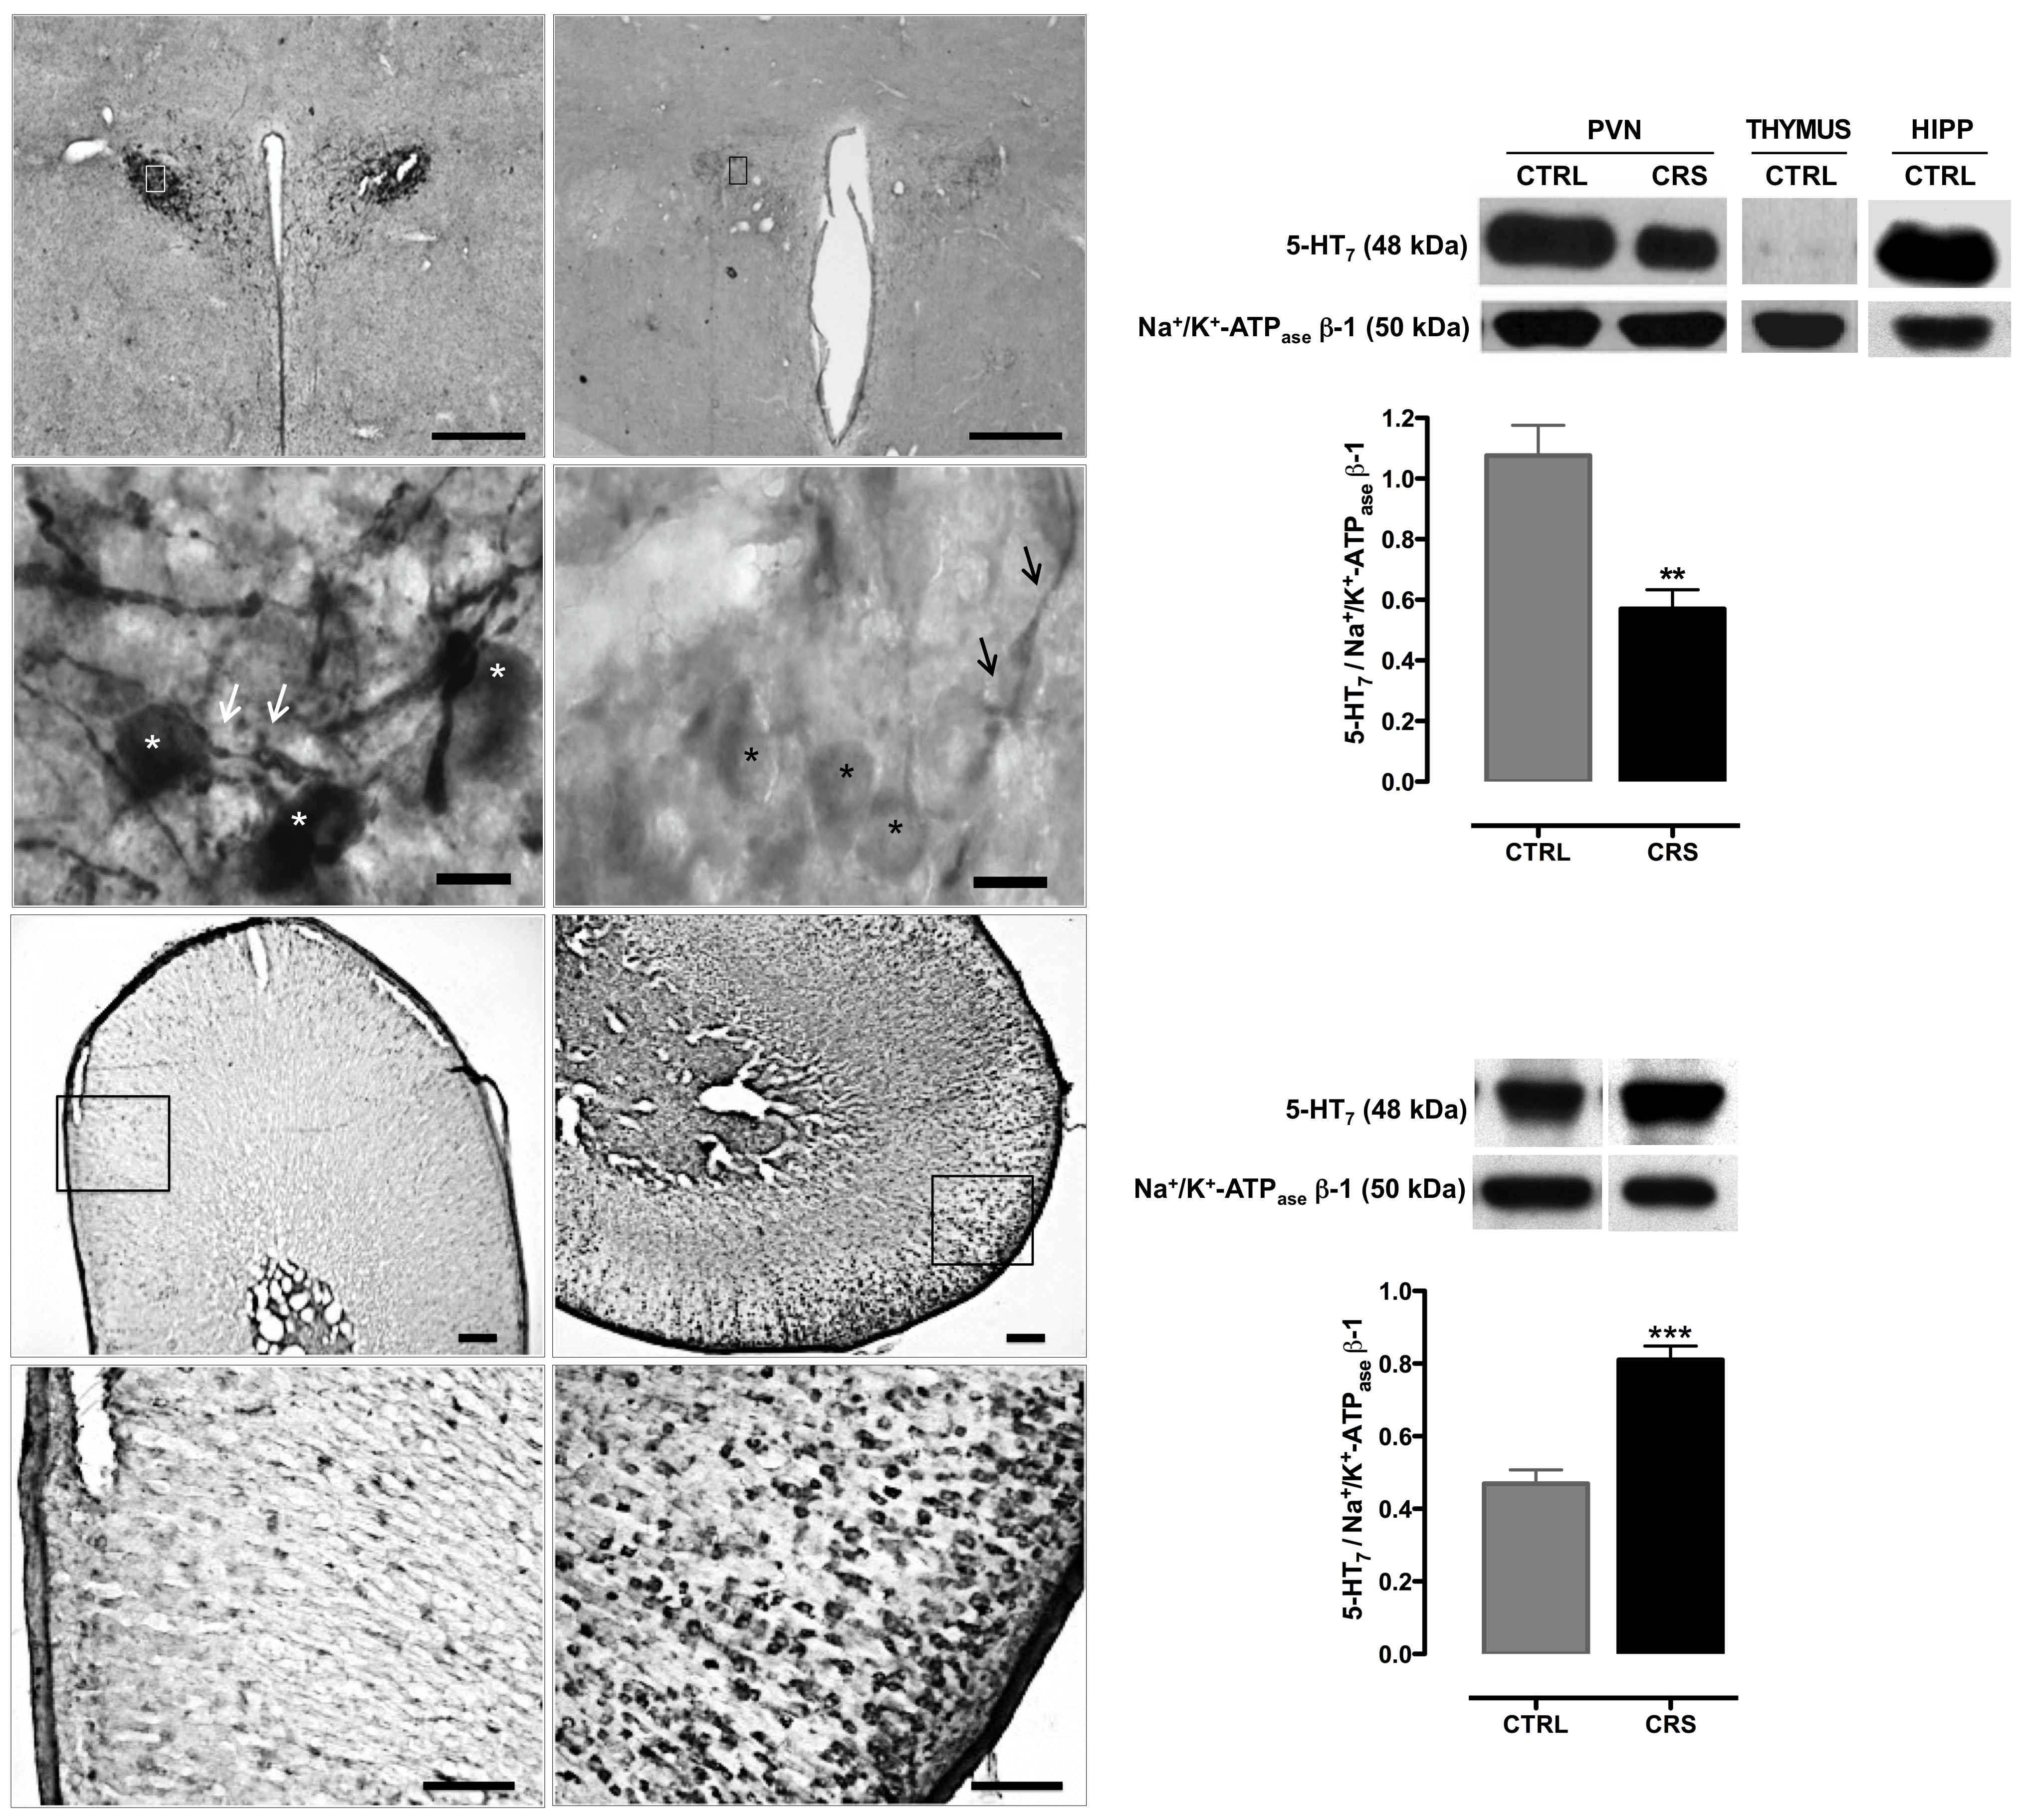
5-HT₇ receptor in PVN and adrenal glands
CTRL
CRS
PVN
AGs

Slide 20
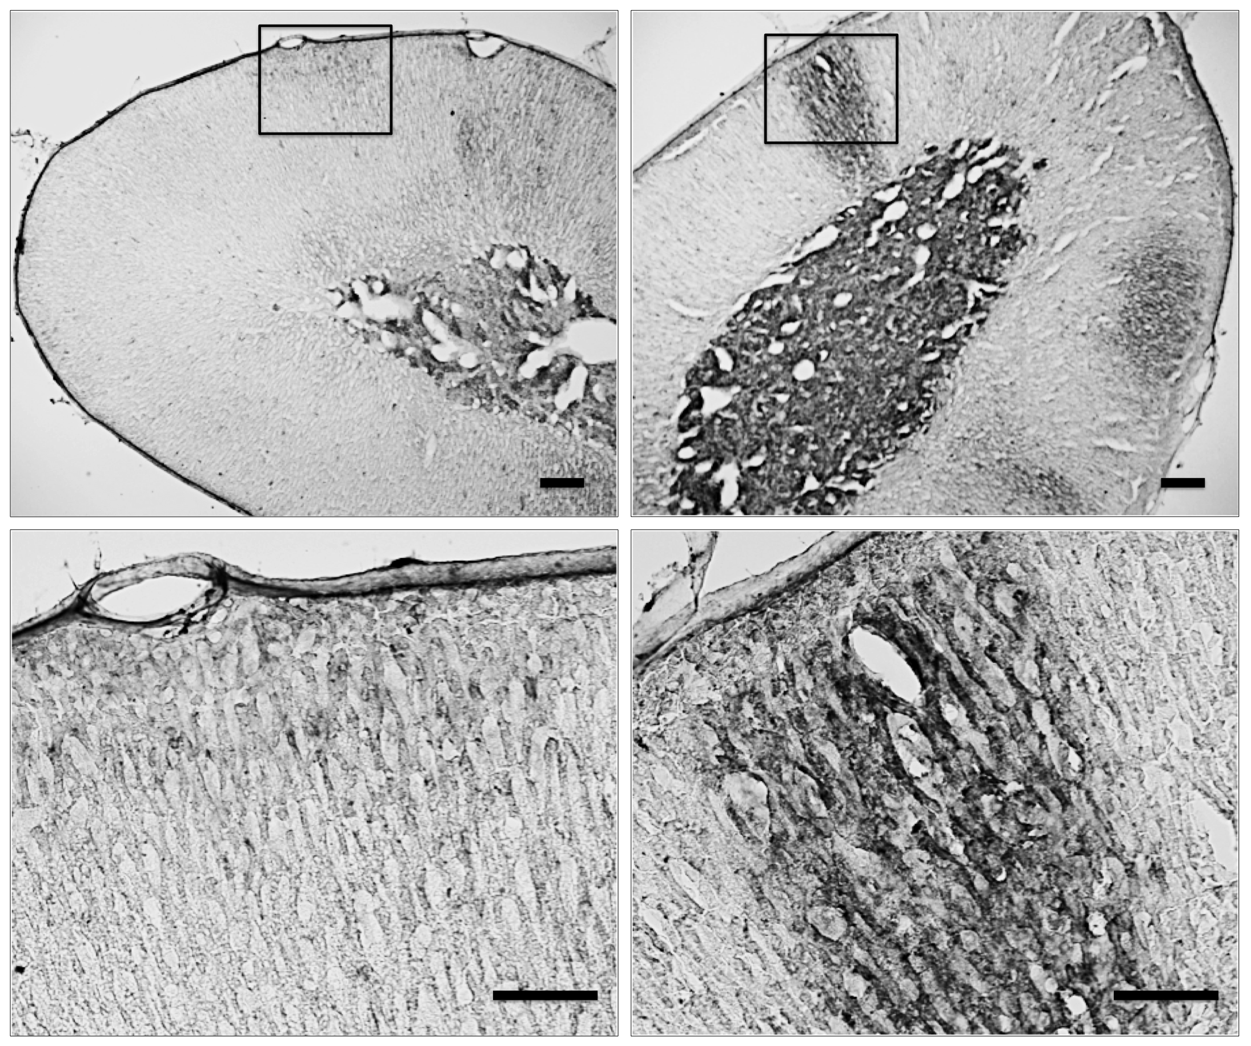
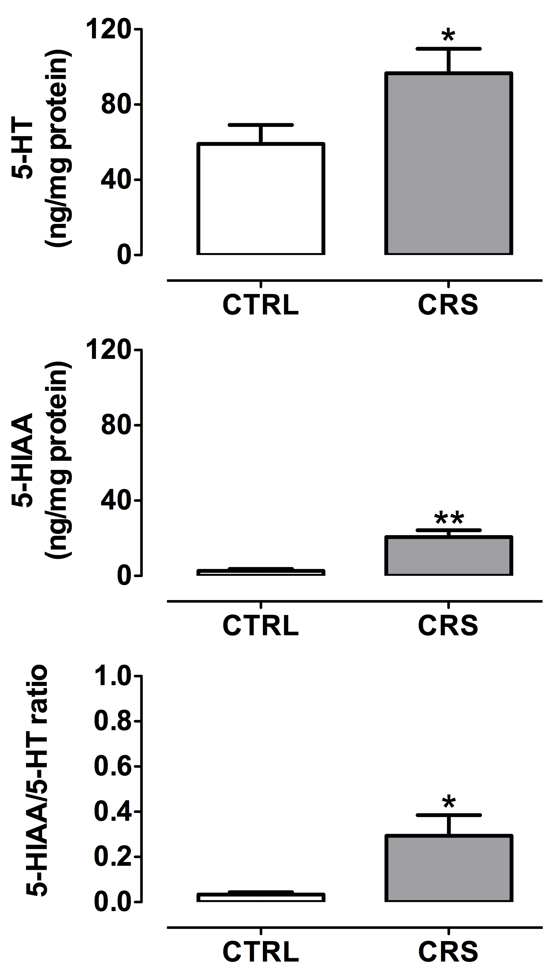
5-HT in adrenal glands
CTRL
CRS

Slide 21
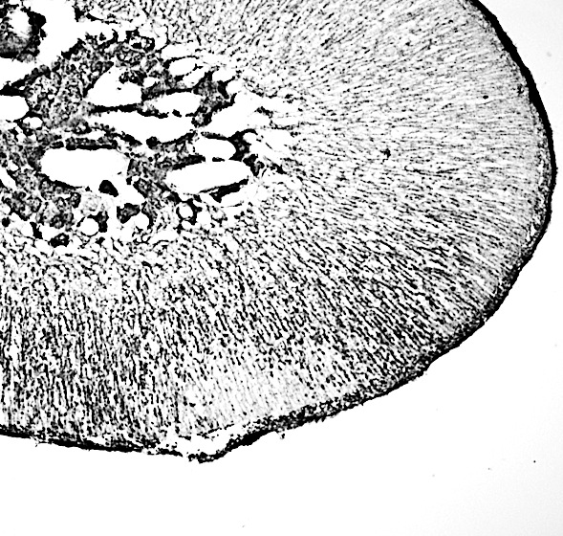
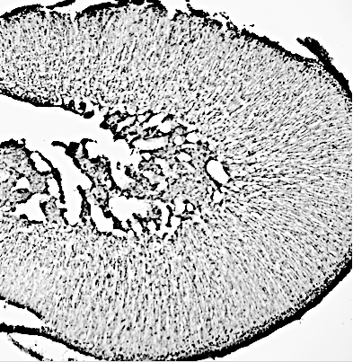
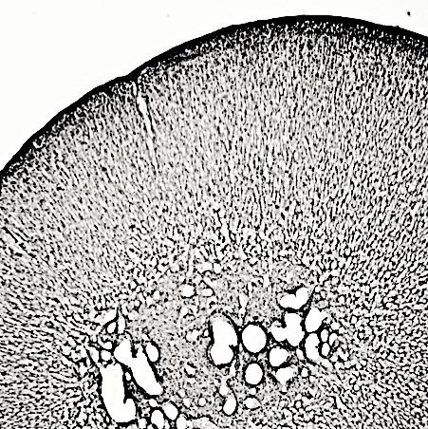
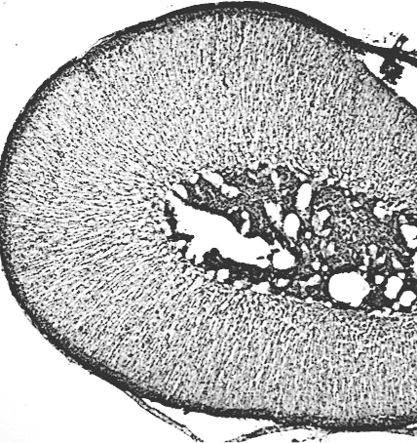
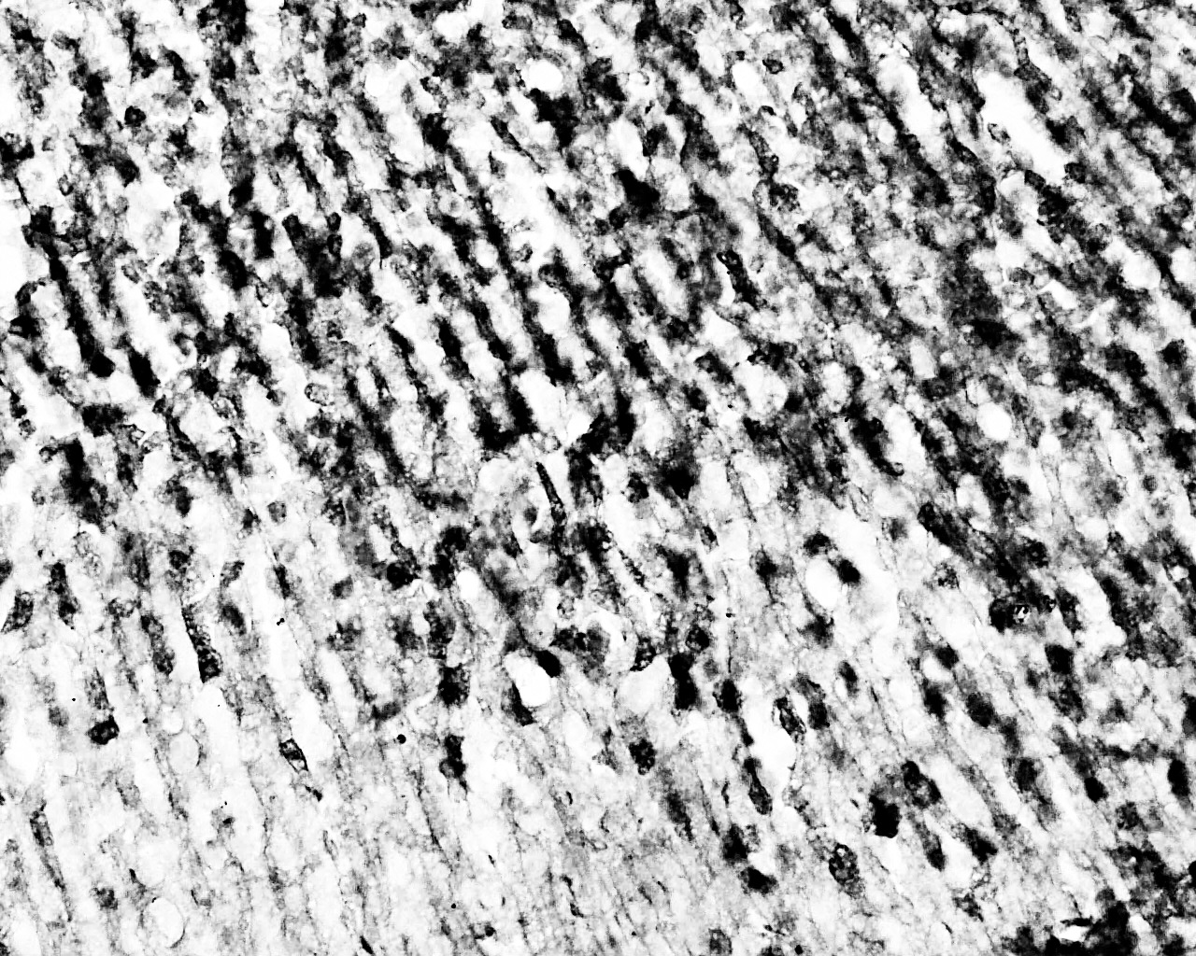
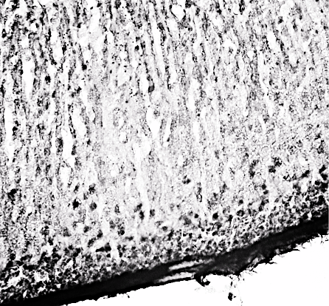
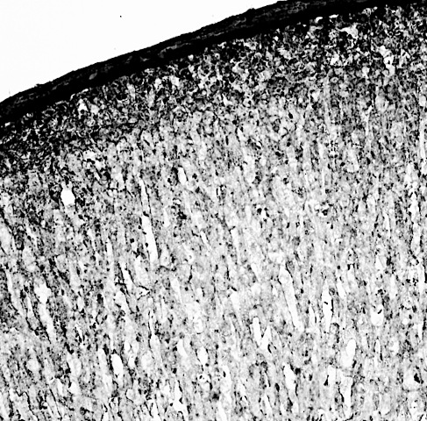

Tryptophan hydroxylase in adrenal cortex
TPH-1-LI
TPH-2-LI
CTRL
CRS
CTRL
CRS

Slide 22
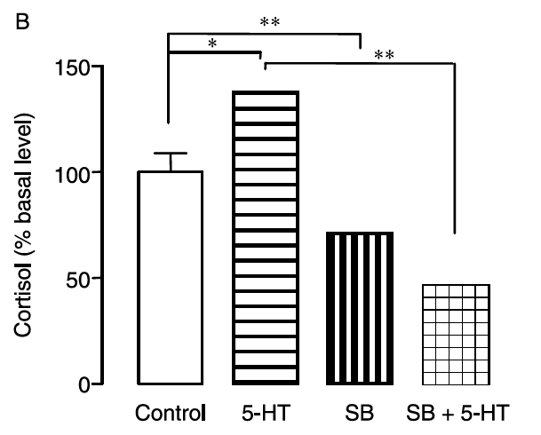
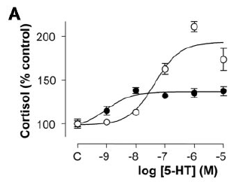
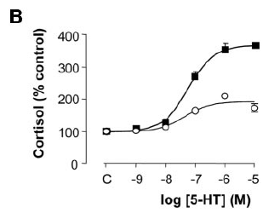
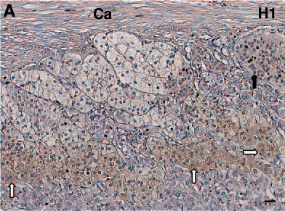
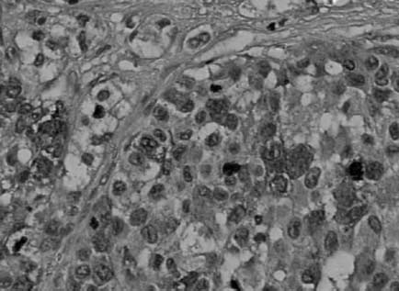
Ectopic 5-HT₇ receptors in AIMAHs, adenomas and carcinomas
normal
T1 tumor
normal
T2 tumor
Contesse et al. (2005). J. Clin. Endocrinol. Metab., 90, 2843-2850
Louiset et al. (2006). J. Clin. Endocrinol. Metab, 15, 1025-1034
Louiset et al. (2008). Endocrine-Related Cancer, 15, 1025-1034

Slide 23
Chronic Stress
X
X
-
-
CRH
ACTH
5-HT₇
Cortisol
5-HT₇
5-HT₇
+
+
5-HT₇
5-HT₇
5-HT₇
Hypothalamus
Pituitary
Adrenal glands
SSRI
=
Antidepressant effect
+
5-HT₇-R antagonist

Slide 24
Acknowledgements
Brenda García-Iglesias (Ph.D. student, Dept. Pharmacology, CINVESTAV-IPN)
M.Sc. Martha Noyola-Díaz, Dept. Pharmacology, CINVESTAV-IPN)
Dr. B. Florán (Dept. Physiology, CINVESTAV-IPN)
Dr. M.E. Garrido (Dept. Physiology, CINVESTAV-IPN)
Dr. C. Rangel (Dept. Physiology, CINVESTAV-IPN)
NIH grant RO1TW006622
CONACYT grant 129625

