Slide 1
Pharmacovigilant actions of Pharmacist on Potassium Cyanide
Gajendra Singh
Dean, Faculty of Pharmaceutical Sciences
Pt. B. D. Sharma University of Health Sciences
Rohtak - 124 001

Slide 2
This is extreme poison!
Don’t touch it!
Will die immediately!
Nobody could taste it!

Slide 3
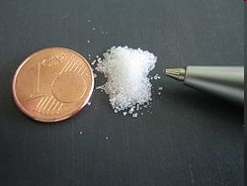
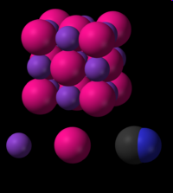

Slide 4
Scientific parameters
Formula | KCN
Chemical constitution | C- 18.58%, K- 60.05%, N- 21.51%
Mol. wt. | 65.11
State | Powder
Colour | White
Form | Crystalline/amorphous/deliquescent/ granular or fused mass
Taste | Acrid
Odour | Characteristic (foul)
M. pt. | 634 ºC
Solubility | Soluble 1 in 2 parts water and 100 parts alcohol

Slide 5
Assay | Commercial grade contains not less than 95% KCN
Category | Violet poison
Fatal dose in Humans | ?????
Lethal i. v. dose in rats | 2.5 mg/kg
Lethal oral dose in dogs | 1.6 mg/kg

Slide 6
NOTEWORTHY FACTS ABOUT KCN ARE:
Is not toxic in all forms or all concentrations.
Does not persist in the environment.
Is not cumulative.
Is not a heavy metal.
Is not radioactive.

Slide 7
Potassium Cyanide is a soluble cyanide salt. When dissolved in water, it readily forms the cyanide ion, CN-.
Cyanide is not exceptional with regards to the amount needed to kill someone.
There are hundreds of other poisons which are more toxic, Arsenic Oxide and Strychnine being two common examples.
What makes cyanide so notorious ? Speed that it acts with. Cyanides are amongst the most fast acting poisons known.

Slide 8
NATURAL SOURCES
Peach
Cassava
Flax
Sorghum
Alfalfa
Bamboo
Pear
Cherry
Plum
Corn
Potato
Cotton
Beans
Bitter almonds etc.

Slide 9
CYANIDES IN NATURE
Cyanide and chemically related compounds are formed, excreted and degraded in nature by a number of species of
Bacteria
Algae
Fungi
Plants and
Insects

Slide 10
HISTORY
Nero and Napoleon III
Alleged execution of prisoners
World war I
HCN used in 1915, FRENCH Army used 4000 ton
World war II
Alleged use of cyanide by Japanese on China
Iran-Iraq war 1980
Alleged Iraq attackers used cyanide on Kurds

Slide 11
Harmfulness

Slide 12
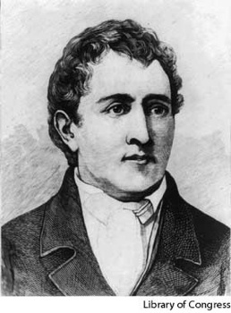
Karl Scheele
Died from tasting his discoveries
Scheele was Pharmaceutical chemist who discovered many chemical elements –oxygen, molybdenum, tungsten, manganese, and chlorine. Scheele had the habit of taste testing his discoveries and fortunately, managed to survive his taste-test of hydrogen cyanide. He died of symptoms strongly resembling mercury poisoning.

Slide 13
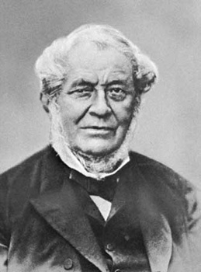
Robert Bunsen
Robert Bunsen discovered burner. He started out his scientific career in organic chemistry but nearly died twice of arsenic poisoning. After his near-death experiences, he lost his right eye sight after a cyanide explosion.

Slide 14
ROUTES OF EXPOSURE
Potassium cyanide can affect the body by
Ingestion
Inhalation
Skin contact
Eye contact

Slide 15
SIGNS AND SYMPTOMS
Mild Toxicity
  Nausea
  Dizziness
  Drowsiness
Moderate Toxicity
  Loss of consciousness for a short period
  Convulsion
  Vomiting
  Cyanosis
Severe Toxicity
  Deep coma
  Dilated non-reactive pupils
  Deteriorating cardio-respiratory function

Slide 16
Cyanide ingestion can cause a short-lasting period of mild respiratory stimulation. There may be no salivation or vomiting.
Convulsions can occur in 73% of the persons.
After the ingestion of cyanide, the average time to onset ataxia is 3 minutes, the average time to overall loss of consciousness is 6.5 minutes and the time to cessation of breathing is 18 minutes.

Slide 17
Human toxicity
Poisoning is due to ingestion, absorption through injured blood vessels or inhalation. Exposure to 150 ppm for 1 hour is threat to life. Death occurs within 10 minutes if exposed to 300 ppm.
LETHAL DOSES
60- 90 mg Hydrogen Cyanide (HCN)
200 mg Potassium Cyanide (KCN)
INGESTION

Slide 18
Absorption of cyanide in the body
Cyanide is rapidly absorbed from
Stomach.
Lungs.
Mucosal surfaces.
Broken skin.

Slide 19
CYANIDE TOXICITY
Concentration (mg.m⁻³) Effect
300 immediately lethal
200 lethal after 10 minutes
150 lethal after 30 minutes
120-150 lethal after 30-60 minutes
50-60 20 minutes to 1 hour without effect
20-40 light symptoms after several hours

Slide 20
Mechanism of action of cyanide in the body
Cyanide inhibits mitochondrial cytochrome oxidase and hence blocks electron transport, resulting in decreased oxidative metabolism and oxygen utilization.
Lactic acidosis occurs as a consequence of anaerobic metabolism.
The oxygen metabolism at the cell level is grossly hampered.

Slide 21
Antidote
Sodium nitrite and sodium thiosulphate. Poisoning is treated with these 2 compounds but death is certain if not attended to within minutes.
Nitrites cause formation of Methemoglobin by combining with the hemoglobin.
Methemoglobin has a higher affinity for cyanide than does cytochrome oxidase and thus promotes its dissociation from this enzyme.
Thiosulfate reacts with the cyanide as the latter is slowly released from cyanomethemoglobin, forming the relatively nontoxic thiocyanate, which is excreted in the urine.

Slide 22
ANTIDOTES OF CYANIDE
Cyanide ion binding
CN¯
Thiocyanate
S2O3¯ SCN¯ + SO3 ¯
Rhodanase
Urine
Notes:
Nitrite leads to oxidation of ferrous (++) haemoglobin to ferric (+++) methaemoglobin.
The basis of this treatment is methaemoglobin’s ability to bind to cyanide ions. If enough methaemoglobin is formed in the blood stream it attracts cyanide away from inhibited cytochrome oxidase, by mass action, forming cyan methaemoglobin and allowing resumption of cellular respiration. Thus the well known methaemoglobin formers amyl nitrite and sodium nitrite were tested, and found to be very effective in treatment.

Slide 23
CYANIDE MANAGEMENT
DECONTAMINATION (absorption)
Nasogastric aspiration
Activated charcoal
Gastric lavage
Emesis
Treatment
        Amyl nitrite
        Sodium nitrite
        Sodium thiosulfate
        High-dose oxygen should be given as soon as possible.

Slide 24
Method of treatment
Amyl nitrite is administered for 30 sec. each minute. The ampule is broken between two pads of gauze and placed over the airway while the patient breathes spontaneously or is ventilated by a bag-mask unit. A new ampule should be used every 3 min.
Sodium nitrite is administered intravenously as 3% solution at a rate of 2.5 to 5.0 ml/min up to a total dose of 10 to 15 ml (300 to 450 mg). Sodium thiosulfate is then administered intravenously as 25% solution at a dose of 50 ml (12.5 g) given over 1 to 2 min.
High dose oxygen is also given.

Slide 25
Concentrated hydroxycobalamin (inactive from Vt. B₁₂ when injected that combines with CN͞ of KCN and forms : Cyanocobalamin (active form of B₁₂).
Concentrated Hydroxycobalamin + KCN → Cyanocobalamin
Formulation:
Cyanokit ( EMD Pharmaceutials, Dushan, North Carolina )

Slide 26
Usefulness

Slide 27
Pharmaceutical and Medical uses
Vitamin B₁₂ stabilization in injection formulations.
Instilled in eye in extremely low concentration to remove silver nitrate stains.
The cyanide compound sodium nitroprusside is occasionally used in emergency medical situations to produce a rapid decrease in blood pressure in humans.
Blood testing : Estimation of hemoglobin using Drapkin’s solution (Potassium Ferricyanide + Potassium Cyanide)
Used as a vasodilator in R & D..
Rodent killer and insect killer.

Slide 28
Commercial uses:
Cyanides are used as insecticides for the fumigation of ships. (FORMULATION CONCERN)
Cyanides are illegally used to capture live fish near coral reefs for the aquarium and for seafood markets. (ENVIRONMENTAL CONCERN)
Gold and silver cyanides are the soluble forms and used in gold and silver extraction.
Electroplating, metallurgy, jewelry and photography.

Slide 29
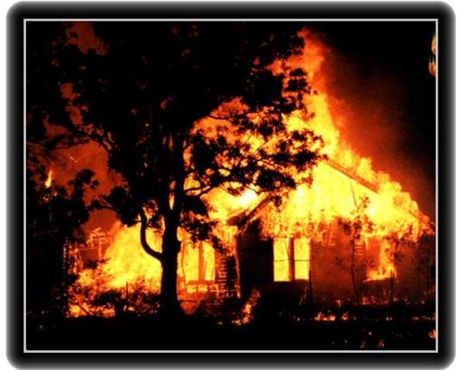
CYANIDE FIRE
CYANIDE/CARBON MONOXIDE

Slide 30
EXPLOSION HAZARDS
  Chlorates plus potassium cyanide explode when heated.
  A mixture of potassium cyanide and nitrites may cause an explosion.
  Nitrogen chloride explodes on contact with potassium cyanide.
  Containers may explode when heated or if they are contaminated with water.
  Upper and lower explosive (flammable) limits in air are not available for potassium cyanide

Slide 31
FIRE FIGHTING INFORMATION
  Potassium cyanide is non-combustible.
  Water-sensitive: Potassium cyanide releases highly flammable and toxic hydrogen cyanide gas on contact with water or damp air and in a fire.
  For small fires, do not use carbon dioxide; use dry chemical, dry sand, or alcohol-resistant foam.
  Foams will react with the cyanogens and release corrosive/toxic gases.

Slide 32
CHEMICAL DANGERS
  Potassium cyanide is water-reactive.
  Potassium cyanide decomposes on contact with water, humidity, carbon dioxide, and acids, producing very toxic and highly flammable hydrogen cyanide gas.
  Potassium cyanide solution in water is a strong base; it reacts violently with acid and is corrosive.
  Potassium cyanide undergoes violent chemical reactions with chlorates and nitrites.

Slide 33
METHODS OF DISSEMINATION:
Indoor/ Outdoor Air: Potassium cyanide can be released into indoor air as fine droplets, liquid spray (aerosol) or fine particles.
  Water: Potassium cyanide can be used to contaminate water.
  Food: Potassium cyanide can be used to contaminate food.

Slide 34
Don't be Careless with Runoff XXXXXX
  Effluent from fire control or dilution with water may be corrosive and/or toxic and it may cause pollution.
  If the situation allows, control and properly dispose off effluent.

Slide 35
Suicide forums on web
Problem
“I injected potassium chloride (50mg/kg) and it wasn't lethal but it burnt like hell, now I have blisters, my arm is swollen and the pain is beyond belief”
Advice
Combining the method with sedatives and muscle relaxants might help.

Slide 36
Use as lethal gas “cruelty”.
During execution, the prisoners took up about 11 minutes to die
Prisoners experienced agonising pain during such execution .
Due to human activation :
Method was abandoned as the primary method of execution world over.

Slide 37
Unconstitutional death penalty by cyanide
Criterion
Death was swift.
Death was miserable and violent.
On balance this is a method “best not used”.

Slide 38
Accidents
In the event of skin contact, immediately wash with soap and water and remove contaminated clothing.
In case of eye contact, promptly wash with huge amount of water for 15 min (lifting upper and lower lids occasionally) and obtain medical attention. If sodium or potassium cyanide is ingested, obtain medical attention immediately.
If cyanide is inhaled, move the person to fresh air and seek medical attention at once. Specific medical procedures for treating cyanide exposure are available but usually must be administered by properly trained personnel.
In the event of a small spill, remove all ignition sources, soak up the sodium cyanide or potassium cyanide with absorbent material, place in an appropriately labelled container, and place in secondary containment for hazardous waste disposal.

Slide 39
Storage and Handling
Sodium cyanide and potassium cyanide should be handled in the laboratory using practices developed by the academic department for such highly toxic chemicals.
In particular, work with cyanides should be conducted in a fume hood to prevent exposure by inhalation
Splash goggles and impermeable gloves should be worn at all times to prevent eye and skin contact.
Cyanide salts should be stored in a cool, dry, secured storage location, separated from acids.

Slide 40
Institutional Storage
KCN has to be protected from air, light and moisture. The material is stored under lock and key under the supervision of at least 3 responsible officers of organization.
Keep away from heat.
Keep away from strong oxidants.
Keep away from acids.
Keep the lid tightly sealed.
Wash hands thoroughly after handling

Slide 41
INCOMPATIBILITY
Potassium cyanide is incompatible with:
Acids : liberates toxic & flammable hydrogen cyanide gas.
Acids : violent reaction.
Aluminium and zinc : corrosive.
Strong oxidants : fire and explosion.
Heating produces toxic and flammable hydrogen cyanide.

Slide 42
Disposal
Excess sodium or potassium cyanide and waste material containing this substance should be placed in an appropriate container and clearly labelled.
Probably laboratory workers avoid its use as far as possible.

Slide 43
THANK YOU

