Slide 1
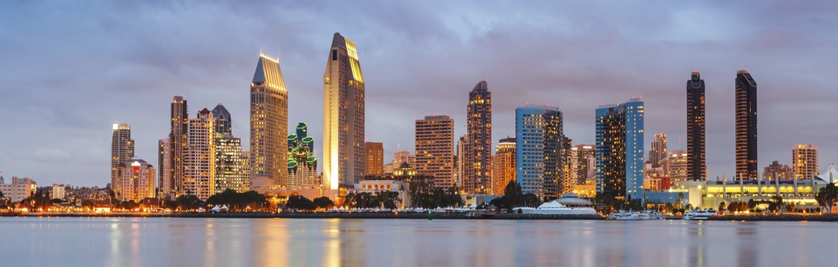

Sex and Cannabis:
Can It Solve Our Intimacy Problems?
Jordan Tishler, MD
InhaleMD
Notes:
1
Cannabis is a very potent aphrodisiac.
We must use it for good.
Sexuality and intimacy are issues for both men and women. We will discuss issues for both. In general, as with most things that are different, I find the commonalities are actually greater and often more important. This is clearly true with regard to addressing sexual issues.
Let us start by thinking a moment about how sexual dysfunction manifests for each gender.

Slide 2
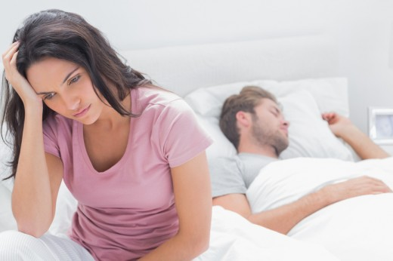
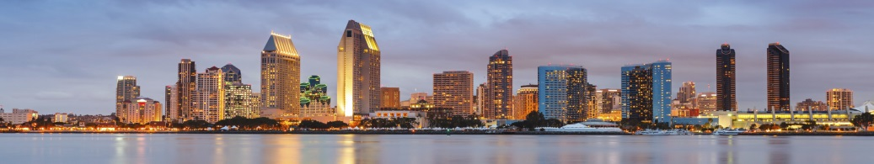
MYTH: Women aren’t interested
U.S. Women are sexually active
65-70% - age 18-50
- Decreasing to 20-40% by age 90
Female Sexual Dysfunction = 40%
Notes:
In women, the common myth is that they aren’t interested in sex. Whether that is thought to be related to hormonal issues, social stigma, ageing, or even just getting bored in a long-term relationsip.
The fact is, however, that when studied, this is BS.
The reality is that women are nearly as sexually active as men, across all age groups, and continue to be sexually active very late into life.
However, when asked, as many as 40% of women report some type of sexual dysfunction. So we can see that Female Sexual Dysfunction is a real and pervasive issue.
Let’s look at men next…

Slide 3
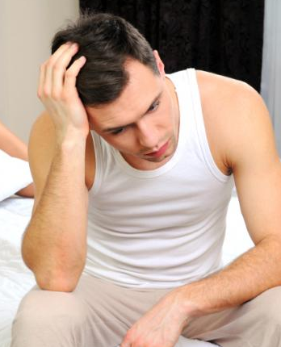

Male sexual dysfunction Is more than just erectile dysfunction
Occurs in up to 50% across all age ranges
Most common complaint is early ejaculation (~30%)
Lack of desire (15-18%)
ED only issue that is age dependent starting ~7%
ranging up to 18% for men >50
Only ED treatable with Viagra etc.
Notes:
Male sexual dysfunction is often presented in the media as, well, a droopy dick. And that certainly is a problem.
However, male sexual dysfunction is really comprised of 3 separate problems of which ED is actually least common.
As you can see, ED is age dependent and at it’s peak, affects about 20% of guys.
Lack of sexual desire in men is as common as ED, and can present at any stage of life.
The most common male problem is early finish, affecting about 30% of men.

Slide 4
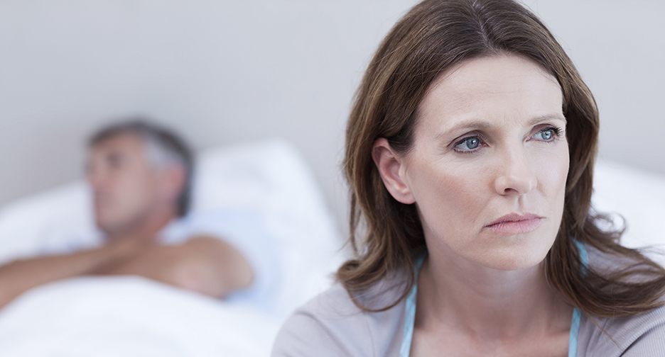
Sexual dysfunction affects people’s lives
Notes:
Sexual dysfunction adversely affects people’s lives!
Negative outcomes include:
Poor self esteem
Mood instability
Depression
Strained relationships with partners

Slide 5
Few people seek or receive care for their sexual problems
Women: 35% receive care from a healthcare provider
Men: < 25% sought care for sexual problems
Studies show providers ready and willing to help!
Notes:
Yet, despite the harmful effects of sexual problems on people’s lives, and the lives of their partners, very few get treatment.
As you can see, women do slightly better at getting care than men, but both groups are pitifully low.
Remember that women, in general, are better at seeking medical care than men.
Studies show that regardless of gender, people don’t get the sexual care they need because of a combination of being unwilling to ask, and their provider being either uncomfortable or too busy to address sexuality in a routine office visit.
Study this month shows that only 24% of providers self-reported being somewhat or very uncomfortable diagnosing FSD.

Slide 6

Understanding how sexuality works
Notes:
Just a quick moment to look at what we know about human sexuality.

Slide 7
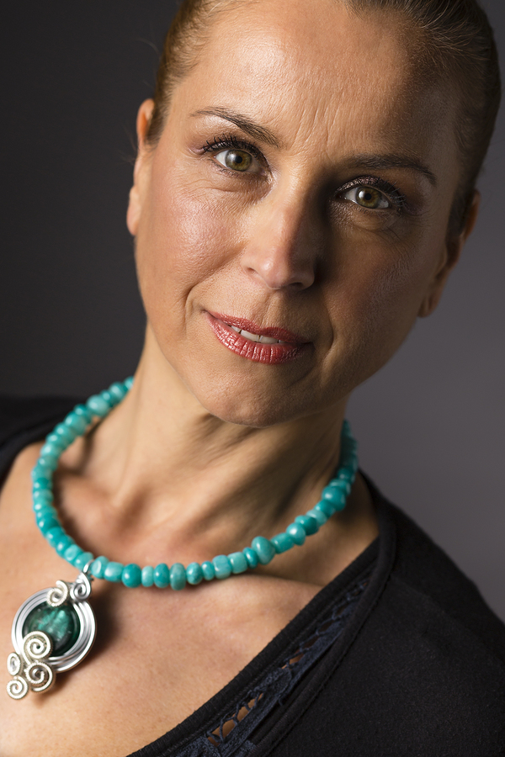
Teresa
(not her real name or photo)
Notes:
Just a quick moment to look at what we know about human sexuality.

Slide 8
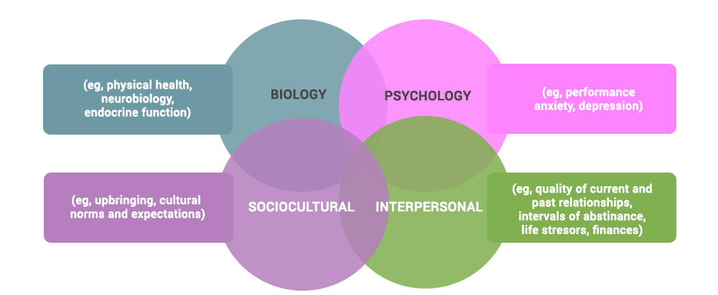
Biopsychosocial understanding of Sexuality
Notes:
The basic understanding of human sexuality really started with Masters and Johnson in the mid 1960s.
They described a 4-phase response to sexual stimulation: excitement, plateau, orgasm, and resolution. This description is actually pretty accurate for both genders when things are working right, but also misses a lot of the earlier important lead up to the actual sex AKA Desire.
What is missing from their concept is only notable when you start looking for why things might not being going well for a person.
In response, to FSD in 2001 Rosemary Basson introduced her concept: encompassing the Masters and Johnson scheme as only as small portion of the whole puzzle, she introduced an understanding that includes intimacy, innate sexual drive, as well as other psychological factors into a non-sequential process that may lead to sexual activity or not, if any of those parts of the puzzle are hampered.
I chose not to show you a slide of Basson’s idea because it’s circular with criss-crosses, and ultimately difficult to follow. However, all of that circular stuff can be thought of as “what leads to desire”.
The slide in front of you, I think, is the most clear and concise representation of our current understanding. While developed, again, for FSD, with different weighting of the factors involved, serves perfectly well to describe male as well as female sexual factors.
In short, for an effective and healthy sexual experience, all four factors: Biology, Psychology, Sociocultural, and Interpersonal must either be healthy or be dealt with.

Slide 9
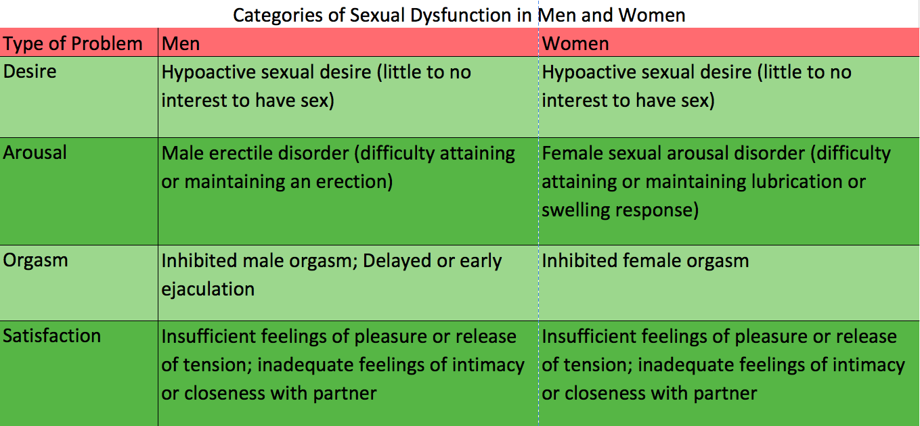

Categories of sexual dysfunction among men and women
Notes:
When things go wrong sexually, the problems manifest in a few categories of ways.
The primary three ways:
Desire
Arousal
Orgasm
The thing that is most striking to me about this chart is the similarity between the problems in men and women as we have discussed before.

Slide 10
Teresa
(not her real name or photo)
Notes:
Just a quick moment to look at what we know about human sexuality.

Slide 11
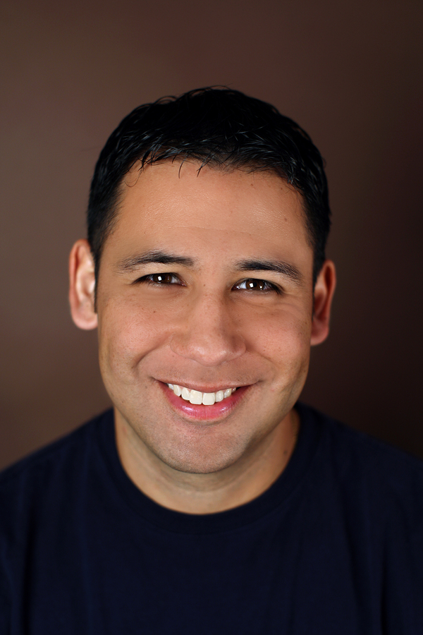
Pedro
(not his real name or photo)
Notes:
Just a quick moment to look at what we know about human sexuality.

Slide 12
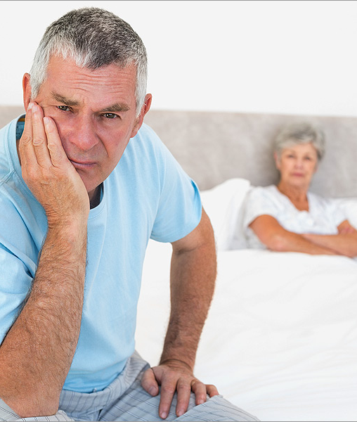
Cannabis Can Help With Sexual Problems
Notes:
Cannabis can help with sexual problems for both men and women.

Slide 13

Women: Cannabis clearly linked to benefits in all 4 phases
Both receptive and proceptive interest
Arousal and lubrication
Climax and satisfaction
Notes:
Just to review: The 4 phases are: Desire, Arousal, Orgasm, and Satisfaction.
Cannabis has been shown to increase female interest in sexual activity. This is true both of willingness to get it on when approached and also of her spontaneous desire and willingness to approach others.
Cannabis has physiologic effects, heightening arousal and vastly increasing lubrication. Tell story of vaginal probe experiment.
Cannabis heightens climax in women, may both prolong orgasm, increase the intensity, and increase their number.
Cannabis causes increased sense of satisfaction by promoting sensual awareness, relaxation, and feelings of “connectedness”. Cannabis has been shown to increase blood levels of Oxytocin, a hormone associated with bonding feelings in both women and men.

Slide 14

Cannabis in males
Good for desire
  May be helpful or harmful to arousal
May be helpful or harmful to climax
Generally positive for satisfaction
Notes:
In men the role of Cannabis is also quite potent, but may be a little more tricky to deal with.
The value of Cannabis sexually in men is very dose dependent. A little is very positive, but too much can cause or worsen problems.
Fundamentally, Cannabis in men, like in women, increases desire.
In lower doses (getting buzzed), Cannabis can be helpful to men with arousal issues (ED) and/or difficulty climaxing, increasing blood flow to the penis and promoting relaxation, de-stressing, and focusing on the activities at hand. For men with early climax, a little buzz can help them sustain intercourse for longer.
However, in both the arousal stage and the climax stage, too much Cannabis (getting wasted, blasted, HAF) leads men to a distracted state in which performance is hampered: erections weaken, minds wander too far to achieve orgasm. Stoner Boner.
Need to keep the dose under control.
Overall, Cannabis promotes satisfaction and feelings of intimacy in men.

Slide 15
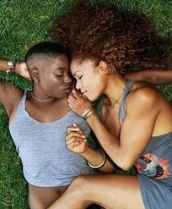
Yes! Cannabis does help with sexuality and intimacy
Regardless of gender, Cannabis promotes Desire, Arousal, Orgasm, and Satisfaction
Overall intimacy in enhanced
In men, lower doses are beneficial compared to higher

