Slide 1










Ribosomal protein S3 secreted from
various cancer cell lines is a possible
cancer biomarker.
Prof. Joon Kim
Lab of Biochemistry Division of Life Sciences Korea University
Seoul, South Korea

Slide 2

















Why are we studying the ribosome biogenesis ?
Major energy consumer of the cell’s resources
Budgeting process
Transcription of rRNA by RNA polymerase I : 60% of the total transcription in the cell
50% of the RNA-polymerase-II-mediated transcription initiation events involve RP genes
In a rapidly growing cell of S. cerevisiae
RNA : DNA = 50 : 1
80% rRNA, 15% tRNA, 5% mRNA
size of the genome (1.43x10⁷ bp) 200,000 ribosomes per cell
Generation time of ~100 min, the cell must produce 2000 ribosomes per min.

Slide 3
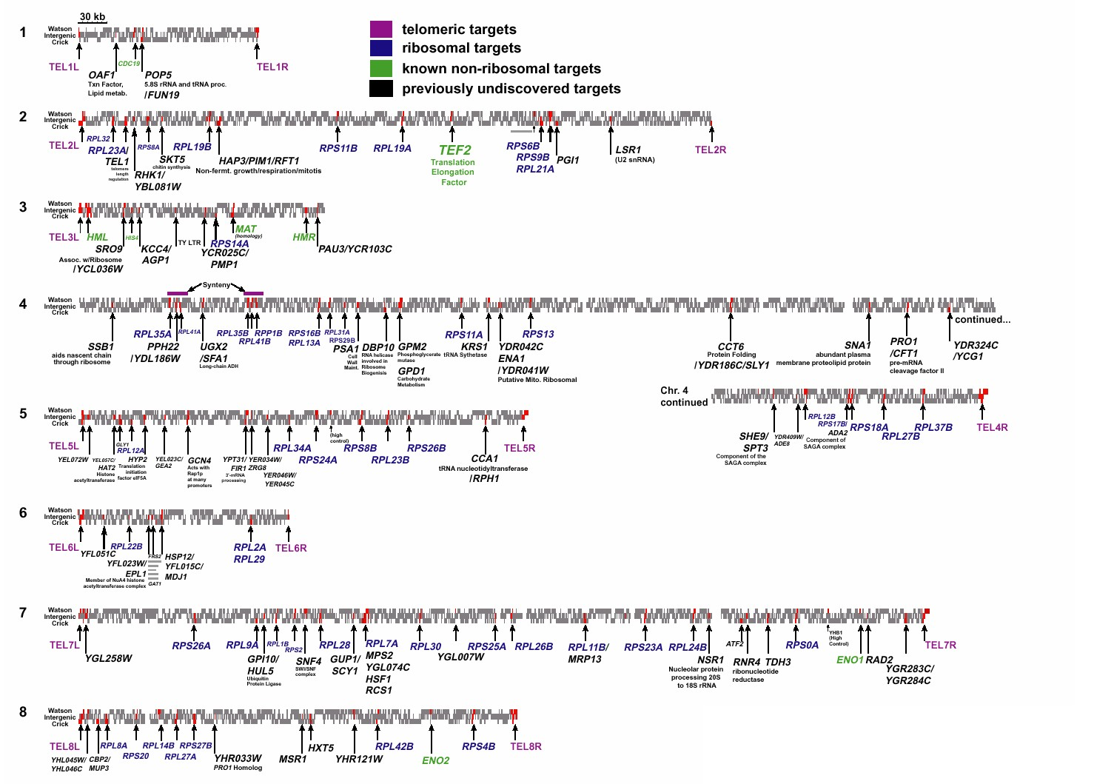
Genome wide scattered ribosomal protein genes

Slide 4











Ribosome (Protein factory of the cell)
Macro regulation
( extracellular environmental condition)
rRNA
(26S, 18S, 5.8S, 5S)
80 ribosomal proteins
Other ribosomal components
Micro regulation
(intracelluar equimolar ratio of
ribosomal components)

Slide 5
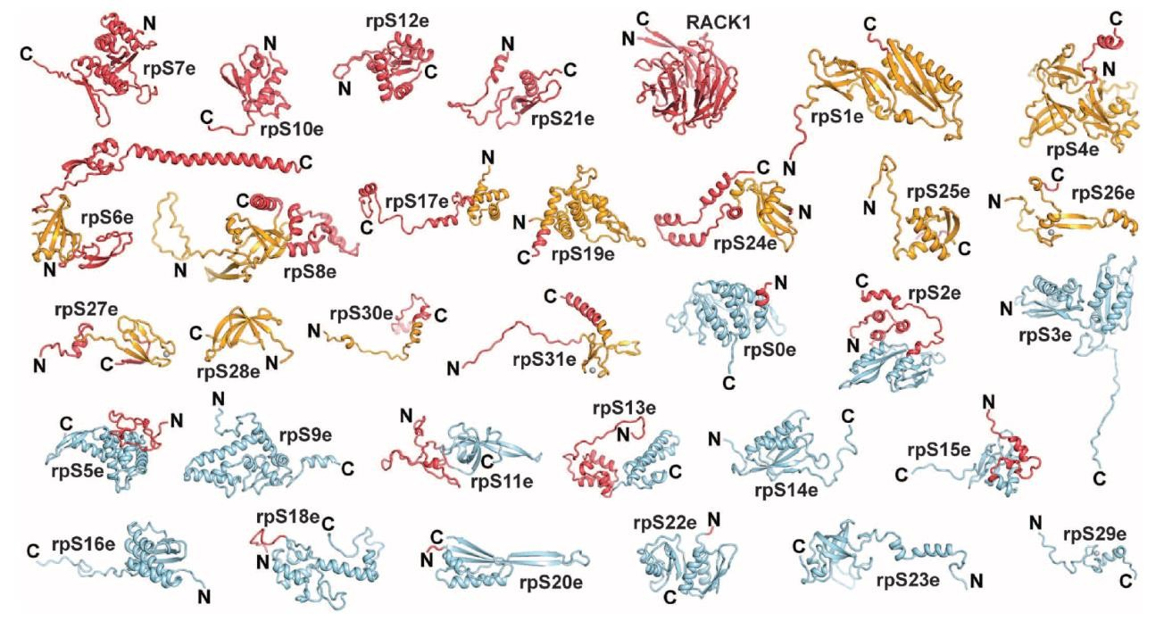
Ribosomal Protein
Science 11 February 2011: vol. 331 no. 6018 730-736
The number of proteins in a ribosome is of 56 in Bacteria.
(22 proteins in the small subunit and 34 proteins in the large subunit)
The number of proteins in a ribosome is of 79 in Human.
(33 proteins in the small subunit and 46 proteins in the large subunit)

Slide 6

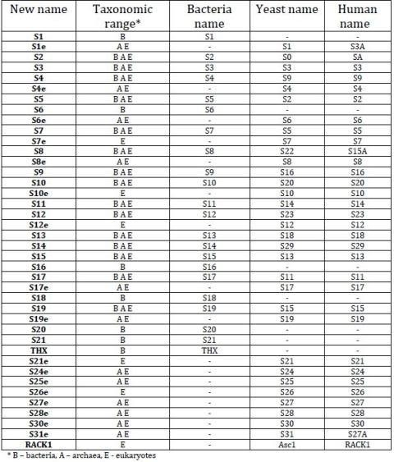
Table 1: New nomenclature for proteins from the small ribosomal subunit

Slide 7
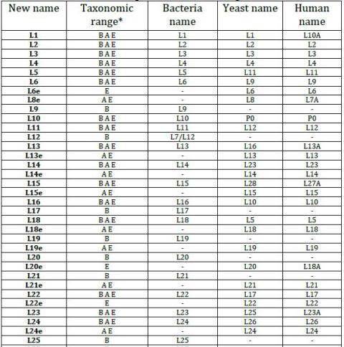
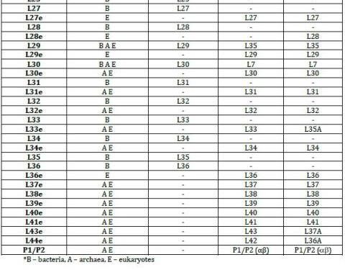
Table 2: Nomenclature for proteins from the large ribosomal subunit

Slide 8
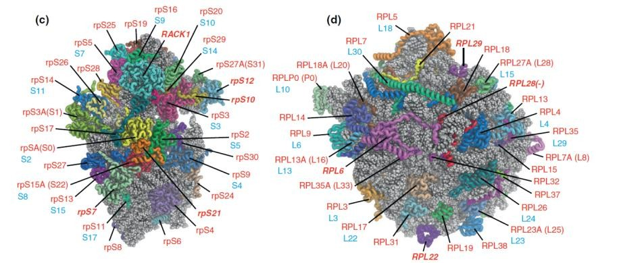

Eukaryotic 40S and 60S subunits
(exposed sides)
Science 331, 730 2011

Slide 9
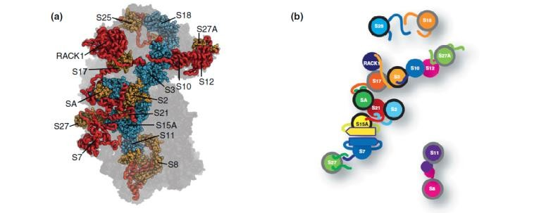
Map of ribosomal protein interaction
(40S)

Slide 10
RPS3 (ribosomal protein small protein 3; UV DNA repair endonuclease Ⅲ)
Ribosomal Function :
a component of 40S ribosomal small subunit
involved in the initiation of translation
Extra-ribosomal Function :
repair function → has AP endonuclease (lyase) activity
  RPS3 promoter has GCN4 binding sites and is regulated
by GCN4
High expression of rpS3 gene
colon adenocarcinomas and adenomatous polyps
N-myc activated tumors Doxorubicin resistant leukemia cell
  very low expressed in brain and retina
  involved in metastasis inhibition, apoptosis

Slide 11
1. Ribosomal protein S3 (rpS3)
cross-link with S2, S4, S5, S9, S10, S12 and S13 in 30S subunit,
L7/L12 in 50S subunit, and initiation factors eIF-2 and eIF-3
Path of mRNA : S2, S3, S4, S5, S7, S11, S12, and S18
2. Extra ribosomal functions of rpS3
* Eukaryotic rpS3, DNA repair & Cancer
(JBC 270:13620, 1995; BBRC 328:962, 2005; BBA-Mol Cell Res 1763:823, 2006;
MCB, 27:3187, 2007; J. Rad.Res. 48:447,2007; Mut. Res. 648:54; BBA-Mol Cell Res 1793:395,
2009, JBC 284:21201, 2009, FEBS Lett 586;356, 2012, JBC 288;2956, 2013, BBA-Mol Cell Res,
1833:2943, 2013, Oncotarget 2016 in press)
[AP, pyrimidine dimer, thymine glycol, 8-oxoguanine, UV-damaged DNA]
S. cerevisiae rpS3 gene (BBA-GRM 1789:741, 2009; Eukaryot Cell, 2009)
Existence of snoRNAs in the introns of mammalian rpS3 gene (Gene 286:292,2002, Gene 368:12, 2006)
* RpS3 induces apoptosis and cell cycle arrest (FEBS Lett 572:92, 2004, Oncogene 31;3317, 2011).
Erk phosphorylates ribosomal protein S3 (BBRC 333:110, 2005)
Involvement of ribosome stability & modification (Mol. Biol. Cell 17:824, 2006, BBRC 385:273, 2009, J. Cell. Biochem. 110:294,2010, EMBO J 30:859, 2011)

Slide 12

Environmental factor
Biological metabolism
Chemical
Mutation
DNA repair
Cell cycle Arrest
Cancer
Normal Cell
Cell death (Apoptosis)

Slide 13
ribosomal protein S3 = DNA repair endonuclease
III
- 729 base | pairs, | 243 amino acids, 26.6 Kd
- Involved | in the | initiation of translation
AP endonuclease (Lyase) activity
Cleaves phosphodiester bond between the pyrimidine dimer
High expression in colorectal cancer
Involved in Xeroderma Pigmentosum & leukemia

Slide 14
Comparison of Genomic Structures of human, Mouse,
and Fugu rpS3 genes and Xenopus rpS1 gene
60 131 95
188 197 19
94
1kb
Human rpS3
E1 E2 E3 E4 E5 E6 E7
GenBank Accession No. L16016, and Y. Lim and J. Kim, AF281313
60
131 94 95
188 197 64
Mouse rpS3
E1 E2 E3 E4 E5 E6 E7
S.M. Lee and J. Kim, GenBank Accession No. AY043296
94
55 131 95 188 205 84
Fugu rpS3
E1 E2 E E5 E6 E7 E3 ⁴
GenBank Accession No. X97794
56
131
94
95
188
206
72
Xenopus rpS1
E1
E2
E3
E4
E5
E6
E7
GenBank Accession No. Z34530

Slide 15

PKCδ-dependent functional switch of rpS3 between translation and DNA repair

Slide 16
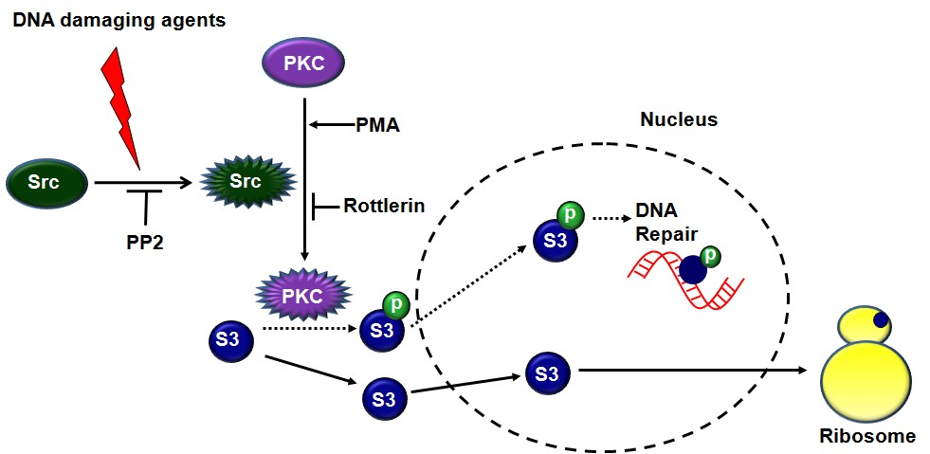
Figure 7. Schematic model describing the regulation of rpS3.
Src tyrosine kinase is activated by genotoxic stress and phosphorylates
tyrosine residue on PKCδ.
Activated PKCδ interacts with and phosphorylates non-ribosomal free rpS3 in the cytoplasm. Unphosphorylated rpS3 participates in ribosome biogenesis while phosphorylated rpS3 remains in the nucleus to take part in DNA repair processes.

Slide 17
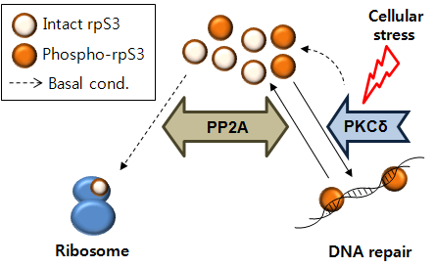
Figure 13. Schematic diagram of bidirectional regulation of rpS3.

Slide 18
Cytoplasmic ribosomal protein S3 (rpS3) plays a pivotal role
in mitochondrial DNA damage surveillance

Slide 19
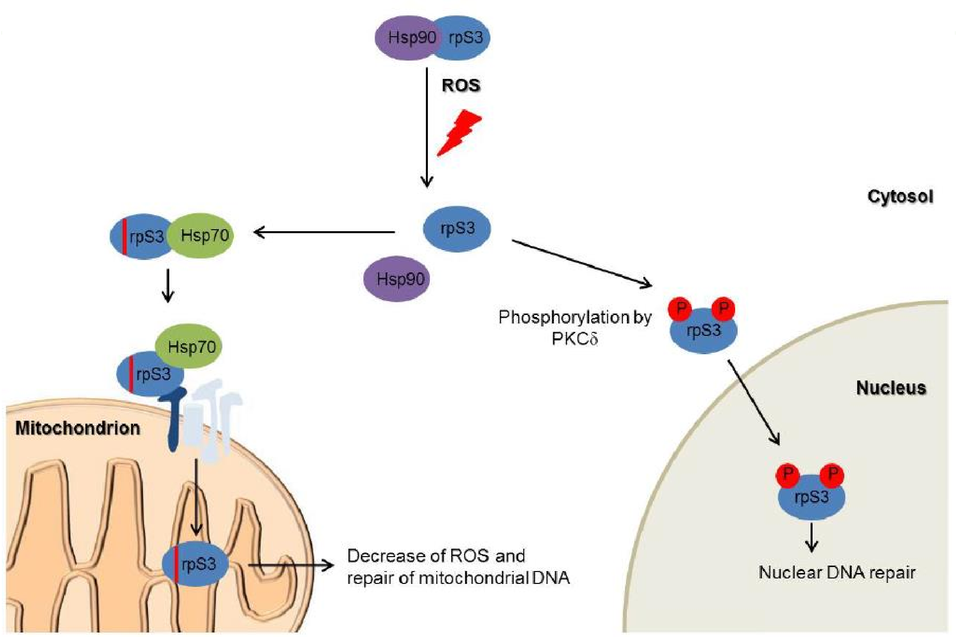
Figure 6.

Slide 20

Conclusions
protein kinase Cδ (PKCδ) interacts with rpS3 and phosphorylates rpS3.
Phosphorylated non-ribosomal rpS3 has an increased endonuclease activity in the nucleus.
The enzyme activity of rpS3 is critical for cell viability against to DNA damage.
RpS3 dephosphorylation is specifically mediated by PP2A through interaction in the nucleus.
Cytoplasmic rpS3 migrates to mitochondria to repair DNA damage.
Cytoplasmic rpS3 in cells determines the fate of multifunctional role of rpS3 protein between DNA repair and translation.
❖ J. Biol. Chem. 284(32): 21201-21208 (2009)
❖ BBA - Mol. Cell Res. 1793(2): 395-405 (2009)
❖ BBA - Mol. Cell Res. 1833: 2943-2952 (2013)

Slide 21
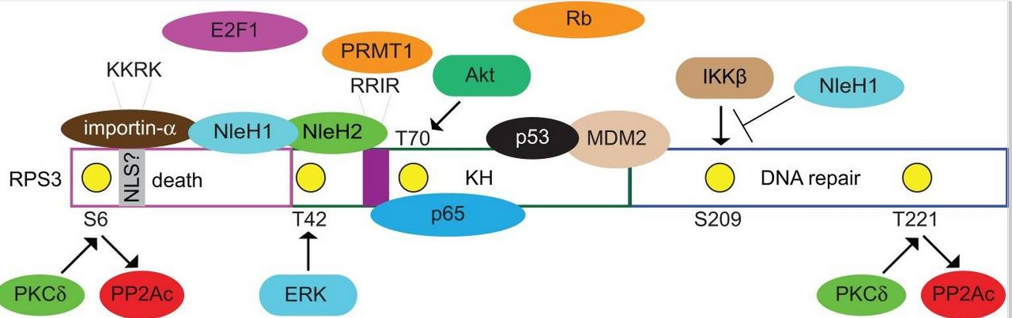
S3 structure
Biochem Biophys Res Commun. 2009 Jul 24;385(2):273-8. Epub 2009 May 19.

Slide 22
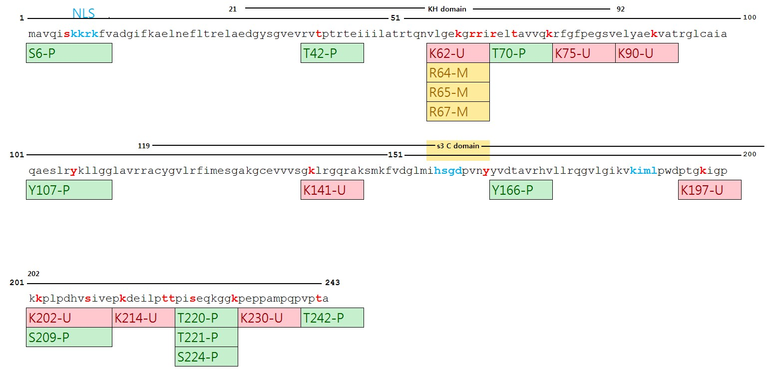
S3 modification site
β-sheet 가 끝나는 부분
~200(PWD)
현재 진행중인 159~243 constructure (proline rich domain) 시작점

Slide 23


rpS3 domain
7-10
21(15)
92(95)
104
188
240 aa
Yeast
NLS
KH domain
S3 C-domain

Slide 24
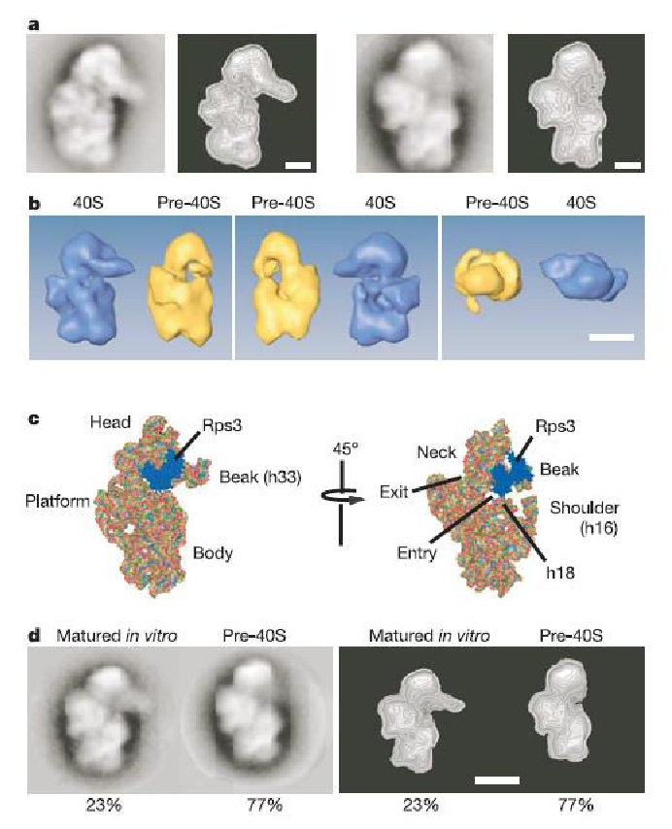

Structure of Ribosome
Vol 441|1 June 2006|doi:10.1038/nature04840

Slide 25
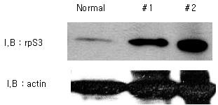
Comparison of rpS3 expression with normal and leukemic patients' PBMC
Normal : Lysates of normal person's PBMC
#1, #2 : Lysates of leukemic patients' PBMC
rpS3 over-expressed in Leukemic patient
: 63%, 12/19

Slide 26
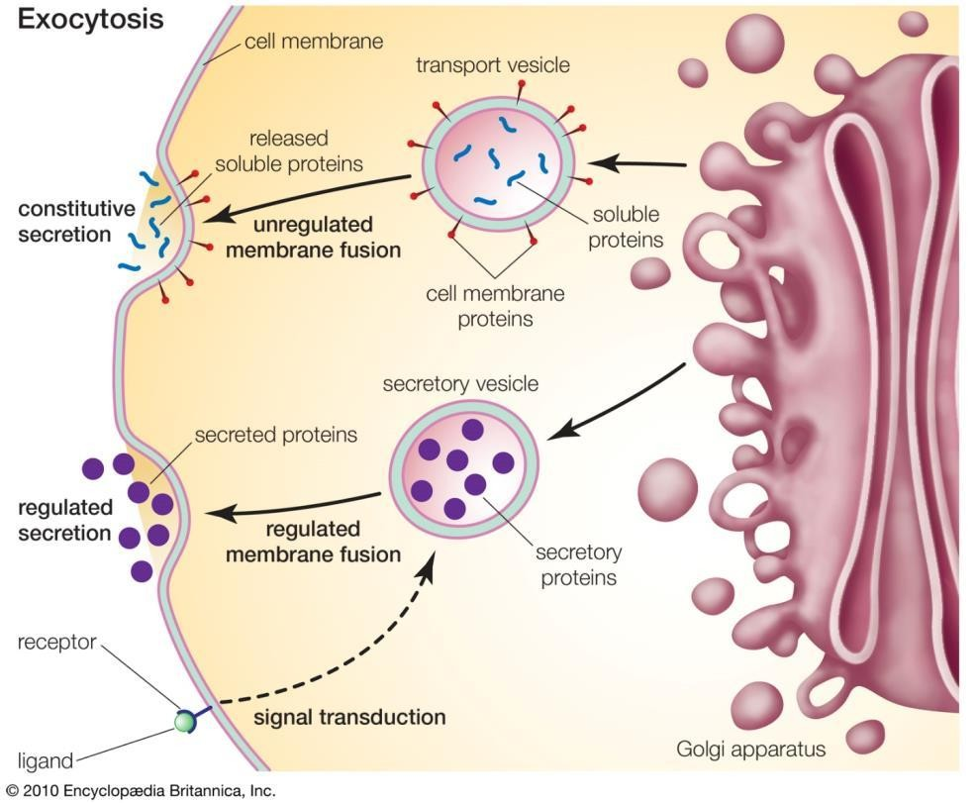
Secretion Pathway

Slide 27







rpS3 secretion from various cancer cell
lines
B
A
HT1080 media
lysate
media MPC11 media
media
IB: rpS3
IB: rpS3
IB: rpL28
IB: rpS6
IB: rpL11
IB: C23
IB: fibrillarin
IB: fibrillarin
1 2
IB: Raf1
3 4 5
HT1080 (A) or MPC11 (B) cancer cells were incubated in serum-free media for 24 h and then the cell culture media were collected and concentrated with an Amicon filter. Cell lysates (lanes 1 and 3), non-cell culture media (lane 4), and the concentrated cell culture media (lanes 2 and 5) were immunoblotted with specific antibodies. C23, fibrillarin, and Raf1 antibodies were used to confirm cell death (C23 as a nucleolar protein, fibrillarin as a nuclear protein, Raf-1 as a cytoplasmic protein).

Slide 28





Increase of S3 secretion in more
malignat cancer cell lines
lysate
media
MPC11 media MPC11-Dox media
IB: rpS3
The cell culture media of MPC11 cancer cells and MPC11-Dox metastatic cancer cells were collected and concentrated, and were subjected to immunoblot analysis using the indicated antibodies. Non-cell culture media were used as a negative control.
IB: rpS6
IB: C23
IB: fibrillarin
IB: Raf1

Slide 29
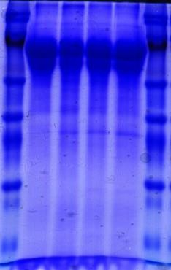



Increase of secretion in
malignant cancer cell lines
A
BEAS-2B
1170-I
1198
1799
B
BEAS-2B
1170-I
1198
1799
(A, B) Cell culture media of each cell line derived from BEAS-2B cells were collected and concentrated, and subjected to Coomassie Brilliant Blue (CBB) staining (A) and an immunoblot analysis (B) (BEAS-2B: immortalized normal, 1170-I: tumorigenic, 1198:transformed but non- tumorigenic, 1799: non-transformed). Nm23-H1 was a representative secreted protein, and C23 was used as a cell death marker.
IB : rpS3
IB : Nm-23
IB : C23
CBB staining

Slide 30
ELISA assay; S3 secreted more
in more invasive cancer cell
lines
1.6
1.4
The enzyme-linked immunosorbent assay (ELISA) assay using the MCF7 and MDA-MB-231 cell lines to have different invasiveness. The secreted rpS3 protein from media of MDA-MB-231 cells, more invasive cells, was more highly detected than the media of MCF7 cells.
( Con. : only DMEM media )
1.2
1
0.8
0.6
0.4
0.2
0
con.
MCF7
MDA-MB-231
Media : 151 μg/ml

Slide 31
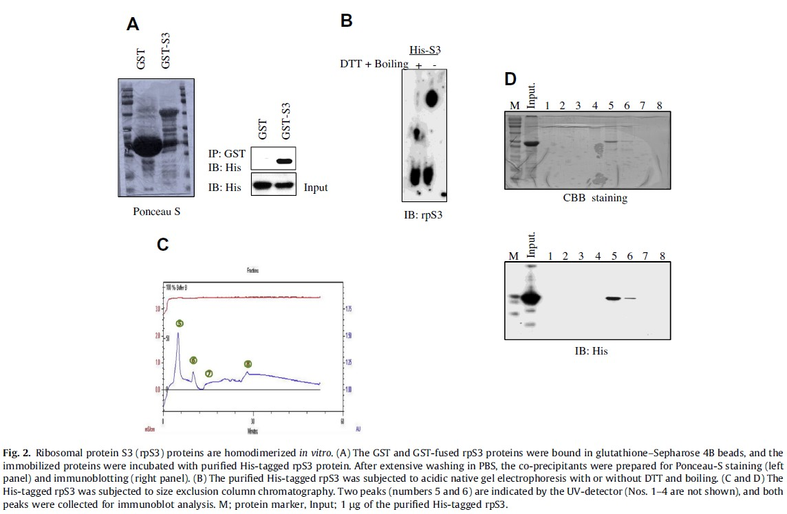
Fig.2 RpS3 proteins are homo-dimerized in vitro.

Slide 32
Ribosomal protein S3 (rpS3) secreted from various
cancer cells is N-linked glycosylated

Slide 33
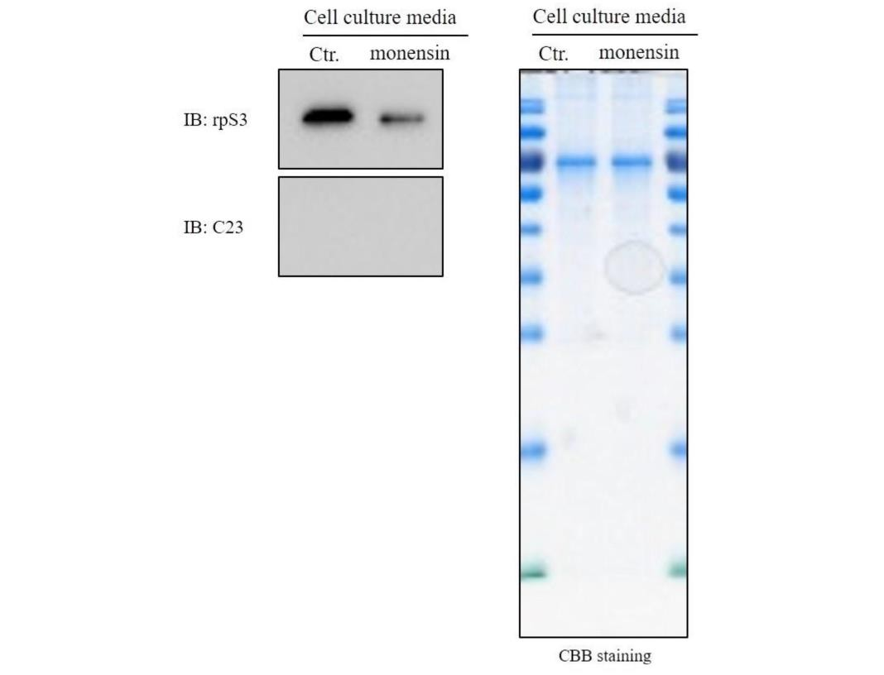
Monensin, an inhibitor from Golgi to ER, prevents S3 secretion.

Slide 34





Secretion of rpS3 is inhibited by brefeldin A, ER to Golgi inhibitor, and tunicamycin, an inhibitor for N-glycosylation.
B
A
Lysate
Cell culture media
BFA TM
BFA TM
4.5
*
Ctr.
Ctr.
*
IB : FAS
4
3.5
IB : rpS3
rpS3 concentration (pg/ml)
3
2.5
IB : MIF
2
1.5
1
IB : Tubulin
0.5
0
Con.
BFA
Tunicamycin
IB : C23
Tatal protein in media (150 μg/ml)
*, P < 0.05

Slide 35
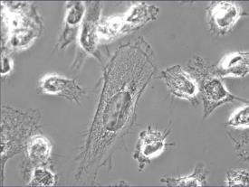
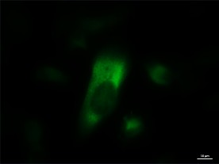
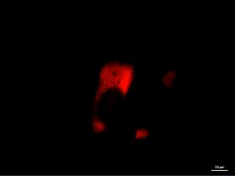
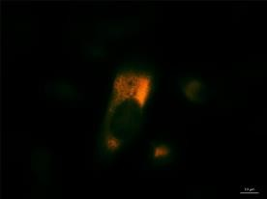
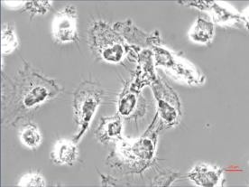
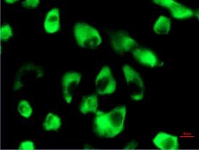
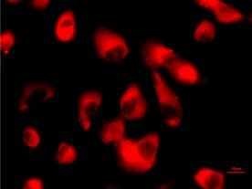
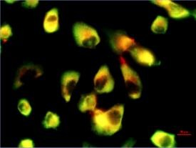
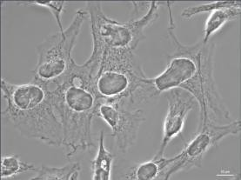
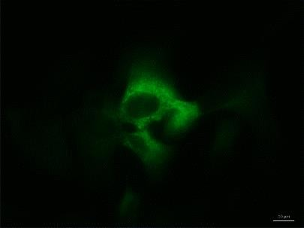
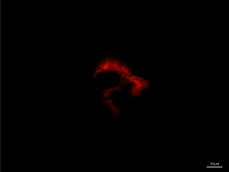
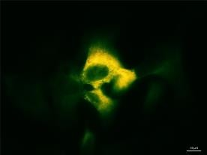
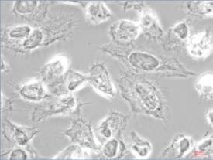
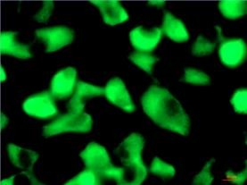
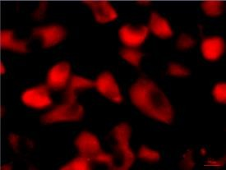
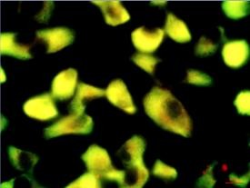
Co-localization of rpS3 with ER after treatment of BFA.
C
Phase contrast
rpS3-FITC
ER-tracker
Merged
BFA-
BFA+

Slide 36
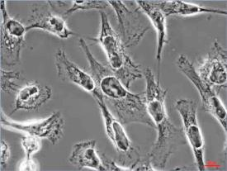
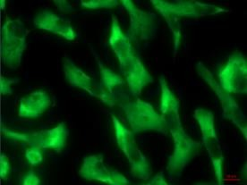
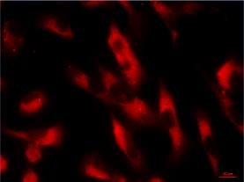
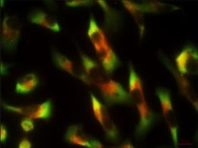
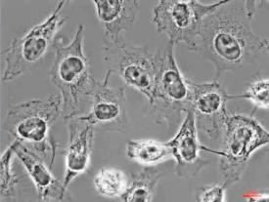
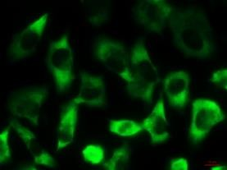
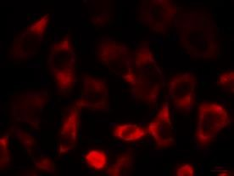
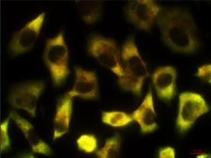
Co-localization of rpS3 with Golgi after treatment of Monensin.
D
Phase contrast
FITC(rpS3)
BODYPI-TR(Golgi)
Merge
Monensin(--)
Monensin(+)

Slide 37

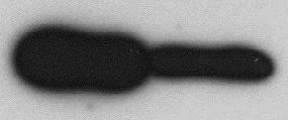
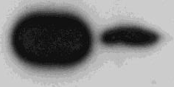
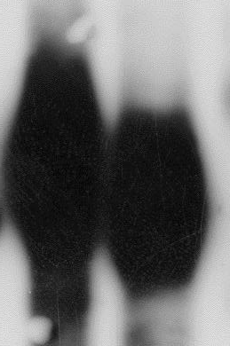

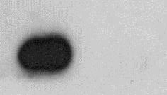

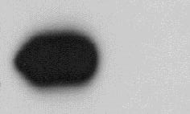
PNGase F treatment decreases size of rpS3 (A),
evidence of N-glycosylation.
ConA column binding (B) :
A
B
Lysate
Media
PNGase F
--
+
Input
Con. A
Input
Con. A
IP : rpS3
IB : rpS3
IB : rpS3
IB : MIF
IP : Fas
IB : Fas
IB : Fas
IB : Rack1

Slide 38
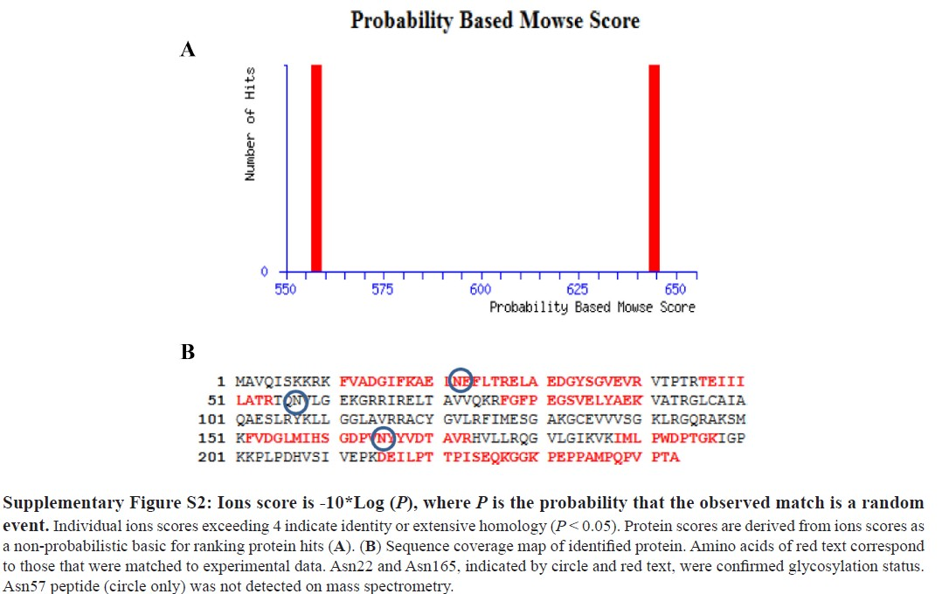

Slide 39






N165 is the glycosylation site.
A
B
Lysate
Cell culture media
Vector
WT
N 57G N 165 G NNGG
Lysate
Vector WT
N 57G N 165 G NNGG
IB : Flag
IB : rpS3
Exogenous (about 33 kDa)
Endogenous (about 30 kDa)
IB : rpS3
Exogenous (about 33 kDa) Endogenous (about 30 kDa)
IB : Flag
IB : Tubulin
IB : Fibrillarin
C
200
180
160
140
120
100
80
60
40
20
0
D
200
180
160
140
120
100
80
60
40
20
0
*
*
*
*
WT
N57G
N165G
NNGG
WT
N57G
N165G
NNGG
*, P < 0.05
*, P < 0.05

Slide 40
Figure 3.
E
**
7
*
rpS3 concentration (pg/ml)
6
5
4
3
2
1
0
WD
N57G N165G
Total protein in media (150 μg/ml)
NNGG
*, P < 0.01
**, P < 0.001

Slide 41
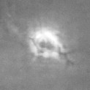


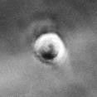



N165G mutation decreases secretion of S3 and invasiveness of cancer
cells.
B
A
Lysate Con. A
FLAG-rpS3
FLAG-N165G
FLAG-rpS3
FLAG-N165G
FLAG-rpS3
IB: FLAG
IB: RACK1 IB: FAS
IB: MIF
FLAG-N165G
IB: rpS3

Slide 42



N165G mutation decreases migration of cancer cells.
C
Control
12hr
16hr
FLAG-rpS3
FLAG-N165G

Slide 43









Knock-down of rpS3 decreases the invasive phenotype of malignant
cancer cell liAnes.
C
3.5
*
HT1080
WM-115
3
*
Scramble
si-rpS3/777 si-rpS3/796
*
Scramble
si-rpS3/777 si-rpS3/796
2.5
RFU
2
1.5
IB: rpS3
1
0.5
IB: Tubulin
0
B
Scramble
si-rpS3/777
si-rpS3/796
*, P < 0.01
HT1080
WM-115

Slide 44











Invasive phenotype of cancer cell lines correlates with secretion level and
glycosylation of rpS3.
A
RBL-2H3
NIH3T3
B
HDF
Lysate
Con. A
HDF
NIH3T3 HT1080 RBL-2H3
HDF
NIH3T3
HT1080 RBL-2H3
HDF
RBL-2H3
NIH3T3
Lysate
IB: rpS3
rpS3
IB: RACK1
C23
IB: FAS
Tubulin (lysate)
IB: MIF
CBB staining (media)
C
HDF
NIH3T3
RBL-2H3
HT1080

Slide 45





D
*
E
3.5
*
*
250
3
*
*
200
*
2.5
2
Invaded cells
150
RFU
1.5
100
1
0.5
50
0
Con.
HDF
NIH3T3
HT1080 RBL-2H3
*, P < 0.05
0
HDF
NIH3T3
RBL-2H3
HT1080
WM-115
*, P < 0.05
F
HDF
NIH3T3
RBL-2H3
HT1080
WM-115

Slide 46
Conclusion
1. The secreted rpS3 requires N-glycosytion.
2. RpS3 is secreted only in cancer cell lines but not in normal cells.
3. When the cells are more malignant, the more rpS3 is secreted; a possible cancer marker?
Oncotarget published on-line June, 2016

Slide 47































德 (덕)
Virtue
Dr. YongJoong Kim Dr. Hag Dong Kim Dr. Tae Sung Kim Ms Min Seon Lee

