Slide 1
Security(Copyright) Issues for Multimedia Content
Jongweon Kim, Ph.D.
Creative Content Labs
Dept. of Contents and Copyright
Sangmyung University, Korea
Notes:
Ladies and Gentlemen.
How are you today? I am Jongweon Kim came from Korea and I am working at Sangmyung University. In Korea, the temperature is about 35 Celsius degree and very hot. However when I arrived here Birmingham, the weather is cool. Anyway, today, I would like to present about security issues for multimedia content. Nowadays, multimedia contents are most important thing in our life. As developing the computer and network technology, the multimedia piracy issues are controversy.

Slide 2
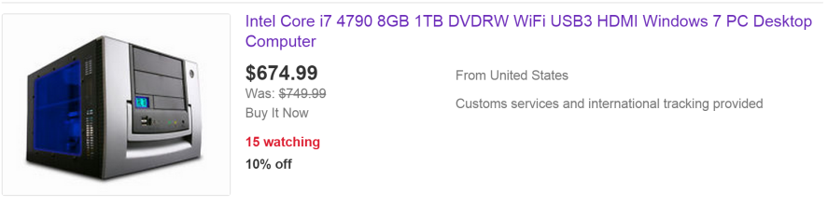
Multimedia Content
Digital technology
  Computer & Networks
Digital Multimedia
  Intangible
  Duplicable without degradation
  Transferable with cost zero and location free
Notes:
When I was a graduate student, I bought a IBM compatible PC AT. I am not sure you are familiar to the PC hardware. The CPU was 80286 AT with 2Mbyte memory and 20MB HDD. Can you imagine the price of the PC? The price was about 1,200 US dollars. These days, if we have 1,200 US dollars, we can buy a computer with i7 quad core or i5 dual core CPU, 8Gbyte memory and 1Tbyte HDD. Indeed including Full-HD 24inch LCD monitor. Actually, value of 1,200 US dollars 25 years ago is not same today’s value. Today’s value is about 3,200 US dollars. How about the performance of the PC? CPU performance may upgrade about 10,000 times and the capacity of memory is extended 4,000 times, the capacity of HDD is extended about 500,000 times.
Now you have powerful computers in your hands or your pockets. With developing the computer and network technology, digital multimedia is grown rapidly. The characteristics of the digital multimedia are intangible, duplicable without degradation and transferable with zero cost, anytime and anywhere.

Slide 3
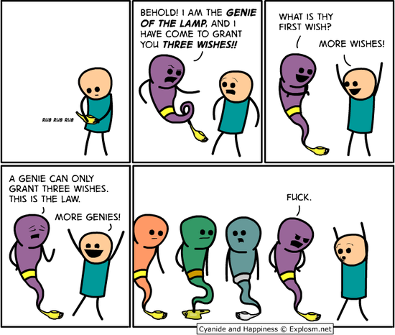
Duplication
Notes:
This cartoon shows the duplicable feature of the digital multimedia. Digital multimedia is composed of binary code and it can be perfectly duplicated. We can’t distinguish the difference between the original and the copycat.
The clever Aladdin is a uploader today.

Slide 4
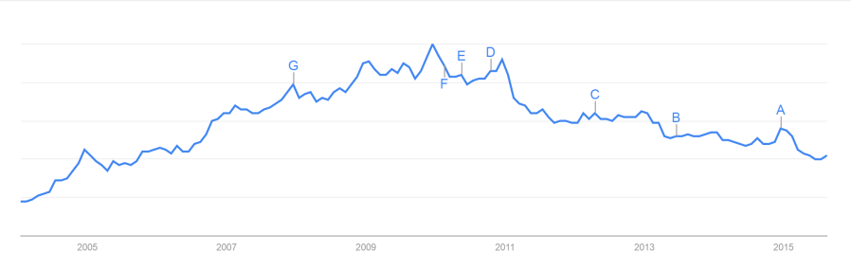
Piracy issues
Napster
  Established in 1999
  Music file sharing via p2p
  RIAA sued
Bittorrent
  Bram Cohen made in 2001
  Enhanced p2p
  Critical problem of Piracy
Notes:
First piracy issue was Napster case. Napster provided a central p2p service to share mp3 songs and RIAA sued Napster. Finally, Napster stopped the service July in 2001, then Napster was bankrupt in 2002 and acquired by Roxio.
At that time, a new p2p technology that was called as Bittorrent was emerged. This technology did not draw attention when it was developed. However, after year 2007, the torrent traffic of world network was about 50% in North America. Torrent becomes now a major term of piracy network.

Slide 5
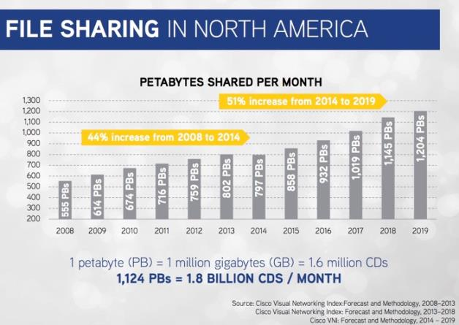
File sharing
http://www.digitalmusicnews.com/permalink/2015/07/16/if-you-think-piracy-is-decreasing-you-havent-looked-at-the-data-2
Notes:
Rightsholdes such as MPAA, RIAA and Hollywood Motion Picture Companies tried to reduce the piracy traffic on the Internet, there is still a lot of traffics for file sharing on the Internet. Digital Music News announced the file sharing traffic will be increased continuously and in 2017, the traffic will be over 1,000PBytes per month. 1PB is 1.6million CDs volume. That is 1,000PB is 1.6Billion CD volume.

Slide 6
Copyright
Rights for creative works
  Bundle of rights
automatically protects those works from the moment they are written down (or painted, or filmed – the technical term is “fixed in a tangible medium”)
In most cases, copyright protection lasts for the life of the author plus 70 years after death.
Notes:
So, why there are many controversies of copyright? What is Copyright?
Copyright is bundle of rights for creative works and applicable to any expression of a creative work. It is granted automatically to protect the creative works from the moment they create (written down, painted, or filmed). Copyright protection lasts for the life of the author plus 70 years after death And if there are coauthors, it lasts for 70 years after death of last coauthor.

Slide 7
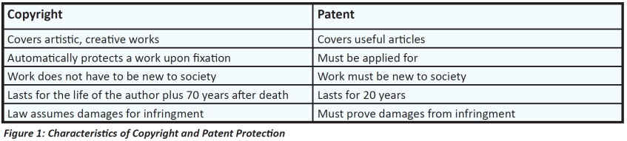
Copyright vs. Patent
Notes:
This table shows the difference between copyright and patent. Copyright protects the expression of the work not idea, otherwise patent protects the idea.
So, Copyright covers artistic, creative works and functional works like computer programs.
Patent lasts for 20 years after apply for registration.

Slide 8


A Tragedy of Copyright in Korea
Notes:
Because there is no duty to express the author and to register their works, there are widespread infringement cases .
In Korea, there was a tragic case in 2007. A teenager uploaded many fantasy nobles on the Internet and a law firm enforced to him the law firm would sue him if he did not arrange with the infringement. Actually, the law firm requested 1,000 US dollars and he could resolve the problem within 500 bucks. However, the boy was cowed and decided to kill himself. How ridiculous !!
Anyway, after this case, Supreme Prosecutors’ Office has adopted the conditional suspension of prosecution and if the first offenders receive copyright education, the Office suspends the prosecution.

Slide 9

Copyleft
The concept of copyleft was described in Richard Stallman's GNU Manifesto in 1985
Solomon: Bible
  There is nothing new under the sun - Ecclesiastes 1:9
Bernard de Chartres
  Standing on the shoulder of giant
Isaac Newton
  If I have seen further it is by standing on the shoulders of giants.
Notes:
The representative movement of anti-copyright is Copyleft. Their movement is based on the proverbs.

Slide 10
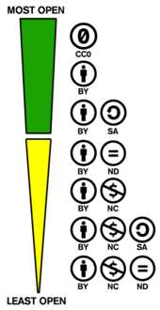
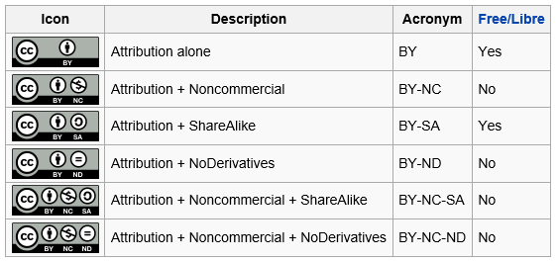

Compromising
Creative Commons License – Lawrence Lessig
Notes:
There is a compromising movement claimed by Lawrence Lessig who is a professor at Havard Law School.
There are basic four rights. BY, SA, NC, ND and six combinational rights.
CC0 means public domain.

Slide 11
New Technology – Aereo
New Technology Platform Allows Consumers Access to Live TV Over the Internet – Feb. 14, 2012
Aereo loses to broadcasters in Supreme Court fight for its life – June 25, 2014
Aereo suspends the service at 11:30 EST today – June 28, 2014
Aereo Files For Chapter 11 Bankruptcy - Nov. 21, 2014
TiVo Receives Approval To Acquire Aereo Assets – March 13, 2015
Notes:
Let’s see a new case in USA. Last year, US supreme court decided Aereo service infringed upon the rights of copyright holders.
Aereo announced a new service platform with new technology in 2012.

Slide 12
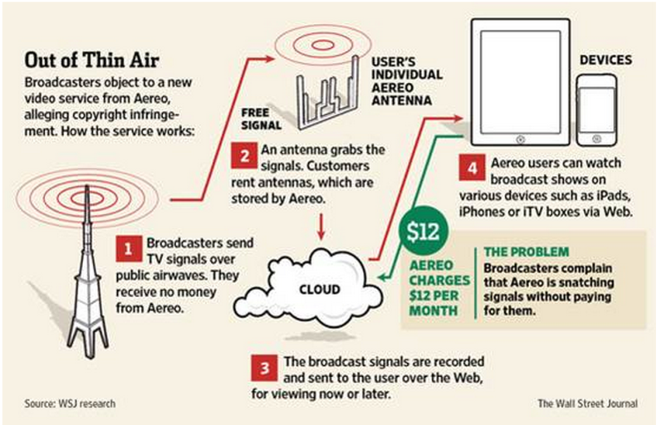
Aereo Service
Notes:
This shows the flow of the Aereo service.

Slide 13

New Technology – Sling Box
Your Slingbox connects to your home network (via WiFi or Ethernet) and sits between your cable or satellite services set-top box and your TV.
The TV signal comes from your set-top box and your Slingbox slings it to any of your devices, anywhere in the world. You can even watch or control your DVR.
You can even use a streamer to watch your TV on a second television.
Notes:
There is other case using new technology. Sling Box was invented by baseball mania.

Slide 14
Global Cooperation
TPP - Trans-Pacific Partnership
America, Japan, Singapore, New Zealand, Vietnam, Canada, Mexico, Australia, Chile, Brunei, Peru, Malaysia
Strengthen Copyright
  Strong demand of USA
Notes:
Actually, copyright issue is a global problem not domestic because the network connects the world. There are many international conventions such as the Bern Convention and WIPO Copyright Treaty. Nowadays, TPP is consist of 12 nations and they have difference of position about Copyright and so on.
Especially, USA asserted to strengthen copyright policy and law.

Slide 15

Technical Measure
Service Security vs. Content Security
  FG-IPTV defined
IP Network
Service Security
Access on the Service
Content Security
Access/Rights to the Content
Notes:
ITU-T IPTV focus group defined service security and content security. The FG defined service security is to access on the service and content security is to access to the content by granted rights.

Slide 16
Category
Technology Solution
TPM (Technical Protection Measures)
RMI (Rights Management Information)
Copy Protection (SCMS: CSS etc.)
Restricted access &
usage
Content Blocking & Filtering (Watermarking, Fingerprinting)
Access Control (STB, Password protected Website)
Aggregated Licensing
Content Usage Metering (Watermarking, Fingerprinting, embedded codes)
Digital Rights Management (Windows RM, Fairplay, etc.)
Discreet
Licensing
Notes:
The category of the technical measure is classified into two group, TPM and RMI. TPM is technical protection measures and RMI is rights management information. In the category of TPM, there are copy protection, access control and digital rights management. In RMI, there are content blocking and filtering and content usage metering. Copy protection technology is adopted CD and DVD using CSS(Content scrambling system). Access Control is adopted settop boxes and DRM was adopted many music and video services. RMIs such as Content blocking and filtering are adopted by Content service provider or ISP.

Slide 17
Digital Rights Management
Based on cryptography
Rights control according to licenses
Rights model
  Permission
  Constraints
DRM free
  Feb. 2007, Steve Jobs
  Thoughts on Music
Notes:
In detail, DRM is based on cryptography and controls the usage rights according to licenses. When we use DRM technology, there is a rights model. The rights model is consist of permissions and constraints. Permission rights are play, print, or view, etc. and Constraints are count, interval, time limit, and etc.
Although DRM is most strong technology to protect multimedia content, it has been complained from many users. Because DRM is usually bound to the devices users can not use their contents if they changed the devices. Actually, the merit of DRM to service provider is that it locks the customers in their service.
In 2007, Steve Jobs who was CEO of Apple argued DRM free service through an article entitled “Thoughts on Music”. In this article, Apple sold about 90 million iPods and 2 billion songs from the iTunes store. On average, that’s 22 songs purchased from the iTunes store for each iPod ever sold. At that time, the iPod held 1,000 songs and most iPod is nearly full. Only 3% of the music on the iPod is purchased from the iTunes store and protected with a DRM. Remaining 97% of the music is unprotected. That’s why DRM is useless and he recommended DRM free.

Slide 18
DRM Reference Architecture
Content Server
Client
Content Repository
Content Package
DRM
Packager
Encryption
Content
Product Info
Metadata
DRM
Controller
Rendering
Application
Financial
Transaction
Rights
DRM
License
Generator
Encryption
Identity
Keys
Rights
Encryption
Keys
Identities
License
License Server
Notes:
This shows DRM reference architecture. Most client devices bind the keys with the system features. This means if you change or loose the device, you can not use the content anymore.

Slide 19
Digital Watermarking
Imperceptible mark into contents
Information hiding
  Copyright holders
  Buyers
Advantages
  Imperceptible
  Inseparable
Notes:
The other technology is digital watermarking. Digital watermarking technology embeds an information into contents imperceptibly. This is a kind of information hiding. We can embed copyright holders information and buyers information.

Slide 20
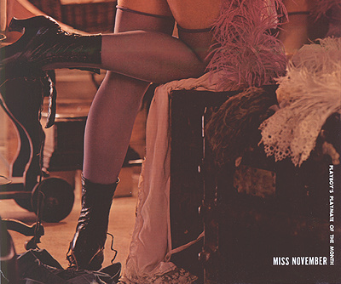
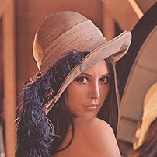
Who is the rightsholder?
Lena in 1972
Notes:
When is digital watermarking useful? This is a case. Are you familiar to the left image? In 1972, a student who was studying image processing, uses an image scanned from a magazine. He distributed the image to everyone who wants to use it. Before long, the rightsowner found the image is theirs. After some concern, the publisher decided to release the rights to the public and we can use this image freely now. Actually, the original version of this image had an information who the owner is, but the student cropped the face image from the original one. No one became aware the image had copyright. Digital watermark can be embedded into overall image.

Slide 21
Digital Fingerprinting
Features of multimedia content
  Like a fingerprint or a DNA
Content Identification by Google
Grace note, Audible magic, etc.
Illegal transmission control of Contents
Notes:
Digital fingerprinting technology is using to identify what the content is. This technology extracts key features from multimedia content and store them into Database. There are many algorithms such as google’s content identification, grace note, audible magic and etc. This is used to control the illegal transmission of contents.

Slide 22
Limitation of Technical Measures
Professor Ed Felton at Princeton University said.
The legal definition of fair use is, by computer scientists’ standards, maddeningly vague. No enumeration of fair uses is provided. There is not even a precise algorithm for deciding whether a particular use is fair. Instead, the law says that judges should make case-by-case decisions based on four factors: the nature of the use; the nature of the original work; the portion of the original work used; and the effect of the use on the market. The law does not say exactly how these factors should be evaluated or even how the factors should be weighted against one another.
To a computer scientist, such imprecision is a bug.
Notes:
Although there are many technical measures, some limitations are existed to protect the content. Copyright is complicated rights granted by laws and the law is not clear to decide the use case is illegal or not. For example, there is fair use.

Slide 23
Technical Challenge for Copyright
Awareness by Deep Learning and big data will be helpful to identify fair use case
Nonlinear watermarking
  embed the mark in the compressed domain and extract the mark in the uncompressed domain. Is it possible ?
Self-destructive content – smart content
  Destroy content by itself if there is illegal intended usage.
Notes:
So, what can we do for copyright protection in the future? I would like to conclude my presentation with three suggestions of technical challenges for copyright.

Slide 24
Thank you !
jwkim@smu.ac.kr

