Slide 1
The development of LPPC in PAS in Blood Transfusion Centre, Faculty of Medicine, Khon Kaen University, Thailand
Jongkol Akahat, Thipaporn Jaroonsirimaneekul, Nuanchan Mungkhunkhamchaw, Kutcharin Phunikhom

Slide 2
Background
Plasma provides more physiological environment for platelet storage
-bicarbonate buffer
-glucose as metabolic substrate
-inhibitors of coagulation activation

Slide 3
Background
Adverse effects of plasma as a storage medium
  Patients receive large quantities of unnecessary and sometimes hazardous substances that are present in the donor plasma.
  Antibodies, allergens, foreign proteins and sometimes drugs, present in plasma may bring about untoward allergic or anaphylactic reactions.
  Transfusion reactions due to non compatible plasma proteins.

Slide 4
Background
Adverse effects of plasma as a storage medium
  Febrile transfusion reactions can be caused by leukocyte fragments, or substances with vasoactive and pyrogenic properties present in plasma.
  Transfusion related acute lung injury(TRALI) is said to be caused by antibodies such as anti-leukocyte antibodies present in the donor’s plasma.

Slide 5
Background
PAS are crystalloid nutrient media
PAS were first developed in the late 1980s, and continued to be improved over the following years
PAS being used in Europe since 1991.
Today, the available PAS mediums replace about 65-70% of the plasma volume in a platelet component.

Slide 6
Advantages of a Platelet Additive Solution
Replacement of Plasma as a storage medium : reduction in patients allergic reactions and transfusion reactions due to decrease in the levels of plasma proteins and antibodies.
Due to decrease in the titer of ABO agglutinins, platelets in PAS do not require ABO compatibility between donor plasma and recipient cells.
Plasma not used for platelet storage can be diverted to other uses such as fractionation.
Immunological Benefit: reduce levels of anti-HLA, HNA antibodies, believed to be one of the mechanisms of TRALI.

Slide 7
Objective
To prepare LPPC in PAS in routine work instead of traditional LPPC

Slide 8
Methods
WB (450 + 10% mL.) centrifuged
at 3,960 rpm 10 minutes (22 ⁰C)
Buffy coat was separation for 30-35 mL.
PCs was pooling four iso-group buffy coat by resuspended with plasma or PAS.

Slide 9




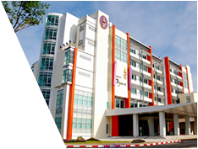
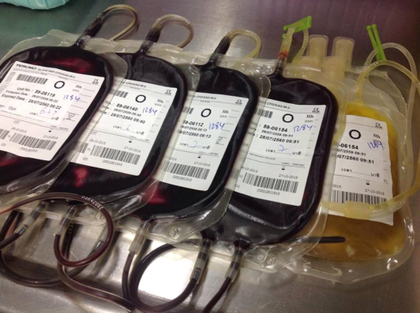
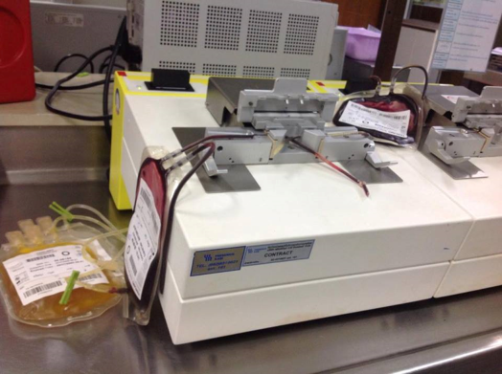
PROCEDURE
4BC
CONNECTED
ABO 
INFECTIOUS 
ANTIBODY SC. 
CONNECTED WITH STERILE CONNECTING DEVICE

Slide 10
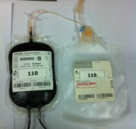
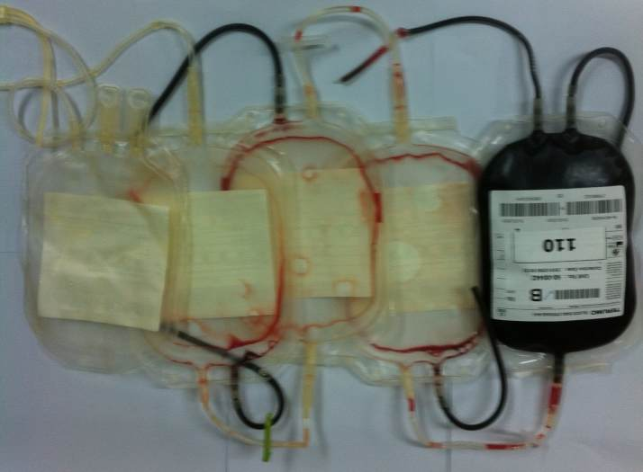
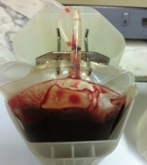
PROCEDURE
WASH
CENTRIFUGE

Slide 11
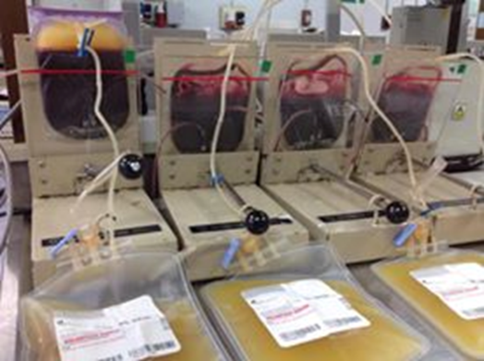
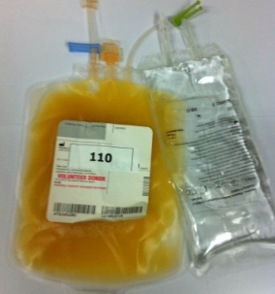
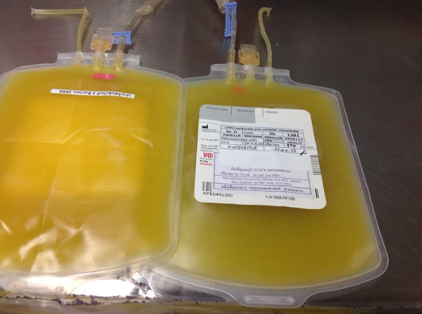
PROCEDURE
CENTRIFUGE & SEPARATE + PAS
PRODUCT
Content
Content

Slide 12
Results : First trial
Types | N | Mean (x10¹¹) | WBC (x10⁹) | Vol. (ml) | U
LPPC in PAS | 30 | 2.8 | 0.1 | 304 | 5.0
LPPC | 175 | 3.9 | 0.1 | 324 | 7.1
Table 1. CBC results in LPPC

Slide 13
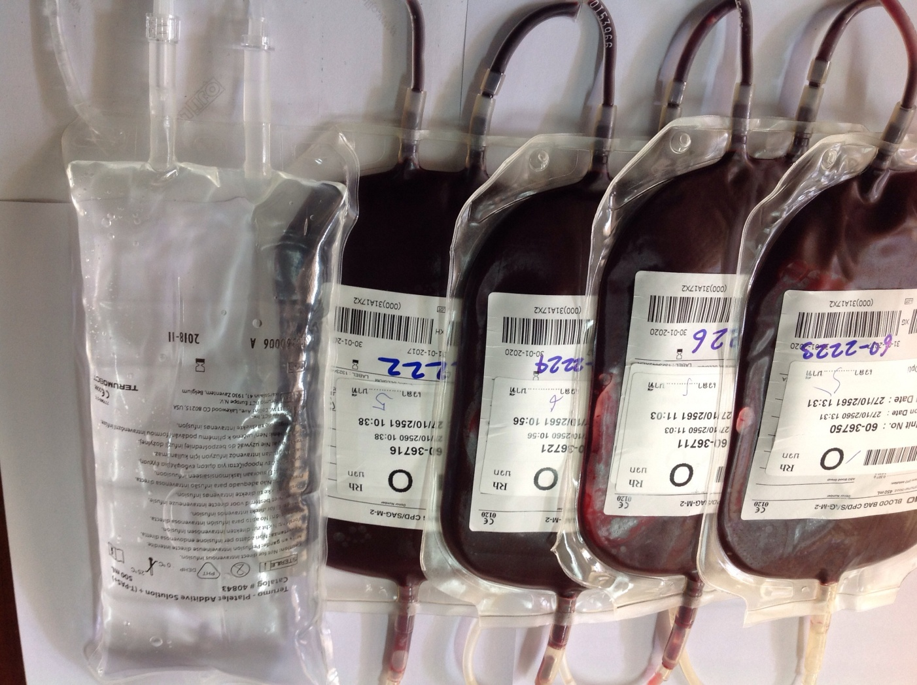
Second trial
PCs was pooling four iso-group buffy coat by resuspended with PAS

Slide 14
PROCEDURE
WASH
CENTRIFUGE

Slide 15
PROCEDURE
CENTRIFUGE & SEPARATE
PRODUCT
Content
Content

Slide 16
Results :Second trial
Types | N | Mean (x10¹¹) | WBC (x10⁹) | Vol. (ml) | U
LPPC in PAS | 45 | 3.6 | 0.2 | 300 | 6.5
LPPC | 175 | 3.9 | 0.1 | 324 | 7.1
Table 2. CBC results in LPPC

Slide 17
Results
anti | Un-dil | 2 | 43 | 28 | 16 | 32 | 64 | 128 | 256 | titer
A | 4 | 4 | 3 | 3 | 2 | 0 | 0 | 0 | 0 | 16
B | 4 | 4 | 4 | 3 | 3 | 2 | 0 | 0 | 0 | 32
Table 3. Titer of Anti-A and Anti-B in LPPC in PAS

Slide 18
Conclusion
LPPC in PAS are classified as low titer that we can use as universal platelet
Content of Platelet by two methods reached the standard unit of LPPC by EU, TRC
> 2.4 x10¹¹ cells/u

Slide 19


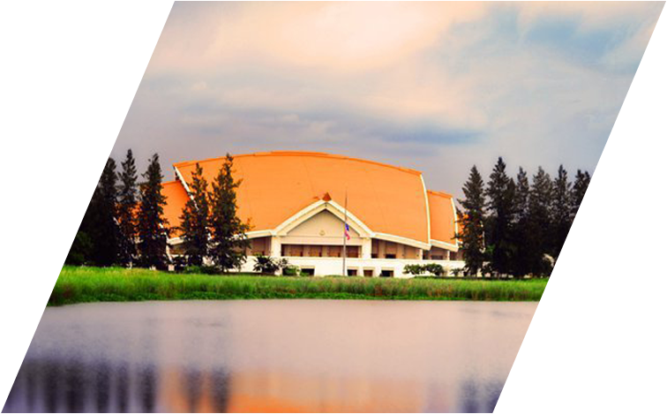
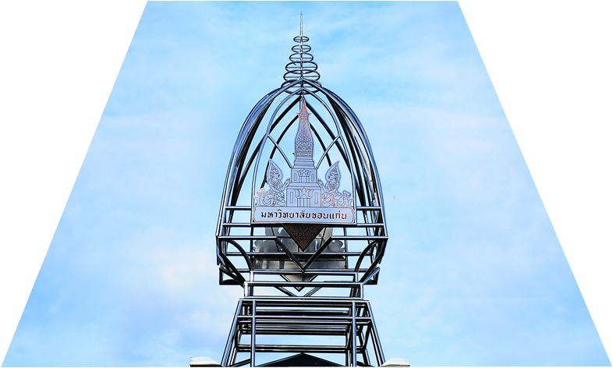

Thank you!
Contact Address:
Jongkol Akahat
Tel: 099-1846355
Email: jonaka@kku.ac.th

