Slide 1
Glycomics approaches to the studies of stem cells and development of glycan-targeted cancer immunotherapy
Alice L. Yu M.D., Ph.D.
John Yu M.D., Ph.D.
Institute of Stem Cell and Translational Cancer Research, Chang Gung Memorial Hospital at Linkou and Chang Gung Univ.
Institute of Cellular and Organismic Biology, Academia Sinica, Taiwan

Slide 2
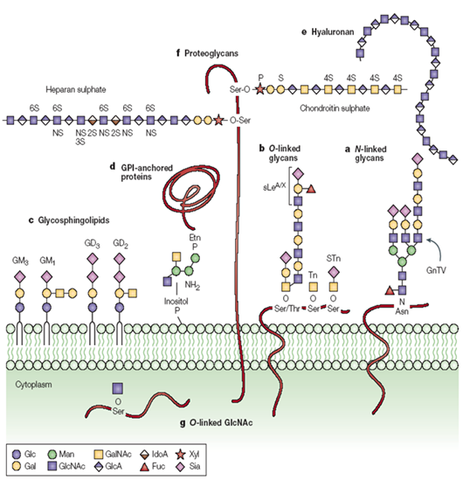
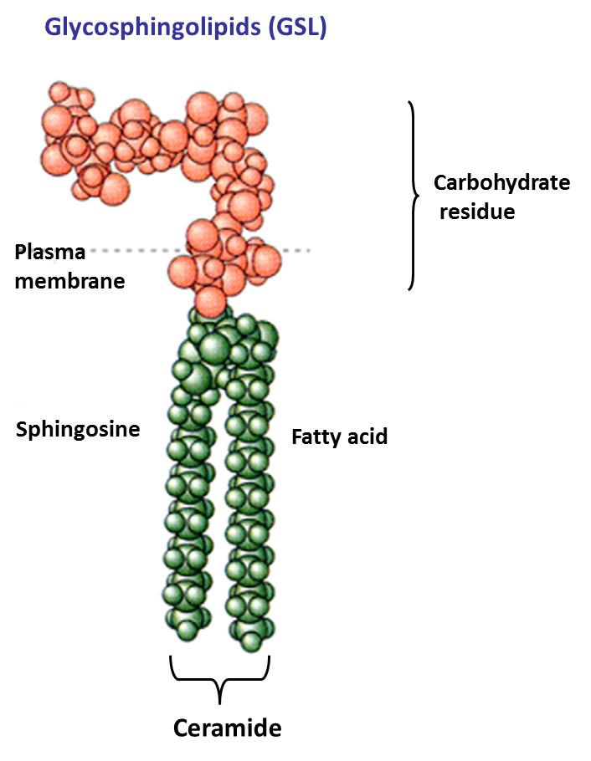
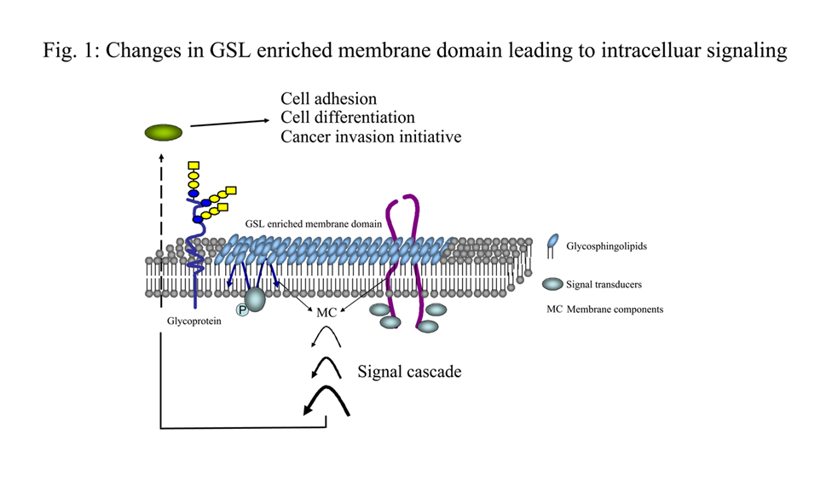
Surface molecules in a cell

Slide 3


Flow cytometric analyses of GSLs in human ES cells, neural progenitor cells, and endodermal cells : GSLs were analyzed using specific antibodies vs the isotype controls

Slide 4
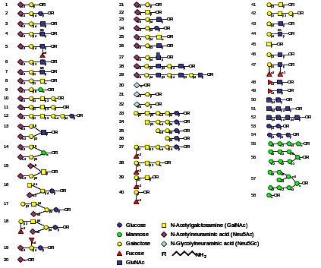
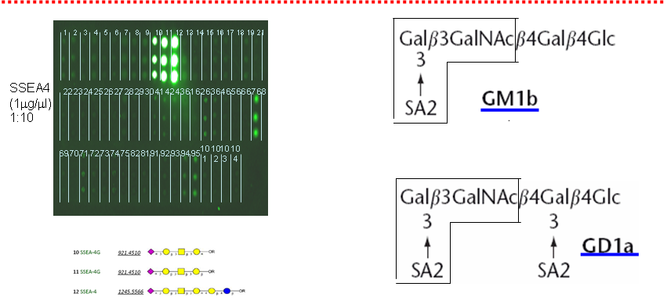
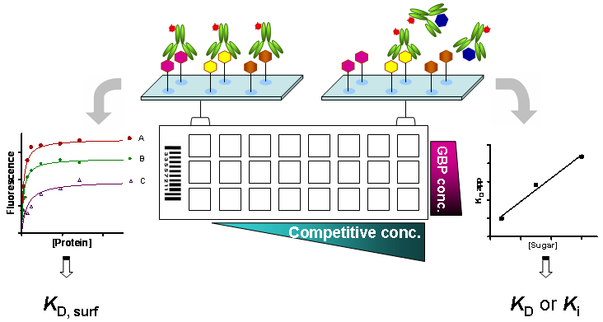
Cross-reactivities of mAbs currently in use for hESC research
Positive immunostaining with mAbs alone may not necessarily reflect a particular entity of GSLs on hESCs

Slide 5
Problems with current stem cell markers
Most surface markers currently in use for ES/iPS cells are either adopted or borrowed from the studies in hematology or embryology
Several previous reports have indicated that these markers for ES/iPS cells are also expressed in differentiated progeny and tissues or they display delayed downregulation during differentiation
The markers used are not unique to stem cells and are used only to enrich the isolated cell subpopulation. Mostly we don’t know their functional roles in cells; these markers characterize but not necessarily define specific stem cells under study.
Thus, it is not surprising that there are often variations for using the surface markers to sort out putative stem cells as reported.

Slide 6
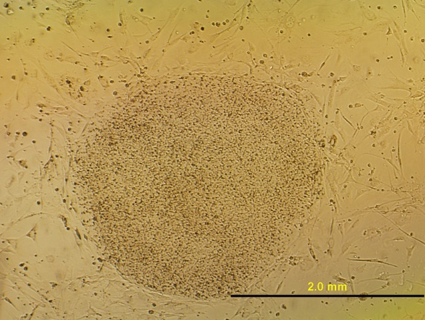
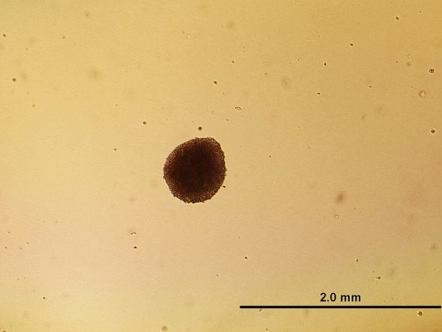
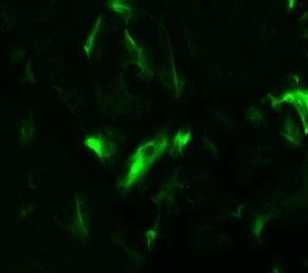
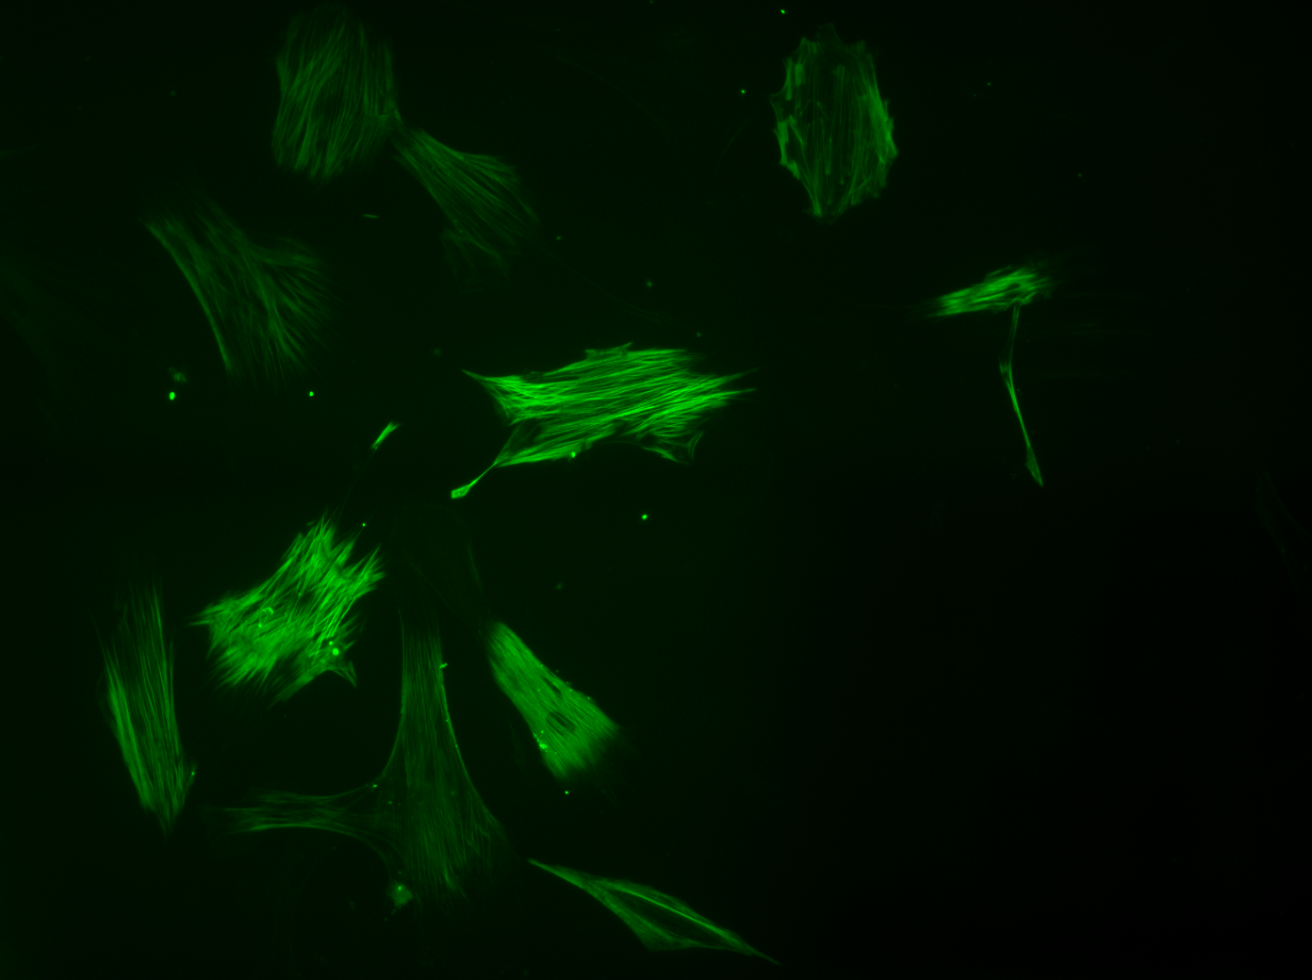

hESCs differentiate into different tissue cells in vitro
hES5 on feeder + bFGF
Treat cells with dispase to completely detach the colonies
Transfer detaching colonies to a low binding dish containing hES media -bFGF
Change medium every day
Embryoid Bodies formation after 24-48 hrs
Plate EBs on gelatin-coating culture dishes in differentiation medium
Harvest EB outgrowth and assay
Change medium every 2 day for 2 weeks
α-smooth
muscle actin
Nestin

Slide 7
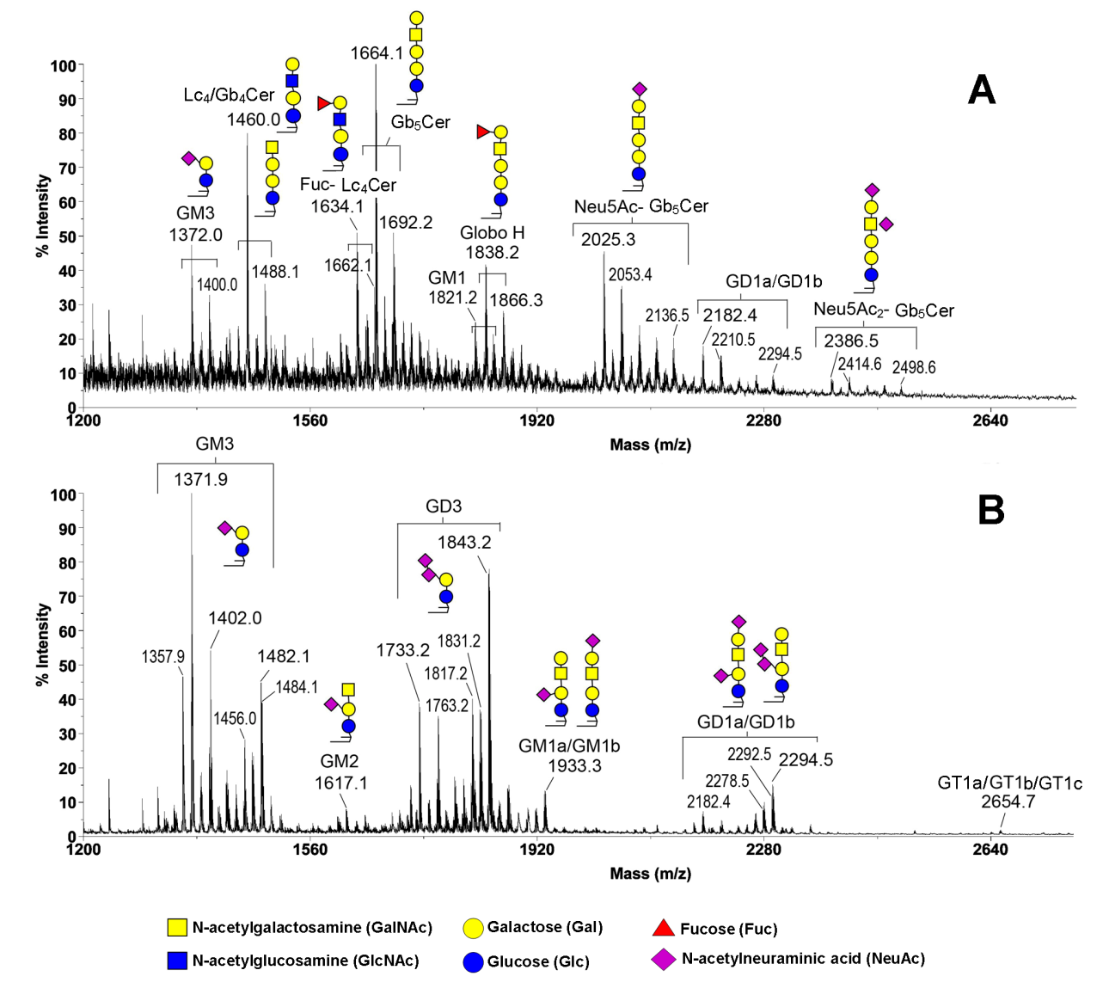
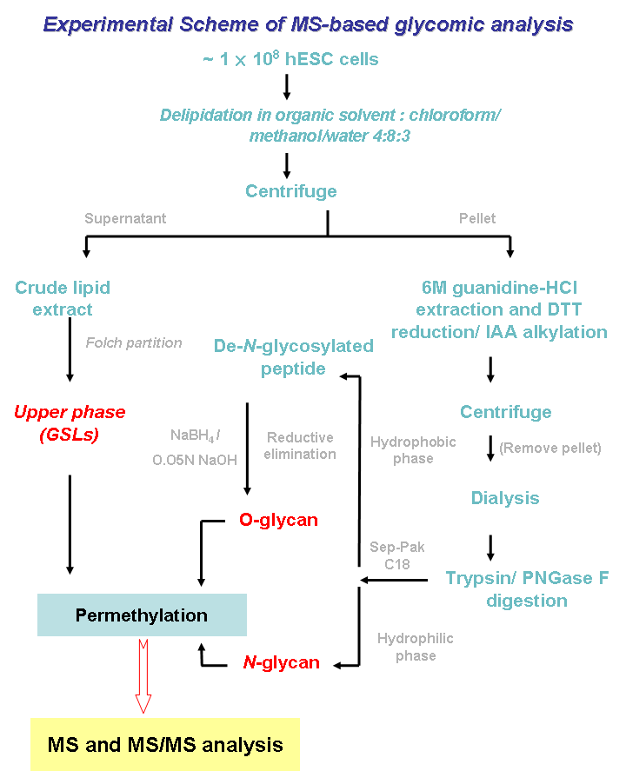

MALDI-MS profiles of glycosphingolipids (GSLs) from undifferentiated hESCs and differentiated EB outgrowth
(Liang YJ et al, PNAS 107: 22564 2010)
Folch partitioning & permethylation
Undifferentiated ES cells
Differentiated EB
Permethylation: neutralize all carboxylic groups on sialic acids by methyl esterification, thus allowing simultaneous semiquantitative profiling

Slide 8
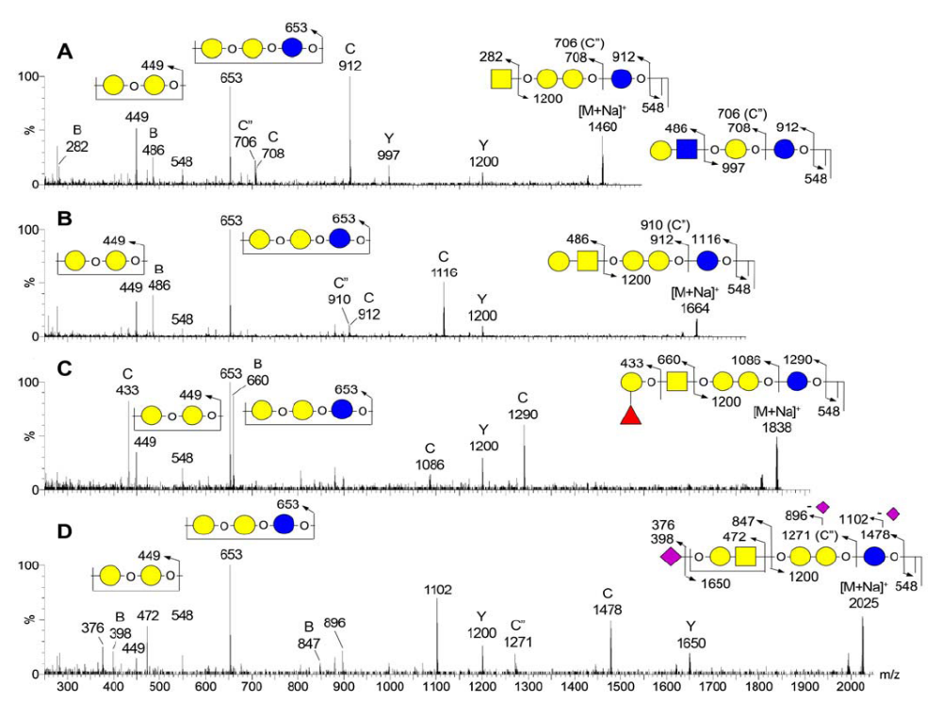

MALDI CID MS/MS sequencing of GSLs for structural determination
Gb4/Lc4
SSEA3
GloboH
SSEA4
Globo- series: SSEA-3, SSEA-4, GloboH, and disialyl-Gb5Cer)
lacto- series GSLs, including Lc4Cer (type 1) and fucosyl Lc4Cer (H type 1)

Slide 9
Switching core structures of GSLs during differentiation of ES cells
Globo- and Lacto-series GSLs
Galα4Galβ4Glcβ1Cer
Galβ3GlcNAcβ3Galβ4Glcβ1Cer
or Galβ4GlcNAcβ3Galβ4Glcβ1Cer
Cer
Cer
Ganglio-series GSLs
Galβ3GalNAcβ4Galβ4Glcβ1Cer
Cer

Slide 10
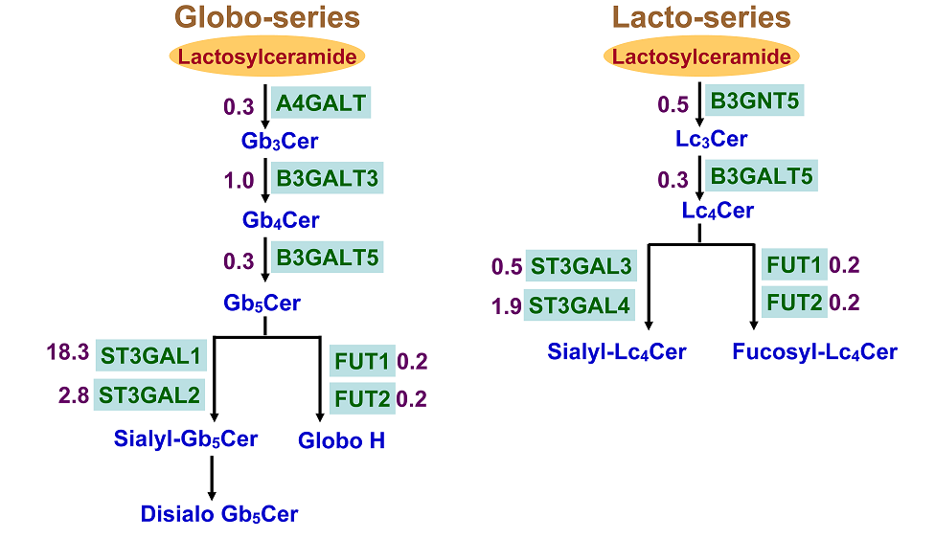
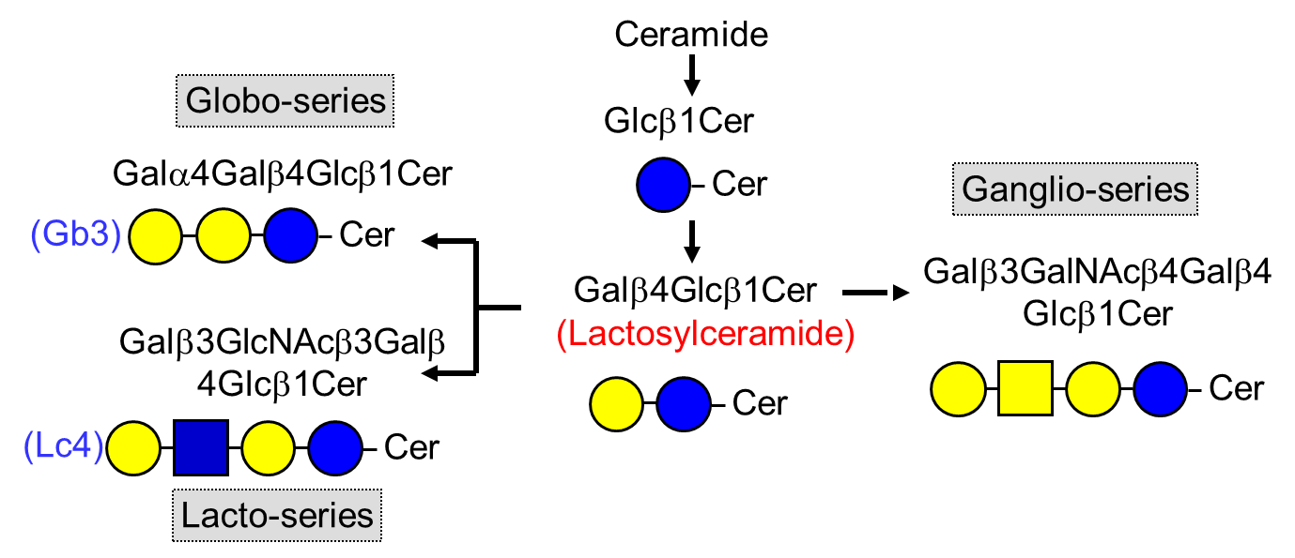
Switching of the Core Structures of GSLs was accompanied with the concerted changes in the expression of glycosyltransferases during differentiation

Slide 11
GSL extraction: Folch extraction vs neutral/ acidic extractions
Since lipids are water-insoluble, the extraction and purification of GSLs requires the use of organic solvents and their combinations.
The number of monosaccharides, charged residues (e.g., sialic acid, sulfate), and ceramide fatty acid chains (C16–C24) affects the polarity of GSLs. Since different GSLs have different polarities, it is impossible to use a single organic solvent to extract all GSLs.
Folch extraction vs neutral/ acidic extractions
Negative vs positive -ion
High pH

Slide 12
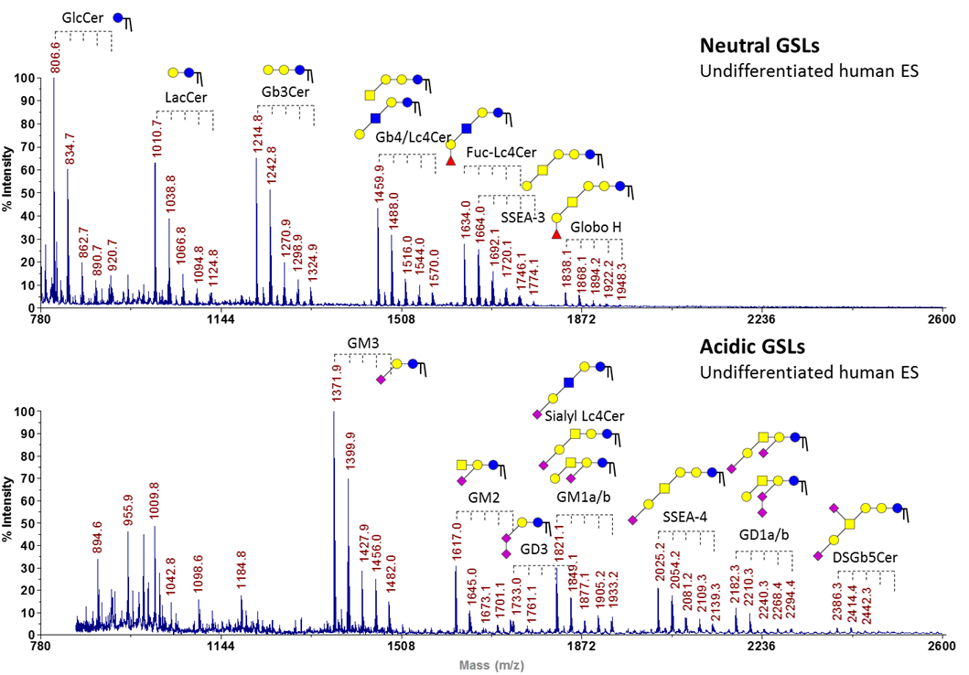
Total MS profiling analyses of neutral- and acidic-GSLs from undifferentiated human ES cells
The GSLs were extracted and prepared with micro solid-phase extraction and anion-exchange chromatography methods. MALDI-TOF MS analyses were carried out in positive-ion mode.

Slide 13
Alterations of GSL expression in human iPS cells and differentiated derivatives

Slide 14
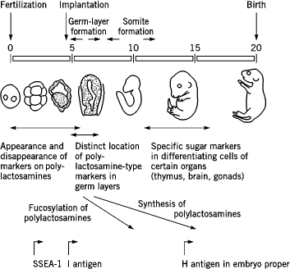
Change of expression patterns of glycosphingolipids during mouse embryonic development
Muramatsu T, 1988
SSEA-3/4
Ganglioseries
GD3
SSEA-1
Gb4
GD1a
GT1b
Hakomori S, 2008
Yu RK, 2007
Lanyi Chang
Notes:
14

Slide 15
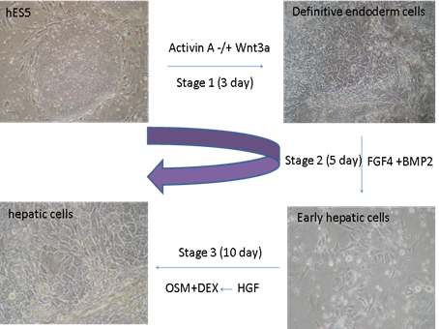
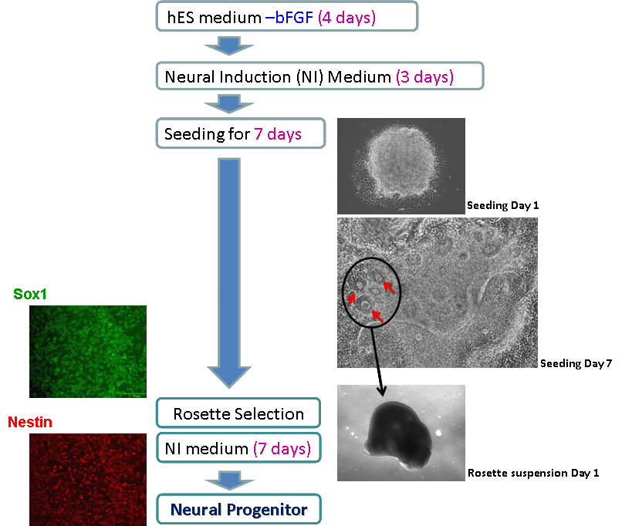
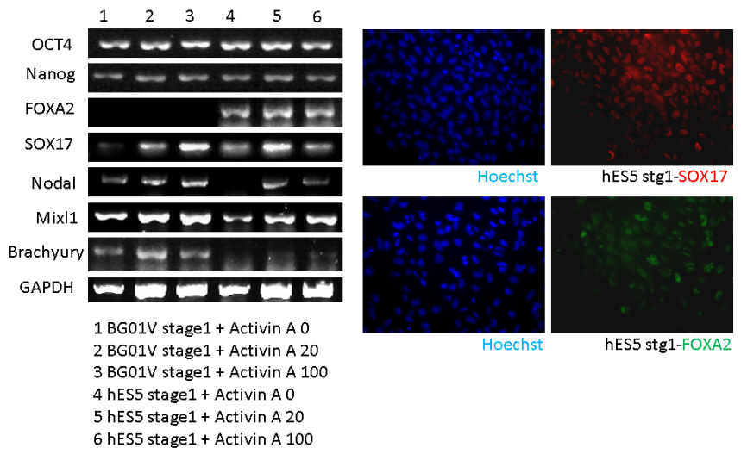
Lineage-specific differentiation of hESCs
(Liang et al, Stem Cells 29: 1995 2011)
Differentiation to common neural precursors
Stage differentiation of hES cells into definitive endoderm and hepatic cells

Slide 16
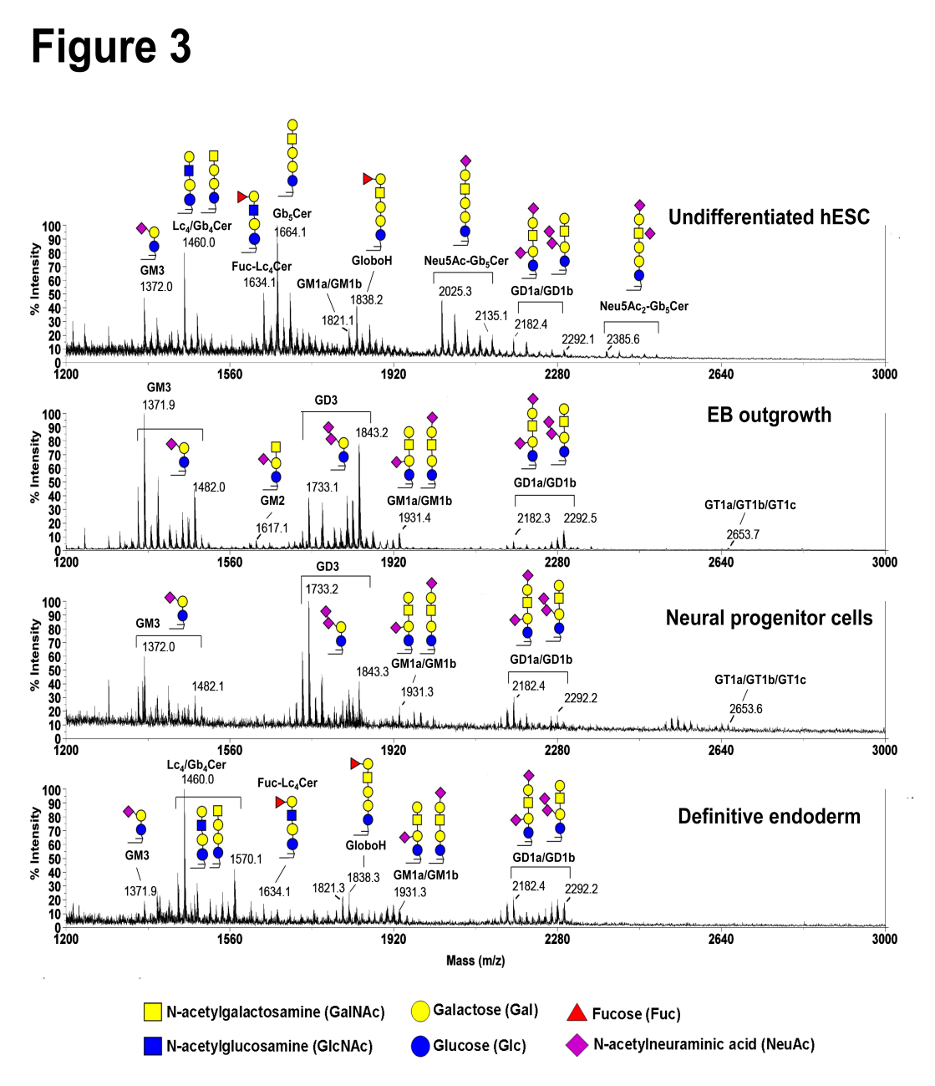
Changes in Glycosphingolipid Composition during Lineage-specific Differentiation of hESCs (Liang YJ, et al Stem Cells 2011)
During hESC differentiation into neural progenitor cells, the core structures of GSLs switched from globo- and lacto- to mostly ganglio-series dominated by GD3.
When hESCs differentiated into endodermal cells, patterns of GSLs totally differed from those observed in EB outgrowth and neural progenitors. The most prominent GSL identified was Gb₄Cer, with no expression of SSEA-3 or -4 antigens, or GD3.

Slide 17
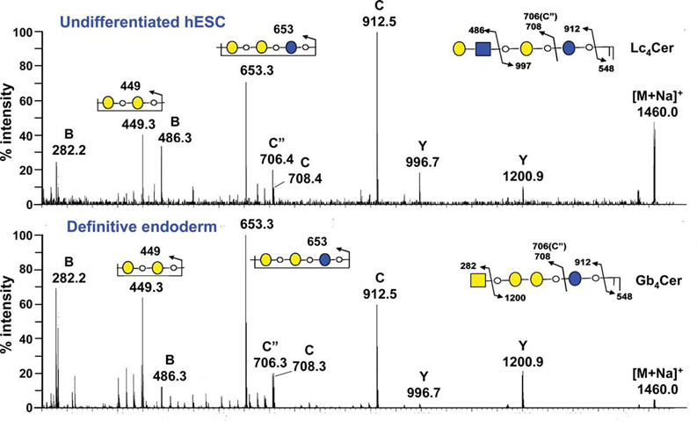


The Gb4 structure was more abundant in definitive endoderm
. The intensities of diagnostic fragments, B and Y ions for (n)Lc4 (m/z 486 and 996) , and for Gb4 (at m/z 282 and 1200) respectively, were used for pairwise comparisons.

Slide 18
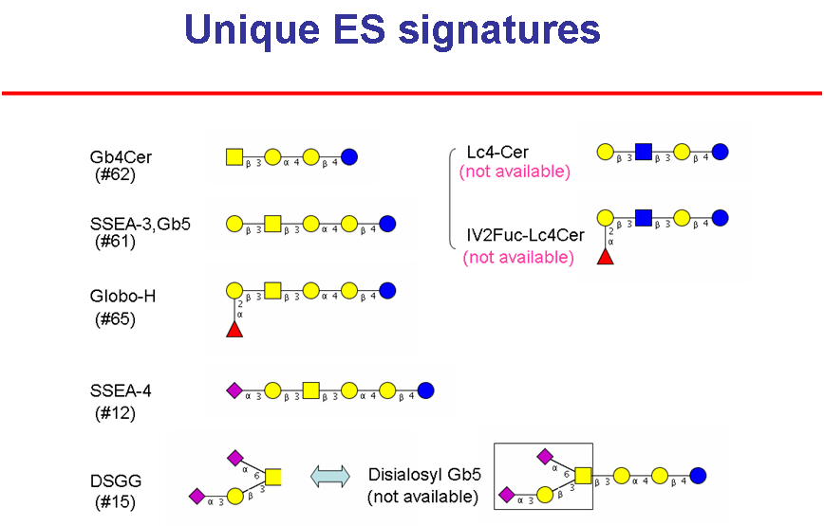
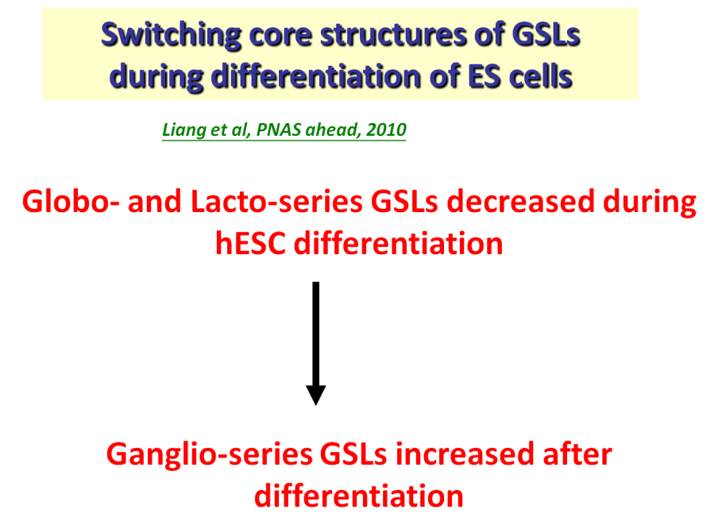
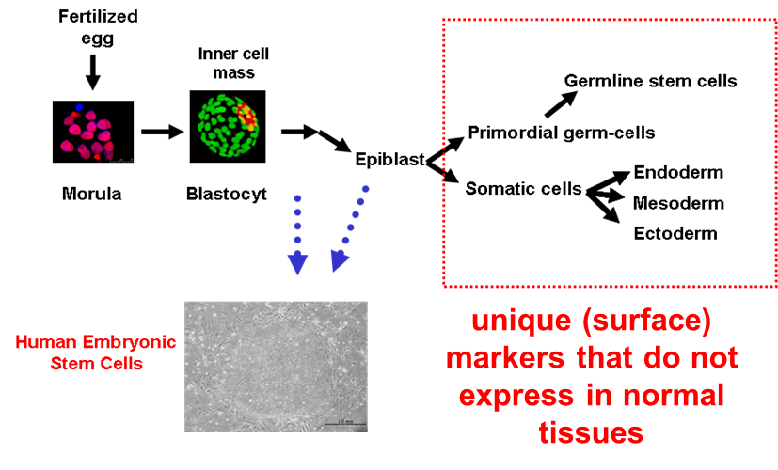
Cancer cells tend to de-differentiate and express oncofetal proteins.
Unique ES surface markers → most likely to be found in cancer cells

Slide 19
Rationales for targeting Globo H or GD2 in cancer immunotherapy
ES differentiation was accompanied with a drastic switch of the profiling of GSLs on cell surface.
Altered glycosylation is a well-known feature of cancer cells. These abnormal glycans contribute to tumorigenesis and metastasis. A variety of tumor associated glycan structures have been identified, including those GSLs expressed on human ES cells or their differentiated derivatives such as Globo H, SSEA-3 [36], GD3, GD2 [50], GM2, Neu5GC-GM3.
Overexpression of these glycoconjugates in tumors with limited expression in normal tissues makes them targets for immunotherapy of cancers.

Slide 20
Antibody-based cancer immunotherapy
Name | Malignancy | Target | Approval
Rituxan/ Ofatumumab/ Obinutuzumab | B cell lymphoma/ B-CLL | CD20 | 1997 2009 2013
Herceptin/ Pertuzumab | Breast, lymphoma | Her-2/neu | 1998 2013
Campath | B-CLL | CD52 | 2001
Avastin | Colo-rectal | VEGF | 2004
Cetuximab Panitumumab | Colo-rectal | EGFR | 2004 2006
Yervoy | Melanoma | CTLA4 | 2011
Brentuximab vedotin | Hodgkin’s lymphoma, Anaplastic large cell lymphoma | CD30-drug | 2012
Ramucirumab | Gastric cancer | VEGFR2 | 2014
Pembrolizumab Nivolumab | Melanoma | PD-1 | 2014
Dinutuximab | Neuroblastoma | GD2 | 2015
Daratumumab | Multiple myeloma | CD38 | 2015
Elotuzumab | Multiple myeloma | CD319 (SLAMF7) | 2015
So far, all approved mAbs are targeting protein antigens, except GD2

Slide 21
Specific biomarkers for cancer → Unique ES markers: e.g. Globo H
Unique ES markers → specific biomarkers for cancer detection and therapy

Slide 22
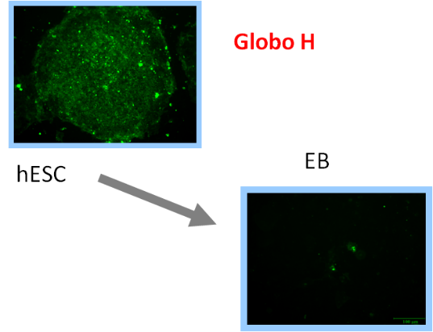
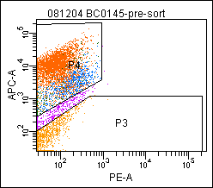
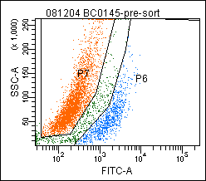
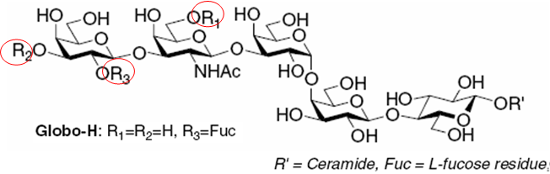
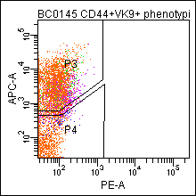
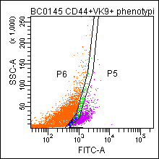
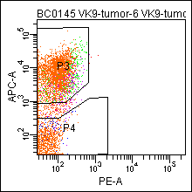
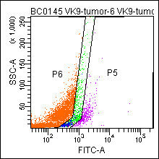
Expression of Globo H in breast cancer stem cells & hESC
negative
CD44
positive
CD24
Globo H
Tumor from Globo H positive cells
CD44
Tumorigenecity
 | 2×10⁴ | 2×10³
Globo H positive | 4/ 4 | 1/ 4
Globo H negative | 1/ 4 | 0/ 4
CD24
Globo H
Tumor from Globo H negative cells
CD44
CD24
Globo H

Slide 23
Rationales & Strategies for targeting Globo H
Triple roles of Globo H in cancer
  Globo H is expressed in breast cancer stem cells and Globo H^{hi} cells are more tumorigenic than Globo H^{lo} cells (Chang WW et al , PNAS August 6, 2008)
  Globo H ceramide acts as an immune checkpoint (Tsai YC, et al J Cancer Science & Therapy 2013)
  Globo H ceramide acts as an angiogenic factor (Cheng JY et al, Cancer Research 2014)
Strategies for Globo H-targeted cancer therapy
  Globo H vaccine:
    Globo H-KLH + OPT821: phase II/III clinical trial completed
    Globo H-DT, OPT-821 or C34 as adjuvant: preclinical development (Huang YL et al, PNAS Feb 2, 2013)
    Phase I clinical trial of Globo H-DT + OPT821 launched in 2016
  Monoclonal antibodies, bispecific antibodies: collaborate with DCB, undergoing preclinical development
  Inhibitors of FUT1/2:
    involved in biosynthesis of Globo H, maintenance of breast cancer stem cell properties
    Since FUT1 and FUT2 knockout mice have normal phenotype
Notes:
LeB, sLeA, LeX, and sLeX epitopes are absent or low in T47D and MB157. As for O-glycans, MB157 seems not to contain fucosylated antigens.
● Knocking down FUT1 and FUT2 decrease GloboH expression. Globo-series GSL are decreased, associated with an increased Ganglio-series GSL in MB157 FUT1 KD. Among Globo-series GSL, GloboH is decreased dramatically, whereas Gb4, Forssman, and SSEA4 are slightly increased.

Slide 24
Uptake of globo H by lymphocytes in vitro and in vivo
Globo H is a tumor associated antigen (including breast cancer stem cells), but also acts as immune checkpoint!

Slide 25
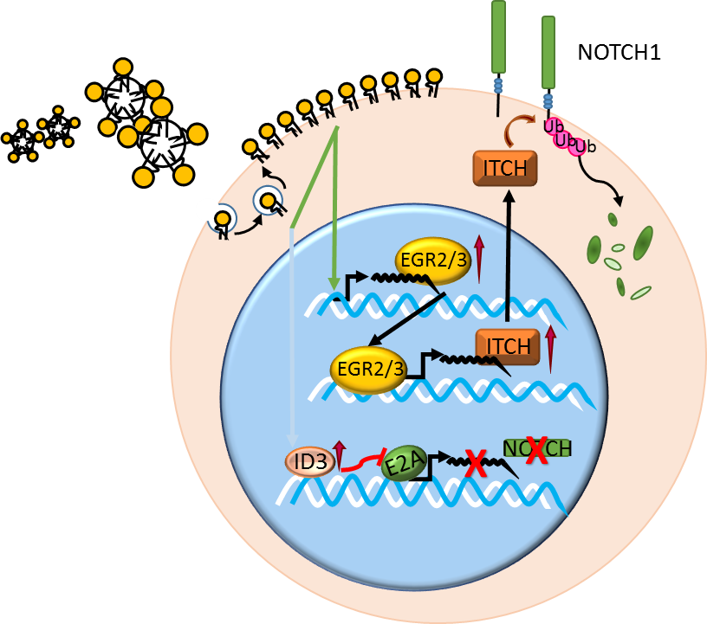
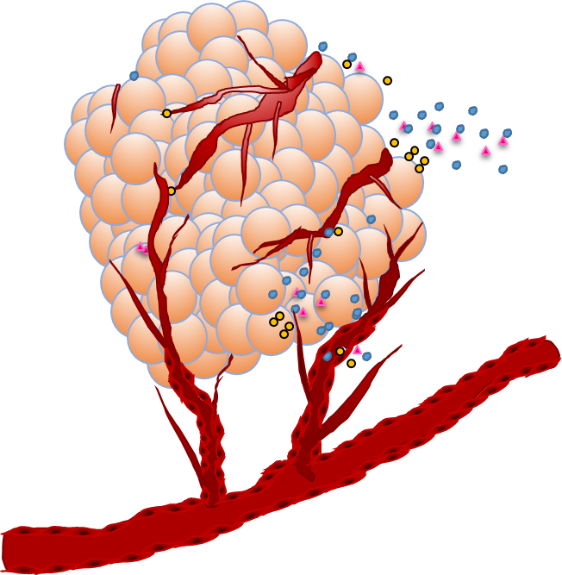
Globo H acts as an immune checkpoint
Globo H ceramide is incorporated into tumor infiltrating lymphocytes
Globo H ceramide suppresses T & B cell responses thru inhibition of NOTCH1 expression mediated by upregulation of id3 and itch
Globo H ceramide enhanced the expression of Egr2/3, which upreguates itch
Regulation of Notch1 expression, activity and stability in T cells
Globo H Cer
Tumor Cells
Tumor infiltrating lymphocytes

Slide 26
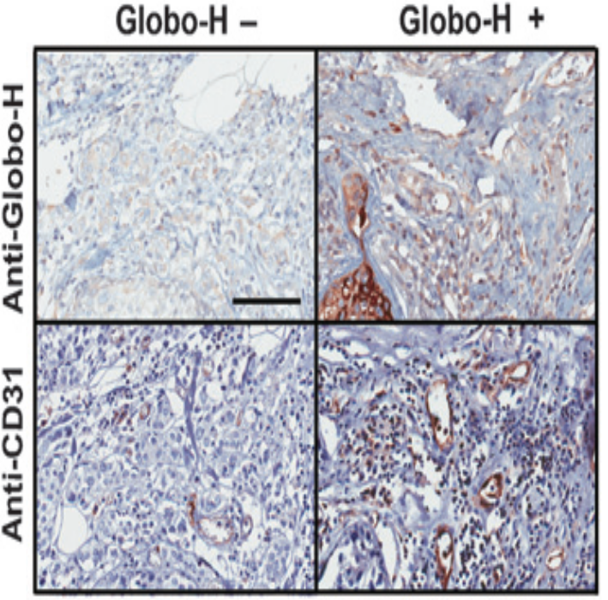
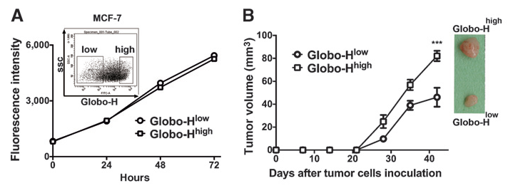
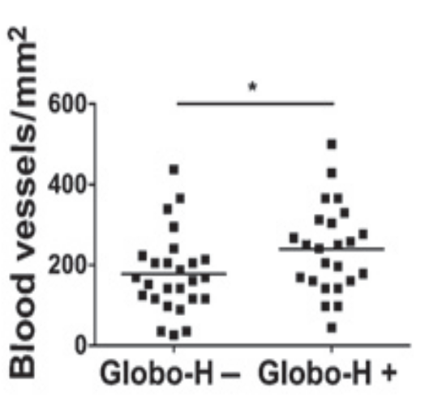
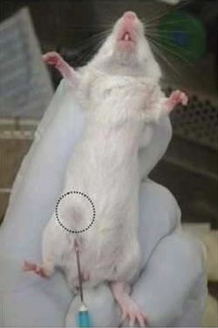
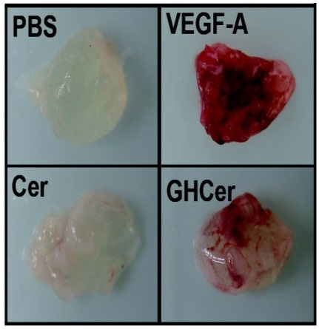
Globo H ceramide acts as angiogenic factor
Globo H is expressed in breast cancer stem cells and promotes stem cell properties
GHCer induces vasculature in Matrigel Plug
P=0.041

Slide 27
Shedding of Globo H-ceramide from tumor promotes angiogenesis in microenvironment

Slide 28
Randomized placebo controlled international phase II/III trial of Globo H-KLH + OPT821 in metastatic breast cancer
Dr. CS Huang & Dr. Alice L. Yu/OBI Pharma, Inc.
Study subjects:
patients with metastatic breast cancer
patients who have achieved CR or PR, or stable for at least 28 days
Study endpoints:
Primary:
  Progression Free survival
  Immune responses
  Toxicities
Secondary: overall survival
Target Accrual:
379 patients with 320 evaluable patients
Taiwan, USA (UCSD, UCSF, UCLA, MD Anderson, etc.), Korea, Hong Kong, India
As of 11/13/2013, 256 patients accrued
Globo H vaccines for clinical trials
Glycans can be as targets for cancer immunotherapy
Notes:
28

Slide 29
Clinical outcome
Unblinded on 2/19/16, vaccine was well-tolerated
Total randomized patients showed no statistical difference in PFS, although those who showed anti-Globo H responses (70~80%)had significant benefit in PFS/OS
Total randomized patients showed a trend for improved OS, but did not reach statistical significant (too early)

Slide 30
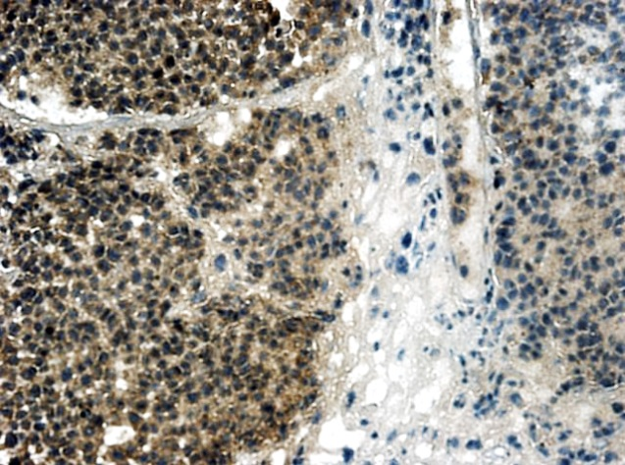



Neuroblastoma cells overexpress GD2, making it a potential target for immune-mediated attack
GD2 is a disialoganglioside
Over 99% of neuroblastoma expresses GD2
Normal tissue expression of GD2 is confined to tissues of neuroectodermal origin, e.g., skin, peripheral nerves and brain tissue
GD2 is also expressed by melanoma, glioma, small cell lung cancer, osteosarcoma and soft tissue cancer.
GalNAc → Gal → Glc → Ceramide
SA
Ralph Reisfeld
SA
David Cheresh
Schultz G, et al. Cancer Res. 1984;44:5914–5920; Cheung NK, et al. Cancer Res. 1985;45:2642–1985

Slide 31
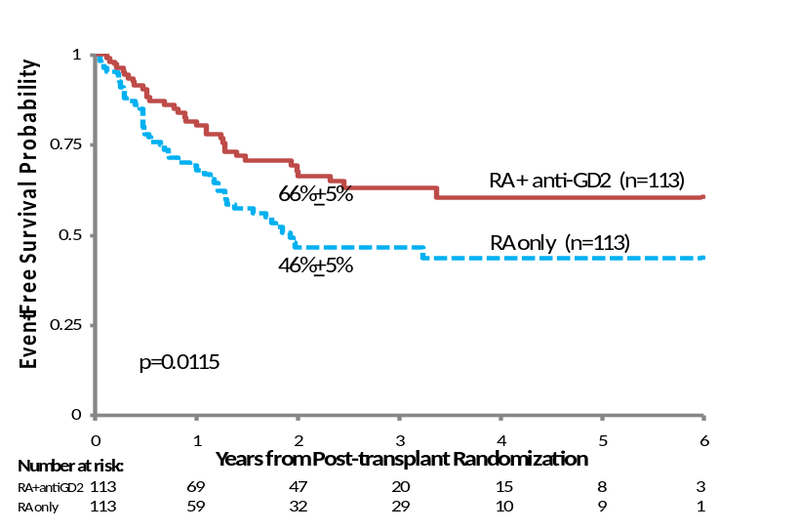
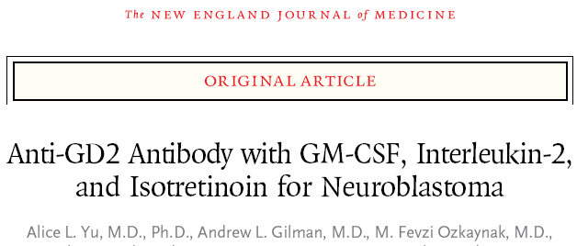

COG ANBL0032
A Phase III randomized study of chimeric anti-GD2 in high risk neuroblastoma following myeloablative therapy and autologous stem cell rescue
Chair: Alice L. Yu MD, PhD; Co-Chair: Andrew Gilman, MD; Vice Chair: M. Fevzi Ozkaynak, MD
Participating institutes:
166 institutes across the USA, Canada, Australia and New Zealand
Notes:
ende

Slide 32

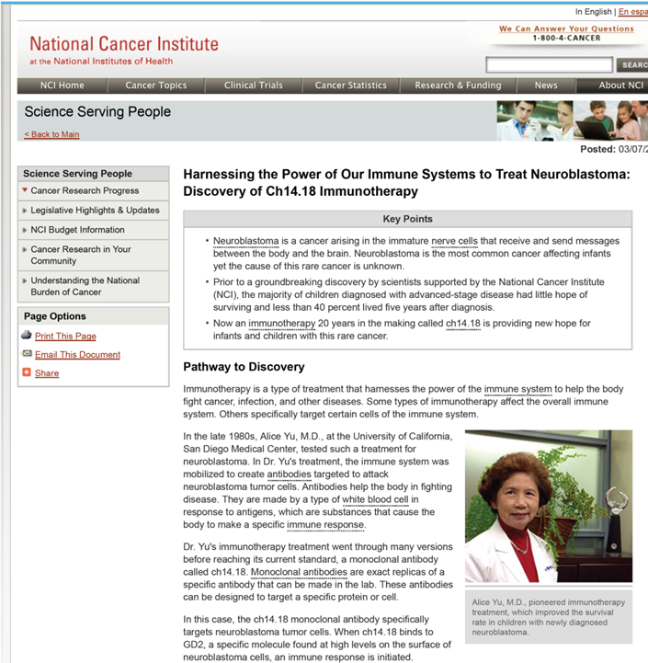
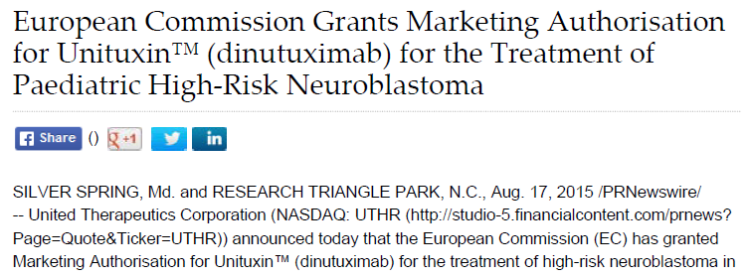
Regulatory approval of Dinutuximab (Unituxin) in USA and Europe for pediatric high-risk neuroblastoma
First FDA- and EMA-approved new therapeutic for high-risk neuroblastoma
First successful immunotherapeutic targeting a non-protein antigen
First agent developed from IND through Phase III trials
  Largely through investigator-initiated effort and NCI support.

Slide 33
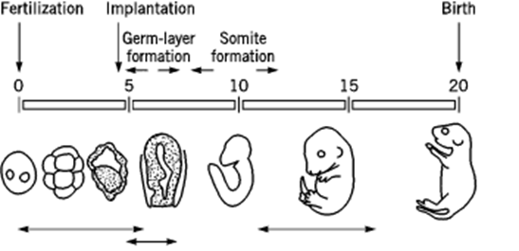
There is a striking switch of the expression patterns of sialylated N-glycoproteins and glycosphingolipids in hESC prior to implantation
Unique ES markers → most likely do not express in normal tissues of mature individuals → potential candidates for early detection and therapy of cancer
Stages of developments of mouse embryo
Glycan-targeted cancer detection and therapy

Slide 34
GD2-targeted immunotherapy of neuroblastoma:
first FDA- and EMA-approved new therapeutic for high-risk neuroblastoma
first successful immunotherapeutic targeting a non-protein antigen
Globo H-targeted immunotherapy:
The expression of Globo H in undifferentiated ES cells disappeared after differentiation at gastrulation.
Over-expression of Globo H in cancer with limited expression in normal tissues.
Triple roles in cancer: a stem cell marker, an immune checkpoint molecule, and an angiogenic factor.
These findings provide further impetus for clinical development of glycan-targeted immunotherapy.

Slide 35
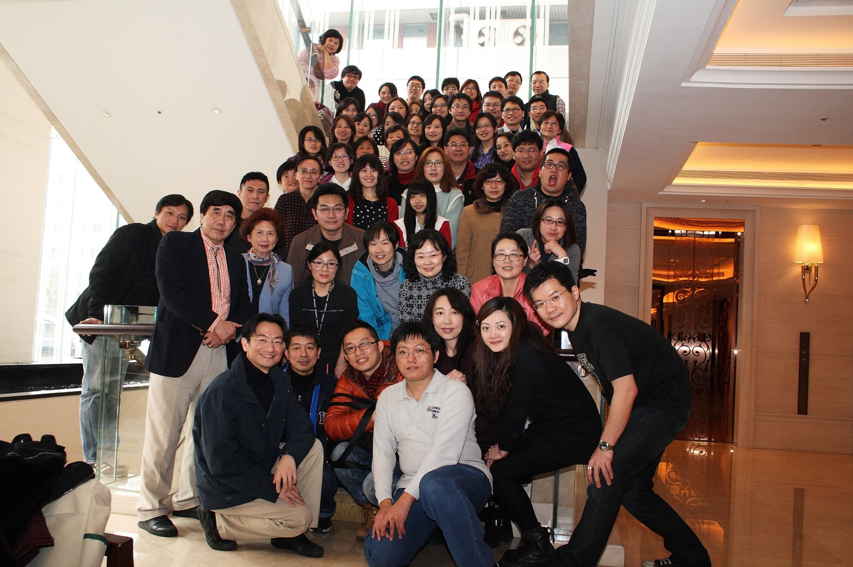





Institute of Stem Cell & Translational Cancer Research
Thank you for your attention !

